Slide 1
mEEC: A Novel Error Estimation Code with Multi-Dimensional Feature
Zhenghao Zhang and Piyush Kumar
Computer Science Department
Florida State University

Slide 2
Wireless Transmission
In a wireless link, a packet may be
Fully received

Slide 3
Wireless Transmission
In a wireless link, a packet may be
Erased

Slide 4
Wireless Transmission
In a wireless link, a packet may be
Partially received

Slide 5
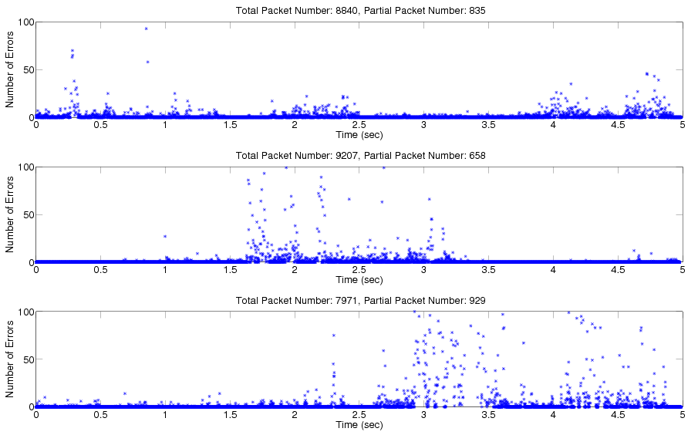
Examples of Partial Packets Measurements
5 seconds, 1500-byte packets, y is the number error bytes

Slide 6
Error Estimation
For a partial packet, how many error bits are there?
Knowing this information, the sender can determine how to best recover the packet
If it has only 100 bit errors in a 12,000 bit packet, should not retransmit every bit

Slide 7
Some Error Estimation Code (EEC)
EEC:
B.Chen, Z. Zhou, Y. Zhao, and H. Yu. Efficient error estimating coding: feasibility and applications. In ACM Sigcomm, 2010.
gEEC:
N. Hua, A. Lall, B. Li, and J. Xu. Towards optimal error-estimating codes through the lens of Fisher information analysis. In ACM SIGMETRICS, pages 125–126, 2012.
gEEC for insertion and deletion channels:
J. Huang, S. Yang, A. Lall, J. K. Romberg, J. Xu, and C. Lin. Error estimating codes for insertion and deletion channels. In ACM SIGMETRICS, pages 381–393, 2014.

Slide 8
General Ideas of EEC
Data packet:
Take samples and use the samples to compute features
The receiver may compute the features too, with the received bits
How the features mismatch tells how many errors
Feature:
Mismatch
Local
Feature:

Slide 9
Features in Existing Work and in mEEC
EEC: the parity bit
gEEC: the number of ‘1’s, the lower 5 bits
mEEC: the number of ’00’ or ‘11’

Slide 10
mEEC – Key Idea
The key idea is to use a multi-dimensional feature, i.e., using one number (color) to represent the features of multiple blocks
Theoretically, the number of dimension can be any value but we use 3 due to the implementation cost
The advantage is that the cost of covering low probability events can be amortized over multiple blocks
Data packet:
Features:
Color:

Slide 11
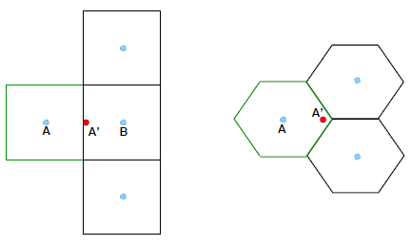
mEEC – A Motivating Example with Two Features
A is the actual point
A and other blue points has the same feature values due to the cut off
To the receiver, if based only on the received feature values, all points are equally likely
The local feature based on the received data bits is received point A’
gEEC
mEEC

Slide 12
mEEC – A Motivating Example with Two Features
gEEC treats the two dimensions individually
a large deviation of one dimension cannot be “corrected” even when the other dimension is fine
mEEC assigns each point on the plane a color basically to increase the distance between points of the same color
The dimensions are no longer independent, a large deviation in one can be corrected if the deviation is small in the other
gEEC
mEEC

Slide 13
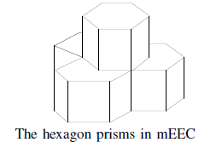
mEEC Coloring
With 3 dimensions, the hexagon prism is used
Spacing filling, the color within the hexagon prism is the same
12-bit color
The minimum between any points of the same color is 16.88 for 1274 colors and 17.20 for the other 2800 colors.
Theoretical upper bound: 19.85

Slide 14
mEEC Encoding
Encoding:
Randomly sample M bits, with no repeat.
Divide the M sampled bits into N blocks, each has W bits, and calculate the features
Group every 3 blocks into a super-block, do a table lookup to find the color
mEEC code is basically the colors of all super-blocks.
Data packet:
Features:
Color:

Slide 15
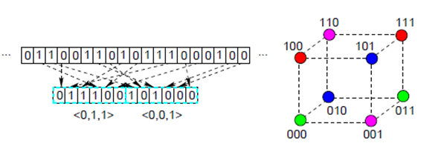
mEEC Encoding Example
The code
Two super-blocks, each consists of 3 blocks, where each block has only 2 bits.
The feature value is clearly either 0 or 1
A total of 8 combinations of feature values of a super-block.
2 bits are used as the color, therefore 4 colors
Bits sampled: 011100101000,
resulting in features [0,1,1] and [0,0,1]
the transmitted colors are green and magenta, respectively.

Slide 16
mEEC Decoding
Calculate the features of the blocks
For each super-block, select a list of candidate points, which are point of the same color as the received color of the super-block and close the received point
For each super-block, for each error ratio, find the candidate point with the maximum likelihood, and use this likelihood as the likelihood of this each error ratio
Select θ, the error ratio with maximum likelihood, as the output

Slide 17
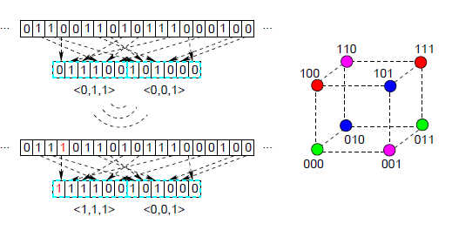
mEEC Decoding Example
The code
Two super-blocks, each consists of 3 blocks, where each block has only 2 bits.
The feature value is clearly either 0 or 1
A total of 8 combinations of feature values of a super-block.
2 bits are used as the color, therefore 4 colors
Bits sampled: 011100101000,
resulting in features [0,1,1] and [0,0,1]
the transmitted colors are green and magenta, respectively.
The channel corrupted the first sampled bit and turned the bits into 111100101000,
the received points are [1,1,1] and [0,0,1].
The first super-block, the candidate list has two points of color green [0,0,0] and [0,1,1].
The decoder will pick [0,1,1] for low error ratio

Slide 18
The Newton Search
As the likelihood function is usually smooth, a Newton search can usually find the peak point much faster than a linear search

Slide 19
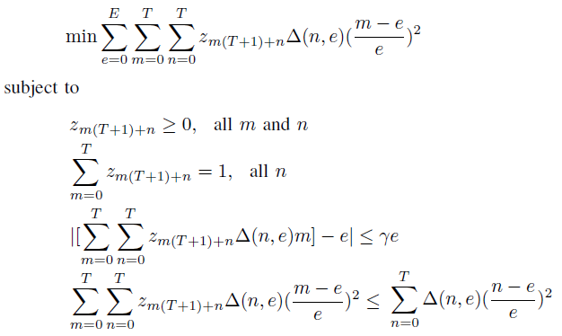
Redistribution
Minimizing the error
Given the initial estimate θ, mEEC randomly selects η as the final output according to a fixed PDF.
The redistribution is like ironing out the wrinkles of the maximum likelihood estimation, which sometimes leads to non-optimal results due to certain approximations used.
Must still be a PDF afterwards
Bias cannot be too large
Error cannot be worse

Slide 20
Complexity of mEEC
Low complexity:
the most time-consuming tasks can be pre-computed and stored in tables of reasonable sizes less than 20 MB in total for the current design
Encoder:
Mainly to map a 3-dimentional feature to a color, by a table, each feature is in [0,80]
Decoder:
Using a table to find for any received point a list of candidate points
The transition probabilities in the likelihood calculation also in tables

Slide 21
Evaluation
Compare with gEEC
Metrics
The relative Mean Squared Error (rMSE):
The relative Mean Squared log Error (rMSlogE):
Large Error Probability (LEProb):
Mean Bias (MnBias):

Slide 22
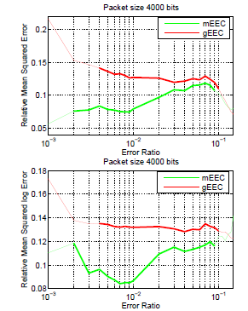
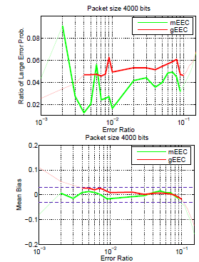
4000-bit packets
Significantly lower rMSE, rMSlogE, and LEProb than gEEC when both estimators have small bias
For example, for rMSE and the error ratio is 0.005, 0.0787 v.s. 0.1374, a 43% gain
Less biased than gEEC
The mean bias of mEEC is within ±2% for error ratios in [0.002, 0:09]

Slide 23
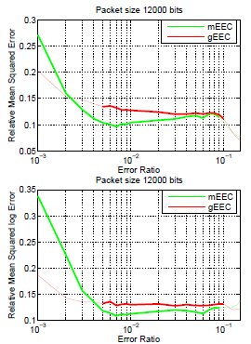
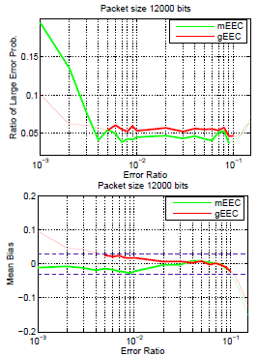
12,000-bit packets
Similar trends, gain is smaller
mEEC estimates according to the sampled data bits. The smaller the packet size, the closer the sampled error ratio is to the actual error ratio of the entire packet.
For error ratios in [0.001; 0.003], still small bias but has much lager estimation errors than other error ratios
The sampled error ratio can differ much more significantly from the error ratio of the packet when the error ratio is very small but the packet is large.

Slide 24
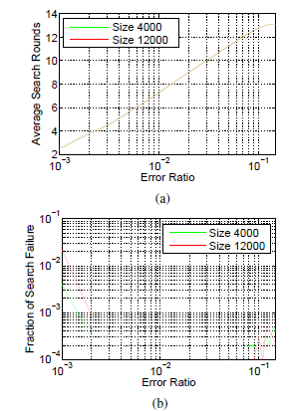
Computation Complexity
Newton Search average 13 iterations or less
Very small fractions of search failure, which needs a linear search

