Slide 1
Friendly Channel-Oblivious Jamming with Error Amplification for Wireless Networks
Zhenghao Zhang and Avishek Mukherjee
Computer Science Department
Florida State University Tallahassee, FL 32306, USA

Slide 2
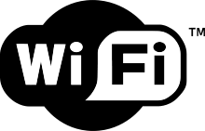
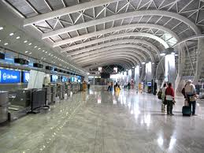
Wi-Fi is widely used
homes
offices
public hot spots, e.g., coffee shops, air ports, college campus
Notes:
How many people go to starbucks just to use Wi-Fi

Slide 3
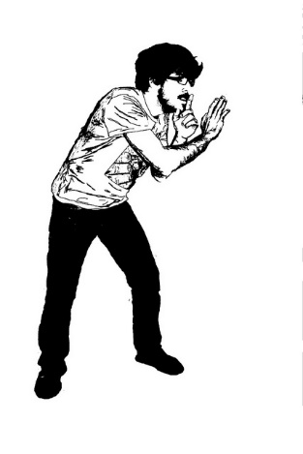
Security of Wi-Fi
Signal is sent in the open air, everyone nearby can overhear
Password can solve the problem, however not in open networks
The problem we are interested in: how to prevent an eavesdropper from being able to decode the packet without password protection, while ensuring the legitimate user can get the packet correctly

Slide 4
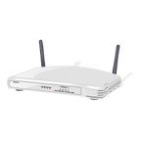
General Approach
Legitimate user
Eavesdropper
Introducing a jammer with multiple antennas
When the sender transmits a packet, the jammer transmits jamming signal simultaneously, but the jamming signal is generated such that it is 0 at the legitimate user but most likely non-zero elsewhere
Sender
Jammer

Slide 5
General Approach
Opposite phase, cancel
Same phase, add up
Legitimate user
Eavesdropper
How this is achieved, roughly speaking:
The jamming signal is a sine wave
One sine wave on each antenna
The jammer supposedly know the phase lag to the legitimate user, and adjusts the phases of sine waves such that it cancels at the legitimate user, but most likely not at other locations
[STROBE, Infocom 2012]
Sender
Jammer

Slide 6
Challenges – (1)
Legitimate user
Eavesdropper
The jamming signal power at any time is not going to cover the entire area, just leaving a hole near the legitimate user
It may happen that the sine waves also have opposite phases at a different eavesdropper
Cannot control really because the eavesdropper may be at any location with any phase lag
Not jammed
Jammer

Slide 7
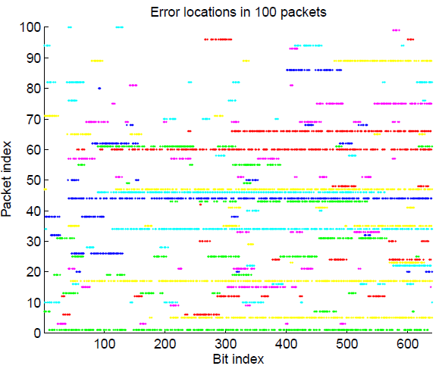
Challenges – (2)
Even when jammed, if the data packet is modulated at a low data rate, with strong error correction code, not going to have a lot of errors!
Results collected with Microsoft Sora when the jamming signal is generated according to STROBE
The eavesdropper still can get MOST bits right!

Slide 8
Our Contribution – (1)
AAAAAAAA
AAAAAAAA
Data
Data
Proposes to employ an error amplifier that can turn just a few errors into many errors
Before sending the data, map it to another string according to a random permutation
After receiving, map the received string according to the reverse of the random permutation
Mapped
BBBBBBBB
Mapped
BBBBBBBB
Received
BBBBBBBB
Received
BBBB3BBB
Reverse
Map
AAAAAAAA
Reverse
Map
89EF2DF1

Slide 9
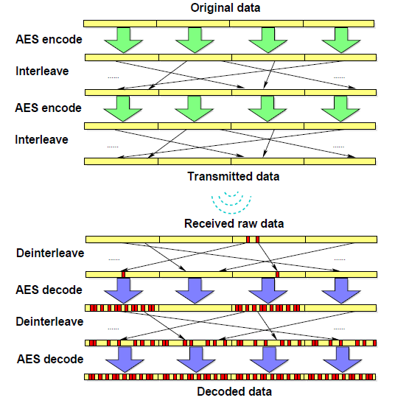
Error Amplifier
Can use AES to implement the error amplifier

Slide 10
Error Amplifier
The argument is that will have to do this anyway because jamming only cannot turn enough data bits into errors
The catch is that both sender and the legitimate user would have to install the error amplifier

Slide 11
Our Contribution – (2)
jMax: a jamming strategy that exploits the error amplifier to more effectively protect user privacy by maximizing the maximum jamming power to any eavesdropper, without knowing the phase lags (CSI, to be exact) of any eavesdropper

Slide 12
jMax
The error amplifier is going to just need a few error bits, so the jamming power to any potential eavesdropper need not be constant high power, which is hard to achieve, instead can be just a spike

Slide 13
jMax
Legitimate user
Eavesdropper
Not knowing the phase lags (CSI) to the eavesdroppers, will just try multiple sets of phase adjustments (jamming vector), each time will cover some areas and leave some holes, but any eavesdropper will unlikely to be in the holes every time
Jammer

Slide 14
jMax
Current design uses 10 jamming vectors, where Λ₁ and Λ₂ are the orthogonal base of the space orthogonal to the legitimate user’s CSI
Theorem: The maximum jamming power jMax introduces to any eavesdropper at least
of the optimal jamming power.

Slide 15
jMax
Intuition:
Any valid jamming vector (the vector to determine the phase and amplitude of the sine waves from each antenna) has to be a linear combination of Λ₁ and Λ₂
The selected jamming vectors are in some sense evenly distributed in the linear space spanned by Λ₁ and Λ₂ and therefore not too far from any vector in this space

Slide 16
jMax – Practical Considerations
For OFDM systems, basically use the same procedure for each subcarrier
One concern is that as different subcarriers have different CSI, their peak power may not be arrived at the same time

Slide 17
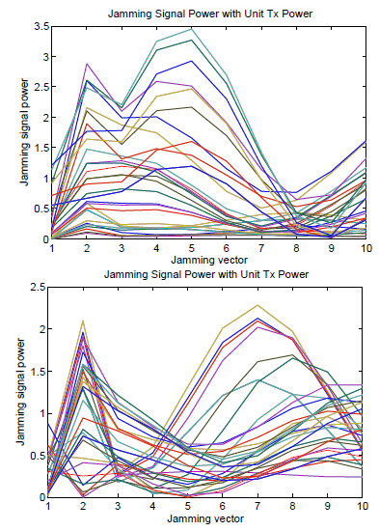
jMax – Practical Considerations
Fortunately, the CSIs of different subcarriers show a lot of correlation
The right is two typical cases of received jamming powers at different subcarriers for the 10 jamming vectors
CSI collected with the Intel 5300 wireless card

Slide 18
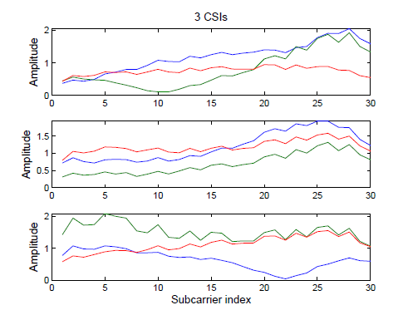
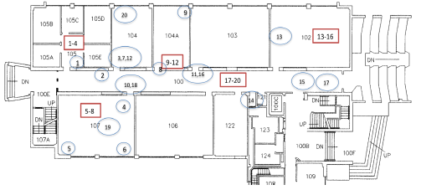
Evaluations
Used the Intel 5300 wireless card with 3 tx and rx antennas to collect the CSI as the CSI a jammer to the user and multiple eavesdroppers

Slide 19
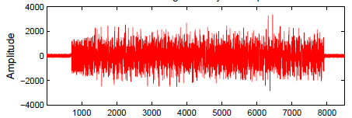
Evaluations
Used Microsoft Sora to transmit packets at all 802.11a data rates (6,9,12,18,24,36,48,54 Mbps) at 3 packet sizes (80, 320, 960 bytes), and recorded the waveform in the air
Our Sora machine has only one antenna, so we assume the sender, user, eavesdroppers all have one antenna

Slide 20
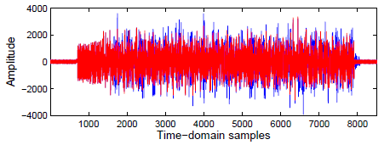
Evaluation
We assume the jammer has 3 antennas, and generate the jamming signal according to jMax jamming vectors, then add the jamming signal to the packet waveform in software, then run the Sora offline decoder

Slide 21
Compared Method
2-ANT: uses only two antennas, cannot change jamming vectors
STROBE: uses all antennas, multiplies either 1 or -1 randomly with Λ₁ and Λ₂ uses the sum
Optimal: uses all antennas, knows the CSI to the eavesdropper

Slide 22
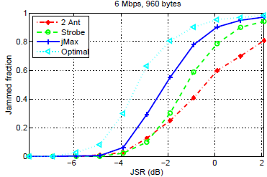
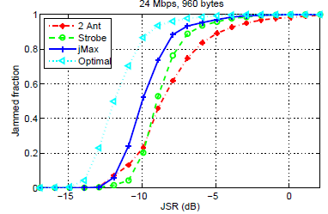
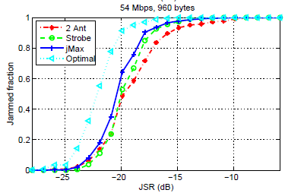
Performance
JSR: tx power of jammer to the tx power of the sender ratio
8 bit errors means a successful jam
Solid gains over STROBE and 2-ANT
JSR needs to be quite large for low data rates and lower for higher data rates
The curve has a large transition range, meaning that some are easy to jam and others more difficult

Slide 23
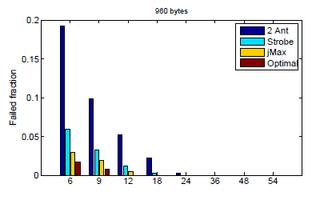
Jamming Failure Ratios
A jamming method may fail to jam certain client and eavesdropper pairs even when the jamming power the largest value we take in the evaluation
jMax is much lower than Strobe and 2-Ant
The gain of 3-antenna methods over 2-Ant suggests that more antennas will further reduce the failure ratio

Slide 24
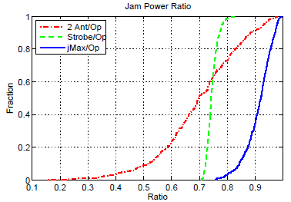
Jam Power Ratio
Find the maximum power ratio of various methods over Optimal
The ratio of jMax roughly matches the theoretical bound

Slide 25
Thank you!

