Slide 1

Fast Compression of the OFDM Channel State Information
Avishek Mukherjee and Zhenghao Zhang
Department of Computer Science
Florida State University

Slide 2
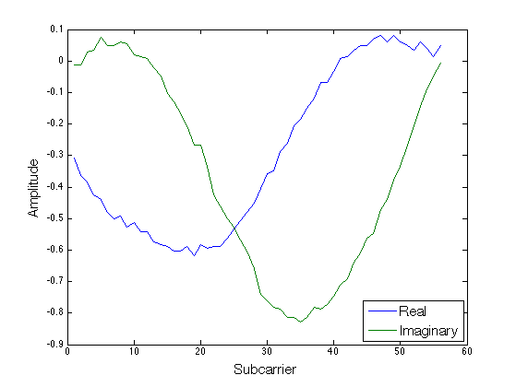
What is Channel State Information (CSI) ?
CSI is simply a complex vector containing the channel coefficients for each subcarrier in an OFDM system.
Used to describe the characteristics of a wireless link between a transmitter and receiver.
Represents the summation of multipath components in fading channels.
Notes:
Show abs figure first
Then explain how we get there

Slide 3
Motivation
Our work was motivated by the discovery of an interesting finding

Slide 4
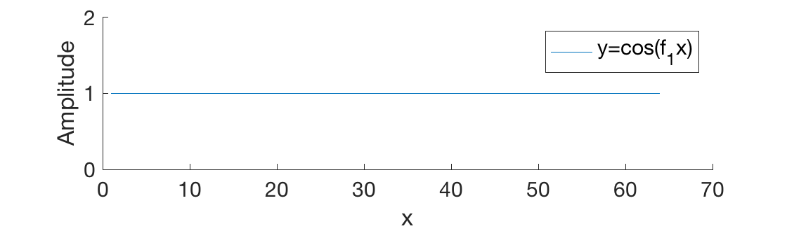
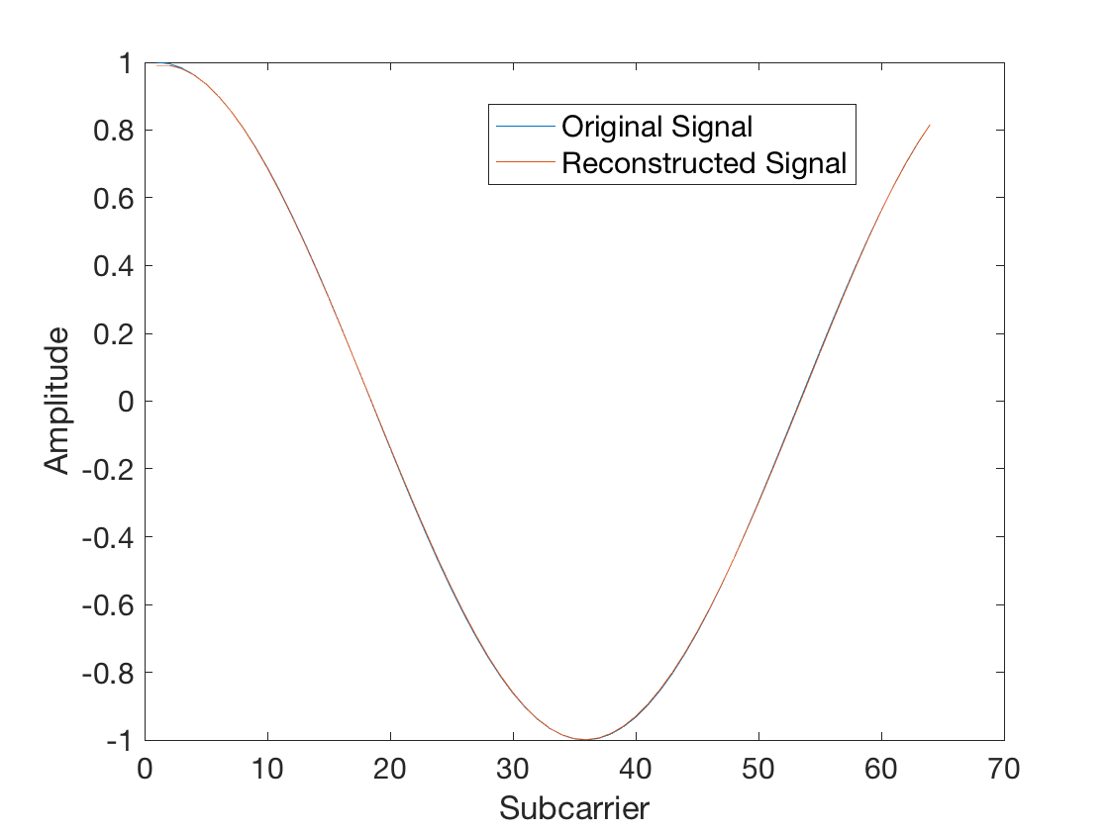
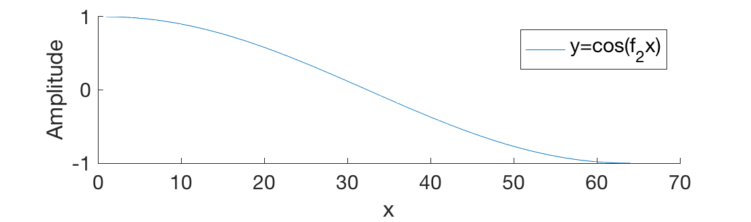
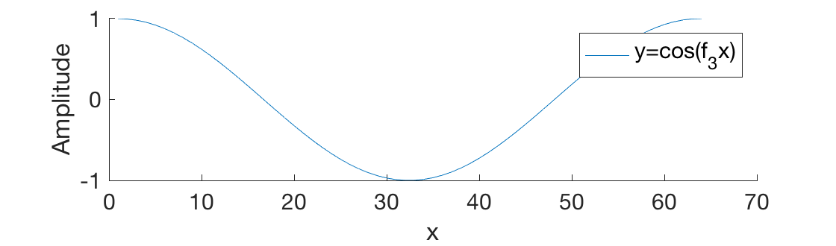
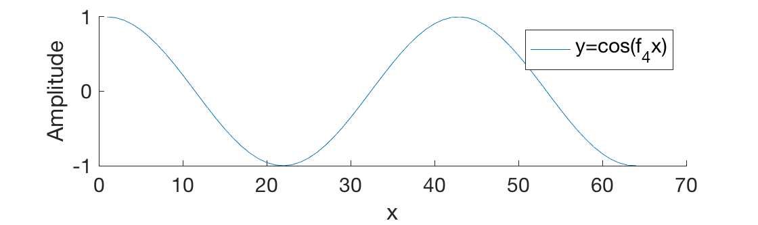
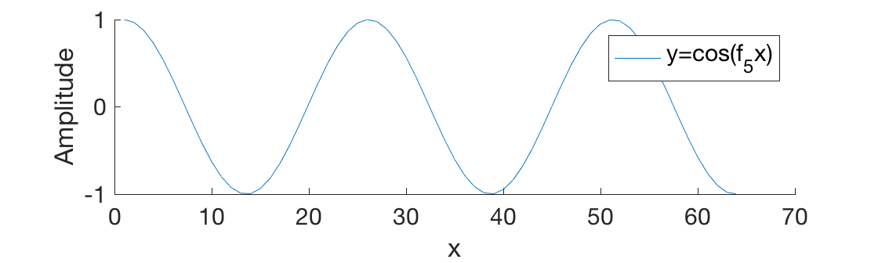
Motivation
Using 5 sinusoids on some constant frequencies we approximated a sinusoid on a single frequency
Linear Combination

Slide 5
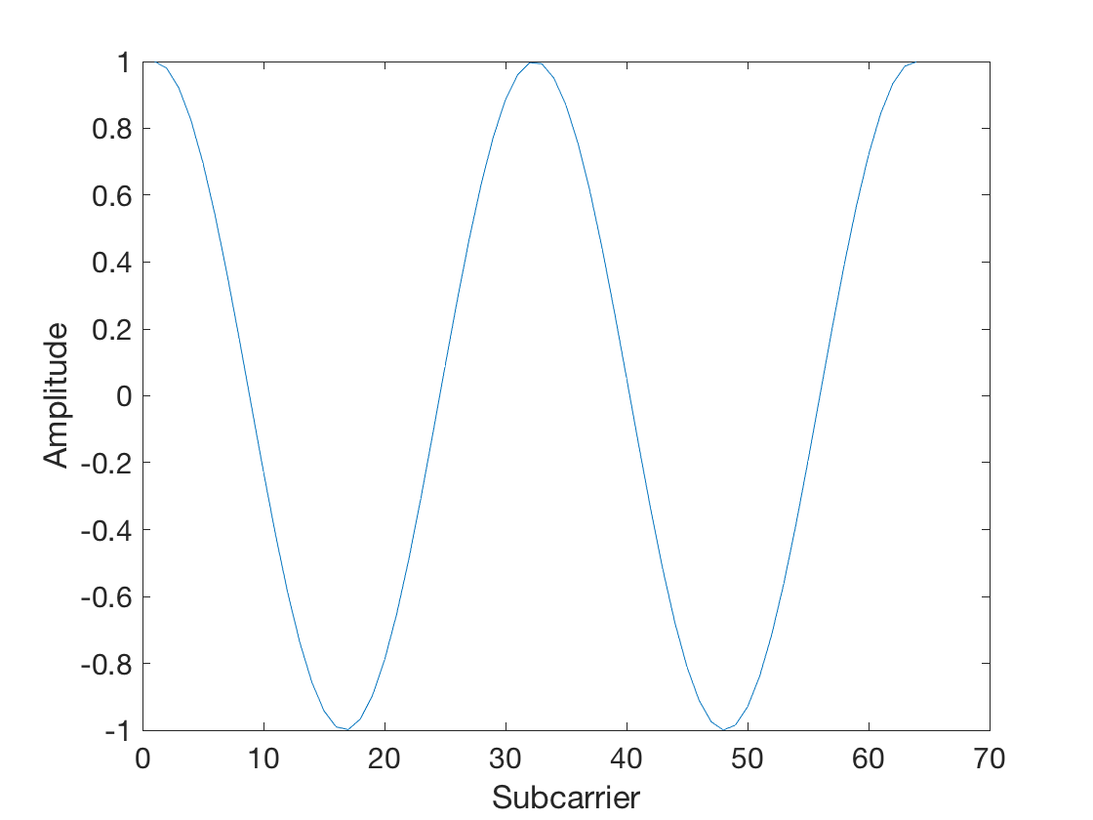
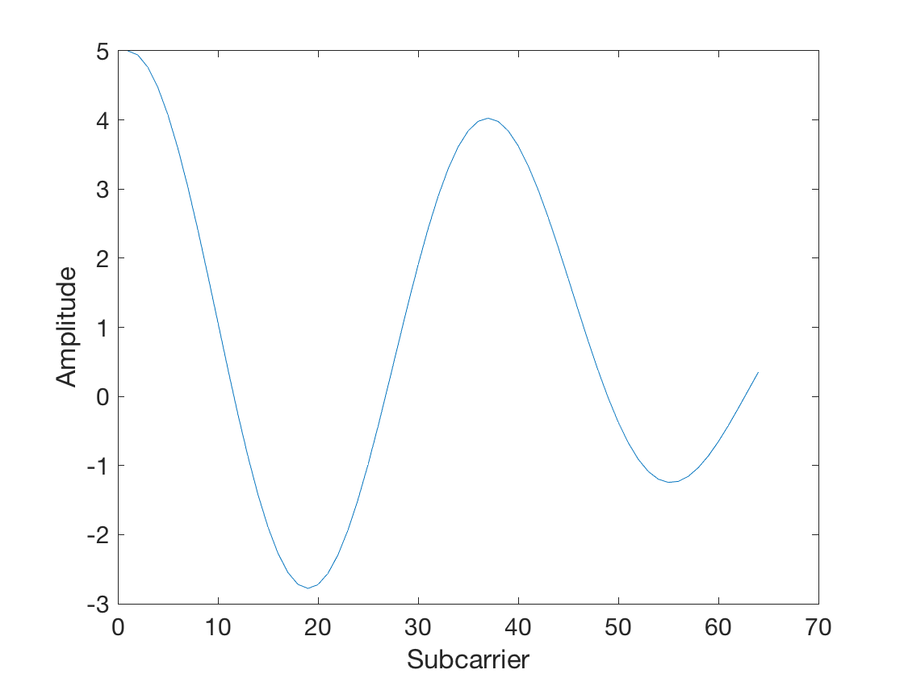
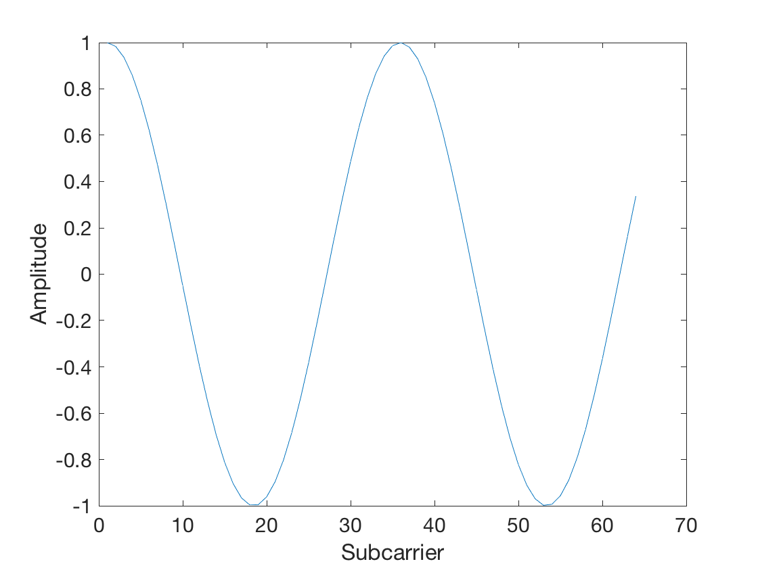
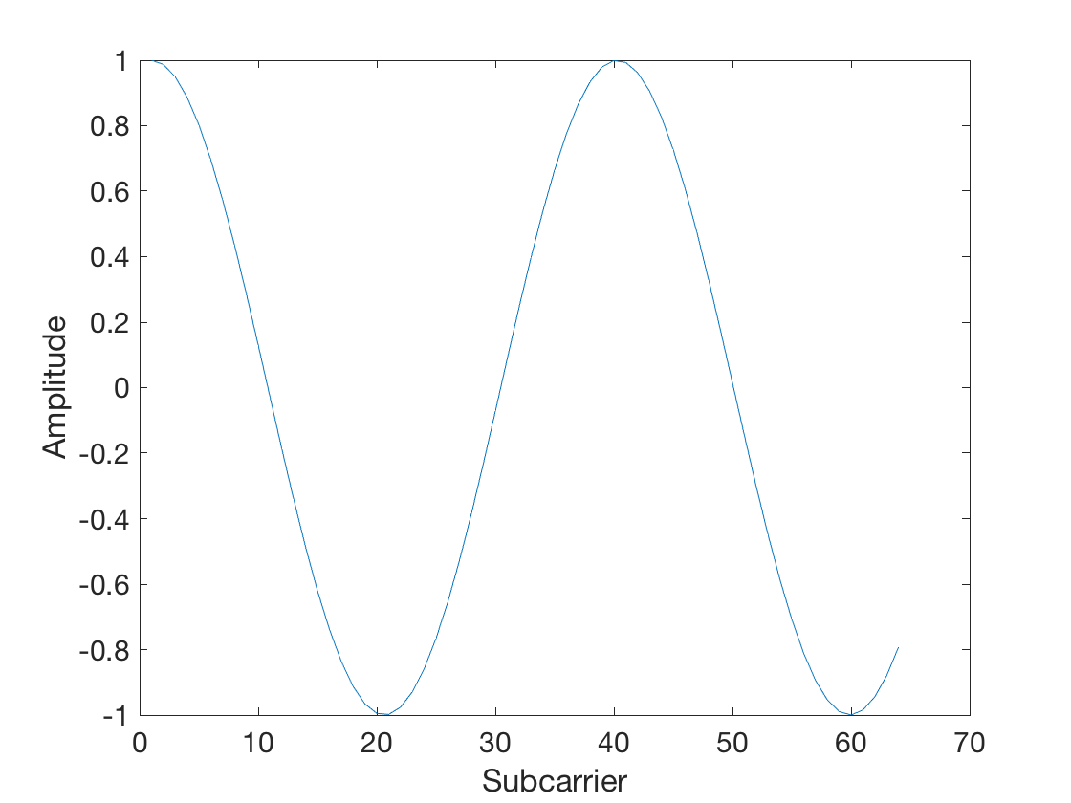
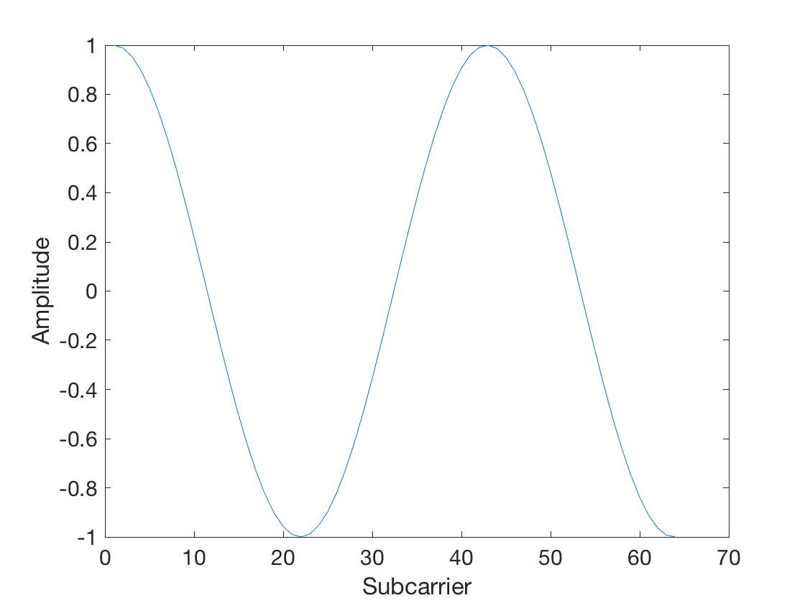
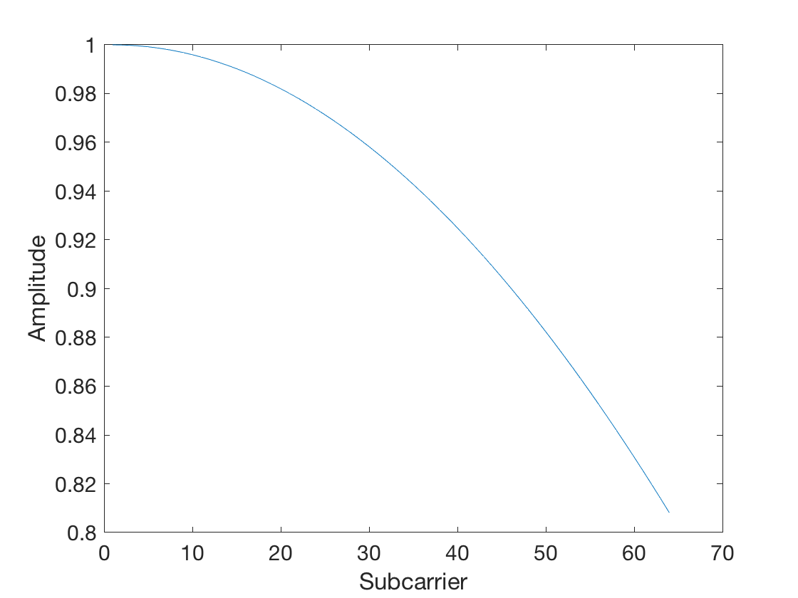
Motivation
What was interesting was that , another composite signal from 5 frequencies

Slide 6
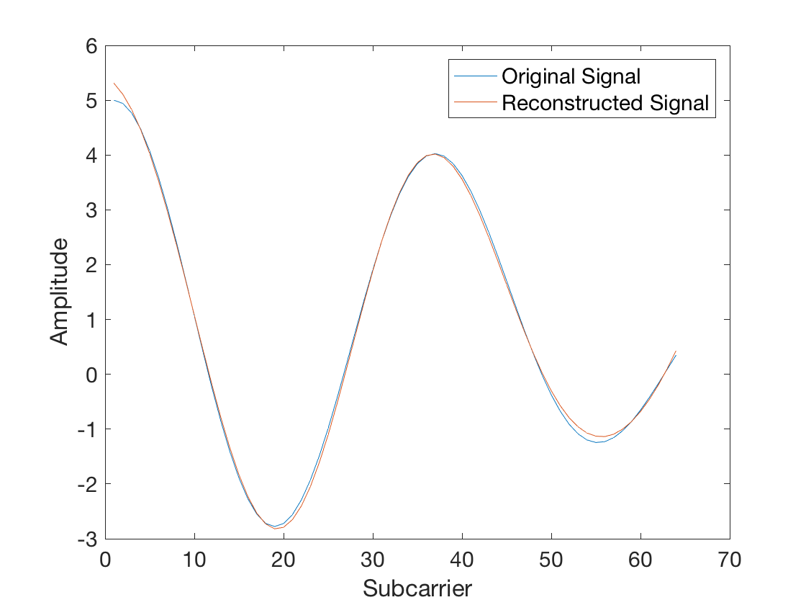
Motivation
Could be fitted with the same base frequencies (with different coefficients)
Linear Combination

Slide 7
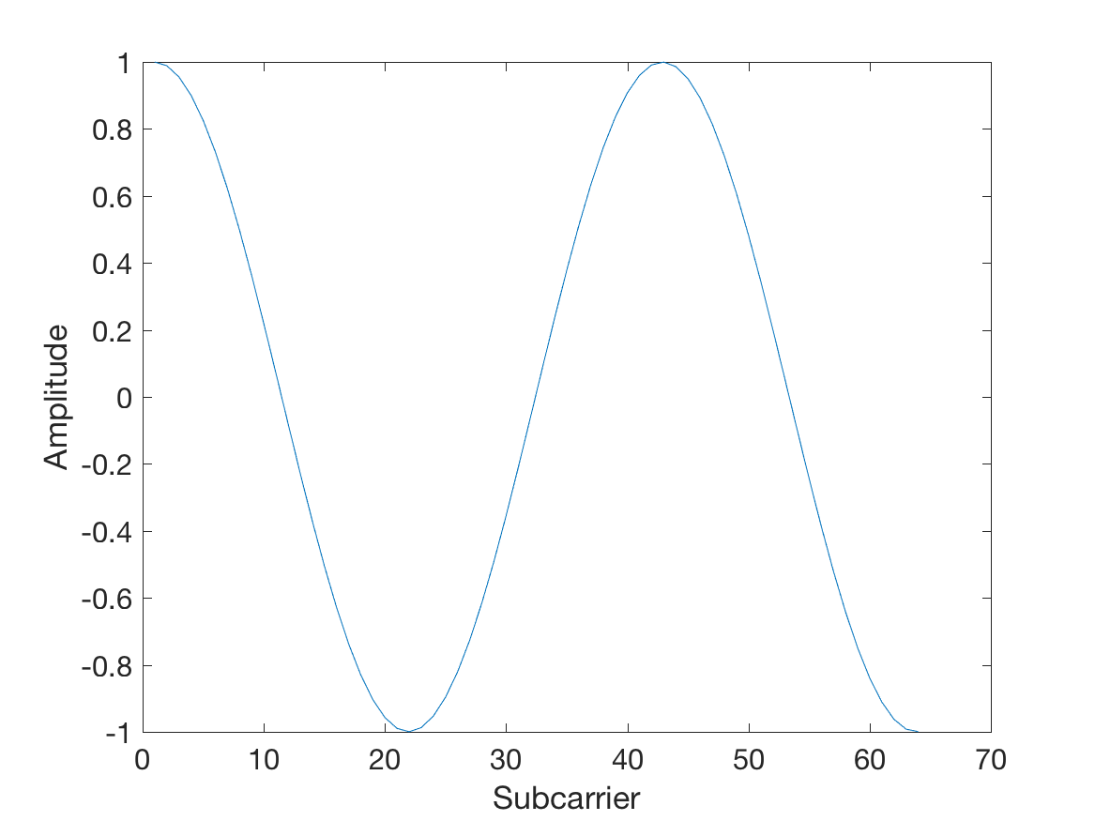
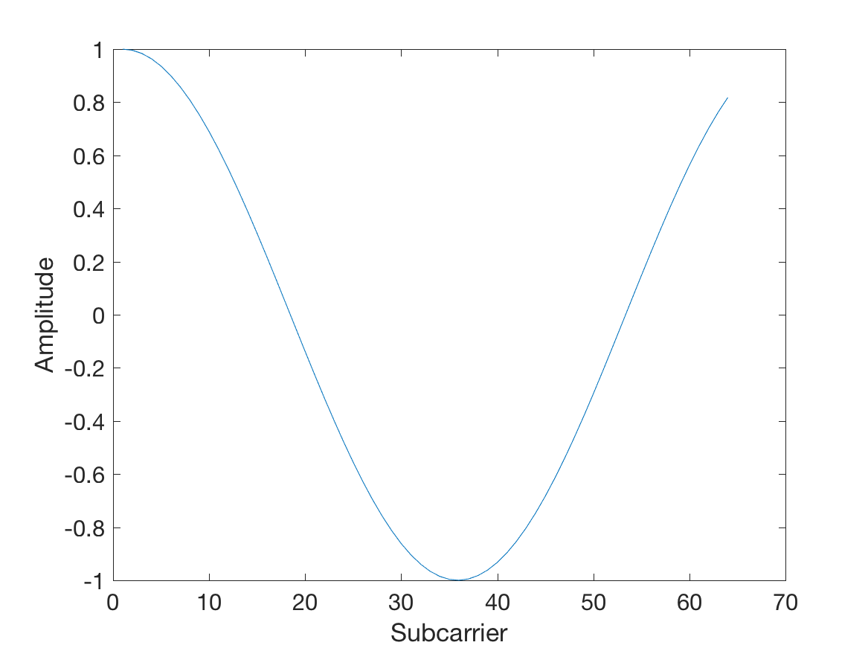
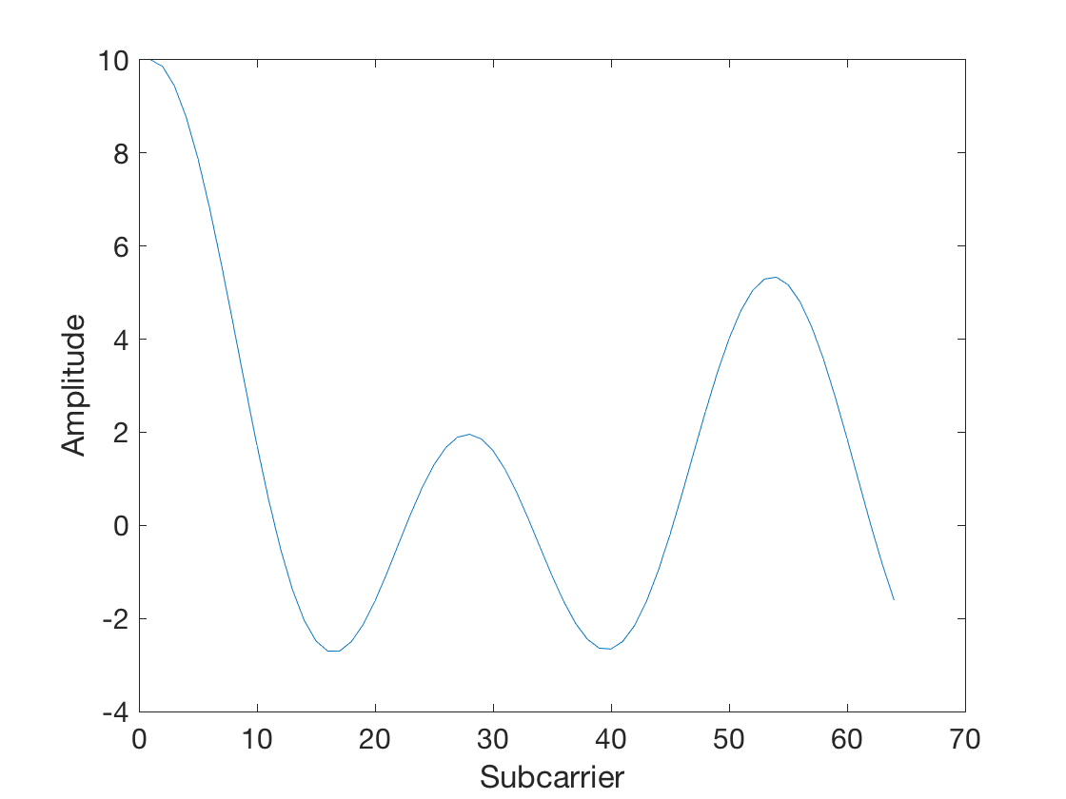
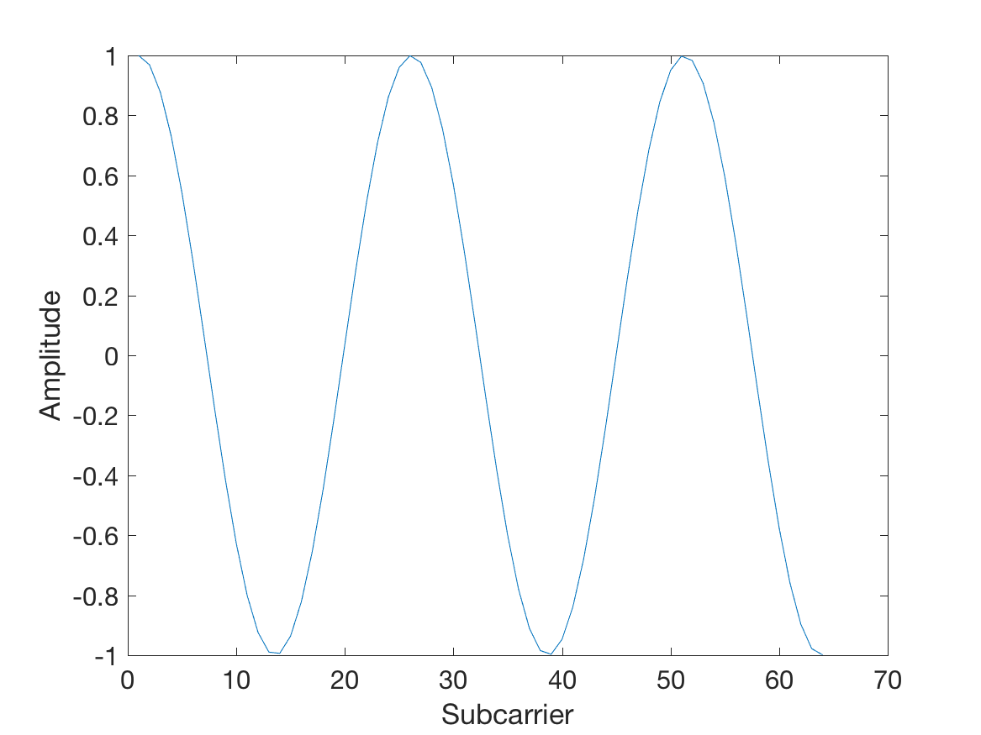
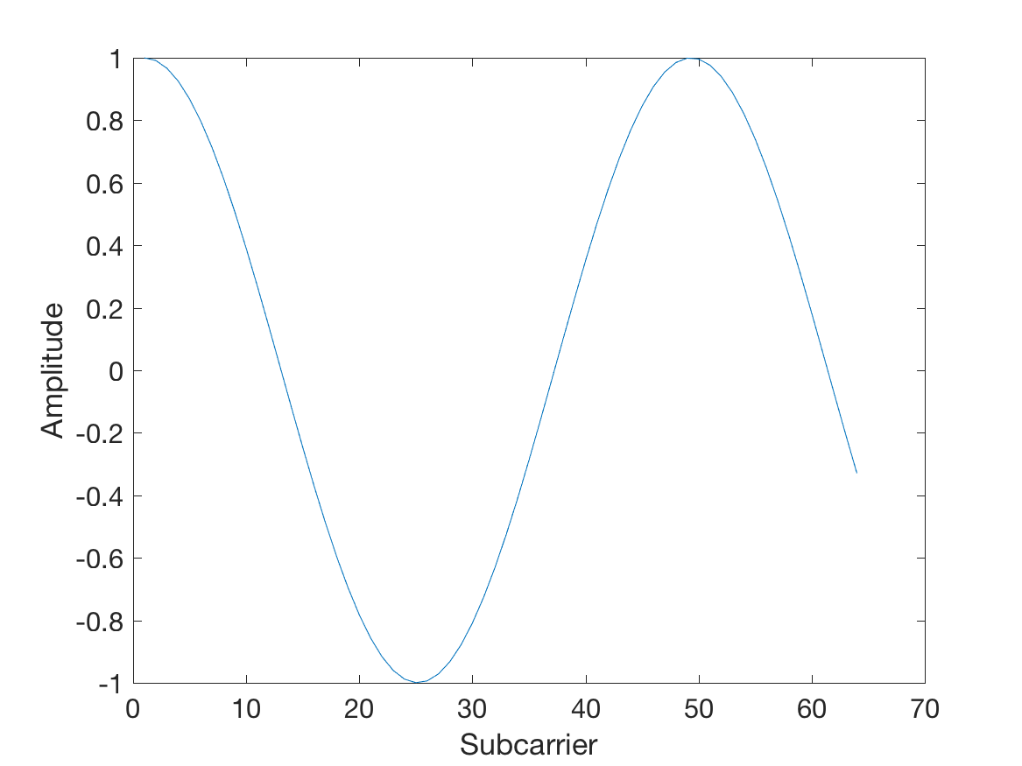
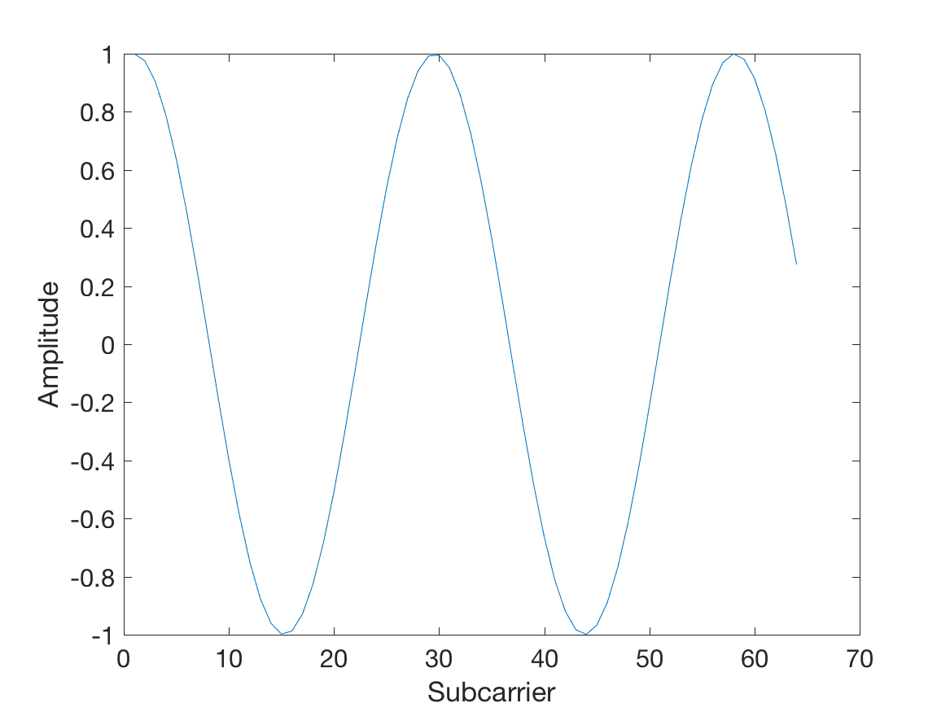
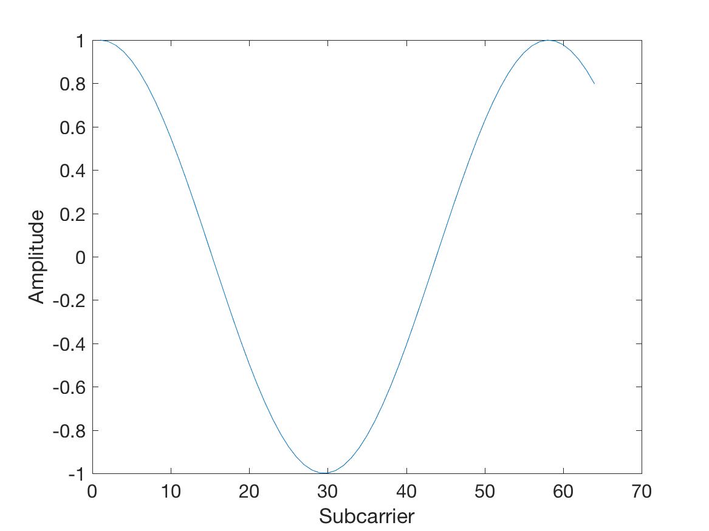

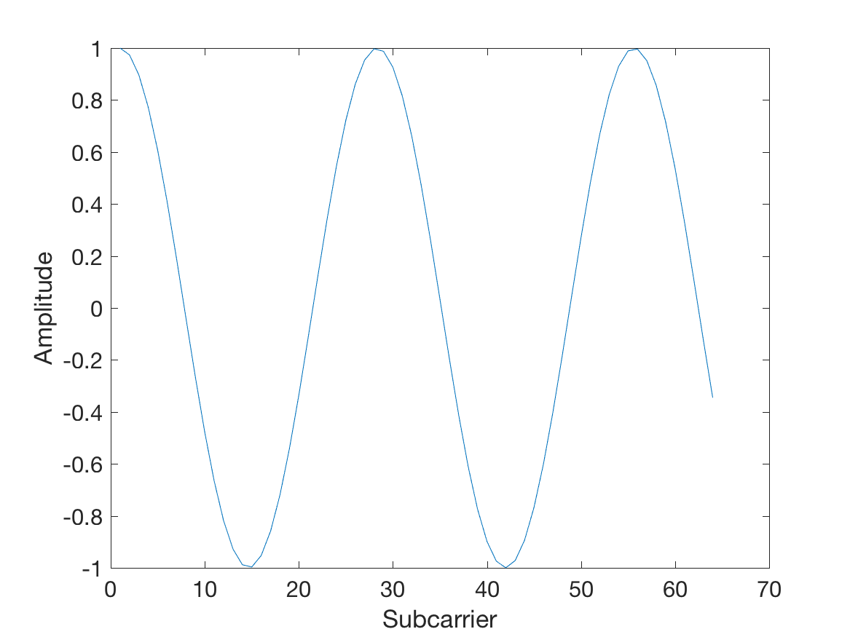
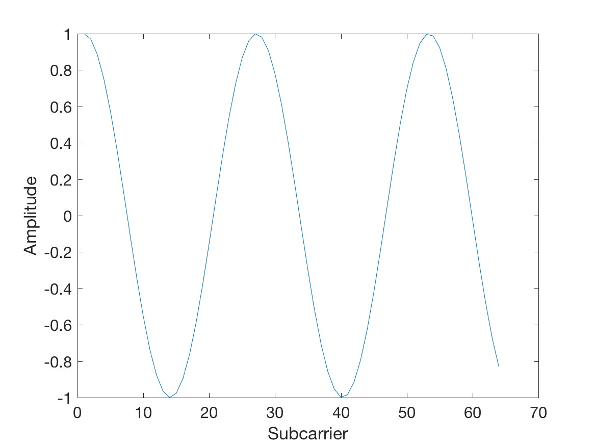
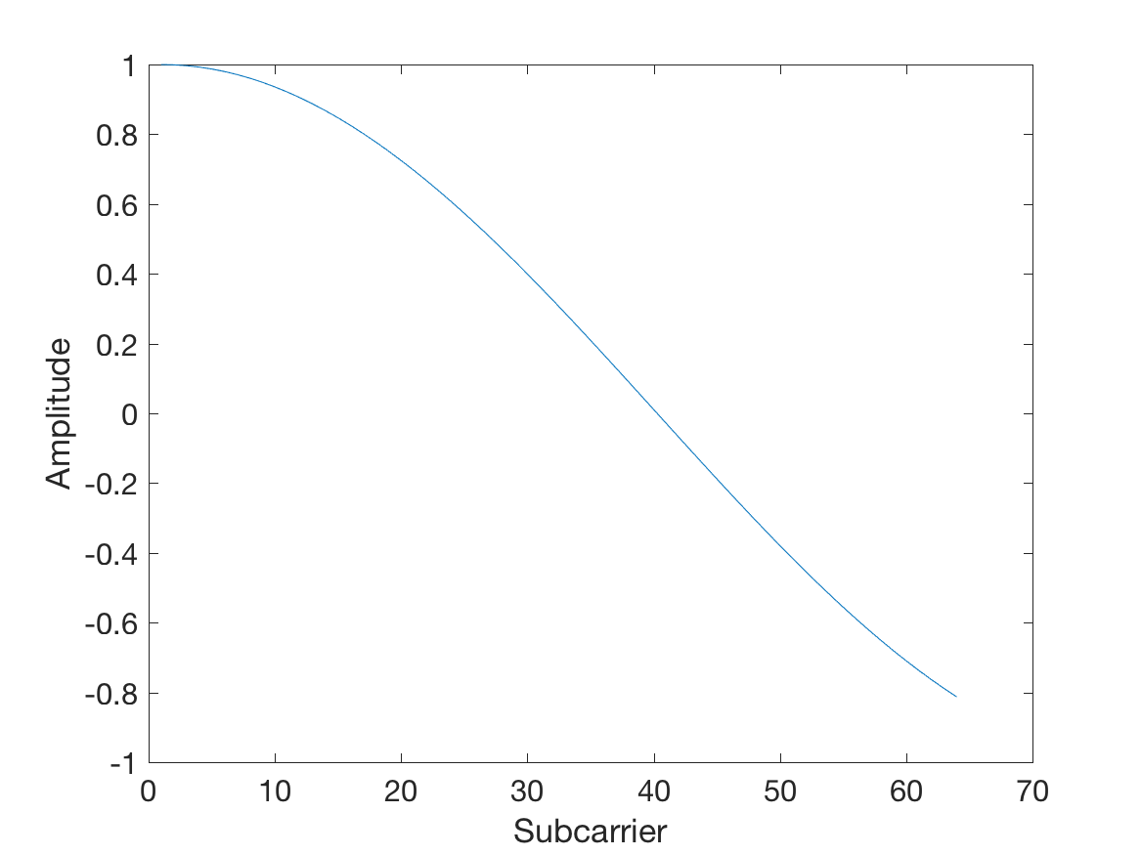
Motivation
We tried to push it further by generating a signal with 10 sinusoids

Slide 8
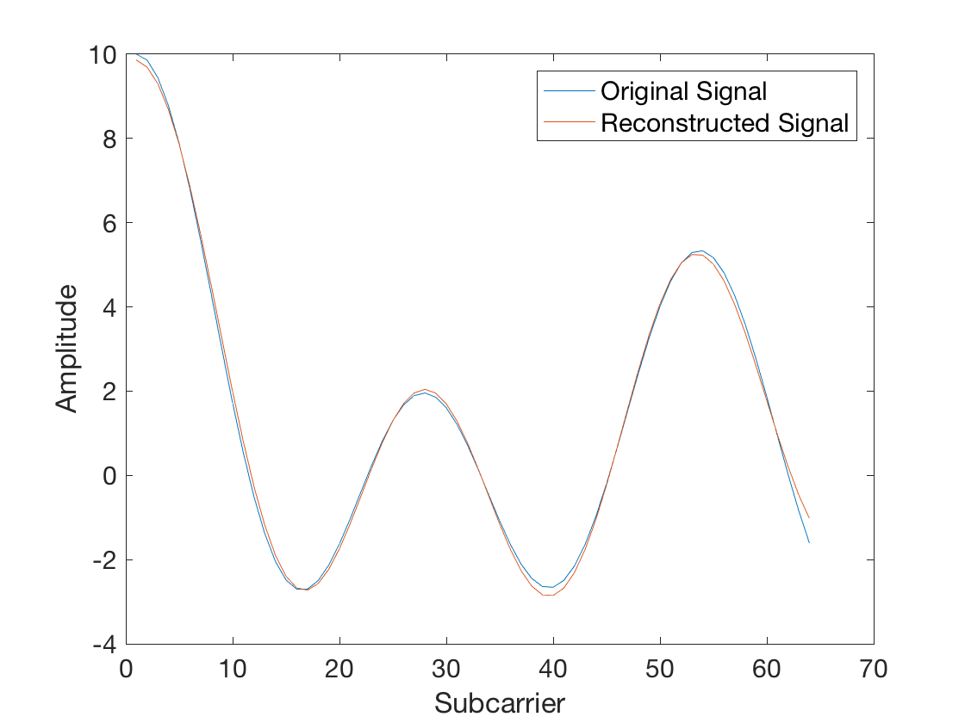
Motivation
We still get a good fit
Linear Combination

Slide 9
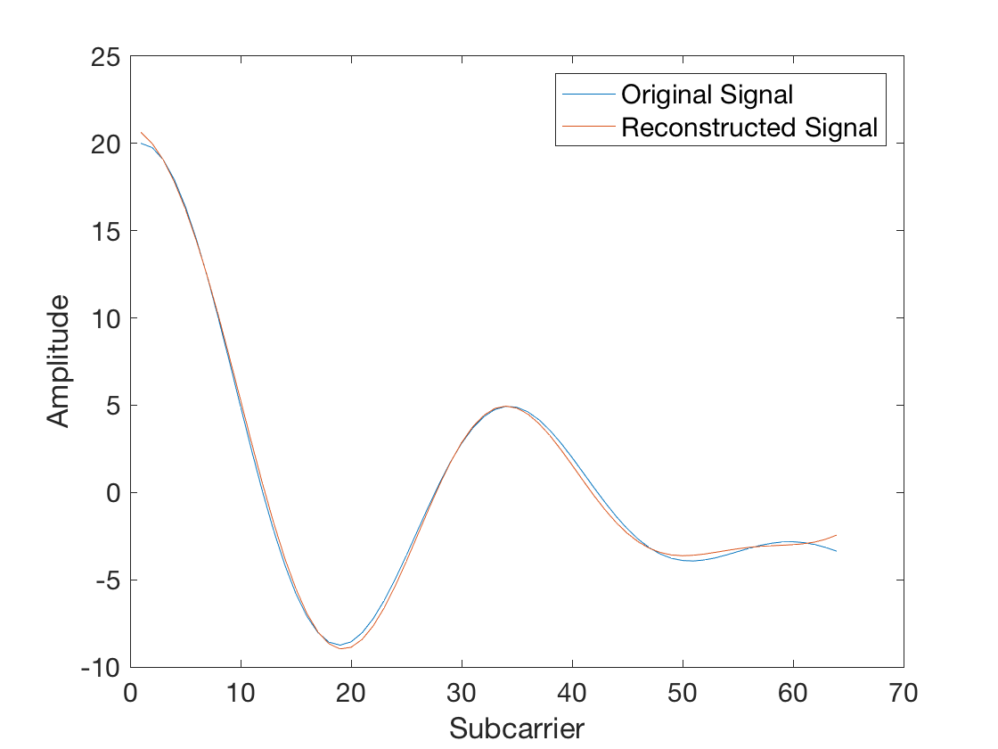
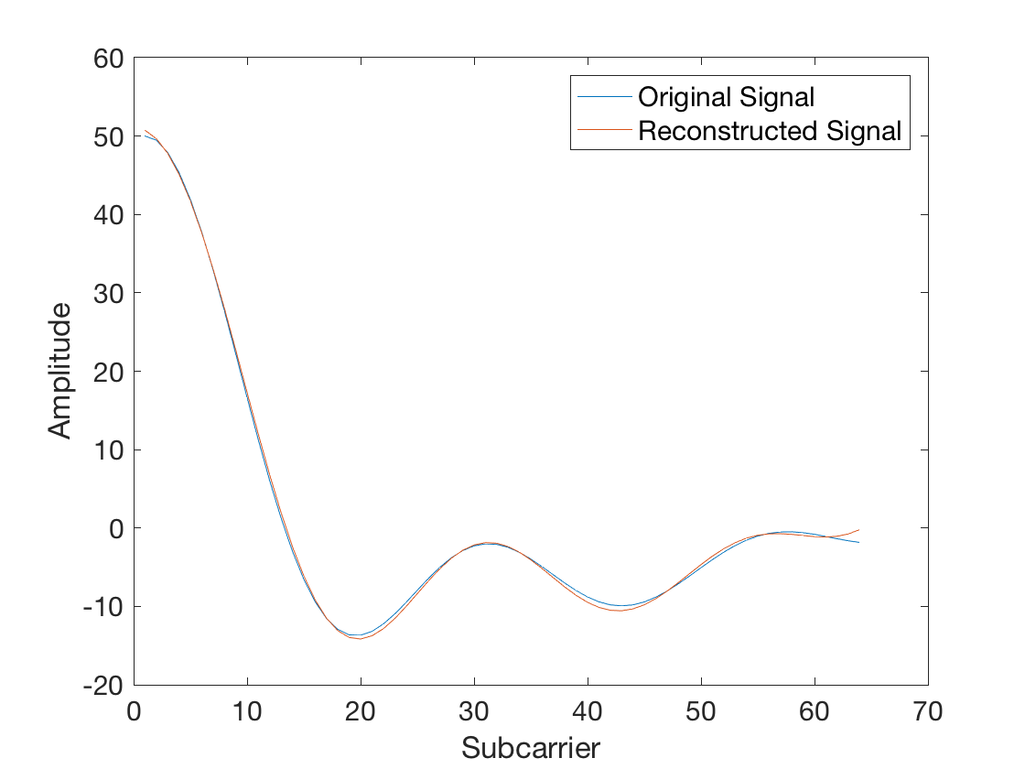
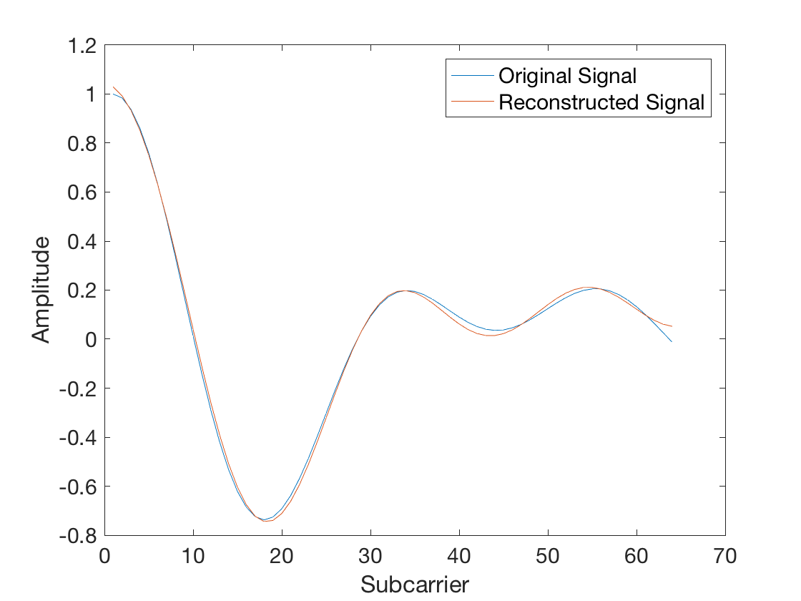
Motivation
We went up to signals generated from 100 sinusoids
We were still able to fit them with the same 5 base frequency sinusoids
20 sine waves
50 sine waves
100 sine waves

Slide 10
Motivation
Can we approximate any sinusoid as a linear combination of constant base frequency sinusoids?
We effectively reconstructed a [64x1] vector using only 5 numbers. i.e. 12.8:1 compression ratio
As the CSI is also a summation of sinusoids, can this theory be also applied to compress the CSI ?

Slide 11
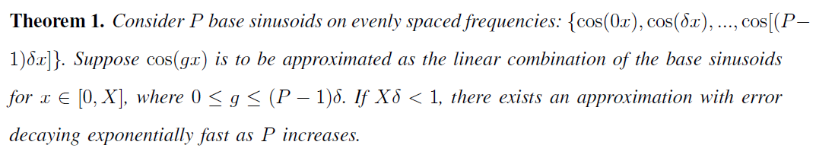
The Theorem

Slide 12
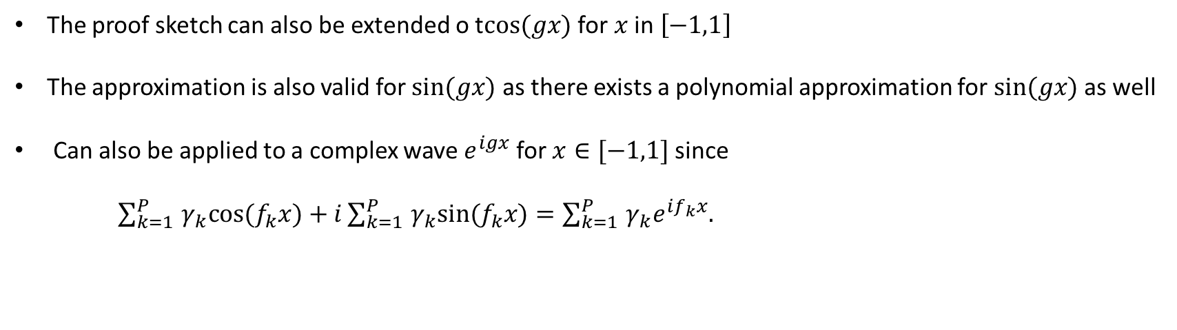
Extensions
The proof sketch can also be extended o t$cos(gx)$ for $x$ in $\left[−1,1\right]$
The approximation is also valid for $sin(gx)$ as there exists a polynomial approximation for $sin(gx)$ as well
Can also be applied to a complex wave $e^{igx}$ for $x∈[−1,1]$ since
$\sum_{k=1}^{P}{‍}γ_{k}cos(f_{k}x)+i\sum_{k=1}^{P}{‍}γ_{k}sin(f_{k}x)=\sum_{k=1}^{P}{‍}γ_{k}e^{if_{k}x}.$

Slide 13
CSIApx
Builds on the polynomial approximation of sinusoids
Uses a linear combination of small number of base sinusoids to approximate the CSI.
Low computational complexity.
Resilience to noise

Slide 14
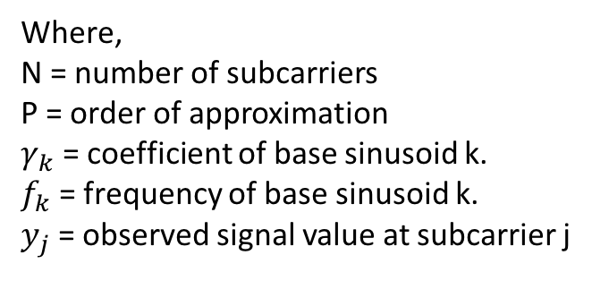
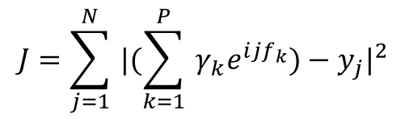
MSE Fit
MSE Fit forms the core of CSIApx.
The sinusoidal approximation for a CSI vector is a minimization of
$$J=\sum_{j=1}^{N}{‍}|(\sum_{k=1}^{P}{‍}γ_{k}e^{ijf_{k}})−y_{j}|^{2}$$
Where,
N = number of subcarriers
P = order of approximation
$γ_{k}$ = coefficient of base sinusoid k.
$f_{k}$ = frequency of base sinusoid k.
$y_{j}$ = observed signal value at subcarrier j

Slide 15
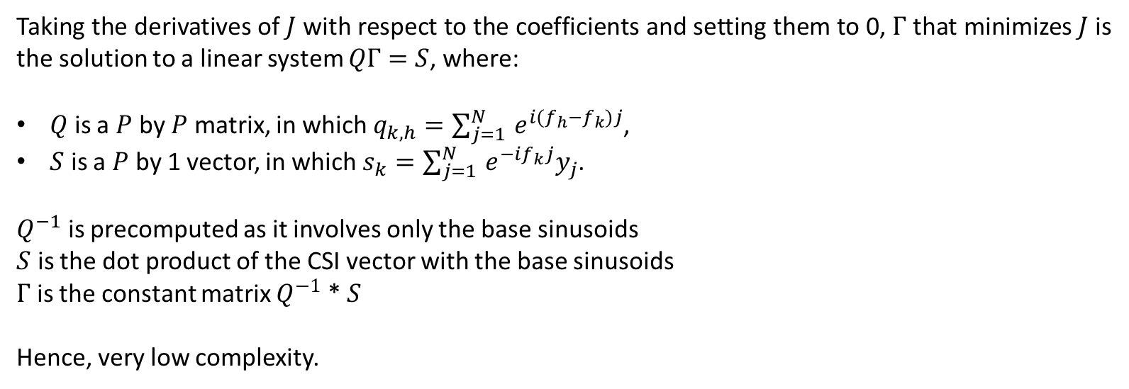
MSE Fit
Taking the derivatives of $J$ with respect to the coefficients and setting them to 0, $Γ$ that minimizes $J$ is the solution to a linear system $QΓ=S$, where:
$Q$ is a $P$ by $P$ matrix, in which $q_{k,h}=\sum_{j=1}^{N}{‍}e^{i(f_{h}−f_{k})j}$,
$S$ is a $P$ by 1 vector, in which $s_{k}=\sum_{j=1}^{N}{‍}e^{−if_{k}j}y_{j}$.
$Q^{−1}$ is precomputed as it involves only the base sinusoids
$S$ is the dot product of the CSI vector with the base sinusoids
$Γ$ is the constant matrix $Q^{−1}$ * $S$
Hence, very low complexity.

Slide 16
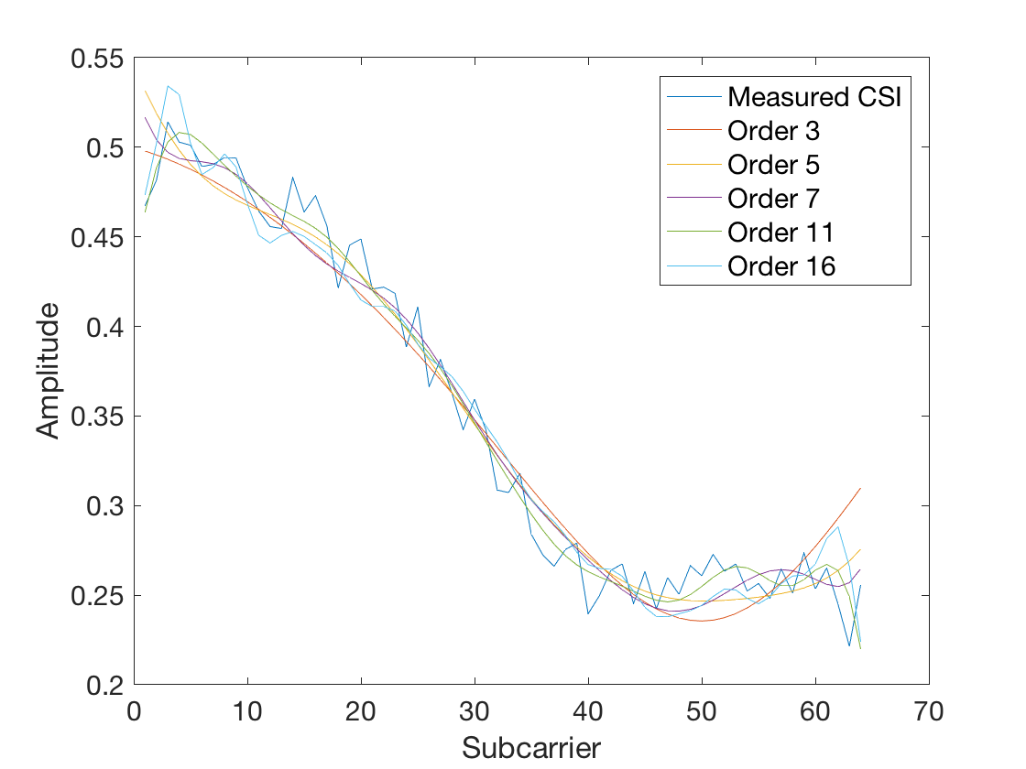
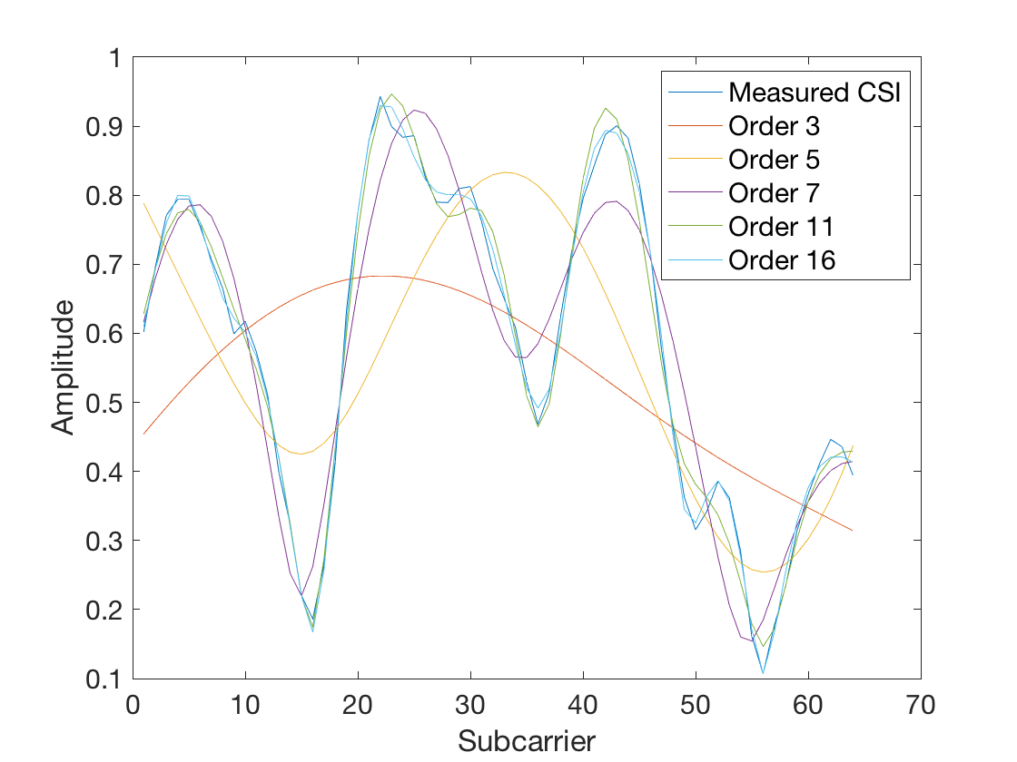
Frequency Selection and Multiple Configurations
One size fits all approach is not optimal
For best accuracy we can use as many as 16 base sinusoids, however at the cost of a poor compression ratio
On the other hand, for highest compression ratio we can use as few as 3 sinusoids, and get very poor fit accuracy
The range of the fit coefficients also depends on the base frequency values

Slide 17
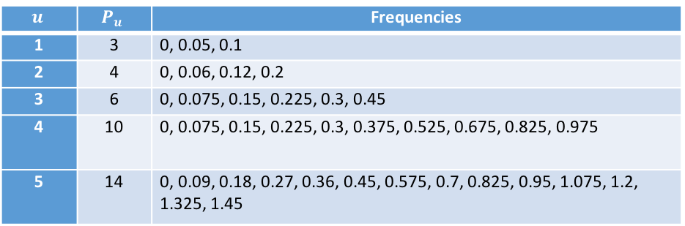
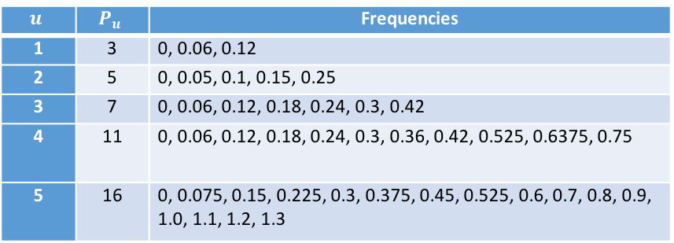
Frequency Selection and Multiple Configurations
So the selection of the base frequencies and configuration depends on
  Compression ratio
  Accuracy
  Implementation cost
  Range of the fit coefficients
The following base frequencies were empirically chosen to work with Wi-Fi . Many values are shared across configurations which reduces implementation cost.
64 subcarriers
40 subcarriers
$$u$$ | $$P_{u}$$ | Frequencies
1 | 3 | 0, 0.06, 0.12
2 | 5 | 0, 0.05, 0.1, 0.15, 0.25
3 | 7 | 0, 0.06, 0.12, 0.18, 0.24, 0.3, 0.42
4 | 11 | 0, 0.06, 0.12, 0.18, 0.24, 0.3, 0.36, 0.42, 0.525, 0.6375, 0.75
5 | 16 | 0, 0.075, 0.15, 0.225, 0.3, 0.375, 0.45, 0.525, 0.6, 0.7, 0.8, 0.9, 1.0, 1.1, 1.2, 1.3
$$u$$ | $$P_{u}$$ | Frequencies
1 | 3 | 0, 0.05, 0.1
2 | 4 | 0, 0.06, 0.12, 0.2
3 | 6 | 0, 0.075, 0.15, 0.225, 0.3, 0.45
4 | 10 | 0, 0.075, 0.15, 0.225, 0.3, 0.375, 0.525, 0.675, 0.825, 0.975
5 | 14 | 0, 0.09, 0.18, 0.27, 0.36, 0.45, 0.575, 0.7, 0.825, 0.95, 1.075, 1.2, 1.325, 1.45

Slide 18
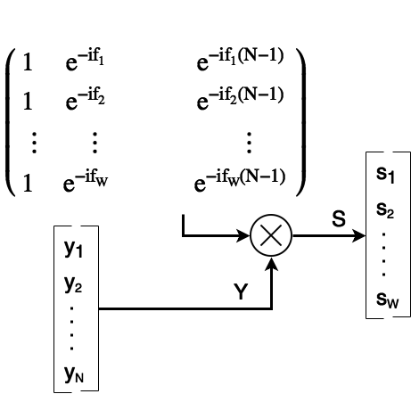
CSIApx

Slide 19
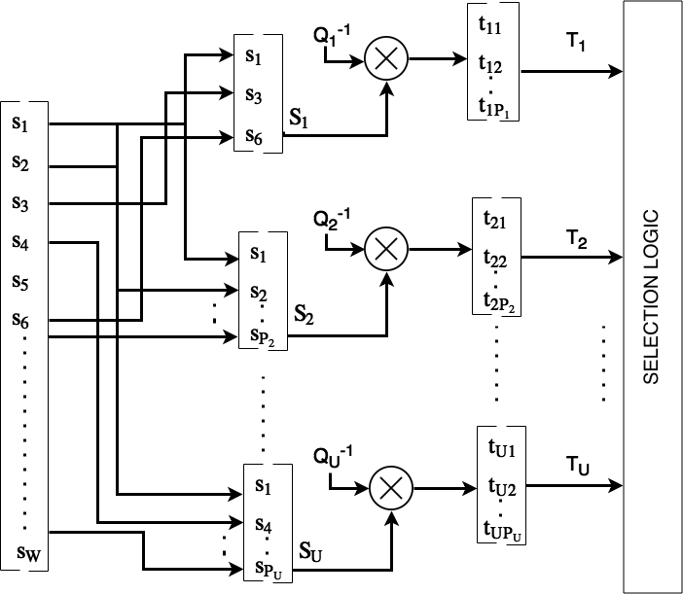
CSIApx

Slide 20
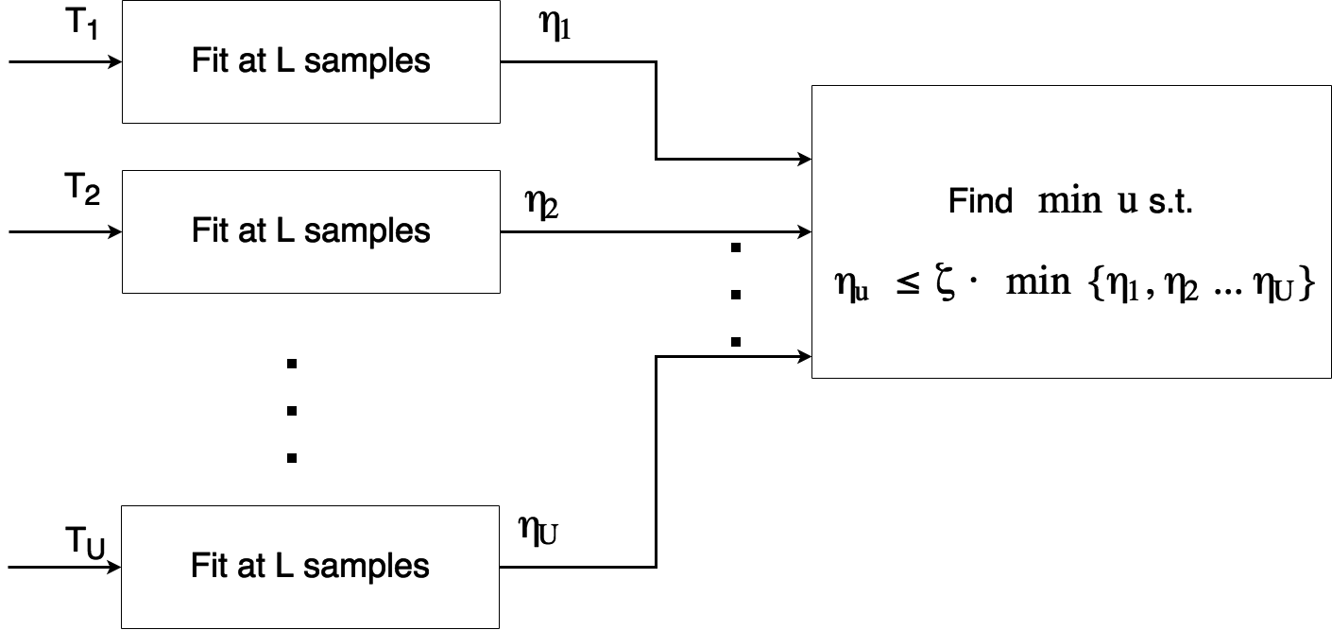
CSIApx

Slide 21
Evaluation
We evaluate CSIApx using the CSI from real world tests as well synthesized CSI from well known models
CSIApx is compared against the current state of the art CTDP (Continuous Time Domain Parameters) extraction
We also take a look at compression using Givens Rotation which is implemented in the current Wi-Fi protocol

Slide 22
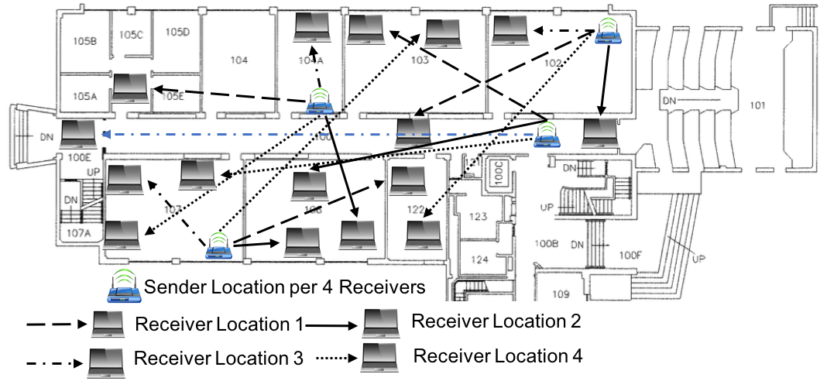
Evaluation with Experimental Data
1. Setup
Collected CSI using Atheros CSITool on 2x2 links in 100 different locations.
CSITool reports 56 complex numbers as the CSI i.e. one number per subcarrier
Experiments represent typical Wi-Fi environments with both line of sight and non line of sight scenarios

Slide 23
Evaluation with Experimental Data
2. Compared Methods
CTDP (Continuous Time Domain Parameters)* extraction is also based on the sinusoidal representation of CSI.
CTDP iteratively selects a sinusoid that matches the current residual signal until the power of the selected sinusoid is below a threshold. This results in high implementation complexity as opposed to CSIApx.
*X. Wang. Channel feedback in OFDM systems. 2014. US Patent 8,908,587.
*X. Wang and S.B. Wicker. Channel estimation and feedback with continuous time domain parameters. IEEE GLOBECOM, pages 4306–4312, 2013.

Slide 24
Evaluation with Experimental Data
2. Compared Methods
We also compare two other methods which are excluded from the evaluation results as their accuracy is much worse than CSIApx at about the same compression ratio.
  CSIFit – which uses non-linear curve fitting to compress the CSI
  FFT coefficients – which extracts the principal components from the fft to reconstruct the CSI

Slide 25
Evaluation (Contd.)
3. Preprocessing
The CSI reported by Atheros CSITool always seems to attenuate towards the end of the spectrum. This is likely done in hardware to limit the power leak to neighboring frequency bands
We pick the middle 40 out of 56 complex numbers, discarding 8 subcarriers from both ends
Some measurements were discarded as they were very weak.
The CSI data on all antenna pairs are normalized such that the maximum amplitude is 1

Slide 26
4. Fit accuracy and Compression Ratio
Out of 7928 experimental cases, CSIApx reported a median fit residual of 0.0828 which translates to an error of 0.0005 per data point.
CTDP has a better fit residual, at the cost of a much lower compression ratio.
CSIApx achieves a much higher compression ratio than CTDP with a mean ratio of 7.68 versus 3.59 against 40 subcarriers
Notes:
Opening statement: Our fit accurscy is very good

Slide 27
4. Fit accuracy and Compression Ratio
CTDP can sometimes use a large number of sinusoids to fit the noise in the data, resulting in a better fit accuracy but at the cost of poor compression ratios.
A constrained version of CTDP (cCTDP) is also evaluated which is essentially CTDP when using similar number of sinusoids as CSIApx.
CSIApx has a better fit accuracy than cCTDP
CSIApx also a better compression ratio as it allows cCTDP to go to a slightly higher configuration.
Both CTDP and cCTDP also need to transmit the base frequency values, whereas CSIApx does not.
Notes:
Opening statement: Our fit accurscy is very good

Slide 28
5. MU-MIMO Rate
This compares the achievable data rate of the users in a MU-MIMO setting when using the actual CSI versus the reconstructed CSI for different methods
CSIApx reported a normalized rate difference of ±3% in 98.3 % of cases
cCTDP performs worse than the CSIApx at 95.7%
Notes:
Talk in terms of compression ratio / focus on machine A

Slide 29
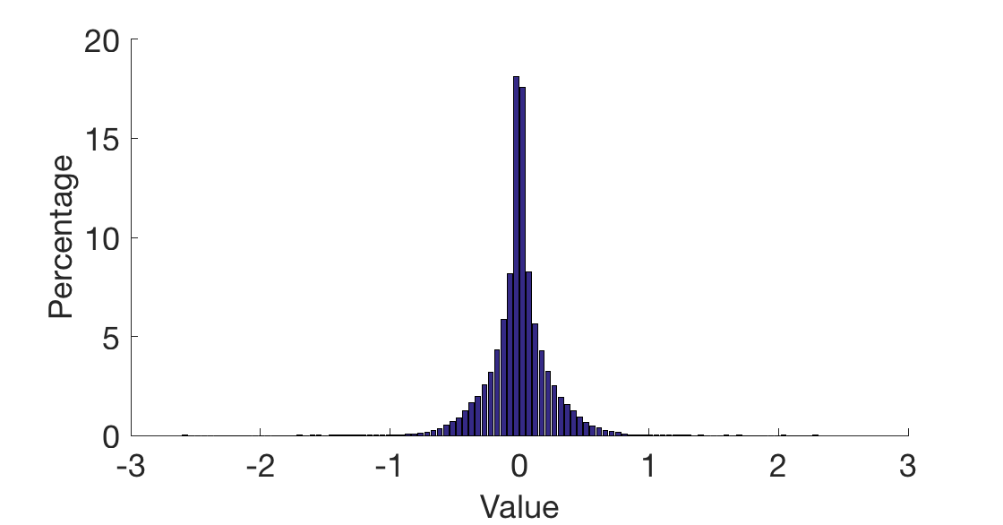
6. Parameter Distribution
The range of the coefficients obtained from the strongest antenna pair in each case follow a smooth distribution and are easy to quantize.
The range of coefficients on other antenna pairs are just scaled versions occupying a smaller range
Notes:
Comparison against naïve LM

Slide 30
Evaluation with Synthesized Data
We further evaluate CSIApx on synthesized CSI data on 3x3 links using the full set of 64 subcarriers.
Evaluation is done on models B, C, D and E that represent typical indoor Wi-Fi environment with 100, 200, 400 and 800 ns delay spread respectively.
Random Gaussian noise is added and CSIApx is also evaluated at different SNR levels such as 15,20,25 and 30dB
Each CSI vector is also rotated by a small random amount to simulate imperfect rotation

Slide 31
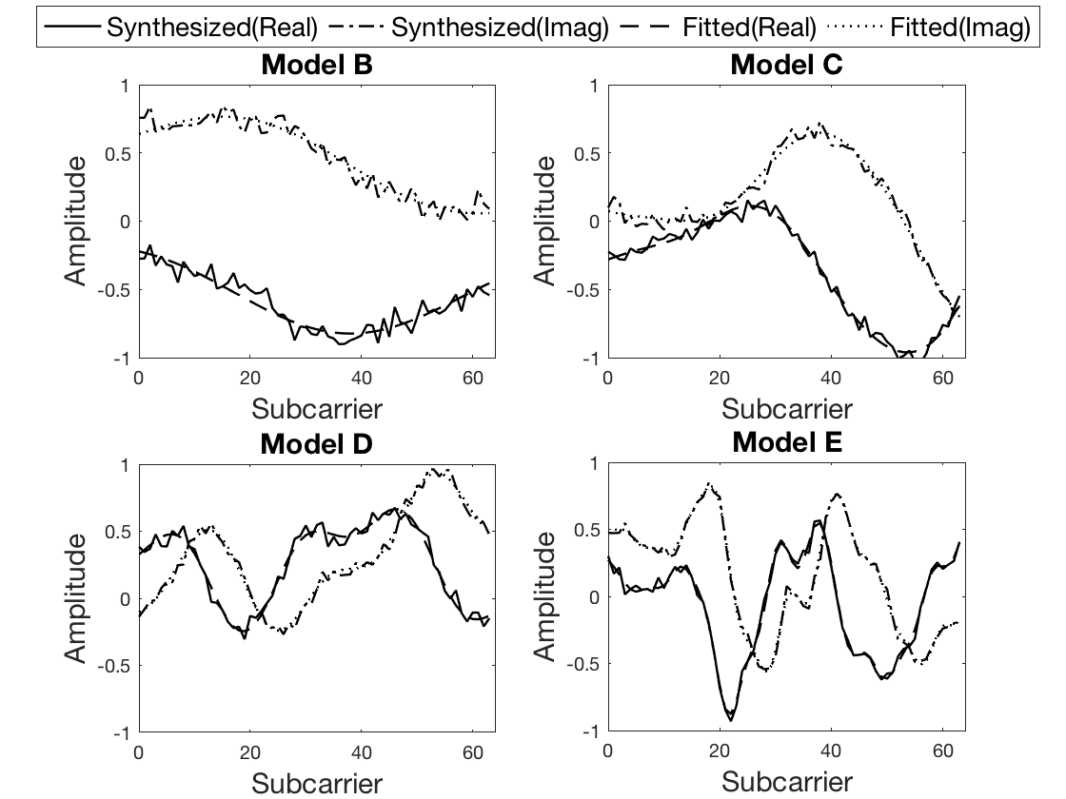
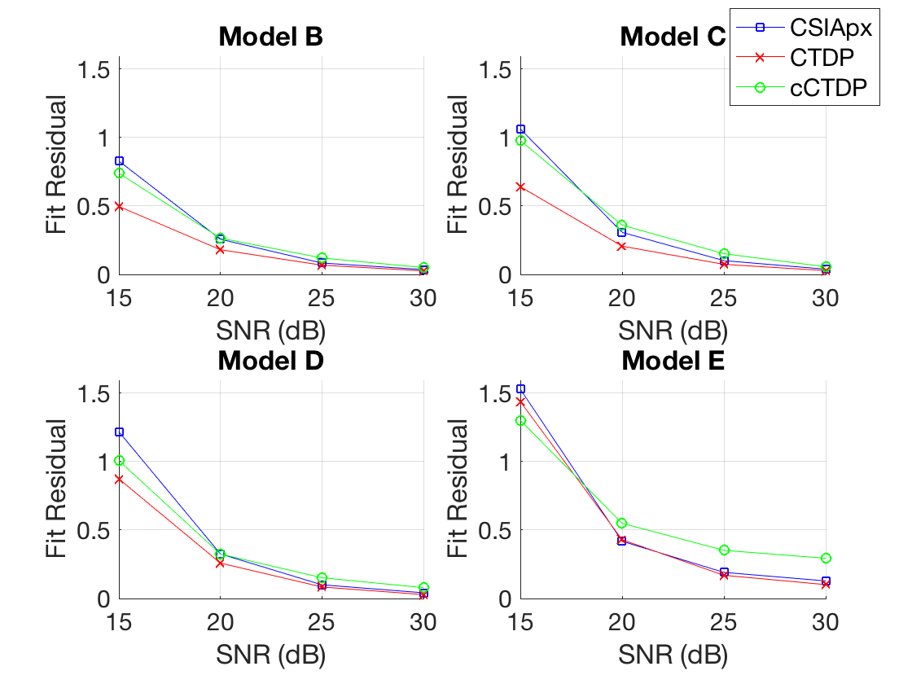
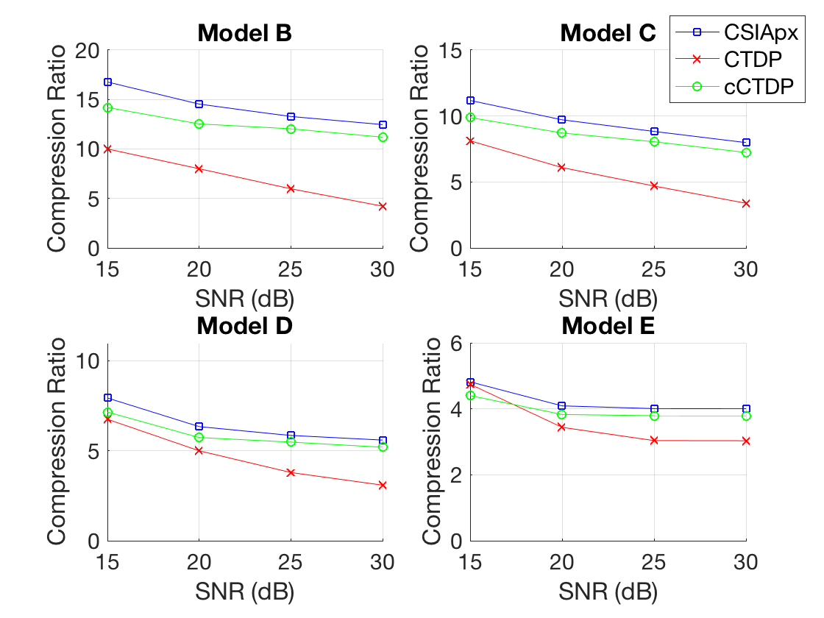
1. Fit accuracy and Compression Ratio
CSIApx works very well on the synthesized data as shown by the figure on the top left.
The average fit residual per point is 0.0007 or lower at 20dB or above. cCTDP performs worse than CSIApx in most situations when the SNR is above 15dB
CSIApx achieves compression ratios of 12.4:1, 7.9:1, 5.5:1, and 4.0:1 against 64 subcarriers at 20dB or above which is higher than both CTDP and cCTDP.

Slide 32
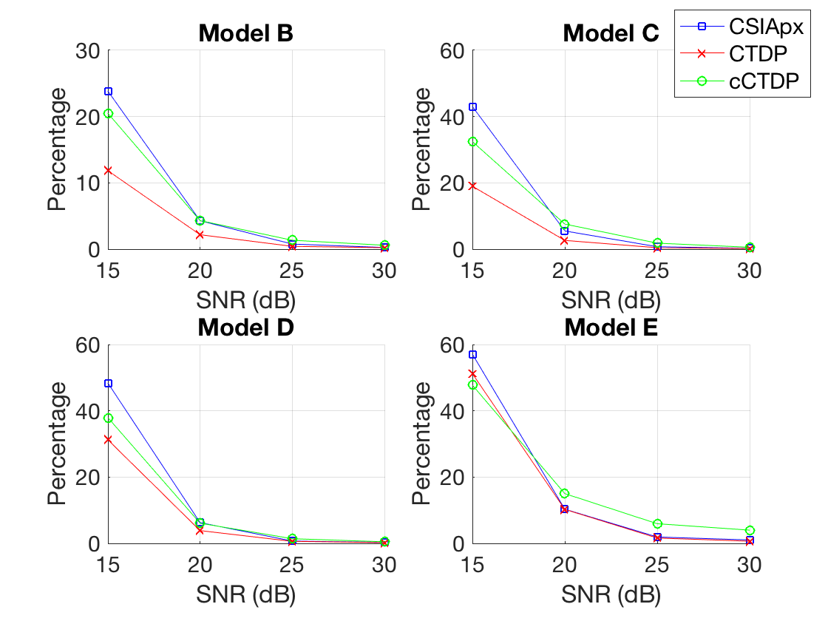
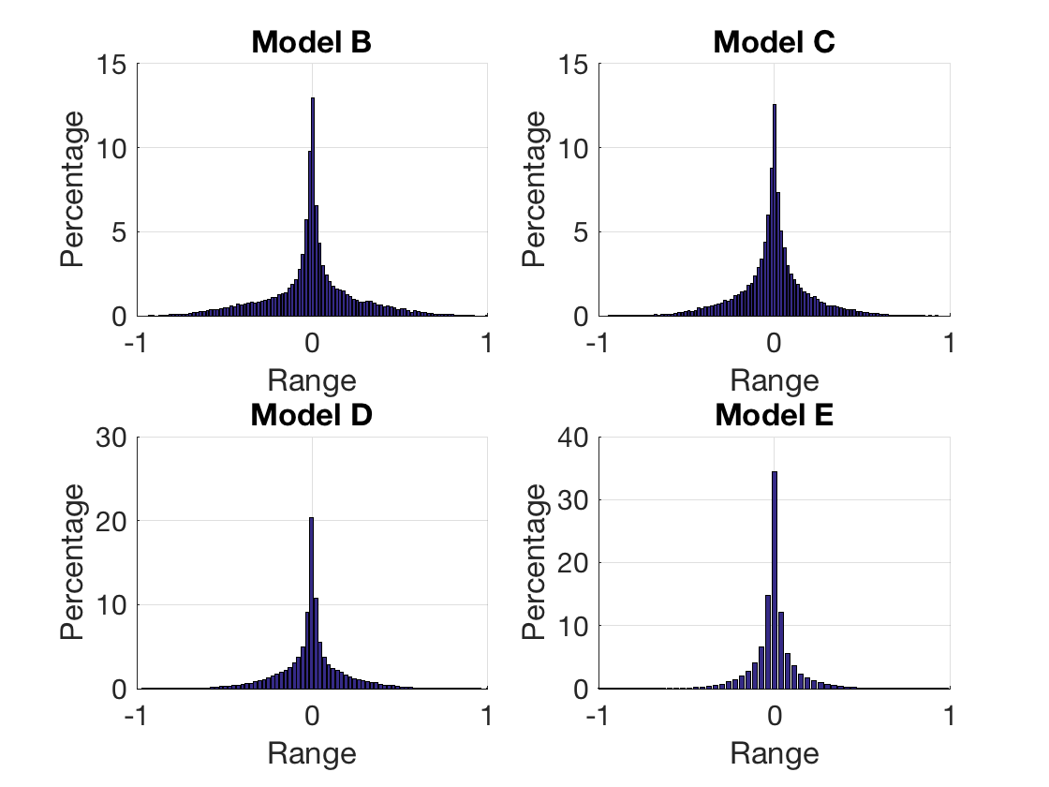
2. MU-MIMO Rate and Parameter Distribution
As with the experimental data the normalized rate difference for CSIApx is between ±3% in most cases at 20dB or higher SNR except for Model E which is very difficult to fit.
CSIApx still manages to do better than cCTDP in most cases.
The fit coefficient distribution is similar to the experimental data, and occupies a small range.

Slide 33
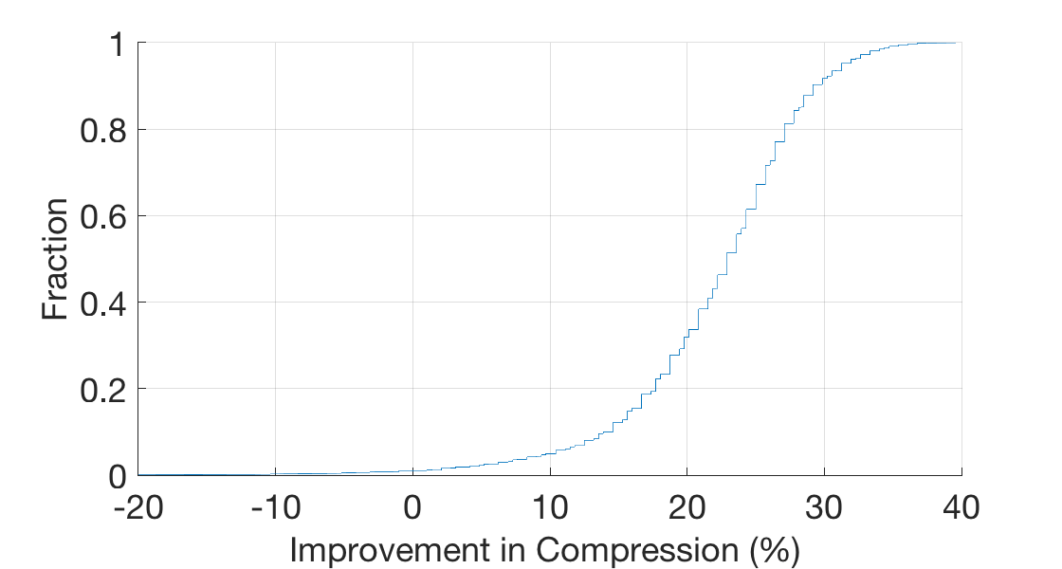
Further Compression using Huffman Coding
CSIApx plays nice with traditional compression methods like Huffman Coding
Huffman coding was applied on the fit coefficients obtained from the evaluation of experimental data.
A 12-bit quantization was used which resulted in negligible quantization error.
The average improvement in compression ratio was 22.1%

Slide 34
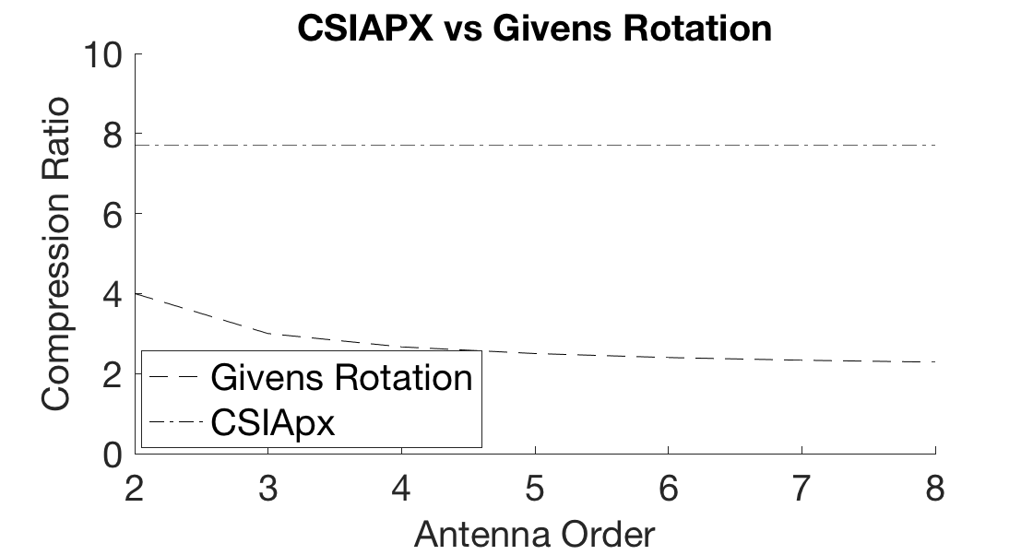
Comparison with Givens Rotation
Current Wi-Fi standard uses Givens Rotation to compress the CSI.
Compression ratio for Givens rotation reduces as the number of antenna pairs increase and approaches 2
CSIApx fits on each individual antenna pair, hence can remain constant even with an increase in antenna pairs
*
*CSIApx compression ratio is from the experimental data

Slide 35
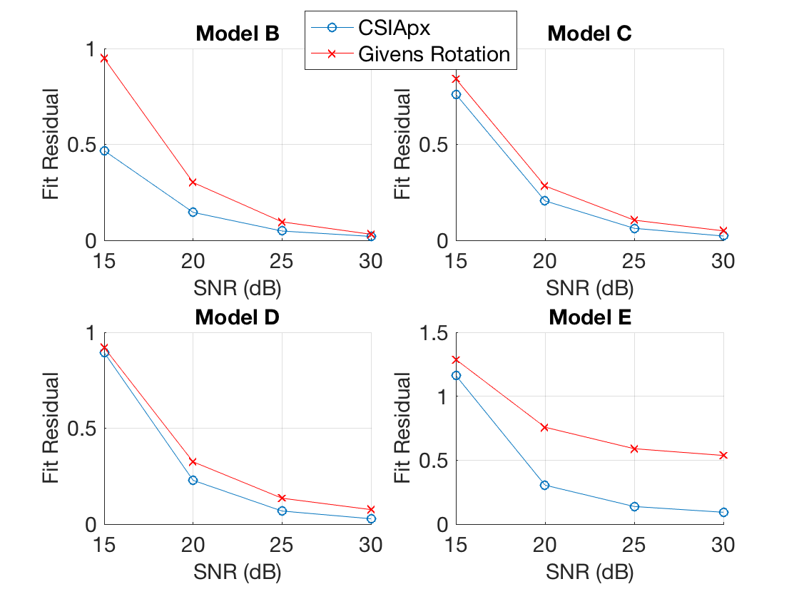

Comparison with Givens Rotation
Givens rotation is of course lossless, however, CSIApx actually does a better job at following the shape of the actual CSI when there is noise because it filters out noise, while Given’s rotation will keep all noise.
It is possible to apply some low pass filter to filter the noise then run Given’s rotation, however,
  It is still not as good as CSIApx because CSIApx is a better filter
  The low pass filter will increase the complexity to close to CSIApx
When compared to the clean signal from our synthesized data evaluation, we see that CSIApx outperforms Givens Rotation both in terms of fit accuracy and achievable data rate in a MU-MIMO setting.
Notes:
The RMS delay spread for all antenna pairs are similar, just use the average RMS delay spread of all antenna pairs as the x axis?

Slide 36
Thank You

