Slide 1

Practical Opportunistic Routing in High-Speed Multi-Rate Wireless Mesh Networks
ACM Mobihoc 2013, August 2013, Bangalore, India.
Acceptance rate: 10.3% (24/234).
Wei Hu, Jin Xie, and Zhenghao Zhang
Department of Computer Science
Florida State University

Slide 2


Wireless Mesh Networks
Created to extend the range of coverage without installing wires.
Cisco wireless mesh network solution:
  http://www.cisco.com/en/US/prod/collateral/wireless/ps5679/ps6548/prod_brochure0900aecd8036884a.html
Commercial wireless mesh service provider, MadCity:
  http://www.madcitybroadband.com/
Wired Internet
A
B
C

Slide 3
Mesh Protocols and Opportunistic Routing
Wired Internet
  Opportunistic Routing
    Packets may be overheard by downstream nodes
    Can reduce the number of packet transmissions
  ExOR [Sigcomm 2004], MORE [Sigcomm 2007], MIXIT [Sigcomm 2008], Crelay [Globecom 2012]
A
B
C
Both got it!

Slide 4
Motivations
An OR protocol preferably:
  Runs on Wi-Fi hardware
  Supports TCP efficiently
  Low complexity in packet forwarding
  Supports multiple data rates
  Supports partial packet recovery
Existing protocols do not meet these requirements

Slide 5

Motivation (1)
Wired Internet
Runs on commodity Wi-Fi devices
  Wi-Fi is the dominant wireless access technology
  MIXIT [Sigcomm 2008] needs to modify the physical layer
A
B
C

Slide 6
Motivation (2)
TCP is the ubiquitous protocol, assumes packets are sent individually
  Expects an ACK after every (1-2) packets
Packet batching is going to interfere with this assumption
  In MORE, ExOR, MIXIT, packets are assembled in a batch and sent, which cannot work with the TCP windowing mechanism
Wired Internet
A
B
C

Slide 7
Motivation (2)
TCP is the ubiquitous protocol, assumes packets are sent individually
  Expects an ACK after every (1-2) packets
Packet batching is going to interfere with this assumption
  In MORE, ExOR, MIXIT, packets are assembled in a batch and sent, which cannot work with the TCP windowing mechanism
Wired Internet
A
B
C

Slide 8

Motivation (3)
Link layer is getting faster and faster
Network layer protocol must be kept simple
Protocols that involve high complexity in packet processing cannot keep up with the high data rates
Wired Internet
A
B
C

Slide 9
Motivation (4)
Link layer usually supports multiple data rates, the performance is usually determined by the selection of data rates
The OR protocol has to be involved in selecting data rates
Existing protocols usually assume a single data rate
Wired Internet
Fast rate, 3 transmissions
A
B
C

Slide 10
Motivation (4)
Link layer usually supports multiple data rates, the performance is usually determined by the selection of data rates
The OR protocol has to be involved in selecting data rates
Existing protocols usually assume a single data rate
Wired Internet
Slow rate, 2 transmissions
A
B
C

Slide 11
Motivation (5)
Partial packets are packets received with the correct header but some corrupted bytes
  In Wi-Fi, such packets are retransmitted, even when there are just a few corrupted bytes
  It is more efficient to repair such packets
Protocols that repair partial packets
  MIXIT: high complexity due to network coding
  Crelay: high complexity due to running error correction
Wired Internet
A
B
C

Slide 12
Practical Opportunistic Routing
We propose POR that meets all requirements
Three main aspects:
  Packet forwarding
  Routing
  Rate selection

Slide 13
POR – Packet Forwarding
The core of POR is packet forwarding
  Goal: to achieve high performance by exploiting packet overhearing and partial packets
  Challenges:
    low complexity
    low overhead
    friendly to TCP

Slide 14
POR – Packet Forwarding
Wired Internet
Our simple solution from a high level:
  The source sends individual packets
  Packet divided into blocks, the checksum of each block attached with the packet
  The forwarder receives a packet but will send the packet when
    A feedback from the downstream node has been received to determine
      If the packet needs to be sent
      Which blocks need to be send
    or until a timeout of 20 ms
  A node will send feedback about a packet it received
    The feedback is the bitmap of correct blocks
    Sent at most 15 ms after receiving the packet
A
B
C

Slide 15
POR – Packet Forwarding
Wired Internet
Main features:
    Runs on Wi-Fi
      Software solution, does not need special hardware support
    Simple
    Works with TCP
      Sending individual packets
    Can exploit overhearing
      because the downstream nodes will use the feedback to announce the overhearing
    Can repair partial packets
      Because the bitmap tells the upstream node can locate the blocks that should be transmitted
A
B
C

Slide 16
POR – Packet Forwarding
Additional features
  Exploiting link layer ACK
    Once an 802.11 ACK is received, consider the packet forwarded to the next hop
    Faster than relying on feedbacks
  Simple congestion control
    If the queue becomes to long, send feedback to suppress the upstream node

Slide 17
POR – Path Selection
POR needs a new path selection algorithm because the path metric is different from existing schemes. Needs to consider
  Overhearing
  Feedback cost
In addition, POR also considers the ability for nodes to adapt to the channel conditions by selecting a good data rate

Slide 18


POR – Path Selection
Wired Internet
Path metric:
  Forward cost:
    Air time to send a data block to the destination
    Can be computed recursively
  Backward cost
    Air time consumed in sending feedbacks to deliver one packet
    Can be computed under some simplifying assumptions
A
B
C

Slide 19
POR – Path Selection
Wired Internet
Dealing with fluctuating channel states
  A link may be operative at high rates for some time, then operative only at low rate
  The path metric should capture this
    Earlier metrics typically assume only one rate is used
A
B
C

Slide 20
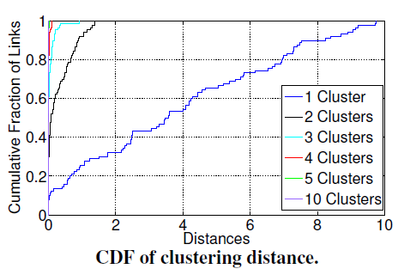
POR – Path Selection
Measured the per second packet receiving ratio at all rates as a vector
Measured 10 seconds – 10 vectors
Usually in no more than 3 clusters

Slide 21
POR – Path Selection
Our solution:
  Quantize link quality into 3 states per link
  Given any path, find the path cost when each link is in a particular state
  Use the weighted average the path costs in individual states as the actual path cost
  Given the path cost, run a simple Dijkstra-like algorithm

Slide 22
POR – Rate Selection
POR needs a new rate selection algorithm because packet can be received by more than one node, thus should adapt to the conditions of multiple links

Slide 23
POR – Rate Selection
Wired Internet
POR rate selection at high level, probe based:
  A node sends small probe packets at candidate rates
    Probes are sent in a batch, 20 probes a batch
  All neighbors measure the loss ratio and report back in special feedbacks
    Measurement is based on sequence numbers, no feedback interpreted as nonoperative rate
  A node selects a rate based on the feedbacks which minimizes the instantaneous path cost
A
B
C

Slide 24
POR – Rate Selection
To limit the probing overhead:
  Only up to 3 rates are probed at a time
  Rates probed will have a 2-second hiatus
  If more rates have the potential to be better than the current rate, the lowest 3 are probed
Can argue that:
  If channel becomes worse, will switch to lower rates quickly
  If channel becomes better, will switch to higher rates after maximum 2 seconds

Slide 25
Evaluation
We implemented POR in the Click modular routing in C++
We evaluated POR for
  Single flow UDP
  Multiple flow UDP
  TCP
We compared POR with
  MORE
  SPP

Slide 26
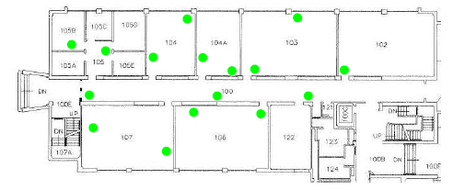
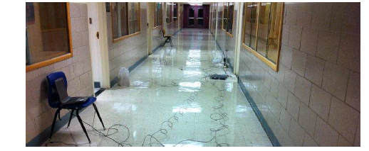
Single Flow UDP: Experiment Setup
We deploy a 16-node testbed
  Each node is a laptop computer with the Cisco Aironet wireless card
  Operates on 5 GHz band
  Use minimum transmission power and 24 Mbps or higher to create multi-hop network
  SPP: Enable auto rate on links
  MORE: Use 24 Mbps because MORE does not support multiple rate

Slide 27
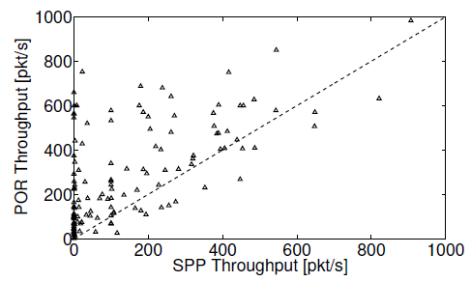
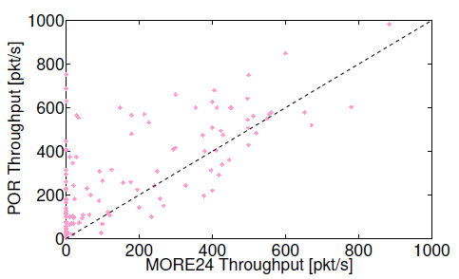
Single Flow UDP: Throughput
Scatter plots show POR outperforms SPP and MORE in most cases

Slide 28
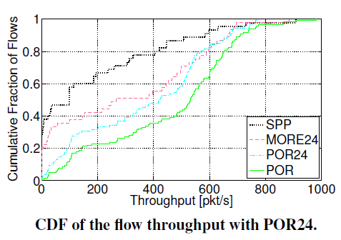
Single Flow UDP: Gain Analysis (1)
POR24: fixing POR rate also at 24 Mbps
Observations:
  POR can efficiently exploit multiple rates, as POR is significantly better than POR24
  POR has efficient packet forwarding, as POR24 is still better than MORE24

Slide 29
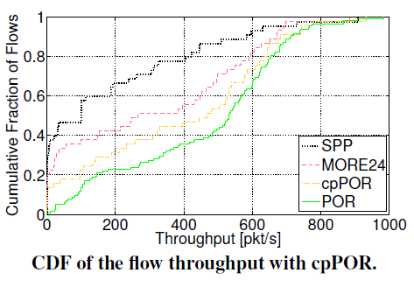
Single Flow UDP: Gain Analysis (2)
cpPOR: disable partial packets
Observation:
  POR efficiently exploits partial packets, as evident from the gain of POR over cpPOR

Slide 30
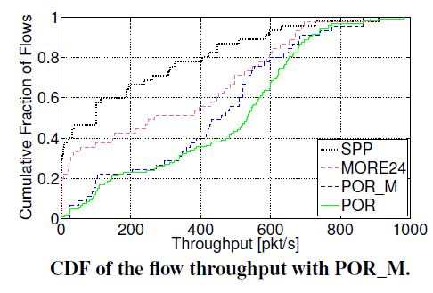
Single Flow UDP: Gain Analysis (3)
POR_M: assume links have only one state
Observation:
  when the throughput is high or low, POR_M performs similar as POR; in between, POR achieves higher throughput than POR_M
  Mediocre links have more states

Slide 31
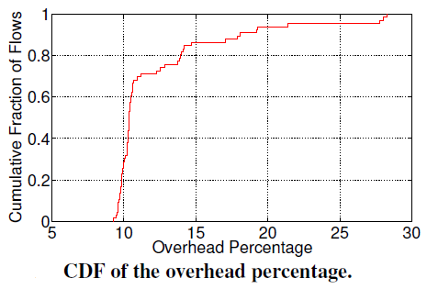
Single Flow UDP: Various Aspects of POR (1)
Overhead
  Includes feedbacks, probe packets, block checksums
  Reasonably low, median around 10%

Slide 32
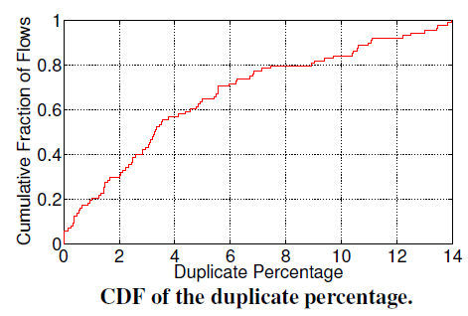
Single Flow UDP: Various Aspects of POR (2)
Duplicate data
  An upstream node send data when the downstream node has already received it
  A good metric for an OR protocol
  Reasonably low, median around 3%

Slide 33
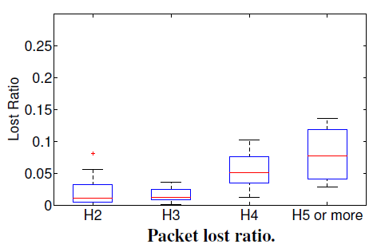
Single Flow UDP: Various Aspects of POR (3)
Packet loss ratio
  Small for 2 hop or 3 hop paths

Slide 34
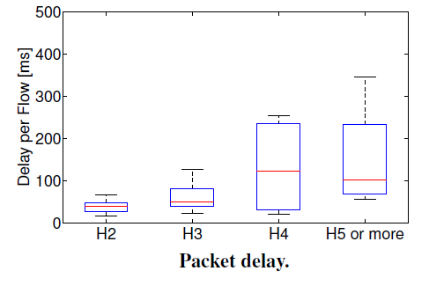
Single Flow UDP: Various Aspects of POR (4)
Delay
  typically around 100 ms and the variance is reasonably small for short paths

Slide 35
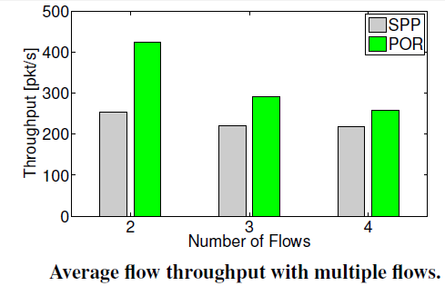
Multiple Flow UDP
POR can support multiple flows
Compare with SPP as the MORE implementation online does not support multiple flows
Multiple flows performance depends on many issues out of the scope of this work, such as network-wide load-balancing
Still, POR achieves higher throughput

Slide 36
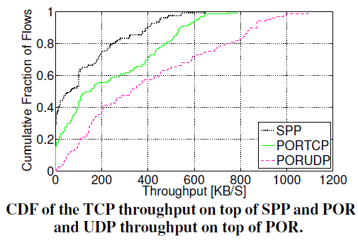
Single Flow TCP
To our best knowledge, the first demonstration of gain in unmodified TCP by an OR protocol over SPP

Slide 37
Thank you!

