Slide 1
L2Relay: a Layer 2 Wi-Fi Packet Relay Protocol
Shuaiyuan Zhou and Zhenghao Zhang
Computer Science Department
Florida State University
10/9/2013
Notes:
Today I am going to present our work: l2relay, a layer 2 wi-fi packet relay protocol.

Slide 2




Wi-Fi has been widely deployed in
  homes
  offices
  public hot spots, e.g., coffee shops, air ports

Slide 3

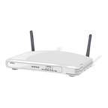

Range Problem
One major problem with Wi-Fi:
  Range

Slide 4
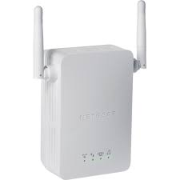
Range Extender
Solution: Add a range extender

Slide 5
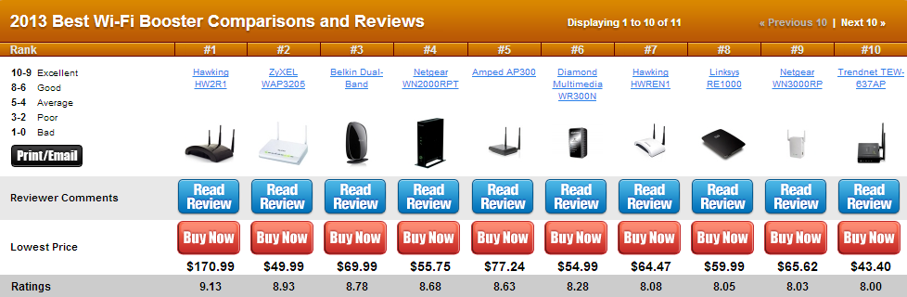
Range Extenders on the Market Today
http://wi-fi-booster-review.toptenreviews.com/

Slide 6

Introduction
Range Extenders
  Repeat every packet, therefore often reduce network speed
Internet
Internet
Got it!
Weak signal
Access
Point
Got it!
Access
Point
Unnecessary!
Notes:
As we know, wi-fi always has a range problem, due to the constraint of transmission power, nodes on the edge of the network often get degraded services.
Adding a range extender can alleviate this problem by relaying AP’s packets, but in some cases, the packet relaying is unnecessary and may actually reduce the network speed.

Slide 7
Introduction
We propose a better solution: L2Relay
  Intelligently relay for packets only when necessary
  A firmware level solution functioning in layer 2
Design Requirements
  Ubiquitous compatibility
  Link quality estimation
  Coping with multiple rates
  Distributed relayer coordination
  Low complexity
Major challenge
  Compatible with all APs and user devices, no modifications to them
Notes:
Therefore, we design a protocol that can intelligently relay packets only when necessary; our solution is on firmware level functioning in layer 2, thus, we name it L2Relay.
In designing L2Relay, we have the following requirements:
We want our relay device to be compatible with all existing APs and nodes without any modification to them. Problems can be simplified if the AP or nodes can be modified, but will limit the deployment of L2Relay.
In designing, we want our relayer to be able to learn the link qualities so that it knows when relaying is necessary; we need to deal with multiple data rates; and as multiple relayers may be installed in one network, they need to coordinate.
Moreover, we want our protocol to be simple and implementable in firmware.
All these requirements brings challenges to our designs, and I will come to our solutions later.

Slide 8
Related Work
Works on packet relay based on node cooperation
  PRO[ACM Mobicom 09], Soft-Repeater[ACM CoNEXT 08], RCMAC[Wireless Pers Commun 11], rDCF[IEEE Trans. on Mobile Computing 06], CoopMAC[IEEE JSAC 07], etc.
  Require some modifications to the AP or the nodes; L2Relay is ubiquitously compatible
  Implemented in the driver or evaluated on simulation; L2Relay has a firmware level implementation
Works on rate selection
  SampleRate[MIT Ph.D. Thesis 05], CHARM[ACM MobiSys 08], RRAA[ACM Mobicom 06], ESNR[ACM SIGCOMM 10], etc.
  The relay device has to select a rate for the sender when the sender is not even aware of it
Notes:
There are lots of packet relaying works. The fundamental difference is existing protocols all requires some modification to the AP or nodes, while L2Relay is designed to be ubiquitous compatible. Also, previous works are either implemented in the driver or evaluated on simulation, while we have a firmware level implementation of L2Relay.
L2Relay handles rate selection to cope with multiple rates, the main difference from existing works is the relay device is supposed to select a rate for the sender while the sender is not aware of it, this is a challenging problem and our solution is unique.

Slide 9
Key Features
Link quality estimation
A novel packet relay procedure
Rate selection for the AP
Relayer selection
Notes:
Next, I will talk some key features of our design.

Slide 10
Key Technical Aspects (I) - Link Quality Estimation
Challenge: When does R decide to be the relayer?
Solution: R learns the link quality
  Passive observations and probing
Internet
Internet
Strong signal,
no need to repeat
Weak signal,
should repeat
L2Relay
L2Relay
Notes:
Link quality estimation is needed for the relayer to decide whether to relay or not.
This is done by both passive observations and active probing.
Why we need to learn the link quality? Sometimes it is better to let the AP do the retransmission.
Next challenge is when does a relayer decide to be the relayer of the node. We see in the following example that

Slide 11
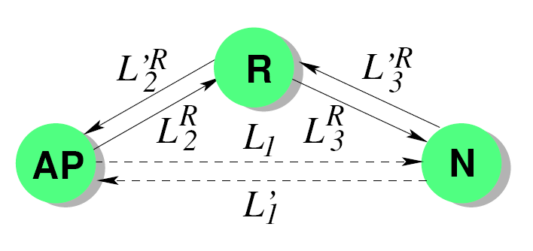
Link Quality Estimation
Packet Receive Ratio (PRR) is maintained for forward and backward links (6 links) and for every data rate
Examples:
: incremented by 1 whenever R receives P correctly
: incremented by 1 whenever R receives P correctly and detects the subsequent ACK from N
: incremented by 1 whenever R receives the PLCP header of P correctly and the MAC header of P indicates the packet is from the AP
Notes:
To learn link quality, the relayer maintains the packet receive ratio for all 6 links and for every data rate.
I will give two examples below.
To estimate PRR for the link from the AP to the node, the relayer maintains two event counters, which counts how many packets from the AP are received correctly and how many ACKs are detected afterwards, then the PRR mu1 is estimated as the number of packets followed by ACKs over the number of total packets.
Next example is to estimate PRR for the link from the AP to the relayer, we have another counter which is how many PLCP headers of a packet from the AP is received correctly, and we estimate mu2 as number of correctly received packets over number of PLCP headers.

Slide 12
Relayer Rank Calculation
R can calculate the expected delivery time of a packet P of unit size when the AP and R transmit at rate and as:
The rank of R ( ) is the minimum expected delivery time of a unit size packet
R will relay if its rank is smaller than the packet delivery time from the AP to the node directly
Notes:
Given the PRRs of all links, the relayer can calculate the expected packet delivery time for a packet of unit size and the rank of the relayer is minimum among all possible data rates.
The relayer will relay if and only if its rank is smaller than packet delivery time from the AP to the node directly.

Slide 13
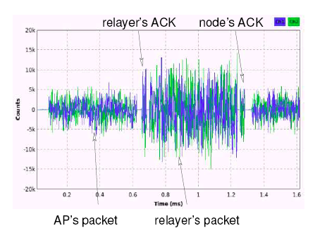
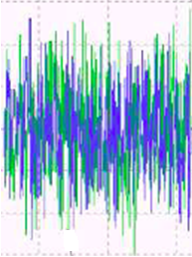
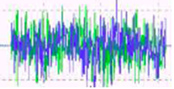
Key Features(II) - Packet Relay Procedure
Challenge: If R is the relayer, when should it relay the packet?
  Sometimes the node can get the packet itself!
Solution: Relayer (R) will relay if R received packet P correctly but did not detect the ACK from N
  ACK detection: checking whether or not the medium is busy when the ACK is supposed to be transmitted (15 us in 802.11g)
R first sends an ACK to the
AP; then transmits P
  Packet transmission is SIFS
  after the ACK (10 us in 802.11g)
relayer’s ACK
node’s ACK
AP’s packet
R’s Timer
R wait for 15 us
relayer’s packet
Notes:
As a relayer, after the AP finished sending a packet, it will relay if it did not detect the ACK from the node.
Our ack detection is done by checking the medium is busy when ACK is supposed to be transmitted.
The packet relay procedure is straightforward: the relayer first sends an ACK to the AP, then transmits the packet SIFS afterwards; the relayer will relay the same packet only modifing the source MAC address.
The first challenge is when does the relayer relay. We say that after the AP’s packet, the relayer will relay if it get the packet correctly but did not detect the ACK from the node.

Slide 14
Relayer Rate Selection
As the relayer of N, R should adapt to the best data rate to N
  Any good algorithms may be used
  Currently we use SampleRate algorithm
Notes:
When relaying packets, the relayer should adapt to the best rate to the node, here, any good rate adaptation algorithms can be used and we currently use the SampleRate algorithm.

Slide 15
Key Features(III) - Rate Exploration
Challenge: The AP’s rate selection algorithm may converge to non-optimal data rates
Solution: Built-in mechanism to encourage the AP to explore more rates
Internet
36 Mbps
AP
54 Mbps
54 Mbps
L2Relay
The AP converges to 54 Mbps, the best
rate to the relayer. The speed to the
client is less than 27 Mbps.
The AP can actually communicate with the
client directly at 36 Mbps. The AP transmits
only at 54 Mbps and cannot see 36Mbps .
Notes:
We realize introducing a relayer may affect the rate selection algorithm by the AP. Here is an example. The AP will converge to 54, which is the best rate to the relayer, and the speed for this two link pass is at most 27; but the AP can actually communicate directly with the node at 36. The problem here in this case is the AP will always transmit at 54 without knowing 36 is better.
So, as a relayer, we need to lead the AP to select the best rate by visiting more rates.

Slide 16
Rate Selection for the AP
Problem: The AP converges to the best rate to R, without knowing the optimal rate (usually lower) to N
Solution: R triggers AP to visit more rates
R has operating mode and exploration mode
In the exploration mode
  Relay policy: only relay AP’s retransmitted packets
Notes:
As I said earlier, the problem here is the AP converges to the best rate to relayer
In our design, the relayer has two working mode, operating mode and exploration mode.
In the exploration mode, the relay will trigger the AP to visit more rates by only relay for AP’s retransmission packets.

Slide 17
Key Technical Aspects (IV) - Multi-Relayer Mode
Challenge: Install multiple L2Relay extenders in the same network, which should automatically converge to an optimal configuration, even when they cannot directly communicate with each other
Solution: A simple query protocol and reliable communication by a technique we call “ACK Reflection”
Internet
L2Relay
L2Relay
L2Relay
Notes:
Another challenge is relayer coordination: when multiple relayers are installed in the same network, they should automatically converged to an optimal configuration, even they cannot communicate directly with each other.
We design a query protocol and achieves reliable communication by ACK reflection.

Slide 18
Relayer Selection
Query-response protocol
  R, the current relayer of N, announces a query message containing its rank
  A relayer with a better rank will respond with its own rank
  R finds the best rank in the response and announce the new relayer
R
New relayer is Q
S
Q
T

Slide 19
Relayer Selection
Key challenge: Reliable communication
Solution: ACK-Reflection
  If R and Q are potential relayers of N, they are able to communicate with N reliably
  Information is announced by modifying the source MAC addresses in the packets
  R sends two small dummy data packets back to back to N at the lowest data rate and the
  N will send ACKs, echoing the source MAC address in the data packets
  When Q receives the ACKs, it can decode the information based on the MAC addresses in the ACKs
  MAC address field is 12 bytes in two packets
MAC
header
Payload
FCS
SA
R
Q
N.A.
N.A.
N.A.
R.A.
R.A.
M.T.
PKT
N.A.
N.A.
N.A.
R.A.
R.A.
R.R.
PKT
ACK
N.A.: MAC address of node
R.A.: MAC address of relayer
M.T.: message type
R.R.: rank of relayer
ACK
Notes:
Spoofing the source address field in MAC header of the packets

Slide 20
Evaluations
Implementation
Evaluation in Emulated Environments
Evaluation in Real-world Environments
Notes:
Next will be our evaluation part.

Slide 21
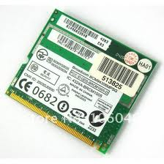
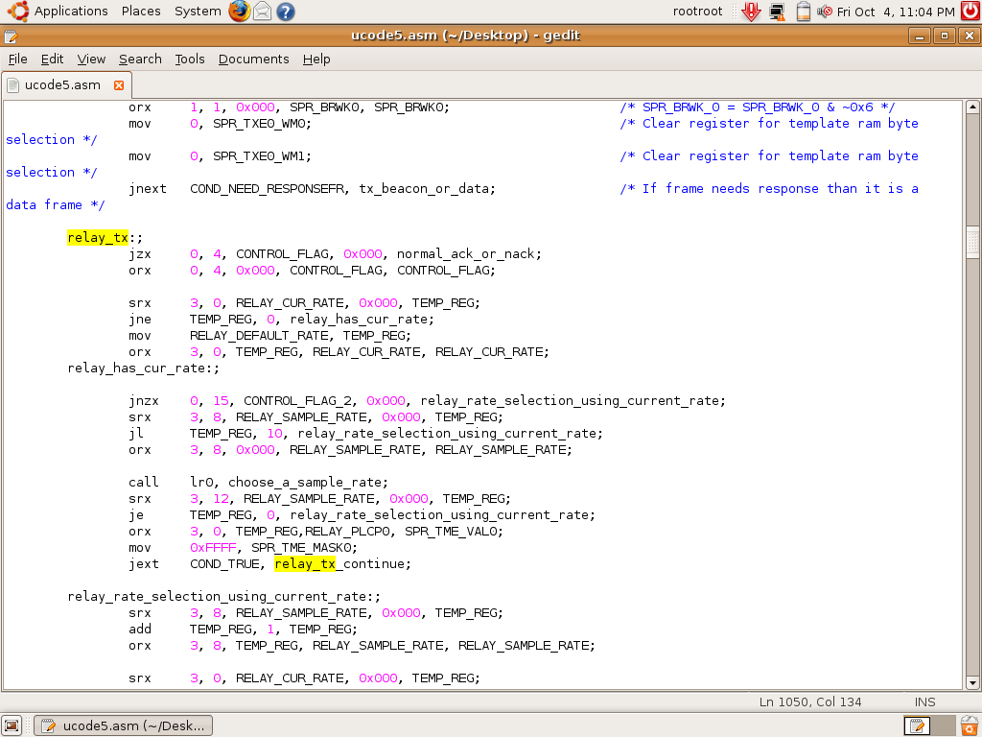
Implementation
Firmware level implementation on BCM
4306 wireless card in assembly
A complete implementation of L2Relay
with support of 802.11g rates and up to 4 nodes
Notes:
We have a firmware level implementation of L2Relay on BCM 4306 card with support of 802.11g rates and up to 4 nodes.

Slide 22
Evaluation in Emulated Environments – Experiment Setup
Channel is repeatable and theoretically predictable
Install a packet dropping module which drops packets and ACKs
Use downlink UDP traffic
20m
150m
Notes:
We first evaluate L2Relay in emulated environments, in which channel is repeatable and theoretically predictable, we install a packet dropping module to drop packets and ACKs.
Why we need emulated channels ? Vs. real channels?
In our experiments, the AP is at the center of environment, one node and one relayer are randomly located within 20 to 150m to the AP.
We use downlink UDP traffic.

Slide 23
Evaluation in Emulated Environments -Performance Comparison
Two compared schemes:
  “Baseline”: only the AP and the node
  “Emulated Range Extender (EmuRExt)”: an emulated range extender implemented in firmware
Notes:
We first see the performance, we compare L2Relay with two scheme: Baseline with only the AP and the node, and an Emulated Range Extender.

Slide 24
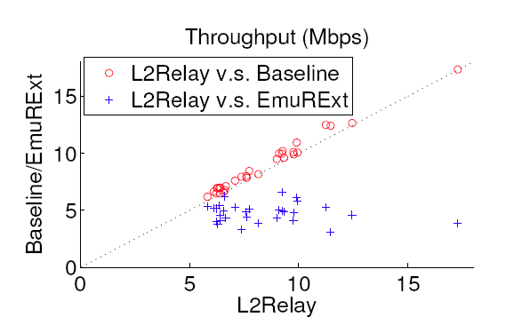
Performance Comparison – One-hop
One-hop: N is close to the AP
thus packet relaying is unnecessary
Scatter plot of throughput. A marker at (x,y) represents an experiment in which L2Relay has throughput x Mbps while the other scheme has throughput y Mbps
L2Relay achieves almost the identical performance as Baseline; EmuRExt suffers much worse performance
Notes:
We begin with two simple cases. The first one is one-hop, where the node is set to be close to the AP.
We refer our fist type of experiment as one-hop, where the node is close to the AP and thus relaying is unnecessary.
Explain scatter plot
From the scatter plot of the throughput, we can see L2Relay achieves almost the same performance as Baseline, the performance of the emulated range extender is worse.
Why extender is worse?

Slide 25
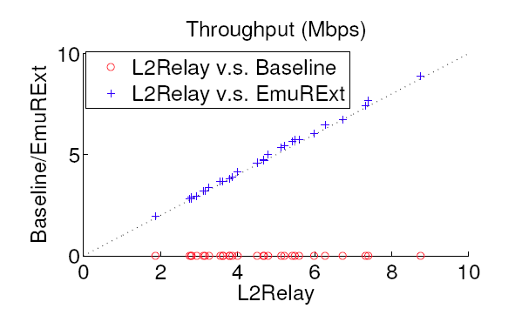
Performance Comparison – Two-hop
Two-hop: N cannot communicate with
the AP and relaying is needed
L2Relay achieves almost identical performance as EmuRExt; Baseline reports a throughput of 0
Scatter plot of throughput
Notes:
The second case is two-hop, basically the node can not communicate with the AP.
The result shows that the performance of L2Relay and emulated range extender are the same, while the throughput of baseline is 0.

Slide 26
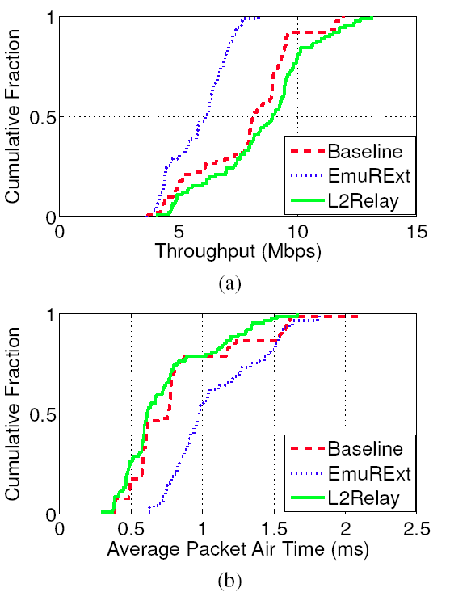
Performance Comparison – Middle-ground
Middle-ground: The AP can communicate
with the node directly while adding a
relayer will theoretically improve the
throughput
L2Relay achieves noticeable
throughput gain than the
other two schemes
  The median gain is 10% over
  Baseline and 45% over EmuRExt
The gain is achieved by more
efficient packet forwarding
(a) CDF of throughput; (b) CDF of packet air time
Notes:
The more interesting case is middle-ground, where the AP can communicate with the node directly while adding a relayer will brings better performance.
Our results show that in this case L2Relay achieves noticeable throughput gain with a median of 10% over baseline and 45% over emulated range extender.
This is because after adding the relayer, the average packet air time is reduced.

Slide 27
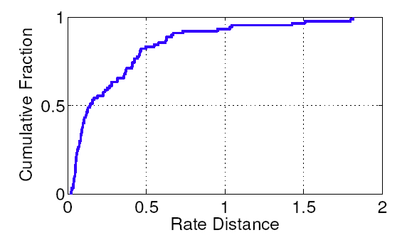
Evaluation in Emulated Environments –Rate Selection of the AP
Rate distance: the difference between AP’s rate and the optimal rate
The AP uses the optimal rate or rates close to the optimal rate in the majority of the cases
CDF of rate distance
Notes:
We then evaluate the rate selection of the AP.
We use a metric called rate distance, which measures the difference between AP’s rate and the optimal rate.
We see that the rate distance is typically a small value, and we claim that the AP always uses the optimal rate or rates close to the optimal rate.

Slide 28
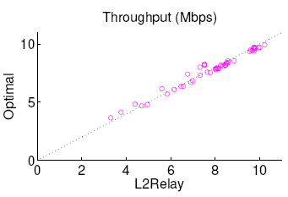
Evaluation in Emulated Environments –Relayer Selection
The AP is at the center, 3 relayers are randomly located
Two types of experiments
  L2Relay: all 3 relayer are on
  Optimal: only the optimal
  relayer is on
The throughput of L2Relay and Optimal are almost identical
  L2Relay is capable of converging to a good relayer in most cases
Scatter plot of throughput
Notes:
To evaluate relayer selection, we deploy 3 relayers beside the AP and the node.
We have two types of experiments, the first one with all 3 relayers on; and the second one with only the optimal one on.
The throughput comparison here shows that L2Relay is able to converging to the good relayer since throughput is almost identical.
In the 3 relayer case, we also record the time since the optimal relayer is turned on to the time it becomes the relayer of the node, we can see this activation time is reasonably fast.

Slide 29
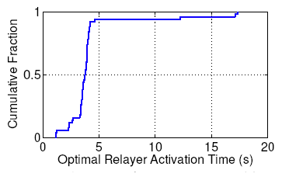
Evaluation in Emulated Environments –Relayer Selection
Activation time: time since the optimal relayer is turned on to the time it becomes the relayer of the node
The activation time of optimal relayer is reasonably fast with a median of around 4 seconds
CDF of activation time of optimal relayer
Notes:
In the 3 relayer experiment, we also record the time since the optimal relayer is turned on to the time it becomes the relayer of the node.
And we can see this activation time is reasonably fast.

Slide 30
Evaluation in Real-world Environments – Experiment Setup
Compared head-to-head with the a Netgear extender (WN3000RP)
A total of 15 network topologies are experimented
Notes:
We also have some real-world experiments, compare our performance head-to-head with a real extender.
In total, we have 15 random network topologies, in each of them, we deploy one AP, 4 nodes, 3 L2Relay relayers and 1 Netgear Extender.

Slide 31
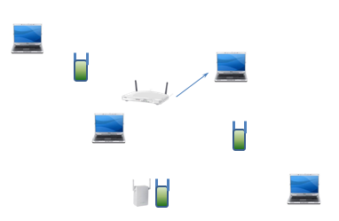
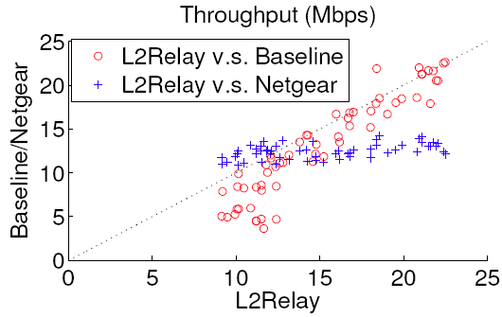
Evaluation in Real-world Environments – Performance Comparison
One-to-one: the AP transmits to
one node
L2Relay achieves higher throughput than both Baseline and Netgear in most cases
  L2Relay is effective in real-world environments
Notes:
We have the one-to-one experiments, the AP transmits to only one node; and one-to-many experiments, the AP transmits to all 4 nodes.
The performance comparison here shows that L2Relay outperforms both the baseline and the Netgear extender and L2Relay is able to support multiple nodes.

Slide 32
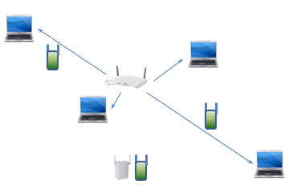
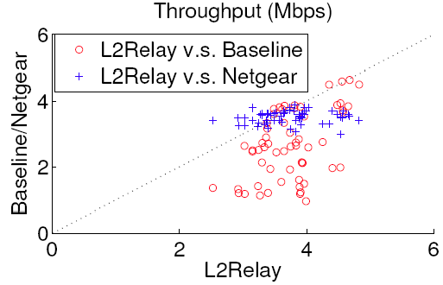
Evaluation in Real-world Environments – Performance Comparison
One-to-many: the AP transmits to
all 4 nodes
L2Relay outperforms both Baseline and Netgear in most cases
  L2Relay is capable of supporting multiple nodes effectively
Gain over Netgear is smaller because of fate sharing
  A slow node drags down the performance of all other nodes
Notes:
We have the one-to-one experiments, the AP transmits to only one node; and one-to-many experiments, the AP transmits to all 4 nodes.
The performance comparison here shows that L2Relay outperforms both the baseline and the Netgear extender and L2Relay is able to support multiple nodes.

Slide 33
Thank you!

