Slide 1

Analog Bloom Filter (ABF) for Ultra-low Latency Random Access in Wireless Networks
Zhenghao Zhang
Associate Professor
Computer Science Department
Florida State University
USA

Slide 2
Let’s Start with Bloom Filter – The Problem
Suppose there are W items, among which only a small fraction actually exist. Want to have a data structure to store this information.
Naïve solution:
  Keep a W-bit vector.
10000000100

Slide 3
Let’s Start with Bloom Filter – Solution
Bloom filter: An efficient data structure for checking the existence of items, using only M (M << W) bits
To set:
  For each item, generate K random numbers in the range [0, M-1].
  If an item actually exists, set the corresponding K bits to 1.
To check:
  An item exists only if all its K bits are 1

Slide 4
Let’s Start with Bloom Filter – Why It Works
Works when the number of actual items is much smaller than the total number of possible items.
  Therefore, only a small fraction of bits are set
  Bloom filter has no False Negatives. If a small fraction of bits are set, the False Positive is also low.

Slide 5









Analog Bloom Filter
Consider a wireless network supporting W nodes, each may want to announce some 1-bit information to the base station:
  I want to transmit some data
  I want to enter power saving mode
  I am back from the power saving mode
  I am a new comer, want to join your network
  …
senddata
want to join
power saving

Slide 6
Analog Bloom Filter
Analog Bloom Filter (ABF) is similar to the Bloom filter:
  Use M OFDM subcarriers as the M-bit vector in the Bloom filter
  Each node is assigned K subcarriers, and may transmit unit power on assigned subcarriers if it has something to say, otherwise silent

Slide 7
Analog Bloom Filter
Key advantage: Just one OFDM symbol (or just part of the subcarriers in one symbol), will learn the states of all nodes in the network
Again, it works when the number of active nodes is small
  True in the application scenario because not many nodes will turn active during two queries
Good for 5G
  Number of nodes is very large with IoT
  Latency is very low, 1ms, have to query every 1ms

Slide 8

Challenges in Decoding the ABF signal
That’s it? Not really. The main challenge is the decoding of the signal
  The signal power on different subcarriers are different
    Frequency selective fading
  The decoder does not know the channel state information (CSI)
    Note that the node may sit idle for a long time and this is the first message it sends, so nothing to learn the CSI from

Slide 9
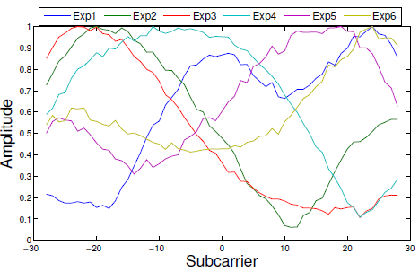
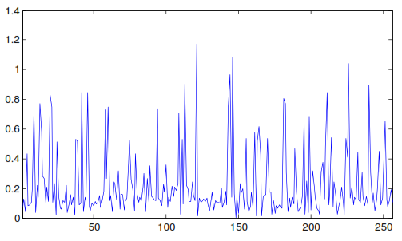
Challenges in Decoding the ABF signal
Amplitude of some 20 MHz measurements
256 subcarriers, 8 active nodes, K=8

Slide 10
BelFix – Energy-based Decoding
Without CSI, decision based on energy:
  If seen enough total energy from the subcarriers assigned to a node, the node should be active
    If a node is active, it will pump energy into the air, and although some subcarriers may be weak, there are most likely some strong ones
Enough energy

Slide 11

BelFix – Challenge
The challenge is that a subcarrier may be assigned to multiple nodes, how to determine how much energy is contributed by a node?

Slide 12
BelFix – The Intuition
A
B
Among the rest of subcarriers assigned to A and B, if very low energy for B but higher energy for A, it makes sense to guess that the energy on this subcarrier is contributed more likely by B, not A.
In other words, the energy from other subcarriers is the belief of other subcarriers on the node.

Slide 13
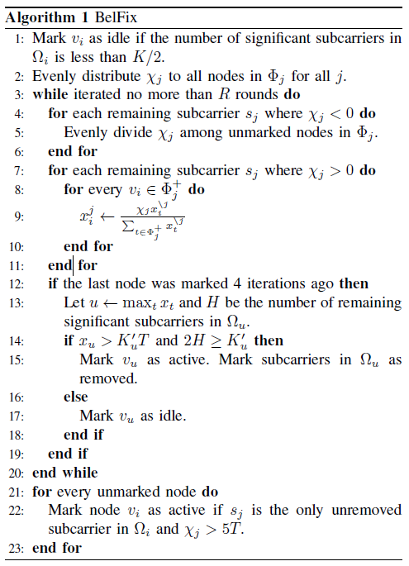
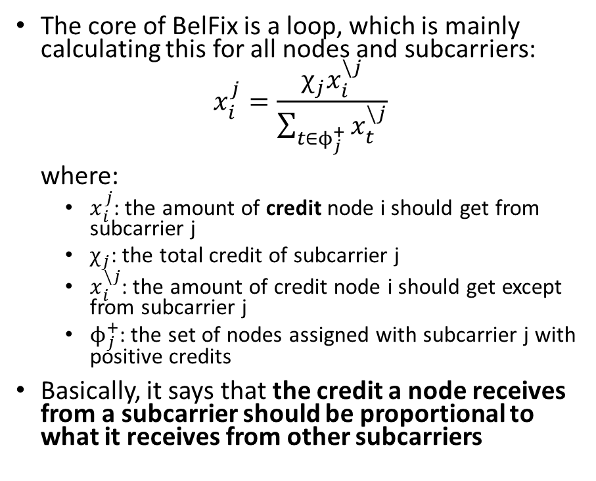
BelFix
The core of BelFix is a loop, which is mainly calculating this for all nodes and subcarriers:
$$x_{i}^{j}=\frac{χ_{j}x_{i}^{\backslash j}}{\sum_{t∈ϕ_{j}^{+}}{x_{t}^{\backslash j}}}$$
where:
  $x_{i}^{j}$: the amount of credit node i should get from subcarrier j
  $χ_{j}$: the total credit of subcarrier j
  $x_{i}^{\backslash j}$: the amount of credit node i should get except from subcarrier j
  $ϕ_{j}^{+}$: the set of nodes assigned with subcarrier j with positive credits
Basically, it says that the credit a node receives from a subcarrier should be proportional to what it receives from other subcarriers

Slide 14
BelFix – Some Details
Initially, all nodes assigned to a subcarrier equally receive credits
Every 4 iterations, check the node with the highest total credit, and marks it as active if the credit and the number of subcarriers with positive credits are both high
Once a node is marked active, all subcarriers assigned to it will be removed

Slide 15
BelFix -- Convergence
Theorem. When all nodes have nonnegative credits, the change of credit any node receive from any subcarrier in iteration i is only a fraction of that in iteration i-1, therefore the convergence is exponentially fast.

Slide 16

BelFix -- Complexity
Complexity is low, because the main calculation is just the credit update equation seen before:
$$x_{i}^{j}=\frac{χ_{j}x_{i}^{\backslash j}}{\sum_{t∈ϕ_{j}^{+}}{x_{t}^{\backslash j}}}$$

Slide 17

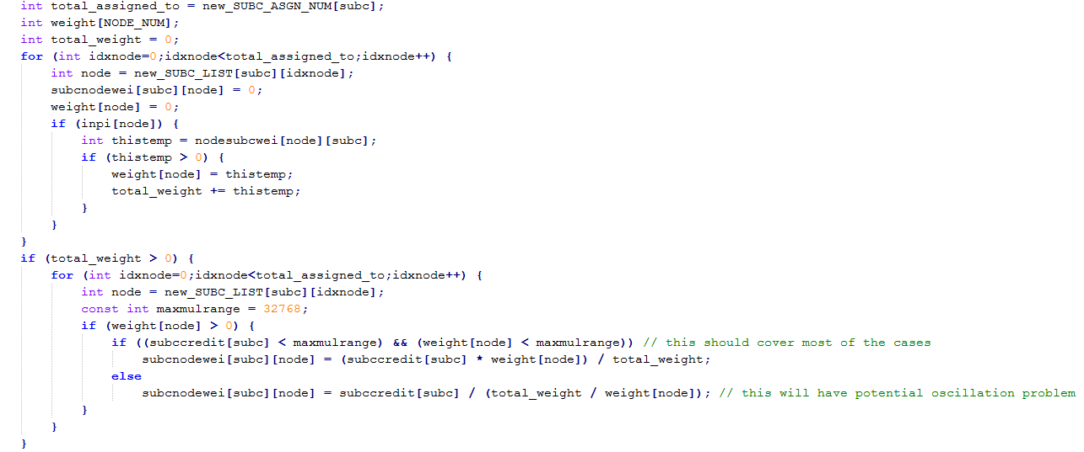
BelFix -- Implementation
Implemented both on Matlab and the Microsoft SORA Software Defined Radio

Slide 18
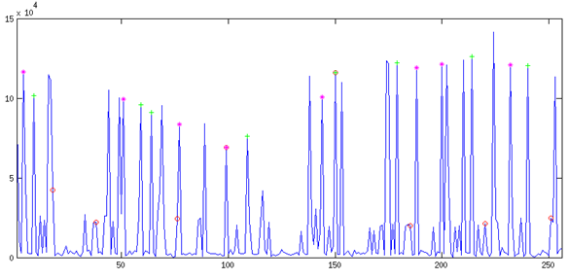
BelFix Real-World Example (1)
Total 12 active nodes. Subcarriers assigned to 3 nodes have been highlighted:
  Node 107, high power
  Node 295, low power,
  Node 476, high power

Slide 19
BelFix Real-World Example (2)
Two subcarriers were assigned to two active nodes:
  Subcarrier 99 was assigned to both nodes 295 and 476
  Subcarrier 150 was assigned to both nodes 107 and 295

Slide 20
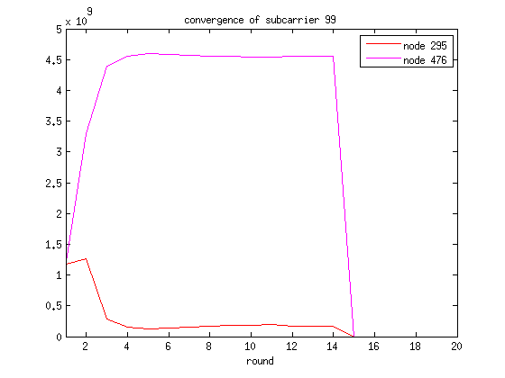
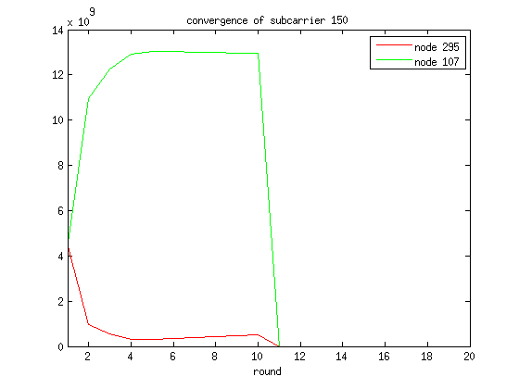
BelFix Real-World Example (3)
Convergence of these two subcarriers
  At the beginning, same
  Then quickly converges
  Node 295 receives less credit than the high power nodes

Slide 21
BelFix -- Performance
Evaluated with both wireless channel model (802.11n model E) and experiments on the implementation with Microsoft SORA SDR
512 total associated nodes, 256 subcarriers
The False Positive and False Negative Ratios are around 10⁻⁴ under typical conditions
  False Positive: says an idle node active
  False Negative: says an active node idle

Slide 22
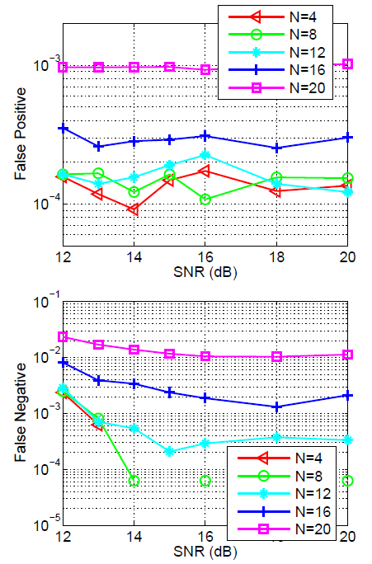
BelFix – Evaluations with Channel Model
Varying the SNR and the number of active nodes (N)
When N <= 12 and SNR >= 15 dB, FP and FN around 10⁻⁴ or lower
When N= 16, still works, N=20 exceeds the capacity

Slide 23
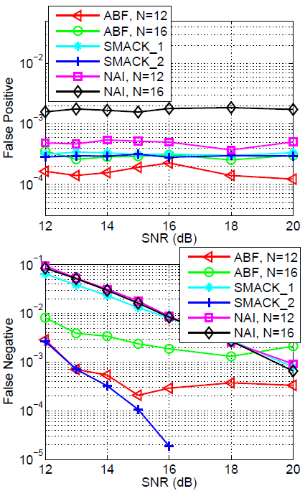
BelFix – Evaluations with Channel Model
Comparing with:
  SMACK [Sigcomm 2009]: each node is assigned dedicated 1 (SMACK_1) or 2 (SMACK_2) subcarriers
  NAI: a naïve decoding algorithm, a node is active if all subcarriers are above a threshold
Observations:
  SMACK_1 does not work, FN very high
  NAI does not work, FN very high
  SMACK_2 works well, but 4 times overhead

Slide 24
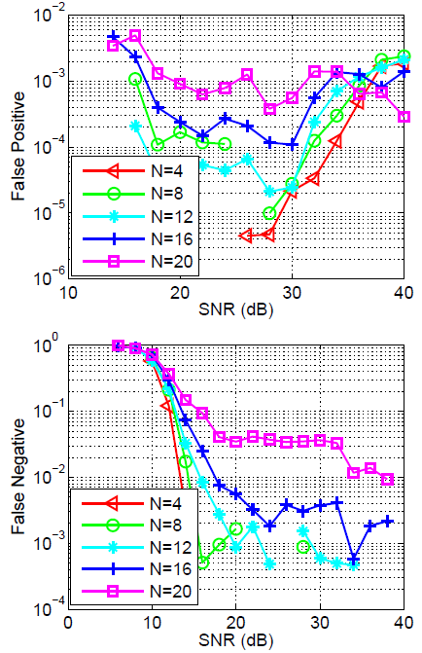
BelFix – Evaluations with SDR Implementation
General trends are similar as simulations
Performance is worse mainly due to
  Using 1 antenna instead of 3
  Some interferences in hardware
Still confirming the practicability of ABF and the BelFix algorithm
  decoding ABF signal from more than one machine simultaneously at a reasonable error ratio in real time even with a software implementation in around 5 ms

Slide 25
Usage Case – A Highly Efficient MAC Protocol
The Access Point (AP) will
  Use ABF to learn the set of nodes with data to send
  Use another method called CFM to learn how much data the nodes have
  Schedule data transmissions
Advantage: with very low overhead, the AP knows the complete queue states of the nodes, can better schedule transmissions

Slide 26
Contention-Free Multi-bit Query (CFM) – Allowing the AP to Obtain Multiple Bits
So, how many bits you want to send?
CFM allows the AP to poll a small set of nodes, but getting multiple bits from each node with one or part of one OFDM symbol
  18 subcarriers per node in the current design, so also very low overhead
  Activate a subset of the assigned subcarriers according to a code

Slide 27
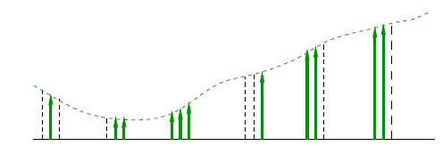
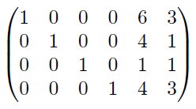
CFM Encoding and Modulation
6 groups, each 3 neighboring subcarriers
The subcarriers are activated based on the code symbol value
  The binary of the symbol value + 1
The code is (6,4) RS code on GF(7)
The codeword: [1, 5, 6, 3, 2, 2]
The generator matrix of the code

Slide 28
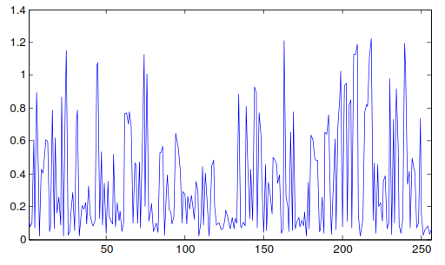
CFM Decoding – High Level
Decode for each node individually
  For each group, calculate a cost for each possible symbol value
  Choose the codeword with minimum total cost
symbol | Cost
0 | 2
1 | 0
2 | 1
3 | 2
4 | 3
5 | 1
6 | 2
symbol | Cost
0 | 1
1 | 1
2 | 0
3 | 3
4 | 2
5 | 2
6 | 1
…
A CFM Symbol with 13 nodes

Slide 29
CFM Decoding – Symbol Value Cost Calculation
Do not have CSI, but the neighboring subcarriers should have similar amplitude
Two cases:
  A subcarrier that should not be activated: the power value
  A subcarrier that should be activated: the difference of its power value with the average power value of all subcarriers that should be activated
Symbol value 4: |0.2-0.6|+0.8+|1-0.6| = 1.6
Symbol value 5: 0.2+|0.8-0.9|+|1-0.9| = 0.4
Example: 0.2, 0.8, 1, the most significant subcarrier is the last

Slide 30
CFM Decoding – Symbol Value Cost Calculation
Theorem. Under a set of assumptions (details in the paper), the expected cost of the actual symbol value will be lower than that of other symbol values.

Slide 31
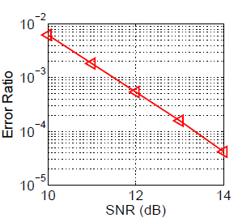
CFM Performance
Evaluated with 802.11n model E
When the SNR is 14 dB or above, lower than 10⁻⁴

Slide 32
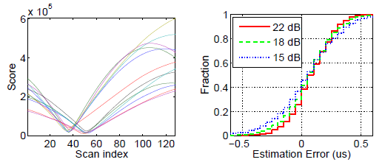
Can Use CFM to Obtain for Free:
weak
strong
An estimate of the channel states of each node
An estimate of the propagation delay of each node

Slide 33
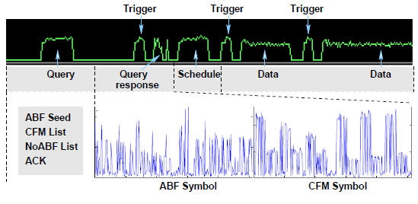
Muqmac: An Efficient Centralized Medium Access Protocol
Centralized
Considers only uplink here
A typical cycle of the protocol

Slide 34
Implementation on the Microsoft Sora SDR
Over 5,000 lines of C++ code, including
  ABF and CFM
  The medium access control sequence code
  A simple link layer protocol to cope with packet loss
  A simple scheduling algorithm

Slide 35
Overcoming Technical Challenges
Synchronization
  the nodes need to respond to the query simultaneously, without timestamps of samples, relied on using identical software and hardware and a trigger packet from the AP
Decoding ABF
  used a dedicated thread for decoding ABF signal, typically 5 ms, schedule data transmissions while decoding
Reducing hardware errors
  pre-modulated packets of certain sizes, when transmitting a data packet, pick the closest one with larger size
Virtual node
  have only 1 machine as the AP and 2 machines as the nodes. A machine host many nodes, the signal is the addition of all nodes in the machine

Slide 36
Muqmac Performance
Compared method, implemented on ideal simulators with no PHY error
  Wi-Fi
  FICA [ACM Sigcomm 2010]
  D-Fi [IEEE Trans. Mob. Comput., 2015]
    dcD-Fi: without Machine Learning decoding
    iD-Fi: ideal case assuming no decoding error
Hardware speed: 6 Mbps as an upper bound

Slide 37
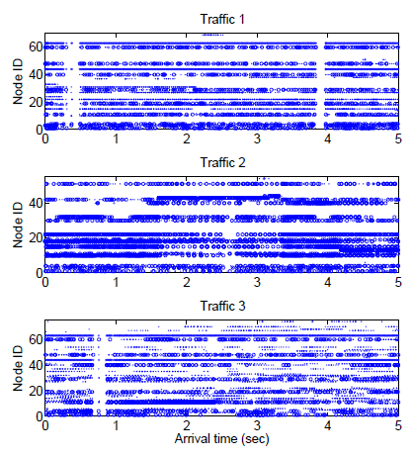
Traffic
Three 5-sec traces traffic at http://www.winlab.rutgers.edu/˜ergin/mobicom2007/

Slide 38
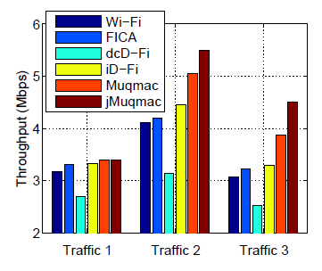
Throughput Comparison
jMuqmac: removing platform-specific overhead
  trigger packets
  difference between premodulated packets and data
  modulation time of query and query response
For traffic 2 and 3:
  Muqmac is much higher, despite packet loss, query loss, and the overhead
  jMuqmac is over 75% and 90% of the PHY speed, respectively

Slide 39
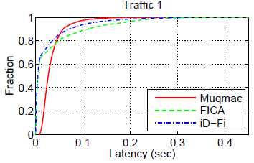
Latency Comparison
The latency with Muqmac is reasonably small
Despite of the additional packet losses and overhead in the testbed
  The average latency of Muqmac is comparable with FICA and iD-Fi
  The latencies of FICA and iD-Fi are much more polarized

Slide 40


