Slide 1
The Karnaugh Map

Slide 2
K-map rules
Draw the K-map. Remember to make sure that the adjacent rows/columns differ by only one bit.
According to the truth table, write 1 in the boxes.
Draw a circle around a rectangle with all 1s. The rectangle must have size 1,2,4,8,16…Then, reduce the terms by writing down the variables whose values do not change in the circle.
For example, if there is a rectangle with two 1s representing ab’c’ and ab’c, you write a term as ab’.
Note that
A term may be covered in multiple circles!
The rectangle can wrap-around!
Simplify to the simplest circuits possible:
Try to get a circle as large as possible.
Try to get the minimum number of circles.
Notes:
Notes:
The two goals do not conflict with each other, because given any optimal schedule, if one box is not covered by the maximum size circle, just replace it with a maximum size circle.
So any box is always covered by the largest circle.
How many circles? Each box needs one circle, i.e., one of the largest ones. Some of these circles may cover more boxes, other less. So the problem is a set covering problem: using the minimum number of circles to cover all boxes.

Slide 3
K-map for exercise 1
K-map
Y = X2’
Because x1 and x0 both take different values in some boxes in the circle, while x2 is 0 in all such boxes
X2 | X1 | X0 | output
0 | 0 | 0 | 1
0 | 0 | 1 | 1
0 | 1 | 0 | 1
0 | 1 | 1 | 1
1 | 0 | 0 | 0
1 | 0 | 1 | 0
1 | 1 | 0 | 0
1 | 1 | 1 | 0
x2x1
x0
00
01
11
10
0
1 | 1 | 0 | 0
1 | 1 | 0 | 0
1

Slide 4
K-map for exercise 2
K-map
Y = X0
Because x2 and x1 both take different values in some boxes in the circle, while x0 is 1 in all such boxes
X2 | X1 | X0 | output
0 | 0 | 0 | 0
0 | 0 | 1 | 1
0 | 1 | 0 | 0
0 | 1 | 1 | 1
1 | 0 | 0 | 0
1 | 0 | 1 | 1
1 | 1 | 0 | 0
1 | 1 | 1 | 1
x2x1
x0
00
01
11
10
0
1 | 1 | 0 | 0
1 | 1 | 1 | 1
1

Slide 5
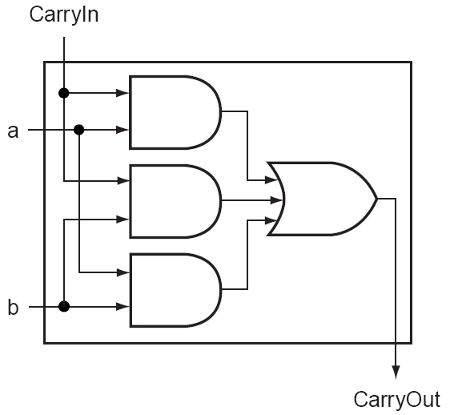
Simplifying Digital Circuits
Reconsider the 1-bit full adder. The carry bit is
But we can implement the function with a much simpler circuit:
How to get there?

Slide 6
K-map for CO
K-map
CO = ab + ac + bc
Notice that the 111 box is covered 3 times!
ab
c
00
01
11
10
0
0 | 0 | 1 | 0
0 | 1 | 1 | 1
1

Slide 7
K-map
F=a’bc’+a’bc+a’b’c+ab’c
ab
c
00
01
11
10
0
0 | 1 | 0 | 0
1 | 1 | 0 | 1
1

Slide 8
K-map
F=a’bc’+a’bc+a’b’c+ab’c
F=a’b+b’c
Notice the wrap around!
ab
c
00
01
11
10
0
0 | 1 | 0 | 0
1 | 1 | 0 | 1
1

Slide 9
K-map
F=a’bc’+a’bc+abc’+abc+a’b’c
ab
c
00
01
11
10
0
0 | 1 | 1 | 0
1 | 1 | 1
1

Slide 10
K-map
F=a’bc’+a’bc+abc’+abc+a’b’c
F=b+a’c
ab
c
00
01
11
10
0
0 | 1 | 1 | 0
1 | 1 | 1
1

Slide 11
K-map
F=a’bc’d+a’bcd+abc’d+abcd+a’b’c’d+abcd’
ab
cd
00
01
11
10
00
1 | 1 | 1
 | 1 | 1
 |  | 1
01
11
10

Slide 12
K-map
F=a’bc’d+a’bcd+abc’d+abcd+a’b’c’d+abcd’
F=bd+a’c’d+abc
ab
cd
00
01
11
10
00
1 | 1 | 1
 | 1 | 1
 |  | 1
01
11
10

Slide 13
Simplifying digital circuit
There are many methods.
Using boolean algebra
Using K-map
By just being really smart…

Slide 14
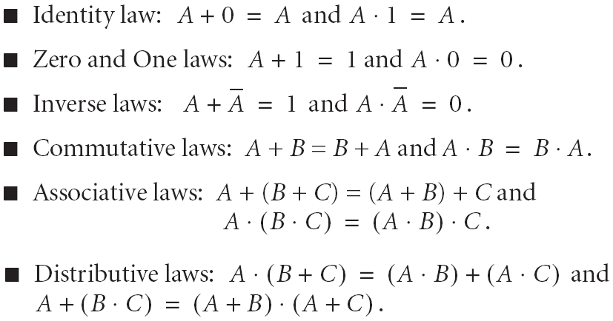
Boolean Algebra Laws
A+A=A, A*A=A

Slide 15
Boolean Algebra
To use Boolean algebra, note that CO= abc’+ab’c+a’bc+abc
Now,
abc’+abc=ab(c’+c)=ab.
ab’c+abc=ac(b’+b)=ac
a’bc+abc=bc(a’+a)=bc
We used term abc three times because abc=abc+abc+abc!

Slide 16
K-map
It is actually more convenient to use K-map to simplify digital circuits.
K-map is a very mechanical procedure. Nothing fancy.
It basically uses two rules: A+A=A, and AB+AB’=A.

Slide 17
Exercise – Design a selector?
Design a circuit that takes two input bits, a and b, and a selector bit s. The function is that if s=0, f=a. if s=1, f=b.

Slide 18
Selector
s | a | b | f
0 | 0 | 0
0 | 0 | 1
0 | 1 | 0
0 | 1 | 1
1 | 0 | 0
1 | 0 | 1
1 | 1 | 0
1 | 1 | 1

Slide 19
Selector
s | a | b | f
0 | 0 | 0 | 0
0 | 0 | 1 | 0
0 | 1 | 0 | 1
0 | 1 | 1 | 1
1 | 0 | 0 | 0
1 | 0 | 1 | 1
1 | 1 | 0 | 0
1 | 1 | 1 | 1

Slide 20
K-map
F=s’ab’+s’ab+sa’b+sab
sa
b
00
01
11
10
0
0 | 1 | 0 | 0
 | 1 | 1 | 1
1

Slide 21
K-map
F=s’ab’+s’ab+sa’b+sab
F=s’a+sb
sa
b
00
01
11
10
0
0 | 1 | 0 | 0
 | 1 | 1 | 1
1

