Slide 1
Digital Circuits

Slide 2
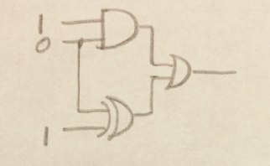
Question
Notes:
0
1 --- 1

Slide 3
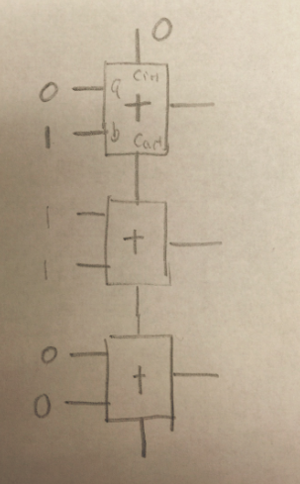
Question
Notes:
10
01
10

Slide 4
Review – Getting the truth table
The first step in designing a digital circuit usually is to get the truth table.
That is, for every input combination, figure out what an output bit should be, and write them down in a table.

Slide 5
Review – From the truth table to circuits
Any truth table can be translated into a circuits consisting of several and gates followed by one or gate.
  It means that any function can be implemented in this way
Call a row in the truth table in which the output is `1’ a ``true row’’ and the input combination in this row a ``true input combination’’ or just a ``true combination.’’
Each and gate corresponds to one ``true row’’ in the truth table. The and gate should output a `1’ if and only if the input combination is the same as this row. If all other cases, the output of this and gate is `0.’
  So, whenever the input combination is the same as one of the ``true combinations,’’ one of the and gates outputs ``1’’, so the output of the or gate is 1.
  If the input combination is not the same as any of the ``true combinations,’’ none of the and gates will output a ``1’’, so the output of the or gate is 0.

Slide 6
Logic Functions
Drawing circuits is … Usually we express logic functions using logic equations which are more succinct and carry the same information
  The OR operator is written as +, as in A + B.
  The AND operator is written as ·, as A · B.
  The unary operator NOT is written as or A’.
Remember: This is NOT the binary field. Here 0+0=0, 0+1=1+0=1, 1+1=1.

Slide 7
Logic functions
For example, the sum in the one-bit full adder is
From a logic function you can immediately know what the circuit looks like.
Truth table == Circuits == Logic function, equivalent.
So we are going to get familiar with getting the logic functions from the truth table

Slide 8
Problems
Ex 1. Assume that X consists of 3 bits, x2 x1 x0. Write a logic function that is true if and only if X contains only one 0

Slide 9
EX 1
X2 | X1 | X0 | output
0 | 0 | 0
0 | 0 | 1
0 | 1 | 0
0 | 1 | 1
1 | 0 | 0
1 | 0 | 1
1 | 1 | 0
1 | 1 | 1

Slide 10
EX 1
X2 | X1 | X0 | output
0 | 0 | 0 | 0
0 | 0 | 1 | 0
0 | 1 | 0 | 0
0 | 1 | 1 | 1
1 | 0 | 0 | 0
1 | 0 | 1 | 1
1 | 1 | 0 | 1
1 | 1 | 1 | 0

Slide 11
Ex 1
Output = x2x1x0’ + x2x1’x0 + x2’x1x0

Slide 12
Ex 2
Assume that X consists of 3 bits, x2 x1 x0. Write a logic functions that is true if and only if X contains an even number of 0s.

Slide 13
EX 2
X2 | X1 | X0 | output
0 | 0 | 0
0 | 0 | 1
0 | 1 | 0
0 | 1 | 1
1 | 0 | 0
1 | 0 | 1
1 | 1 | 0
1 | 1 | 1

Slide 14
EX 2
X2 | X1 | X0 | output
0 | 0 | 0 | 0
0 | 0 | 1 | 1
0 | 1 | 0 | 1
0 | 1 | 1 | 0
1 | 0 | 0 | 1
1 | 0 | 1 | 0
1 | 1 | 0 | 0
1 | 1 | 1 | 1

Slide 15
Ex 2
Output = x2x1’x0’ + x2’x1’x0 + x2’x1x0’+ x2x1x0

Slide 16
Ex 3
Assume that X consists of 3 bits, x2 x1 x0. Write a logic functions that is true if and only if X when interpreted as an unsigned binary number is no less than 5.

Slide 17
Ex 3
X2 | X1 | X0 | output
0 | 0 | 0
0 | 0 | 1
0 | 1 | 0
0 | 1 | 1
1 | 0 | 0
1 | 0 | 1
1 | 1 | 0
1 | 1 | 1

Slide 18
Ex 3
X2 | X1 | X0 | output
0 | 0 | 0 | 0
0 | 0 | 1 | 0
0 | 1 | 0 | 0
0 | 1 | 1 | 0
1 | 0 | 0 | 0
1 | 0 | 1 | 1
1 | 1 | 0 | 1
1 | 1 | 1 | 1

Slide 19
Ex 3
Output = x2x1’x0 + x2x1x0’+ x2x1x0

Slide 20
In class exercises 1
Assume that X consists of 3 bits, x2 x1 x0. Write a logic functions that is true if and only if X when interpreted as an unsigned binary number is less than 4.

Slide 21
In class exercises 2
Implement a circuit with three inputs (X2, X1, X0), and one output O. O should be 1 only when X2, X1, X0 are representing an odd binary number.

