Slide 1
Digital Logic

Slide 2
Abstractions in CS (gates)
Basic Gate: Inverter
Truth Table
I
O
I
O
0
1
1
0
GND
I
O
Resister (limits conductivity)
Vcc

Slide 3
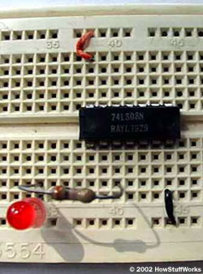
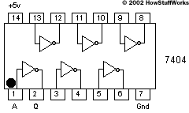
Abstractions in CS (gates)
Truth Table
I
O
I
O
0
1
1
0

Slide 4
Abstractions in CS (gates)
Basic Gate: NAND (Negated AND)
Truth Table
A
B
A
B
Y
Y
0
0
1
1
0
1
0
1
1
1
1
0
GND
A
B
Y
Vcc

Slide 5
Abstractions in CS (gates)
Basic Gate: AND
Truth Table
A
B
Y
0
0
1
1
0
1
0
1
0
0
0
1
A
B
Y

Slide 6
Abstractions in CS (gates)
Other Basic Gates: OR gate
Truth Table
A
B
Y
0
0
1
1
0
1
0
1
0
1
1
1
A
B
Y

Slide 7
Abstractions in CS (gates)
Other Basic Gates: XOR gate
Truth Table
A
B
Y
0
0
1
1
0
1
0
1
0
1
1
0
A
B
Y

Slide 8
Logic Blocks
Logic blocks are built from gates that implement basic logic functions
Any logical function can be constructed using AND gates, OR gates, and inversion.

Slide 9
Adder
In computers, the most common task is add.
In MIPS, we write “add $t0, $t1, $t2.” The hardware will get the values of $t1 and $t2, feed them to an adder, and store the result back to $t0.
So how the adder is implemented?

Slide 10
Half-adder
How to implement a half-adder with logic gates?
A half adder takes two inputs, a and b, and generates two outputs, sum and carry. The inputs and outputs are all one-bit values.
a
sum
b
carry

Slide 11
Half-adder
First, how many possible combinations of inputs?

Slide 12
Half-adder
Four combinations.
a | b | sum | carry
0 | 0
0 | 1
1 | 0
1 | 1

Slide 13
Half-adder
The value of sum should be? Carry?
a | b | sum | carry
0 | 0
0 | 1
1 | 0
1 | 1

Slide 14
Half-adder
Okay. We have two outputs. But let’s implement them one by one.
First, how to get sum? Hint: look at the truth table.
a | b | sum
0 | 0 | 0
0 | 1 | 1
1 | 0 | 1
1 | 1 | 0

Slide 15
Half-adder
Sum
a
sum
b

Slide 16
How about carry?
The truth table is
a | b | carry
0 | 0 | 0
0 | 1 | 0
1 | 0 | 0
1 | 1 | 1

Slide 17
Carry
So, the circuit for carry is
a
carry
b

Slide 18
Half-adder
Put them together, we get
a
sum
b
carry

Slide 19
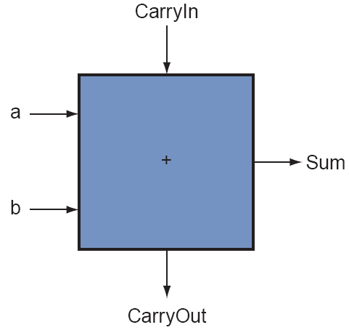
1-Bit Adder
1-bit full adder
Also called a (3, 2) adder

Slide 20
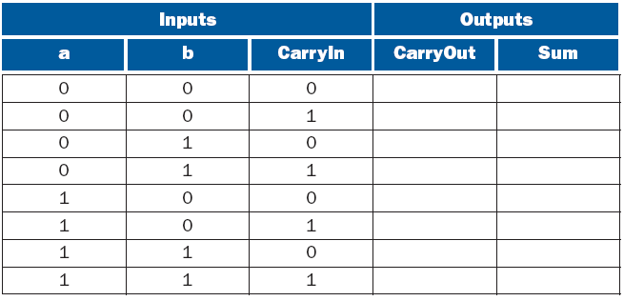
Constructing Truth Table for 1-Bit Adder

Slide 21
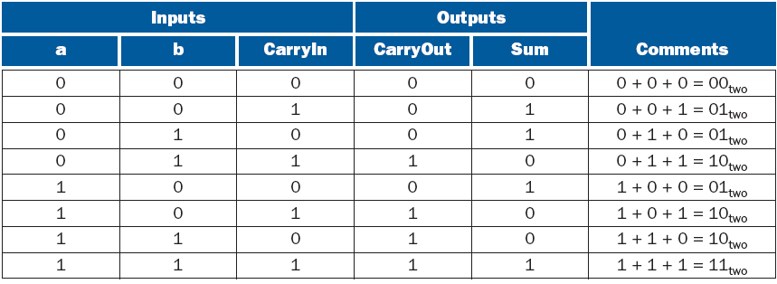
Truth Table for a 1-Bit Adder

Slide 22
Sum?
Sum is `1’ when one of the following four cases is true:
a=1, b=0, c=0
a=0, b=1, c=0
a=0, b=0, c=1
a=1, b=1, c=1

Slide 23
Sum
The idea is that we will build a circuit made of and gates and or gate faithfully according to the truth table.
Each and gate corresponds to one ``true’’ row in the truth table. The and gate should output a ```1’’ if and only if the input combination is the same as this row. If all other cases, the output is ``0.’’
So, whenever the input combination falls in one of the ``true’’ rows, one of the and gates is ``1’’, so the output of the or gate is 1.
If the input combination does not fall into any of the ``true’’ rows, none of the and gates will output a ``1’’, so the output of the or gate is 0.

Slide 24
Boolean Algebra
We express logic functions using logic equations using Boolean algebra
The OR operator is written as +, as in A + B.
The AND operator is written as ·, as A · B.
The unary operator NOT is written as . or A’.
Remember: This is not the binary field. Here 0+0=0, 0+1=1+0=1, 1+1=1.

Slide 25
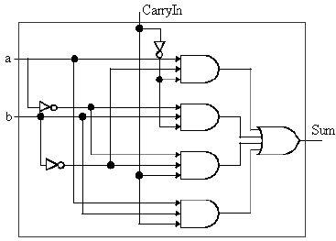
Sum

Slide 26
Carryout bit?
Carryout bit is ‘1’ also on four cases. When a, b and carryin are 110, 101, 011, 111.
Does it mean that we need a similar circuit as sum?

Slide 27
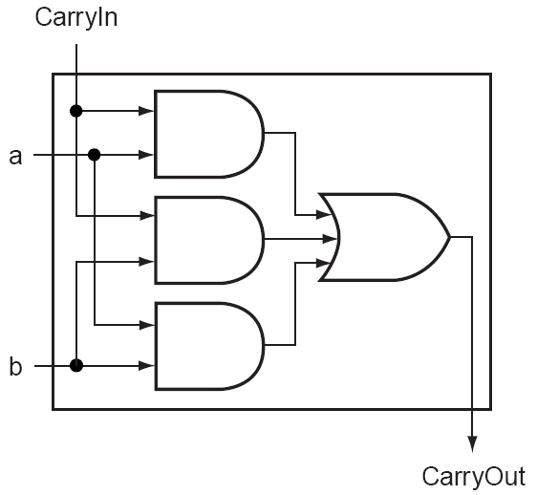
Carryout bit
Actually, it can be simpler

Slide 28
Delay
Hardware has delays.
Delay is defined as the time since the input is stable to the time when the output is stable.
How much delay do you think the one-bit half adder is and the one-bit full adder is?

Slide 29
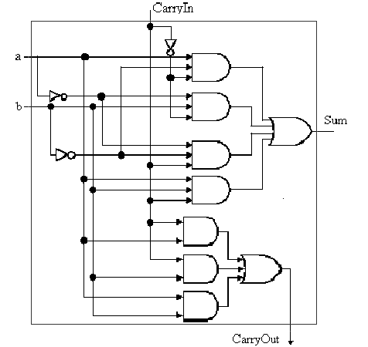
1-Bit Adder

Slide 30
32-bit adder
How to get the 32-bit adder used in MIPS?

Slide 31
32-bit adder

