Slide 1
Review

Slide 2
Interger Number Representations
To convert an unsigned decimal number to binary: you divide the number N by 2, let the remainder be the first digit. Then divide the quotient by 2, then let the remainder be d1, then divide the quotient by 2, then let the remainder be d2, until the quotient is less than 2.
2’s complement. To convert a negative number to binary: invert each bit, and then add 1.

Slide 3
Problem
The binary representation of -57_{ten} in 8 bits in 2’s complement is
(a) 11000111
(b) 10011111
(c) 11010111
(d) None of the above.
Notes:
Answer: (a). 57 is 00111001 -> 11000110 -> 11000111

Slide 4
Number with Fractions
Numbers with fractions. Convert the integer part and the fraction part to binary separately, then put a dot in between.
To get the binary representation of the fraction, divide the fraction first by 0.5 (2⁻¹), take the quotient as the first bit of the binary fraction, then divide the remainder by 0.25 (2⁻²), take the quotient as the second bit of the binary fraction, then divide the remainder by 0.125 (2⁻³),…
Floating numbers. Single precision. 32 bits.

Slide 5
Floating Numbers
Single precision. 32 bits.
Double precision. 64 bits. Bias is 1023.
31 | 30 | 29 | 28 | 27 | 26 | 25 | 24 | 23 | 22 | 21 | 20 | 19 | 18 | 17 | 16 | 15 | 14 | 13 | 12 | 11 | 10 | 9 | 8 | 7 | 6 | 5 | 4 | 3 | 2 | 1 | 0
s | Exponent |  |  |  |  |  |  |  |  |  |  | fraction
1 bit | 11 bits |  |  |  |  |  |  |  |  |  |  | 20 bits
Fraction (continued)
32 bits

Slide 6
Special Cases Considered
Single precision |  | Double precision |  | Object represented
Exponent | Fraction | Exponent | Fraction
0 | 0 | 0 | 0 | 0
0 | nonzero | 0 | nonzero | ±denormalized number
1-254 | anything | 1-2046 | anything | ±floating-point number
255 | 0 | 2047 | 0 | ± infinity
255 | nonzero | 2047 | nonzero | NaN (Not a number)

Slide 7
Problem
The single precision floating number representation of -22.75_{ten} is
(a) 1 10000111 011 0100 0000 0000 0000 0000
(b) 1 10000011 011 0110 0000 0000 0000 0000
(c) 0 10000100 011 1110 0000 0000 0000 0000
(d) None of the above.
Notes:
Answer: (b). 22.75->10110.11->1.011011 *2^4-> 1 1000 0011 011011…

Slide 8
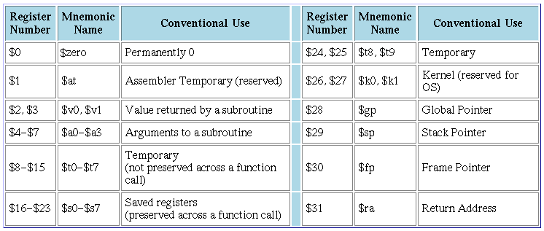
MIPS
MIPS registers

Slide 9
MIPS
MIPS instructions (not complete)
R-type: add, sub, and, or, sll,…
add $t0, $t1, $t2 # add $1, $t2, put the result in $t0
Memory: lw, sw, lb, sb.
lw $t0, 4($t1) # read the data at the address of # $t1+4, put it in $t0
Branch: beq, bne, …
beq $t0, $t1, SOMEWHERE # if $t0 is equal to $t1, the # next instruction to be # executed is at the address
# specified by SOEMWHERE
# (PC+4+offset)
Jump: j, jal, jr
j SOMEWHERE # the next instruction should be at the address # specified by SOMEWHERE (The upper 4 bits from PC+4, the # lower 26 bits from the instruction, the last 2 bits 0)
Immediate type:
addi $t0, $t0, 4 # add $t0 by 4 and put it in $t0

Slide 10
MIPS Instruction Encoding
Each MIPS instruction is exactly 32 bits
R-type (register type)
I-type (immediate type)
J-type (jump type)
op rs rt rd shamt funct
op rs rt 16 bit address or constant
op 26 bit address

Slide 11
MIPS Coding
If else. Assume f to h are in $s0 to $s4.

Slide 12
while loop
Assume that i and k correspond to registers $s3 and $s5 and base array save is in $s6

Slide 13
Problem
If $t0 is holding 0, $t1 is holding 1, what will be the value stored in $t2 after the following instructions?
srl $t1, $t1, 1
bne $t0, $t1, L1
addi $t2, $t0, 1
L1: addi $t2, $t0, 2
(a) 1.
(b) 2.
(c) 3.
(d) None of the above.
Notes:
Answer: b.

Slide 14
(b)
bgt $t0, $t1, L1
add $t2, $t0, $s0
sw $t1, 0($t2)
j Exit
L1: add $t2, $t1, $s0
lw $t0, 0($t2)
Exit:
(c)
bgt $t0, $t1, L1
sll $t2, $t0, 2
add $t2, $t2, $s0
lw $t1, 0($t2)
j Exit
L1: sll $t2, $t1, 2
add $t2, $t2, $s0
sw $t0, 0($t2)
Exit:
(d) None of the above.
Consider the following C code
if (a > b)
a = A[b];
else
A[a] = b;
where A is an integer array. Which of the following correctly implements the code above, assume a is in $t0, b is in $t1, and the starting address of A is in $s0? (bgt is “branch if greater than.”)
(a)
bgt $t0, $t1, L1
add $t2, $t0, $s0
lw $t1, 0($t2)
L1: add $t2, $t1, $s0
sw $t0, 0($t2)
Exit:
Notes:
Answer: D. correct one:
bgt $t0, $t1, L1
sll $t2, $t0, 2
add $t2, $t2, $s0
sw $t1, 0($t2)
j Exit
L1:sll $t2, $t1, 2
add $t2, $t2, $s0
lw $t0, 0($t2)
Exit:

Slide 15
MIPS Function
jal Funct:
The next instruction will be at address specified by Funct
PC+4 will be stored in $ra
jr $ra:
The next instruction will be the one at address equal to the content in $ra
Calling a function is more like going to a function and then come back

Slide 16
.data
array:
.word 12, 34, 67, 1, 45, 90, 11, 33, 67, 19
msg_done:
.asciiz "done!\n"
.text
.globl main
main:
la $s7, array
li $s0, 0 #i
li $s1, 0 #res
li $s6, 9
loop:
sll $t0, $s0, 2
add $t0, $t0, $s7
lw $a0, 0($t0)
lw $a1, 4($t0)
jal addfun
add $s1, $s1, $v0
addi $s0, $s0, 1
beq $s0, $s6, done
j loop
done:
li $v0,4
la $a0,msg_done
syscall
jr $ra
addfun:
add $v0, $a0, $a1
jr $ra

Slide 17
Problem
Consider the following code segment. What will the code do?
li $ra, 0x04000000
jal f1
other instructions…
f1: addi $ra, $ra, -8
jr $ra
(a) It will enter a loop and can never come out.
(b) It will jump to the instruction located at address 0x04000000.
(c) It will call f1 once, then continue to execute other instructions following the jal f1 instruction.
(d) None of the above.
Notes:
Answer: a.

Slide 18
MIPS Calling Conventions
MIPS assembly follows the following convention in using registers
$a0 - $a3: four argument registers in which to pass parameters
$v0 - $v1: two value registers in which to return values
$ra: one return address register to return to the point of origin

Slide 19
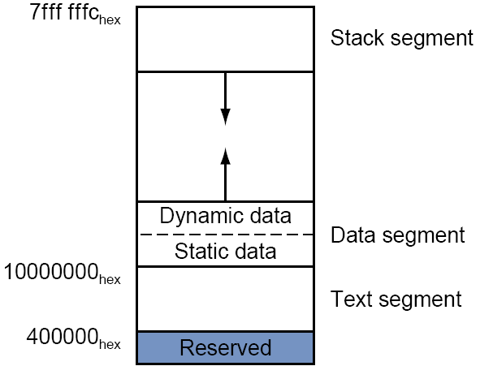
MIPS stack
The stack in MIPS is a memory space starting at 0x7ffffffc and growing DOWN.
The top of the stack is always pointed by the stack pointer, $sp (the address of the first element space in the stack should always be in $sp).
A function should save the registers it touches on the stack before doing anything, and restore it before returning.

Slide 20
MIPS Calling Conventions - more
MIPS software divides 18 of the registers into two groups
$t0 - $t9: 10 temporary registers that are not preserved by the callee on a procedure call
These are caller-saved registers since the caller must save the ones it is using
$s0 - $s7: 8 saved registers that must be preserved on a procedure call
These are callee-saved registers since the callee must save the ones it uses
In general,
if there is a register that the callee may change, and the caller still needs it after calling the callee, the caller should save it and restore it before using it, such as $ra.
If there is a register that the caller is not expected to change after calling the callee, the callee should save it, such as $s0.

Slide 21
Saving $s0

Slide 22
MIPS interrupt
For external interrupt, your code is executing, and if an event happens that must be processed,
The address of the instruction that is about to be executed is saved into a special register called EPC
PC is set to be 0x80000180, where the interrupt handlers are located
Then, after processing this interrupt, call “eret” to set the value of the PC to the value stored in EPC
Note the difference between an interrupt and a function call. In a function call, the caller is aware of going to another address. In interrupt, the “main program” is not.

Slide 23
Supporting floating point. Load and Store
Load or store from a memory location (pseudoinstruction ). Just load the 32 bits into the register.
l.s $f0, val
s.s $f0, val
Load immediate number (pseudoinstruction )
li.s $f0, 0.5

Slide 24
Arithmetic Instructions
abs.s $f0, $f1
add.s $f0, $f1, $f2
sub.s $f0, $f1, $f2
mul.s $f0, $f1, $f2
div.s $f0, $f1, $f2
neg.s $f0, $f1

Slide 25
Data move
mov.s $f0, $f1
mfc1 $t0, $f0
mtc1 $t0, $f0

Slide 26
Convert to integer and from integer
cvt.s.w $f0, $f0 # convert the 32 bit in $f0 currently representing an integer to float of the same value
cvt.w.s $f0, $f0 # the reverse

Slide 27
Comparison instructions
c.lt.s $f0,$f1 #set a flag in coprocessor 1if $f0 < $f1, else clear it. The flag will stay until set or cleared next time
c.le.s $f0,$f1 #set flag if $f0 <= $f1, else clear it
bc1t L1 # branch to L1 if the flag is set
bc1f L1 # branch to L1 if the flag is 0

Slide 28
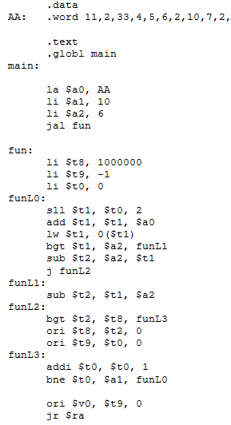
Read the MIPS code and answer the following questions. What does function fun do? What is the value returned in $v0 after the function is called?
Notes:
Find the index of the element that is closest to the value in $a2. 5.

