Slide 1
MIPS I/O and Interrupt

Slide 2
SPIM I/O and MIPS Interrupts
The materials of this lecture can be found in A7-A8 (3rd Edition) and B7-B8 (4th Edition).

Slide 3
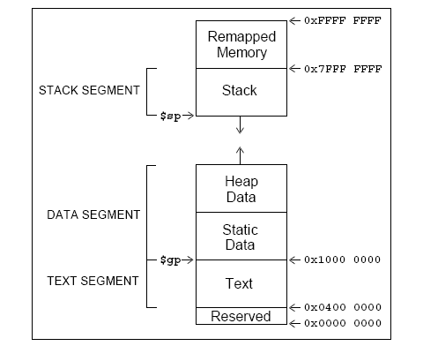
The MIPS memory
Actually, everything above 0x7fffffff is used by the system.

Slide 4
What is in there?
Special operating system functions
I/O registers mapped to memory addresses
Kernel data
…

Slide 5
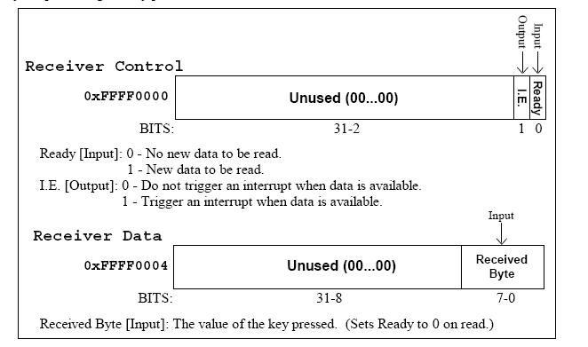
SPIM Input
SPIM allows you to read from the keyboard (which is similar to reading something from the true I/O register)

Slide 6
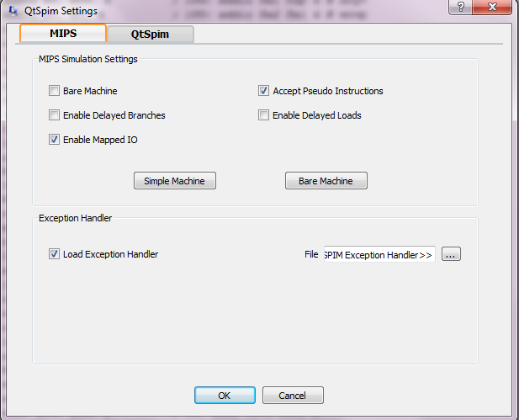
.text
.globl main
main:
addi $s0, $0, 113 # q key
lui $t0, 0xFFFF # $t0 = 0xFFFF0000;
waitloop: lw $t1, 0($t0)
andi $t1, $t1, 0x0001
beq $t1, $zero, waitloop
lw $a0, 4($t0)
beq $a0, $s0, done
li $v0,1
syscall
li $v0,4
la $a0, new_line
syscall
j waitloop
done: li $v0, 10 # exit
syscall
.data
new_line: .asciiz "\n”
Remember to select ``mapped I/O’’ in PCSpim settings.
To set it, select ``Simulator’’ then ``Settings…’’

Slide 7
SPIM output
Similar to the input, SPIM has two memory locations for output
0xffff0008: Transmitter control.
Bit 1: interrupt enable
Bit 0: ready
0xffff000c: Transmitter data.
Bit 0-7: data byte

Slide 8
SPIM output
If you need to show something on the console, do the following:
Check if ready bit is 1. If yes, proceed. Otherwise, wait.
Write to the data. The ready bit will be reset to 0, and will be set to 1 after the byte is transmitted.

Slide 9
question
Is this the most efficient way to do it?
Remember that the processor usually has a lot of things to do simultaneously

Slide 10
Interrupt
The key problem is that the time when the input occurs cannot be predicted by your program
Wouldn’t it be nice if you could “focus on what you are doing” while be “interrupted” if some inputs come?

Slide 11
MIPS interrupt
EPC=0x00000128
EPC= something
With external interrupt, if an event happens that must be processed, the following things will happen:
The address of the instruction that is about to be executed is saved into a special register called EPC
PC is set to be 0x80000180, the starting address of the interrupt handler
which takes the processor to the interrupt handler
The last instruction of the interrupt should be “eret” which sets the value of the PC to the value stored in EPC
a
a
add $t0, $t1, $t0
a
a
sub $t2, $t1, $t0
a
a
sub $t0 $s0, $a0
0x00000128:
a
a
sll $t0, $t0, 2
.
.
.
0x80000180:
a
a
add $k0, $k1, $k0
a
a
sub $k1, $k0, $k1
a
a
eret

Slide 12
MIPS Interrupt
EPC=0x00000128
EPC= something
t0= 10
t0= something
t0= 3000
Is it okay to use $t0 in the interrupt?
Note the difference between an interrupt and a function call.
For a function call, the caller is aware of the function call, so, it is not expecting the value of $t0 to be the same after the call.
For an interrupt, the user program is running and gets interrupted. The user program does not know about the interruption at all.
So, if you changed $t0 inside an interrupt, after the interrupt returns, the user program will not even be aware of the fact that it has been interrupted, and will use the wrong value of $t0.
a
a
add $t0, $t1, $t0
a
a
sub $t2, $t1, $t0
a
a
sub $t0 $s0, $a0
0x00000128:
a
a
sll $t0, $t0, 2
.
.
.
0x80000180:
a
a
add $t0, $k1, $k0
a
a
sub $t0, $k0, $k1
a
a
eret

Slide 13
Interrupt
Interrupt handlers should be short.
Usually should just use the interrupt to set some flags, and let the main program to check the flags
Flags can be registers and can be checked much faster than reading from the outside

Slide 14
MIPS interrupt
Coprocessor 0 is a part of the CPU to handle interrupts. In SPIM, Coprocessor 0 contains the
BadVAddr (8), storing the memory address causing the exception
Count (9), increment by 1 every 10ms by default
Compare (11), if equals to Count, trigger an interrupt of level 5
Status (12),
Bit 8-15: interrupt mask. A bit being ``1’’ means that this interrupt is enabled.
Bit 4: user mode. With SPIM, always 1.
Bit 1: exception level (EXL). Normally ``0,’’ set to ``1’’ if an exception occurred. When ``1,’’ no further interrupt is enabled and EPC is not updated.
Bit 0: interrupt enable. Enable (``1’’) or disable (``0’’) all interrupts.
Cause (13)
Bit 8-15: pending interrupts . A bit being ``1’’ means that this interrupt situation occurred, even if it is not enabled.
Bit 2-6: Exception code. ``0’’ is hardware interrupt.
EPC (14)
Config (16), config the machine
These registers can be read and modified using the instructions mfc0 (move from coprocessor 0) and mtc0 (move to coprocessor 0).

Slide 15
MIPS Interrupt
$k0 and $k1 are both used as temporary variables in interrupt servicing routines.

Slide 16
Code we used (Copy and paste it to an editor)
.data
new_line: .asciiz "\n"
.text
.globl main
main: mfc0 $a0, $12 # read from the status register
ori $a0, 0xff11 # enable all interrupts
mtc0 $a0, $12 # write back to the status register
lui $t0, 0xFFFF # $t0 = 0xFFFF0000;
ori $a0, $0, 2 # enable keyboard interrupt
sw $a0, 0($t0) # write back to 0xFFFF0000;
li $s6, 10000 # $s6 used to pass the ascii code
li $s7, 10000 # a large number impossible to be an ascii code
loop: beq $s6, $s7, loop
ori $a0, $s6, 0
li $v0,1 # print it here.
syscall
li $v0,4 # print the new line
la $a0, new_line
syscall
mfc0 $t0, $12 # Set Status register
andi $t0, 0xfffe # clear ENABLE
mtc0 $t0, $12 # write back to status
li $s6, 10000 # $s0 used to pass the ascii code
mfc0 $t0, $12 # Set Status register
ori $t0, 1 # set ENABLE
mtc0 $t0, $12 # write back to status
j loop
li $v0, 10 # exit,if it ever comes here
syscall
.kdata # kernel data
s1: .word 10
s2: .word 11
.ktext 0x80000180 # kernel code starts here
sw $v0, s1 # To show how to save, we use these registers
sw $a0, s2 # not using the stack because the interrupt might be
# triggered by a memory reference
# using a bad value of the stack pointer
mfc0 $k0, $13 # Cause register
srl $a0, $k0, 2 # Extract ExcCode Field
andi $a0, $a0, 0x1f
bne $a0, $zero, kdone # Exception Code 0 is I/O. Only processing I/O here
lui $v0, 0xFFFF # $v0 = 0xFFFF0000;
lw $s6, 4($v0) # get the input key
kdone: lw $v0, s1 # Restore other registers
lw $a0, s2
mtc0 $0, $13 # Clear Cause register
mfc0 $k0, $12 # Set Status register
andi $k0, 0xfffd # clear EXL bit
ori $k0, 0x11 # Interrupts enabled
mtc0 $k0, $12 # write back to status
eret # return to EPC

Slide 17
Questions
Which of the following statements about the MIPS interrupt mechanism is true?
(a) $EPC is created mainly for robustness. The interrupt can actually use $ra to save the return address.
(b) It is okay to modify $t0 inside the interrupt because the main program is not expecting $t0 to be unmodified after the interrupt.
(c) Both of the above.
(d) None of the above.
Notes:
d

Slide 18
Questions
Suppose a MIPS interrupt handler modifies $at but forgets to restore it before returning. Suppose the interrupt is invoked only once. After it is invoked, which of the following statements is true?
(a) The main program will not run correctly.
(b) The main program will not run correctly only if the interrupt is invoked during a function call.
(c) The main program will run correctly.
(d) None of the above.
Notes:
d

