Slide 1
MIPS function continued

Slide 2
Recursive functions
So far, we have seen how to write
A simple function
A simple function that have to use the stack to save values
A function that calls another function
We are going to see how to write a recursive function

Slide 3
Recursive functions
Recursive relations naturally exist, such as calculating the factorial of a number:
n! = n * (n-1) * (n-2) … *2 * 1 = n* (n-1)!

Slide 4
Recursive functions
How do we write the recursive relation down in programs?
In C, it will look like:
int fact(int n)
{
int res;
if (n <= 1)
res = 1;
else
res = n * fact(n-1);
return res; }

Slide 5
Implementing a Recursive Function
It is a recursive function – a function that calls itself.
It will keep on calling itself, with different parameters, until a terminating condition is met.
It’s like writing a loop. You can also write a loop to do something over and over again, until some exiting condition is met.

Slide 6
The Recursive Function
Let’s first pretend that we have a function that can calculate the factorial of numbers, called fact_nm1, and we just need to implement the recursive step.
So our job is easy: subtract n by 1, call fact_nm1, then multiply n by $v0 (which should have (n-1)!).
fact: addi $a0, $a0, -1
jal fact_nm1
mul $v0, $v0, $a0
jr $ra

Slide 7
The Recursive Function
Not going to work because we changed $ra and $a0 with calling the function, but we still need them after the call
fact: addi $sp, $sp, -8
sw $ra, 4($sp)
sw $a0, 0($sp)
addi $a0, $a0, -1
jal fact_nm1
lw $ra, 4($sp)
lw $a0, 0($sp)
addi $sp, $sp, 8
mul $v0, $v0, $a0
jr $ra

Slide 8
The Recursive Function
Hold on, we also can solve the problem in a special case, when n<2
fact: addi $sp, $sp, -8
sw $ra, 4($sp)
sw $a0, 0($sp)
slti $t0, $a0, 2
beq $t0, $0, fact_L1
ori $v0, $0, 1
lw $ra, 4($sp)
lw $a0, 0($sp)
addi $sp, $sp, 8
jr $ra
fact_L1:addi $a0, $a0, -1
jal fact_nm1
lw $ra, 4($sp)
lw $a0, 0($sp)
addi $sp, $sp, 8
mul $v0, $v0, $a0
jr $ra

Slide 9
The Recursive Function
Changing fact_nm1 to fact will make it work!
fact: addi $sp, $sp, -8
sw $ra, 4($sp)
sw $a0, 0($sp)
slti $t0, $a0, 2
beq $t0, $0, fact_L1
ori $v0, $0, 1
lw $ra, 4($sp)
lw $a0, 0($sp)
addi $sp, $sp, 8
jr $ra
fact_L1:addi $a0, $a0, -1
jal fact
lw $ra, 4($sp)
lw $a0, 0($sp)
addi $sp, $sp, 8
mul $v0, $v0, $a0
jr $ra

Slide 10
What happens if we call fact(3)?
First call, compare 3 with 1, call fact again – fact(2).
Second call, compare 2 with 1, call fact again – fact(1).
Third call, compare 1 with 1, return 1.
Return to the state when fact(2) was called. Multiply 2 with 1, return 2.
Return to the state when fact(3) was called. Multiply 3 with 3, return 6.

Slide 11
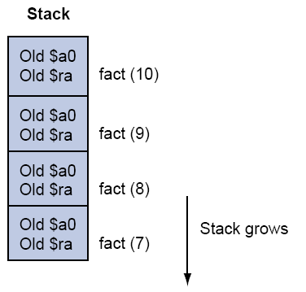
The Stack During Recursion

Slide 12
Two other MIPS pointers
$fp: When you call a C function, the function may declare an array of size 100 like int A[100]. It is on the stack. You would want to access it, but the stack pointer may keep changing, so you need a fixed reference. $fp is the “frame pointer,” which should always point to the first word that is used by this function.
$gp: the “global pointer.” A reference to access the static data.

