Slide 1
MIPS functions

Slide 2
Question
A stack is a data structure that is first in first out.
Notes:
N

Slide 3
Question
In MIPS, accessing the stack involves two instructions.
Notes:
Y, addi $sp, $sp, -4, sw …,

Slide 4
Question
A function can save registers values on the stack but need not pay attention to the order when restoring them.
Notes:
False

Slide 5
Questions
Which of the following statements about MIPS stack is true?
(a) If a function has to modify $sp, it can save $sp on the stack by a “sw $sp, 0($sp)” instruction and restore it later by a “lw $sp, 0($sp)” instruction.
(b) A “push” operation adds a new number to the stack. “push $t0” can be implemented as a pseudo instruction as “sw $t0, -4($sp).”
(c) Both of the above.
(d) None of the above.
Notes:
d

Slide 6
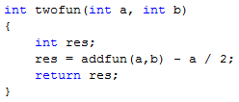
Function calls inside a function
What if we need to call another function inside a function? Will this work?
twofun:
addi $sp, $sp, -4
sw $s0, 0($sp)
jal addfun
srl $s0, $a0, 1
sub $v0, $v0, $s0
lw $s0, 0($sp)
addi $sp, $sp, 4
jr $ra

Slide 7
Function calls inside a function
The problem is that the value of $ra is changed whenever you use jal somelabel.
How to deal with it?
twofun:
addi $sp, $sp, -4
sw $s0, 0($sp)
jal addfun
srl $s0, $a0, 1
sub $v0, $v0, $s0
lw $s0, 0($sp)
addi $sp, $sp, 4
jr $ra

Slide 8
The working versions
twofun1:
addi $sp, $sp, -4
sw $s0, 0($sp)
addi $sp, $sp, -4
sw $ra, 0($sp)
jal addfun
srl $s0, $a0, 1
sub $v0, $v0, $s0,
lw $ra, 0($sp)
addi $sp, $sp, 4
lw $s0, 0($sp)
addi $sp, $sp, 4
jr $ra
twofun2:
addi $sp, $sp, -8
sw $s0, 4($sp)
sw $ra, 0($sp)
jal addfun
srl $s0, $a0, 1
sub $v0, $v0, $s0,
lw $ra, 0($sp)
lw $s0, 4($sp)
addi $sp, $sp, 8
jr $ra

Slide 9
Saving registers
In case of nested function calls, before calling a function, to be safe, the caller should
save $t0-$t9
save $a0-$a3
If such registers are needed later. and
save $ra
Because $ra is going to be needed later and it will be changed
The callee should
save $s0-s7

Slide 10
Question
Which of the following statements about MIPS stack is true?
(a) If a function does not call another function, it does not have to save $ra on the stack.
(b) If $sp is modified inside the function, it must be saved on the stack.
(c) If a function calls another function, it must save $v0 on the stack.
(d) None of the above.
Notes:
A

Slide 11
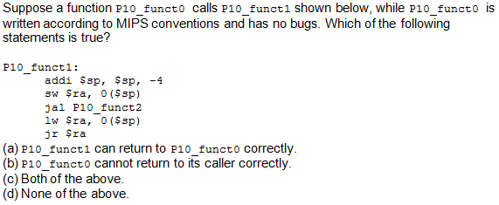
Notes:
c

