Slide 1
MIPS Functions

Slide 2
Questions
A MIPS function is called by the jal instruction, which does two things: 1) going to the address of the first instruction in the function, 2) passing the arguments in $a0 to $a3.
Notes:
False, does not pass arguments

Slide 3
Questions
A MIPS function must be ended by the jr $ra instruction.
Notes:
true

Slide 4
Questions
MIPS functions are stored in a different part in the memory and not in the same part as the main function.
Notes:
False

Slide 5
Questions
A MIPS function has explicitly declare a name along with the list of arguments to be passed to it, including the names and the types.
Notes:
False. No such list is explicitly maintained.

Slide 6
Questions
A function in MIPS cannot have loops.
Notes:
false

Slide 7
Questions
In MIPS, the name of a function is a special data type.
Notes:
false

Slide 8
Questions
The jal L1 instruction jumps to L1, and saves the address of L1 into $ra.
Notes:
False. The next one into $ra

Slide 9
Questions
Suppose $s0, $v0, and $a0 are holding 60, 0, and 35, respectively. After the program executes till p9L2, what will be the value in $v0?
jal p9L1
j p9L2
p9L1: add $v0, $v0, $a0
blt $v0, $s0, p9L1
jr $ra
p9L2:
(a) 100
(b) 70
(c) The program will never run to p9L2.
(d) None of the above.
Notes:
b

Slide 10
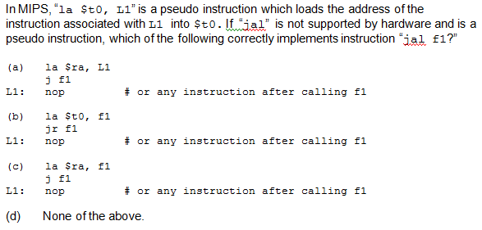
Notes:
A

Slide 11
MIPS Calling Conventions
MIPS assembly follows the following convention in using registers
$a0 - $a3: four argument registers in which to pass parameters
$v0 - $v1: two value registers in which to return values
$ra: one return address register to return to the point of origin

Slide 12
MIPS Conventions
Quite often, our function needs to use some registers to do dome calculation. So we will modify the values of them.
We can use $t0-$t9 freely inside a function, because the caller does not expect the values inside $t0-$t9 to stay the same after the function call.
But, the caller do expect the values in $s0 to $s7 to be the same after a function call.

Slide 13
MIPS Conventions
So, just try to avoid using $s0 and $s7 inside a function whenever possible.
But what if do need it? Such occasions will arise…

Slide 14
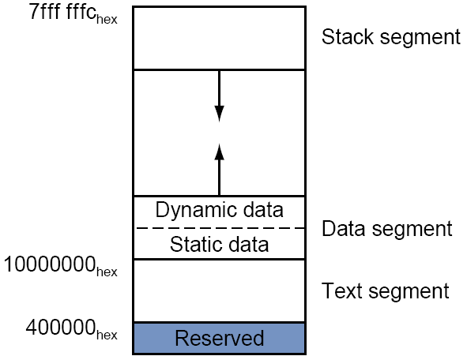
Stack
So, if we do have to use $s0 - $s7, we MUST save it somewhere before entering the main part of the function, and restore it before we return (before we execute “jr $ra”).
In MIPS, we save them in the stack.
Stack is a part in the memory allocated for functions. It starts at 0x7ffffffc and grows down as we add more stuffs to it.
Stack is “first in last out.”

Slide 15
$sp
The top address of the stack, the address of the first word that is storing value, is (should be) always stored in $sp.
So, adding a word into the stack (pushing a word onto the stack) is a two-step thing, because you have to maintain the correctness of $sp:
addi $sp, $sp, -4
sw $s0, 0($sp)

Slide 16
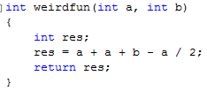
Suppose we want to

Slide 17
Stack and $sp
Suppose we want to store a/2 in $s0.
How do we get a/2?
At the beginning, we do
addi $sp, $sp, -4
sw $s0, 0($sp)
At the end, we do
lw $s0, 0($sp)
addi $sp, $sp, 4

Slide 18
.data
A: .word 12, 34, 67, 1, 45, 90, 11, 33, 67, 19
.text
.globl main
main:
la $s7, A
li $s0, 0 #i
li $s1, 0 #res
li $s6, 9
loop: sll $t0, $s0, 2
add $t0, $t0, $s7
lw $a0, 0($t0)
lw $a1, 4($t0)
jal weirdfun
add $s1, $s1, $v0
addi $s0, $s0, 2
blt $s0, $s6, loop
done: li $v0,10
syscall
weirdfun: addi $sp, $sp, -4
sw $s0, 0($sp)
srl $s0, $a0, 1
add $t0, $a0, $a0
add $t0, $t0, $a1
sub $t0, $t0, $s0
ori $v0, $t0, 0
lw $s0, 0($sp)
addi $sp, $sp, 4
jr $ra

