Slide 1
MIPS coding

Slide 2
Questions
If $t0 is holding 30, in the binary of instruction add $t2, $t0, $t1, the rs field should be 30?
Notes:
No, should be the index of $t0

Slide 3
Questions
Is it true that because the j instruction has to specify the entire address, it has a smaller opcode field?
Notes:
no

Slide 4
Questions
Is it correct to write an instruction addi $t0, $t0, 100000?
Notes:
No, the number is too large

Slide 5
Questions
Is it true that instruction beq $t0, $t1, L1 does not store the entire address associated with L1 but the offset with respect to its own address?
Notes:
Yes

Slide 6
Questions
Is it true that the PC (program counter) always stores the address of the current instruction, except when encountering beq, bne, and j?
Notes:
no

Slide 7
Questions
It would be nice if we have an instruction like beq $t0, 5, L1
which compares $t0 with the constant 5 and jumps if they are the same. Does MIPS have this instruction? Why?
Notes:
Does not have it. Cannot fit in two immediate numbers.

Slide 8


Loop example 2
How to translate the following to MIPS assembly?
  We first translate into a C program using if and goto

Slide 9

Compiling a while loop in C
Assume that i and k correspond to registers $s3 and $s5 and starting address of array save is in $s6

Slide 10
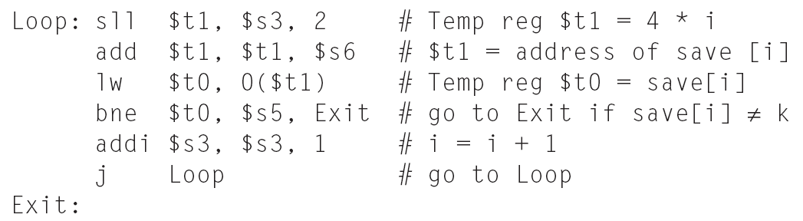
Compiling a while loop in C
Assume that i and k correspond to registers $s3 and $s5 and starting address of array save is in $s6

Slide 11
While Loop
How many instructions will be executed for the following array save?
  Assume that k = 10 and i = 0 initially

Slide 12
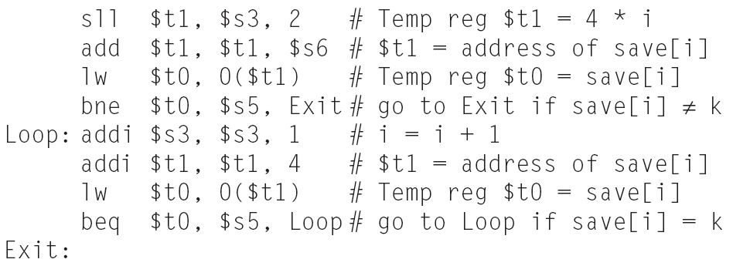
Optimized
How many instructions now?
  Assume k = 10 and i = 0 initially

Slide 13
The loop code
.data
save:.word 10, 10, 10, 10, 10, 11, 12,
.text
.globl main
main:
li $s3, 0
li $s5, 10
la $s6, save
Loop:
sll $t1, $s3, 2
add $t1, $t1, $s6
lw $t0, 0($t1)
bne $t0, $s5, Exit
addi $s3, $s3, 1
j Loop
Exit:
done:
li $v0, 10 # these two lines are to tell the simulator to stop
syscall

Slide 14
Loop Example 3
Finding the largest element in an array
The idea is to use a register, say, $t9, to keep the largest number we have seen so far, go through the array, if encounter a number larger than the one in $t9, replace $t9 with this number

Slide 15
Loop ex 3
data
A: .word 12, 34, 67, 1, 45, 90, 11, 33, 67, 19
.text
.globl main
main:
la $s0, A
li $s1, 10 # number of elements in the array
li $t0, 0 # $t0 as i
li $t9, 0 # $t9 as the max number
LOOP: sll $t1, $t0, 2 # these 3 instructions read A[i] into $t1
add $t1, $t1, $s0
lw $t1, 0($t1)
slt $t2, $t9, $t1 # compare $t1 with $t9, $t2 should be 1 if $t9 is smaller
beq $t2, $0, LOOP_NEXT # if $t2 is 0, means $t9 is larger than $t1, nothing needs to be done
ori $t9, $t1, 0 # if came here, $t2 is 1, replace $t9 with $t1
LOOP_NEXT: addi $t0, $t0, 1 # increment i by 1
bne $t0, $s1, LOOP # if i!=$s1, continue to the next element in the array
done:
li $v0,10 # these two lines tell the simulator to stop
syscall

