Slide 1
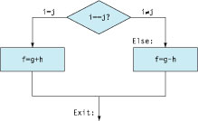
Instructions for Making Decisions
A distinctive feature of programs is that they can make different decisions based on the input data

Slide 2
Instruction beq (branch if equal)
To support decision making, MIPS has conditional branch instruction:
beq register1, register2, L1
Equivalent to the following in C:
if (register1 == register2) goto L1;
In other words, if the two registers have the same value, go to L1; otherwise, nothing happens
L1 is a label, which can be considered as the name of the address of an instruction.
An instruction is also stored in the memory, and of course has an address
The address is 32 bits, but is impossible to know or be remembered by the programmers, so we create labels to refer to the addresses
We can write lines like to introduce a label for an instruction:
L1: add $t0, $t1, $t2
Go to a label means that fetch that instruction at the address associated with a label from the memory and execute the instruction
An address can be associated with more than one label
Keep in mind that if the condition is not true, nothing happens, meaning that the processor will just execute the instruction appearing immediately after the beq in your program

Slide 3
Instruction bne
Similarly, bne (branch not equal) means go to L1 if the value in register1 does not equal to the value in regster2
bne register1, register2, L1

Slide 4
Instruction j (jump)
MIPS has also an unconditional branch, equivalent to goto in C:
j L1
Jump to the instruction labeled with L1

Slide 5
Compiling if-then-else
Suppose variables f, g, h, i, and j are in registers $s0 through $s4, how to implement the following in MIPS?

Slide 6
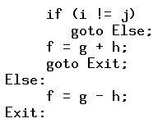
Compiling if-then-else
Suppose variables f, g, h, i, and j are in registers $s0 through $s4, how to implement the following in MIPS?

Slide 7
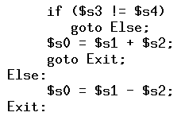
Compiling if-then-else
Suppose variables f, g, h, i, and j are in registers $s0 through $s4, how to implement the following in MIPS?

Slide 8
MIPS Assembly for if-then-else
Now it is straightforward to translate the C program into MIPS assembly

Slide 9
Questions
If $t0 is holding 17, $t1 is holding 8, what will be the value stored in $t2 after the following instructions?
andi $t0, $t0, 3
beq $t0, $0, L1
addi $t0, $t0, 1
L1: add $t2, $t0, $t1
(a) 10.
(b) 8.
(c) 2.
(d) None of the above.
Notes:
Answer: a.

