Slide 1
MIPS Assembly

Slide 2
Why are we learning assembly
Comparing to higher level languages such as C, assembly languages
are more difficult to write, read, and debug.
have poor portability – Every processor has its own assembly language. The MIPS code you write is NOT going to run on Intel processors.
Then why are we learning it?
After learning the first assembly language, the second will be MUCH easier
It brings us closer to the processor, which is the goal of this course.

Slide 3
MIPS ISA
There are many different Instruction Set Architectures designed for different applications with different performance/cost tradeoff
Including Intel-32, PowerPC, MIPS, ARM ….
We focus on MIPS architecture
Microprocessor without Interlocked Pipeline Stages
A RISC (reduced instruction set computer) architecture
In contrast to CISC (complex instruction set computer)
Similar to other architectures developed since the 1980's
Almost 100 million MIPS processors manufactured in 2002
Used by NEC, Nintendo, Cisco, Silicon Graphics, Sony, …

Slide 4
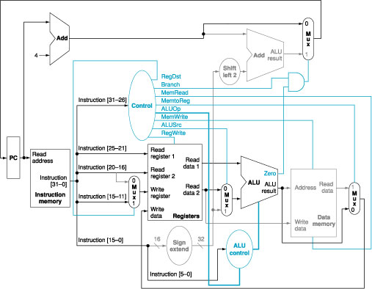
A peek into the future…

Slide 5
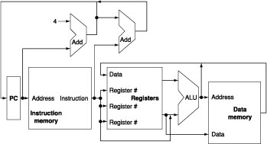
Abstract View of MIPS Implementation

Slide 6
MIPS Instruction Set
An instruction is a command that hardware understands
Instruction set is the vocabulary of commands understood by a given computer
It includes arithmetic instructions, memory access instructions, logical operations, instructions for making decisions

Slide 7
Arithmetic Instructions
Each MIPS arithmetic instruction performs only one operation
Each one must always have exactly three variables
add a, b, c # a = b + c
Note that these variables can be the same though
If we have a more complex statement, we have to break it into pieces

Slide 8
Arithmetic Instructions
Example
f = (g + h) – (i + j)

Slide 9
Arithmetic Instructions
Example
f = (g + h) – (i + j)
add t0, g, h # temporary variable t0 contains g + h
add t1, i, j # temporary variable t1 contains i + j
sub f, t0, t1 # f gets t0 – t1

Slide 10
Operands of Computer Hardware
In C, we can define as many as variables as we need
In MIPS, operands for arithmetic operations must be from registers
MIPS has thirty-two 32-bit registers

Slide 11
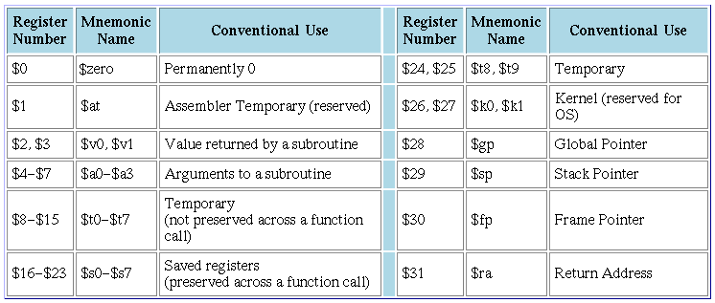
MIPS Registers

Slide 12
Arithmetic Instructions
Example
f = (g + h) – (i + j)
#In MIPS, add can not access variables directly
#because they are in memory
# Suppose f, g, h, i, and j are in $s0, $s1, $s2, $s3, $s4 respectively
add $t0, $s1, $s2 # temporary variable t0 contains g + h
add $t1, $s3, $s4 # temporary variable t1 contains i + j
sub $s0, $t0, $t1 # f gets t0 – t1

Slide 13
Memory Operands
Since variables (they are data) are initially in memory, we need to have data transfer instructions
Note a program (including data (variables)) is loaded from memory
We also need to save the results to memory
Also when we need more variables than the number of registers we have, we need to use memory to save the registers that are not used at the moment
Data transfer instructions
lw (load word) from memory to a register
sw (store word) from register to memory

Slide 14
Using Load and Store
Memory address in load and store instructions is specified by a base register and offset
This is called base addressing

Slide 15
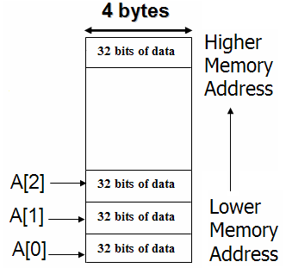
Using Load and Store
How to implement the following statement using the MIPS assembly we have so far?
Assuming the address of A is in $s3 and the variable h is in $s2
A[12] = h + A[8]

Slide 16
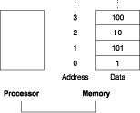
Specifying Memory Address
Memory is organized as an array of bytes (8 bits)

Slide 17
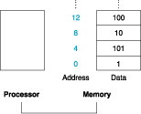
Specifying Memory Address
MIPS uses words (4 bytes)
Each word must start at address that are multiples of 4
This is called alignment restriction
Big Endian

Slide 18
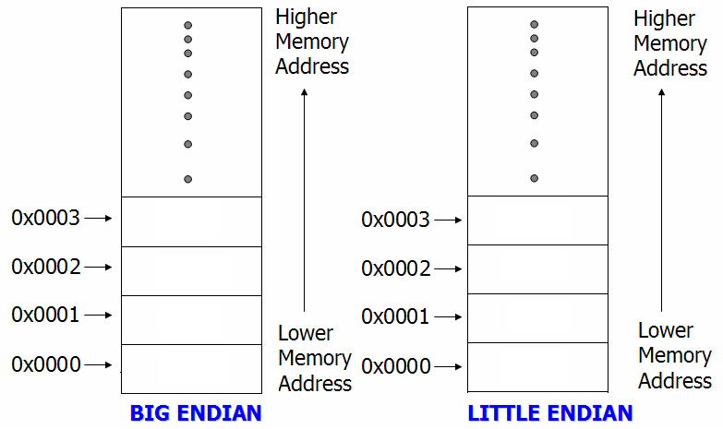
Example of Endianness
Store 0x87654321 at address 0x0000, byte-addressable

Slide 19
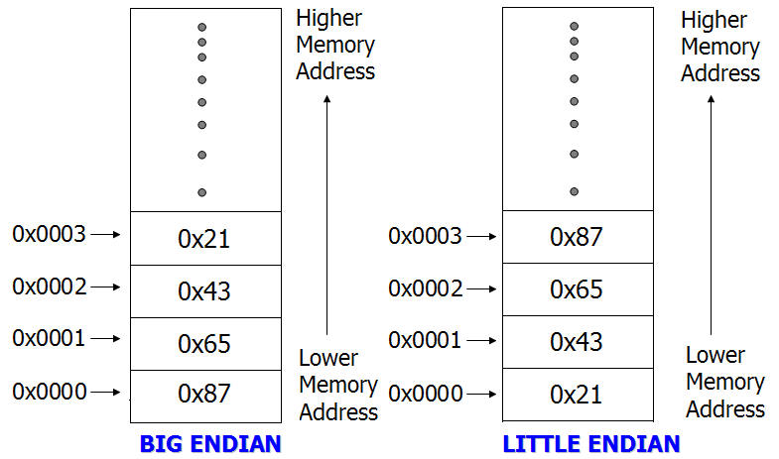
Example of Endianness
Store 0x87654321 at address 0x0000, byte-addressable

