Slide 1
MIPS assembly

Slide 2
Computer Model
What’s in a computer?
Processor, memory, I/O devices (keyboard, mouse, LCD, video camera, speaker), disk, CD drive, …

Slide 3
Computer Model
Processor
Memory
register
ALU
data
0011100..111
0011100..111
0011100..111
instruction
I/O device
00111111..111
00111011..111

Slide 4
Registers and ALU
A processor has registers and ALU
  Registers are where you store values (e.g., the value of a variable)
  The values stored in registers are sent to the ALU to be added, subtracted, anded, ored, xored, …, then the result is stored back in a register. Basically it is the heart of the processor and does the calculation.

Slide 5
Memory
Memory is modeled as a continuous space from 0 to 0xffff…ffff.
Every byte in the memory is associated with an index, called address.
We can read and write:
  Given the address to the memory hardware, we can read the content in that byte.
  Given the address and a byte value, we can modify the content in the memory at that addres.

Slide 6
Program and Data
Programs consist of instructions and data, both stored in the memory
Instructions are also represented as 0’s and 1’s
A program is executed instruction by instruction

Slide 7
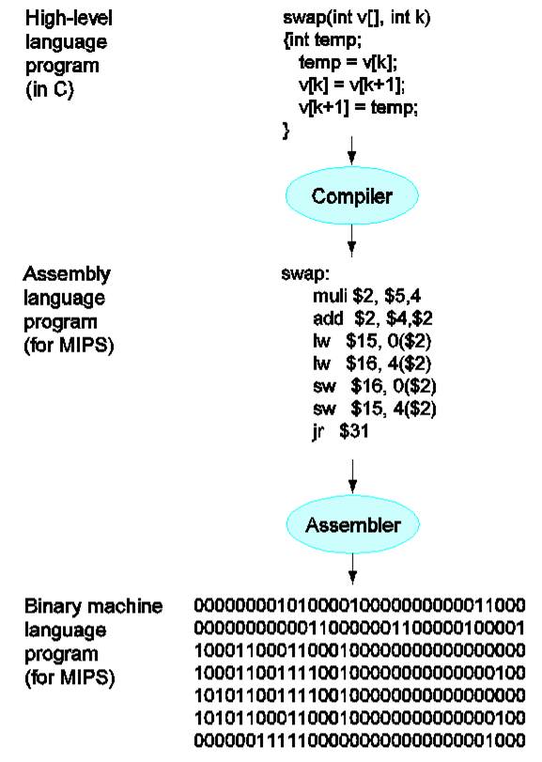

Slide 8
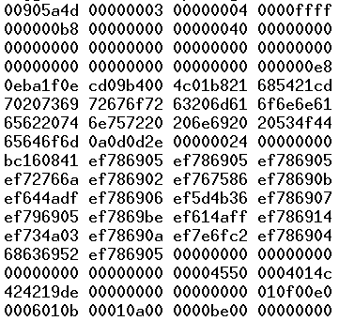
GoogleEarth.exe

Slide 9
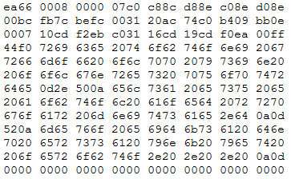
Linux Kernel

Slide 10
Questions
We can store a 10,000 bye array in the register.
Notes:
False. the register size is small

Slide 11
Questions
The calculation in the computer happens in the ALU.
Notes:
yes

Slide 12
Questions
If byte value in the memory at address 100 is 89, the value at address 101 cannot be smaller than 89.
Notes:
False. The content is independent of the address.

Slide 13
Questions
To write to the memory, you only need to provide the value to be written.
Notes:
False. The address, where to write this value to.

Slide 14
Questions
If the byte at memory address 100 is currently 63 and we write a new value 78 to address 100, address 101 is going to save 63.
Notes:
False. The old value will be overwritten.

