Slide 1
CDA 3100 Fall 2015

Slide 2
Special Thanks
Thanks to Dr. Xiuwen Liu for letting me use his class slides and other materials as a base for this course

Slide 3
Course Information

Slide 4
About Me
My name is Zhenghao Zhang
  Why I am teaching this course: I worked for two years as an embedded system engineer, writing codes for embedded controllers.

Slide 5
Class Communication
This class will use class web site to post news, changes, and updates. So please check the class website regularly
Please also make sure that you check your emails on the account on your University record
Blackboard will be used for posting the grades

Slide 6
Required Textbook
The required textbook for this class is
  “Computer Organization and Design”
    The hardware/software interface
  By David A. Patterson and John L. Hennessy
  Fifth Edition

Slide 7
Lecture Notes and Textbook
All the materials that you will be tested on will be covered in the lectures
  Even though you may need to read the textbook for review and further detail explanations
  The lectures will be based on the textbook and handouts distributed in class

Slide 8
Motivations

Slide 9
What you will learn
How does the software instruct the hardware to perform the needed functions
What is going on in the processor
How a simple processor is designed

Slide 10
Why This Class Important?
If you want to create better computers
  It introduces necessary concepts, components, and principles for a computer scientist
  By understanding the existing systems, you may create better ones
If you want to build software with better performance
If you want to have a good choice of jobs
If you want to be a real computer scientist

Slide 11
Required Background

Slide 12
Required Background
Based on years of teaching this course, I find that you will suffer if you do not have the required C/C++ programming background.
We will need assembly coding, which is more advanced than C/C++.
If you do not have a clear understanding at this moment of array and loop , it is recommended that you take this course at a later time, after getting more experience with C/C++ programming.

Slide 13
Array – What Happens?
#include <stdio.h>
int main (void)
{
int A[5] = {16, 2, 77, 40, 12071};
A[A[1]] += 1;
return 0;
}
Notes:
A[1] = 2, so A[2] <- 78.

Slide 14
Loop – What Happens?
#include <stdio.h>
int main ()
{
int A[5] = {16, 20, 77, 40, 12071};
int result = 0;
int i = 0;
while (result < A[i]) {
result += A[i];
i++;
}
return 0;
}
Notes:
result = 113, i=3

Slide 15
Getting Started!

Slide 16
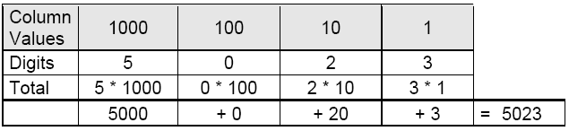
Decimal Numbering System
We humans naturally use a particular numbering system

Slide 17
Decimal Numbering System
For any nonnegative integer , its value is given by
  Here d₀ is the least significant digit and d_{n} is the most significant digit

Slide 18
General Numbering System – Base X
Besides 10, we can use other bases as well
  In base X,
  Then, the base X representation of this number is defined as d_{n}d_{n-1}…d₂d₁d_{0.}
  The same number can have many representations on many bases. For 23 based 10, it is
    23_{ten}
    10111_{two}
    17_{sixteen}, often written as 0x17.

Slide 19
Commonly Used Bases
Base | Common Name | Representation | Digits
10 | Decimal | 5023_{ten} or 5023 | 0-9
2 | Binary | 1001110011111_{two} | 0-1
8 | Octal | 11637_{eight} | 0-7
16 | Hexadecimal | 139F_{hex} or 0x139F | 0-9, A-F
  Note that other bases are used as well including 12 and 60
Which one is natural to computers?
  Why?

Slide 20
Meaning of a Number Representation
When we specify a number, we need also to specify the base
  For example, 10 presents a different quantity in a different base
☺
  There are 10 kinds of mathematicians. Those who can think binarily and those who can't... http://www.math.ualberta.ca/~runde/jokes.html

Slide 21
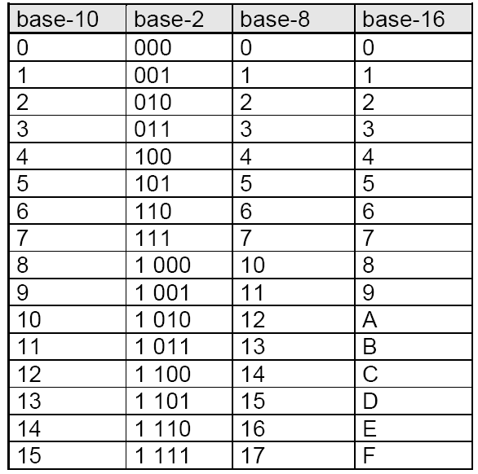

Slide 22
Question
How many different numbers that can be represented by 4 bits?

Slide 23
Question
How many different numbers that can be represented by 4 bits?
Always 16 (2⁴), because there are this number of different combinations with 4 bits, regardless of the type of the number these 4 bits are representing.
Obviously, this also applies to other number of bits. With n bits, we can represent 2^{n} different numbers. If the number is unsigned integer, it is from 0 to 2^{n}-1.

