Slide 1
Other Processors

Slide 2
Other Processors
Having learnt MIPS, we can learn other major processors.
Not going to be able to cover everything; will pick on the interesting aspects.

Slide 3
ARM
Advanced RISC Machine
The major processor for mobile and embedded electronics, like iPad
Simple, low power, low cost

Slide 4
ARM
One of the most interesting features is the conditional execution.
That is, an instruction will execute if some condition is true, otherwise it will not do anything (turned into a nop).

Slide 5
ARM
A set of flags, showing the relation of two numbers : gt, equal, lt.
cmp Ri, Rj # set the flags depending on the values in Ri and Rj
subgt Ri, Ri, Rj # i = i – j if flag is gt
sublt Ri, Ri, Rj # i = i – j if flag is lt
bne Label # goto Label if flag is not equal

Slide 6
ARM
How to implement
while (i != j) {
if (i > j)
i -= j;
else
j -= i;
}

Slide 7
ARM
In MIPS, assume i is in $s0, j in $s1:
Loop: beq $s0, $s1, Done
slt $t0, $s0, $s1
beq $t0, $0, L1
sub $s0, $s0, $s1
j Loop
L1: sub $s1, $s1, $s0
L2: j Loop

Slide 8
ARM
In ARM,
Loop: cmp Ri, Rj
subgt Ri, Ri, Rj
sublt Rj, Rj, Ri
bne Loop

Slide 9
ARM
Discussion: Given the MIPS hardware setup, can we support conditional execution? How?
Will have to introduce the cmp instruction

Slide 10
Intel Processor

Slide 11
Basic Program Execution Registers
General purpose registers
There are eight registers (note that they are not quite general purpose as some instructions assume certain registers)
Segment registers
They define up to six segment selectors
EIP register – Effective instruction pointer
EFLAGS – Program status and control register

Slide 12
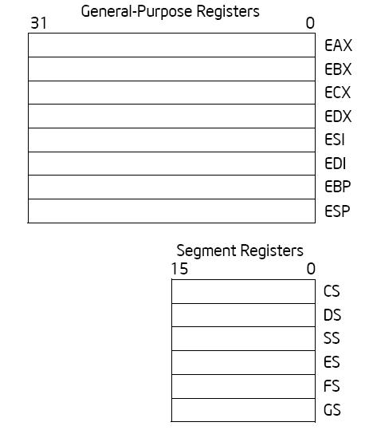
General Purpose and Segment Registers

Slide 13
General Purpose Registers
EAX — Accumulator for operands and results data
EBX — Pointer to data in the DS segment
ECX — Counter for string and loop operations
EDX — I/O pointer
ESI — Pointer to data in the segment pointed to by the DS register; source pointer for string operations
EDI — Pointer to data (or destination) in the segment pointed to by the ES register; destination pointer for string operations
ESP — Stack pointer (in the SS segment)
EBP — Pointer to data on the stack (in the SS segment)

Slide 14
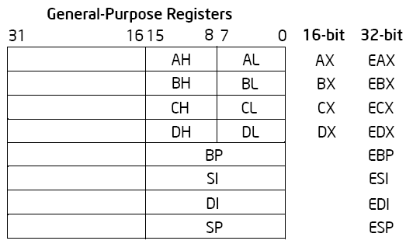
Alternative General Purpose Register Names

Slide 15
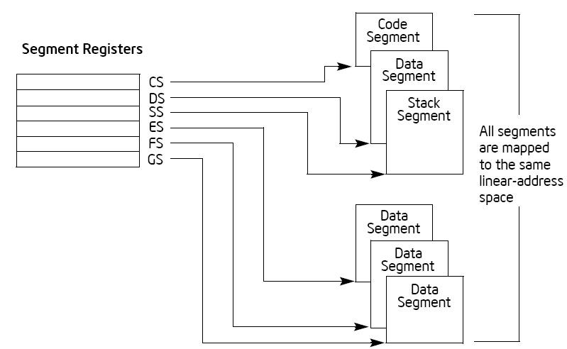
Segment Registers

Slide 16
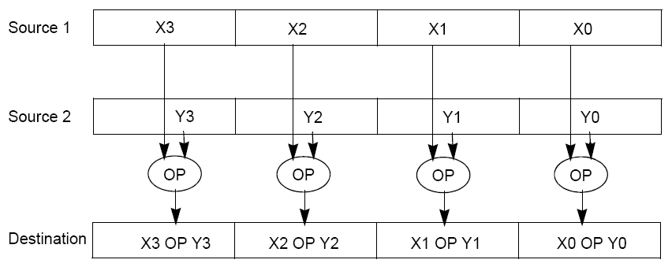
SIMD
To improve performance, Intel adopted SIMD (single instruction multiple data) instructions.
Streaming SIMD Extensions (SSE) introduced eight 128-bit data registers (called XMM registers)
In 64-bit modes, they are available as 16 64-bit registers
The 128-bit packed single-precision floating-point data type, which allows four single-precision operations to be performed simultaneously

Slide 17
GCC Inline Assembly
GCC inline assembly allows us to insert inline functions written in assembly
http://www.ibiblio.org/gferg/ldp/GCC-Inline-Assembly-HOWTO.html
GCC provides the utility to specify input and output operands as C variables
Basic inline
Extended inline assembly

Slide 18
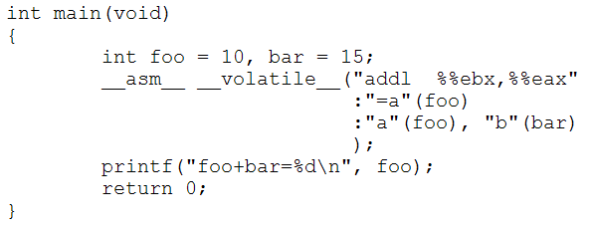
GCC Inline Assembly
A simple example:

Slide 19
Using SSE
#define mulfvec4_SSE(a, b, c) \
{ \
__asm__ __volatile__ ("movups %1, %%xmm0 \n\t" \
"movups %2, %%xmm1 \n\t" \
"mulps %%xmm0, %%xmm1 \n\t" \
"movups %%xmm1, %0 \n\t" \
:"=m" (c) \
:"m" (a), \
"m" (b)); \
}

Slide 20
BCM4306 Wireless Card Processor

Slide 21
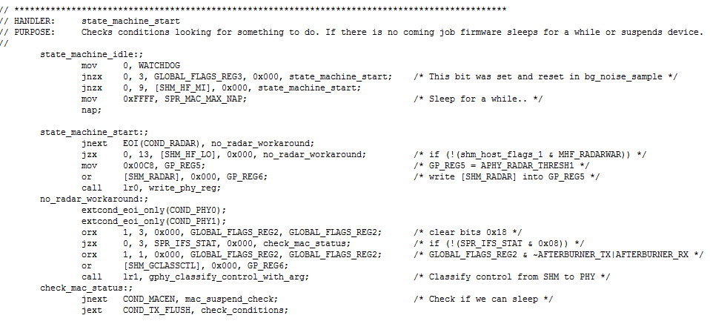
A Part of the Code from http://www.ing.unibs.it/~openfwwf/

