Slide 1
MIPS processor continued

Slide 2
Question
How to implement the datapath of a processor supporting jal and R type?

Slide 3
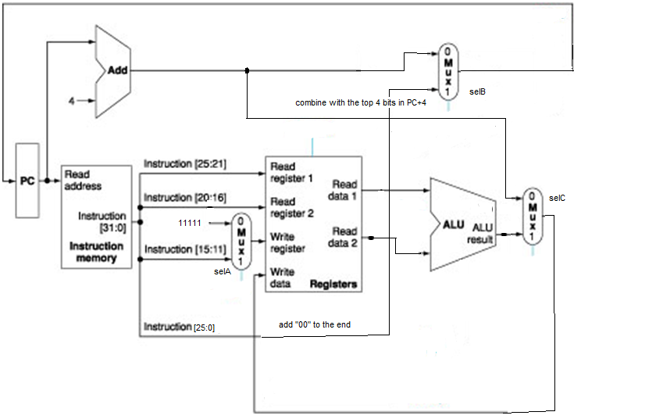
jal and R-type

Slide 4
Control Signals
Control signals include ALUCtrl and the signals to control the 2-1 selectors
They are generated according to the current instruction, using the opcode [31-27] and the funct [5-0] field in the instruction.

Slide 5
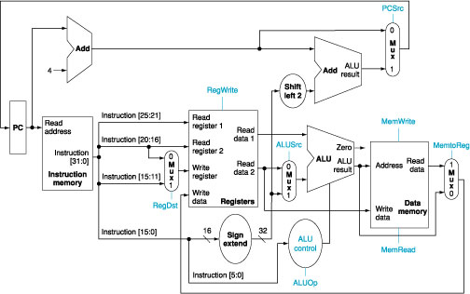
Datapath for Memory, R-type and Branch Instructions, plus the control signals

Slide 6
The Effect of Control Signals
Signal name | Effect when deasserted | Effect when asserted
RegDst | The register destination number for the Write register comes the rt field (20:16) | The register destination number for the Write register comes the rd field (15:11)
RegWrite | None. | The register on the Write register input is written with the value on the Write data input.
ALUSrc | The second ALU operand comes from the second register file output | The second ALU operand is the sign-extended, lower 16 bits of the instruction
PCSrc | The PC is replaced by the output of the adder that computes the value of PC + 4 | The PC is replaced by the output of the adder that computes the branch target
MemRead | None. | Data memory contents designated by the address input are out on the Read data output.
MemWrite | None. | Data memory contents designated by the address input are replaced by the value on the Write data input.
MemtoReg | The value fed to the register Write data input comes from the ALU | The value fed to the register Write data input comes from the data memory

Slide 7
Table for Control Line Setting
Note: Branch is anded with ALU zero output to produce PCSrc
Instruction | RegDst | ALUSrc | Memto- Reg | Reg Write | Mem Read | Mem Write | Branch | ALUOp1 | ALUOp0
R-format
Lw
Sw
beq

Slide 8
Table for Control Line Setting
Instruction | RegDst | ALUSrc | Memto- Reg | Reg Write | Mem Read | Mem Write | Branch | ALUOp1 | ALUOp0
R-format | 1 | 0 | 0 | 1 | 0 | 0 | 0 | 1 | 0
lw | 0 | 1 | 1 | 1 | 1 | 0 | 0 | 0 | 0
sw | X | 1 | X | 0 | 0 | 1 | 0 | 0 | 0
beq | X | 0 | X | 0 | 0 | 0 | 1 | 0 | 1

Slide 9
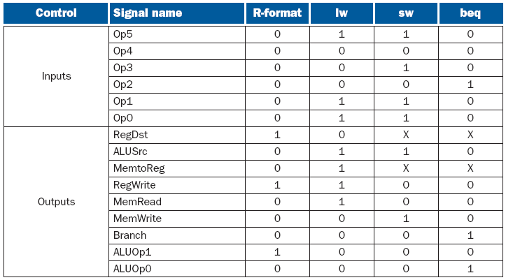
Truth Table for Control Function

Slide 10
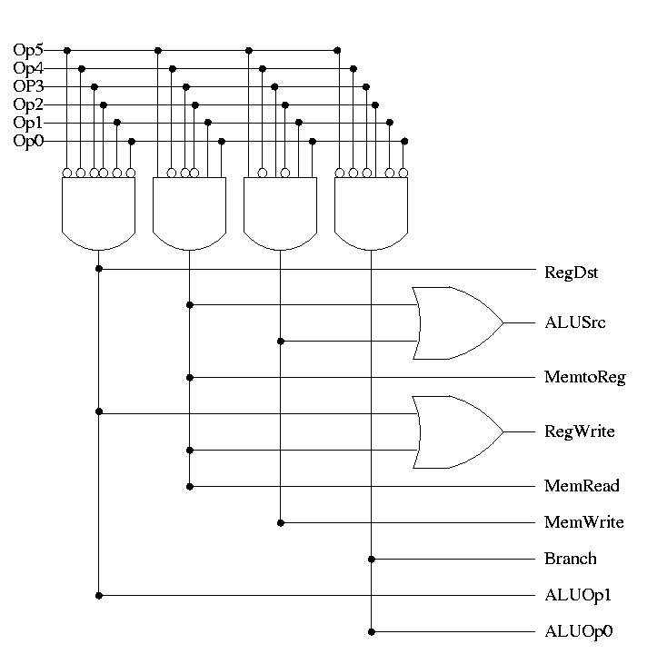
Implementation Using PLA
R
lw
sw
beq
The way to
read this --
There are only 4
possible combination
of inputs
Notes:
0

Slide 11
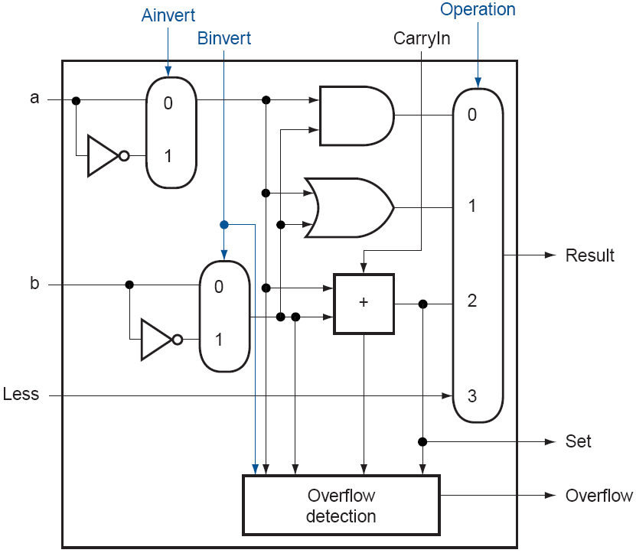
MIPS ALU unit

Slide 12
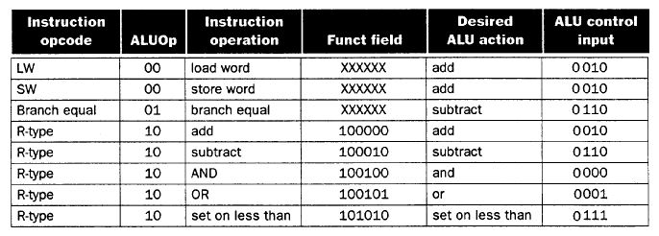
ALU Control
Use Opcode to get ALUOp, then combine ALUOp with Funct
Two levels of decoding, more efficient
Assume ALUOp has been determined as such for each instruction

Slide 13
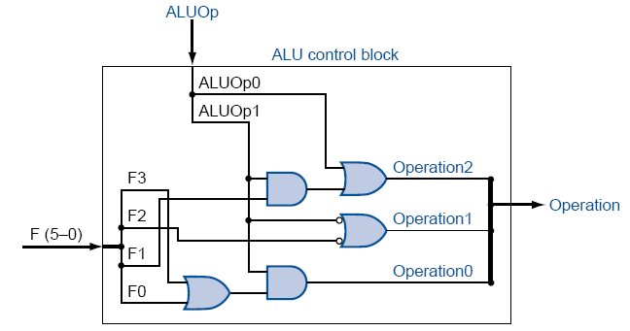
One Implementation
ALU control bit 3 is always 0 for this set of instructions
Can verify that the output is correct for lw, sw, beq
For R-type, op2=F1, op1= ~F2, op0 = F3 | F0

