Slide 1
MIPS processor continued

Slide 2
Review
Different parts in the processor should be connected appropriately to be able to carry out the functions.
Connections depending on what we need
Learnt R-type, lw, sw, beq

Slide 3
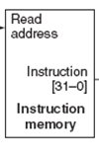
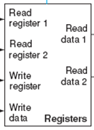
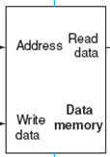
lw & sw?
Notes:
Do both lw and sw, and ask for student participation

Slide 4
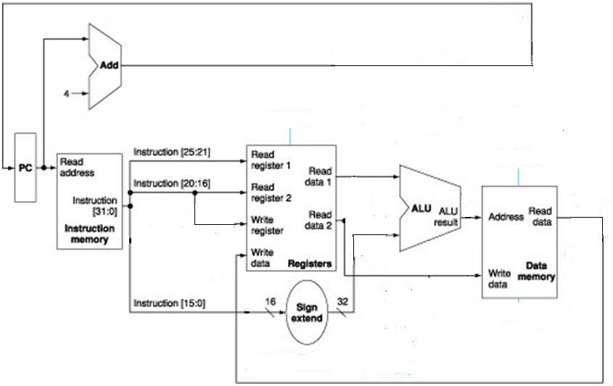
Data path only for lw and sw (answer)
Notes:
To support two instructions, first just get one done, then see if it still works for the second. If it works then done. Otherwise, see what wires need to be added.

Slide 5
Data path for both R-type and memory-type instructions
add $rd, $rs, $rt, format: opcode (6 bits) rs (5 bits) rt (5 bits) rd (5 bits) 00000 funct (6 bits)
lw $rt, offset_value($rs): opcode (6 bits) rs (5 bits) rt (5 bits) offset (16 bits)
sw $rt, offset_value($rs): opcode (6 bits) rs (5 bits) rt (5 bits) offset (16 bits)
Notes:
Some connecttions are the same, like readreg1, ALUa
Sometimes wreg is this, sometimes that
Sometimes ALUb is readdata2 (add), sometimes it is the immediate number (lw, sw)
Sometimes Wdata is this, …

Slide 6
Data path for both R-type and memory-type instructions
add $rd, $rs, $rt, format: opcode (6 bits) rs (5 bits) rt (5 bits) rd (5 bits) 00000 funct (6 bits)
lw $rt, offset_value($rs): opcode (6 bits) rs (5 bits) rt (5 bits) offset (16 bits)
sw $rt, offset_value($rs): opcode (6 bits) rs (5 bits) rt (5 bits) offset (16 bits)

Slide 7
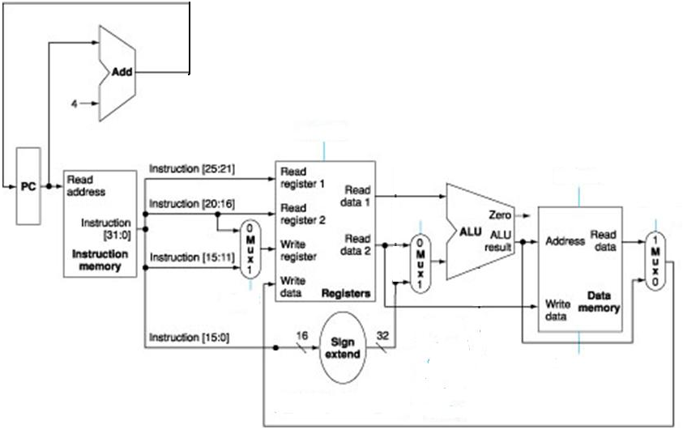
Answer

Slide 8
Datapath for R-type, memory, and branch operations

Slide 9
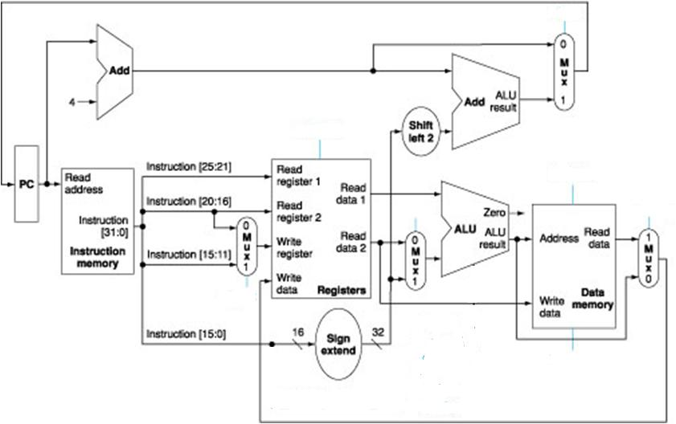
Datapath for R-type, memory, and branch operations (Answer)

Slide 10
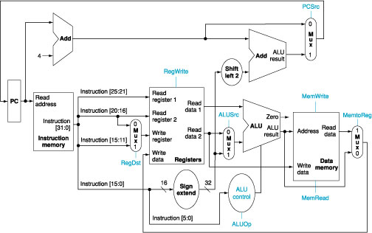
Datapath for Memory, R-type and Branch Instructions, plus the control signals

Slide 11
Jump Instruction
Jump instruction seems easy to implement
We just need to replace the lower 28 bits of the PC with the lower 26 bits of the instruction shifted by 2 bits
The shift is achieved by simply concatenating 00 to the jump offset

Slide 12
Implementing Jumps
The one we have supports arithmetic/logic instructions, branch instructions, load and store instructions
We need also to support the jump instruction
What are the changes we need to make?
31
26
25
0
0
0
0
0
1
0
opcode
Address

Slide 13
Add j?

Slide 14
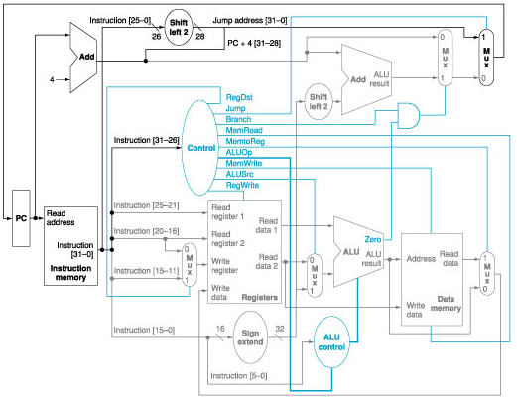
Supporting Jump Instruction

Slide 15
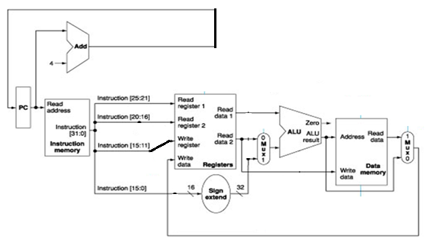
Questions
Which statement is true about the datapath below?
The data path supports lw.
The data path supports sw.
Both of the above.
None of the above.

Slide 16
Questions
Which statement is true about the datapath below?
The data path supports lw.
The data path supports sw.
Both of the above.
None of the above.
Notes:
b

Slide 17
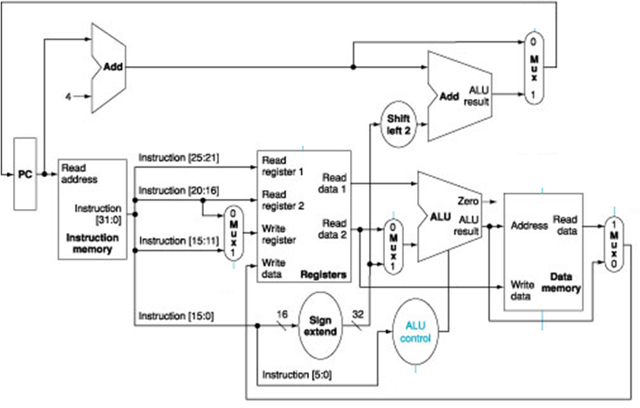
Questions
The following datapath supports R-type, lw, sw, and beq. Which of the following statements is true if we decide to support less instructions?
If only to support R-type and lw, we need exactly 3 2-1 MUX.
If only to support R-type and beq, we need exactly 2 2-1 MUX.
Both of the above.
None of the above.
Notes:
a

Slide 18
Questions
Consider the MIPS processor that supports the R-type, lw, sw, and beq instructions. Suppose $t0 is holding 9, $t1 is holding 4, the data memory location 4*i is holding value i, when we encounter the following instruction:
beq $t0, $t1, L1
where L1 is the 4th instruction after the beq instruction. Suppose the control signal for a 2-1 MUX is 0 if we do not care about its value. What will be the stable values showing at ports WriteData of the register file and WriteData of the data memory during the execution of this instruction?
(a) 1 and 9.
(b) 5 and 4.
(c) 20 and 4.
(d) None of the above.
Notes:
b

Slide 19
In Class Exercise – Supporting Jump Register and R-type

Slide 20
Performance
Assume that
Memory access: 200ps
ALU and adders: 100 ps
Register file read: 50ps
Register file write: 10ps (the clk-to-q delay)
PC update: 10ps (the clk-to-q delay)
The setup time of DFFs: 10ps
Other parts do not have delay
How fast is
An R-type instruction?
A lw instruction?
A sw instruction?
A beq instruction?
Need to find the critical path – the longest path

Slide 21
R-type
PC
ready
instruction
ready
register
ready
ALU
ready
register
written
So, the clock needs to be at least 10+200+50+100+10 = 370ps
Will there be a problem if the next instruction is also an R-type instruction, considering that the register is written and stable only after the next rising edge of the clock?
Figure not to the exact scale
Notes:
Note that once the instruction is stable, all control signals are stable, so the D signals to the D flip flops are stable. Ultimately what we change is the D signal – either the old Q or some new stuff. They will not change until the next rising edge of the clock, so the D will be stable till the next rising edge of the clock – all that we cares.

Slide 22
lw
PC
ready
instruction
ready
register
ready
ALU
ready
Data mem
ready
register
written
So, the clock needs to be at least 10+200+50+100+200+10 = 570ps
Figure not to the exact scale

Slide 23
beq
PC
ready
instruction
ready
register
ready
ALU
ready
Adder 1
ready
Adder 2
ready
So, it is 10+200+50+100+10 = 370ps
Figure not to the exact scale

Slide 24
Clock cycle
So, how long should the clock cycle be?
Is it efficient?

