Slide 1
Finite State Machine Continued

Slide 2
In class exercise
Design a 2-bit up-down counter with a control signal U. If U=0, count down, else count up.

Slide 3
Combinational and Sequential Circuit
Digital logic systems can be classified as combinational or sequential.
  Combinational circuits can be completely described by the truth table.
  Sequential systems contain state stored in memory elements internal to the system. Their behavior depends both on the set of inputs supplied and on the contents of the internal memory, or state of the system. Thus, a sequential system cannot be described with a truth table. Instead, a sequential system is described as a finite-state machine (or often just state machine).

Slide 4
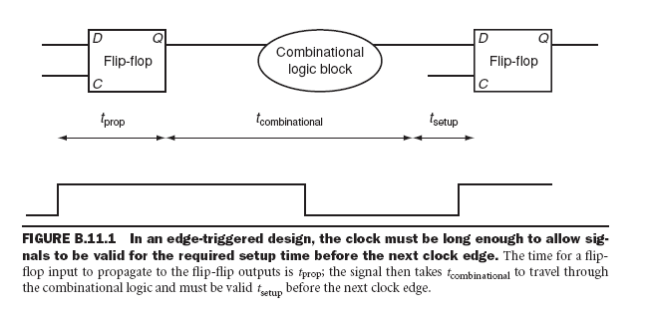
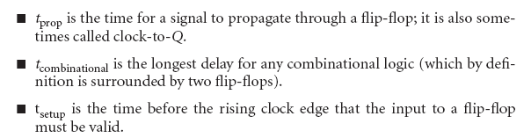
Clock cycle

Slide 5
Finite State Machines
A finite state machine has a set of states and two functions called the next-state function and the output function
  The set of states correspond to all the possible combinations of the internal storage
    If there are n bits of storage, there are 2^{n} possible states
  The next state function is a combinational logic function that given the inputs and the current state, determines the next state of the system

Slide 6
Finite State Machines
The output function produces a set of outputs from the current state and the inputs
  There are two types of finite state machines
  In a Moore machine, the output only depends on the current state
  While in a Mealy machine, the output depends both the current state and the current input
  We are only going to deal with the Moore machine.
  These two types are equivalent in capabilities

Slide 7
Implementing an FSM
Outputs
Implement
transition
functions
Inputs
Current state
Next state
D
Q

Slide 8
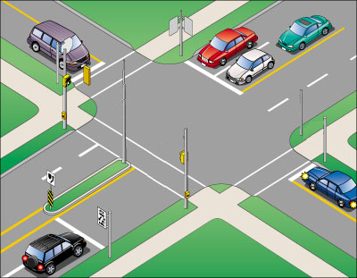
Intelligent Traffic Controller
We want to use a finite state machine to control the traffic lights at an intersection of a north-south route and an east-west route
  We consider only the green and red lights
  We want the lights to change no faster than 30 seconds in each direction
    So we use a 0.033 Hz clock

Slide 9
Intelligent Traffic Controller
There are two output signals
  NSlite: When the signal is asserted, the light on the north-south route is green; otherwise, it should be red
  EWlite: When the signal is asserted, the light on the east-west route is green; otherwise, it should be red

Slide 10
Intelligent Traffic Controller
There are two inputs
  NScar: Indicates that there is at least one car that is over the detectors placed in the roadbed in the north-south road
  EWcar: Indicates that there is at least one car that is over the detectors placed in the roadbed in the east-west road

Slide 11
Intelligent Traffic Controller
The traffic lights should only change from one direction to the other only if there is a car waiting in the other direction
  Otherwise, the light should continue to show green in the same direction

Slide 12
Intelligent Traffic Controller
Here we need two states
  NSgreen: The traffic light is green in the north-south direction
  EWgreen: The traffic light is green in the east-west direction

Slide 13
Graphical Representation
EWCar=0, NSCar=0 or 1
NSCar=0, EWCar=0 or 1
NSCar=1, EWCar=0 or 1
NSgreen
EWgreen
EWCar=1, NSCar=0 or 1

Slide 14
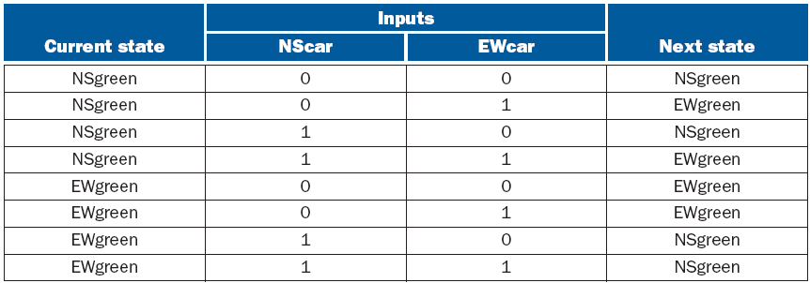
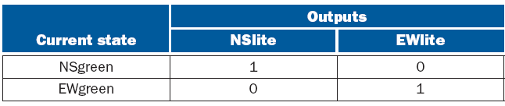
Next State Function and Output Function

Slide 15
State Assignment
We need to assign state numbers to the states
  In this case, we can assign NSgreen to state 0 and EWgreen to state 1
  Therefore we only need 1 bit in the state register

Slide 16
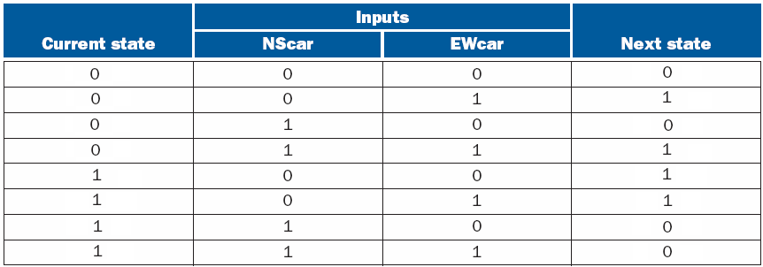
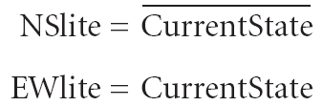
Combinational Logic for Next State Function

Slide 17
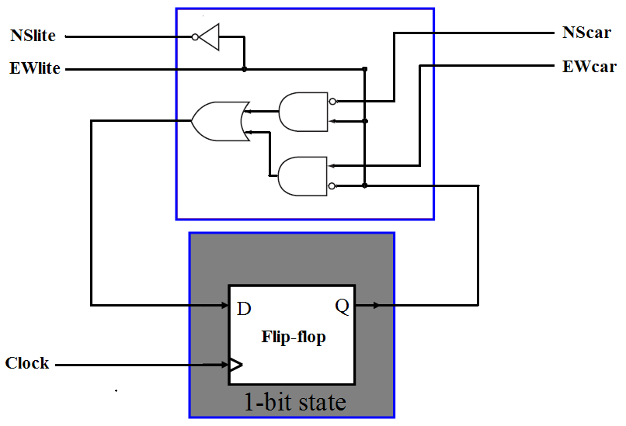
Implementing Intelligent Traffic Controller

Slide 18
Four Steps to Build a Finite State Machine
Step 1 – State diagram and state table
  There are no set procedures and diagrams. Application dependent
  Choose a state to be the starting state when power is turned on the first time
  A state diagram can be represented by a graph or by a table

Slide 19
Four Steps to Build a Finite State Machine
Step 2 – State assignment
  Assign a unique binary number to each state
  Rewrite the state table using the assigned number for each state
Step 3 – Combinational logic for next state function and output function
Step 4 - Implementation

Slide 20
FSM
The state is updated at the edge of the clock cycle
The next state is computed once every clock.

Slide 21
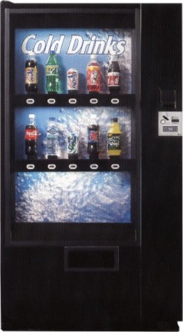
Finite State Machine for a Vending Machine
Build a custom controller
for a vending machine.
We could use a general
purpose processor, but
we might save money
with a custom controller.
Take coins, give drinks

Slide 22
Inputs and Outputs
Inputs:
coin trigger
refund button
drink selectors
Outputs:
drink release latches
Coin refund latch

Slide 23
Specifications
Sells only two kinds of drinks, A,B. (For now, assume all drinks are available in the machine.)
All drinks are $0.50.
Accepts quarters only. If you put in more than $0.50, consider it as $0.50.
  Will respond to refund button. If pressed, release all quarters.
If the current amount of money is less than $0.50
  Will not respond to select buttons.
If the current amount of money is $0.50
  Will respond to select buttons. If SA is pressed, release drink A, if SB is pressed, release drink B. Then, take in all the money.

Slide 24
Controller Outputs
Suppose the latch to be used to build the vending machine is controlled by one bit. It will be closed if the control signal is 0. If the control signal is 1 for a duration of one clock cycle, it will open for a period of time sufficient to allow things stored to fall through; after that, if the control signal is 0, it will be closed. If it is 1, it will stay open until the control signal returns to 0.
Controller outputs are: L_A, L_B, L_RF, L_TK. These are signals to control the latches.
  L_A=1, the latch for drink A opens, and drink A will fall out.
  L_B=1, the latch for drink B opens, and drink B will fall out.
  L_RF=1, the latch for coin refund opens, and coins will fall out.
  L_TK = 1, the latch for coin take opens, and coins will fall from the temporarily storing place to the inside of the machine.
  Based on the specification of the latches, we need to set the control signals to be 1 for one clock.

Slide 25
Inputs
Inputs include some buttons: SA, SB, RF.
  SA = 1 when the user is pressing the select A button, else it is 0
  SB = 1 when the user is pressing the select B button, else it is 0
  RF = 1 when the user is pressing the refund button, else it is 0
Inputs also include CIS (coin insert). When a coin is falling in, CIS is 1 for one clock cycle (from one falling edge to the next falling edge). It is 0 all other time.

Slide 26
Design
How to design this controller, given the specifications and the inputs and the outputs?
Is this a stateless controller, or a controller with states?

Slide 27
State
To tell if a controller has states or not, the simplest way is to check if the controller’s output is relevant to what happened in the past. If it is relevant, it has state; otherwise it does not.
The vending machine controller has state, because the controller’s response to the same input (e.g., SA) is different depending on the number of quarters inserted.

Slide 28
Identifying the States
We need at least three states to remember how many quarters we have got.
  S0: The initial state. Got 0 quarters.
  S1: Got 1 quarter.
  S2: Got 2 quarters.

Slide 29
State Diagram
S0
S1
S2
CIS = 1

Slide 30
State Diagram
When got $0.50, if the user presses select button, should release drink, take money, and go back to state S0.
But is this diagram correct?
S0
S1
S2
CIS = 1
SA = 1

Slide 31
State Diagram
Not complete – we haven’t take action yet.
When the SA is pressed, the controller should change some output signal – not shown in the diagram
S0
S1
S2
CIS = 1
SA = 1

Slide 32
Change the output
The output to be changed, clearly, is the L_A and L_TK.
By the specification, we should let them be 1 for one clock cycle.
clk
SA
L_A
L_TK

Slide 33
Other options
Can we just let the latch be controlled by the SA button, meaning that the latch is open when SA is pressed?
If we do this, I will just get free drinks.
So the latch has to be determined by the states somehow.
Can we just say that the latch is open if in state S2 and when SA is pressed?
When in state S2, if SA is pressed, the next state is not S2 – the overlapping time may not be enough because SA can become 1 at arbitrary time.

Slide 34
The Action State For SA
To ensure that the control signal stays high for one clock cycle, we need another state.
In S3,
  L_A = 1
  L_TK = 1
S0
S1
S3
S2
CIS = 1
SA = 1
automatic

Slide 35
The complete diagram
CIS = 1
RF = 1
S0
S1
SA = 1
SB = 1
automatic
S3: L_A=1, L_TK=1
S3
S2
S4: L_B=1, L_TK=1
S5: L_RF=1
S4
S5

