Slide 1
Similarity Search in Graph Databases: a Multi-Layered Indexing Approach
Yongjiang Liang, Peixiang Zhao
CS @ FSU
zhao@cs.fsu.edu

Slide 2
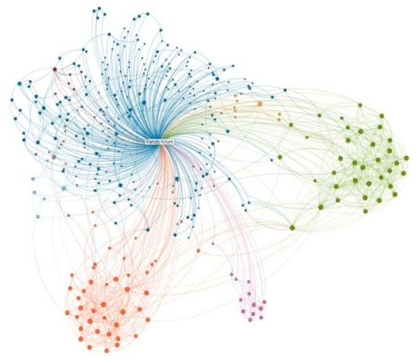
Outline
Introduction
State-of-the-art solutions
ML-Index & similarity search
Experiments
Conclusion

Slide 3


Introduction
Graphs are ubiquitous
How to enable efficient access methods and flexible, structure-aware querying capabilities for a large collection of graphs?
  Exact graph querying may be too rigid and limited
  There are noise and distortions in graphs
  Rank-based exploration is highly desirable
Similarity Search

Slide 4



Introduction
Applications for graph similarity search
  Chemistry: new drug discovery and synthesis
  CV&PR: identity discovery, object detection, scene identification
  Bioinformatics: biological pathway enumeration
How to model similarity for graphs?
  A general metric for fine-grained graph structure/content proximity
  Computation is in NP-hard
Graph Edit Distance

Slide 5
Introduction
Graph edit operations
  Vertex/Edge insertion, deletion, relabeling
Graph edit distance, GED (q, g)
  The minimum number of graph edit operations to modify q to g
q
g
GED(q, g) = 5
3. Add new edge (P, C₁)
4. Add new edge (P, C₂)
5. Relabel edge (C₁, C₂)
1. Relabel N to S
2. Add new vertex P
Notes:
Sulfur
Phosphorous

Slide 6
Problem Formulation
Similarity Search in Graph Databases
Given a graph database G ={g₁, g₂, ……, g_{n}} , a query graph q, and a GED threshold 𝝉 , to find as output all the data graphs g_{i} ∈ G such that GED(g_{i} , q) ≤ 𝝉
NP Hard !

Slide 7
State-of-the-art Solutions
The filtering-verification framework
  Filtering unpromising graphs from G to form a candidate set C
  GED(g_{i} , q) ≥ ≥ 𝝉
  Verify the GED constraint upon C
  |C| <<|G|
K-AT[TKDE’12], SEGOS[ICDE’12], b-Tree[CIKM’13], Pars[VLDB’13]
  Each graph is decomposed to (𝝉+1) partitions, if every partition p_{i} is NOT contained (subgraph isomorphic) in q, g_{i} is filtered
GED(g_{i} , q)
1. Cost-effective
2. Cheap to compute
3. Powerful filtering capabilities

Slide 8

Technical Questions Arise Here
Partition-based GED Similarity Search
  How to choose the right number of partitions
  for each data graph?
  𝝉 + 1
  How to partition each data graph?
  Random partitioning
  How to guarantee the query performance?
  One-layer index, no performance guarantees
  Multilayered-layer index with performance guarantees
𝝉 + k (k ≥ 1)
Selectivity-aware partitioning
ML- Index !

Slide 9


Partition-based GED Lower Bounds
For each graph g in G
  Decompose it to partitions
If GED(g_{i} , q) ≤ 𝝉
  There must exist at least k partitions contained in q
Tighter GED bounds: When k > 1, the prob. of filtering a false-positive graph from G is higher than when k = 1
(𝝉 + k)
k: a variable k ≥ 1
g
q
𝝉 = 2, k = 2

Slide 10
Selectivity-aware Graph Partitioning
A motivating example
Selectivity of partitions
  Partition size
  Vertex/Edge label frequency
A linear, greedy selectivity-aware graph partitioning algorithm
  Assign a vertex to a partition with maximum selectivity gain
g
q
𝝉 = 2, k = 2

Slide 11
Multi-Layered Indexing Framework
Idea: incorporating multiple, as opposed one, GED lower bounds to strengthen the collaborative filtering capabilities
  w.h.p., a false-positive graph will be identified and filtered from G
  Similarity search performance is theoretically guaranteed !
ML-Index (Multi-Layered Index): L distinct layers of indices. For each layer:
  A partitioned-based GED lower-bound, characterized by k_{i}
  A graph partitioning scheme
  Resultant graph partitions for false-positive graph filtering

Slide 12
Multi-Layered Indexing Framework

Slide 13
ML-Index Based Similarity Search
Given a query q, explore ML-Index layer-by-layer for candidate generation. Graphs passing ALL layers of GED lower-bounds constitute the candidate set, C
Time complexity
GED Verification
Candidate Generation
Initialization & Set operations

Slide 14

Experiments
Evaluation Methods
  Pars [VLDB’13]
  Selectivity
  ML-Index
Datasets
  AIDS, Protein, GraphGen
Evaluation Metric
  Index construction cost
  Similarity search performance

Slide 15
Index Construction Cost
# Features (AIDS)
Index Size (AIDS)
Index Time (AIDS)

Slide 16
Similarity Search Performance
AIDS Dataset

Slide 17
Conclusions
Problem: enable GED-based similarity search in large graph databases
  Widely varying real-world applications
  NP-hard
ML-Index: a multi-layered graph indexing framework
  A generic, parameterized, tighter GED lower bound
  Selectivity-aware graph partitioning
  Multi-layered indexing with guaranteed search performance

Slide 18
Thank you !
Q & A

