Slide 1
gSparsify: Graph Motif Based
Sparsification for Graph Clustering
Peixiang Zhao
Department of Computer Science
Florida State University
zhao@cs.fsu.edu

Slide 2
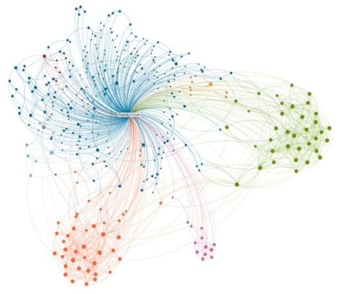

Synopsis
Introduction
gSparsify: Graph motif based sparsification
  Cluster significance
  Path-based indexing and computation
Experiments
Conclusions
Notes:
Clustering significance provides a quantitative way to evaluate the importance of edges within a graph in terms of the graph clustering, and we make use of graph motifs as basic elements to quantify this significance
Evaluating cluster significance of edges need a cost enumeration of graph motifs from graphs, we consider an indexing based approach to facilitate the computation.

Slide 3
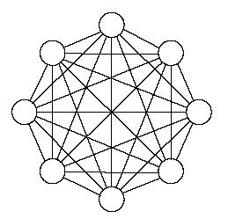
Introduction
Graphs:
  A generic model and ubiquitous abstraction for correlated/inter-connected data
  Examples: social networks, bioinformatics, business intelligence, scientific computation, and the Web
Graph Clusterings:
  Partition vertices of a graph into a series of clusters with an objective to optimizing
    Intra-cluster density
    Inter-cluster sparsity
  Applications: community detection, visualization, ranking, and search

Slide 4
Challenges and Graph Sparsification Solutions
Existing Challenges
  Real-world graphs are massive in scale
    Many graph clustering solutions are hard to scale in large graphs
  Real-world graphs are “dirty”
    There exist many extremely tangled, noisy edges that easily obfuscate intrinsic cluster properties of graphs
Graph sparsification
  Simplify (Reduce) the input graph G (V, E) into another graph G’(V, E’) where |E’| << |E|
    Noisy edges eliminated while crucial structures of graphs well preserved

Slide 5

Sparsification Based Graph Clustering
Graph
Sparsification
More Efficient!
Graph Clustering Algorithm A
C$≈$C “
Graph Clusters C
Graph Clusters C “
Verification
Notes:
Step 1: The traditional graph clustering approach: Apply existing graph clustering algorithms A on graph G: Time-demanding; Low-quality clustering results C due to noisy graph structures
Step 2: We reduce the original graph G into a much simplified graph G’, while the core structures and salient features of G are still well preserved in G’
Step 3: We apply the same graph clustering algorithm A, on the sparsified graph G’, as opposed to G, which is supposed to be much more efficient (because G’ is much smaller than G)
Step 4: We verify that the resultant clusters from G and G’ are close to each other, while the benefit for sparsification is that we significantly reduce the data size for graph clustering while still preserving the quality of graph clusters

Slide 6

Wait. Technical Questions Arise Here
Graph Sparsification for graph clustering
  How can we differentiate “significant” edges from “insignificant” ones?
  How to quantify and compute such “edge importance” efficiently?
  How to sparsify the graph?
  Can the resultant spasified graph G’ still preserve the clustering properties (and to what extent) of the original graph G?

Slide 7
gSparsify
Goal
  Sparsify G in a way that cluster-significant edges are retained, while edges with little or no clustering insight are filtered
Ideas
  Structure-aware graph motif based cluster significance
  Path-based indexing for short-length cycle motif enumeration
Results
  An effective preprocessing step for existing graph clustering techniques
  Significant speedup with no comprise for clustering quality

Slide 8
A Motivating Example
gSparsify
G with the hair-ball structure
|V|=34, |E|=127
Sparsified G’ with four core clusters revealed
|V|=34, |E|= 48
Notes:
Step 1: The input graph G has a hair-ball structure where graph clusters are hard to detect
Step 2: We apply gSparsify to preferentially retain cluster-significant edges that well preserve the core cluster structures, and eliminate those noisy edges with little or no clustering insight
Step 3: We derive a more concise, cluster structure enhanced, sparsified graph G’, upon which existing graph clustering methods can be efficiently applied to detect graph clusters.

Slide 9
Graph Motifs: What and Why
Graph Motifs
  Small, connected graphs encoding local graph structures
  Elementary features representing key structure-aware functionalities of graphs

Slide 10
Graph Motifs: What and Why
Evidence: Clusters are oftentimes dense subgraphs involving many small-size graph motifs like cycles
  An intra-cluster edge is more likely to be located within closed motifs (cycles) than inter-cluster edges
  Cycles are simplest position-insensitive motifs, and thus easier to be enumerated and quantified
  Many complex motifs are simply composed by cycles
We use cycle motifs to quantify the “significance” of edges in terms of graph clustering

Slide 11
Cluster Significance
We quantify the cluster significance of an edge e in terms of basic cycle motifs
  Count-based significance
  (Normalized) Ratio-based significance
  For l ≤ l₀, we aggregate cluster significance scores of e in order to quantify how often e is involved in a series of cycle motifs
    The higher the cluster significance scores of e, the more likely e is an intra-cluster edge!
The number of cycles of length l encompassing e
The number of paths of length l penetrating e

Slide 12
Cluster Significance: An Example
Notes:
This experiment is on the same graph shown in Page 7. We use two different cluster significance methods: count-based (upper diagram) and ratio-based(lower diagram) to compute the cluster significance for every edge in the graph. Note that we’ve known for each edge, it is an intra-cluster edge or an inter-cluster edge.
The x-axis is the vertex id ranging from 1 to 34, for each vertex, we depict for each of its incidence edges, the cluster significance score.
It can be witnessed that, intra-cluster edges (blue dots) and inter-cluster edges (red diamonds) can be well separated based on the cluster significance modelling, no matter count-based or ratio-based computation is used.

Slide 13
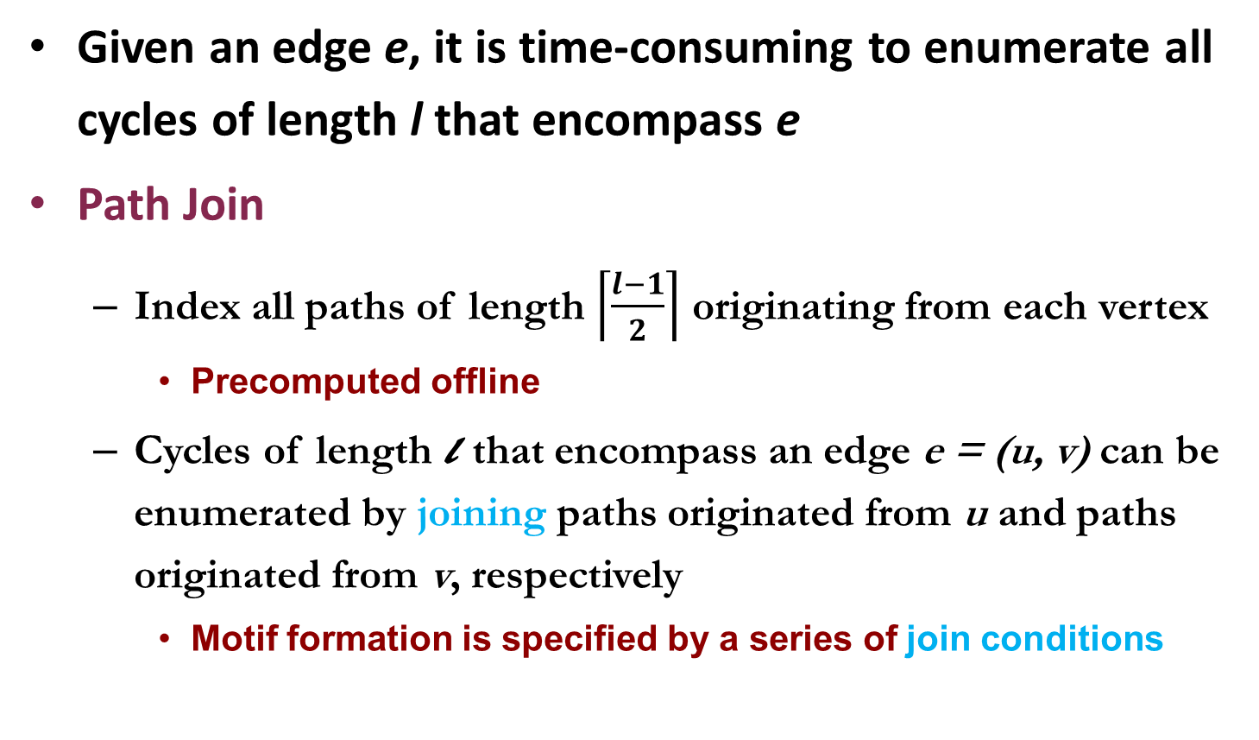
Cluster Significance: How to Compute
Given an edge e, it is time-consuming to enumerate all cycles of length l that encompass e
Path Join
  Index all paths of length $\left\lceil \frac{l−1}{2}\right\rceil$ originating from each vertex
    Precomputed offline
  Cycles of length l that encompass an edge e = (u, v) can be enumerated by joining paths originated from u and paths originated from v, respectively
    Motif formation is specified by a series of join conditions

Slide 14
Cluster Significance: How to Compute
Three cycles of length 4 encompassing (u, v)
Seven cycles of length 5 encompassing (u, v)

Slide 15
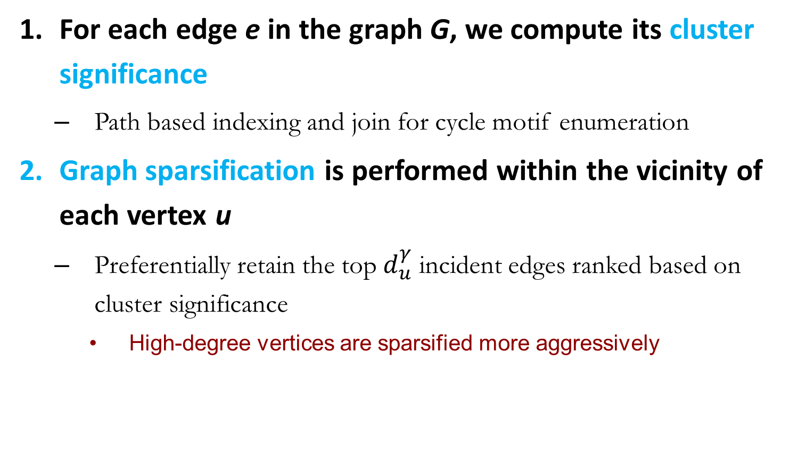
gSparsify: The Algorithm
For each edge e in the graph G, we compute its cluster significance
  Path based indexing and join for cycle motif enumeration
Graph sparsification is performed within the vicinity of each vertex u
  Preferentially retain the top $d_{u}^{γ}$ incident edges ranked based on cluster significance
    High-degree vertices are sparsified more aggressively
Notes:
d_u is the degree of the vertex u

Slide 16

Experiments
Datasets
  Yeast PPI network, DBLP, Orkut
Graph Clustering Methods
  METIS, Graclus, MCL
Evaluation Metric
  Sparsification ratio
  Clustering quality (F-score, graph conductance)
  Speedup for graph clustering
In comparison with L-Spar
  Satuluri etc. in SIGMOD’11 (triangle motif with MinHash)
Notes:
Sparsification ratio: the percentage of edges left AFTER graph sparsification
Cluster quality, empirically the higher the F-score, the better the clustering quality, the lower the graph conductance, the better the clustering quality

Slide 17
Experimental Results
Notes:
Sparsification ratio: For each graph dataset, we proactively sparsify the original graphs, the resultant sparsified graphs contain roughly 1/5 to ¼ of overall edges
Speedup: clustering on sparsified graphs can bring from 2x upto 37x speedup, compared with applying the same graph clustering algorithms on the original graphs
Clustering quality: the clustering on sparsified graphs can bring equal-quality, or even a little bit enhanced quality, graph clusters, compared with the clusters derived from the original graphs.
The F-score for Yeast dataset is N.A. because there is no groundtruth information for clusters.

Slide 18
Experimental Results
Notes:
The x-axis is the cycle length threshold l_0.
If more cycle motifs are considered, the cluster significance of edges can be quantified based on multiple cycle motifs. Therefore, intra-cluster edges are more easily to be figured out from with graphs.
F-scores get higher proportionally, indicating better clustering quality.
Graph conduction drops proportionally, indicating better clustering quality.

Slide 19
Conclusions
Graph sparsification
  Identify and preferentially retain cluster significant edges from a graph G into a sparsified graph G’
Graph motif based cluster significance
  Short-length cycles to quantify structure significance
  Path based indexing and join to facilitate the computation
Future directions
  More efficient graph motif enumeration methods
  More complicated graph motifs
  Sparsification for other graph computational tasks

Slide 20

Thank you!
Q & A

