Slide 1
Study Guide for Final Exam
Processor: single-cycle and pipelining

Slide 2
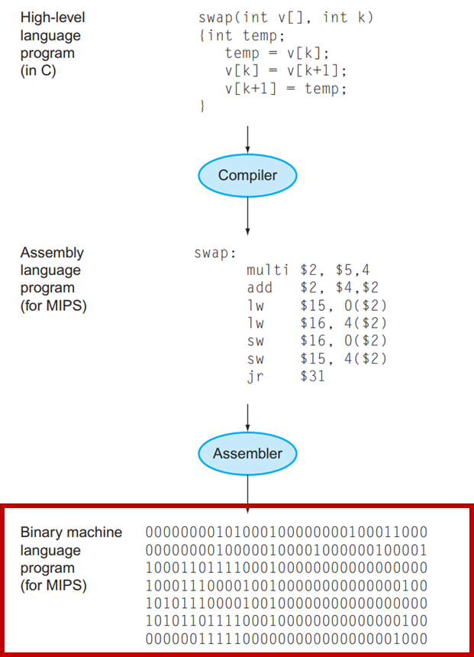
What are Single-Cycle and Pipeline?
In general:
1. High-level language is compiled into assembly language.
2, Assembly language is encoded into binary machine language
3, Single-Cycle and Pipeline are two different versions of the processor to implement above instructions.
Each binary machine language is stored in the instruction memory.
The reference to each binary machine language is stored in the program counter.

Slide 3
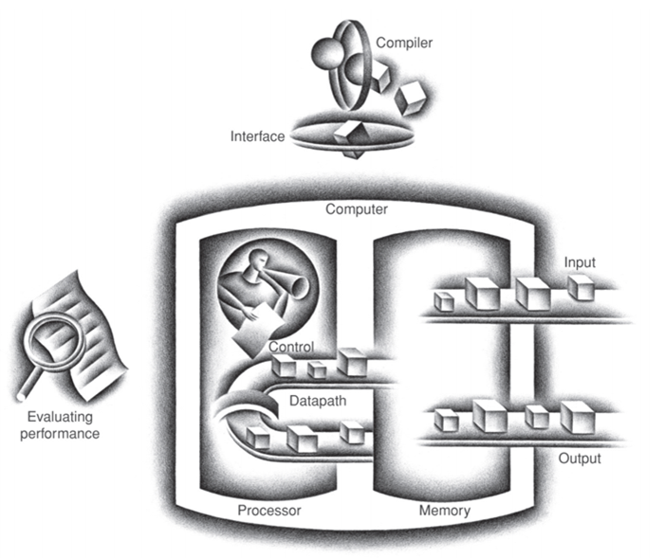
PROCESSORS
Single-Cycle and Pipeline are two different versions of the processor to implement the instructions set like MIPS.
Single-Cycle: a simple version
Each instruction is implemented in one clock cycle
Pipeline: a realistic version
Multiple instructions in different stages are implemented in one clock cycle.
Two processor components: datapath and control
Single-Cycle: what are the datapath and control? (required)
Pipeline: what are the datapath and control? (required)
Clock cycle: the clock cycle time is the amount of time for one clock period to elapse

Slide 4
Single-Cycle Datapath and Control
A subset of the MIPS instruction set to learn the principles and techniques
R-format instruction: add, sub, and, or, slt
lw, sw,
beq
j
Required: know how to implement above and other MIPS instructions.
Datapath
Control

Slide 5
Single-Cycle Datapath and Control
Datapath consists of the functional units of the processor
Elements that hold data
1, Program counter
Store address of current instruction
Update at the end of every clock cycle
Used for all instructions
2, Instruction memory
Store instructions (binary): supply instructions given an address
Used for all instructions
3, Register file
Store the processor’s 32 general-purpose registers
Used for R-format instructions, lw, sw, beq
Support read (R-format, lw, sw, beq) and write (R-format, lw)operations
4, Data memory
Contain data used for the program
Used for lw, sw
Support read (lw) and write (sw) operations

Slide 6
Single-Cycle Datapath and Control
Datapath consists of the functional units of the processor
Elements that operate on data
5, ALU (Specific operation depends on the ALU control signal)
R-format: operate on data in registers to get result
lw, sw: operate on data in rs register and immediate value to get
the address of data in memory
beq: compare data values in rs and rt registers to decide whether
to jump to the branch target address
6, Sign-extend: sign-extend the 16-bit offset field to a 32-bit value
Lw and sw: get the offset to calculate the address of the data
in memory
beq: to compute the branch target address relative to the branch
instruction address.
7 and 10, adder and shift left 2:
beq: to compute the actual branch target address
8, adder: increment the PC to hold the address of the next instruction.
The target addresses in beq and j are based on the result of the adder (PC + 4);
All instructions.
9, Shift left 2: only used for j instruction.

Slide 7
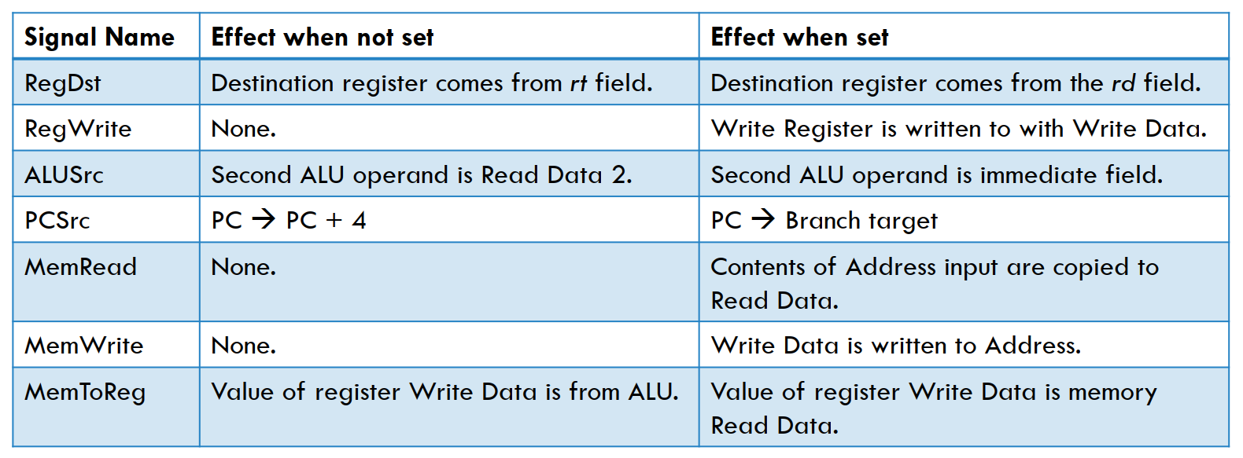
Single-Cycle Datapath and Control
Control commands the datapath regarding when and how to route and operate on data
11, Control Unit
Input: opcode of each instruction
Output: appropriate signals:
Operation to be performed by ALU: ALUOp
Whether register file needs to be written: RegWrite
Signals for multiple intermediate multiplexors: RegDst, ALUSrc, Branch, MemReg
Whether data memory needs to be written or read: MemRead, MemWrite

Slide 8
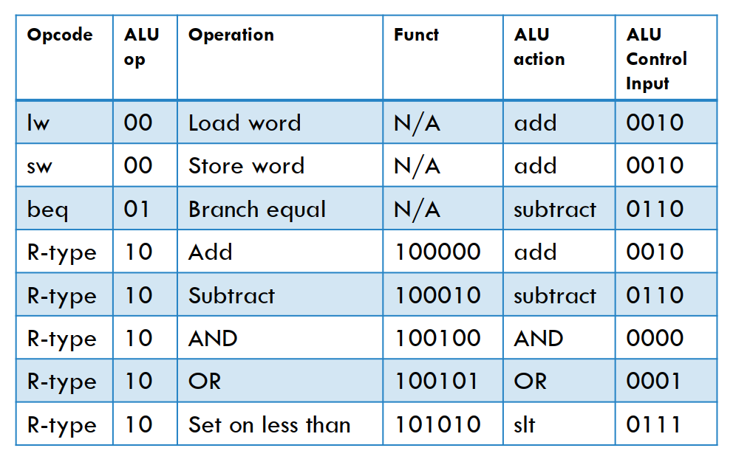
Single-Cycle Datapath and Control
Control commands the datapath regarding when and how to route and operate on data
12, ALU Control Unit
The 2-bit ALUop input indicates whether an operation should be add (00) for lw and sw, subtract (01) for beq, or determined by the funct input (10).
The 6-bit Funct input corresponds to the funct field of R-format instructions.
The output ALU Control Input is the input to ALU to control ALU

Slide 9
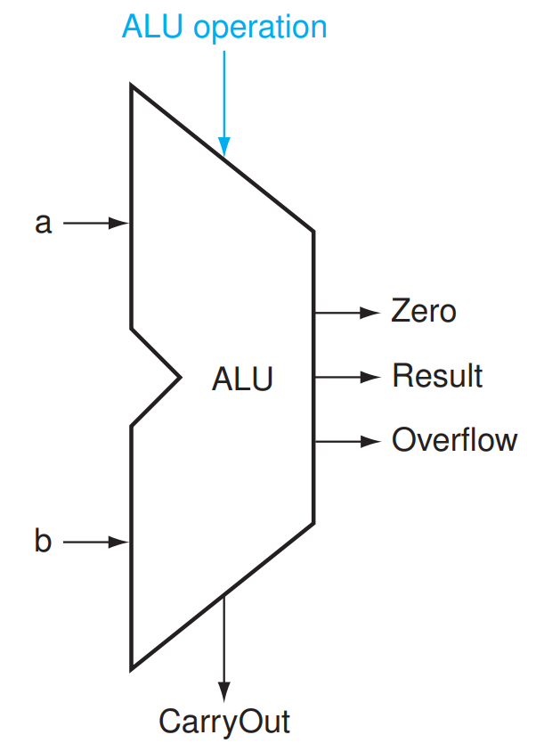
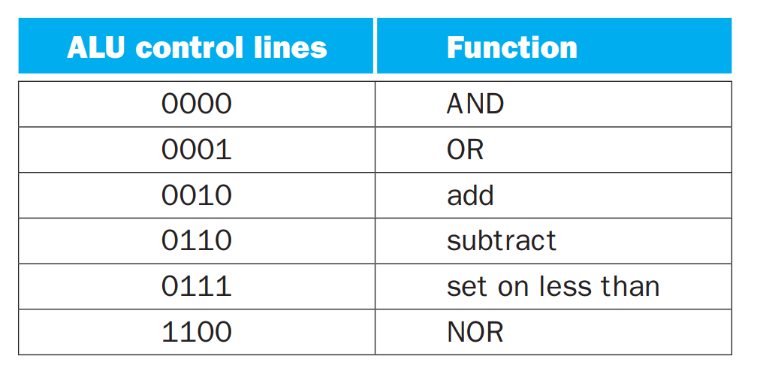
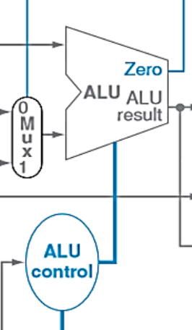
For your understanding – ALU
ALU: we learned its implementation in Logic Design
ALU Operation
lw, sw: add offset to data value in register to get the address.
ALU Control Input: 0010
beq: subtract data in two registers for equality comparison
ALU Control Input: 0110

Slide 10
General steps taken to execute a program.
Instruction fetching: use the address in the PC to fetch the current instruction from instruction memory.
All instructions
Instruction decoding: determine the fields within the instruction
All instructions
Instruction execution: perform the operation indicated by the instruction.
R-format instructions
lw, sw
beq
j
Update the PC to hold the address of the next instruction.
All instructions

Slide 11
R-format Instruction
All R-format instructions read two registers, rs and rt, and write to a register rd
Steps:
1. Grab instruction address from PC
2. Fetch instructions from instruction memory
3. Decode instructions
4. Pass rs, rt, rd into read register and write register arguments
rs: Instruction [25 - 21] -> Read register 1
rt: Instruction [20 - 16] -> Read register 2
rd: Instruction [15 - 11] -> Write register (RegDst = 1)
5. Retrieve data from Read data 1 (rs) and Read data 2 (rt)
6. Pass data in rs and rt into the ALU as operands of the operation to be performed. (ALUop = 10, funct(instruction [5-0] decides operation type: add, sub, and, or, slt ))
7. Retrieve result of operation performed by ALU and pass back as the write data argument of the register file (RegWrite = 1).
8. Add 4 bytes to the PC value to obtain the word-aligned address of the next instruction.
Other control signals:
Pass data from Read data 2 to ALU: ALUSrc = 0
No memory participation: MemtoReg = 0, MemRead = 0, MemWrite = 0.
Not branch instruction: Branch = 0
Datapath shown in yellow. Relevant control line assertions in green.

Slide 12
lw Instruction lw $rt, immed ($rs)
lw loads data with address sign-extend (immed) + value in $rs in Data memory to $rt
Steps:
1. Grab instruction address from PC
2. Fetch instructions from instruction memory
3. Decode instructions
4. Pass rs, rt into read register and write register arguments
rs: Instruction [25 - 21] -> Read register 1
rt: Instruction [20 - 16] -> Write register (RegDst = 0)
Pass immed into Sign-extend to sign-extend the 16-bit immediate to 32-bits
5. Retrieve data from Read data 1 (rs) and data from Sign-extend (ALUSrc = 1).
Pass them to ALU.
6. Add data in rs and sign-extend immed in ALU (ALUop = 00)
7. Retrieve result by ALU, which is the address of data, and pass it to Address in Data memory
8, Retrieve associated data from Read data in Data memory and write it into $rt.
(MemRead = 1, MemWrite = 0, MemtoReg = 1, RegWrite = 1)
9. Add 4 bytes to the PC value to obtain the word-aligned address of the next instruction.
Other control signals:
Not branch instruction: Branch = 0
Datapath shown in yellow. Relevant control line assertions in green.

Slide 13
sw instruction sw $rt, immed ($rs)
sw writes data in $rt to Data memory with address sign-extend (immed) + value in $rs
Steps:
1. Grab instruction address from PC
2. Fetch instructions from instruction memory
3. Decode instructions
4. Pass rs, rt into read register and write register arguments
rs: Instruction [25 - 21] -> Read register 1
rt: Instruction [20 - 16] -> Read register 2
Pass immed into Sign-extend to sign-extend the 16-bit immediate to 32-bits
5. Retrieve data from Read data 1 (rs) and data from Sign-extend (ALUSrc = 1).
Pass them to ALU.
6. Add data in rs and sign-extend immed in ALU (ALUop = 00)
7. Retrieve result by ALU, which is the address of data, and pass it to Address in Data memory.
Retrieve data from Read data 2 (rt) and pass it to Write data in Data memory.
8. Write data of Write data into the address indicated by Address in Data memory. (MemRead = 0, MemWrite = 1)
9. Add 4 bytes to the PC value to obtain the word-aligned address of the next instruction.
Other control signals:
Do not write data into register: RegWrite = 0, RegDst = X, MemtoReg = X
Not branch instruction: Branch = 0
Datapath shown in yellow. Relevant control line assertions in green.

Slide 14
Beq instruction beq $rs, $rs, target
beq compares the contents of $rs and $rt for equality and uses the 16-bitimmediate field to compute the target address of the branch relative to the current address
Steps:
1. Grab instruction address from PC
2. Fetch instructions from instruction memory
3. Decode instructions
4. Pass rs, rt into read register and write register arguments
rs: Instruction [25 - 21] -> Read register 1, rt: Instruction [20 - 16] -> Read register 2
Pass immed into Sign-extend to sign-extend the 16-bit immediate to 32-bits
5. A. compute the target address:
Note: immed field represents the number of words offset from PC+4
Sign-extended value is left-shifted by two, which is then added to PC+4
5. B. compare the data values in rs and rt.
(1) Retrieve data from Read data 1 (rs) and Read data 2 (rt)
(2) Pass data in rs and rt into the ALU for comparison (ALUSrc = 0, ALUop = 01)
(3) This output for ALU is specifically hardwired to be set when data values are equal
6. Update the word-aligned address of the next instruction for PC:
PC + 4 + left-shifted value if equal, PC + 4 if not equal
Control signals:
Branch instruction: Branch = 1
Do not write data into register: RegWrite = 0, RegDst = X, MemtoReg = X
Not use data memory: MemRead = 0, MemWrite = 0
Datapath shown in yellow. Relevant control line assertions in green.

Slide 15
J-format instructions j targaddr
The next instruction to be executed is at the address of label targaddr
Steps:
1. Grab instruction address from PC
2. Fetch instructions from instruction memory
3. Decode instructions
4. Update the word-aligned address of the next instruction for PC
Take the 26-bit target address field of the j instruction
Left-shift by two (instructions are word-aligned)
Concatenate the result with the upper 4 bits of PC+4
[31-28] Upper 4 bits of PC + 4 | [27-2] 26-bit target_addr [25-0] | [1-0] 00
word-aligned address of the next instruction
Datapath shown in yellow. Relevant control line assertions in green.

Slide 16
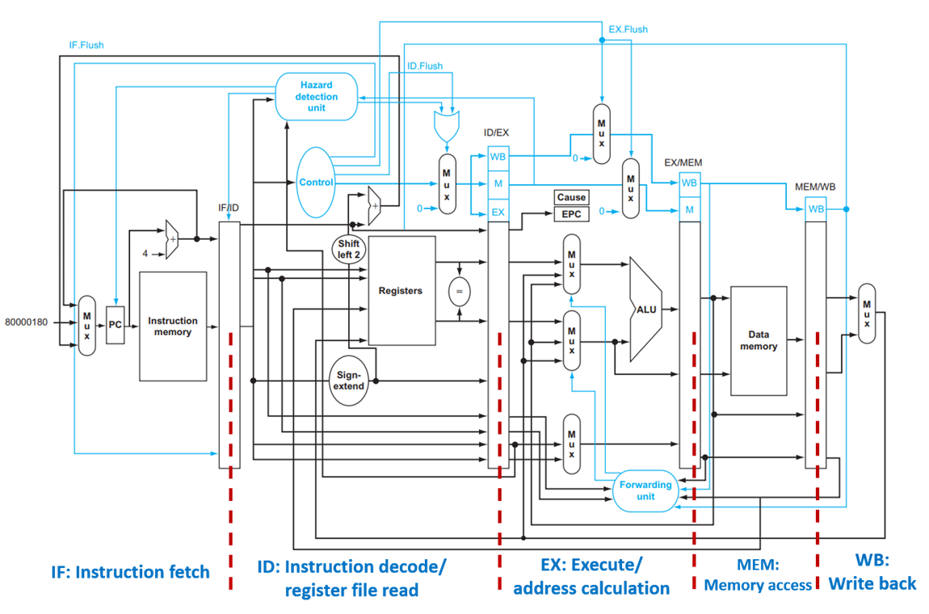
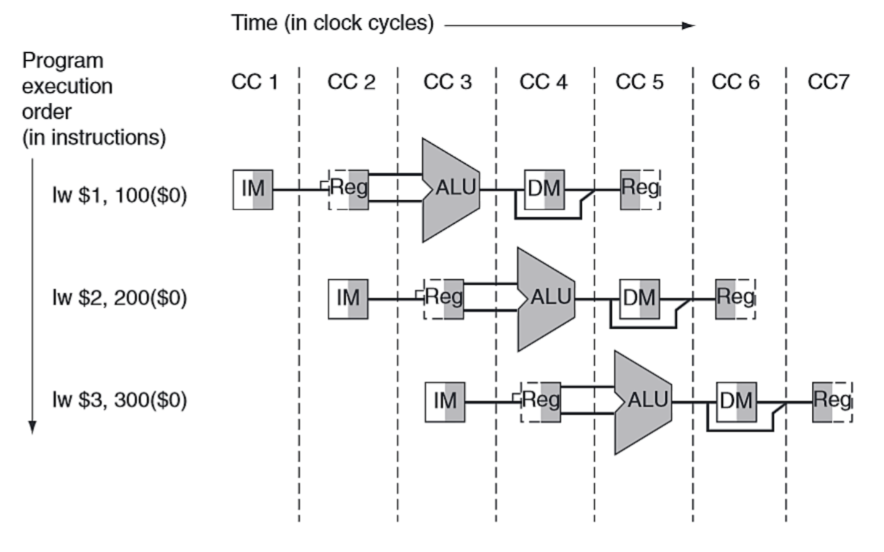
Pipelining
Execute an instruction over multiple cycles
Execute multiple instructions per cycle (overlap) as long as they are at different stages
Increase the throughput, but not the instruction latency
The speedup is ideally the same as the number of stages in the pipeline, as long as the number of instructions is much larger than the number of stages.
Pipelining Stages: IF, ID, EX, MEM, WB
Pipeline register: store data across cycles.
Dependencies: relationships between instructions that prevent one instruction from being moved past another
Hazards: situation where next instruction cannot execute in the following cycle.
Three types: structural, data, and control.
Forwarding: forward the needed data as soon as possible to the instruction which depends on it
Ls, R format;
R format; R format
Stalls: technique of stalling an instruction until a pipeline hazard no longer exists.
Bubble: the nickname of pipeline stall
Flushing: zeroing the instruction pipeline when there is a stall

Slide 17
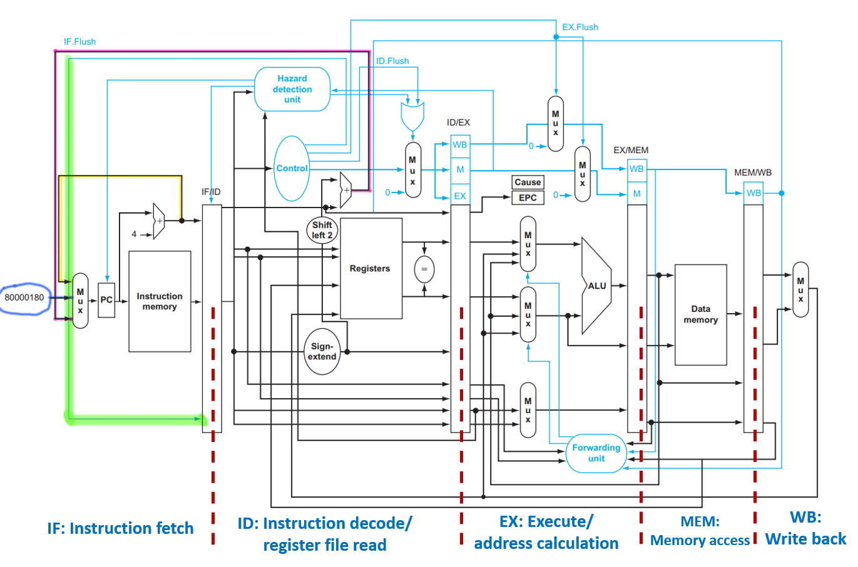
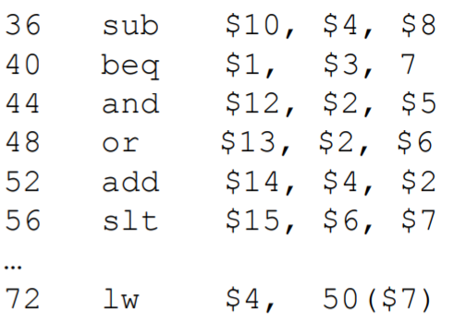
IF Stage
Datapath:
Instruction is read from memory using the contents of PC and placed in the IF/ID;
The PC address is incremented by 4 and written back to the PC register (yellow line), as well as placed in the IF/ID register in case the instruction needs it later.
Control signal: None
Handle control hazard: if the branch is taken
Purple line: branch target address is written to PC;
Green line: create a stall - zero out the content in IF/ID.
For example:
CC3: IF: and.
ID: beq, beq is taken. 72 is written to PC. IF.Flush zeros out and in IF/ID.
CC4: IF: lw.
ID: bubble (and is zeroed out)
EX: beq
Handel exception: exception is detected
Blue line: the address of the exception handler routine for the instruction is written to PC. (Details will be shown in EX stage)
800000180 is the address when it is the overflow exception

Slide 18
ID Stage
and $4, $2, $5
lw $2, 20($1)
Datapath:
The registers $rs and $rt are read from the register file and stored in the ID/EX.
The 16-bit immediate field is sign-extended to 32-bits and stored in the ID/EX.
The register $rd is passed to ID/EX (R-format)
The PC+4 value is copied from the IF/ID register into the ID/EX register in case the instruction needs it later.
IF/IDWrite
ID/EX.MemRead
PCWrite
Control signals: generated given opcode and passed to ID/EX.
RegDst, ALUop, ALUSrc (EX)
Branch MemRead MemWrite (MEM)
RegWrite, MemToReg (WB)
Handle data hazard brought by lw:
In the event that we have a lw immediately followed by an
instruction that reads its result, we must perform a stall.
ID/EX.RegisterRt
How to detect such hazard: add Hazard detection unit with the following condition
What happens when stalling the pipeline:
(1) Pink line: have the control unit output all nine control lines as 0’s, as if inserting an instruction that does nothing. ()
(2) PCWrite and IF/IDWrite: keep PC and IF/ID registers unchanged
Handle control hazard (brown box):
Calculate the branch target address; (2) Compare data values in two registers
(3) If the branch is taken, the address 72 is written to the PC (discussed in IF Stage)

Slide 19
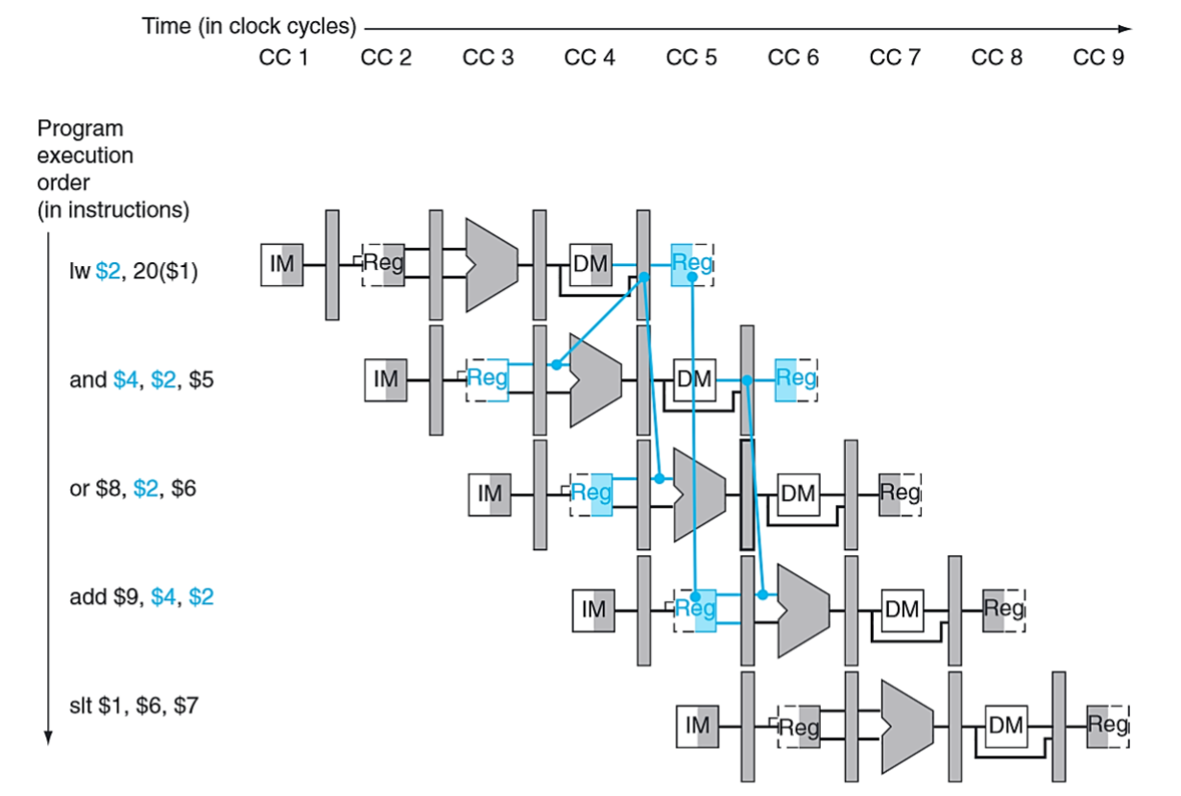
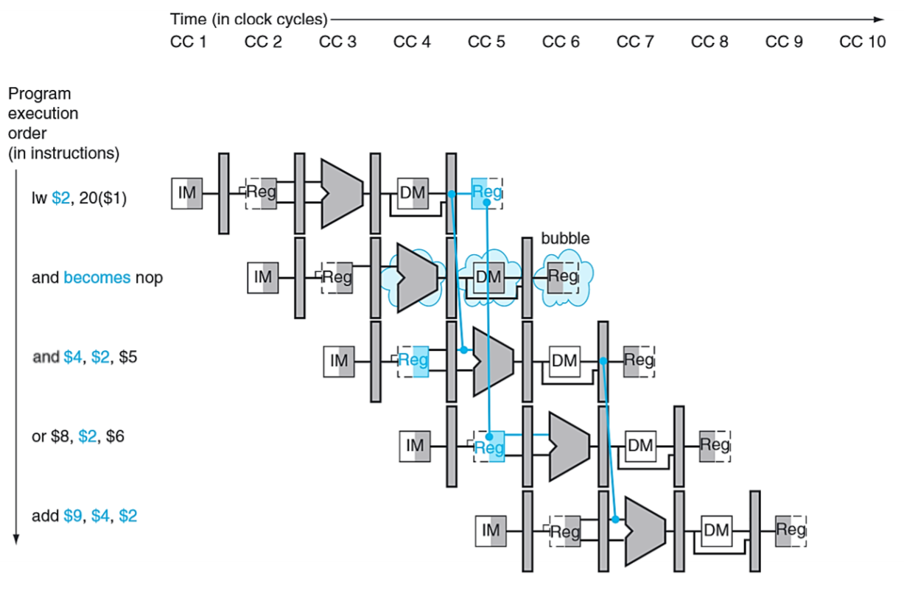
Data hazard brought by lw
Without handling data hazard
Even with forwarding, the dependency from a load word instruction goes backward in CC4.
It is impossible!!!
Key point: the data from data memory is written into $2 after MEM
Handling data hazard: adding a hazard detection unit in the ID stage
CC3:
ID/EX.MemRead = 1: lw is in EX stage, the instruction next to lw is in ID stage; ID/EX.RegisterRt: $rt in lw
IF/ID. RegisterRs: $rs in the instruction next to lw; IF/ID. RegisterRt: $rt in the instruction next to lw
Stall the pipeline：
（1）Insert an instruction which does nothing：
have the control unit output all nine control lines as 0’s.
（2）Keep PC and IF/ID registers to remain unchanged
Bubbles are inserted.
and instruction reads data from the $2 and pass it to ALU in CC5.

Slide 20
EX Stage
Datapath:
Calculates addresses for accessing memory. The result is placed in EX/MEM (lw, sw)
Perform arithmetic/logical operations on either two register values or a register and an immediate (R-format). The result is placed in EX/MEM
The contents of the $rt register are copied from the ID/EX to the EX/MEM. (sw)
The write register number is passed into EX/MEM. ($rd for R-format, $rt for lw)
EX/MEM.RegWrite, EX/MEM.WriteReg
MEM/WB.RegWrite, MEM/WB.WriteReg
Forwardb
ForwardA
Control signals: passed to EX/MEM
Branch MemRead MemWrite (MEM)
RegWrite, MemToReg (WB) are passed to EX/MEM
EX/MEM.WriteReg
ID/EX.RegisterRs
MEM/WB.WriteReg
ID/EX.RegisterRt
Handle data hazard brough by R-format: add forwarding unit
In the event that we have a R-format immediately followed by an instruction that reads its result, we must perform forwarding.
Handle exception : any unexpected change in control flow, e.g. overflow
(Please visit P15-18 in Pipeline 6 - Branch and Exception (update))
When an exception is detected:
EPC (Exception Program Counter): store the address of the exception-causing instruction
Cause: record the cause of the exception
Flush the instructions from the pipeline by asserting IF. Flush, ID. Flush, EX.Flush – this includes the instruction causing the exception and any subsequent instructions
Begin fetching instructions at the address of the exception handler routine to PC (IF)

Slide 21
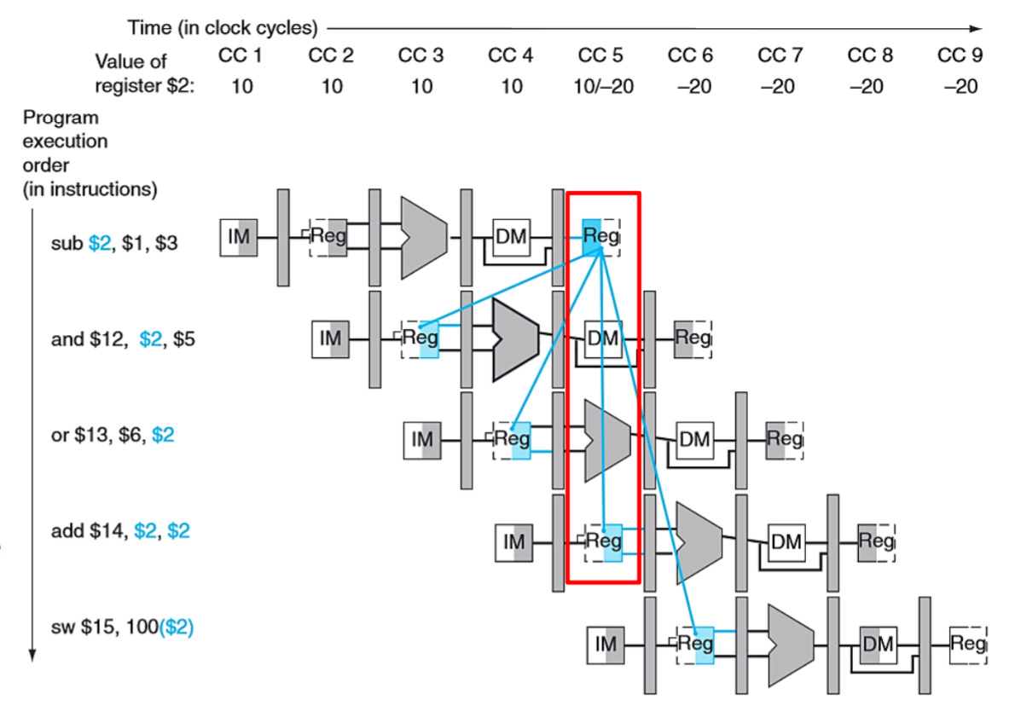
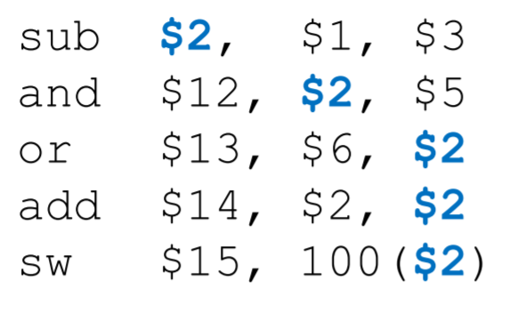
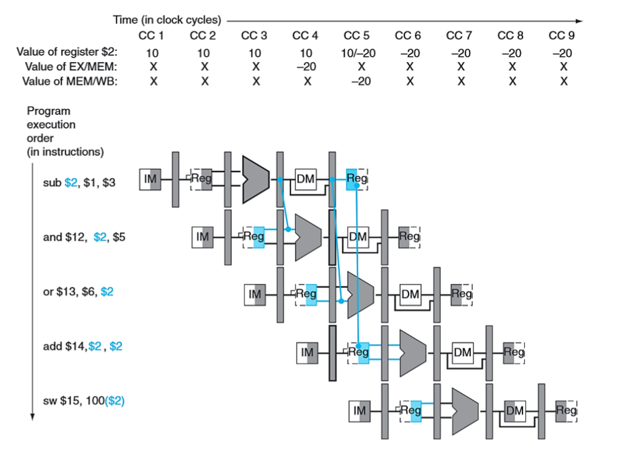
Data hazard brought by R-format
add is not affected (red box):
sub is writing the value of $2 to the register file in the same cycle that add is reading the value of $2.
We assume that the write operation takes place in the first half of the clock cycle, while the read operation takes place in the second half. Therefore, the updated $2 value is available. Add is not affected.
Key point: The last four instructions, which read from $2, are all dependent on the first instruction, which writes a value to $2.
The only data hazards occur for instructions 2 and 3 (Dependency lines go back in time)
Sub writes $2 in CC5
and reads $2 in CC3
or reads $2 in CC4
Solution: forwarding
sub calculates new values in CC3, which is to be written to $2 in CC5
If we simply forward the data as soon as it is calculated, then we will have it in time for the subsequent instructions to execute.
The new value calculated in CC3 is passed into EX/MEM.
In CC4, EX/MEM passes it to input of ALU for and. Meanwhile, EX/MEM passes it to MEM/WB.
In CC5, MEM/WB passes it to input of ALU for or
Question: how to detect this data forward and how to decide the input of ALU (Register file, prior ALU result, prior prior ALU result)
In cycle 4, when and is in its EX stage and sub is in its MEM stage, ID/EX.RegisterRs will be $2. In this same cycle, EX/MEM.WriteReg will be $2. The fact that they refer to the same register means we have a potential data hazard.

Slide 22
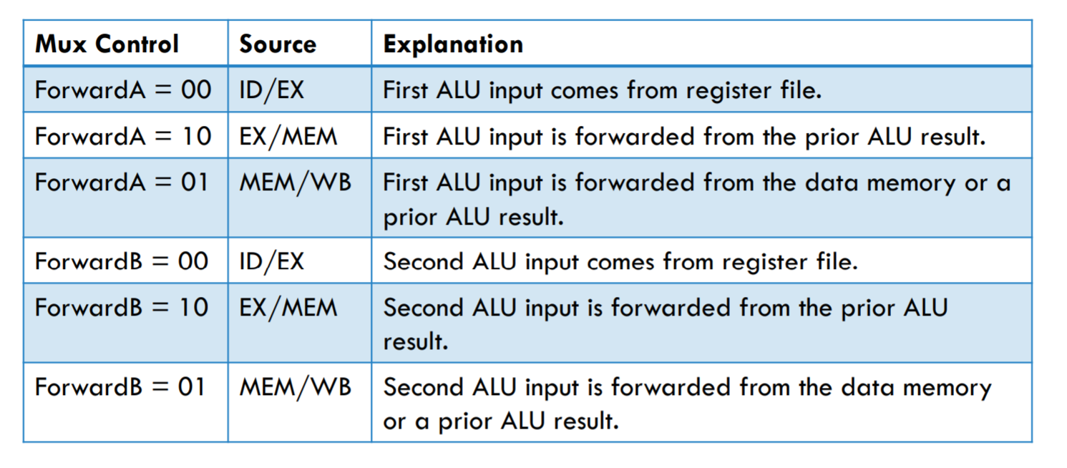
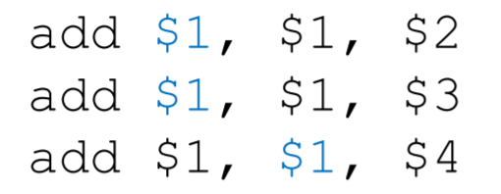
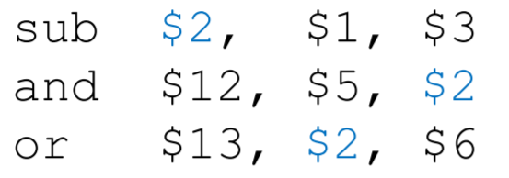
Data hazard (R-format)– detection and forwarding
EX/MEM.RegWrite, EX/MEM.WriteReg
MEM/WB.RegWrite, MEM/WB.WriteReg
The second data hazard is both a 1a and 2a data hazard.
Forwardb
ForwardA
The current instruction is in EX. We check whether data hazard happens.
EX/MEM.WriteReg
Type 1:
CC4
and: EX
sub: MEM
ID/EX.RegisterRs
MEM/WB.WriteReg
ID/EX.RegisterRt
Detection condition
We want to forward the value from the second instruction, not the first! This is the only way to simulate synchronous execution. Generally, we should never resolve as if
it’s a type 2 hazard if there is also a type 1 hazard for that source register.
That is the reason why we have blue conditions in Type 2 hazard
Type 2:
CC5
or: EX
sub: WB
Detection condition

Slide 23
MEM and EX Stage
MEM Stage
Datapath:
Take the address stored in the EX/MEM and use it to access data memory. (lw, sw)
Take the contents of $rt from the EX/MEM pipeline and write it to data memory at the address specified. (sw)
The data read from memory is stored in the MEM/WB. (lw)
Pass data calculated in ALU from EX/MEM to MEM/WB. (R-format)
The write register number is passed into MEM/WB. (lw, R-format)
Control signals:
RegWrite, MemToReg (WB) are passed to MEM/WB
EX Stage
Datapath:
Read the data from the MEM/WB and write it back to the register file.

Slide 24
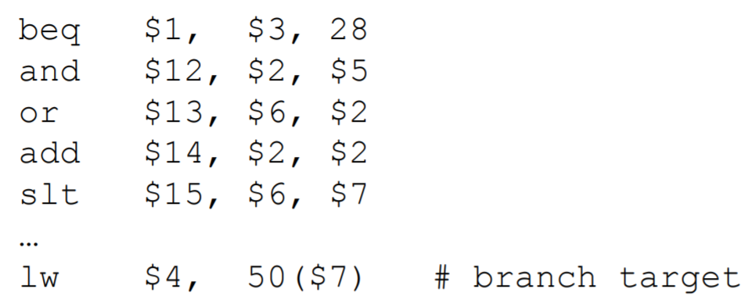
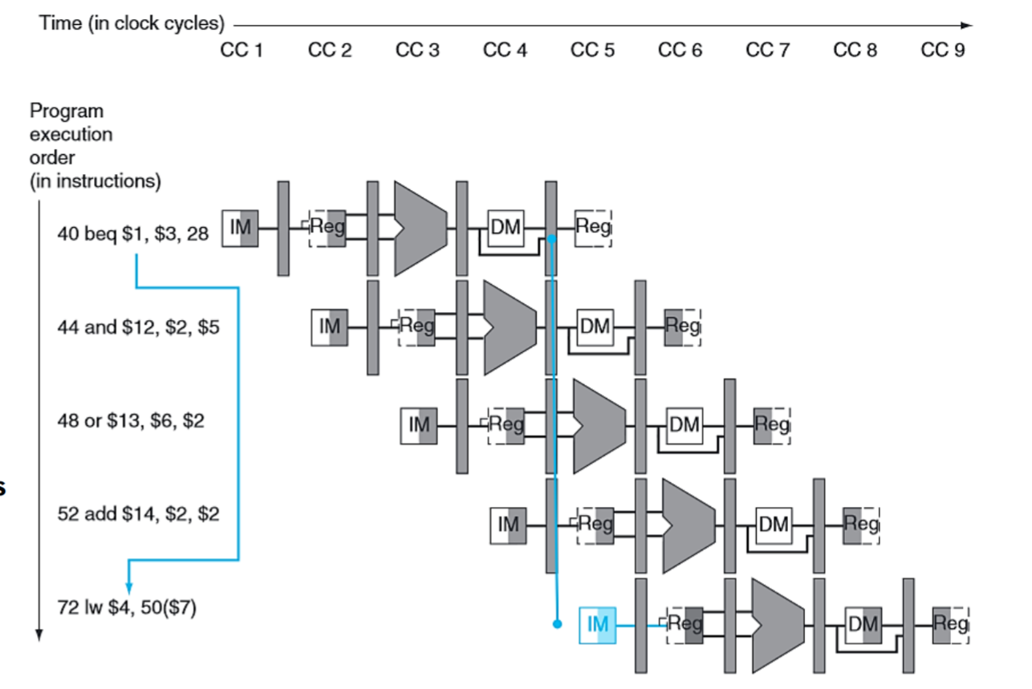
Control Hazard brought by beq
The branch target is not written back to the PC until the 4th cycle.
By this point, the subsequent three instructions have already started executing. If branch is taken, control hazard happens.
Solution:
Assuming branch not taken.
Easy to implement.
High cost – three stalls if wrong.
Performing branching in the ID stage.
Reduce the potential delay of a branch instruction
Harder to implement – must add forwarding and hazard control earlier.
Lower cost – one stall if branch is taken.
Dynamic Branch prediction:
Assuming branch not taken – the simplest approach
the correct instructions will already be executing anyway
If we’re proven wrong in the 4th stage of the branch instruction, then the other three instructions need to be flushed from the datapath. This is done by setting their control lines to 0 when the reach the EX stage. The next significant instruction will be the branch target .

Slide 25
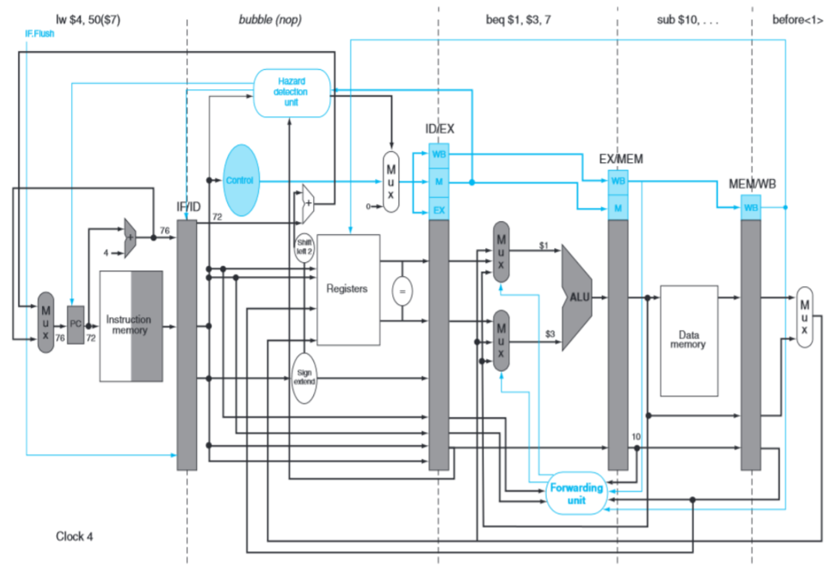
Performing branching in the ID stage.
CC3:
CC4:
beq is in its ID stage
We calculate the branch target as well as the branch decision. At the end of this cycle, if the branch is taken, the address 72 is written to the PC to be fetched in CC4.
Add a new control to the IF/ID register which is responsible for zeroing out its contents – creating a stall.
beq is in its EX stage
A bubble appears in ID stage
The branch target instruction is fetched in IF stage

Slide 26
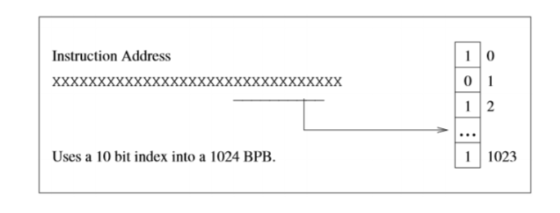
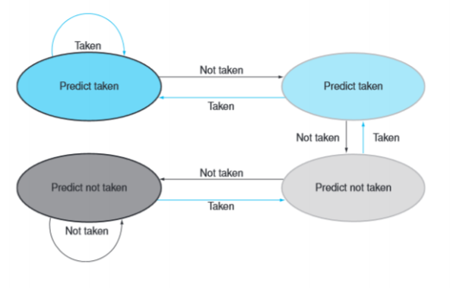
Dynamic Branch Prediction
we look up the address of the instruction to see if the branch was taken last time. If so, we will predict that the branch will be taken again and optimistically fetch the instructions from the branch target rather than the subsequent instructions.
3 types of buffers to see if the branch was taken last time:
1-bit branch prediction buffer (BPB)
2-bit branch prediction buffer state
branch target buffer (BTB)
A small memory
Index: lower portion of the branch instruction address
Element: 1 bit indicating whether the branch prediction was taken last time.
We make our prediction based on the bit found in the buffer.
If the prediction turns out to be incorrect, then we flip the bit in the buffer and correct the pipeline
Disadvantage: low prediction accuracy
A small memory
Index: lower portion of the branch instruction address
Element: 2 bits indicating strongly or weakly (box) prediction taken or not taken last time
We make our prediction based on the bit found in the buffer.
A branch that is strongly favors taken or not taken will be mismatched only once.
We can access the buffer during the IF stage to determine whether the next instruction needs to be calculated or we can continue with sequential execution.
A small memory
Index: lower portion of the branch instruction address
Element:
Tag: higher portion of the branch instruction address
Target: the target address of the branch.
If the BPB predicts the branch is taken, and the higher order bits of the instruction match the BTB tag, then we write the target to PC.

