Slide 1
Study Guide for Final Exam
Memhier

Slide 2
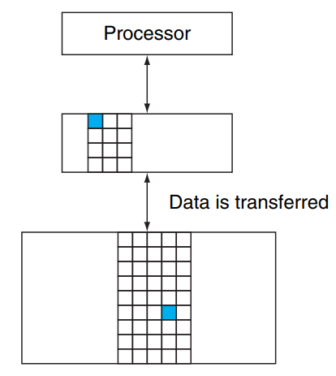
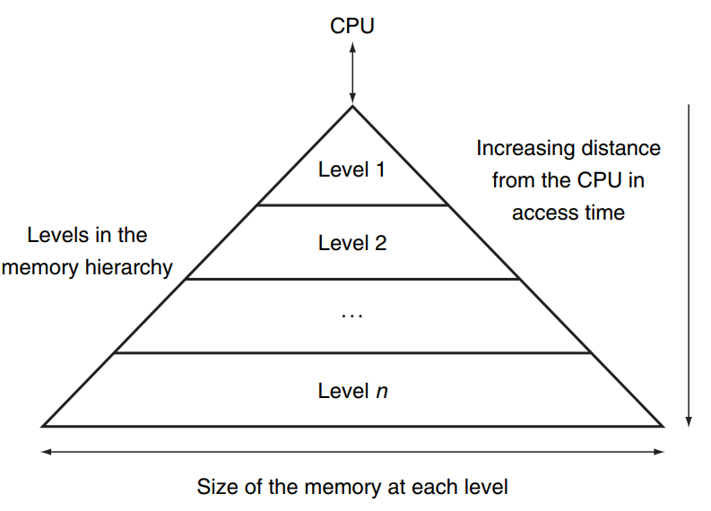
Memory Hierarchy
During executing instructions, both instructions and data are read from or written to the memory. This chapter talks about the memory implementation. The illusion is we can access the large memory as fast as a very small memory
Memory Hierarchy structure
Caches: caches and main memory
Big story: when the processor would like to access data (either read from or write to) in the memory, it first requests data from the cache. If the data is not in the cache, the data will be fetched from the main memory. During this process, we have two questions:
How do we know if a data item is in the cache -- tag
If it is, how do we find it -- index
Answers:
Direct-mapped cache, Set-associative cache, full-associative cache
Every pair of levels in the memory hierarchy can be thought of as having an
upper and lower level.
All data in a level is typically also found
in the next largest level.
Level 1: Cache (SRAM)
Level 2: main memory (DRAM or flash memory)
Level 3: magnetic disk
Block: unit of information that can be either present or not in a cache. e.g. machine language of the instruction, the data to be read in lw instruction.
Hit: data requested in a by the processor is found in a specified level of the hierarchy.
Concepts with hit: hit time, hit rate
Miss: data requested in a by the processor is not found in a specified level of the hierarchy.
Concepts with miss:miss time, miss rate, miss penalty
Virtual Memory: main memory and magnetic disk
Big story: each program is complied into its own address space. Virtual memory implements the translation of the program’s address space to physical addresses. If we cannot find the data with physical address in main memory, we will go the magnetic disk to fetch data.
Page table: address translation
Translation-lookside buffer (TLB): make address translation fast
Note: TLB is a cache, it can be direct-mapped, set-associative, and full associative. It obeys the basic rules for cache.
Take advantage of the principle of locality:
Temporal locality: if an item is referenced, it will tend to be referenced again soon
Spatial locality: if an item is referenced, items whose addresses are close by will tend to be referenced soon.

Slide 3
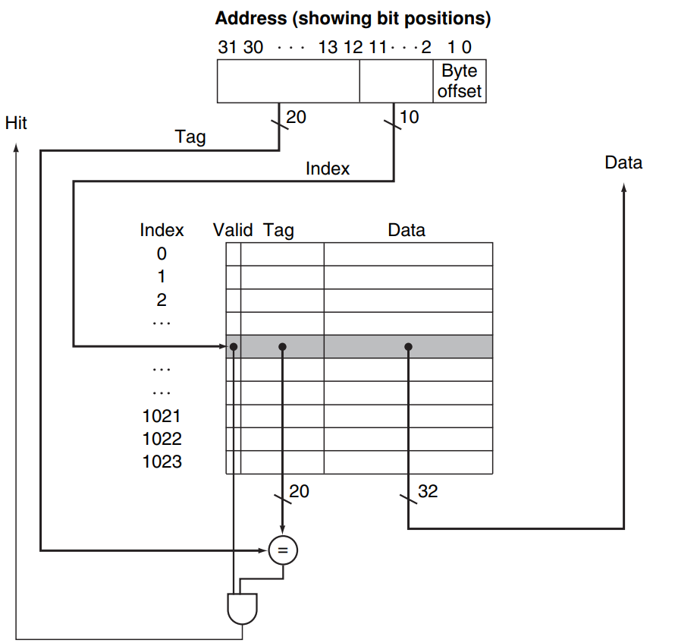
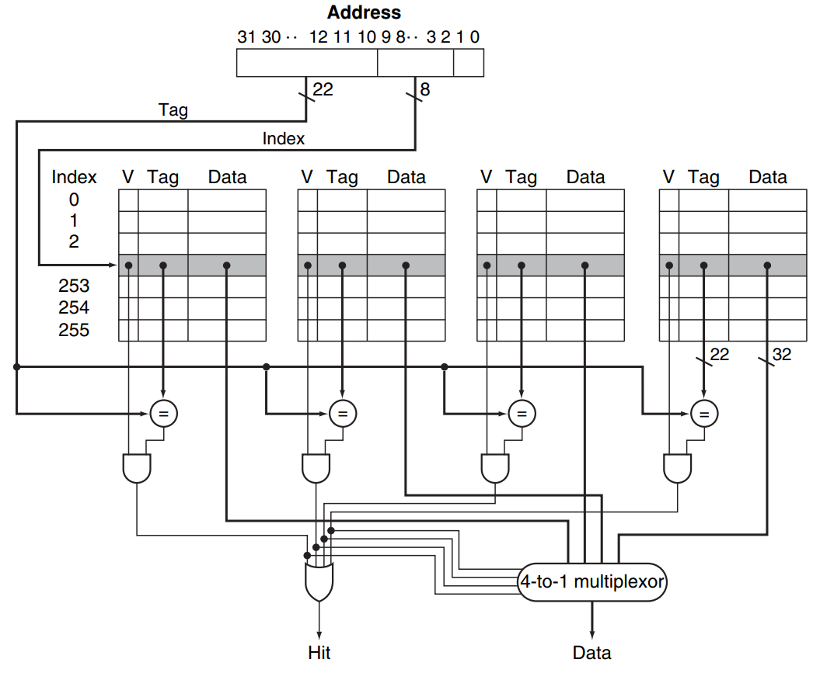
Caches
The processor knows the requested data’s address in main memory. Its length is assumed as 32bits.
An n-way set-associative cache
consists of a number of sets, each of which consists of n blocks
Direct-mapped cache: each blook in main memory is mapped directly to exactly one location in the cache.
Set-associative cache: a cache that has a fixed number of locations (sets) where each block can be placed.
How to read block in the cache given its address in main memory?
Step 1: Find the unique set in the cache given by the index. The bits for index depends on the total number of sets not blocks
Step 2: Compare Tag with the tag fields in all blocks (search)
Step 3: Fetch data from the equal tag
For the address:
Index: select cache entry.
Tag: identify whether selected cache entry corresponds to the requested data
Byte offset: indicate the first byte accessed within a block. It is given by log₂(num bytes in block)
For the cache:
Tag: upper bits of block address in main memory
Valid bit: identify whether selected cache entry contains a valid address
Data: the requested data by processor
How to write block to the cache given its address in main memory?
Step 1: Find the unique set in the cache given by the index.
Step 2: Obey written policy and written miss polity.
Note:
If a requested block indeed needs to be written into cache, it can be placed in any blocks in the given set.
If the requested block is to replace one block in the given set, we use LRU scheme: the block replaced is the one that has been unused for the longest time.
How to get total bits are required for a direct-mapped cache?
The bits in each cache entry * the number of cache entry
The bits in cache entry = 1 + Tag + data
Tag = 32 – Byte offset - index
How to write data to cache given an address?
Write-through: write data into both the cache and main memory
Write-back: only write the data to the cache block. The updated block is only written back to memory when it is replaced by another block. A dirty bit is used to indicate whether the block needs to be written or not.
What if the block to be written is not in the cache?
Write allocate: the block is loaded into the cache on a write miss.
No-write allocate: the block is not loaded into the cache on a write miss. Block simply updated in main memory.
How to read data from cache given its address in main memory?
Step 1: divide up address into Tag, Index, Byte offset (word offset);
Step 2: select cache entry based on index;
Step3: check Valid bit in the cache. If it is 0, we cannot read the data, a miss. Otherwise, go to Step 4.
Step 4: compare the Tag in address and Tag field in cache entry. If they are equal, the data is read by processor. Otherwise, the data in the cache entry is not the requested data, a miss. The processor fetches data from the main memory
Full-associative cache: a block can be placed in any location in the cache.
To find a given block in a fully associative cache, all the entries in the cache must be searched
Please understand two examples in the slides: WRITE-THROUGH, NO-WRITE ALLOCATE, and WRITE-BACK, WRITE ALLOCATE

Slide 4
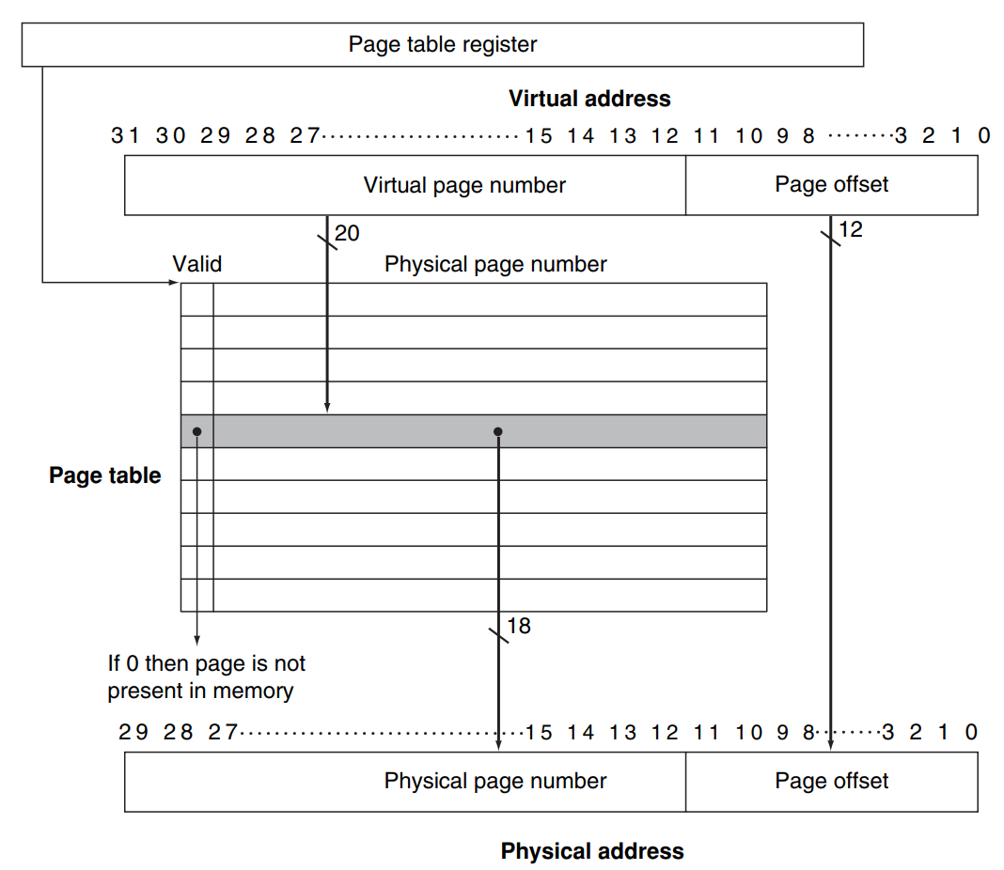
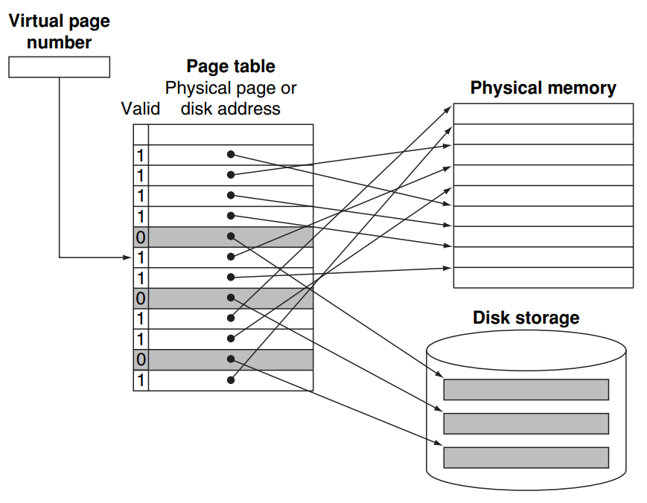
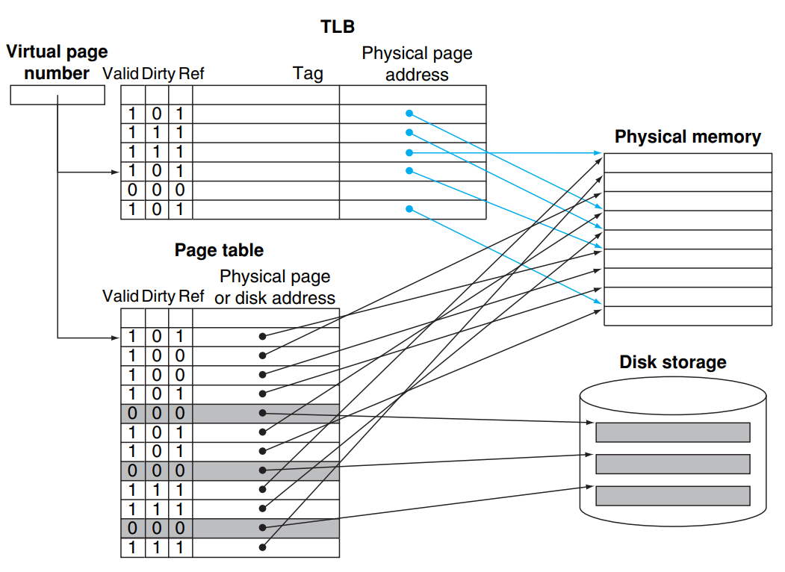
Virtual Memory
Virtual memory translates the program’s address space to physical addresses, which can used to access main memory
address translation
The TLB acts as a cache of the page table for the entries that map to physical pages only.
How to read requested page given virtual address
Step 1: divide up virtual address into virtual page number, page offset. # of page offset bits = log₂(page size); # of virtual page number bits = 32 - # of page offset bits.
Step 2: Look for physical page number given virtual page number in page table.
Step 3: Get the physical address: physical page number | page offset
Step 4: check valid bit. If 1, fetch page from main physical memory with physical address. If 0, fetch page from disk.
translation-lookaside buffer (TLB): a cache that keeps track of recently used address mappings to try to avoid an access to the page table.
Given a virtual page number (after removing page offset):
Index to TLB: its lower portion; # of bits = log₂(# of entries in TLB)
Tag in TLB: its higher portion; #of virtual page number bits - #of Index bits
Valid bit: if 1, we find the physical page number in TLB directly. If 0, the page table is examined.
Ref bit: if we find the physical page number in TLB, ref bit is set to 1 (not required)
Dirty bit: if the processor performs a write, dirty bit is set to 1 (not required)
Note: If there is no matching entry in the TLB for a page, the page table is examined. Otherwise, we find the physical page number in TLB directly.
Note: TLB is a cache, it can be direct-mapped, set-associative, and full associative. It obeys the basic rules for cache.
Page: a virtual memory block.
Page offset: number of bits determines the page size
Page table: contain the virtual to physical address translations. The index is the virtual page number. Each entry contains the physical page number.
Valid bit: if 1, the page is in the main memory. If 0, the page is not in the main memory and a page fault occurs.
Page table register: point to the start of the page table in main memory since page table resides there.
Write policy: write-back.
perform the individual writes into the page in memory, and copy the page back to disk when it is replaced in the memory
Page table is not cache. It contains a mapping for every possible virtual page

