Slide 1
Introduction to Parallel Computing

Slide 2
Parallel Computers and Parallel Computing
What is a parallel computer?
  A collection of processing elements that communicate and cooperate to solve problems.
  What is a processing element?
    A basic unit that can execute a computation task
    Depending on the context, it can be a whole computer, a CPU, a CPU core, a GPU core, or a functional unit.
  Three key elements in a parallel computer:
    More than one processing element – this allows multiple computations to be performed in parallel!
    The processing elements are connected, and can communicate with one another when needed
    The processing elements cooperate to solve problems.

Slide 3
Most Contemporary Computing Devices are Parallel Computers
  Mobile devices, IoT devices, many have multi-core CPUs
    IPhone 13, A15 – 6 CPU cores, 16 Neural Engine cores, 4 GPU cores
  Desktop or laptop, multi-core CPU
  A high-end gaming computer (CPU + GPU)
  Multi-core server
  Linprog cluster
  FSU Research Computing Center (RCC)
  Cloud Computing platforms (Amazon AWS, Google cloud).
  Frontier supercomputer at Oak Ridge National Laboratory (No. 1 in June 2024 , 1714.81 Peta flops per second peak performance)
In today’s world, almost any computing device is a parallel computing device!
Uniprocessor systems
Multi-processor systems

Slide 4
Question
Can the programs that you wrote take advantage of the parallel computing capability of modern computing devices?
Parallel computing typically means utilizing many computing resources in a device or a system (which may be a cluster of devices) at the same time to solve ONE problem.
  Solving the problem of the same size faster (e.g High Frequency Trading)
  Solving the problem of bigger sizes in the same time (e.g. Large Language Models like ChatGPT)

Slide 5
Example: Calculating PI
h, sum = 1.0 / 1000000000, 0.0
for in in range(1000000000):
x = h * (i-0.5)
sum + = 4.0 / (1.0 + x * x)
CPU 0
CPU 1
h, sum = 1.0 / 1000000000, 0.0
for in in range(500000000):
x = h * (i-0.5)
sum + = 4.0 / (1.0 + x * x)
h, sum = 1.0 / 1000000000, 0.0
for in in range(500000000, 1000000000):
x = h * (i-0.5)
sum + = 4.0 / (1.0 + x * x)
Solve problem faster
with 2 CPUs:
h, sum = 1.0 / 2000000000, 0.0
for in in range(1000000000):
x = h * (i-0.5)
sum + = 4.0 / (1.0 + x * x)
h, sum = 1.0 / 2000000000, 0.0
for in in range(1000000000, 2000000000):
x = h * (i-0.5)
sum + = 4.0 / (1.0 + x * x)
Solve a larger problem
with 2 CPUs:

Slide 6
Parallel Computers and Parallel Computing
Parallel computer
  A collection of processing elements that communicate and cooperate to solve problems.
Parallel computing
  Parallel computing is a type of computation where many calculations or processes are performed simultaneously.
  Parallel computing is performed on a parallel computer where multiple processing elements are utilized simultaneously.
Parallel programs
  Parallel programs are programs that can simultaneously utilize multiple processing elements, usually having multiple threads of execution.
  Sequential programs: programs where instructions are executed in sequence.

Slide 7
Why parallel computing (more) ?
Some large-scale applications can use any amount of computing power.
  Scientific computing applications
    Weather simulation. More computing power means more finer granularity and prediction longer into the future.
    Training of large machine learning models in many domains, such as ChatGPT.
In small scale, we would like our programs to run faster as the technology advances – conventional sequential programs are not going to do that.
  CPU frequence has stopped at around 4GHz for more than 15 years, and single threaded programs are not running much faster during this period of time.
  What we see during the period is that the number of Cores in CPUs steadily increases.

Slide 8
LLMs: today’s driven force for Parallel Computing
A parallel computing example: ChatGPT
  Under the hood of a large language model is a large deep neural network, which consists of layers of artificial neurons and connections between them.
  Each connection is associated with a weight, each neuron is also associated with a bias.
  Training of a neural network is to get to the right weights and biases such that the error across the training data is minimized.
Input
layer
Hidden
layer 1
Hidden
layer 2
Hidden
layer 3
Output
layer

Slide 9

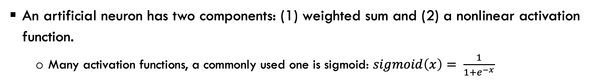



A single neuron
Activation function
b
$$X_{1}^{(i)}$$
w1
Neuron
O=sigmoid(L)
L = ${w1∗X}_{1}^{(i)}+…+wm∗X_{m}^{(i)}$+b
$$X_{m}^{(i)}$$
wm
An artificial neuron has two components: (1) weighted sum and (2) a nonlinear activation function.
  Many activation functions, a commonly used one is sigmoid: $sigmoid\left(x\right)= \frac{1}{1+e^{−x}}$

Slide 10

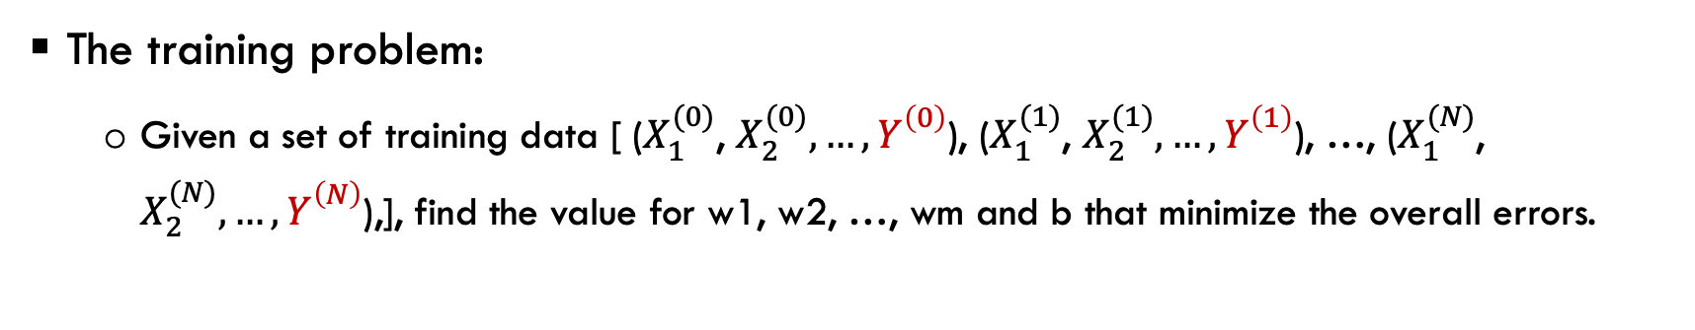

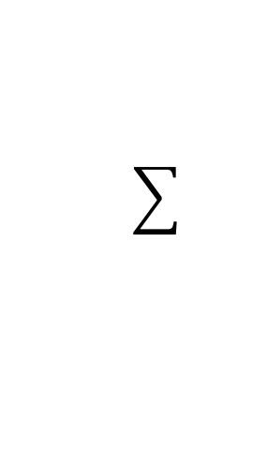

Training of a single neuron
Activation function
b
$$X_{1}^{(i)}$$
w1
Neuron
O=sigmoid(L)
L = ${w1∗X}_{1}^{(i)}+…+wm∗X_{m}^{(i)}$+b
$$X_{m}^{(i)}$$
wm
The training problem:
  Given a set of training data [ ($X_{1}^{(0)}$, $X_{2}^{(0)}, …, Y_{}^{\left(0\right)}$), ($X_{1}^{(1)}$, $X_{2}^{(1)}, …, Y_{}^{\left(1\right)}$), …, ($X_{1}^{(N)}$, $X_{2}^{(N)}, …, Y_{}^{\left(N\right)}$),], find the value for w1, w2, …, wm and b that minimize the overall errors.

Slide 11
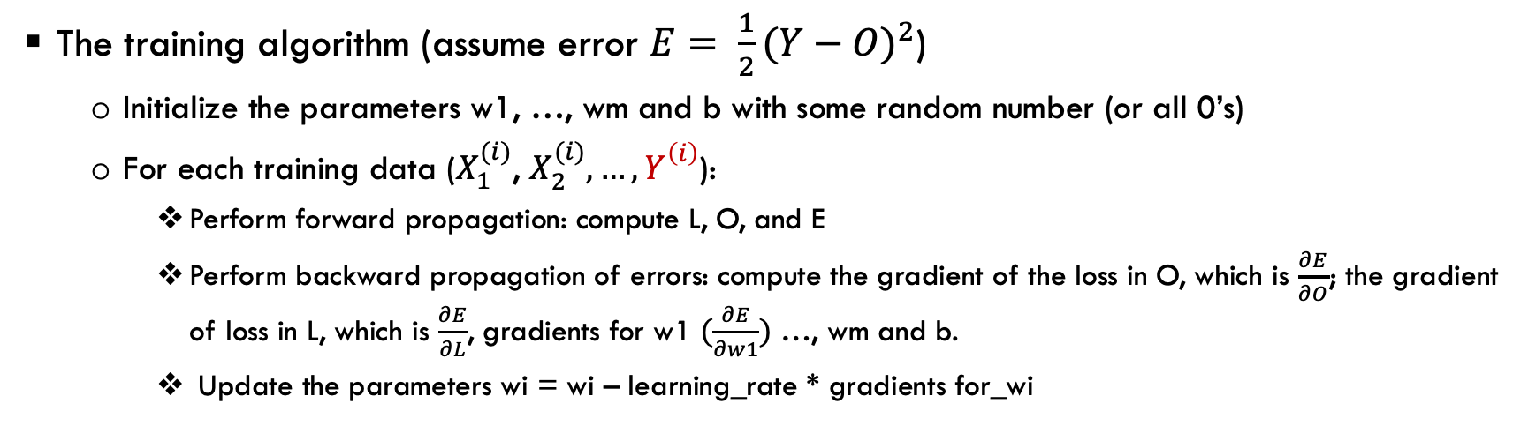
Training of a single neuron
Activation function
b
$$X_{1}^{(i)}$$
w1
Neuron
O=sigmoid(L)
L = ${w1∗X}_{1}^{(i)}+…+wm∗X_{m}^{(i)}$+b
$$X_{m}^{(i)}$$
wm
The training algorithm (assume error $E= \frac{1}{2}(Y−O)^{2}$)
  Initialize the parameters w1, …, wm and b with some random number (or all 0’s)
  For each training data ($X_{1}^{(i)}$, $X_{2}^{(i)}, …, Y_{}^{\left(i\right)}$):
    Perform forward propagation: compute L, O, and E
    Perform backward propagation of errors: compute the gradient of the loss in O, which is $\frac{∂E}{∂O}$; the gradient of loss in L, which is $\frac{∂E}{∂L}$, gradients for w1 $(\frac{∂E}{∂w1})$ …, wm and b.
    Update the parameters wi = wi – learning_rate * gradients for_wi

Slide 12
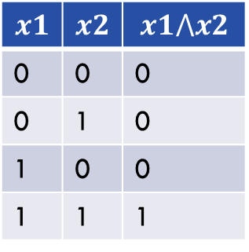

Training for the logic AND with a single neuron
In general, one neuron can be trained to realize a linear function.
Logic AND function is a linear function:
$$x1$$ | $$x2$$ | $$x1⋀x2$$
0 | 0 | 0
0 | 1 | 0
1 | 0 | 0
1 | 1 | 1
(0, 1)
(1, 1)
(0, 0)
(1, 0)
Logic AND ($⋀$) operation

Slide 13


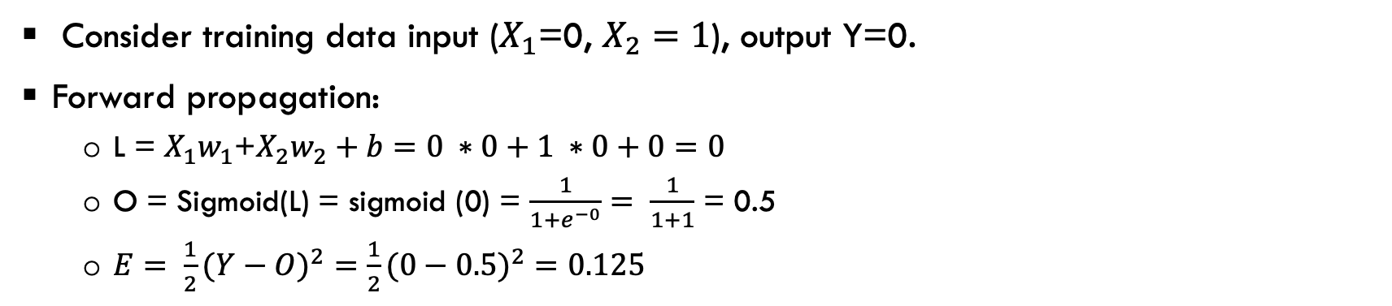



Training for the logic AND with a single neuron
b=0
$X_{1}$=0
$w_{1}$=0
∑
Sigmoid(s)
O=Sigmoid(0)=0.5
$$X_{2}=1$$
$w_{2}$=0
L$=X_{1}w_{1}$+$X_{2}w_{2}+b=0$
Activation function
Consider training data input ($X_{1}$=0, $X_{2}=1$), output Y=0.
Forward propagation:
  L = $X_{1}w_{1}$+$X_{2}w_{2}+b=0 ∗0+1 ∗0+0=0$
  O = Sigmoid(L) = sigmoid (0) = $\frac{1}{1+e^{−0}}= \frac{1}{1+1}$ = 0.5
  $E= \frac{1}{2}(Y−O)^{2}=$ $\frac{1}{2}(0−0.5)^{2}=0.125$

Slide 14

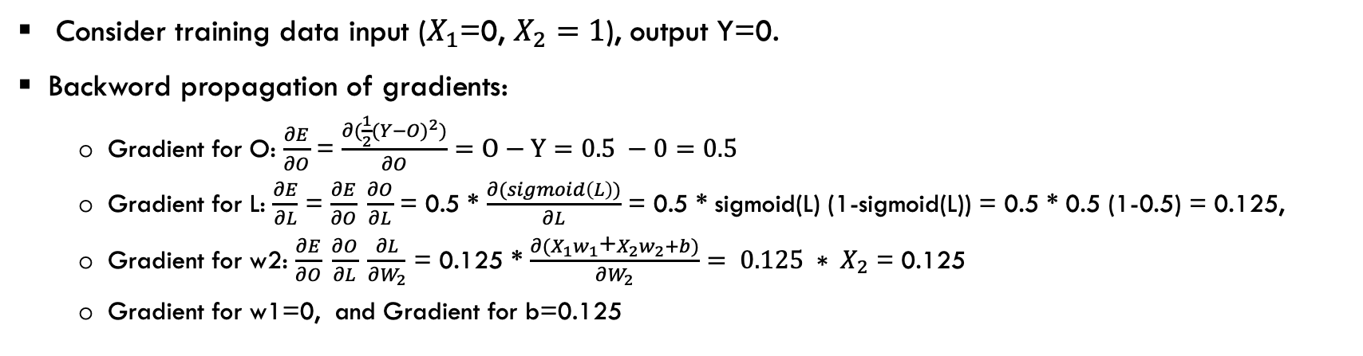



Training for the logic AND with a single neuron
b=0
$X_{1}$=0
$w_{1}$=0
∑
Sigmoid(s)
O=Sigmoid(0)=0.5
$$X_{2}=1$$
$w_{2}$=0
L$=X_{1}w_{1}$+$X_{2}w_{2}+b=0$
Activation function
Consider training data input ($X_{1}$=0, $X_{2}=1$), output Y=0.
Backword propagation of gradients:
  Gradient for O: $\frac{∂E}{∂O}$ = $\frac{∂(\frac{1}{2}(Y−O)^{2})}{∂O}=O−Y=0.5 −0=0.5$
  Gradient for L: $\frac{∂E}{∂L}$ = $\frac{∂E}{∂O} \frac{∂O}{∂L}$ = 0.5 * $\frac{∂(sigmoid\left(L\right))}{∂L}$ = 0.5 * sigmoid(L) (1-sigmoid(L)) = 0.5 * 0.5 (1-0.5) = 0.125,
  Gradient for w2: $\frac{∂E}{∂O} \frac{∂O}{∂L} \frac{∂L}{∂W_{2}}$ = 0.125 * $\frac{∂{(X}_{1}w_{1}\text{+}X_{2}w_{2}+b)}{∂W_{2}}= {0.125 ∗ X}_{2}$ = 0.125
  Gradient for w1=0, and Gradient for b=0.125

Slide 15
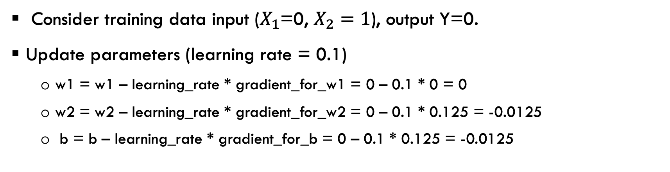
Training for the logic AND with a single neuron
(See lect9/one_neuron.cpp)
b=0
$X_{1}$=0
$w_{1}$=0
∑
Sigmoid(s)
O=Sigmoid(0)=0.5
$$X_{2}=1$$
$w_{2}$=0
L$=X_{1}w_{1}$+$X_{2}w_{2}+b=0$
Activation function
Consider training data input ($X_{1}$=0, $X_{2}=1$), output Y=0.
Update parameters (learning rate = 0.1)
  w1 = w1 – learning_rate * gradient_for_w1 = 0 – 0.1 * 0 = 0
  w2 = w2 – learning_rate * gradient_for_w2 = 0 – 0.1 * 0.125 = -0.0125
  b = b – learning_rate * gradient_for_b = 0 – 0.1 * 0.125 = -0.0125

Slide 16
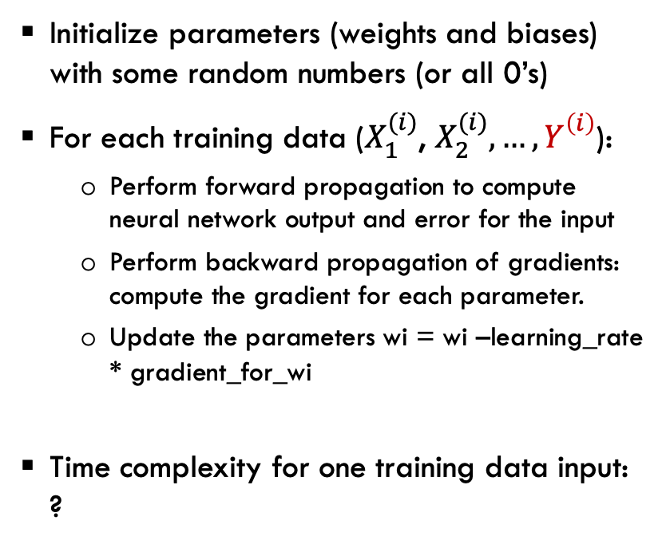
Training the deep neural network has the same process as training one neuron
Initialize parameters (weights and biases) with some random numbers (or all 0’s)
For each training data ($X_{1}^{(i)}$, $X_{2}^{(i)}, …, Y_{}^{\left(i\right)}$):
  Perform forward propagation to compute neural network output and error for the input
  Perform backward propagation of gradients: compute the gradient for each parameter.
  Update the parameters wi = wi –learning_rate * gradient_for_wi
Time complexity for one training data input: ?
Input
layer
Hidden
layer 1
Hidden
layer 2
Hidden
layer 3
Output
layer

Slide 17
Training ChatGPT
ChatGPT 4 has 1 trillion parameters.
The size of the training data is also huge, in trillions.
Total computations?
Time it takes to train ChatGPT with parallel computing:
  5-6 months with 10,000 V100 GPU.
Input
layer
Hidden
layer 1
Hidden
layer 2
Hidden
layer 3
Output
layer

Slide 18
Why parallel computing?
Bigger: Solving larger problems in the same amount of time.
Faster: Solving the same sized problem in a shorter time.
We would not have had ChatGPT without parallel computing!
  Major world powers are racing to build larger and larger supercomputers.

Slide 19
Classifying parallel computing systems: Flynn’s Taxonomy
Computing is basically executing instructions that operate on data.
Flynn’s taxonomy classifies the system based on the parallelism in instruction stream and parallelism in data stream.
  single instruction stream or multiple instruction streams.
  single data stream or multiple data streams.

Slide 20
Flynn’s taxonomy
Single Instruction Single Data (SISD)
Single Instruction Multiple Data (SIMD)
Multiple Instructions Multiple Data (MIMD)
Multiple Instructions Single Data (MISD)

Slide 21
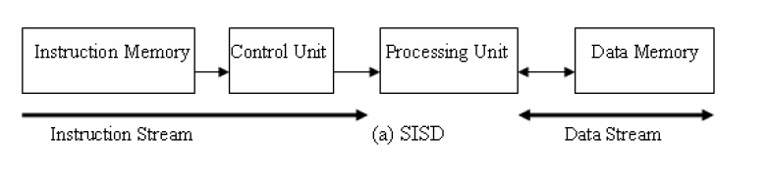
SISD
At one time, one instruction operates on one data
  Traditional sequential architecture, Von Neumann architecture.

Slide 22
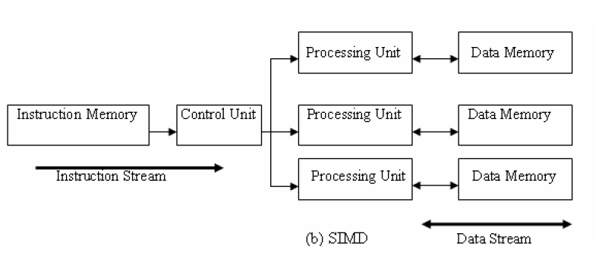
SIMD
Single control unit and multiple processing units. The control unit fetches an instruction and broadcast control to all processing units. The instruction operates on different data.
  Can achieve massive processing power with minimum control logic
  SIMD instructions allow for sequential reasoning.

Slide 23
SIMD
Exploit data-level parallelism
  Matrix-oriented scientific computing and deep learning applications
  Media (image and sound) processing
Vector machines, MMX, SSE (Streaming SIMD Extensions), AVX (Advanced Vector eXtensions), GPU (extend SIMD or SIMT)

Slide 24
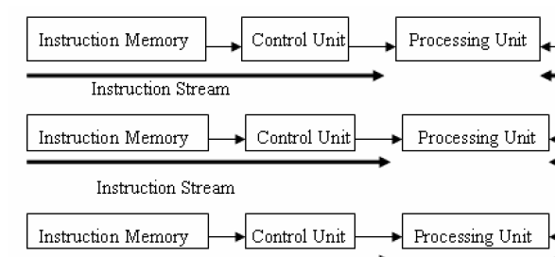

MISD
Not commonly seen, no general purpose MISD computer has been built.
Systolic array is one example of an MISD architecture.

Slide 25
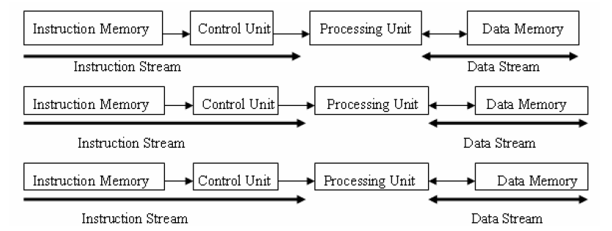
MIMD
Multiple instruction streams operating on multiple data streams
  MIMD can be thought of as many copies of SISD machine.
  Distributed memory multi-computers, shared memory multi-processors, multi-core computers.

Slide 26
Flynn’s Taxonomy
Type | Instruction Streams | Data Streams | Examples
SISD | 1 | 1 | Early computers, Von Neumann architecture, turing machine
SIMD | 1 | N | Vector architectures, MMX, SSE, AVX, GPU
MISD | N | 1 | No general purpose machine, systolic array
MIMD | N | N | Multi-core, multi-processor, multi-computer, cluster

Slide 27
Modern classification (Sima, Fountain, Kacsuk)
Based on how parallelism is achieved
  Data parallelism: same function operating on many data
  Function parallelism: performing many functions in parallel
    Control parallelism, task parallelism depending on the level of the functional parallelism.
Parallel architectures
Data-parallel
architectures
Function-parallel
architectures

Slide 28
Functional-parallel architectures
Function-parallel architectures
Thread level Parallel Arch
Process level Parallel Arch
Instruction level Parallel Arch
(ILPs)
(MIMDs)
Distributed Memory MIMD
Pipelined processors
Superscalar processors
Shared Memory MIMD
VLIWs

Slide 29
What types of (sequential) applications can be improved by parallel computing
If we have an infinite number of processors, it is possible to make sequential program run much faster?
A = 2;
B = 4;
C = 6;
D = 10;
A = 2;
B = A + A;
C = B * A;
D = C+1;
For(i=0; i<100000; i+= 1)
a[i] = b[i] + c[i];

Slide 30
Dependency and Parallel Execution
When two instructions operate on the same data with at least one instruction write to the data, we say that there exists data dependency between the two instructions.
  True dependency – read after write
  Output dependency – write after write
  Anti-dependency – write after read
Parallel execution can change the timing to execute the instruction. With data dependence, the instructions have to be executed in exactly the same order to have the same semantic (we would say the instructions cannot be parallelized).
A = 1
B = A * 2
A = 1
A = 2
B = A +1
A = 2

Slide 31
Dependency
In addition to data dependency, a program may also have control dependency.
Due to the dependencies, a typical program will have a portion that can be parallelized, and the other part that cannot be parallelized.
A = 2;
B = A + A;
C = b * A;
D = c+1;
For(i=0; i<100000; i=+)
a[i] = 0;

Slide 32
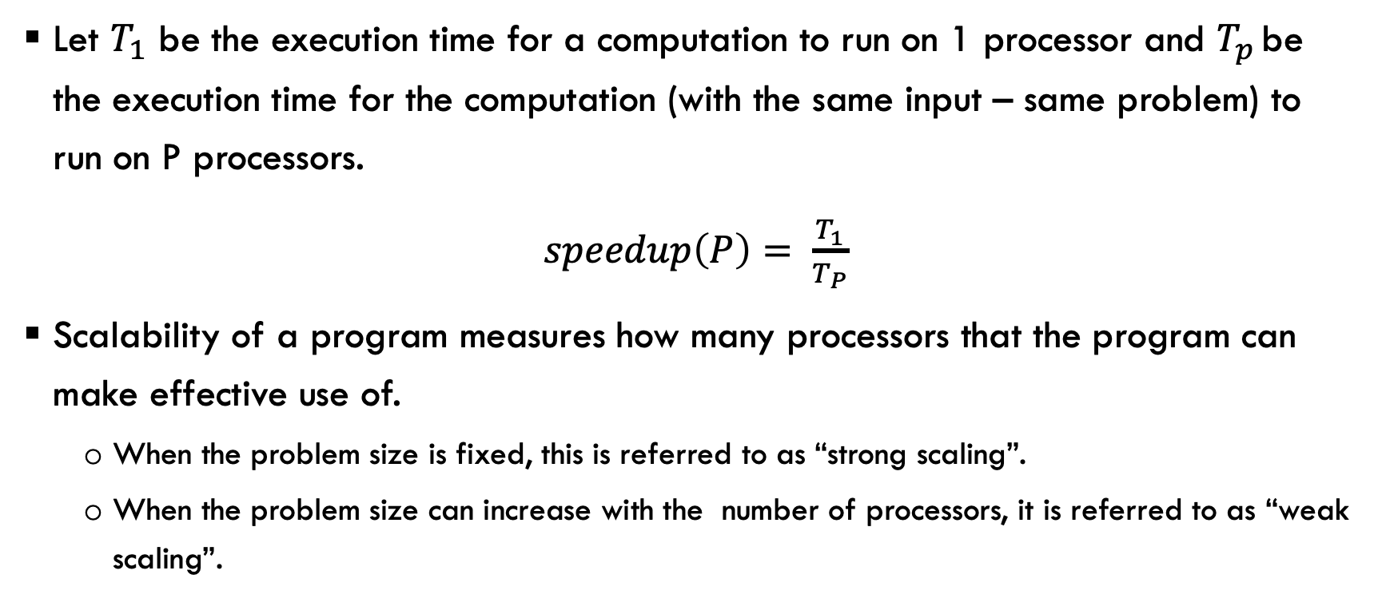
Speedup and Scalability
Let $T_{1}$ be the execution time for a computation to run on 1 processor and $T_{p }$be the execution time for the computation (with the same input – same problem) to run on P processors.
$speedup\left(P\right)= \frac{T_{1}}{T_{P}}$
Scalability of a program measures how many processors that the program can make effective use of.
  When the problem size is fixed, this is referred to as “strong scaling”.
  When the problem size can increase with the number of processors, it is referred to as “weak scaling”.

Slide 33
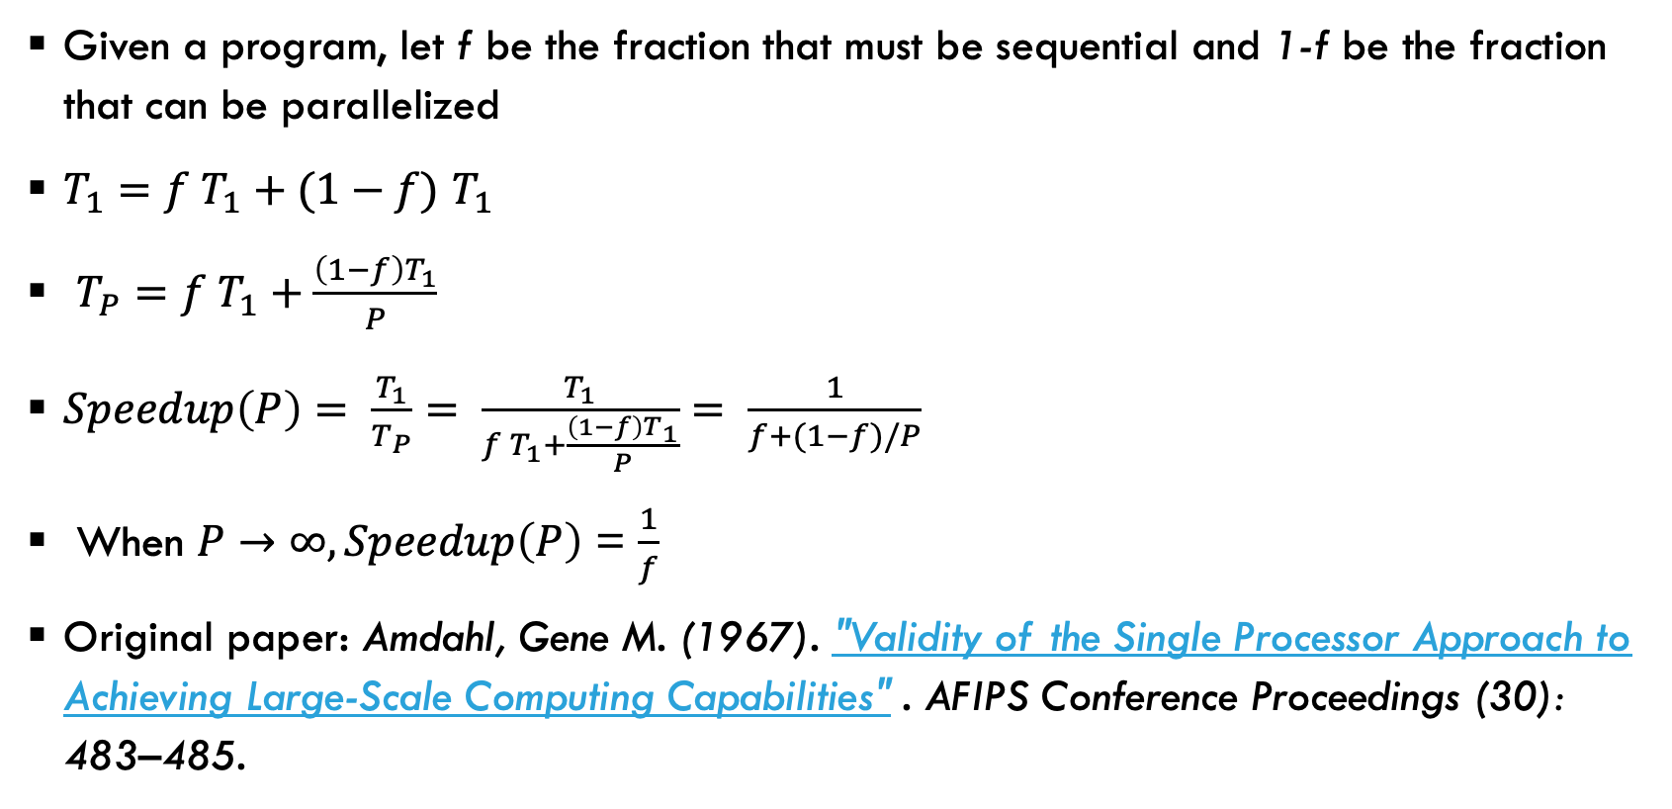
Amdahl’s Law (fixed size speedup, strong scaling)
Given a program, let f be the fraction that must be sequential and 1-f be the fraction that can be parallelized
$T_{1}=f T_{1}+(1−f)$ $T_{1}$
$T_{P}=f T_{1}+\frac{\left(1−f\right)T_{1}}{P}$
$Speedup\left(P\right)= \frac{T_{1}}{T_{P}}= \frac{T_{1}}{f T_{1}+\frac{\left(1−f\right)T_{1}}{P}}= \frac{1}{f+(1−f)/P}$
When $P→∞, Speedup\left(P\right)$ = $\frac{1}{f}$
Original paper: Amdahl, Gene M. (1967). "Validity of the Single Processor Approach to Achieving Large-Scale Computing Capabilities" . AFIPS Conference Proceedings (30): 483–485.

Slide 34
Amdahl’s law
Amdahl’s law: As P increases, the percentage of work in the parallel region reduces, performance is more and more dominated by the sequential region.
time
P=1
P=2
P=4

Slide 35
Question
Let a program has f=10% sequential component and 90% parallel component. What is the speedup one will get with 2 processors, 5 processors and 10 processors?
If a person tell you that he is able to speed up the program by 15 times, what would be your responds?

Slide 36
Gustafson’s Law (scaled speedup, weak scaling)
Large scale parallel/distributed systems are expected to allow for solving problem faster or larger problems.
  Amdahl’s Law indicates that there is a limit on how faster it can go.
  How about bigger problems? This is what Gustafson’s Law sheds lights on!
In Amdahl’s law, as the number of processors increases, the amount of work in each node decreases (more processors sharing the parallel part).
In Gustafson’s law, as the number of processors increases, the amount of work in each node remains the same (doing more work collectively).

Slide 37
Gustafson’s law
Gustafson’s law: As P increases, the total work on each process remains the same. So the total work increases with P.
time
P=1
P=2
P=4

Slide 38
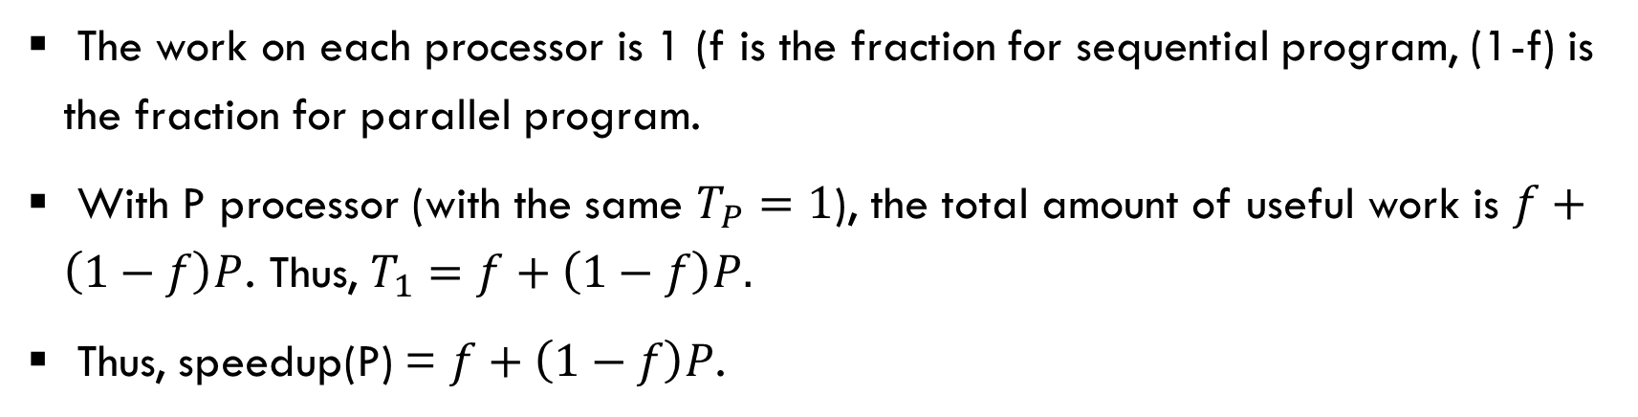
Gustafson’s Law (scaled speedup, weak scaling)
The work on each processor is 1 (f is the fraction for sequential program, (1-f) is the fraction for parallel program.
With P processor (with the same $T_{P}=1$), the total amount of useful work is $f+\left(1−f\right)P$. Thus, $T_{1}=f+\left(1−f\right)P.$
Thus, speedup(P) = $f+\left(1−f\right)P$.
No of PEs | Strong scaling speedup (Amdalh’s law, f = 10%) | Weak scaling speedup (Gustafson’s law, f = 10%)
2 | 1.82 | 1.9
4 | 3.07 | 3.7
8 | 4.71 | 7.3
16 | 6.40 | 14.5
100 | 9.90 | 90.1

Slide 39
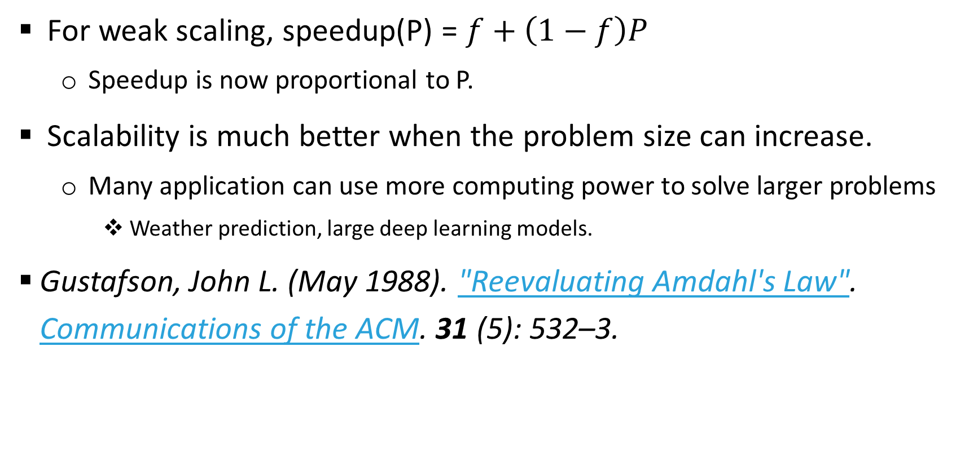
Implication of Gustafson’s law
For weak scaling, speedup(P) = $f+\left(1−f\right)P$
  Speedup is now proportional to P.
Scalability is much better when the problem size can increase.
  Many application can use more computing power to solve larger problems
    Weather prediction, large deep learning models.
Gustafson, John L. (May 1988). "Reevaluating Amdahl's Law". Communications of the ACM. 31 (5): 532–3.

