Slide 1
Nonblocking and Signal Driven I/O
Blocking vs. non-blocking I/O
Nonblocking input, output, accept, and connect
Concepts and steps for using signal-driven I/O
UDP echo server using signal-driven I/O
Readings
  UNP Section 6.2, CH16, Ch25

Slide 2
Blocking vs. Nonblocking I/O
Blocking I/O
  When an operation cannot be completed immediately, the process is put into sleep
Nonblocking I/O
  When an operation cannot be completed immediately, the function return immediately with an error, so the process can proceed accordingly (e.g. elect to do something else).
Default I/O operations are all blocking
  Non-blocking IO has implications on input, output, accept, and connect.

Slide 3
Input Operations
Functions read, recvfrom, readv, recv, recvmsg
Blocking socket
  TCP: sleep until some data arrives
  UDP: sleep until a UDP datagram arrives
Nonblocking socket
  Return immediately with an error EWOULDBLOCK, if no data in receive buffer

Slide 4
Output Operations
Functions write, sendto, writev, send, and sendmsg
Blocking socket
  TCP: sleep until room is available in send buffer
  UDP: does not have socket send buffer. A process can be blocked due to buffering etc in protocol stack.
Nonblocking socket
  TCP: return immediately with an error EWOULDBLOCK, if no room in send buffer
  UDP: send operation cannot be completed due to various reasons

Slide 5
Accepting New Connections
Function accept
Blocking socket
  Sleep until some new connections available
Nonblocking socket
  Return immediately with an error EWOULDBLOCK, if no new connection is available

Slide 6
Initiating Outgoing Connections
Function connect (for TCP)
Blocking socket
  Sleep until ACK is received for SYN packet.
Nonblocking socket
  Return immediately with an error of EINPROGRESS, if connection cannot be established immediately
  Note that a connection may be established immediately

Slide 7
Making Socket Nonblocking
File control function
  cmd: F_GETFL and F_SETFL
I/O control function
  Request: FIONBIO
#include <fcntl.h>
int fcntl(int fd, int cmd, … /* int arg */)
flag = fcntl(sockfd, F_GETFL, 0);
fcntl(sockfd, F_SETFL, flag | O_NONBLOCK);
#include <sys/ioctl.h>
int ioctl(int fd, int request, … )
int on = 1
ioctl(sockfd, FIONBIO, (char *)&on);

Slide 8
How to Handle Nonblocking I/O
A nonblocking function returns immediately, what’s next?
Choice 1: Do some other things
  A program may not have other things to do
Choice 2: keeping on “polling” until success
  Waste system resources
Choice 3: blocking somewhere until some operation can be performed
  select() function

Slide 9
Select and Nonblocking I/O
When is a socket “ready” for nonblocking I/O?
  When data arrives in receive buffer, it is ready for read
  When room is available in send buffer, it is ready for write
  For server side (accept), when a new connection is available, it is ready for both read and write
  For client side (connect), when a connection is established, it is ready for write; when a connection cannot be established, it is ready for both read and write
    So how you know if a connection has been established successfully or not
    getsockopt to retrieve SO_ERROR (0 -> success)

Slide 10
Blocking and Nonblocking Echo Client
Blocking echo client
  echo_client_select.cpp
Nonblocking echo client
  echo_client_nonblocking.cpp

Slide 11
Pros and Cons of Nonblocking I/O
Advantage
  More control, possibly higher performance
Disadvantages
  Much more complicated
  Buffer needs to be maintained by application program if message needs to be forwarded from one socket to another
    Cannot guarantee all writes complete
  Other complications like connect
Use concurrent and multiplexed design instead of nonblocking I/O, if possible

Slide 12
Signal-Driven I/O
Notes:
Last time we studied nonblocking I/O, where functions like read/write/accept/connect will return immediately if socket is not “ready”. Today we will discuss another advanced form of I/O---signal-driven I/O. We will discuss the concepts of signal-driven I/O, and the steps we must take into develop signal-driven I/O programs. We will also illustrate the concepts and steps of signal-driven I/O by developing a UDP echo server.
We emphasize here that, like nonblocking I/O, signal-driven I/O does not only apply to socket, it applies to other disk or other device access.

Slide 13
Motivation
Efficiently detecting an asynchronous event (arrival of a connection, arrival of a message, etc) is difficult.
  Blocking IO: can block for a long time
  Nonblocking IO: do not block for a long time, but must keep polling – tedious
  How do we deal with other types of asynchronous events? E.g. input from keyboard?
    Using interrupt
    Corresponding to this, we have signal driven IO
Notes:
In signal-driven I/O, we do not directly try to read from a socket. Instead, we wait for the signal SIGIO, which will be generated by the kernel when something happens to a socket descriptor. When we receive the signal, then we will read data from the descriptor.
In order for us to use signal-driven I/O, we must take a few steps. The first step is to associate a signal handler with the signal SIGIO. We are familiar with this part. We can use functions signal or sigaction to set a handler for SIGIO.
The second step is to set the socket owner. Essentially, we let the system know where the signal SIGIO should be delivered. The last step is to enable the signal-driven I/O for the socket, that is, changing the socket from the default blocking socket to signal-driven socket. We will detail the last two steps in the following slides.

Slide 14
Signal-driven I/O
The kernel raises a signal (SIGIO) when something happens to a file descriptor
Three steps to use signal-driven I/O with sockets
  Establish a signal handler for SIGIO
    Functions signal/sigaction
  Set the socket owner
    fcntl with command F_SETOWN
  Enable signal-driven I/O for the socket
    fcntl with command O_SETFL (turn on O_ASYNC)
    ioctl with request FIOASYNC
Notes:
In signal-driven I/O, we do not directly try to read from a socket. Instead, we wait for the signal SIGIO, which will be generated by the kernel when something happens to a socket descriptor. When we receive the signal, then we will read data from the descriptor.
In order for us to use signal-driven I/O, we must take a few steps. The first step is to associate a signal handler with the signal SIGIO. We are familiar with this part. We can use functions signal or sigaction to set a handler for SIGIO.
The second step is to set the socket owner. Essentially, we let the system know where the signal SIGIO should be delivered. The last step is to enable the signal-driven I/O for the socket, that is, changing the socket from the default blocking socket to signal-driven socket. We will detail the last two steps in the following slides.

Slide 15
Set Socket Owner
    Function fcntl with command F_SETOWN
      fcntl(int fd, int cmd, … /* int arg*/)
      Set process ID or process group ID to receive SIGIO and SIGURG signals
      Arg > 0: process ID == arg
      Arg < 0: process group ID == |arg|
fcntl(sockfd, F_SETOWN, getpid());
Notes:
We use the function fcntl to set the socket owner. It is achieved via the command F_SETOWN. The command F_SETOWN set the process ID or process group ID to receive SIGIO and SIGURG signals. The third parameter arg informs the kernel the process ID or the group ID, depending on the value of arg. When arg is positive, it specifies the process ID.
The following line of code shows how to use fcntl to set socket owner in a program.

Slide 16
Enable Signal-Driven I/O for Socket
    Function fcntl with command F_SETFL
  Turn on O_ASYNC
Function ioctl with request FIOASYNC
int flag;
flag = fcntl(sockfd, F_GETFL, 0);
fcntl(sockfd, F_SETFL, flag | O_ASYNC);
int on = 1;
ioctl(sockfd, FIOASYNC, &on);
Notes:
In order to enable signal-driven I/O, we can use either fcntl or ioctl.

Slide 17
Complication of Signal-Driven I/O
Signals are not queued when they are blocked
  When SIGIO is blocked, at most one SIGIO signal will be pending even if two pieces of data arrive
  No one to one mapping between number of signals and arrived data
In handler of SIGIO, we need to handle all arriving data
  Read until there is no data (how?)
Nonblocking I/O needs to be used with signal-driven I/O
Notes:
One particular problem that we need to pay attention when we use signal-driven I/O is, recall that, when a signal is blocked, the kernel only maintain one instance of a signal, even if it is generated multiple times. What is the consequence for socket programming? In signal-driven I/O, when SIGIO is blocked, at most one SIGIO will be pending in the kernel even if more than one packet arrive. This means that, when we start to read data from socket after we have received the signal SIGIO, we must not make any assumption about the amount of that data that is in the receive buffer. We need to continue read until there is no data left in the receive buffer. However, if we are using a blocking socket, we will be blocked when we try to read and there is no data in the receive buffer. So how we should handle this situation? Well, we need to use signal-driven I/O together with nonblocking I/O.

Slide 18
When is SIGIO raised?
For UDP sockets
  A datagram arrives
  An error occurs
For TCP sockets
  A connection request has completed
  A disconnect request has been initiated
  A disconnect request has completed
  Half of a connection has been shut down
  Data has arrived
  Data has been sent
Too many SIGIOs for a TCP socket – rarely used
  listening socket
Notes:
We said that when something happens on a socket descriptor, the signal SIGIO will be generated by the kernel. So what is “something”? Or when is SIGIO raised? It depends on the transport layer protocol we are using.
For UDP, two conditions can trigger the generation of the SIGIO signal: a datagram has arrived, or some error has occurred.
For TCP, it is much complicated. Many conditions can trigger the generation of signal SIGIO. For example, …. For this reason, signal-driven I/O is rarely used for TCP sockets. One exception is listening socket, given that the only condition to trigger SIGIO is when a connection has been established.

Slide 19
Echo Server with Signal-Driven I/O
Examples udp_echo_server.cpp and udp_echo_client.cpp
A particular use of signal-driven I/O is NTP (network time protocol)
  Time sensitive.
  A server needs to record the accurate arrival time of a datagram and return to client.

Slide 20
Summary of I/O models
    Blocking
    Nonblocking
    Multiplexed
    Signal driven
    Asynchronous

Slide 21
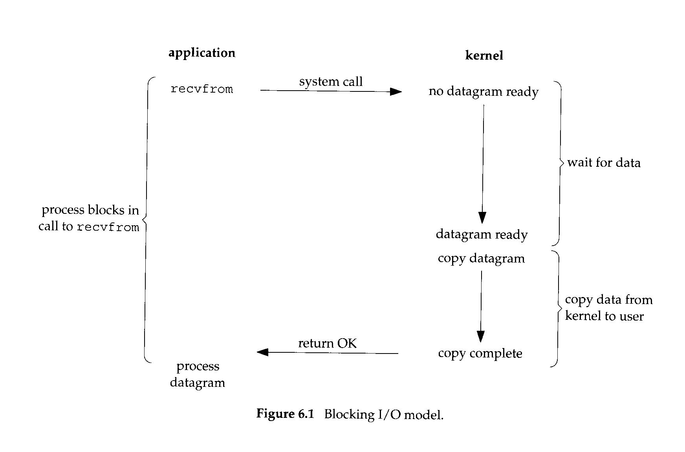
Blocking IO

Slide 22
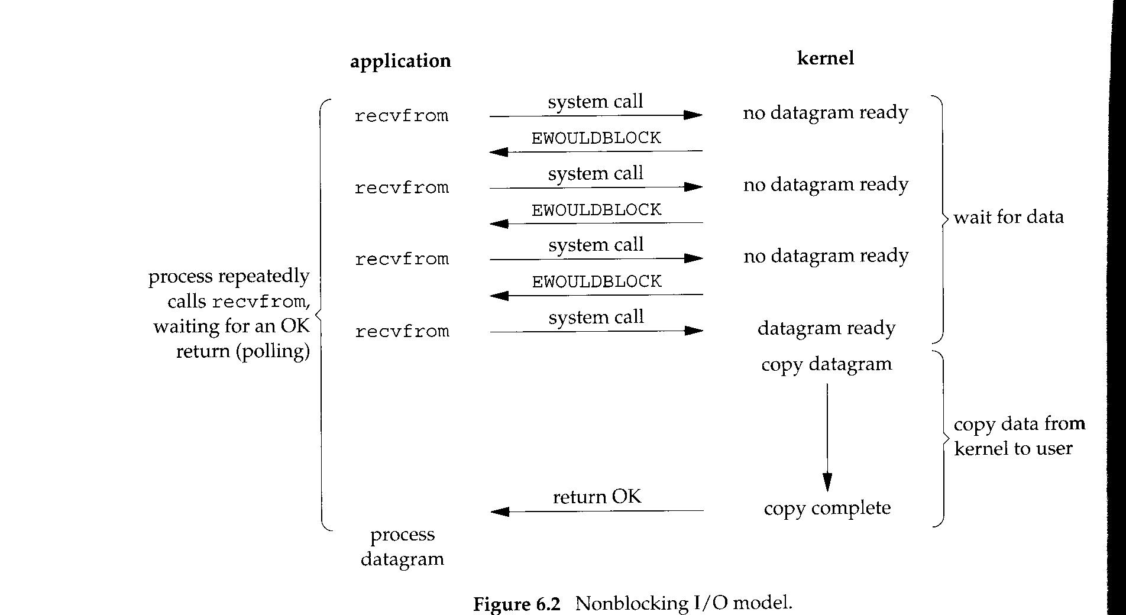
Nonblocking IO

Slide 23
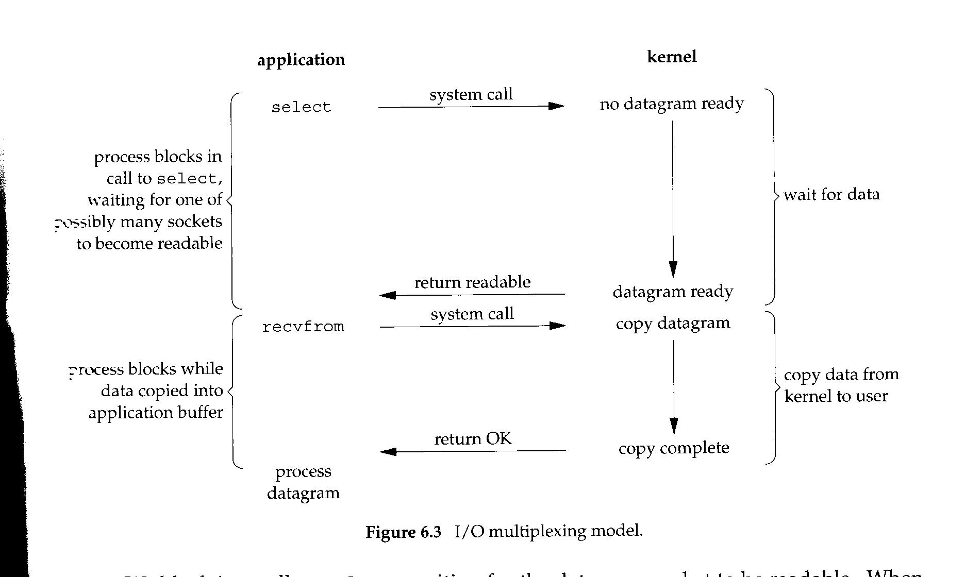
I/O Multiplexing

Slide 24
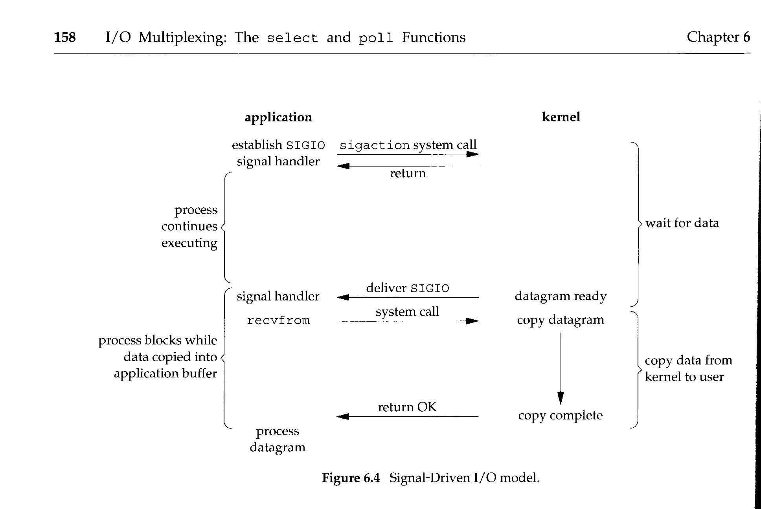
Signal driven

Slide 25
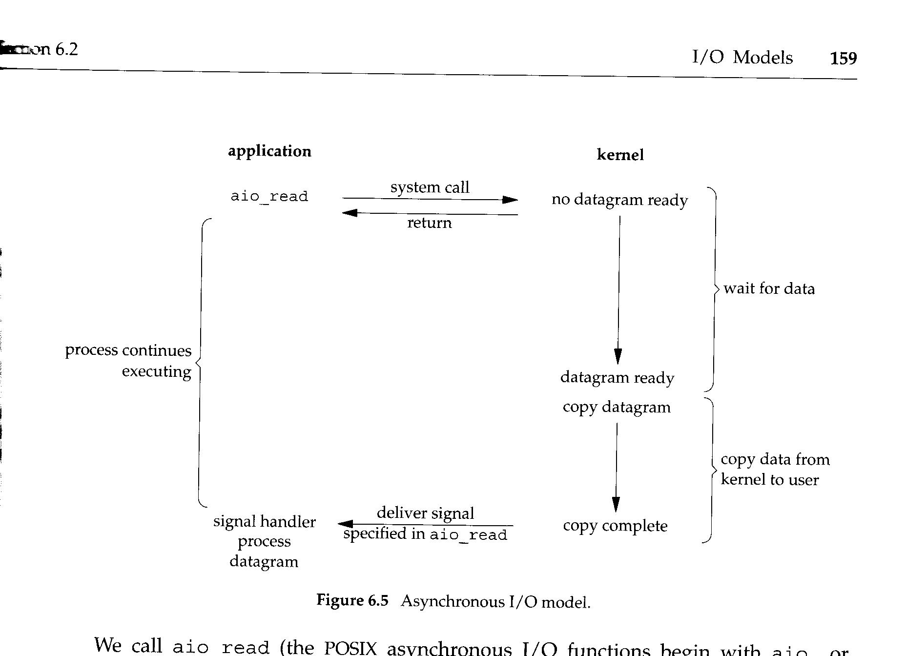
Asynchronous IO

