Slide 1
Introduction to Parallel Computing

Slide 2
Parallel Computers and Parallel Computing
What is a parallel computer?
  A collection of processing elements that communicate and coorperate to solve problems.
  What is a processing element?
    Depending on the context, it can be a whole computer, a CPU, a CPU core, a GPU core, or a functional unit.
  Three key elements in a parallel computer:
    More than one processing element. More than one processing element allows computation to be performed in parallel!
    The processing elements are connected, and can communicate with one another when needed
    The processing elements corporate to solve problems.

Slide 3
Most Contemporary Computing Systems are Parallel Computers
  Mobile devices, IoT devices, many have multi-core CPUs
    IPhone 13, A15 – 6 CPU cores, 16 Neural Engine cores, 4 GPU cores
  Desktop or laptop, multi-core CPU
  A high-end gaming computer (CPU + GPU)
  Multi-core server
  Linprog cluster
  FSU Research Computing Center (RCC)
  Cloud Computing platforms (Amazon AWS, Google cloud).
  Frontier supercomputer at Oak Ridge National Laboratory (No. 1 in June 2024 , 1714.81 Peta flops per second peak performance)
In today’s world, almost any computing device is a parallel computing device!
Uniprocessor systems
Multi-processor systems

Slide 4
Parallel Computers and Parallel Computing
Parallel computer
  A collection of processing elements that communicate and coorperate to solve problems.
Parallel computing
  Parallel computing is a type of computation where many calculations or processes are performed simultaneously.
  Parallel computing is performed on a parallel computer where multiple processing elements are utilized simultaneously.
  Parallel programming .vs. concurrent programming
Parallel programs
  Parallel programs are programs that can simultaneously utilize multiple processing elements, usually having multiple threads of execution.
  Sequential programs: programs where instructions are executed in sequence.

Slide 5
Why parallel computing?
Bigger: Solving bigger problem in the same amount of time
  Example: scientific computing applications such as weather simulation. More computing power means more finer granularity and prediction longer into the future.
Faster: Solving the problem of the same size in a smaller amount of time
  Example: Cracking a password with 1 computer takes 20 hours -> 12 minutes with 100 computers.

Slide 6
What types of (sequential) applications can be improved by parallel computing
Parallel programming typically starts with sequential programming - converting the sequential program to an equivalent parallel program.
  If we have an infinite number of processors (or processing elements), it is possible to make sequential program run much faster?
A = 2;
B = 4;
C = 6;
D = 10;
A = 2;
B = A + A;
C = B * A;
D = C+1;
For(i=0; i<100000; i+= 1)
a[i] = b[i] + c[i];

Slide 7
Dependency
When two instructions operate on the same data with at least one instruction write to the data, we say that there exists data dependency between the two instructions.
  True dependency – read after write
  Output dependency – write after write
  Anti-dependency – write after read
Due to the dependencies, a typical program will have a portion that can be parallelized, and the other part that cannot be parallelized.
A = 2;
B = A + A;
C = b * A;
D = c+1;
For(i=0; i<100000; i=+)
a[i] = 0;

Slide 8
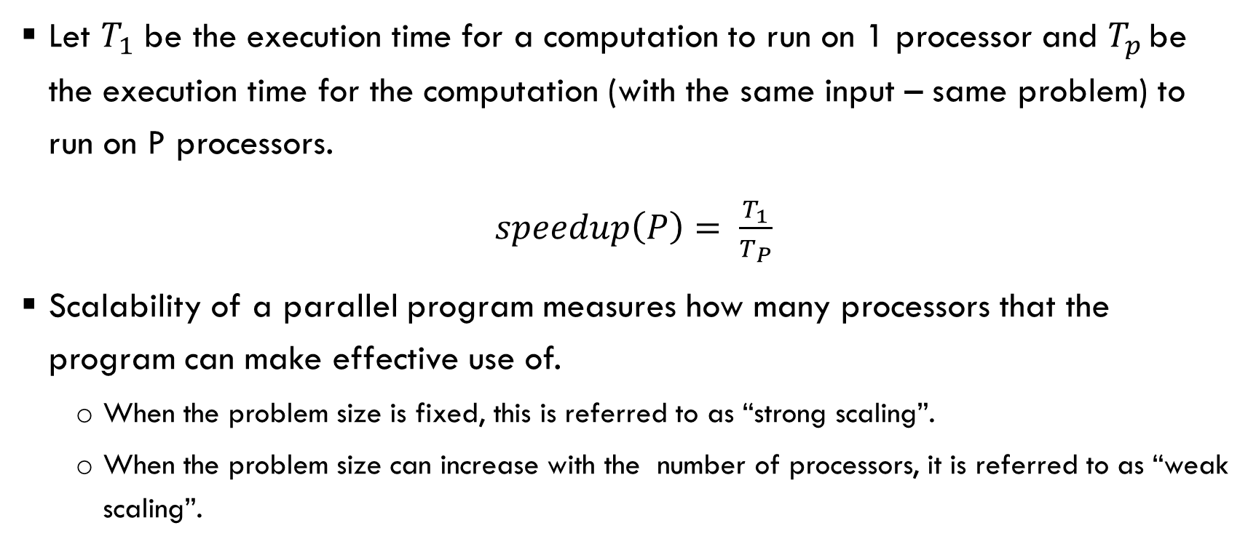
Speedup and Scalability
Let $T_{1}$ be the execution time for a computation to run on 1 processor and $T_{p }$be the execution time for the computation (with the same input – same problem) to run on P processors.
$speedup\left(P\right)= \frac{T_{1}}{T_{P}}$
Scalability of a parallel program measures how many processors that the program can make effective use of.
  When the problem size is fixed, this is referred to as “strong scaling”.
  When the problem size can increase with the number of processors, it is referred to as “weak scaling”.

Slide 9
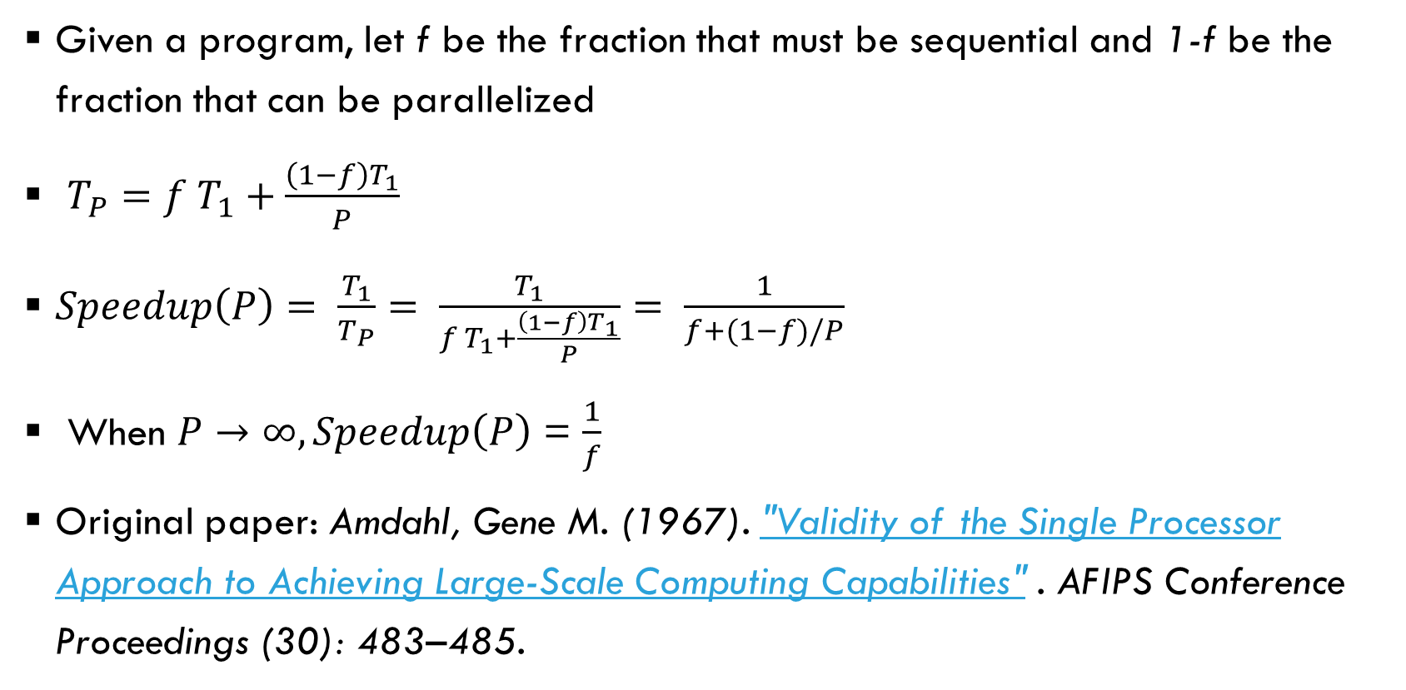
Amdahl’s Law (fixed size speedup, strong scaling)
Given a program, let f be the fraction that must be sequential and 1-f be the fraction that can be parallelized
$T_{P}=f T_{1}+\frac{\left(1−f\right)T_{1}}{P}$
$Speedup\left(P\right)= \frac{T_{1}}{T_{P}}= \frac{T_{1}}{f T_{1}+\frac{\left(1−f\right)T_{1}}{P}}= \frac{1}{f+(1−f)/P}$
When $P→∞, Speedup\left(P\right)$ = $\frac{1}{f}$
Original paper: Amdahl, Gene M. (1967). "Validity of the Single Processor Approach to Achieving Large-Scale Computing Capabilities" . AFIPS Conference Proceedings (30): 483–485.

Slide 10
Amdahl’s law
Amdahl’s law: As P increases, the percentage of work in the parallel region reduces, performance is more and more dominated by the sequential region.
time
P=1
P=2
P=4

Slide 11
Question
Let a program has f=10% sequential component and 90% parallel component. What is the speedup one will get with 2 processors, 5 processors, 10 processors and infinite number of processors?

Slide 12
Gustafson’s Law (scaled speedup, weak scaling)
Large scale parallel/distributed systems are expected to allow for solving problem faster or larger problems.
  Amdahl’s Law indicates that there is a limit on how faster it can go.
  How about bigger problems? This is what Gustafson’s Law sheds lights on!
In Amdahl’s law, as the number of processors increases, the amount of work in each node decreases (more processors sharing the parallel part).
In Gustafson’s law, as the number of processors increases, the amount of work in each node remains the same (doing more work collectively).

Slide 13
Gustafson’s law
Gustafson’s law: As P increases, the total work on each process remains the same. So the total work increases with P.
time
P=1
P=2
P=4

Slide 14
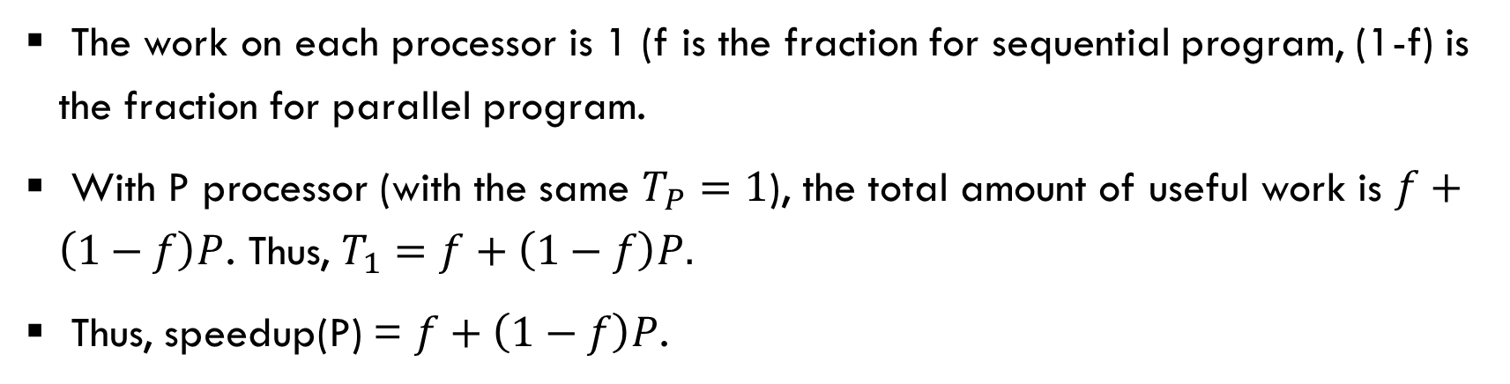
Gustafson’s Law (scaled speedup, weak scaling)
The work on each processor is 1 (f is the fraction for sequential program, (1-f) is the fraction for parallel program.
With P processor (with the same $T_{P}=1$), the total amount of useful work is $f+\left(1−f\right)P$. Thus, $T_{1}=f+\left(1−f\right)P.$
Thus, speedup(P) = $f+\left(1−f\right)P$.
No of PEs | Strong scaling speedup (Amdalh’s law, f = 10%) | Weak scaling speedup (Gustafson’s law, f = 10%)
2 | 1.82 | 1.9
4 | 3.07 | 3.7
8 | 4.71 | 7.3
16 | 6.40 | 14.5
100 | 9.90 | 90.1

Slide 15
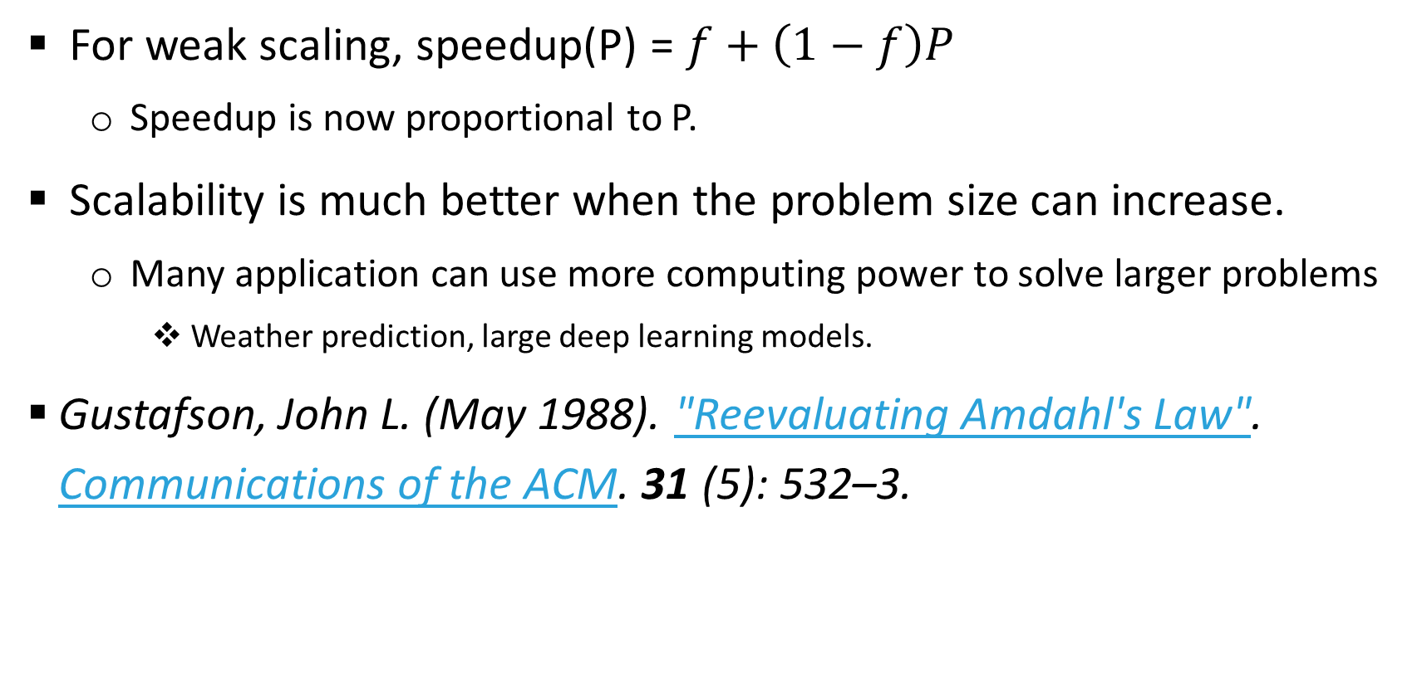
Implication of Gustafson’s law
For weak scaling, speedup(P) = $f+\left(1−f\right)P$
  Speedup is now proportional to P.
Scalability is much better when the problem size can increase.
  Many application can use more computing power to solve larger problems
    Weather prediction, large deep learning models.
Gustafson, John L. (May 1988). "Reevaluating Amdahl's Law". Communications of the ACM. 31 (5): 532–3.

