Slide 1
Today’s topic
Other server design alternatives
  Preforked servers
  Threaded servers
  Prethreaded servers

Slide 2
Sequential server
socket()
bind()
Handle one
connection at
a time
listen()
accept()
read()
write()
read()
close()

Slide 3
Sequential server
Concurrent server (example2.c)
socket()
socket()
bind()
bind()
listen()
listen()
Loop forever
accept()
accept()
read()
fork
Close
accepted
socket
Close listen
socket
write()
read()
write()
read()
close()
close()
read()

Slide 4
Multiplexed server
socket()
bind()
listen()
Loop forever
select
If listen socket is active → accept, book keeping
If data socket is active: read/write
If read returns 0, close the socket, book keeping
If standard input is active: act accordingly

Slide 5
Multiplexed server (example4.c):
  Multiplexed server/concurrent server: which one is more efficient?
  Can we have the best of both worlds?

Slide 6
Preforked server:
  Main limitation with the concurrent server
    fork overheads.
    Is context switching a big problem?
    Removing the fork overheads
      Pre-fork N processes and use them forever.

Slide 7
Sequential server
Prefork server (example5.c)
socket()
socket()
bind()
bind()
listen()
listen()
accept()
N Fork()’s
read()
accept()
accept()
read()
read()
write()
write()
write()
close()
close()
close()

Slide 8
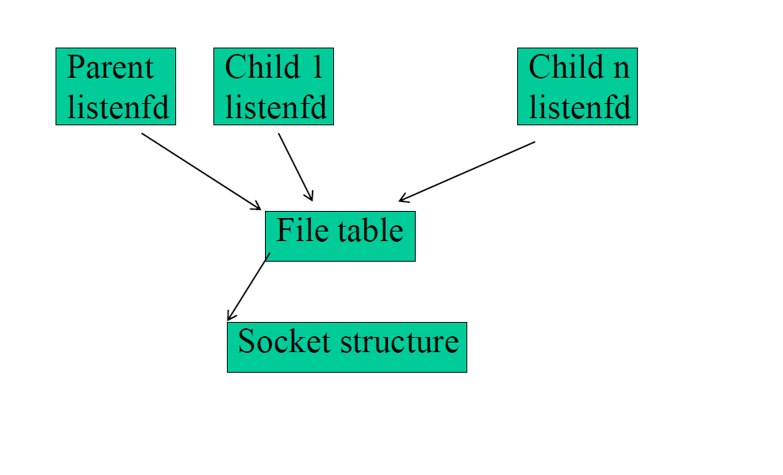
Preforked Servers
Accept: It extracts the first connection request on the queue of pending
connections, creates a new connected socket, and returns a new file
descriptor referring to that socket. The newly created socket is not in
the listening state. The original socket sockfd is unaffected by this call.
Only one will return!!

Slide 9
Preforked server:
  Disadvantages
    Not easy to guess the “right” number of child processes.
  Comparison to other server implementation techniques:
    Single CPU, multiple CPU’s
  Concurrent, multiplex, and prefork are building blocks for server implementation. One can use a combination of techniques.
    E.g. pre-fork N multiplexed servers.

Slide 10
IO multiplexing with threads
  IO mutiplexing at the process level requires the select call.
  Multi-threading can achieve the same effect
    Idea: use one thread to process one input stream
    Multiplexing is implicit at the systems level
  See echo_client_thread.cpp
    getaddrinfo – a network address and service translation method.

Slide 11
Threaded Server
  Limitations with process-based concurrent servers
    Fork is expensive
    Inter-process communications are hard
  Threads
    Lightweight process
    Crashing one thread will kill all program
  See echo_server_thread.cpp
    Not robust
    implemented like concurrent server.
    Can share data structures

Slide 12
Prethreaded Servers
A number of threads are precreated to handle clients
  Only one thread can be blocked on accept()
  Access to accept () controlled by a mutex
  See echo_server_prethread.cpp

