Slide 1
Basic TCP Socket API
Basic APIs
  socket, bind, listen, connect, accept, close, read, write
Other helpful functions
Readings
  UNP Ch3, Ch4, and Ch11

Slide 2
Connection-Oriented Application
Server gets ready to service clients
  Creates a socket
  Binds a local address to the socket
    Server’s address should be made known to clients
Client contacts the server
  Creates a socket
  Connects to the server
    Client has to supply the address of the server
Server accepts connection requests from clients
Further communication is specific to application

Slide 3
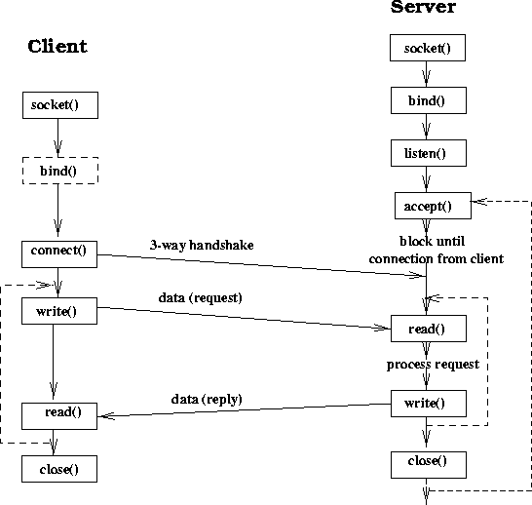
Sequential Server

Slide 4
Creating a Socket
#include <sys/socket.h>
int socket(int family, int type, int protocol);
  Family: AF_INET, AF_INET6, AF_LOCAL, AF_ROUTE, AF_KEY.
  Type: SOCK_STREAM, SOCK_DGRAM, SOCK_RAW
    TCP: AF_INET, SOCK_STREAM
    UDP: AF_INET, SOCK_DGRAM
    IPv4: AF_INET, SOCK_RAW
  Protocol: usually 0 except for raw sockets
  Return descriptor (like file descriptor), -1 on error.
AF_XXX and PF_XXX

Slide 5
Binding Socket with a Local Address
int bind(int sd, const struct sockaddr *addr, socklen_t len)
sd: socket descriptor returned by socket()
addr: pointer to sockaddr structure containing local address to be bound to socket
len: length of address structure
Returns 0 if success, -1 otherwise
Optional to client
Servers normally need to bind
  system assigns a dynamic port number (when connect or listen is called)

Slide 6
Socket Address Structure
struct in_addr {
in_addr_t s_addr;
}
struct sockaddr_in {
uint8_t sin_len;
sa_family_t sin_family;
in_port_t sin_port;
struct in_addr sin_addr;
char sin_zero[8];
}
struct sockaddr {
uint8_t sa_len;
sa_family_t sa_family;
char sa_data[14];
}

Slide 7
bind()
Controlling IP addresses and port numbers
when filling the socket address
Address port result
INADDR_ANY 0 system selects addr and port
INADDR_ANY !=0 system selects addr, user selects port
Local IP address 0 user selects addr, system selects port
Local IP address !=0 user selects both addr and port

Slide 8
Client: Connecting to a Server
#include <sys/socket.h>
int connect(int sockfd, const struct sockaddr *servaddr, socklen_t addrlen);
    Servaddr: socket address structure (ip address and port)
connect() actively starts the TCP connection establishment phase.
  Possible errors:
    No response: retry a number of times before it quits.
    Get response RST (not SYN/ACK), ECONNREFUSED, nobody is listening in that port
    Get ICMP response, keep trying, EHOSTUNREACH or ENETUNREACH.

Slide 9
listen()
Convert an active socket into a passive socket
  #include <sys/socket.h>
  int listen(int sockfd, int backlog)
  Backlog: number of connections that the kernel should queue for the socket.
    Two kind of queues (incomplete and complete)
  Backlog not well defined.
  E.g: backlog= 5: AIX 4.2(8), Linux2.0.27(5), SunOS4.1.4(8), Solaris2.5.1(6).

Slide 10
Server: Accepting Connection Request
#include <sys/socket.h>
int accept (int sockfd, struct sockaddr *cliaddr, socklen_t *addrlen);
Return client’s address in cliaddr
Blocking by default
See example1.c and example2.c
After accept, the TCP connection between client and server is established. You can then use the write/read to communicate data.
  Read and write have the same semantics as the read and write for file operation.

Slide 11
Some Useful Functions
Converting the byte orders
    #include <netinet/in.h>
    uint16_t htons(uint16_t host16bitvalue);
    uint32_t htonl(uint32_t host32bitvalue);
    uint16_t ntohs(uint16_t net16bitvalue);
    uint32_t ntohl(uint32_t net32bitvalue);
Some byte manipulation functions:
    #include <string.h>
    void *memset(void *dst, int c, size_t len);
    void *memcpy(void *dst, void *src, size_t nbytes);
    void *memcmp(const void *ptr1, const void *ptr2, size_t nbytes);

Slide 12
Some Useful Functions
Address conversion functions
  inet_aton/inet_addr/inet_ntoa
  inet_pton and inet_ntop // these are newer ones
Information about socket
  getsockname and getpeername
  getsockopt and setsockopt
Name and address conversions
  gethostbyname, gethostbyaddr
  getservbyname, getservbyport
  getaddrinfo, gai_strerror, freeaddrinfo // newer ones

Slide 13
Echo Client and Server
See echo_client.cpp and echo_server.cpp
Note that, the client program may be blocked forever, even if the server crashes, if the user does not type anything after the connection has been established.

