Slide 1
Optimizing for Single Thread Performance
Modern processor architectures have many features for improving program executing performance
  Caching, out of order execution, speculative execution, branch prediction
  etc
Our focus is on software level optimization - what a programmer can do to make a program run faster.
  Focusing on loops (loop optimizations), why loops?

Slide 2
Restructuring loops and its impact on performance
Restructuring loops changes how the program iterates through the loops, which in turn changes the memory access pattern inside the loop. This can have significant performance impact due to the computer memory hierarchy.
Restructuring loop may also enable the exploitation of other hardware features.
for (i=0; i<size; i++)
for (k=0; k<size; k++)
a[k][i] = 0;
for (k=0; k<size; k++)
for (j=0; j<size; j++)
a[k][j] = 0;

Slide 3
Semantically equivalent loop restructuring
The restructured loops should have the same semantic as the original loops.
  What about this:
for (i=0; i<4; i++)
a[i] = a[i+1] + 1;
for (i=3; i>=0; i--)
a[i] = a[i+1] + 1;

Slide 4
Semantically equivalent loop restructuring
for (i=0; i<4; i++)
a[i] = a[i+1] + 1;
a[0] = a[1] + 1;
a[1] = a[2] + 1;
a[2] = a[3] + 1;
a[3] = a[4] + 1;
The restructured loops should have the same semantic as the original loops.
  If there is data dependence between two statements (in different iterations), the order of the two statements must be preserved in the restructured loops!
  If all dependences in the loops are honored, the semantic of the restructured loops is the same as the orginal loops.
for (i=3; i>=0; i--)
a[i] = a[i+1] + 1;

Slide 5
Loop restructuring example
See loop1.c, loop2.c, and loop3.c

Slide 6
Data Dependence
Two instructions (tasks) have dependence when they operate on the same data with at least one operation being write.
The order of two instructions can be swapped when they do not have dependence.
Three types of data dependence:
  True dependence: Write X-Read X (RAW)
  Output dependence: Write X – Write X (WAW)
  Anti dependence: Read X – Write X (WAR)
  What about RAR?

Slide 7
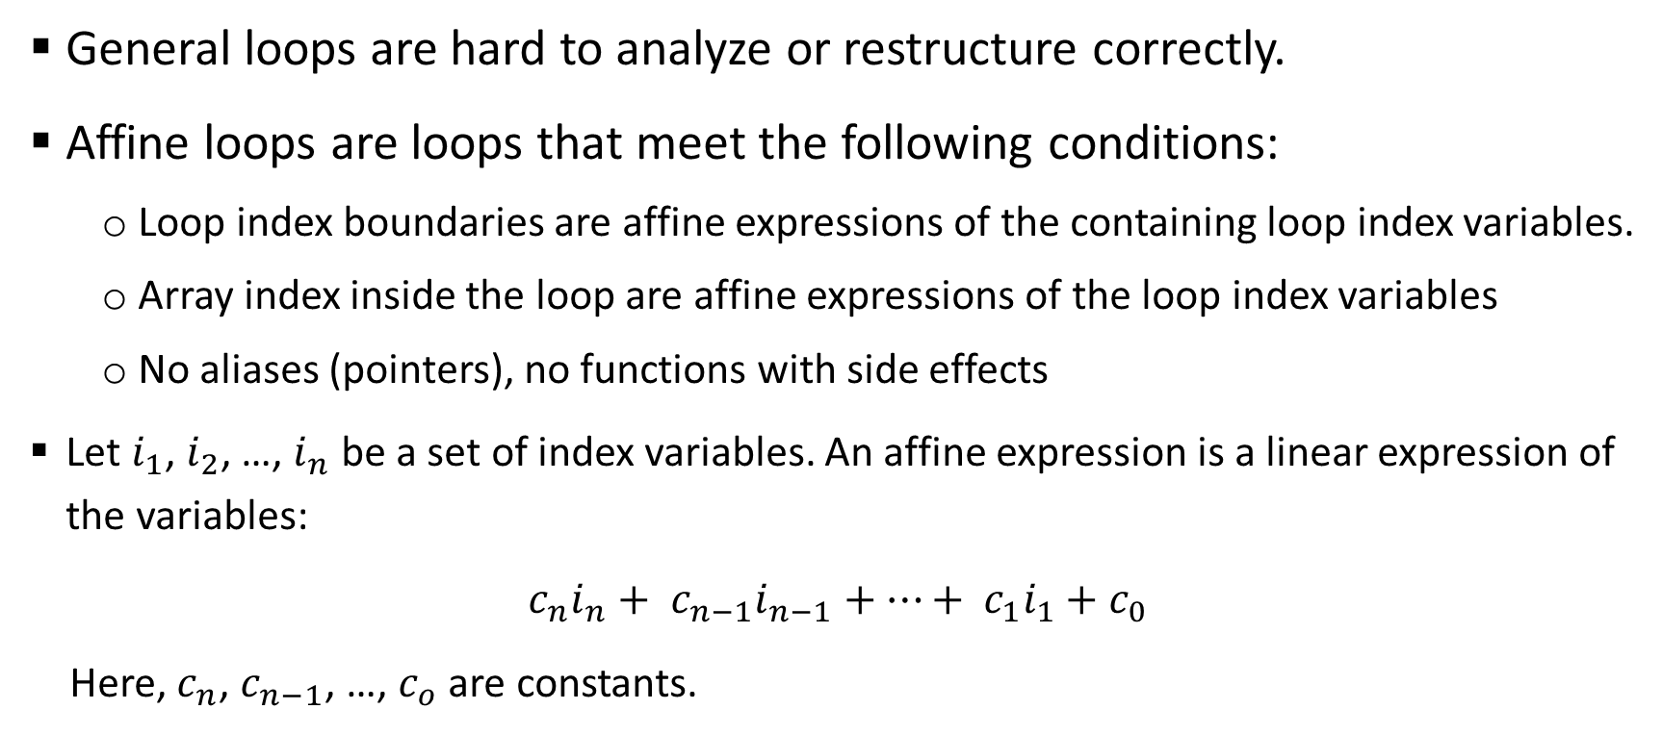
Affine loops
General loops are hard to analyze or restructure correctly.
Affine loops are loops that meet the following conditions:
  Loop index boundaries are affine expressions of the containing loop index variables.
  Array index inside the loop are affine expressions of the loop index variables
  No aliases (pointers), no functions with side effects
  Let $i_{1}$, $i_{2}$, …, $i_{n}$ be a set of index variables. An affine expression is a linear expression of the variables:
  $c_{n}i_{n}+ c_{n−1}i_{n−1}+…+ c_{1}i_{1}+c_{0}$
  Here, $c_{n}$, $c_{n−1}$, …, $c_{o}$ are constants.
for (i =0; i<n; i++)
for (j=0; j<n; j++)
m[i+1][2*j] = 0;
An example affine loop

Slide 8
Dependence analysis
To determine if a certain loop restructuring technical can be applied, we need to know all data dependence among statements in the loops
  This is done through dependence analysis: calculating which statement in an iteration depends on which statement in another iteration, and the type of dependence
Type: anti-dependence
Between: iteration I to iteration i+1
Distance: 1
Direction vector: <+>
for (i=0; i< 1000; i--)
a[i] = a[i+1] + 1;

Slide 9
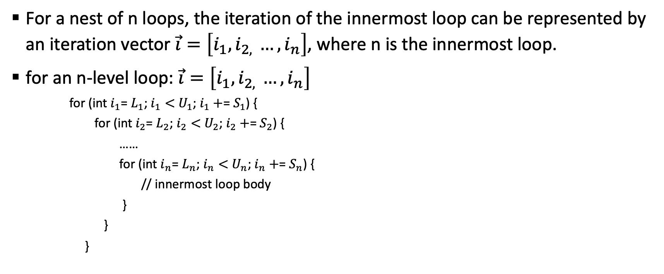
Iteration Number and Vector
For a nest of n loops, the iteration of the innermost loop can be represented by an iteration vector $\vec{i}=\left[i_{1}, i_{2, }…, i_{n}\right]$, where n is the innermost loop.
for an n-level loop: $\vec{i}=\left[i_{1}, i_{2, }…, i_{n}\right]$
    for (int $i_{1}$= $L_{1}$; $i_{1}<$ $U_{1}$; $i_{1}+$= $S_{1}$) {
    for (int $i_{2}$= $L_{2}$; $i_{2}<$ $U_{2}$; $i_{2}+$= $S_{2}$) {
    ……
    for (int $i_{n}$= $L_{n}$; $i_{n}<$ $U_{n}$; $i_{n}+$= $S_{n}$) {
    // innermost loop body
    }
    }
    }

Slide 10
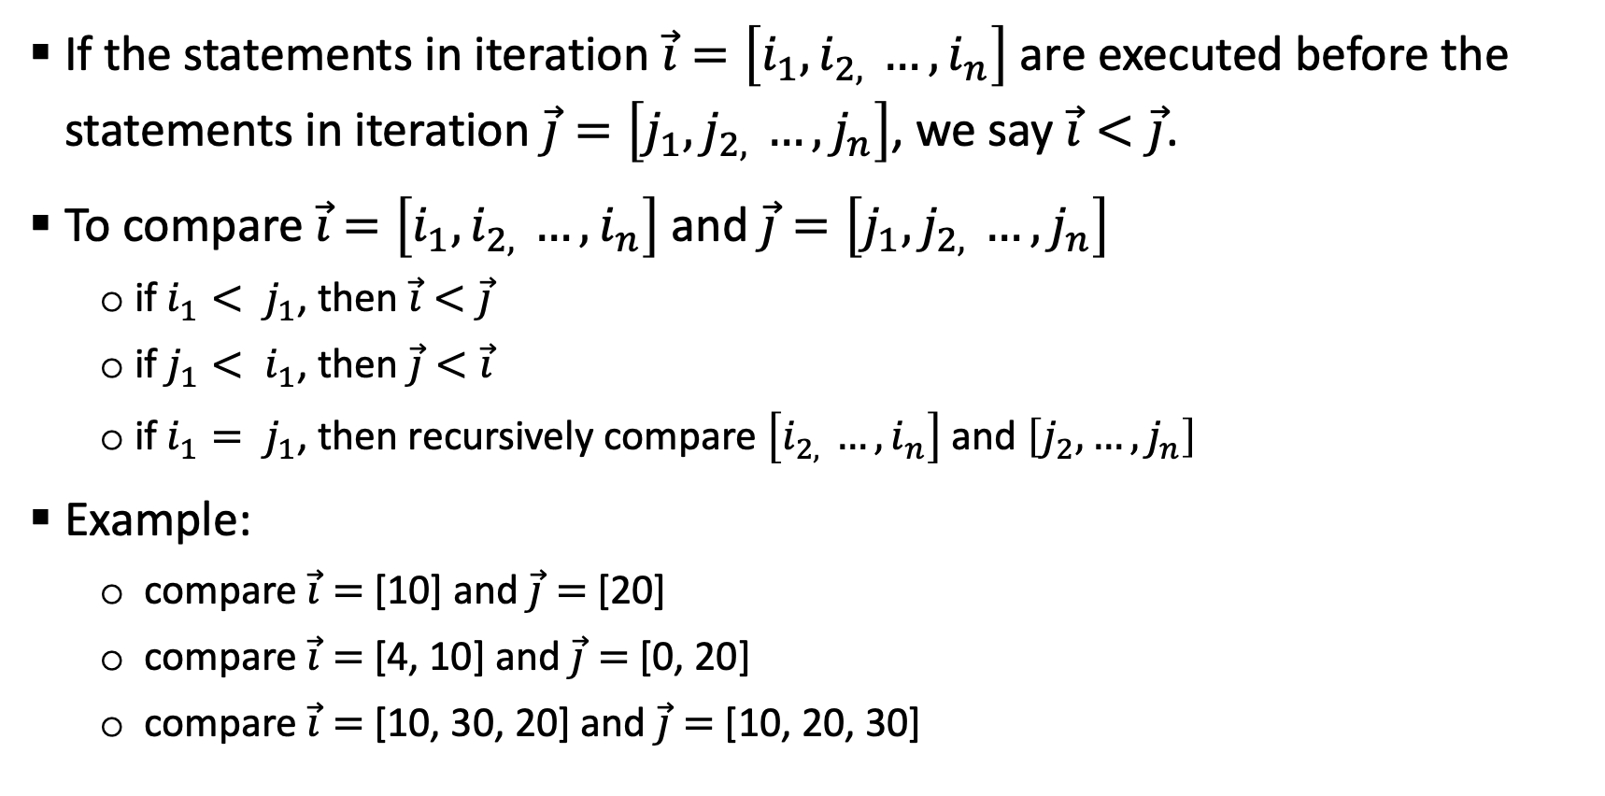
Iteration Number and Vector
If the statements in iteration $\vec{i}=\left[i_{1}, i_{2, }…, i_{n}\right]$ are executed before the statements in iteration $\vec{j}=\left[j_{1}, j_{2, }…, j_{n}\right]$, we say $\vec{i}<\vec{j}$.
To compare $\vec{i}$ $=\left[i_{1}, i_{2, }…, i_{n}\right]$ and $\vec{j}=\left[j_{1}, j_{2, }…, j_{n}\right]$
  if $i_{1}< j_{1}$, then $\vec{i}<\vec{j}$
  if $j_{1}< i_{1}$, then $\vec{j}<\vec{i}$
  if $i_{1}= j_{1}$, then recursively compare $\left[i_{2, }…, i_{n}\right]$ and $\left[j_{2}, …, j_{n}\right]$
Example:
  compare $\vec{i}=$[10] and $\vec{j}=$[20]
  compare $\vec{i}=$[4, 10] and $\vec{j}=$[0, 20]
  compare $\vec{i}=$[10, 30, 20] and $\vec{j}=$[10, 20, 30]

Slide 11
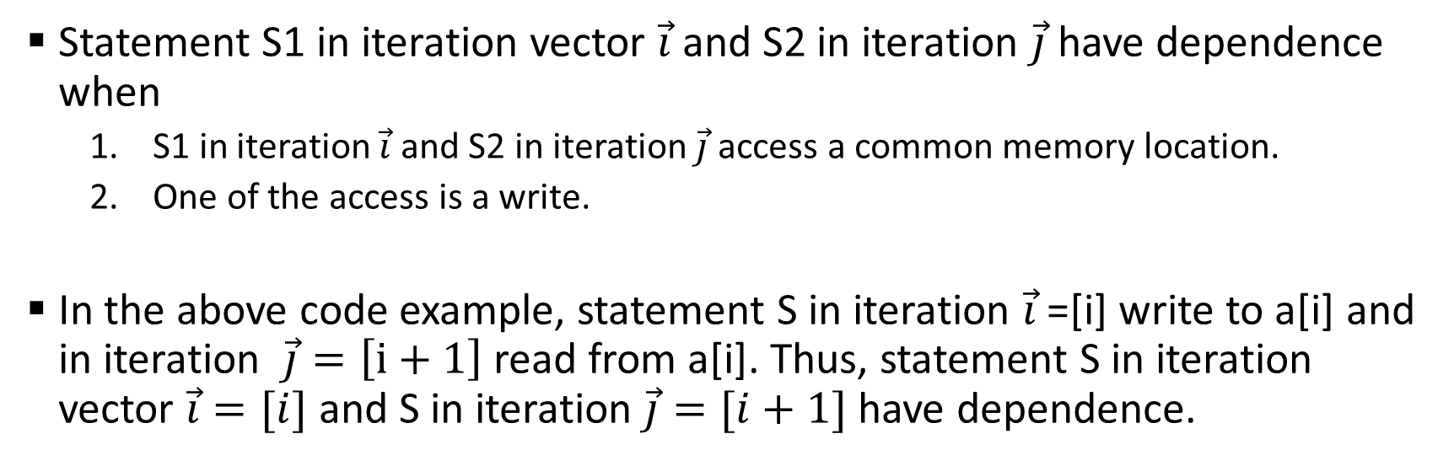
Dependence in a loop
for (i=1; i<n; i++)
S: a[i] = a[i-1] + b[i];
Statement S1 in iteration vector $\vec{i}$ and S2 in iteration $\vec{j}$have dependence when
  S1 in iteration $\vec{i}$ and S2 in iteration $\vec{j}$ access a common memory location.
  One of the access is a write.
In the above code example, statement S in iteration $\vec{i}$=[i] write to a[i] and in iteration $\vec{j}=\left[i+1\right]$ read from a[i]. Thus, statement S in iteration vector $\vec{i}=[i]$ and S in iteration $\vec{j}=[i+1]$have dependence.

Slide 12
Loop carried dependence
A loop-carried dependence is a dependence that is present only when the dependence is between statements in different iterations of a loop.
  Otherwise, we call it loop-independent dependence.
Loop-carried dependence must be preserved when we restructure the loop (change the order in the iteration space).
Loop-carried dependence is also what prevents loops from being parallelized.

Slide 13
Loop Reordering transformation
A loop reordering transformation preserves a dependence if it preserves and relative execution order of the source and sink of the dependence.
Any reordering transformation that preserves every dependence in a program preserves the semantics of the program
Loop optimization: Finding the reordering transformation that preserves all dependence in the program while achieving performance
  Find all dependence distance/direction vector in the loops, make sure that the transformations preserves all of them.

Slide 14
Scalar replacement of array elements
for (i=0; i<N; i++)
for(j=0; j<N; j++)
for (k=0; k<N; k++)
c(i, j) = c(i, j) + a(i, k)* b(k, j);
Scalar replacement allows registers to be allocated to the scalar, which reduces memory references.
  Registers are almost never allocated to array elements.
Notice in the example that ct creates loop carried dependence.
for (i=0; i<N; i++)
for(j=0; j<N; j++) {
ct = c(i, j)
for (k=0; k<N; k++)
ct = ct + a(i, k)* b(k, j);
c(i, j) = ct;
}

Slide 15
Loop normalization
for (i=a; i<b; i+= c) {
// loop body
}
Make the loop index variable starts from 1 (or 0) with a step of 1.
It does not do too much by itself. But it simplifies the iteration space and makes it easier to manipulate, which enables other optimizations.
for (ii=1; ii<(b-a)/c; ii++) {
i = a + (ii-1) *c;
// loop body
}

Slide 16
Loop transformations
Change the shape and direction of loop iterations
  Change the access pattern
    Increase data reuse (locality)
    Reduce overheads
  Valid transformations need to maintain all loop carried dependence.
  Unimodular transformations
    Loop interchange, loop permutation, loop reversal, loop skewing, and many others
  Loop fusion and distribution
  Loop tiling
  Loop unrolling

Slide 17
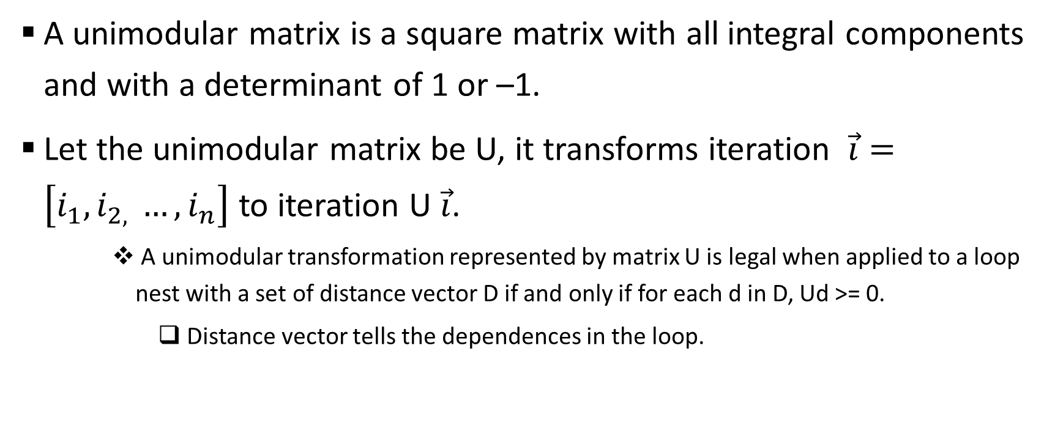
Unimodular transformations
A unimodular matrix is a square matrix with all integral components and with a determinant of 1 or –1.
Let the unimodular matrix be U, it transforms iteration $\vec{i}=\left[i_{1}, i_{2, }…, i_{n}\right]$ to iteration U $\vec{i}$.
    A unimodular transformation represented by matrix U is legal when applied to a loop nest with a set of distance vector D if and only if for each d in D, Ud >= 0.
      Distance vector tells the dependences in the loop.

Slide 18
Unimodular transformations: loop interchange
for (i=0; i<n; i++)
for (j=0; j < n; j++)
a(i, j) = a(i-1, j) + 1;
for (j=0; j<n; j++)
for (i=0; i < n; i++)
a(i,j) = a(i-1, j) + 1;
Distance vector = [1, 0]
Ud >= 0, the transformation for this loop nest is legal.

Slide 19
Unimodular transformations: loop permutation
for (i=0; i<n; i++)
for (j=0; j < n; j++)
for (k=0; k < n; k++)
for (l=0; l<n; l++)
// loop body
for (k=0; k<n; k++)
for (l=0; l < n; l++)
for (i=0; i < n; i++)
for (j=0; j<n; j++)
// loop body

Slide 20
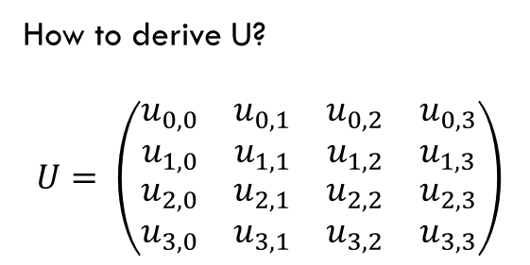
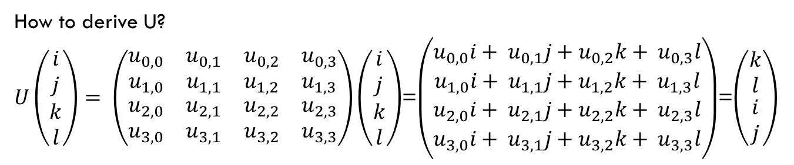
Unimodular transformations: loop permutation
for (i=0; i<n; i++)
for (j=0; j < n; j++)
for (k=0; k < n; k++)
for (l=0; l<n; l++)
// loop body
for (k=0; k<n; k++)
for (l=0; l < n; l++)
for (i=0; i < n; i++)
for (j=0; j<n; j++)
// loop body
How to derive U?
$$U= \left(\begin{matrix}\begin{matrix}u_{0,0} & u_{0,1} \\ u_{1,0} & u_{1,1}\end{matrix} & \begin{matrix}u_{0,2} & u_{0,3} \\ u_{1,2} & u_{1,3}\end{matrix} \\ \begin{matrix}u_{2,0} & u_{2,1} \\ u_{3,0} & u_{3,1}\end{matrix} & \begin{matrix}u_{2,2} & u_{2,3} \\ u_{3,2} & u_{3,3}\end{matrix}\end{matrix}\right)$$
How to derive U?
$U\left(\begin{matrix}\begin{matrix}i \\ j\end{matrix} \\ \begin{matrix}k \\ l\end{matrix}\end{matrix}\right)= \left(\begin{matrix}\begin{matrix}u_{0,0} & u_{0,1} \\ u_{1,0} & u_{1,1}\end{matrix} & \begin{matrix}u_{0,2} & u_{0,3} \\ u_{1,2} & u_{1,3}\end{matrix} \\ \begin{matrix}u_{2,0} & u_{2,1} \\ u_{3,0} & u_{3,1}\end{matrix} & \begin{matrix}u_{2,2} & u_{2,3} \\ u_{3,2} & u_{3,3}\end{matrix}\end{matrix}\right)\left(\begin{matrix}\begin{matrix}i \\ j\end{matrix} \\ \begin{matrix}k \\ l\end{matrix}\end{matrix}\right)$=$\left(\begin{matrix}\begin{matrix}u_{0,0}i+ u_{0,1}j+u_{0,2}k+ u_{0,3}l \\ u_{1,0}i+ u_{1,1}j+u_{1,2}k+ u_{1,3}l\end{matrix} \\ \begin{matrix}u_{2,0}i+ u_{2,1}j+u_{2,2}k+ u_{2,3}l \\ u_{3,0}i+ u_{3,1}j+u_{3,2}k+ u_{3,3}l\end{matrix}\end{matrix}\right)$=$\left(\begin{matrix}\begin{matrix}k \\ l\end{matrix} \\ \begin{matrix}i \\ j\end{matrix}\end{matrix}\right)$
Hence, $u_{0,0}i+ u_{0,1}j+u_{0,2}k+ u_{0,3}l=k ⇒u_{0,2}$ = 1, $u_{0,0}$ = 0, $u_{0,1}$ = 0, $u_{0,3}$ = 0

Slide 21
for (int i = 0; i<n; i++)
for (int j=0; j<n; j++)
for (int k=0; k<n; k++) {
S1: a[i+1][j][k-2] = a[i][j][k] + 1;
S2: a[i+1][j-1][k+2] = c[i][j][k] + d[i][j][k];
}
Is this legal?
Distance vectors for the loop
[1, 0, -2], [1, -1, 2], and [0, 1, -4].
for (int k = 0; k<n; k++)
for (int i=0; i<n; i++)
for (int j=0; j<n; j++) {
S1: a[i+1][j][k-2] = a[i][j][k] + 1;
S2: a[i+1][j-1][k+2] = c[i][j][k] + d[i][j][k];
}

Slide 22
Unimodular transformations: loop reversal
for (i=0; i<n; i++)
for (j=0; j < n; j++)
a(i,j) = a(i-1, j) + 1.0;
for (i=0; i<n; j++)
for (j=n; j >=0; i--)
a(i,j) = a(i-1, j) + 1.0;

Slide 23
Unimodular transformations: loop skewing
for (i=0; i<n; i++)
for (j=0; j < n; j++)
a(i) = a(i+ j) + 1.0;
for (i=0; i<n; i++)
for (j=i+1; j <i+n; j++)
a(i) = a(j) + 1.0;

Slide 24
Loop fusion
Takes two adjacent loops that have the same iteration space and combines the body.
  Legal when there are no flow, anti- and output dependences in the fused loop.
  Why
    Increase the loop body, reduce loop overheads
    Increase the chance of instruction scheduling
    May improve locality
for (i=0; i<n; i++)
a(i) = 1.0;
for (j=0; j<n; j++)
b(j) = 1.0
for (i=0; i<n; i++) {
a(i) = 1.0;
b(i) = 1.0;
}

Slide 25
Loop distribution
Takes one loop and partitions it into two loops.
  Why
    Reduce memory trace
    Improve locality
    Increase the chance of instruction scheduling
for (i=0; i<n; i++) {
a(i) = 1.0;
b(i) = a(i);
}
for (i=0; i<n; i++)
a(i) = 1.0;
for (i=0; i<n; i++)
b(i) = a(i)

Slide 26
Loop tiling
Replacing a single loop into two loops.
  for(I=0; I<n; I++) … → for(I=0; I<n; I+=t) for (ii=I, ii < min(I+t,n); ii++) …
    T is call tile size;
N-deep nest can be changed into n+1-deep to 2n-deep nest.
for (i=0; i<n; i++)
for (j=0; j<n; j++)
for (k=0; j<n; k++)
For (i=0; i<n; i+=t)
for (ii=I; ii<min(i+t, n); ii++)
for (j=0; j<n; j+=t)
for (jj=j; jj < min(j+t, n); jj++)
for (k=0; j<n; k+=t)
for (kk = k; kk<min(k+t, n); kk++)

Slide 27
Loop tiling
When using with loop interchange, loop tiling create inner loops with smaller memory trace – great for locality.
Loop tiling is one of the most important techniques to optimize for locality
  Reduce the size of the working set and change the memory reference pattern.
For (i=0; i<n; i+=t)
for (ii=I; ii<min(i+t, n); ii++)
for (j=0; j<n; j+=t)
for (jj=j; jj < min(j+t, n); jj++)
for (k=0; j<n; k+=t)
for (kk = k; kk<min(k+t, n); kk++)
For (i=0; i<n; i+=t)
for (j=0; j<n; j+=t)
for (k=0; k<n; k+=t)
for (ii=I; ii<min(i+t, n); ii++)
for (jj=j; jj < min(j+t, n); jj++)
for (kk = k; kk<min(k+t, n); kk++)

Slide 28
Loop Tiling example
For (i=0; i<160000; i++)
for (j=0; j<160000; j++)
a[i][j] = b[i][j] + c[i][j];
For (i=0; i<10000; i+=16)
for (j=0; j<10000; j+=16)
for (ii=I; ii<16; ii++)
for (jj=j; jj<16; jj++)
a[ii][jj] = b[ii][jj] + c[ii][jj];
The inner loop has a small memory footprint and may
Fit in L1 cache.

Slide 29
Loop unrolling
Reduce control overheads.
Increase chance for instruction scheduling.
Large body may require more resources (register).
This can be very effective!!!!
for (i=0; i<100; i++) a(i) = 1.0;
for (i=0; i<100; i+=4) {
a(i) = 1.0;
a(i+1) = 1.0;
a(i+2) = 1.0;
a(i+3) = 1.0;
}

Slide 30
Loop optimization in action
Use matrix multiply as a working example to demonstrate loop optimizations:
  Architecture features
  Loop restructuring techniques
  Same principles extend to optimizing other types of programs

Slide 31
Matrix multiplication
Optimizing matrix multiply:
    for (i=1; i<=N; i++)
    for (j=1; j<=N; j++)
    for(k=1; k<=N; k++)
    c(i, j) = c(i, j) + A(i, k)*B(k, j)
See the naïve_mm() routine in my_mm.c
  No dependence in the loops. The innermost loop body, c(i, j) = c(i, j) + A(i, k)*B(k, j), can be executed in any order, allow many loop optimization techniques to be applied.
First try: rely on compiler to improve the performance (turn on –O3 flag in gcc)
  See the performance improvement with ‘./a.out 1024 2 0’ (run 1024x1024 matrix multiply two times using naïve_mm()
  Can we go further?

Slide 32
Improve Cache Performance
Cache performance
  Cache is designed to support spatial locality: when a memory location is accessed, its nearby memory is likely accessed efficiently
  Cache is designed to support temporal locality: when a memory location is accessed, repeated access in the near future is likely efficient.
Cache performance is closely related to the memory access pattern in the innermost loop.
  Access pattern is affected by the memory storage scheme
  C compiler by default
    Stores a one dimensional array continuously
    Stores a multiple dimensional array using the row-major order

Slide 33
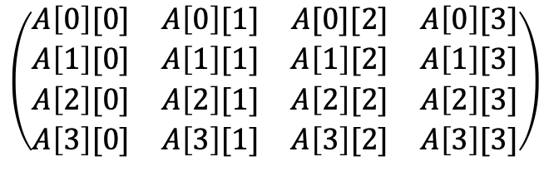
Row-major order and column-major order
Row-major order:
Column-major order:
$$\left(\begin{matrix}A\left[0\right][0] & A\left[0\right][1] & A[0][2] & A\left[0\right][3] \\ A\left[1\right][0] & A\left[1\right][1] & A\left[1\right][2] & A\left[1\right][3] \\ A\left[2\right][0] & A\left[2\right][1] & A\left[2\right][2] & A\left[2\right][3] \\ A\left[3\right][0] & A\left[3\right][1] & A\left[3\right][2] & A\left[3\right][3]\end{matrix}\right)$$
A[0][0]
A[0][1]
A[0][2]
A[0][3]
A[1][0]
A[1][1]
A[1][2]
A[1][3]
A[2][0]
A[2][1]
…
A[0][0]
A[1][0]
A[2][0]
A[3][0]
A[0][1]
A[1][1]
A[2][1]
A[3][1]
A[0][2]
A[1][2]
…

Slide 34
Access pattern in the innermost loop
A array
B array
Innermost loop
    for(k=1; k<=N; k++)
    c(i, j) = c(i, j) + A(i, k)*B(k, j)
Let i=1, j=0.
Array A’s access pattern: A[1][0], A[1][1], A[1][2], …
Array B’s access pattern: B[0][0], B[1][0], B[2][0], …
Access of A is continuous and has great spatial locality.
Access of B is strided and does not have spatial locality.
A[0][0]
A[0][1]
A[0][2]
A[0][3]
A[1][0]
A[1][1]
A[1][2]
A[1][3]
A[2][0]
A[2][1]
…
B[0][0]
B[0][1]
B[0][2]
B[0][3]
B[1][0]
B[1][1]
B[1][2]
B[1][3]
B[2][0]
B[2][1]
…

Slide 35
Fix the access to the B array
A array
B array
W array
A[0][0]
A[0][1]
A[0][2]
A[0][3]
A[1][0]
A[1][1]
A[1][2]
A[1][3]
A[2][0]
A[2][1]
…
B[0][0]
B[0][1]
B[0][2]
B[0][3]
B[1][0]
B[1][1]
B[1][2]
B[1][3]
B[2][0]
B[2][1]
…
B[0][0]
B[1][0]
B[2][0]
B[3][0]
B[0][1]
B[1][1]
B[2][1]
B[3][1]
B[0][2]
B[1][2]
…
Make a copy of B
Array that use column-major order.

Slide 36
The code
Improve spatial locality in the inner loop, references to both A and B have a stride 1.
  Transpose Array B before go into this operation (assuming row-major storage).
  See my_mm1() routine, and run with ‘./a.out 1024 2 1’
Transpose b /* for all i, j, w(i, j) = b(j, i) */
For (i=1; i<=N; i++)
for (j=1; j<=N; j++)
for(k=1; k<=N; k++)
c(i, j) = c(i, j) + a(i, k)*w(j, k)

Slide 37
Scalar replacement of array elements
for (i=0; i<N; i++)
for(j=0; j<N; j++)
for (k=0; k<N; k++)
c(i, j) = c(i, j) + a(i, k)* b(k, j);
Scalar replacement allows registers to be allocated to the scalar, which reduces memory references.
  Registers are almost never allocated to array elements.
See my_mm2() routine
Try ‘./a.out 1024 2 2’
for (i=0; i<N; i++)
for(j=0; j<N; j++) {
ct = c(i, j)
for (k=0; k<N; k++)
ct = ct + a(i, k)* b(k, j);
c(i, j) = ct;
}

Slide 38
Improving temporal locality
Each item in A and B is used N times – there are opportunities for temporal locality
In the innermost loop, each item in A and B is used once – the current code structure has poor temporal locality
  Inner loops memory footprint is too large:
    A(1..N, i), B(1..N, j)
Technique to improve temporal locality:
  Loop tiling + loop interchange

Slide 39
Loop tiling
Replacing a single loop into two loops.
  for(I=0; I<n; I++) … → for(I=0; I<n; I+=t) for (ii=I, ii < min(I+t,n); ii++) …
    T is call tile size;
N-deep nest can be changed into n+1-deep to 2n-deep nest.
for (i=0; i<n; i++)
for (j=0; j<n; j++)
for (k=0; j<n; k++)
For (i=0; i<n; i+=t)
for (ii=i; ii<min(i+t, n); ii++)
for (j=0; j<n; j+=t)
for (jj=j; jj < min(j+t, n); jj++)
for (k=0; j<n; k+=t)
for (kk = k; kk<min(k+t, n); kk++)

Slide 40
Loop exchange
When using with loop exchange, loop tiling create inner loops with smaller memory trace – great for temporal locality.
Loop tiling + loop exchange is one of the most important techniques to optimize for locality
  Reduce the size of the working set and change the memory reference pattern.
For (i=0; i<n; i+=t)
for (ii=I; ii<min(i+t, n); ii++)
for (j=0; j<n; j+=t)
for (jj=j; jj < min(j+t, n); jj++)
for (k=0; j<n; k+=t)
for (kk = k; kk<min(k+t, n); kk++)
For (i=0; i<n; i+=t)
for (j=0; j<n; j+=t)
for (k=0; k<n; k+=t)
for (ii=I; ii<min(i+t, n); ii++)
for (jj=j; jj < min(j+t, n); jj++)
for (kk = k; kk<min(k+t, n); kk++)

Slide 41
Improve temporal locality
See my_mm4() routine, run with ‘./a.out 1024 2 4’
      for (j=1; j<=N; j+=t)
      for(k=1; k<=N; k+=t)
      for(I=1; i<=N; i+=t)
      for (ii=I; ii<=min(I+t-1, N); ii++)
      for (jj = j; jj<=min(j+t-1,N);jj++) {
      t = c(ii, jj);
      for(kk=k; kk <=min(k+t-1, N); kk++)
      t = t + A(kk, ii)*B(kk, jj)
      c(ii, jj) = t
      }

Slide 42
Reducing branch instructions: Loop unrolling
Reduce control overheads.
Increase chance for instruction scheduling.
Large body may require more resources (register).
This can be very effective!!!!
for (i=0; i<100; i++) a(i) = 1.0;
for (i=0; i<100; i+=4) {
a(i) = 1.0;
a(i+1) = 1.0;
a(i+2) = 1.0;
a(i+3) = 1.0;
}

Slide 43
Loop unrolling
See my_mm5() routing and run ‘./a.out 1024 2 5’
for (j=1; j<=N; j+=t)
for(k=1; k<=N; k+=t)
for(I=1; i<=N; i+=t)
for (ii=I; ii<=min(I+t-1, N); ii++)
for (jj = j; jj<=min(j+t-1,N);jj++) {
t = c(ii, jj);
t = t + A(kk, ii) * B(kk, jj);
t = t + A(kk+1, ii) * B(kk+1, jj);
……
t = t + A(kk+15, ii) * B(kk + 15, jj);
c(ii, jj) = t
}
This assumes the loop can be nicely unrolled, you need to take care of the boundary condition.

Slide 44
Instruction scheduling
See my_mm6() routine and run ‘./a.out 1024 2 6’
  ‘+’ would have to wait on the results of ‘*’ in a typical processor.
  ‘*’ is often deeply pipelined: feed the pipeline with many ‘*’ operation.
  Effective for older machine, no longer effective on the current linprog.
for (j=1; j<=N; j+=t)
for(k=1; k<=N; k+=t)
for(I=1; i<=N; i+=t)
for (ii=I; ii<=min(I+t-1, N); ii++)
for (jj = j; jj<=min(j+t-1,N);jj++) {
t0 = A(kk, ii) * B(kk, jj);
t1 = A(kk+1, ii) * B(kk+1, jj);
……
t15 = A(kk+15, ii) * B(kk + 15, jj);
c(ii, jj) = c(ii, jj) + t0 + t1 + … + t15;
}

