Slide 1
Graphs Algorithms
Sections 9.1, 9.2, and 9.3

Slide 2
Graphs
A graph G = (V, E)
  V: set of vertices (nodes)
  E: set of edges (links)
Complete graph
  There is an edge between every pair of vertices
Two kinds of graph
  Undirected
  Directed (digraph)
Undirected graph:
  E consists of sets of two elements each: Edge {u, v} is the same as {v, u}
v₁
v₂
v₃
v₄
v₅
v₆
v₇
v₈

Slide 3
Directed Graphs
A directed graph, or digraph:
  E is set of ordered pairs
  Even if edge (u, v) is present, the edge (v, u) may be absent
Directed graphs are drawn with nodes for vertices and arrows for edges
v₁
v₂
v₃
v₄
v₅
v₆
v₇
v₈

Slide 4
Terminology
Adjacency
  Vertex w is adjacent to v if and only if (v, w) is in E
Weight
  A cost parameter associated with each edge
Path
  A sequence of vertices w₁,w₂,…,w_{n}, where there is an edge for each pair of consecutive vertices
Length of a path
  Number of edges along path
  Length of a path of n vertices is n-1
Cost of a path
  Sum of the weights of the edges along the path
v₁
v₂
v₃
3
5
-2
2
v₄
v₅
v₆
4
-1
v₇
1
v₈

Slide 5
Cycles
v₂
v₃
v₁
v₂
v₃
v₁
v₄
v₄
v₅
v₆
v₅
v₆
v₇
v₇
v₈
v₈
A path is simple
  if all its vertices are distinct (except that the first and last may be equal)
A cycle is a path w₁,w₂,…,w_{n}=w₁,
  A cycle is simple if the path is simple.
  Above, v₂, v₈, v₆, v₃, v₅, v₂ is a simple cycle in the undirected graph, but not even a path in the digraph

Slide 6
Further terminology
v₁
v₂
v₃
An undirected graph G is connected if,
  for each pair of vertices u, v, there is a path that starts at u and ends at v
A digraph H that satisfies the above condition is strongly connected
Otherwise, if H is not strongly connected, but the undirected graph G with the same set of vertices and edges is connected, H is said to be weakly connected
v₄
v₅
v₆
v₇
v₈
v₁
v₂
v₃
v₄
v₅
v₆
v₇
v₈

Slide 7
Representation of Graphs
To store graph information, we need to store the connectivity (link) information.
Two popular representations
  Adjacency matrix
    Use a 2-dimension array to store the connectivity: A[u][v] is true if there is an edge from u to v, false otherwise
    A[u][v] may store the weight for a weighed graph
  Adjacency list
    Each node maintains a list of neighbors (adjacent nodes)

Slide 8
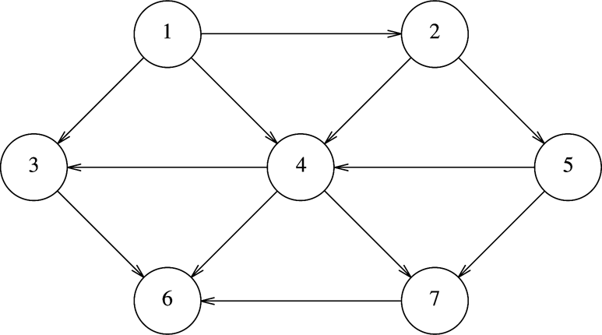
Representation of Graphs
Adjacency matrix
  A[u][v] is true if there is an edge from u to v
  False otherwise
  For a weighted graph, assign weight instead of true/false
  O(1) time to decide whether (u, v) is an edge
  A[N][N] – O(|V|²) space
    Wasteful if the graph is sparse (not many edges)
F | T | T | T | F | F | F
F | F | F | T | T | F | F
F | F | F | F | F | T | F
F | F | T | F | F | T | T
F | F | F | T | F | F | T
F | F | F | F | F | F | F
F | F | F | F | F | T | F
Adjacency matrix

Slide 9
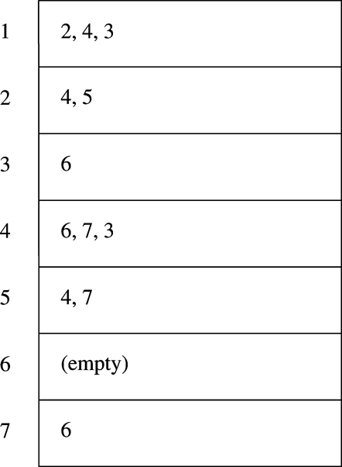
Representation of Graphs
Adjacency list
  Each node maintains a list of neighbors (adjacent nodes)
  Need to go through the list to decide if (u, v) is an edge
  Takes O(|V|+|E|) space
Adjacency list

Slide 10
Representation of Graphs
Adjacency matrix .vs. adjacency list
  O(|V|²) .vs. O( |V| + |E| )
  Are typical practical graphs dense or sparse?
  A popular social media network can easily have tens of millions of users. Can their adjacency matrix be stored in one computer?

Slide 11
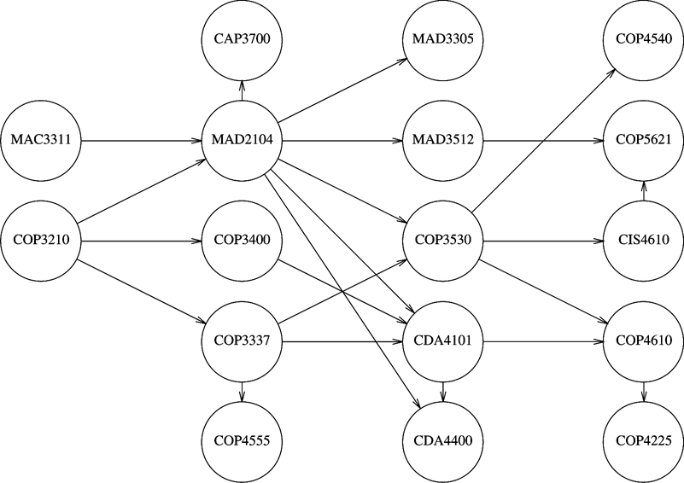
Topological sorting
Let G be a directed acyclic graph (DAG)
Topological sorting
  an ordering the vertices of G such that if there is an edge from v_{i} to v_{j}, then v_{j} appears after v_{i}
One topological sorting
MAC3311, COP3210,
MAD2104, CAP3700,
COP3400, COP3337,
COP4555, MAD3305,
MAD3512, COP3530,
CDA4101, COP4610,
CDA4400, COP4225,
CIS4610, COP5621,
COP4540

Slide 12
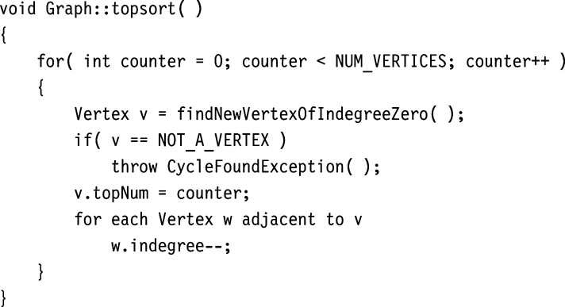
Topological sorting
In a DAG, there must be a vertex with no incoming edges
Have each vertex maintain its indegree
  Indegree of v = number of edges (u, v)
Repeat
  Find a vertex of current indegree 0,
  assign it a rank,
  reduce the indegrees of the vertices in its adjacency list
Running time
  = O(|V|²)

Slide 13
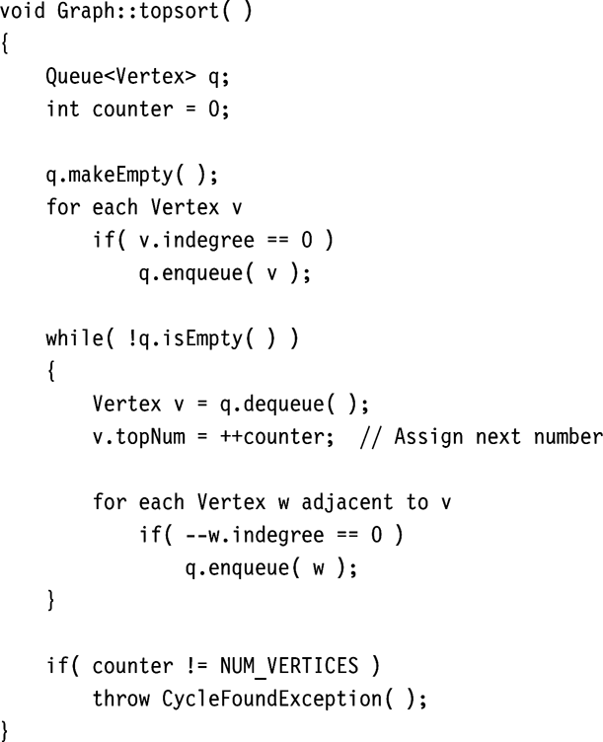
Topological sort
A better algorithm
  separating nodes with indegree 0
  Use a queue to maintain nodes with indegree 0
  O(|E|+|V|)

Slide 14
Single-Source Shortest-Path Problem
Given a graph, G = (V, E), and a distinguished vertex, s, find the shortest path from s to every other vertex in G.
Unweighted shortest paths
  Breadth-first search
Weighted shortest paths
  Dijkstra’s algorithm
    Assuming no negative edges in graph

Slide 15
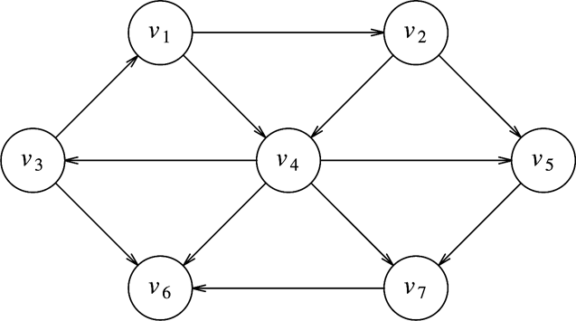
Unweighted shortest paths (Example)
Find shortest paths from v₃ to all other nodes

Slide 16
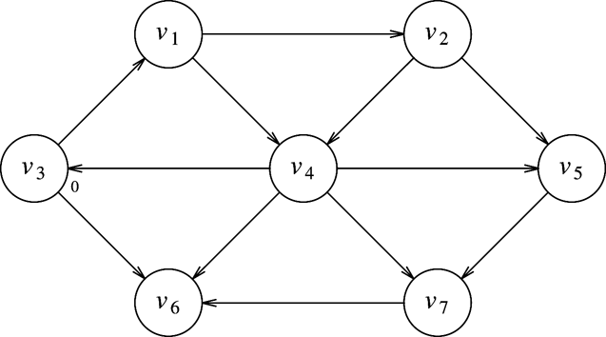
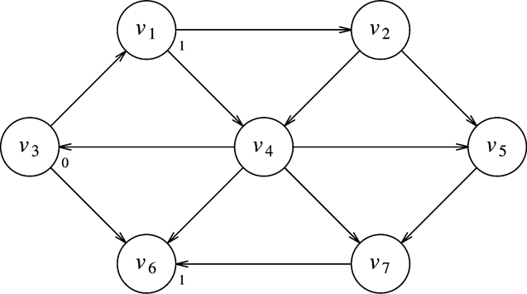
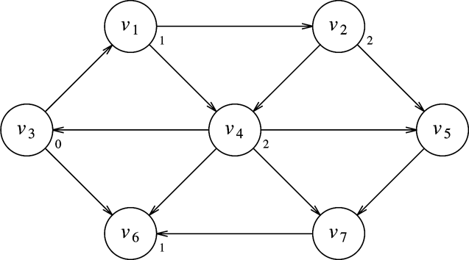
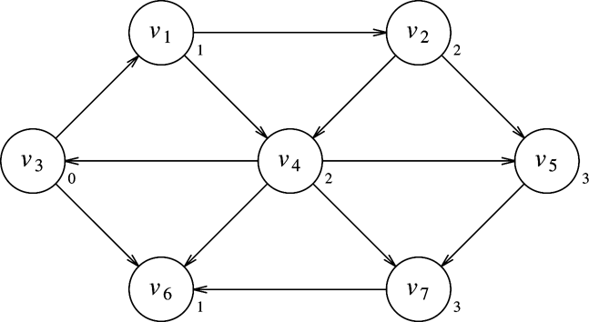
Example (Cont’d)
(1)
(2)
(3)
(4)

Slide 17
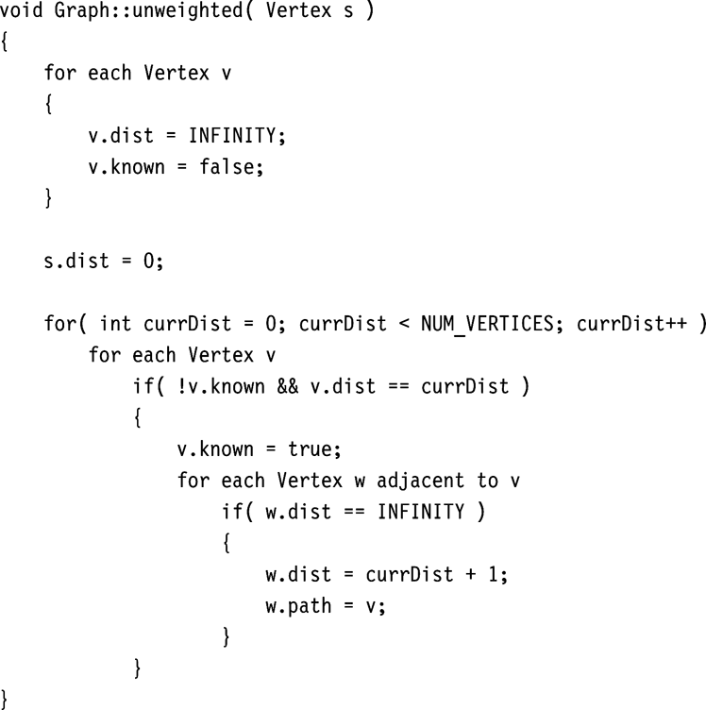
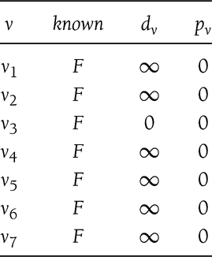
Implementation of unweighted shortest paths
Running time O(|V|²)

Slide 18
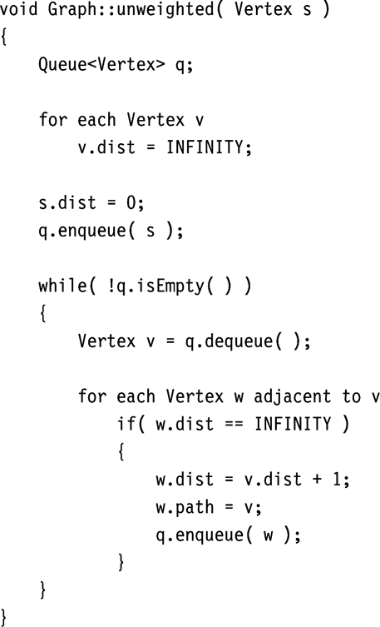
A better way
Separating unknown nodes with minimum distance
Using queue to track the nodes to visit
Complexity
  O(|E|+|V|)

Slide 19
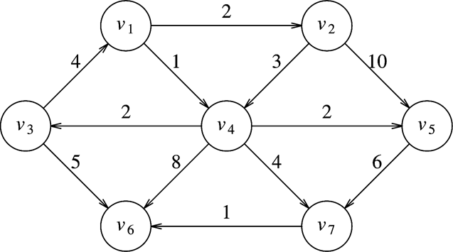
Weighted graphs: Dijkstra’s algorithm
The weighted-edge version of the previous algorithm is called Dijkstra’s algorithm for shortest paths
The process: (1) pick one node with the shortest distance, (2) update the distance for all nodes that are adjacent to the picket node, (3) repeat until all nodes are picked.

Slide 20
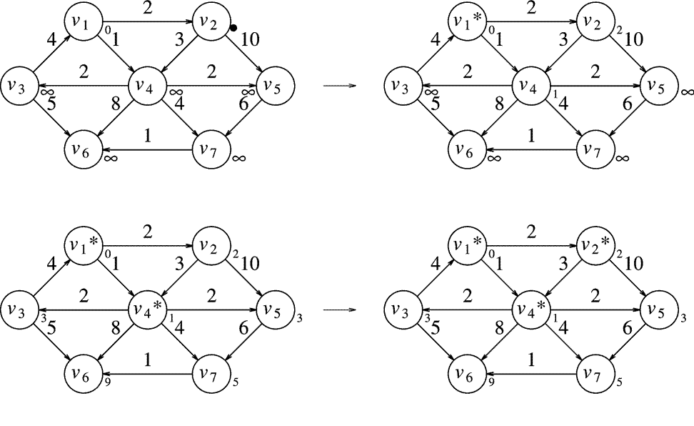
Example (Source is v₁)

Slide 21
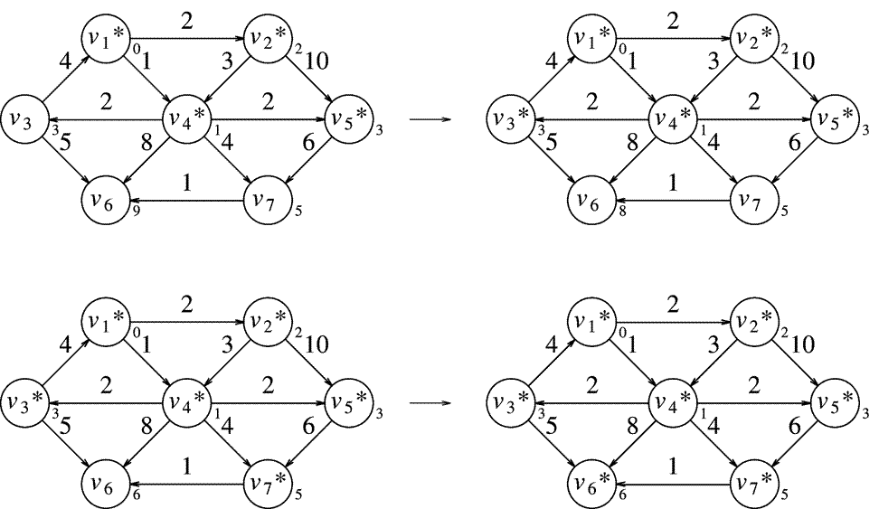
Example (Cont’d)

Slide 22
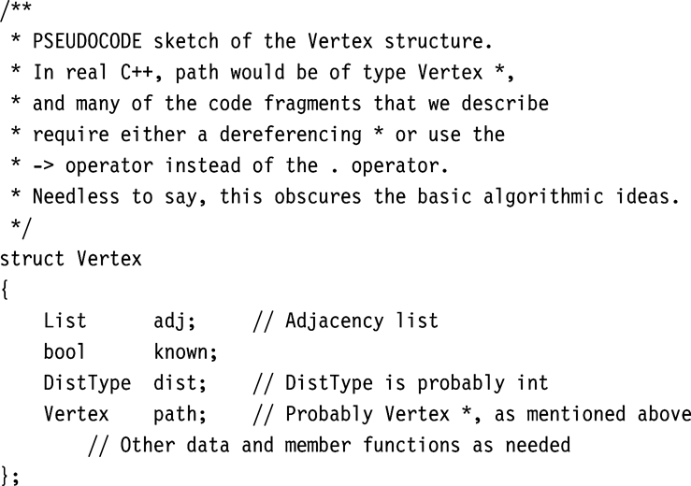
Implementation of Dijkstra’s Algorithm

Slide 23
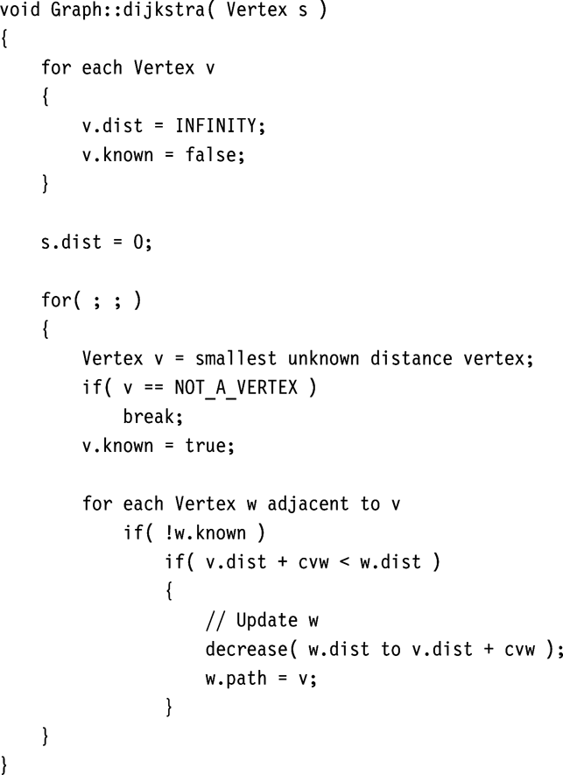
Implementation (Cont’d)
Complexity depends on how smallest distance vertex identified.
Sequential search
  O(|V|²)
Priority queue (heap)
  O(|E|log|V|+|V|log|V|)
Fibonacci heap
  O(|E| + |V|)

