Slide 1
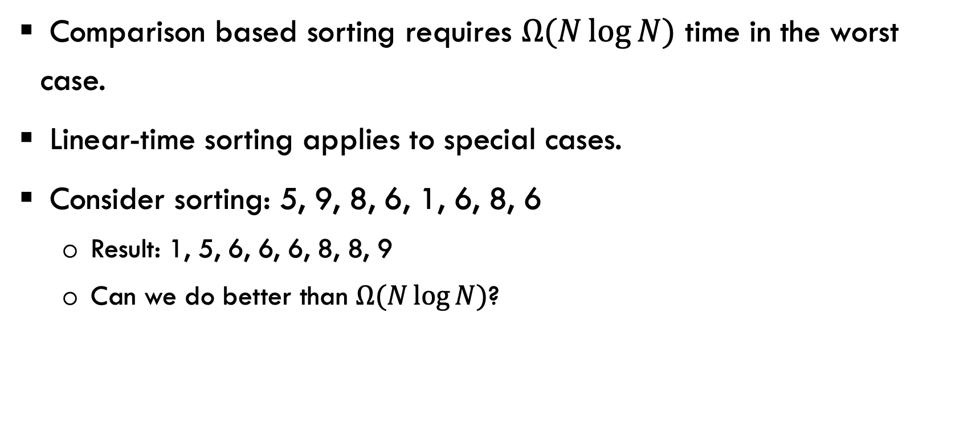
Linear-Time Sorts (Chapter 7.11)
Comparison based sorting requires $Ω(N\log{N)}$ time in the worst case.
Linear-time sorting applies to special cases.
Consider sorting: 5, 9, 8, 6, 1, 6, 8, 6
  Result: 1, 5, 6, 6, 6, 8, 8, 9
  Can we do better than $Ω(N\log{N)}$?

Slide 2
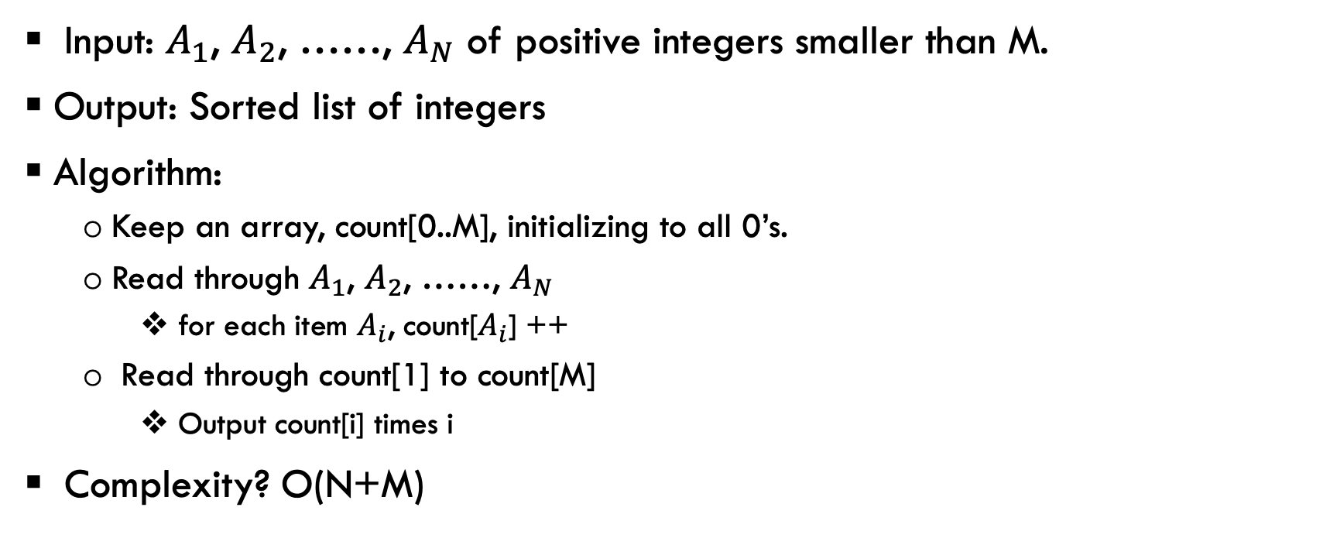
Bucket sort
Input: $A_{1}$, $A_{2}$, ……, $A_{N}$ of positive integers smaller than M.
Output: Sorted list of integers
Algorithm:
  Keep an array, count[0..M], initializing to all 0’s.
  Read through $A_{1}$, $A_{2}$, ……, $A_{N}$
    for each item $A_{i}$, count[$A_{i}$] ++
  Read through count[1] to count[M]
    Output count[i] times i
Complexity? O(N+M)

Slide 3
Bucket Sort
To sort: 5, 9, 8, 6, 1, 6, 8, 6
Count[]: 0 1 2 3 4 5 6 7 8 9
After going through the input data: count[0] = 0, count[1] = 1, ......
Read through count[0] to count[9], output count[i] times i.
Question:
  Whaf if the data contain other fields than the key?
0 | 0 | 0 | 0 | 0 | 0 | 0 | 0 | 0 | 0 | 0

Slide 4
Bucket Sort
What if the data has other fields than the key?
  Modify the count array to be an array of buckets (just like the Hash table in our project).
  Is the sorting stable in this case?
O(N+M) algorithm, good if M is in the same order as N.
limitation: needs an O(M) space, so M cannot be very large.
What if we want to use the idea of Bucket sort to sort based on social security number? xxx-xx-xxxx
  Do it naively, the size of the count array = 1,000,000,000

Slide 5
Radix Sort
What if we want to use the idea of Bucket sort to sort based on social security number? xxx-xx-xxxx
We can use a count array of size 1000, and perform bucket sort 3 times to sort based on the social security number.
  Use bucket sort to sort from the last significant bits to the most significant bits
    Sort based on the last three digits in the first pass
    Sort based on the middle three digits in the second pass
    Sort based on the first three digits in the third pass
  Because bucket sort is stable, after the three passes, the data will be sorted.
  This is the idea of radix sort.

Slide 6
Radix sort
Use bucket sort multiple times. Let us use Radix sort to sort the following numbers (assume each time, only one digit can be sorted):
064 008 216 512 027 729 001 342
First pass, sort the last digit:
After the first iteration: 001, 512, 342, 064, 216, 027, 008, 729
0 | 1 | 2 | 3 | 4 | 5 | 6 | 7 | 8 | 9
 | 001 | 512, 342 | 064 |  |  | 216 | 027 | 008 | 729

Slide 7
Radix sort
Second pass input data:
001, 512, 342, 064, 216, 027, 008, 729
Second pass, sort the middle digit:
After the second iteration: 001, 008, 512, 216, 027, 729, 342, 064
0 | 1 | 2 | 3 | 4 | 5 | 6 | 7 | 8 | 9

Slide 8
Radix sort
Second pass input data:
001, 008, 512, 216, 027, 729, 342, 064
Third pass, sort the first digit:
After the second iteration: 001, 008, 027, 064, 216, 342, 512, 729
0 | 1 | 2 | 3 | 4 | 5 | 6 | 7 | 8 | 9

Slide 9
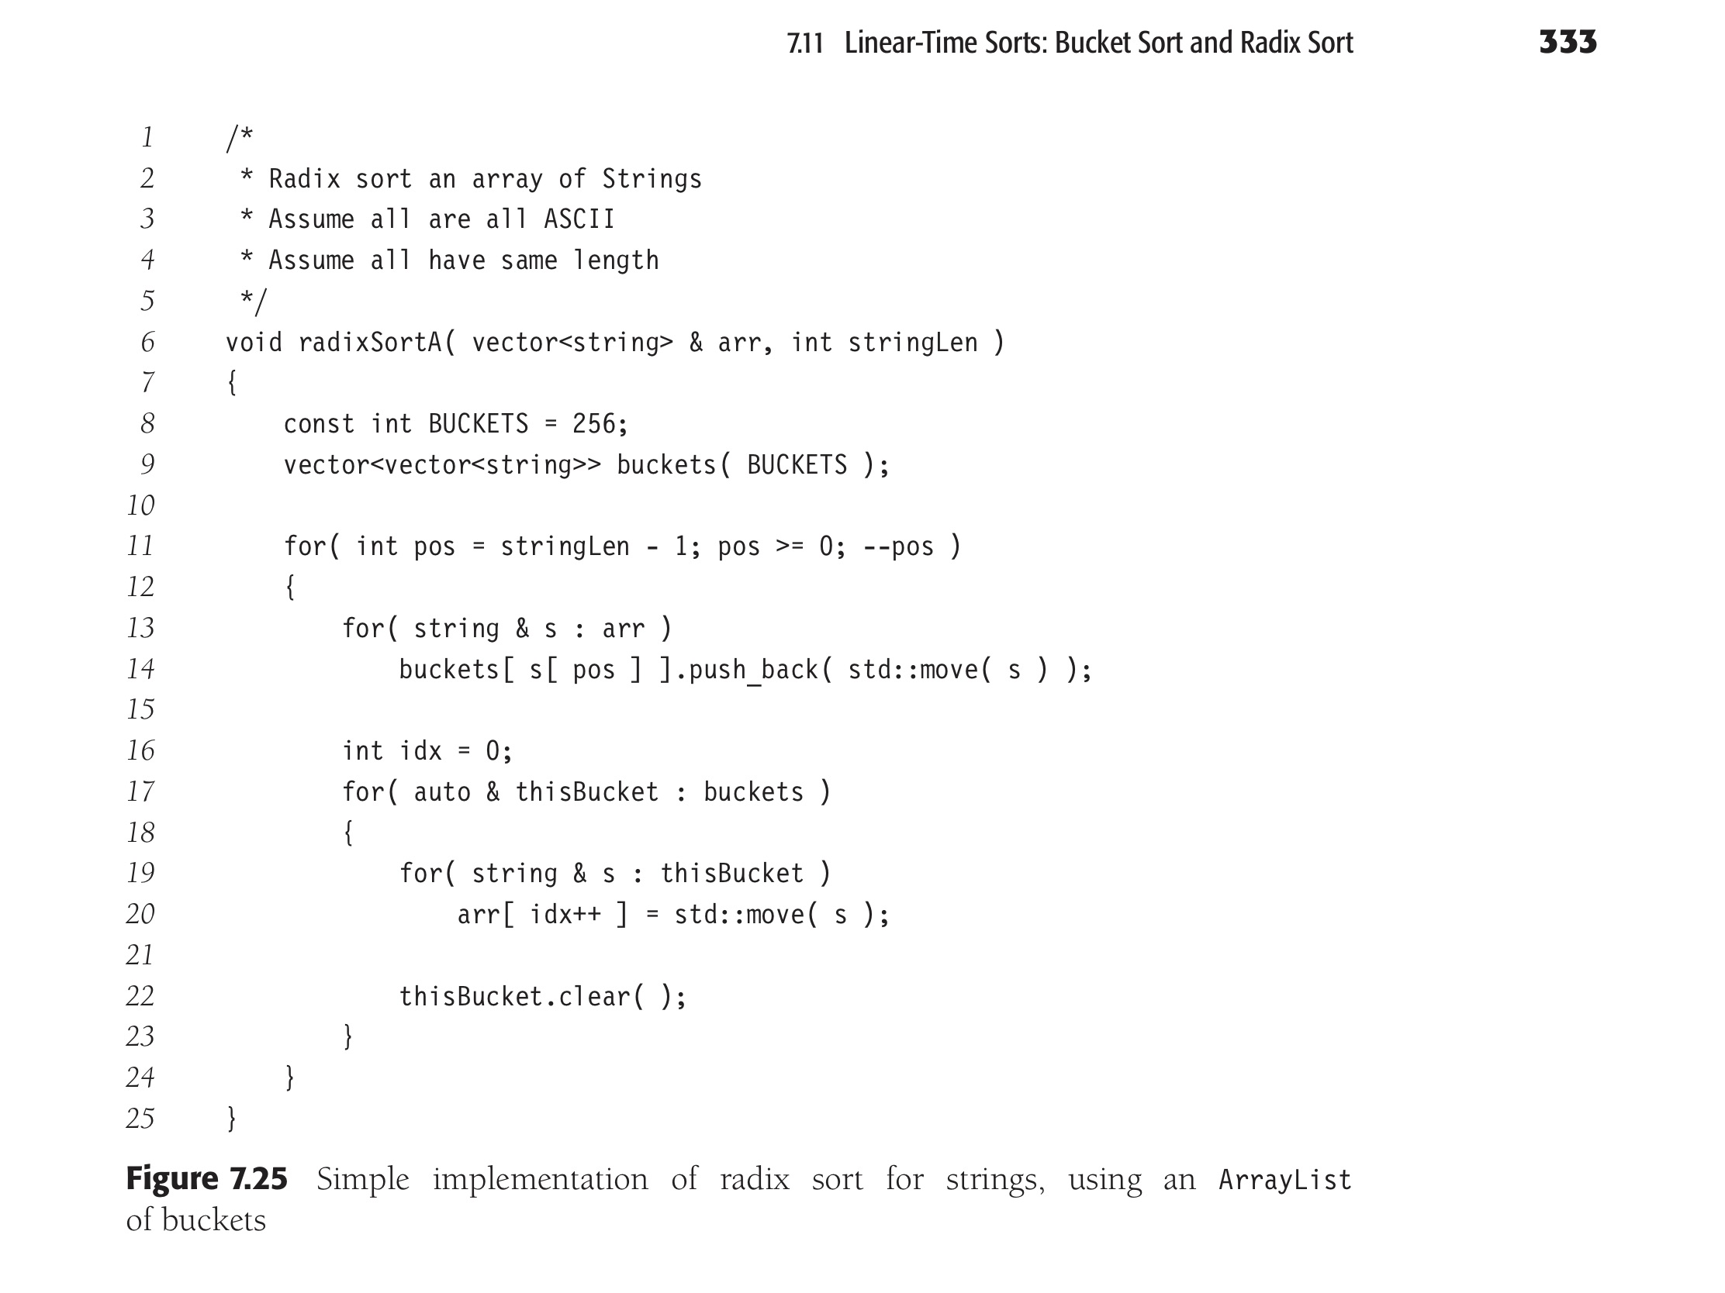
Radix sort to sort strings

Slide 10

Sorting Summary
Lower bound results:
  Lower bound for “simple” comparison-based sorting (comparison/swap between adjacent items) : Ω$\left(N^{2}\right)$
  Lower bound for general comparison-based sorting Ω$\left(N\log{N}\right)$

Slide 11
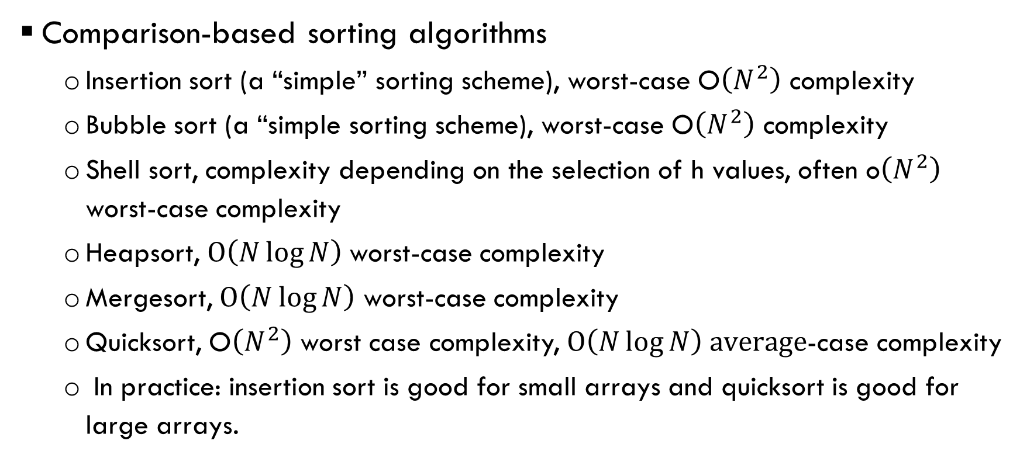
Sorting Summary
Comparison-based sorting algorithms
  Insertion sort (a “simple” sorting scheme), worst-case O$\left(N^{2}\right)$ complexity
  Bubble sort (a “simple sorting scheme), worst-case O$\left(N^{2}\right)$ complexity
  Shell sort, complexity depending on the selection of h values, often o$\left(N^{2}\right)$ worst-case complexity
  Heapsort, O$\left(N\log{N}\right)$worst-case complexity
  Mergesort, O$\left(N\log{N}\right)$ worst-case complexity
  Quicksort, O$\left(N^{2}\right)$ worst case complexity, O$\left(N\log{N}\right) average$-case complexity
  In practice: insertion sort is good for small arrays and quicksort is good for large arrays.

Slide 12
Sorting Summary
Linear time sorting algorithms
  These algorithms are not comparison-based, and require knowledge of the data to be sorted (value range).
  Bucket sort and radix sort, O(N+M) complexity.

Slide 13
Exercise, sort 064 008 216 512 027 729 001 342
Insertion sort.
  Initially, only the first element is sorted.
  In each of the iterations, the data item next to the sorted array is added to sorted list
  Show the array content after each iteration

Slide 14
Exercise, sort 064 008 216 512 027 729 001 342
Bubble sort.
  In each iteration, iterate through each data item, swap it with the next item if they are out of order.
  Show the array content after each iteration

Slide 15
Exercise, sort 064 008 216 512 027 729 001 342
Shell sort.
  Let us assume that h = 5, 3, 1
  In each iteration, elements that are h-space apart are sorted.
  Show the array content after each iteration

Slide 16
Exercise, sort 064 008 216 512 027 729 001 342
Heap sort.
  Build the max-heap of N elements from bottom-up
  Perform deleteMax and place the item at the end of the array
  Show the array content after the heap is built, and after each item is removed.

Slide 17
Exercise, sort 064 008 216 512 027 729 001 342
Mergesort.
  If N=1, then return
  Otherwise, partition the array into two equal parts and recursively call mergesort to sort the two parts. After that, merge the two sorted lists.
  Show the partitions and the content of the array after each phase is done!

Slide 18
Exercise, sort 064 008 216 512 027 729 001 342
Quicksort.
  Pick a pivot. Partition the array into two parts, one for items smaller than the pivot, one for the items larger than the pivot.
  Recursively call quicksort to sort the two parts.
  Show the content of the array after each partitions (assume pivot is the first item in the list).

