Slide 1
Heapsort, Mergesort, and Quicksort
Sections 7.5 to 7.7

Slide 2
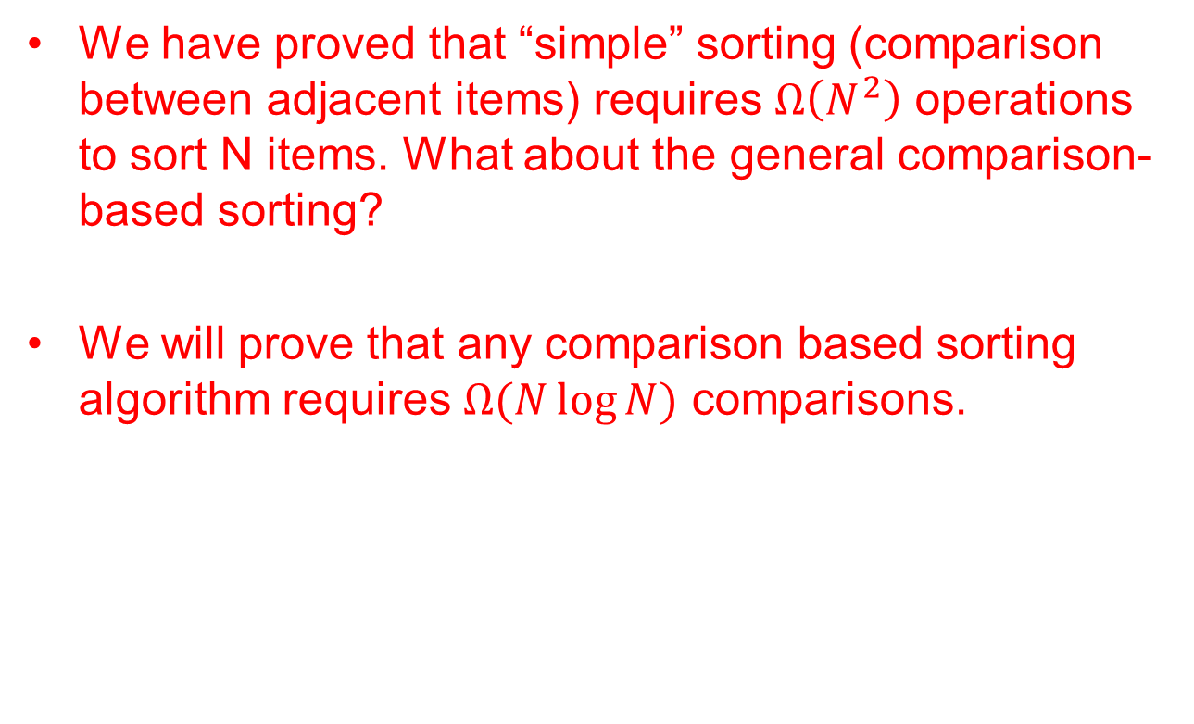
A General Lower Bound for Sorting
We have proved that “simple” sorting (comparison between adjacent items) requires $Ω\left(N^{2}\right)$ operations to sort N items. What about the general comparison-based sorting?
We will prove that any comparison based sorting algorithm requires $Ω(N\log{N)}$ comparisons.

Slide 3
A General Lower Bound for Sorting
  Consider sorting 3 numbers: a, b, and c (let us assume they are not equal). How many comparisons do we need to sort these three numbers?
    Can we do it with one comparison?
    Can we do it with two comparisons?

Slide 4
A General Lower Bound for Sorting
  Consider trying to sort 3 numbers: a, b, and c (let us assume they are not equal). How many comparisons do we need to sort these three numbers?
    How to model the whole process so that we do not miss any cases?
    What are the possible sorted orders of a, b, and c?
      3 * 2 *1 cases
a < b < c
a < c < b
b < a < c
b < c < a
c < a < b
c < b < a
At the end of any sorting algorithm, the sorting algorithm
needs to come to one of these results

Slide 5
Modeling comparison based sorting
a < b < c, a < c < b
b < a < c, b < c < a
c < a < b, c < b < a
At the beginning, all are possibility
Refine the possibilities by
Comparison (eg. compare a to b)
a < b
b < a
a < b < c, a < c < b
c < a < b
b < a < c, b < c < a
c < b < a
b < c
c < b
b < c
c < b
a < b < c
a < c < b
b < a < c
b < c < a
c < a < b
c < b < a
A sorting algorithm decides which two items to compare at each step.

Slide 6
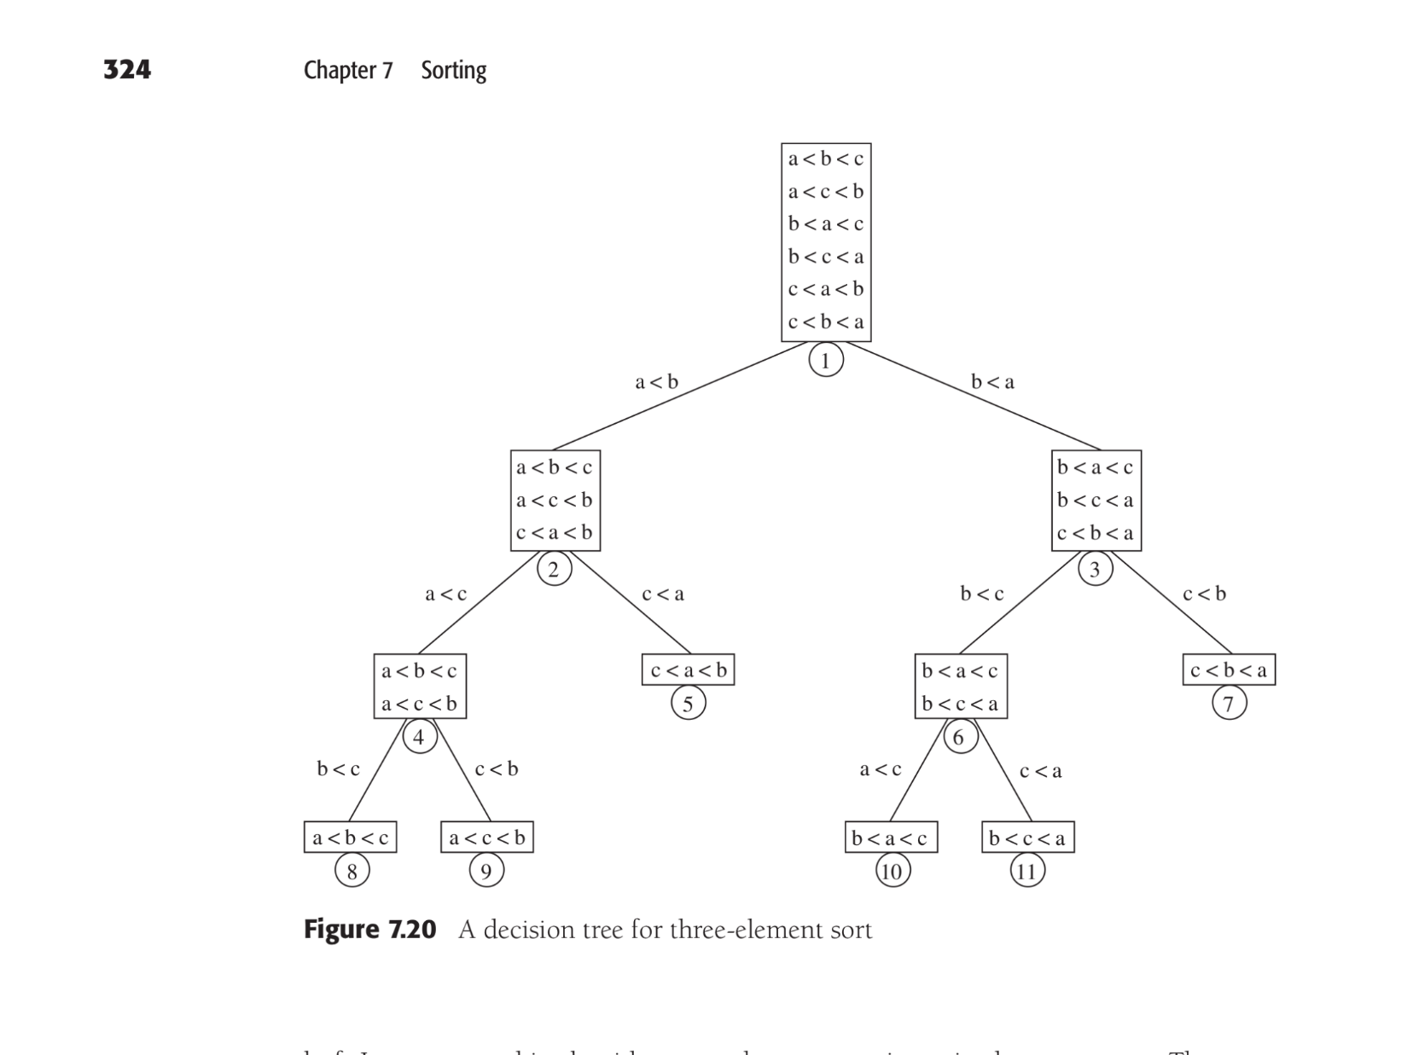
A decision tree for three elements sort

Slide 7
A General Lower Bound for Sorting
Back to this question: Consider sorting 3 numbers: a, b, and c (let us assume they are not equal). How many comparisons do we need to sort these three numbers?
  There are many such trees for sorting 3 numbers. Is there a sorting algorithm that can get the solution in 2 comparisons?
    The model is a binary tree with 6 leaves!
      The tree height is at least 3!
    Same idea is applied to find the lower bound for any sorting of N items.

Slide 8
A General Lower Bound for Sorting
Decision tree: Each node in the decision tree represents a set of possible orderings of the elements consistent with the comparisons that have been made. The results of the comparisons are the tree edges.
  The root represents the set of all possible orderings: when the sorting algorithm is given an array to sort, any possible ordering is a possibility!
  Each node performs one comparison, which partitions its set of orderings into two sets based on the comparison results. The two sets are in each of its children, respectively.
  The algorithm needs to perform enough comparison to get to a set that contains one ordering (the sorting result).

Slide 9
A General lower bound for comparison based sorting
Each comparison based sorting algorithm can be represented by a binary decision tree
  Different algorithms differ in the items selected for comparison at each node.
  The worst case complexity of a sorting algorithm is the largest number comparisons needed.
    With the decision tree model, what is the tree terminology for this?

Slide 10
A General lower bound for comparison based sorting
Each comparison based sorting algorithm can be represented by a binary decision tree
  Different algorithms differ in the items selected for comparison at each node.
  The worst case complexity of a sorting algorithm is the largest number comparisons needed.
    With the decision tree model, what is the tree terminology for this?
      The height of the decision tree!
  The most efficient sorting algorithm is the one with the smallest height!
  The lower bound for any comparison based sorting is the height of that smallest tree. Can we figure this out?

Slide 11
A General lower bound for comparison based sorting
The lower bound for any comparison based sorting is the height of the decision tree for the most efficient sorting algorithm. Can we figure this out?
  We cannot by looking at different sorting algorithms
  Instead, we need to look at the decision tree in general
    Remember how we derive a lower bound for sorting 3 numders?
  But do have some information about the decision tree, which allows us to derive the lower bound of the height of decision trees. What do we have?

Slide 12
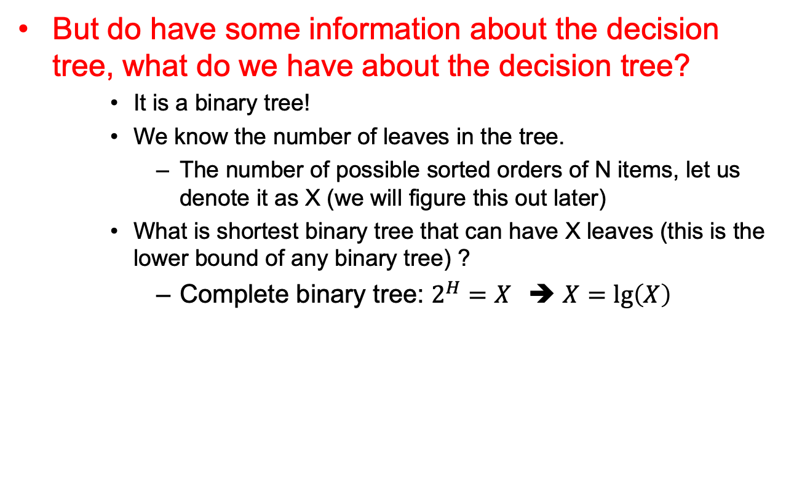
A General lower bound for comparison based sorting
But do have some information about the decision tree, what do we have about the decision tree?
    It is a binary tree!
    We know the number of leaves in the tree.
      The number of possible sorted orders of N items, let us denote it as X (we will figure this out later)
    What is shortest binary tree that can have X leaves (this is the lower bound of any binary tree) ?
      Complete binary tree: $2^{H}=X$➔ $X=\lg\left(X\right)$

Slide 13
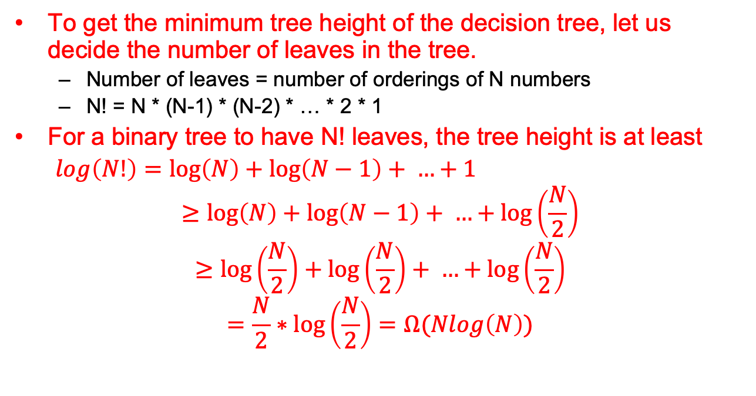
A General lower bound for comparison based sorting
To get the minimum tree height of the decision tree, let us decide the number of leaves in the tree.
  Number of leaves = number of orderings of N numbers
  N! = N * (N-1) * (N-2) * … * 2 * 1
For a binary tree to have N! leaves, the tree height is at least
$\log\left(N!\right)=\log\left(N\right)+\log\left(N−1\right)+ …+1$
$$≥\log\left(N\right)+\log\left(N−1\right)+ …+\log\left(\frac{N}{2}\right)$$
$$≥\log\left(\frac{N}{2}\right)+\log\left(\frac{N}{2}\right)+ …+\log\left(\frac{N}{2}\right)$$
$$=\frac{N}{2}∗\log\left(\frac{N}{2}\right)=Ω(Nlog\left(N\right))$$
No comparison based sorting
algorithm can be better than O(N lg(N))

Slide 14
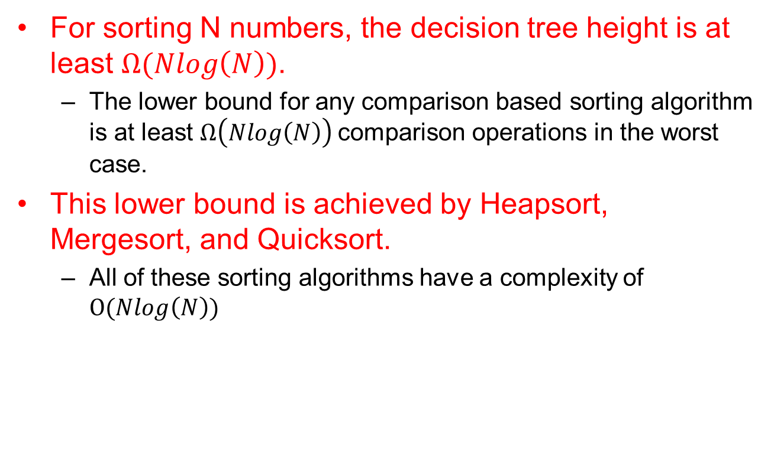
A General lower bound for comparison based sorting
For sorting N numbers, the decision tree height is at least $Ω(Nlog\left(N\right))$.
  The lower bound for any comparison based sorting algorithm is at least $Ω\left(Nlog\left(N\right)\right)$comparison operations in the worst case.
This lower bound is achieved by Heapsort, Mergesort, and Quicksort.
  All of these sorting algorithms have a complexity of $O(Nlog\left(N\right))$

Slide 15
Heapsort
Build a binary minHeap of N elements
  O(N) time
Then perform N deleteMin operations
  log(N) time per deleteMin
Total complexity O(N log N)
However it requires an extra array to store results
  In addition to the heap
To eliminate this requirement
  Using heap to store sorted elements
  Using maxHeap instead of minHeap

Slide 16
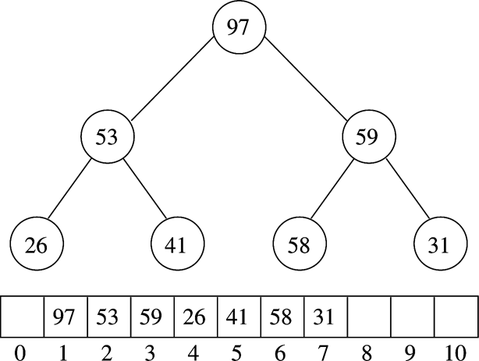
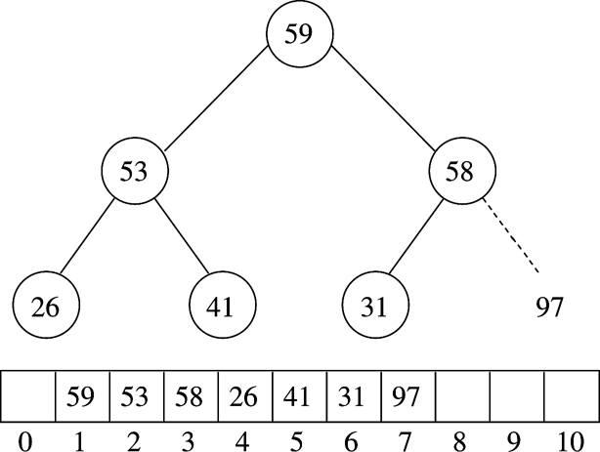
Example (MaxHeap)
After BuildHeap
After first deleteMax

Slide 17
Heapsort Implementation
// Standard heapsort.
template <typename Comparable>
void heapsort( vector<Comparable> & a )
{
// build heap
for( int i = a.size( ) / 2 - 1; i >= 0; --i )
percDown( a, i, a.size( ) );
// deleteMax
for( int j = a.size( ) - 1; j > 0; --j )
{
std::swap( a[ 0 ], a[ j ] );
percDown( a, 0, j );
}
}
/* Internal method for heapsort.
* i is the index of an item in the heap.
* Returns the index of the left child. */
inline int leftChild( int i )
{
return 2 * i + 1;
}
/**
* Internal method for heapsort that is used in
* deleteMax and buildHeap.
* i is the position from which to percolate down.
* n is the logical size of the binary heap.
*/
template <typename Comparable>
void percDown( vector<Comparable> & a, int i, int n )
{
int child;
Comparable tmp;
for( tmp = std::move( a[ i ] ); leftChild( i ) < n; i = child )
{
child = leftChild( i );
if( child != n - 1 && a[ child ] < a[ child + 1 ] )
++child;
if( tmp < a[ child ] )
a[ i ] = std::move( a[ child ] );
else
break;
}
a[ i ] = std::move( tmp );
}
Notice that the root is at a[0] instead of a[1].
2NlogN comparisons

Slide 18
Mergesort
Divide the N values to be sorted into two halves
Recursively sort each half using Mergesort
  Base case N=1 ➔ no sorting required
Merge the two sorted halves into one sorted list

Slide 19
Merging two sorted lists
Keep a counter for each list, starting at the beginning of the lists.
Compare the two values indexed by the counters, output the smaller value and increment the counter.
When one list is processed, output all items in the other list.
Example: merging (and sorting) the following two sorted lists.
  1, 13, 24, 26
  2, 15, 27, 38
  Compare 1 and 2 and output 1

Slide 20
Merging two sorted lists
Compare 13 and 2 and output 2
  1, 13, 24, 26 output: 1
  2, 15, 27, 38
  ----
  1, 13, 24, 26 output: 1, 2
  2, 15, 27, 38
  ----
  1, 13, 24, 26 output: 1, 2, 13,
  2, 15, 27, 38
  ----
  1, 13, 24, 26 output: 1, 2, 13, 15
  2, 15, 27, 38
Compare 13 and 15 and output
Compare 24 and 15 and output
What is the complexity of merging two sorted lists into
one sorted list?

Slide 21
Mergesort
mergeSort(a, tmpArray, begin, end)
{
If ( begin + 1 == end ) return; // one item sorted!
int center = ( begin + end ) / 2;
mergeSort( a, tmpArray, left, center );
mergeSort( a, tmpArray, center + 1, right );
merge( a, tmpArray, left, center + 1, right );
}

Slide 22
Mergesort example
Divide the N values to be sorted into two halves
Recursively sort each half using Mergesort
  Base case N=1 ➔ no sorting required
Merge the two sorted halves into one sorted list
16 15 14 11 10 9 8 1 2 4 7 6 5 3 12 13
16 15 14 11 10 9 8 1 2 4 7 6 5 3 12 13
16 15 14 11 10 9 8 1 2 4 7 6 5 3 12 13
16 15 14 11 10 9 8 1 2 4 7 6 5 3 12 13
At this time, the algorithm merges sorted lists of one elements
15 16 11 14 9 10 1 8 2 4 6 7 3 5 12 13

Slide 23
Merge sort example
15 16 11 14 9 10 1 8 2 4 6 7 3 5 12 13
11 14 15 16 1 8 9 10 2 4 6 7 3 5 12 13
8 9 10 11 14 15 16 2 3 4 5 6 7 12 13
1 2 3 4 5 6 7 8 9 10 11 12 13 14 15 16

Slide 24
Mergesort Implementation
// Mergesort algorithm (driver).
template <typename Comparable>
void mergeSort( vector<Comparable> & a )
{
vector<Comparable> tmpArray( a.size( ) );
mergeSort( a, tmpArray, 0, a.size( ) - 1 );
}
/**
* Internal method that makes recursive calls.
* a is an array of Comparable items.
* tmpArray is an array to place the merged result.
* left is the left-most index of the subarray.
* right is the right-most index of the subarray.
*/
template <typename Comparable>
void mergeSort( vector<Comparable> & a,
vector<Comparable> & tmpArray, int left, int right )
{
if( left < right )
{
int center = ( left + right ) / 2;
mergeSort( a, tmpArray, left, center );
mergeSort( a, tmpArray, center + 1, right );
merge( a, tmpArray, left, center + 1, right );
}
}

Slide 25
/**
* Internal method that merges two sorted halves of a subarray.
* a is an array of Comparable items.
* tmpArray is an array to place the merged result.
* leftPos is the left-most index of the subarray.
* rightPos is the index of the start of the second half.
* rightEnd is the right-most index of the subarray.
*/
template <typename Comparable>
void merge( vector<Comparable> & a, vector<Comparable> & tmpArray,
int leftPos, int rightPos, int rightEnd )
{
int leftEnd = rightPos - 1;
int tmpPos = leftPos;
int numElements = rightEnd - leftPos + 1;
// Main loop
while( leftPos <= leftEnd && rightPos <= rightEnd )
if( a[ leftPos ] <= a[ rightPos ] )
tmpArray[ tmpPos++ ] = std::move( a[ leftPos++ ] );
else
tmpArray[ tmpPos++ ] = std::move( a[ rightPos++ ] );
while( leftPos <= leftEnd ) // Copy rest of first half
tmpArray[ tmpPos++ ] = std::move( a[ leftPos++ ] );
while( rightPos <= rightEnd ) // Copy rest of right half
tmpArray[ tmpPos++ ] = std::move( a[ rightPos++ ] );
// Copy tmpArray back
for( int i = 0; i < numElements; ++i, --rightEnd )
a[ rightEnd ] = std::move( tmpArray[ rightEnd ] );
}

Slide 26
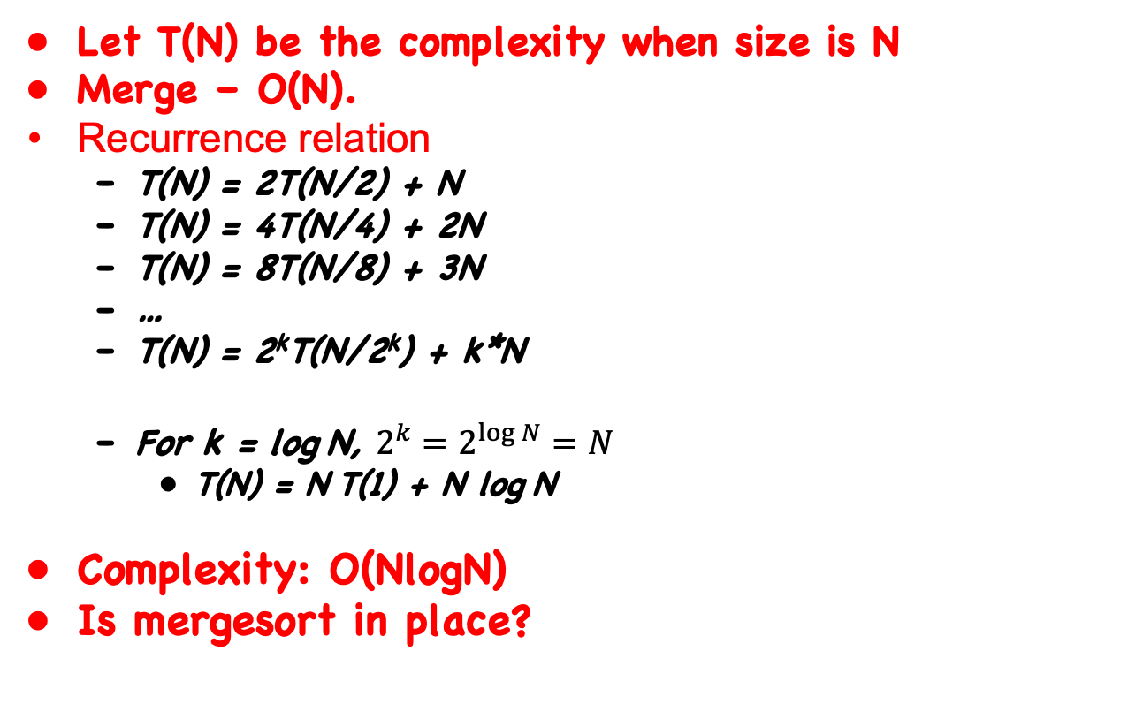
Mergesort complexity analysis
Let T(N) be the complexity when size is N
Merge – O(N).
Recurrence relation
  T(N) = 2T(N/2) + N
  T(N) = 4T(N/4) + 2N
  T(N) = 8T(N/8) + 3N
  …
  T(N) = 2^{k}T(N/2^{k}) + k*N
  For k = log N, $2^{k}=2^{\log{N}}=N$
    T(N) = N T(1) + N log N
Complexity: O(NlogN)
Is mergesort in place?

Slide 27
Quicksort
Fastest known sorting algorithm in practice
  Caveat: not always stable sorting
  Can do it as a stable sort, but some partition techniques do not guarantee this.
Average case complexity →O(N log N )
Worst-case complexity → O(N²)
  Rarely happens, if coded correctly
Can vary in space complexity, depending on strategies chosen.

Slide 28
Quicksort Outline
Divide and conquer approach
Given array S to be sorted
  If size of S < 1 then done;
  Pick any element v in S as the pivot
  Partition S-{v} (remaining elements in S) into two groups
    S1 = {all elements in S-{v} that are smaller than v}
    S2 = {all elements in S-{v} that are larger than v}
  Return {quicksort(S1) followed by v followed by quicksort(S2) }
Trick lies in handling the partitioning (step 3).
  Picking a good pivot
  Efficiently partitioning in-place

Slide 29
Quicksort example
81
43
31
57
75
13
92
65
26
0
Select pivot
81
43
31
57
75
13
65
26
0
92
partition
13
31
57
65
81
43
26
0
92
75
Recursive call
Recursive call
0
13
26
31
43
57
75
81
92
Merge
0
13
26
31
43
57
65
75
81
92

Slide 30
Picking the Pivot
Pivot partitions the array into two subsets. What is the idea Pivot?
Example: 13 81 92 43 31 65 57 26 75
Sorted: 13 26 31 43 57 65 75 81 92
If you have all the knowledge, which value you would pick as the pivot to have the best performance?

Slide 31
Picking the Pivot
Partition takes O(N) time.
If we pick the middle of the list, the two subsets both have roughly N/2 items
  T(N) = 2 T(N/2) + N, T(N) = O(N log N) – same as the merge sort
If we pick the side (largest or smallest)
  T(N) = T(N-1) + N, same as insertion sort, T(N) = O(??)?

Slide 32
Picking the Pivot
Example: 13 81 92 43 31 65 57 26 75
Sorted: 13 26 31 43 57 65 75 81 92
Which value is the best pivot selection? Which value is the worst pivot selection?

Slide 33
Picking the Pivot
How would you pick one?
Strategy 1: Pick the first element in S
  Works only if input is random
  What if input S is sorted, or even mostly sorted?
    All the remaining elements would go into either S1 or S2!
    Terrible performance!
  Why worry about sorted input?
    Remember → Quicksort is recursive, so sub-problems could be sorted
    Plus mostly sorted input is quite frequent

Slide 34
Picking the Pivot (contd.)
Strategy 2: Pick the pivot randomly
  Would usually work well, even for mostly sorted input
  Unless the random number generator is not quite random!
  Plus random number generation is an expensive operation

Slide 35
Picking the Pivot (contd.)
Strategy 3: Median-of-three Partitioning
  Ideally, the pivot should be the median of input array S
    Median = element in the middle of the sorted sequence
  Would divide the input into two almost equal partitions
  Unfortunately, its hard to calculate median quickly, without sorting first!
  So find the approximate median
    Pivot = median of the left-most, right-most and center element of the array S
    Solves the problem of sorted input

Slide 36
Picking the Pivot (contd.)
Example: Median-of-three Partitioning
  Let input S = {6, 1, 4, 9, 0, 3, 5, 2, 7, 8}
  left=0 and S[left] = 6
  right=9 and S[right] = 8
  center = (left+right)/2 = 4 and S[center] = 0
  Pivot
    = Median of S[left], S[right], and S[center]
    = median of 6, 8, and 0
    = S[left] = 6

Slide 37
Partitioning Algorithm
Original input : S = {6, 1, 4, 9, 0, 3, 5, 2, 7, 8}
Get the pivot out of the way by swapping it with the last element
Have two ‘iterators’ – i and j
  i starts at first element and moves forward
  j starts at last element and moves backwards
8 1 4 9 0 3 5 2 7 6
pivot
8 1 4 9 0 3 5 2 7 6
i
j
pivot

Slide 38
Partitioning Algorithm (contd.)
While (i < j)
  Move i to the right till we find a number greater than pivot
  Move j to the left till we find a number smaller than pivot
  If (i < j) swap(S[i], S[j])
  (The effect is to push larger elements to the right and smaller elements to the left)
Swap the pivot with S[i]

Slide 39
Partitioning Algorithm Illustrated
i
j
pivot
8 1 4 9 0 3 5 2 7 6
Move
i
j
pivot
8 1 4 9 0 3 5 2 7 6
swap
i
j
pivot
2 1 4 9 0 3 5 8 7 6
move
i
j
pivot
2 1 4 9 0 3 5 8 7 6
swap
i
j
pivot
2 1 4 5 0 3 9 8 7 6
move
j
i
pivot
i and j
have crossed
2 1 4 5 0 3 9 8 7 6
Swap S[i]
with pivot
2 1 4 5 0 3 6 8 7 9
j
i
pivot

Slide 40
Dealing with small arrays
For small arrays (say, N ≤ 20),
  Insertion sort is faster than quicksort
Quicksort is recursive
  So it can spend a lot of time sorting small arrays
Hybrid algorithm:
  Switch to using insertion sort when problem size is small
  (say for N < 20)

Slide 41
Quicksort Driver Routine
/**
* Quicksort algorithm (driver).
*/
template <typename Comparable>
void quicksort( vector<Comparable> & a )
{
quicksort( a, 0, a.size( ) - 1 );
}

Slide 42
Quicksort Pivot Selection Routine
/**
* Return median of left, center, and right.
* Order these and hide the pivot.
*/
template <typename Comparable>
const Comparable & median3( vector<Comparable> & a, int left, int right )
{
int center = ( left + right ) / 2;
if( a[ center ] < a[ left ] )
std::swap( a[ left ], a[ center ] );
if( a[ right ] < a[ left ] )
std::swap( a[ left ], a[ right ] );
if( a[ right ] < a[ center ] )
std::swap( a[ center ], a[ right ] );
// Place pivot at position right - 1
std::swap( a[ center ], a[ right - 1 ] );
return a[ right - 1 ];
}
Swap a[left], a[center]
and a[right] in-place
Pivot is in a[center] now
Swap the pivot a[center]
with a[right-1]

Slide 43
Quicksort routine
/*a is an array of Comparable items.
* left is the left-most index of the subarray. right is the right-most index of the subarray. */
template <typename Comparable>
void quicksort( vector<Comparable> & a, int left, int right )
{
if( left + 10 <= right )
{
const Comparable & pivot = median3( a, left, right ); // has a side effect
// Begin partitioning
int i = left, j = right - 1;
for( ; ; ) {
while( a[ ++i ] < pivot ) { }
while( pivot < a[ --j ] ) { }
if( i < j )
std::swap( a[ i ], a[ j ] );
else
break;
}
std::swap( a[ i ], a[ right - 1 ] ); // Restore pivot
quicksort( a, left, i - 1 ); // Sort small elements
quicksort( a, i + 1, right ); // Sort large elements
}
else // Do an insertion sort on the subarray
insertionSort( a, left, right );
}
move
swap

Slide 44
Runtime analysis
Worst-case
Average case
Best case

Slide 45
Reading Assignment
Chapter 7.11 Linear time sorts: Bucket Sort and Radix sort!

