Slide 1
Sorting Algorithms
Sections 7.1 to 7.4

Slide 2
Comparison-Based Sorting
Comparison based sorting: sorting is based on comparison of different elements?
  Can we sort without comparison? Will talk later.
  Examples:
    Input – 2,3,1,15,11,23,1
    Output – 1,1,2,3,11,15,23
  Class ‘Animals’
    Sort Objects – Rabbit, Cat, Rat ??
      Class must specify how to compare Objects
  In general, need the support of
    ‘<‘ and ‘>’ operators

Slide 3
Sorting Definitions
In place sorting
  Sorting of a data structure does not require any external data structure for storing the intermediate steps
External sorting
  Sorting of records not present in memory
Stable sorting
  If the same element is present multiple times, then they retain the original positions
    Stable sorting
      Input – 2,3,1,15,11,23,1
      Output – 1,1,2,3,11,15,23
    Not stable sorting
      Input – 2,3,1,15,11,23,1
      Output – 1,1,2,3,11,15,23

Slide 4
C++ STL sorting algorithms
sort function template
void sort (iterator begin, iterator end)
void sort (iterator begin, iterator end, Comparator cmp)
  begin and end are start and end marker of container (or a range of it)
  Container needs to support random access such as vector
  sort is not stable sorting
  Function template stable_sort() is.

Slide 5
Bubble Sort
Simple and uncomplicated
Compare neighboring elements
Swap if out of order
Two nested loops
O(n²)

Slide 6
Bubble Sort
template <typename T>
void bubbleSort(vector<T> &a) {
n = a.size();
T tmp;
for (i=0; i<n-1; i++) { // number of elements sorted
for (j=0; j<n-1-i; j++)
if (a[j+1] < a[j]) { // compare neighbors
tmp = a[j]; // swap a[j] and a[j+1]
a[j] = a[j+1];
a[j+1] = tmp;
}
}
}
}
http://www.ee.unb.ca/brp/lib/java/bubblesort/

Slide 7
Bubble Sort Example
2, 3, 1, 15
2, 1, 3, 15 // after one loop
1, 2, 3, 15 // after second loop
1, 2, 3, 15 // after third loop

Slide 8
Insertion Sort
O(n²) sort
N-1 passes
  After pass p all elements from 0 to p are sorted
  Following step inserts the next element in correct position within the sorted part

Slide 9
Insertion Sort
/**
* Simple insertion sort.
*/
template <typename Comparable>
void insertionSort( vector<Comparable> & a )
{
for( int p = 1; p < a.size( ); ++p )
{
Comparable tmp = std::move( a[ p ] );
int j;
for( j = p; j > 0 && tmp < a[ j - 1 ]; --j )
a[ j ] = std::move( a[ j - 1 ] );
a[ j ] = std::move( tmp );
}
}

Slide 10
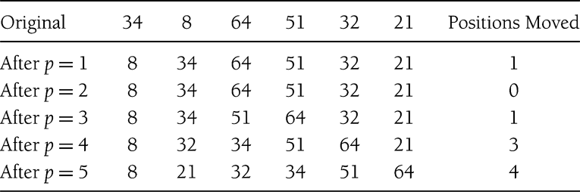
Insertion Sort: Example

Slide 11
Insertion Sort - Analysis
Pass p involves at most p comparisons
Total comparisons = ∑i ; i = [1, n-1]
= O(n²)

Slide 12
Insertion Sort - Analysis
Worst Case ?
  Reverse sorted list
  Max possible number of comparisons
  O(n²)
Best Case ?
  Sorted input
  1 comparison in each pass
  O(n)

Slide 13
Lower Bound on ‘Simple’ Sorting
Simple sorting
  Performing only adjacent exchanges
  Such as bubble sort and insertion sort
Inversions
  an ordered pair (i, j) such that i<j but a[i] > a[j]
  34,8,64,51,32,21
  (34,8), (34,32), (34,21), (64,51), (64, 32), (64, 21), (51, 32), (51, 21), (32, 21)
A sorted array has no inversion.
For each adjacent exchange, how many inversions are resolved?

Slide 14
Lower Bound on ‘Simple’ Sorting
Each adjacent exchange resolves exactly one inversion!
How many inversions are there in the worst case for an array of n elements?
What is the worst case complexity of any simple sorting algorithm (counting the number of adjacent exchanges)?

Slide 15
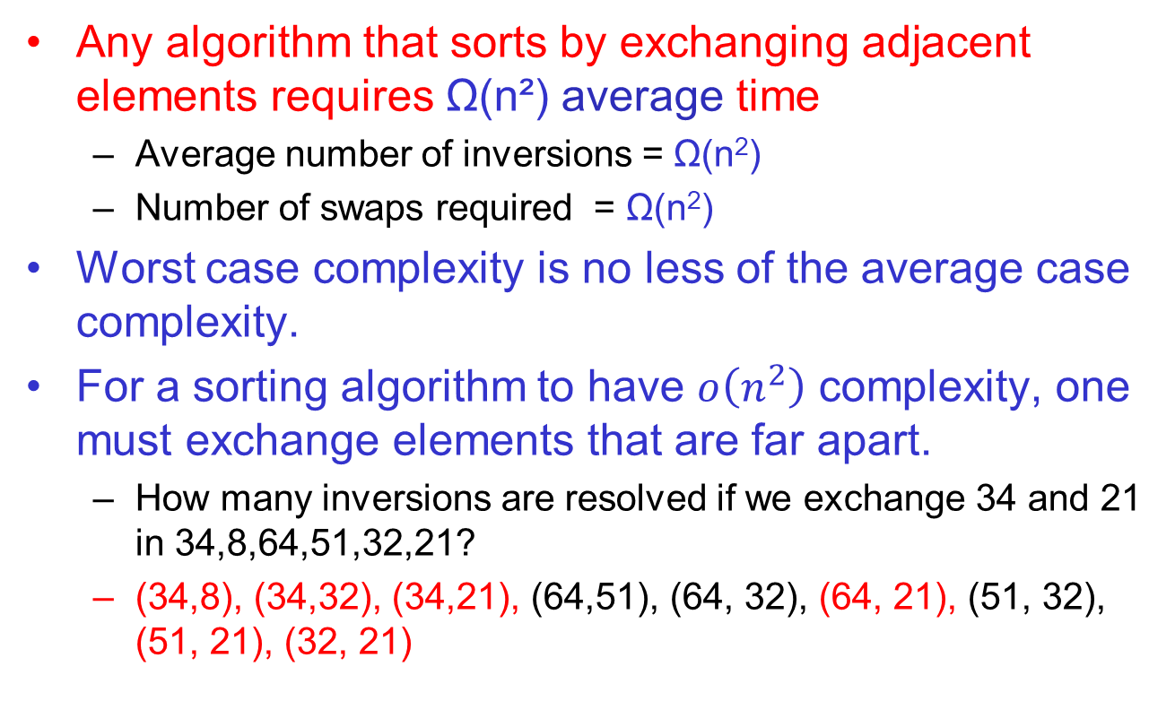
Theorem 2
Any algorithm that sorts by exchanging adjacent elements requires Ω(n²) average time
  Average number of inversions = Ω(n²)
  Number of swaps required = Ω(n²)
Worst case complexity is no less of the average case complexity.
For a sorting algorithm to have $o\left(n^{2}\right)$ complexity, one must exchange elements that are far apart.
  How many inversions are resolved if we exchange 34 and 21 in 34,8,64,51,32,21?
  (34,8), (34,32), (34,21), (64,51), (64, 32), (64, 21), (51, 32), (51, 21), (32, 21)

Slide 16
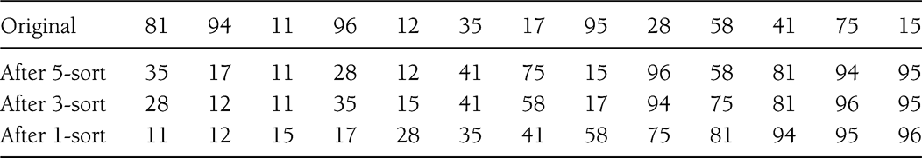
Shell Sort
A sorting algorithm that allows comparison of not adjacent items.
h–sort: all elements spaced h apart are sorted.
Performing h-sort using insertion sort, the items compared are no longer adjacent – potential for improvement.

Slide 17
Shell Sort
Also referred to as Diminishing Increment Sort
Increment sequence: h₁, h₂,.., h_{k} = 1.
In the original design of shell sort
  Start with h = floor(n/2); keep reducing by half in each iteration

Slide 18
Shell Sort
/**
* Shellsort, using Shell's (poor) increments.
*/
template <typename Comparable>
void shellsort( vector<Comparable> & a )
{
for( int gap = a.size( ) / 2; gap > 0; gap /= 2 )
for( int i = gap; i < a.size( ); ++i )
{
Comparable tmp = std::move( a[ i ] );
int j = i;
for( ; j >= gap && tmp < a[ j - gap ]; j -= gap )
a[ j ] = std::move( a[ j - gap ] );
a[ j ] = std::move( tmp );
}
}

Slide 19
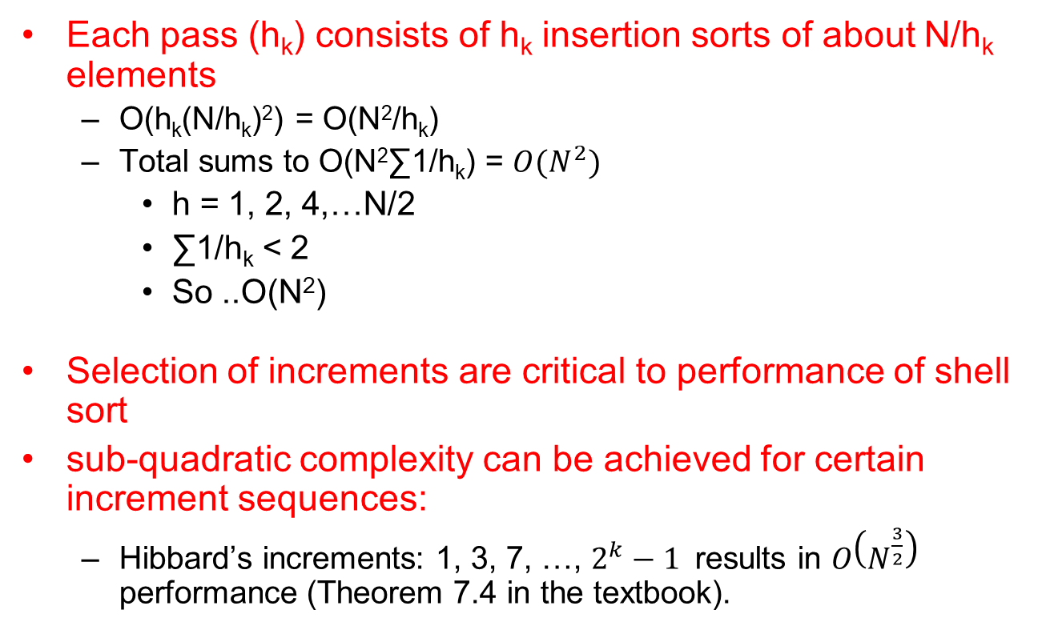
Shell Sort - Analysis
Each pass (h_{k}) consists of h_{k} insertion sorts of about N/h_{k} elements
  O(h_{k}(N/h_{k})²) = O(N²/h_{k})
  Total sums to O(N²∑1/h_{k}) = $O(N^{2})$
    h = 1, 2, 4,…N/2
    ∑1/h_{k} < 2
    So ..O(N²)
Selection of increments are critical to performance of shell sort
sub-quadratic complexity can be achieved for certain increment sequences:
  Hibbard’s increments: 1, 3, 7, …, $2^{k}−1$ results in $O\left(N^{\frac{3}{2}}\right)$ performance (Theorem 7.4 in the textbook).

Slide 20
Reading assignment
Sections 7.5, 7.6, and 7.7

