Slide 1
Priority Queues (Heaps)
Sections 6.1 to 6.5

Slide 2
Priority Queues - motivation
Consider the CPU scheduling problem:
  Jobs (programs that need to be executed by the CPU) come and go in a computing system
  A computer has many jobs that need to be executed, CPU scheduling decides which job gets to physically use the CPU.
  This is a fundamental problem in Computer Science
  For the computer system to do a good job in CPU scheduling, we need a data structure to store all jobs to be scheduled. Let us consider what data structure we should use for this purpose.

Slide 3
Priority Queues - motivation
CPU scheduling – round-robin scheduler
  Each job takes turn to use the CPU.
  Fairness: If a job comes earlier than another job, it needs to be executed earlier. If a job has been scheduled, it should not be scheduled a second time if there exists a job that has not been scheduled once.
  What data structure should we use for a round-robin scheduler?

Slide 4
Priority Queues - motivation
CPU scheduling – round-robin scheduler
  Each job takes turn to use the CPU.
  Fairness: If a job comes earlier than another job, it needs to be executed earlier. If a job has been scheduled, it should not be scheduled a second time if there exists a job that has not been scheduled once.
  What data structure should we use for a round-robin scheduler?
Answer: queue
  First In, First Out
  When a new job comes, put it at the end of the queue (Enqueue())
  At the time when the CPU is free (a job can be scheduled), remove the job at the head of the queue (Dequeue())

Slide 5
Priority Queues - motivation
CPU scheduling – shortest job first
  Shortest job first always schedules the job with the shortest execution time
  Optimize for average wait time (user experience)
  Would queue still work?

Slide 6
Priority Queues - motivation
CPU scheduling – shortest job first
  Shortest job first always schedules the job with the shortest execution time
  Optimize for average wait time (user experience)
  Would queue still work?
    When we remove, we don’t want to remove from the head of the queue, but rather, we want to remove the smallest item in the queue.
  The data structure that supports this is called Priority queue

Slide 7
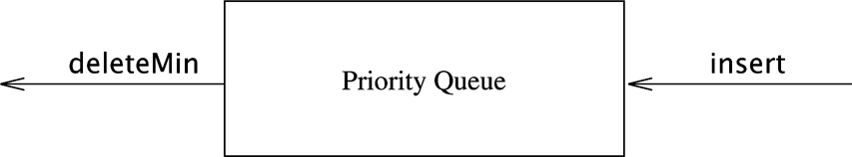
Priority Queues
Regular queue supports
  First In, First Out
  Enqueue(): add a new element
  Dequeue(): remove oldest element in queue
Data structure supports
  Insert(): add a new element
  deleteMin(): delete minimum element in priority queue

Slide 8
Applications of Priority Queues
In Operating Systems
  Shortest Job First process scheduling
In Simulators
  Scheduling the next event (smallest event time)
In essence
  Any event/job management that assign priority to events/jobs
Greedy algorithms
  Ones that operate by repeatedly finding a minimum

Slide 9
Possible Priority Queue Implementation
Implemented as adaptor class around
  Linked lists (or another container with linear structure)
    O(N) worst-case time on either insert() or deleteMin()
  AVL Trees
    O(log(N)) worst-case time on insert() and delete()
Heaps
  This is the topic of this chapter
  O(logN) worst case for both insertion and delete operations
  Why another data structure if we can already do it with AVL trees

Slide 10
Priority Queue Implementation
Heaps .vs. AVL trees for priority queue
  Same worst case complexity for insert and removeMin: all O(logN)
  The big O notion ignores the constant factor!
    Insert and removeMIN with Heap have much smaller constant factors than with AVL trees
      With AVL tree, all items are completely sorted, which is an overkill.

Slide 11
Partially Ordered Trees
A partially ordered tree (POT) is a tree T such that:
  There is an order relation <= defined for the vertices of T
  For any vertex p and any child c of p, p <= c
Consequences:
  The smallest element in a POT is the root
  No conclusion can be drawn about the order of children

Slide 12
Binary Heaps
A binary heap is a partially ordered complete binary tree.
  The tree is completely filled on all levels except possibly the lowest.
In a more general d-Heap
  A parent node can have d children
We simply refer to binary heaps as heaps
root
4
3
2
1
0

Slide 13
Vector Representation of Complete Binary Tree
Storing elements in vector in level-order
  Parent of v[k] = v[k/2]
  Left child of v[k] = v[2*k]
  Right child of v[k] = v[2*k + 1]
  In this case root is at v[1].
  Root can be at v[0].
root
R
l
r
ll
lr
rl
rr
1
2
3
4
5
6
7
R
l
r
ll
lr
rl
rr

Slide 14
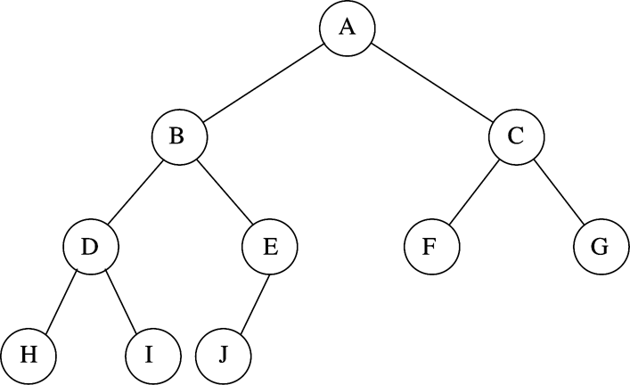
Heap example
Parent of v[k] = v[k/2]
Left child of v[k] = v[2*k]
Right child of v[k] = v[2*k + 1]

Slide 15
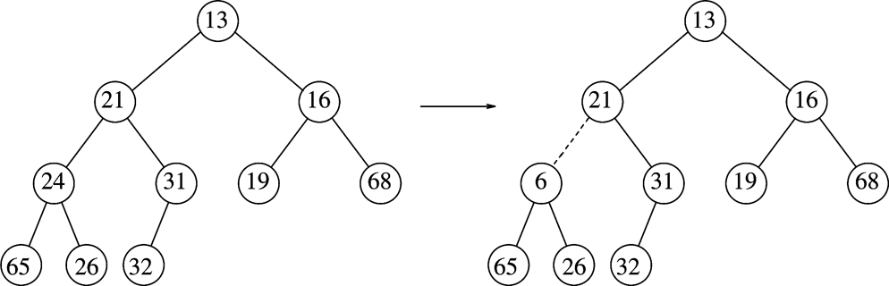
Examples
Which one is a heap?

Slide 16
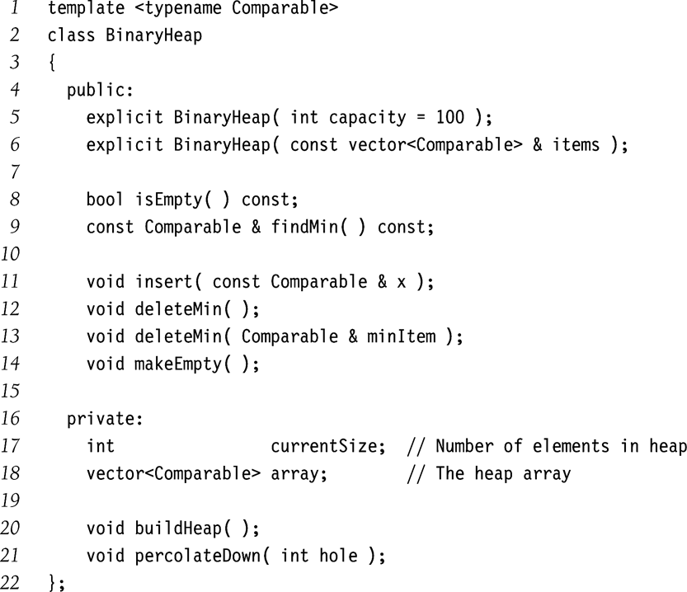
Implementation of Priority Queue (heap)

Slide 17
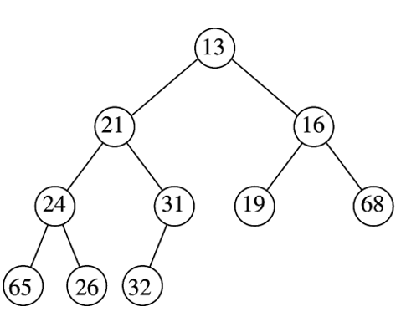
Basic Heap Operations: insert(x)
What is the shape of the heap after 14 is inserted into the following heap?

Slide 18
Basic Heap Operations: insert(x)
What is the shape of the heap after 14 is inserted into the following heap?
Is this still a heap?
Where is the problem?
How to fix it?
14
13 21 16 24 31 19 68 65 26 32 14

Slide 19
Basic Heap Operations: insert(x)
Create a hole at next leaf (empty)
// Repair upward
Repeat
  Locate parent
  if POT not satisfied (should x inserted in the hole)
    Sliding parent element to hole
  else
    Stop
Insert x into hole

Slide 20
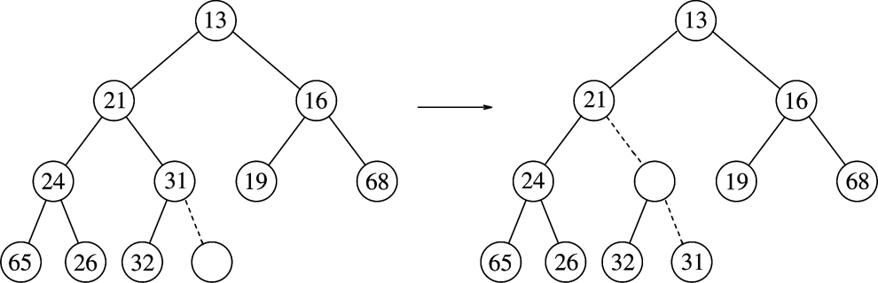
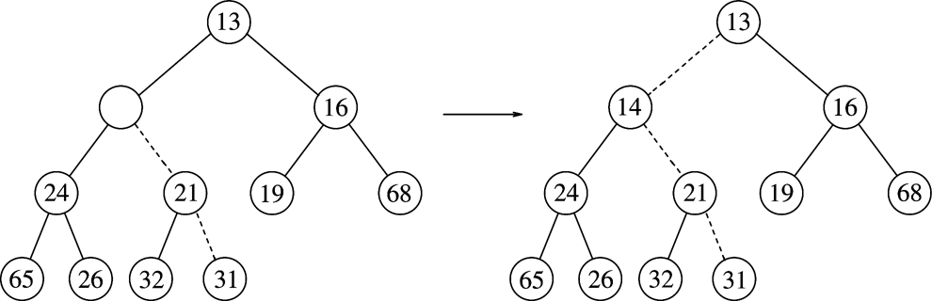
Insertion Example: insert(14)
(1)
(2)
(3)
(4)

Slide 21
Implementation of insert
/**
* Insert item x, allowing duplicates.
*/
void insert( const Comparable & x )
{
if( currentSize == array.size( ) - 1 )
array.resize( array.size( ) * 2 );
// Percolate up
int hole = ++currentSize;
Comparable copy = x;
array[ 0 ] = std::move( copy ); // for terminating the following loop
for( ; x < array[ hole / 2 ]; hole /= 2 )
array[ hole ] = std::move( array[ hole / 2 ] );
array[ hole ] = std::move( array[ 0 ] );
}

Slide 22
Basic Heap Operations: deleteMin()
What is the shape of the heap when deleteMin is performed on the following heap?

Slide 23
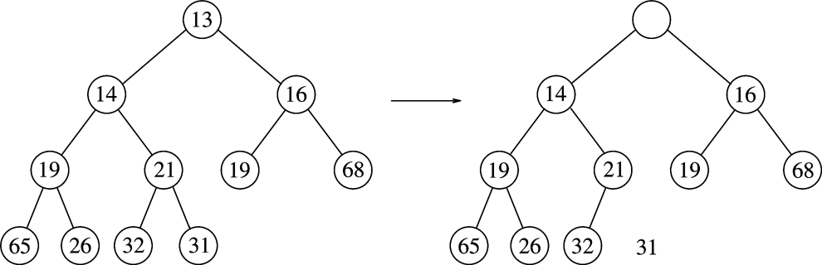
Basic Heap Operations: deleteMin()
What is the shape of the heap when deleteMin is performed on the following heap?
14 16 19 21 19 68 65 26 32 31
Fix the heap after move 31!
How?
31 14 16 19 21 19 68 65 26 32

Slide 24
Basic Heap Operations: deleteMin()
Move the last element to the root and then fix the heap!
  Find the smaller child. If the new element is larger than the smaller child (POT property violation), swap with the small child
  Repeat in the new subtree
31
X
31 14 16 19 21 19 68 65 26 32

Slide 25
Basic Heap Operations: deleteMin()
Delete the root element
// root becomes a hole
// Must move last element (last leaf) to somewhere
Let y be the last element (rightmost leaf node)
Repeat
  find the smaller child of the hole
  if POT not satisfied (should y inserted in hole)
    Sliding smaller child into hole
  else
    Stop
Insert y into hole

Slide 26
deleteMin() example

Slide 27
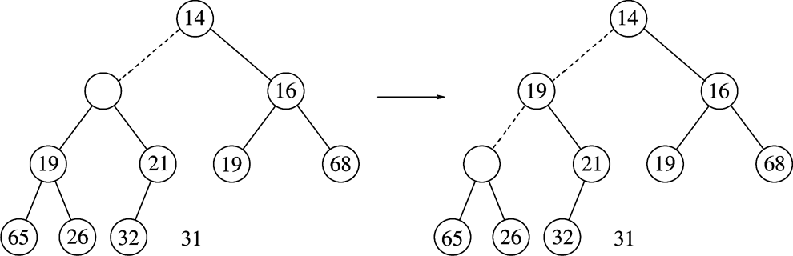
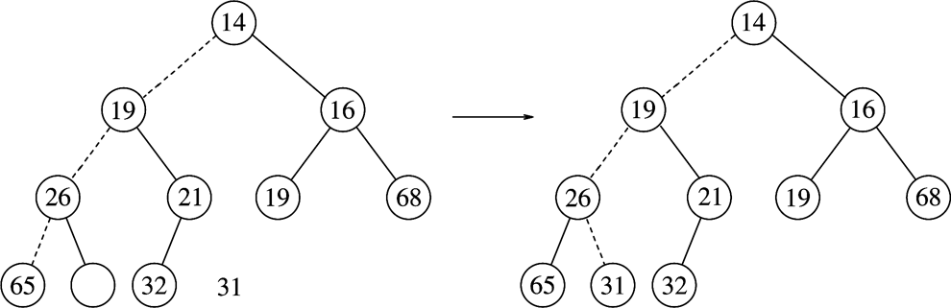
deleteMin() Example (Cont’d)

Slide 28
Implementation of deleteMin()
/ * Remove the minimum item.
* Throws UnderflowException if empty. */
void deleteMin( )
{
if( isEmpty( ) )
throw UnderflowException{ };
array[ 1 ] = std::move( array[ currentSize-- ] );
percolateDown( 1 );
}
/ * Remove the minimum item and place it in minItem.
* Throws Underflow if empty. */
void deleteMin( Comparable & minItem )
{
if( isEmpty( ) )
throw UnderflowException{ };
minItem = std::move( array[ 1 ] );
array[ 1 ] = std::move( array[ currentSize-- ] );
percolateDown( 1 );
}

Slide 29
Implementation of deleteMin()
/**
* Internal method to percolate down in the heap.
* hole is the index at which the percolate begins.
*/
void percolateDown( int hole )
{
int child;
Comparable tmp = std::move( array[ hole ] );
for( ; hole * 2 <= currentSize; hole = child )
{
child = hole * 2;
if( child != currentSize && array[ child + 1 ] < array[ child ] )
++child;
if( array[ child ] < tmp )
array[ hole ] = std::move( array[ child ] );
else
break;
}
array[ hole ] = std::move( tmp );
}

Slide 30
Constructor
Construct heap from a collection of item
How to?
  Naïve methods
  Insert() each element
  Worst-case time: O(N(logN))
  We show an approach taking O(N) worst-case
Basic idea
  First insert all elements into the tree without worrying about POT
  Then, adjust the tree to satisfy POT

Slide 31
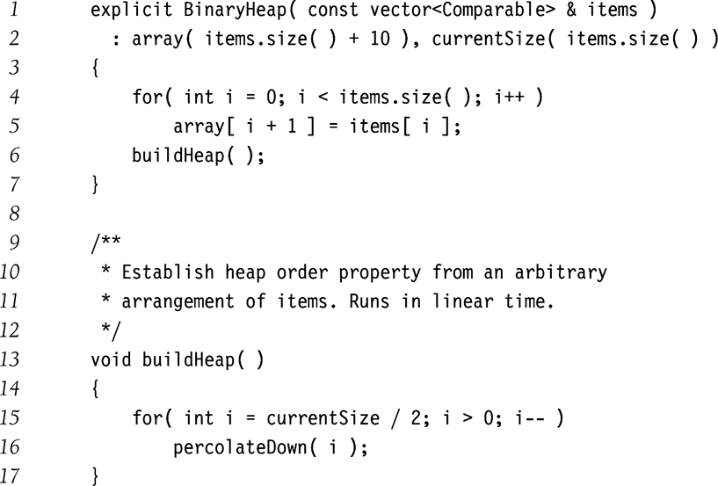
Constructor

Slide 32
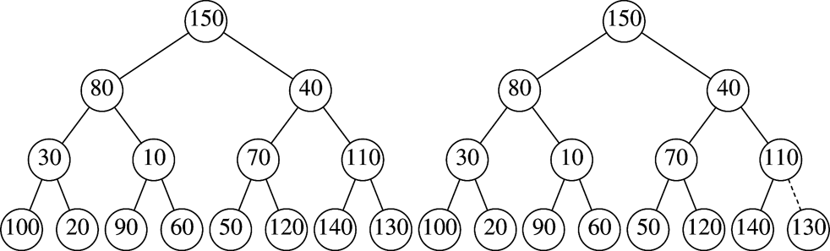
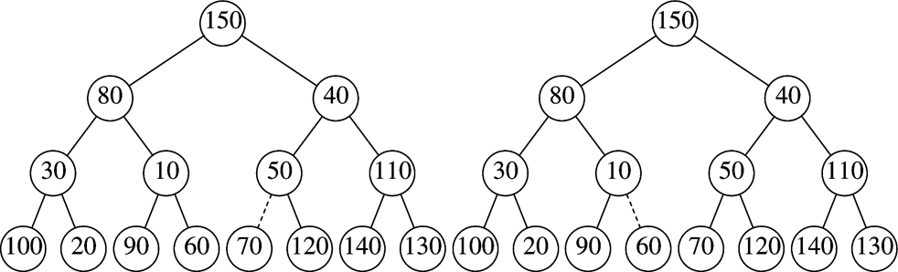
Example
percolateDown(7)
percolateDown(6)
percolateDown(5)

Slide 33
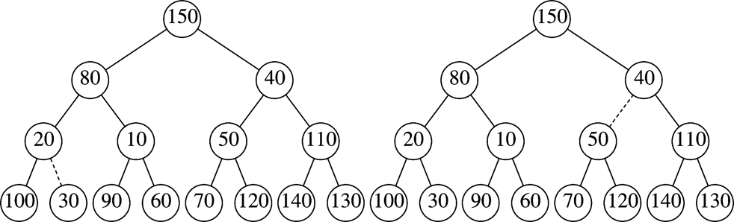
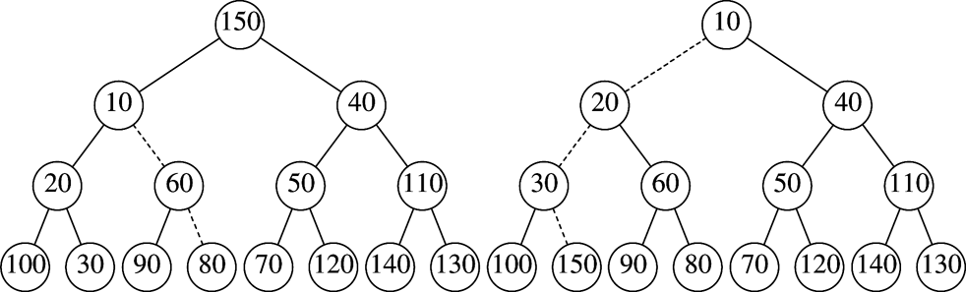
percolateDown(4)
percolateDown(3)
percolateDown(2)
percolateDown(1)

Slide 34
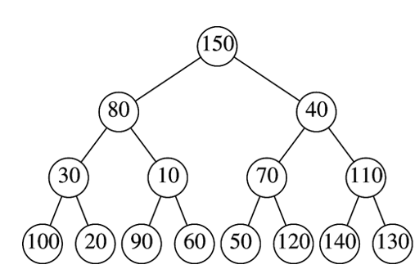
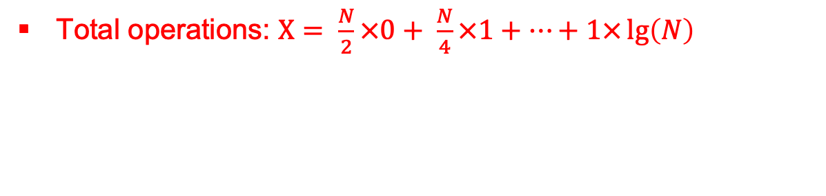
Complexity for buildheap
1 node, lg(N) ops
N/4 nodes, 1 op each
N/2 nodes, 0 op each
Total operations: $X= \frac{N}{2}×0+ \frac{N}{4}×1+…+1×\lg\left(N\right)$

Slide 35
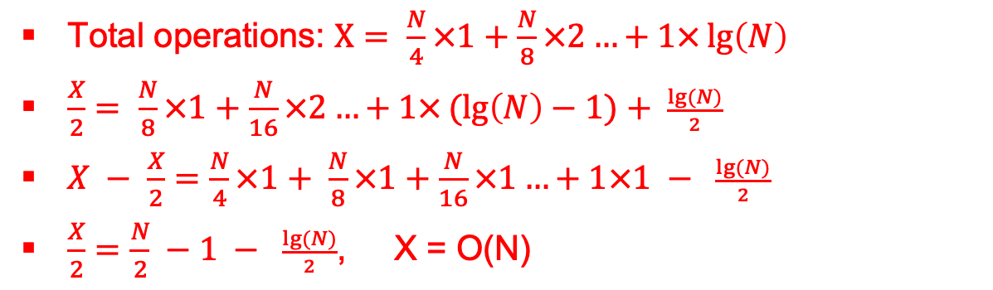
Complexity for buildheap
1 node, lg(N) ops
N/4 nodes, 1 op each
N/2 nodes, 0 op each
Total operations: $X= \frac{N}{4}×1+\frac{N}{8}×2…+1×\lg\left(N\right)$
$\frac{X}{2}= \frac{N}{8}×1+\frac{N}{16}×2…+1×(lg\left(N\right)−1)+ \frac{lg⁡(N)}{2}$
$X − \frac{X}{2}=\frac{N}{4}×1+ \frac{N}{8}×1+\frac{N}{16}×1…+1×1 − \frac{lg⁡(N)}{2}$
$\frac{X}{2}=\frac{N}{2} −1 − \frac{lg⁡(N)}{2}$, X = O(N)

Slide 36
C++ STL Priority Queues
priority_queue class template
  Implements deleteMax instead of deleteMin in default
  MaxHeap instead of MinHeap
Template
  Item type
  container type (default vector)
  comparator (default less)
Associative queue operations
  Void push(t)
  void pop()
  T& top()
  void clear()
  bool empty()

Slide 37
#include <iostream>
#include <vector>
#include <queue>
#include <functional>
#include <string>
using namespace std;
// Empty the priority queue and print its contents.
template <typename PriorityQueue>
void dumpContents( const string & msg, PriorityQueue & pq )
{
cout << msg << ":" << endl;
while( !pq.empty( ) )
{
cout << pq.top( ) << endl;
pq.pop( );
}
}
// Do some inserts and removes (done in dumpContents).
int main( )
{
priority_queue<int> maxPQ;
priority_queue<int,vector<int>,greater<int>> minPQ;
minPQ.push( 4 ); minPQ.push( 3 ); minPQ.push( 5 );
maxPQ.push( 4 ); maxPQ.push( 3 ); maxPQ.push( 5 );
dumpContents( "minPQ", minPQ );
dumpContents( "maxPQ", maxPQ );
return 0;
}

Slide 38
Reading Assignment
Chapter 7

