Slide 1
Designing Hash Tables
Sections 5.3, 5.4, 5.5, 5.6

Slide 2
Recap
The basic idea of hash table is to approximate a giant array that is indexed by the key
A hash table is an array where the index of the data object is computed (by the hash function) based on the key of the data.
  Index = hash(key) % table_size;
The situation when two keys are hashed into the same index is called a conflict or collision.
A good hash function does not remove all conflicts. It statistically minimizes the probability of collision across the key space.

Slide 3
Designing a Hash Table
Hash function: establishing a key with an indexed location in a hash table.
  E.g. Index = hash(key) % table_size;
Resolve conflicts:
  Need to handle case where multiple keys mapped to the same index.
  Two representative solutions
    Chaining with separate lists.
    Probing open addressing

Slide 4
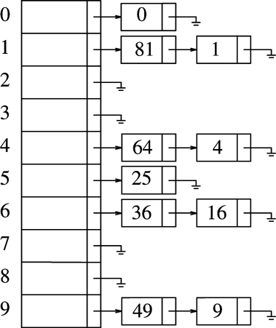
Separate Chaining
Each table entry is a list (or vector) – the hash table is physically an array of lists.
Multiple keys mapped to the same entry will be stored in the list
Example
  Hash(k) = k mod 10
  (10 is not a prime, just for illustration)
  array[i]

Slide 5
Search with Separate Chaining
Assumption: hash(k) = k % 10
Each array[i], 0 <= i < size, is a list.
To search for a key X
  index = hash(X)
  Check list array[index] to see if X is in it.
Exercise: search 57, 16, 30

Slide 6
Insert with Separate Chaining
Assumption: hash(k) = k % 10
Each array[i], 0 <= i < size, is a list.
To insert key X
  index = hash(X)
  Insert X into list array[index]
Exercise: insert 57, 21

Slide 7
Delete with Separate Chaining
Assumption: hash(k) = k % 10
Each array[i], 0 <= i < size, is a list.
To delete key X
  index = hash(X)
  delete X from list array[index]
Exercise: delete 25, 1

Slide 8
Separate Chaining
With separate chaining, the hash table is an array(or vector) of containers (list, vector, etc)
How can the insert, remove, and search complexity be O(1)?

Slide 9
Separate Chaining
With separate chaining, the hash table is an array of containers (list, vector, etc)
How can the insert, remove, and search complexity be O(1)?
  The trick is to make the expect number of items in each list to be 1!
  The number of lists in the hash table (this is typically called thesize of the hash table) needs to be roughly the same as the number of data items in the hash table.

Slide 10
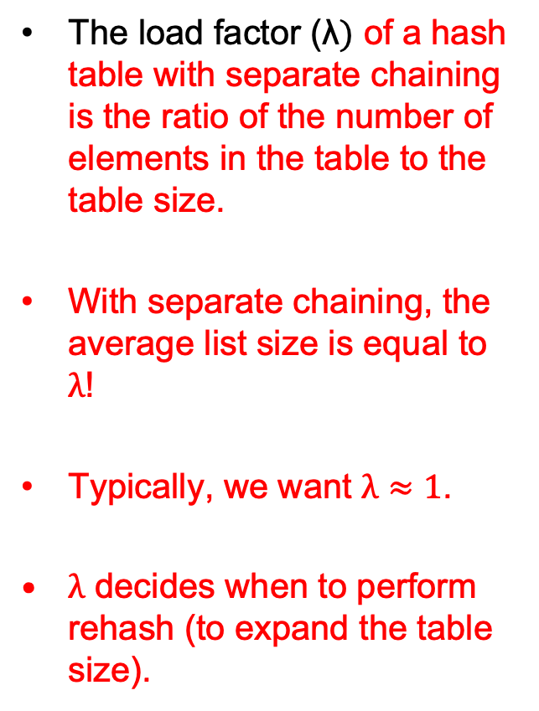
Separate Chaining
The load factor (λ$)$ of a hash table with separate chaining is the ratio of the number of elements in the table to the table size.
With separate chaining, the average list size is equal to $λ$!
Typically, we want $λ≈1$.
$λ$ decides when to perform rehash (to expand the table size).

Slide 11
Separate Chaining Implementation
template <typename HashedObj>
class HashTable
{
public:
explicit HashTable( int size = 101 ) ;
bool contains( const HashedObj & x ) const;
void makeEmpty( );
bool insert( const HashedObj & x );
bool insert( HashedObj && x);
bool remove(const HashedObj & x);
private:
vector<list<HashedObj>> theLists; // the array of the lists
int currentSize;
void rehash();
size_t myhash(const HashedObj & x) const;
};
Type Declaration for
Separate Chaining
Hash Table

Slide 12
HashedObj
Needs to provide
  Equality operators (operator== or operator!= )
  Hash function
    Provided for standard types such as string and int
    In C++11, function object template is used to implement hash functions, using so-called template specialization.
    template <typename key>
    class hash { // class template
    public:
    size_t operator()(const key &k) const;
    };
    template <>
    class hash<string> { // class template specialization
    public:
    size_t operator() (const string & key) {
    …
    }
    };

Slide 13
An Example Class for HashedObj
class Employee {
public:
const string & getName() const
{ return name; }
bool operator==(const Employee &rhs) const
{ return getName() == rhs.getName(); }
bool operator!=(const Employee &rhs) const
{ return !(*this == rhs); }
// additional public members not shown
private:
string name;
double salary;
int seniority;
// additional private members not shown
};
template <>
class hash<Employee> {
public:
size_t operator() (const Employee & item) {
static hash<string> hf;
return hf(item.getName());
}
};

Slide 14
Separate chaining
size_t myhash(const HashedObj &x) {
static hash<HashedObj> hf;
return hf(x) % theLists.size();
}

Slide 15
Separate Chaining (Cont’d)
void makeEmpty() {
for (auto & thisList : theLists) {
thisList.clear();
}
}
bool contains(const HashedObj & x) const {
auto & whichList = theLists[myhash(x)];
return find(begin(whichList), end(whichList), x) != end(whichList);
}
bool remove(const HashedObj & x) {
auto & whichList = theLists[myhash(x)];
auto itr = find(begin(whichList), end(whichList), x);
if (itr == end(whichList))
return false;
whichList.erase(itr);
--currentSize;
return true;
}

Slide 16
Separate Chaining (contd.)
bool insert(const HashedObj & x) {
auto & whichList = theLists[myhash(x)];
if (find(begin(whichList), end(whichList), x) != end(whichList))
return false;
whichList.push_back(x);
// rehash, see Section 5.5
if (++currentSize > theLists.size())
rehash();
return true;
}

Slide 17
Complexity for contain?
Worst case?
Average case?

Slide 18
Hash Tables Without Chaining
Try to avoid buckets with separate lists – no list, just an array of elements.
Still need to resolve conflicts -- use Probing Hash Tables
  If collision occurs, try another cell in the hash table.
  More formally, try cells h₀(x), h₁(x), h₂(x), h₃(x)… in succession until a free cell is found.
    h_{i}(x) = hash(x) + f(i)
    And f(0) = 0

Slide 19
Linear Probing
f(i)=i
  Try hash(x), hash(x)+1, hash(x)+2, ……
Insert (assume no duplicated keys)
  Index = hash(key) % table_size;
  If table[index] is empty, put information (key and others) in entry table[index].
  If table[index] is not empty then
      Index ++; index = index % table_size;
      goto 2.
Search (key)
  Index = hash(key) % table_size;
  If (table[index] is empty) return –1 (not found).
  Else if (table[index].key == key) return index;
  Index ++; index = index % table_size; goto 2.

Slide 20
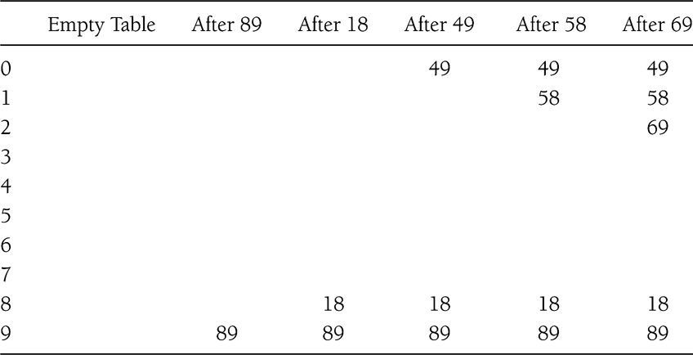
Example
Insert 89, 18, 49, 58, 69 (hash(k) = k mod 10)

Slide 21
Linear probing
Delete
  Can be tricky, must maintain the consistency of the hash table. Why? Consider delete 89 in the previous slide
  What is the simplest deletion strategy you can think of??

Slide 22
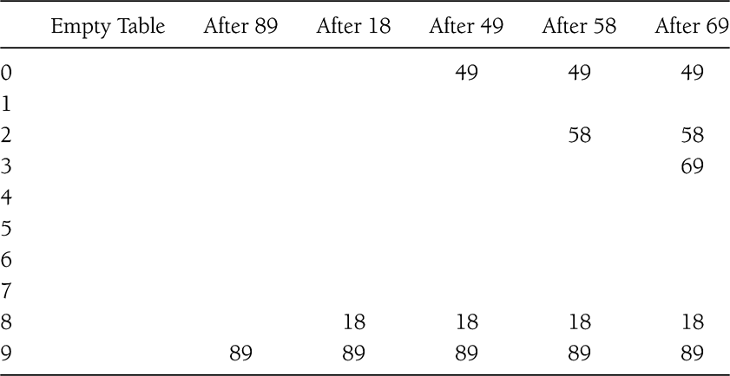
Quadratic Probing
f(i) = i²
hash(x), hash(x)+1, hash(x) + 4, ……

Slide 23
Probing strategy hash table
template <typename HashedObj>
class HashTable {
public:
explicit HashTable(int size = 101);
bool contains(const HashedObj & x) const;
void makeEmpty();
bool insert(const HashedObj & x);
bool insert(HashedObj && x);
bool remove(const HashedObj & x);
enum EntryType {ACTIVE, EMPTY, DELETED};
private:
struct HashEntry {
HashedObj element;
EntryType info;
HashEntry(const HashedObj & e = HashedObj{}, EntryType I = EMPTY)
: element{e}, info{i} {}
HashEntry(HashedObj &&e, EntryType I = EMPTY)
: element{std::move(e)}, info{i} {}
};
vector<HashEntry> array;
int currentSize;
bool isActive(int currentPos) const;
int findPos(const HashedObj & x) const;
void rehash();
size_t myhash(const HashedObj & x) const;
};

Slide 24
Quadratic probing (contains())
bool contains(const HashedObj &x) const {
return isActive(findPos(x));
}
int findPos(const HashedObj & x) const {
int offset = 1;
int currentPos = myhash(x);
while (array[currentPos].info != EMPTY &&
array[currentPos].element != x) {
currentPos += offset;
offset += 2;
if (currentPos >= array.size())
currentPos -= array.size();
}
return currentPos;
}
bool isActive(int currentPos) const {
return array[currentPos].info == ACTIVE;
}
step (i) | pos | offset | next pos
0 | h(x) | 1 | h(x)+1
1 | h(x)+1 | 3 | h(x)+4
2 | h(x)+4 | 5 | h(x)+9
3 | h(x)+9 | 7 | H(x)+16

Slide 25
Quadratic probing
bool insert(const HashedObj & x) {
// insert x as active
int currentPos = findPos(x);
if (isActive(currentPos))
return false;
array[currentPos].element = x;
array[currentPos].info = ACTIVE;
// rehash; see Section 5.5
if (++currentSize > array.size() / 2)
rehash();
return true;
}
bool remove(const HashedObj & x) {
int currentPos = findPos(x);
if (! isActive(currentPos))
return false;
array[currentPos].info = DELETED;
return true;
}

Slide 26
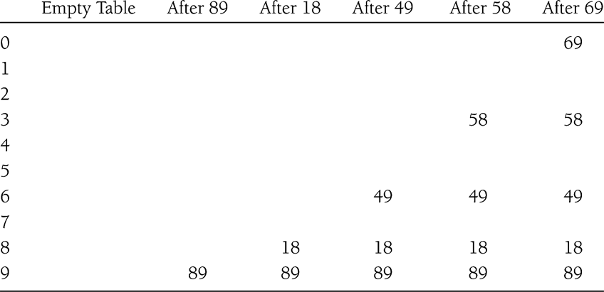
Double Hashing
f(i) = i*hash₂(x)
E.g. hash₂(x) = 7 – (x % 7)
What if hash₂(x) = 0 for some x? this should never happen

Slide 27
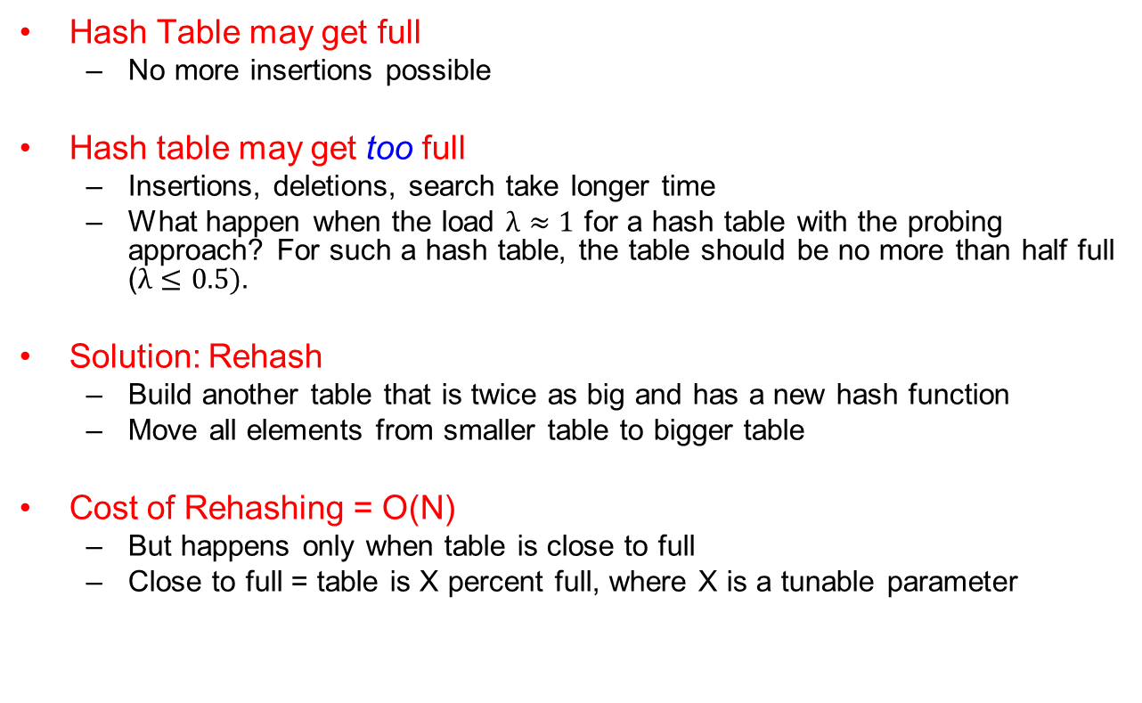
Rehashing
Hash Table may get full
  No more insertions possible
Hash table may get too full
  Insertions, deletions, search take longer time
  What happen when the load $λ≈1$ for a hash table with the probing approach? For such a hash table, the table should be no more than half full ($λ≤0.5).$
Solution: Rehash
  Build another table that is twice as big and has a new hash function
  Move all elements from smaller table to bigger table
Cost of Rehashing = O(N)
  But happens only when table is close to full
  Close to full = table is X percent full, where X is a tunable parameter

Slide 28
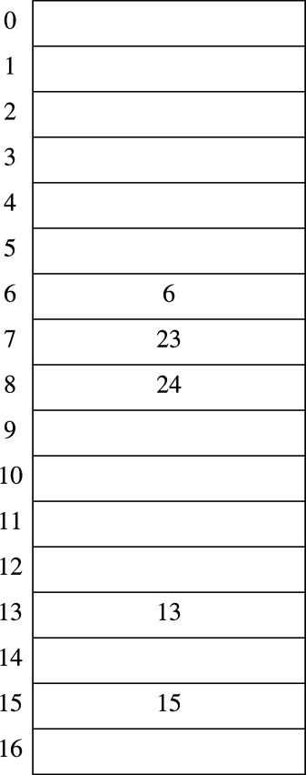
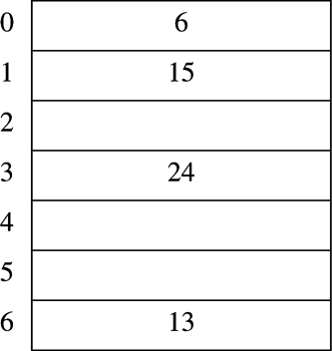
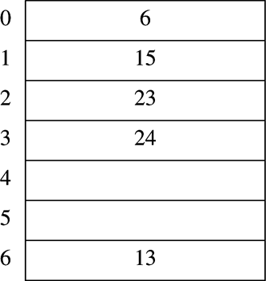
Rehashing Example, why the sizes?
Original Hash Table
After Rehashing
After Inserting 23

Slide 29
Rehashing Implementation
/** rehashing for quadratic probing hash table */
void rehash() {
vector<HashEntry> oldArray = array;
// create new double-sized, empty table
array.resize(nextPrime(2 * oldArray.size()));
for (auto & entry : array)
entry.info = EMPTY;
// copy table over
currentSize = 0;
for (auto & entry : oldArray)
if (entry.info == ACTIVE)
insert(std::move(entry.element));
}

Slide 30
Rehashing implementation
/** rehashing for separate chaining hash table */
void rehash() {
vector<list<hashedObj>> oldLists = theLists;
// create new double-sized, empty table
theLists.resize(nextPrime(2 * theLists.size()));
for (auto & thisList: theLists)
thisList.clear();
// copy table over
currentSize = 0;
for (auto & thisList : oldLists)
for (auto & x : thisList)
insert(std::move(x));
}

Slide 31
Hash Table in C++ Library
Supported in C++11 STL
Both set and map
  unordered_set (multiset)
  unordered_map (multimap)
To use, include the corresponding header files
  <unordered_set>
  <unordered_map>
Examples
  unordered_set<string> ht_str;
  unordered_map<int, bool> ht_int;
  Examples/r7

Slide 32
Reading assignment
Chapter 6

