Slide 1
Trees 4: B-Trees
Reading: Sections 4.7

Slide 2
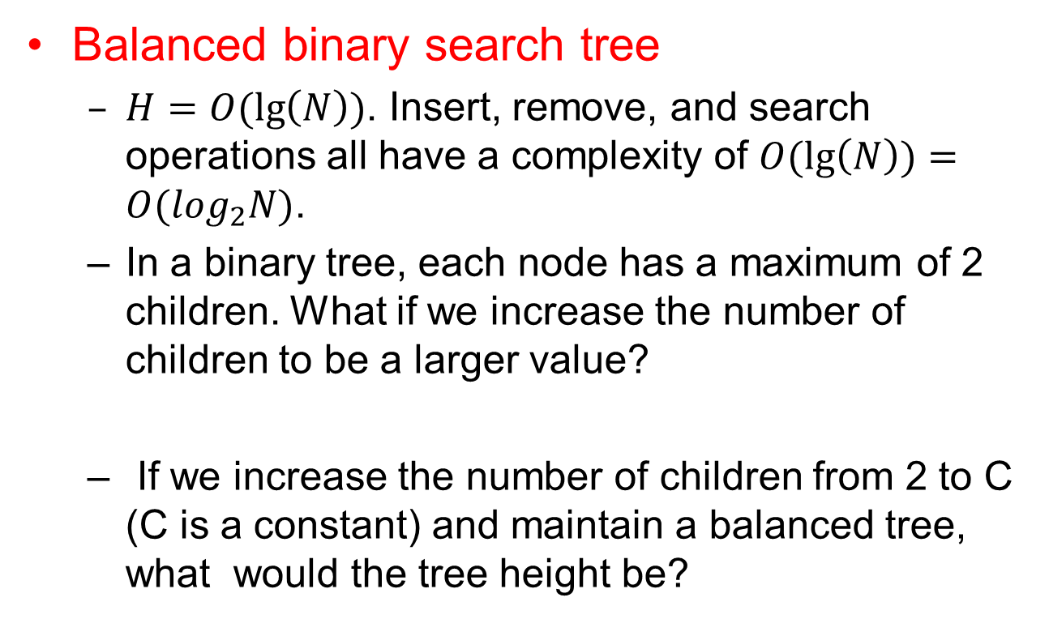
B-trees: motivation
Balanced binary search tree
  $H=O(\lg\left(N\right))$. Insert, remove, and search operations all have a complexity of $O(\lg\left(N\right))=O(\log_{2}N)$.
  In a binary tree, each node has a maximum of 2 children. What if we increase the number of children to be a larger value?
  If we increase the number of children from 2 to C (C is a constant) and maintain a balanced tree, what would the tree height be?

Slide 3
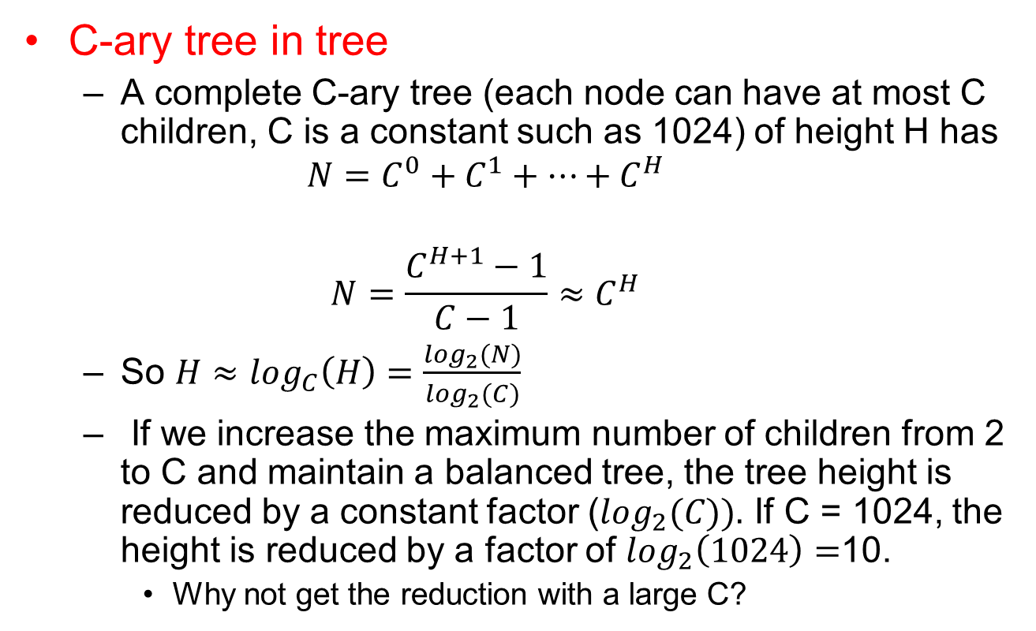
B-trees: motivation
C-ary tree in tree
  A complete C-ary tree (each node can have at most C children, C is a constant such as 1024) of height H has
  $${N=C}^{0}+C^{1}+…+C^{H}$$
  $$N=\frac{C^{H+1}−1}{C−1}≈C^{H}$$
  So $H≈\log_{C}\left(H\right)=\frac{\log_{2}(N)}{\log_{2}(C)}$
  If we increase the maximum number of children from 2 to C and maintain a balanced tree, the tree height is reduced by a constant factor ($\log_{2}(C)).$ If C = 1024, the height is reduced by a factor of $\log_{2}\left(1024\right)=$10.
    Why not get the reduction with a large C?

Slide 4
B-trees: motivation
Using a larger degree than 2 in tree
  If we increase the degree from 2 to C=1024, the height is reduced by a factor of 10.
  Reducing the tree height is not a clean-cut winner because the logic to decide which child to go to in each node also gets more complicated
    Needs a lot of comparisons to make the decision. For C=1024, if we do binary search over 1024 potential choices within each node, we will still need at least 10 comparisons to make the decision.

Slide 5
B-Trees motivation
From the previous analysis, balanced binary tree should be good enough.
The analysis assumes that computation within a node and accesses new tree nodes are all done in CPU. If the data does not fit in memory, some part of data may be stored on hard disk.
  CPU speed is in millions of instructions per second
    3GHz machines
      Equals roughly 3000 million instructions per seconds
  Typical disk speeds about 7,200 RPM
    Roughly 120 disk accesses per second
  So accessing disk is incredibly expensive.
So we will be willing to do more computation to organize our data better and make fewer disk accesses: computation with a node is done in CPU, traversal tree nodes may cause disk access (e.g. in database).

Slide 6
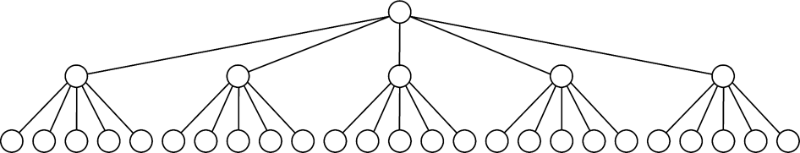
M-ary Trees
Allows up to M children for each node
  Instead of max two for binary trees
A complete M-ary tree of N nodes has a depth of log_{M}N
Example of complete 5-ary tree of 31 nodes

Slide 7
M-ary search tree
Similar to binary search tree, except that
Each node has (M-1) keys to decide which of the M branches to follow.
Larger M ➔ smaller tree depth
But how to make M-ary tree balanced?

Slide 8
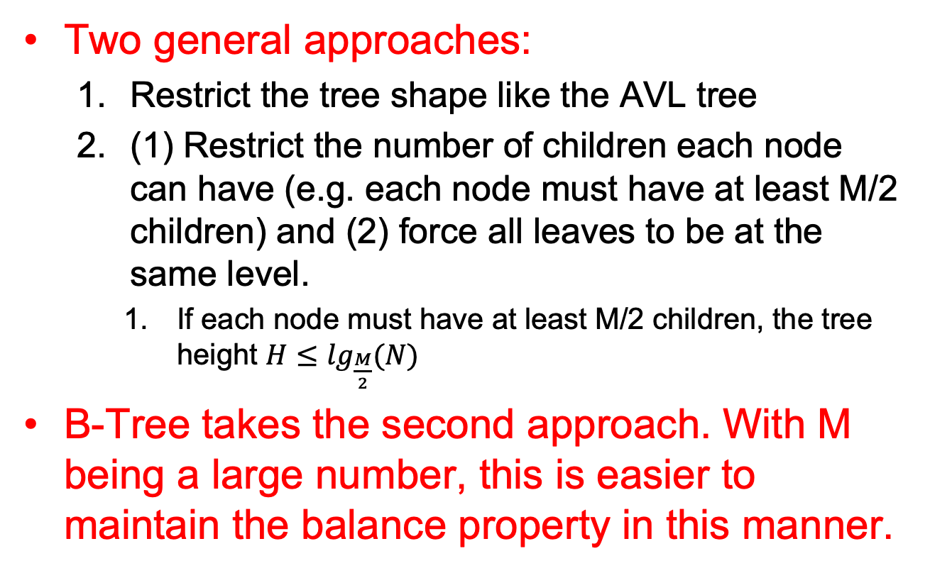
Balanced M-ary search tree
Two general approaches:
  Restrict the tree shape like the AVL tree
  (1) Restrict the number of children each node can have (e.g. each node must have at least M/2 children) and (2) force all leaves to be at the same level.
    If each node must have at least M/2 children, the tree height $H≤\lg_{\frac{M}{2}}(N)$
B-Tree takes the second approach. With M being a large number, this is easier to maintain the balance property in this manner.

Slide 9
B-Tree (or Balanced Trees)
B-Tree is an M-ary search tree with the following balancing restrictions
  Data items are stored at the leaves
  Non-leaf nodes store up to M-1 keys to guide the searching (keys are sorted within a node)
    Key i represents the smallest key in subtree (i+1)
  The root can either be a leaf, or have between 2 to M children
  All non-leaf nodes except the root have between ceil(M/2) and M children
  All leaves are at the same depth and have between ceil(L/2) and L data items, for some L.

Slide 10
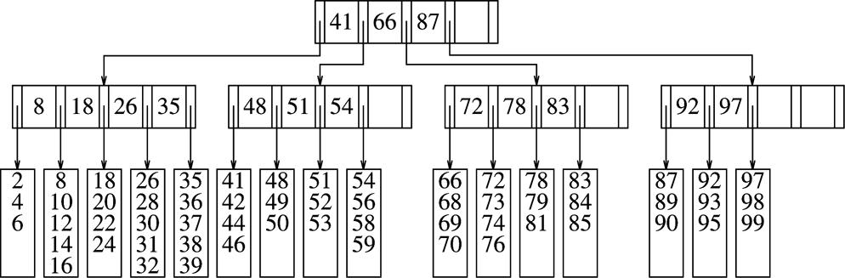
B-Tree Example (M=5, L=5)
All leaves are in the same level
How many children each node must have? How many data each leaf node must have?

Slide 11
B-Tree Example (M=5, L=5)
All data are stored in the leaf nodes only
Data in the non-leaf nodes can be derived from the data in the leaf nodes.
  The purpose of the non-leaf nodes is to find the data in the leaf nodes quickly. Such nodes are sometimes called indexing nodes.

Slide 12
B-Tree Example (M=5, L=5)
Given the leaf nodes, logically how to populate the non-leaf nodes?
  The data in each non-leaf node are sorted (data are sorted in leaf nodes too).
  The i-th key in a node is the smallest data in the i+1 th subtree.
  If the leaf nodes in a B-tree is decided, the whole tree is decided!

Slide 13
B-Tree Example (M=5, L=5)
What is the range of the data in the i+1 th subtree of a node?
  The i-th key in a node is the smallest data in the i+1 th subtree.

Slide 14

B-Tree Example (M=5, L=5)
What is the range of the data in the i+1 th subtree of a node?
  The i-th key in a node is the smallest data in the i+1 th subtree.
  ${key}_{i} ≤X <{key}_{i+1}$

Slide 15

B-tree search
If $data<{key}_{0}$ then go to ${subtree}_{0}$
If $data≥{key}_{largest}$ then go to ${subtree}_{largest+1}$
Else ${key}_{i}≤data<{key}_{i+1}$ then go to ${subtree}_{i+1}$
Try search 40, 58, 94, 71.

Slide 16
B-tree insert
Do a search to find the leaf node where the data is supposed to be
Insert the data into the leaf if there is space.
Otherwise, split the leaf into two (which results in one more entry in its parent node, this in turn may result in parent node to split)

Slide 17
B-Tree Example
Insert 57.

Slide 18
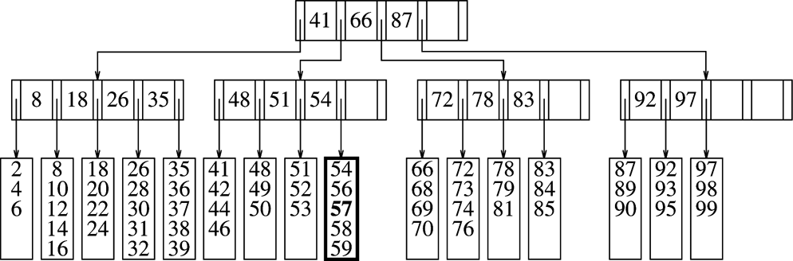
B-Tree: Inserting a value
After insertion of 57. Now insert 55.

Slide 19
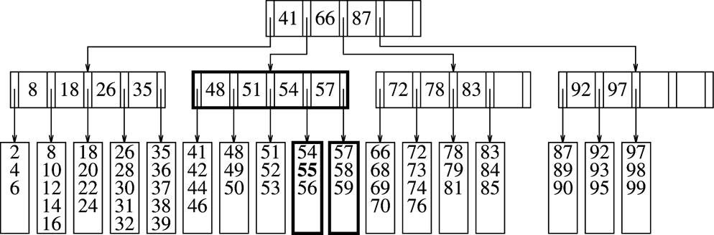
B-Tree: Inserting a value (cont’d)
Inserting 55.
Splits a full leaf into two leaves.
Now insert 40?

Slide 20
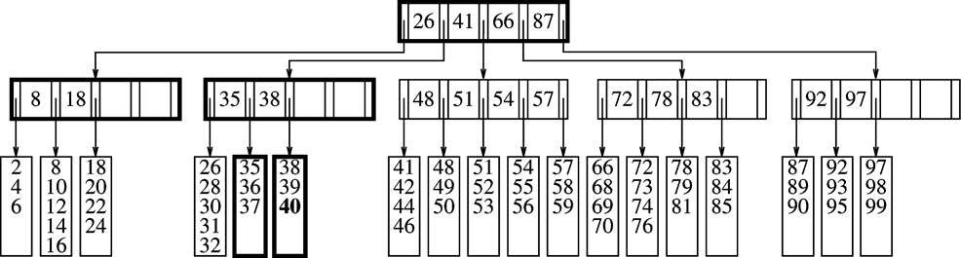
B-Tree: Inserting a value (contd)
Now try to insert 43 and 45: the tree grows!!

Slide 21

B-tree delete
Do a search to find the leaf node to delete the data and delete the data.
If the leaf still has at least $\left\lceil \frac{L}{2}\right\rceil$data entries, then done. Otherwise, merge with data in neighboring leaf to make sure that each leaf still has at least $\left\lceil \frac{L}{2}\right\rceil$data entries

Slide 22
B-Tree: Inserting a value (contd)
Now delete 99.

Slide 23
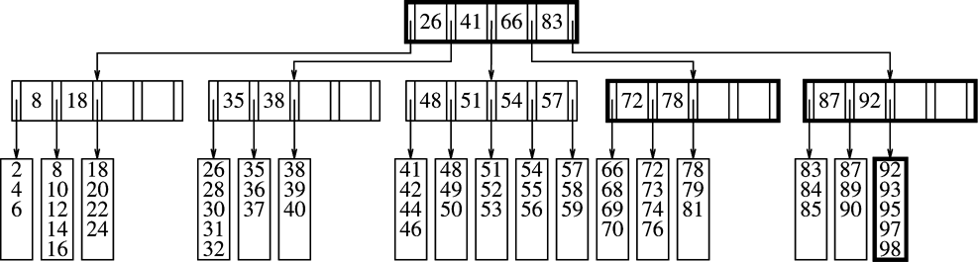
B-tree: Deletion of a value
Deletion of 99
Causes combination of two leaves into one.
Can recursively combine non-leaves

Slide 24
B-tree: Deletion of a value
Deletion of 85: the second level node
would merge (keep deleting and the
tree will eventually shrink).

Slide 25
Questions
How does the height of the tree grow?
How does the height of the tree reduce?

Slide 26
Reading Assignment
Section 4.8
Chapter 5

