Slide 1
Trees 4: AVL Trees
Reading: Sections 4.4, 4.6, and 4.7

Slide 2
Motivation of a balanced binary search tree
Binary search tree has very simple search, insert and remove algorithms
  The complexity of all of the above operations is O(H) where H is the height of the tree
  Binary search tree does not guarantee a small H: in the worst case, H = N or (O(N)).
    Give a scenario that we build a bad binary tree
  It would be ideal if we can maintain a binary search tree whose height H = O(lg(N))!
    Search, insert, remove, findmin, findmax all have O(lg(N)) complexity!
    Balanced binary search tree achieves this!

Slide 3
AVL (Adelson-Velskii and Landis) Trees
AVL tree is one of such balanced binary search trees!
AVL tree is binary search tree with the balance condition
  For every node in tree, height of left and right subtree can differ by at most 1
  This condition guarantees that H = O(log(N))

Slide 4
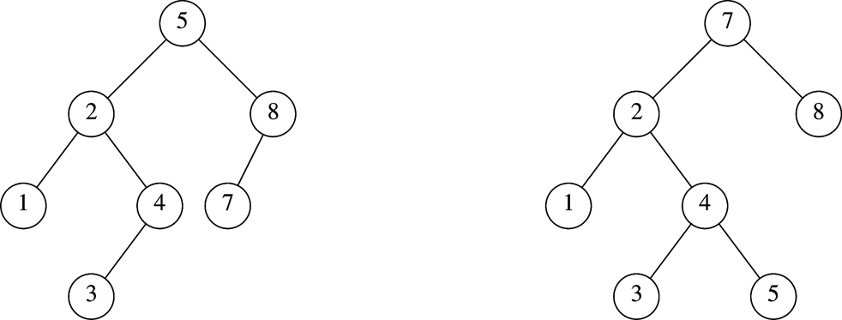
Which is an AVL Tree?

Slide 5
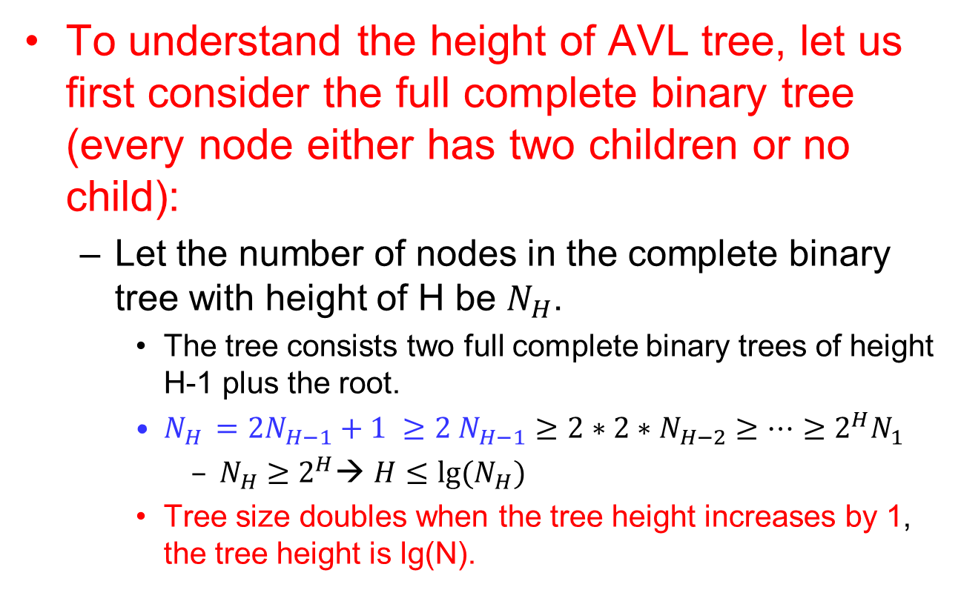
Height of AVL Trees
To understand the height of AVL tree, let us first consider the full complete binary tree (every node either has two children or no child):
  Let the number of nodes in the complete binary tree with height of H be $N_{H}$.
    The tree consists two full complete binary trees of height H-1 plus the root.
    $N_{H }=2N_{H−1}+1 ≥2 N_{H−1}≥2∗2∗N_{H−2}≥…≥2^{H}N_{1}$
      $N_{H}≥2^{H}$→ $H≤lg⁡(N_{H})$
    Tree size doubles when the tree height increases by 1, the tree height is lg(N).

Slide 6
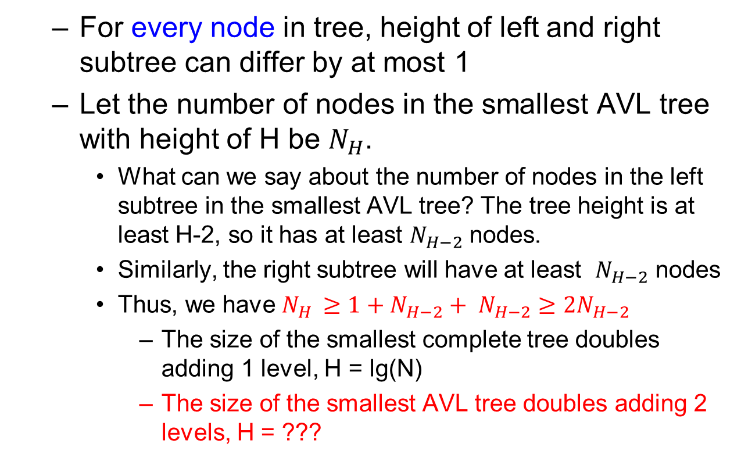
Height of AVL Trees
  For every node in tree, height of left and right subtree can differ by at most 1
  Let the number of nodes in the smallest AVL tree with height of H be $N_{H}$.
    What can we say about the number of nodes in the left subtree in the smallest AVL tree? The tree height is at least H-2, so it has at least $N_{H−2}$ nodes.
    Similarly, the right subtree will have at least $N_{H−2}$ nodes
    Thus, we have $N_{H }≥1+N_{H−2}+ N_{H−2}≥2N_{H−2}$
      The size of the smallest complete tree doubles adding 1 level, H = lg(N)
      The size of the smallest AVL tree doubles adding 2 levels, H = ???

Slide 7
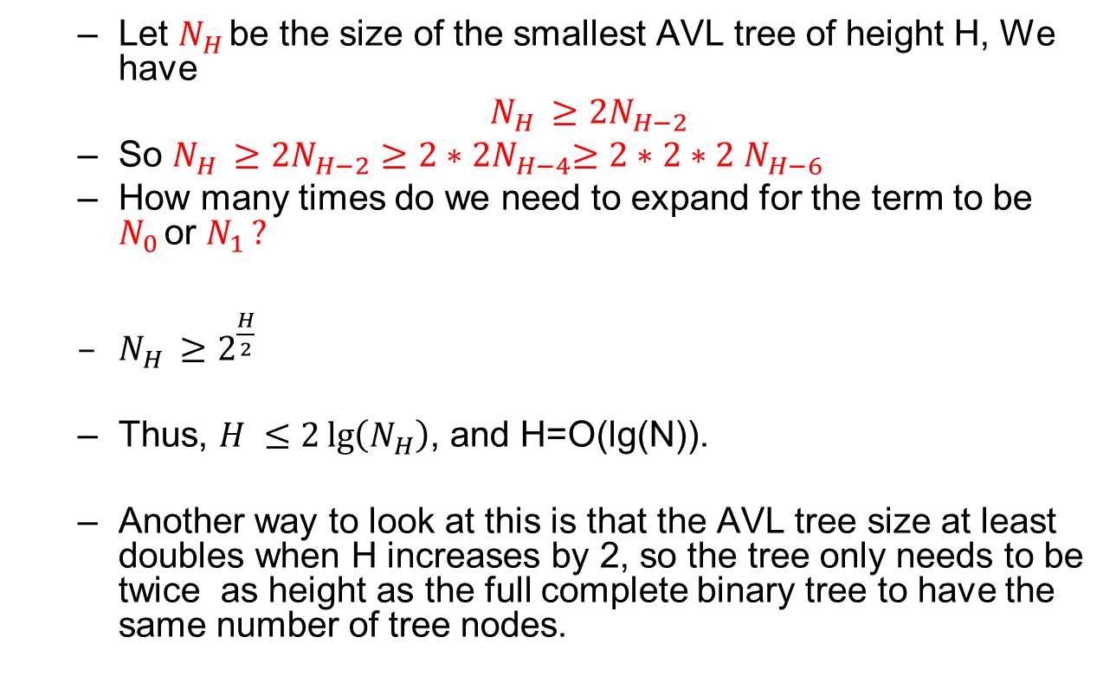
Height of AVL Trees
  Let $N_{H }$be the size of the smallest AVL tree of height H, We have
  $N_{H }≥2N_{H−2}$
  So $N_{H }≥2N_{H−2}≥2{∗2N}_{H−4}≥2∗2∗2 N_{H−6 }$
  How many times do we need to expand for the term to be $N_{0 }$or $N_{1 }?$
  $N_{H }≥2^{\frac{H}{2}}$
  Thus, $H ≤2\lg\left(N_{H}\right)$, and H=O(lg(N)).
  Another way to look at this is that the AVL tree size at least doubles when H increases by 2, so the tree only needs to be twice as height as the full complete binary tree to have the same number of tree nodes.

Slide 8
AVL (Adelson-Velskii and Landis) Trees
AVL tree is a balanced binary search tree!
AVL tree is binary search tree with the balance condition that guarantees that H = O(lg(N))
  What is the balance condition?
  If we can maintain the balance condition in the insert and remove operations to AVL tree (with O(H) for each insert and remove, we have a data structure that achives O(lg(N)) for search, insert, and remove.
    A set of O(1) “Rotate” operations if condition violated when inserting/removing nodes

Slide 9
AVL Trees
Overhead
  Extra space for maintaining height information at each node (used to maintain the tree balance).
Advantage
  Insert, remove, and search operations are all O(log(N))

Slide 10
Insertion into AVL tree
Insert into a BST tree
If the tree is no longer a AVL tree after insertion, perform correction operations to make it a AVL tree again.
  It turns out that the correction operation only need to perform on the deepest node when the AVL tree property is violated!
  How to find this node?

Slide 11
Balance Condition Violation after insertion
Violation cases at node k (deepest node)
  Case 1: the new node is inserted into the left subtree of k
    Can k has no left child in this case?
  Case 2: the node is inserted into the right subtree of k
    Can k have no right child in this case?
  If a node inserted into the left sub-tree of k causing the AVL property being violated, k must have a left child
  If a node inserted into the right sub-tree of k causing the AVL property being violated, k must have a right child
  So we further partition the cases into four cases, which is easier for the correction operation!

Slide 12
Balance Condition Violation after insertion
Violation cases at node k (deepest node)
  Case 1: an insertion into left subtree of left child of k
  Case 2: an insertion into right subtree of left child of k
  Case 3: an insertion into left subtree of right child of k
  Case 4: insertion into right subtree of right child of k
  Cases 1 and 4 equivalent
    Single rotation to rebalance
  Cases 2 and 3 equivalent
    Double rotation to rebalance

Slide 13
Balance Condition Violation after insertion
Violation cases at node k (deepest node)
  Case 1: an insertion into left subtree of left child of k
  Case 2: an insertion into right subtree of left child of k
  Case 3: an insertion into left subtree of right child of k
  Case 4: insertion into right subtree of right child of k
  Example: insert 10 (case 1) to the left tree, insert 300 to the right tree (case 4). How about case 2 and case 3?
100
100
50
200

Slide 14
Balance Condition Violation after insertion
  Example: insert 10 (case 1) to the tree.
100
100
50
50
50
10
100
Rotation:
some local
pointer
adjustments
Balanced
tree
10
Tree is
balanced
again.
Tree becomes
imbalanced
after insertion

Slide 15
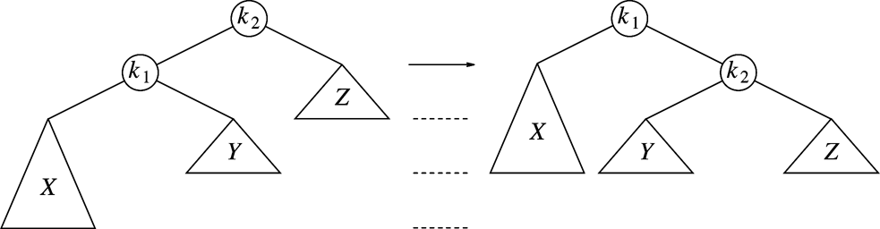
Single Rotation (Case 1)
Reeplace node k₂ by node k₁
Set node k₂ to be right child of node k₁
Set subtree Y to be left child of node k₂

Slide 16
Single Rotation (Case 1)
Before the insertion: X, Y, Z have the same height (why?)
The tree height at k1 after the insertion is the same the tree height at k2 before insertion (why?)
  The rest of the tree still meet the AVL tree requirement. No more fixes are needed.

Slide 17
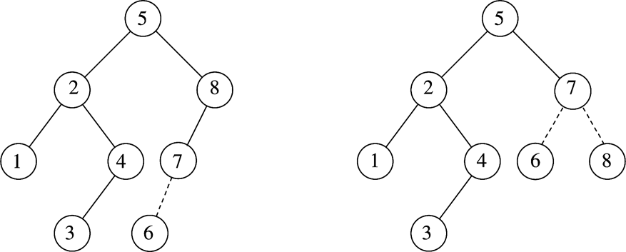
Example
After inserting 6
  Balance condition at node 8 is violated

Slide 18
Another example: How would the tree looks like after insert 1 to the following tree?
50
10
100
8
20

Slide 19
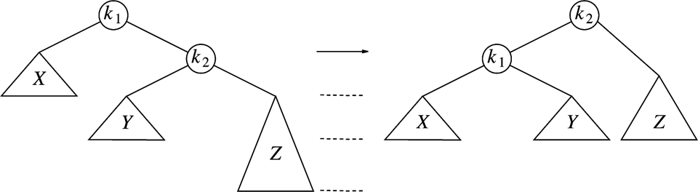
Single Rotation (Case 4)
Replace node k₁ by node k₂
Set node k₁ to be left child of node k₂
Set subtree Y to be right child of node k₁

Slide 20
Example
Inserting 3, 2, 1, and then 4 to 7 sequentially into empty AVL tree
3
2
2
1
3
1

Slide 21
Example (Cont’d)
Inserting 4
Inserting 5
2
1
3
4
2
1
3
4
5

Slide 22
Example (Cont’d)
Inserting 5
2
2
1
3
4
1
4
5
3
5

Slide 23
Example (Cont’d)
Inserting 6
2
1
4
3
5
6

Slide 24
Example (Cont’d)
Inserting 6
Inserting 7
4
2
2
5
1
4
1
3
6
3
5
6
4
2
5
1
3
6
7

Slide 25
Example (Cont’d)
Inserting 6
Inserting 7
4
2
2
5
1
4
1
3
6
3
5
6
4
4
2
6
2
5
1
3
5
7
1
3
6
7

Slide 26
Summary
Find the deepest node whose AVL property is violated
  Consider only the nodes from the root to the new node
Perform the (single) rotation and done!

Slide 27
Single Rotation for case 2? Does not work
Consider a simple case 2: insert 70 to the following tree.
After single rotation, the tree still not balanced
Double rotations needed for case 2 and case 3
100
50

Slide 28
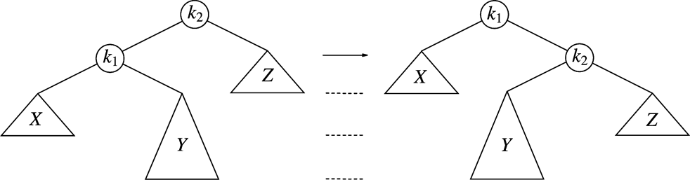
More generally, single rotation does not work for Cases 2 and 3
After single rotation, k₁ still not balanced
Double rotations are needed for case 2 and case 3

Slide 29
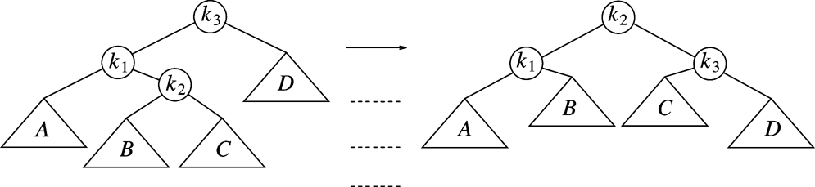
Double Rotation (Case 2)
Left-right double rotation to fix case 2
First rotate between k₁ and k₂
Then rotate between k₂ and k₃

Slide 30
Double Rotation (Case 2)
We always have k1, k2, k3 after the insertion in case 2
What about A, B, C, D?
After the insertion, the height of k2 must grow by 1
D’s height is 1 less than k2’s height before rotation
  D’s height is either the same as C or 1 more: K3 is balanced after rotation
A’s height is equal to k2’s height before rotation
  A’s height is either the same as B or 1 more: K1 is balanced after rotation
After the rotation, the tree height is the same as the tree before rotation

Slide 31
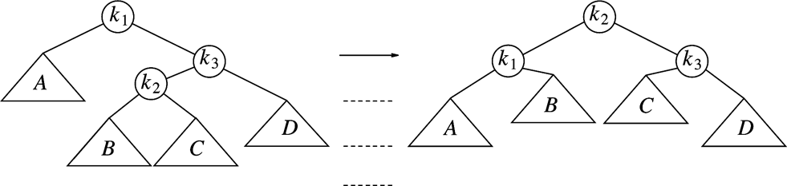
Double Rotation (Case 3)
Right-left double rotation to fix case 3
First rotate between k₂ and k₃
Then rotate between k₁ and k₂

Slide 32
Example
Continuing the previous example by inserting
  16 down to 10, and then 8 and 9
Inserting 16 and 15
4
4
2
6
2
6
1
3
5
15
1
3
5
7
7
16
16
15

Slide 33
Example (Cont’d)
Inserting 14
Other cases as exercises
4
4
2
7
2
6
1
3
6
15
1
3
5
15
14
16
7
16
5
14

Slide 34
Summary: Case 1 and Case 4

Slide 35
Summary: Case 2 and Case 3

Slide 36
Summary
The four fixing operations do not need to relate to insert or remove operation. We can just look at the tree and do the fixing.
  The left of the left is too tall: Apply case 1
  The right of the left is too tall: Apply case 2
  The left of the right is too tall: Apply case 3
  The right of the right is too tall: Apply case 4
These fixings will make the tree AVL tree for the node and its descendents, but may change the tree height.
  For the insertion case, the tree height does not change.

Slide 37
Delete
Single rotation or double rotation are both O(1).
Depending on the shape of the tree, either single rotation or double rotation will fix the AVL property of one node
Delete can be done by deleting as in BST delete, and then fix all nodes along the path from the root to the deleted node, this would take at most O(lg(N))

Slide 38
Implementation of AVL Tree
struct AvlNode
{
Comparable element;
AvlNode *left;
AvlNode *right;
int height;
AvlNode( const Comparable & ele, AvlNode *lt, AvlNode *rt, int h = 0 )
: element{ ele }, left{ lt }, right{ rt }, height{ h } { }
AvlNode( Comparable && ele, AvlNode *lt, AvlNode *rt, int h = 0 )
: element{ std::move( ele ) }, left{ lt }, right{ rt }, height{ h } { }
};
/**
* Return the height of node t or -1 if nullptr.
*/
int height( AvlNode *t ) const
{
return t == nullptr ? -1 : t->height;
}

Slide 39
Insertion into an AVL Tree
/**
* Internal method to insert into a subtree.
* x is the item to insert.
* t is the node that roots the subtree.
* Set the new root of the subtree.
*/
void insert( const Comparable & x, AvlNode * & t )
{
if( t == nullptr )
t = new AvlNode{ x, nullptr, nullptr };
else if( x < t->element )
insert( x, t->left );
else if( t->element < x )
insert( x, t->right );
balance( t );
}

Slide 40
Insertion into an AVL Tree (Cont’d)
static const int ALLOWED_IMBALANCE = 1;
// Assume t is balanced or within one of being balanced
void balance( AvlNode * & t )
{
if( t == nullptr )
return;
if( height( t->left ) - height( t->right ) > ALLOWED_IMBALANCE )
if( height( t->left->left ) >= height( t->left->right ) )
rotateWithLeftChild( t );
else
doubleWithLeftChild( t );
else
if( height( t->right ) - height( t->left ) > ALLOWED_IMBALANCE )
if( height( t->right->right ) >= height( t->right->left ) )
rotateWithRightChild( t );
else
doubleWithRightChild( t );
t->height = max( height( t->left ), height( t->right ) ) + 1;
}
Case 1
Case 2
Case 4
Case 3

Slide 41
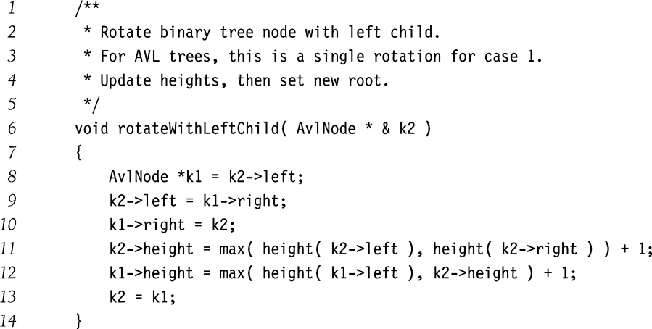
Single Rotation (Case 1)

Slide 42
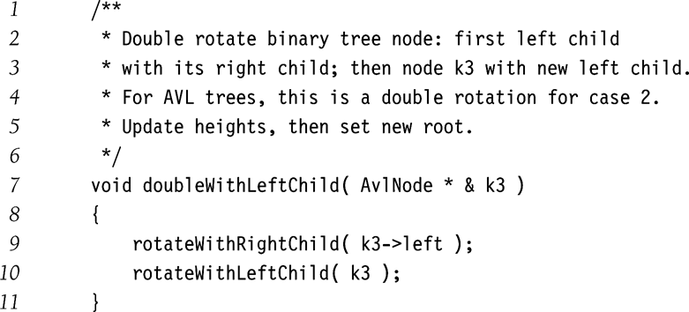
Double Rotation (Case 2)

Slide 43
Remove
Just do the binary search tree remove, and then call balance(t) at the end. See the book for the code.

