Slide 1
Trees : Part 1
Reading: Section 4.1
  Theory and Terminology
  Preorder, Postorder and Levelorder Traversals

Slide 2
Theory and Terminology
Definition: A tree is a connected graph with no cycles
Consequences:
  Between any two vertices, there is exactly one unique path

Slide 3
A Tree?
9
10
11
12
5
6
7
8
2
3
4
1

Slide 4
A Tree? Nope
9
10
11
12
5
6
7
8
2
3
4
1

Slide 5
A Tree?
9
10
11
12
5
6
7
8
2
3
4
1

Slide 6
A Tree? Yup
9
10
11
12
5
6
7
8
2
3
4
1

Slide 7
Theory and Terminology
Definition: A rooted tree is a graph G such that:
  G is connected
  G has no cycles
  G has exactly one vertex called the root of the tree
Consequences
  A tree T can be arranged so that the root is at the top
  Parent vs. child nodes and edges
    Is edge only between a parent and a child?
  Sibling nodes
    Nodes of same parent nodes
  Leaf nodes
    Nodes without children nodes
root
1
2
3
4
5
6
7
8
9
10
11
12

Slide 8
Theory and Terminology
Path from n₁ to n_{k}
  Descending path: A sequence of nodes n₁, n₂, …, n_{k}, where n_{i} is parent of n_{i+1}
  Ascending path: n_{i} is child of n_{i+1}
  Ascending followed by descending??
  Descending followed by ascending??
Length of path
  Number of edges on path
root
1
2
3
4
5
6
7
8
9
10
11
12

Slide 9
Theory and Terminology
Consequences
  A unique path from the root to any vertex is a descending path
Depth of a vertex v
  Length of the unique descending path from root to v
  The root is at depth 0
  its neighboring vertices are vertices of depth 1, and so on…
  Set of all vertices of depth k is called level k of the tree
depth = 0
root
1
depth = 1
2
3
4
depth = 2
5
6
7
8
depth = 3
9
10
11
12

Slide 10
Theory and Terminology
Definitions
  Height of a vertex v is the length of the longest path from v to one of its descendant leaves.
  The height of a tree is the height of the root
    Equal to the maximum depth of the tree
depth = 0
root
1
height = 3
depth = 1
2
3
4
height = 2
height
depth = 2
5
6
7
8
height = 1
depth = 3
9
10
11
12
height = 0
What is height of node 5?

Slide 11
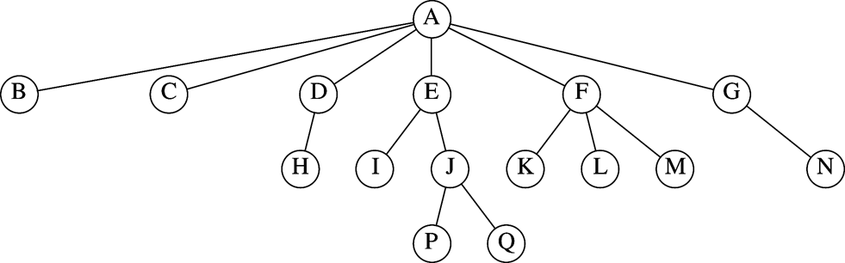
Example of rooted tree
Which are the parent nodes?
Which are the child nodes?
Which are the leaves?
What is the height and depth of the tree?
What is the height and depth of node E? Node F?

Slide 12
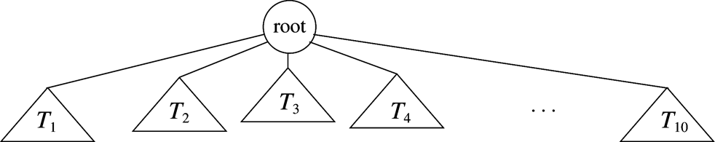
Rooted Tree: Recursive definition
A graph with N nodes and N-1 edges
Graph has
  one root r
  Zero or more non-empty sub-trees, each of whose root is connected to r by an edge.
  Every node except the root has one parent

Slide 13
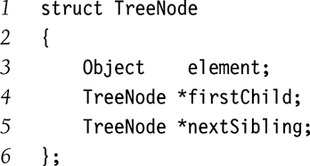
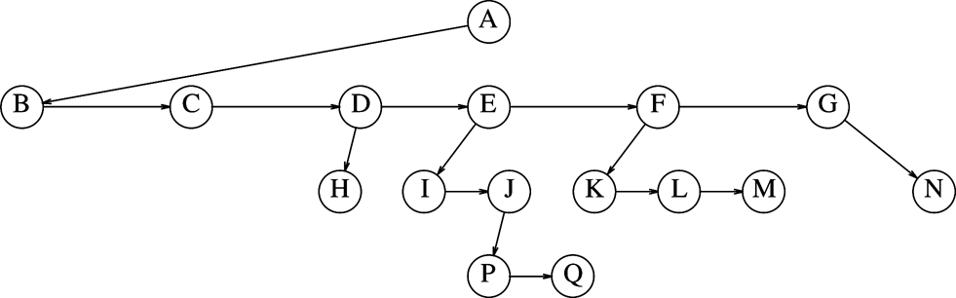
A simple Tree Implementation
Each node points to
  Its first child
  Its next sibling
  Back to its parent (optional)

Slide 14
Tree Traversals
Definition: A traversal is the process for “visiting” all of the vertices in a tree
  Often defined recursively
  Each kind corresponds to an iterator type
  Iterators are implemented non-recursively
  Preorder traversal
  Postorder traversal
  Levelorder traversal

Slide 15
Preorder Traversal
Visit root, then visit child sub-trees (recursive definition)
  Note that children of the root have an order
    In the example: visit root, visit T1, visit T2, …, visit T10
How to implement preorder traversal
  Depth-first search
    Begin at root
    Visit vertex on arrival
Implementation may be recursive, stack-based, or nested loop

Slide 16
Preorder Traversal
root
1
root
1
(1)
2
3
4
(2)
2
3
4
5
6
7
8
5
6
7
8
root
1
root
1
(3)
2
3
4
2
3
4
(4)
5
6
7
8
5
6
7
8

Slide 17
Preorder Traversal
root
1
root
1
(5)
2
3
4
2
3
4
(6)
5
6
7
8
5
6
7
8
root
1
root
1
(7)
2
3
4
2
3
4
(8)
5
6
7
8
5
6
7
8

Slide 18
Preorder Traversal
root
1
2
3
4
5
6
7
8
Preorder traversal result: 1, 2, 5, 6, 3, 7, 8, 4

Slide 19
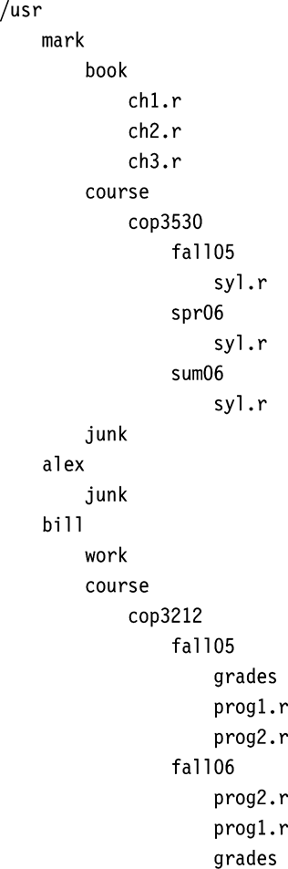
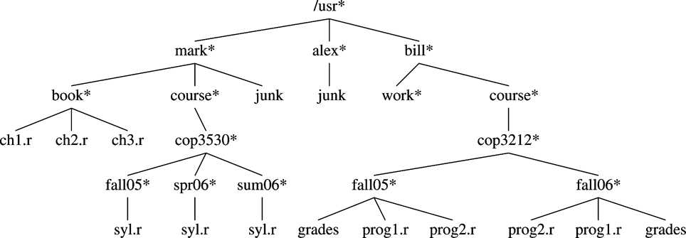
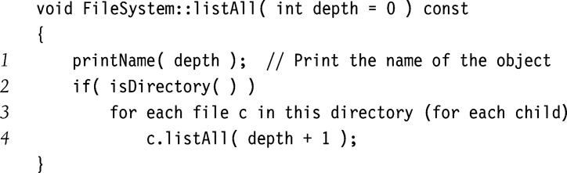
Preorder Traversal of UNIX Directory Tree (‘ls –R’)

Slide 20
Postorder Traversal
Visit child vertices, then visit root (recursive definition)
  In the example: visit T1, visit T2, …, visit T10, visit root
How to implement the postorder traversal
  Depth-first search
    Begin at root
    Visit vertex on departure
Implementation may be recursive, stack-based, or nested loop

Slide 21
Postorder Traversal
root
1
root
1
(1)
2
3
4
2
3
4
(2)
5
6
7
8
5
6
7
8
root
1
root
1
(3)
2
3
4
2
3
4
(4)
5
6
7
8
5
6
7
8

Slide 22
Postorder Traversal
root
1
root
1
(5)
2
3
4
2
3
4
(6)
5
6
7
8
5
6
7
8
root
1
root
1
(7)
2
3
4
2
3
4
(8)
5
6
7
8
5
6
7
8

Slide 23
Postorder Traversal (5, 6, 2, 7, 8, 3, 4, 1)
root
1
root
1
(9)
2
3
4
2
3
4
(10)
5
6
7
8
5
6
7
8
root
1
root
1
(11)
2
3
4
2
3
4
(12)
5
6
7
8
5
6
7
8

Slide 24
Postorder Traversal
root
1
root
1
(13)
2
3
4
2
3
4
(14)
5
6
7
8
5
6
7
8
root
1
root
1
2
3
4
2
3
4
(15)
(16)
5
6
7
8
5
6
7
8

Slide 25
Preorder Traversal
root
1
2
3
4
5
6
7
8
Post order traversal result: 5, 6, 2, 7, 8, 3, 4, 1

Slide 26
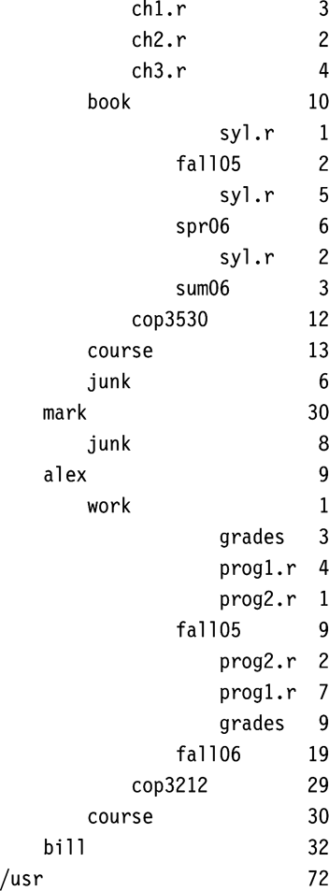

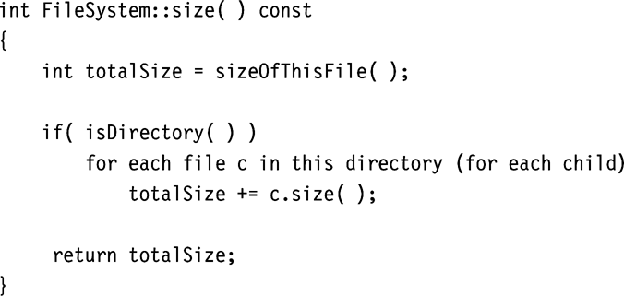
Postorder Traversal
Calculating Size of Directory (‘du’)

Slide 27
Levelorder Traversal
Visit all vertices in level, starting with level 0 and increasing
How to implement levelorder traversal
  AKA breadth-first traversal
  Breadth-first search
    Begin at root
    Visit vertex on departure
Only practical implementation is queue-based

Slide 28
Levelorder Traversal
root
1
root
1
(1)
2
3
4
2
3
4
(2)
5
6
7
8
5
6
7
8
root
1
root
1
(3)
2
3
4
2
3
4
(4)
5
6
7
8
5
6
7
8

Slide 29
Levelorder Traversal (1, 2, 3, 4, 5, 6, 7, 8)
root
1
root
1
(5)
2
3
4
2
3
4
(6)
5
6
7
8
5
6
7
8
root
1
root
1
(7)
2
3
4
2
3
4
(8)
5
6
7
8
5
6
7
8

Slide 30
Preorder Traversal
root
1
2
3
4
5
6
7
8
Levelorder traversal result: 1, 2, 3, 4, 5, 6, 7, 8

Slide 31
Traversal Orderings
Preorder: depth-first search (possibly stack-based), visit on arrival
Postorder: depth-first search (possibly stack-based), visit on departure
Levelorder: breadth-first search (queue-based), visit on departure

Slide 32
What are the results of preorder, postorder, and levelorder traversals of the following tree?
root
1
2
3
4
9
5
6
7
8
10
11
Preorder traversal result:
Postorder traversal result:
Levelorder traversal result:

Slide 33
Reading Assignment
Sections 4.2 and 4.3

