Slide 1
Chapter 4 to Chapter 7 Concept review
Chapter 4: Tree
Chapter 5: Hash table
Chapter 6: Priority queue

Slide 2
Chapter 4 Tree
Concepts:
  Tree: A connected graph with no cycle
  Rooted tree: A connected graph with no cycle and a particular node called root
    Parent node, child node, sibling nodes, ancestors, descendants, leaf nodes
    True or false: Some edges in a tree connects sibling nodes?
    Depth of a vertex
    Height of a vertex

Slide 3
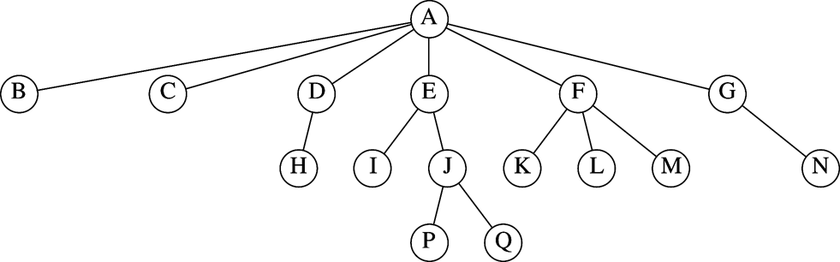
List the ancestors of J:
List the descendent of E:
Height and depth of E:
Sibling of H:
Children of E:

Slide 4
Chapter 4 Tree
Concepts:
  Recursive definition of a rooted tree
  Binary tree
  Complete binary tree
  Vector representation of a complete binary tree:
    Root at array[0]:
      For array[i]: the parent is array[(i-1) / 2], children are array[2*i + 1], and array[2*I + 2]
    Root at array[1]
      For array[i]

Slide 5
Draw the binary tree form of the following array representing the complete binary tree
A B C D E F G H I J

Slide 6
Tree traversal
1
pre-order:
in-order:
post-order:
level-order:
2
3
5
6
7
8

Slide 7
Building tree from tree traversal results
True of false: Given any two tree traversal results from pre-order, in-order and post-order traversals, one can uniquely determine the tree.
Given pre-order and in-order traversal strings, build the tree.
  Determine the root (the first node visited in pre-order traversal)
  Determine the pre-order and in-order strings for the left and right sub-trees
    in-order substring for the left subtree is the substring before the root. Let the number of letters be X.
    pre-order substring for the left subtree is the substring after the root with X items.
    in-order substring for the right subtree?
    Pre-order substring for the right subtree is?
  Recursively build the left and right sub-trees.
What is the string for post-order traversal of the tree with
  string for pre-order traversal: ABCDEFG
  string for in-order traversal: CBDEAFG

Slide 8
Binary search tree
Definition: A binary tree B is called a binary search tree iff:
  There is an order relation < defined for the vertices of B
  For any vertex v, and any descendant u of v.left, u < v
  For any vertex v, and any descendent w of v.right, v < w
Binary search tree is also known as Totally Ordered Tree
Describe how to perform search, insert, and remove on a binary search tree.
Build the binary search tree by inserting the following numbers into an empty binary search tree: 100, 50, 60, 55, 200, 150, 160, 30, 52
After the tree is built, remove 60, 50, 100

Slide 9
AVL tree
AVL tree definition: AVL tree is binary search tree with the balance condition: for every node in tree, height of left and right subtree can differ by at most 1.
An AVL tree is maintained by fixing the node(s) that violate the balance condition after each insertion and deletion.
  The fixing is done through single or double rotation.
  For insert, the fixing only needs to be performed at the lowest level node that violates the condition.
    How to find that node to be fixed in insertion?

Slide 10
AVL tree
How to find that node to be fixed in insertion?
  Check from the parent of the newly inserted node upward to the root. The first node that violates the condition is the node to be fixed (and this is the only node that needs fix).
Depending on the position of the inserted node with respect to the node to be fixed, there are four cases:
  Left of the left children of the node to be fixed (case 1, single rotation)
  Right of the left (case 2, double rotation)
  Left of the right (case 3, double rotation)
  Right of the right (case 4)

Slide 11
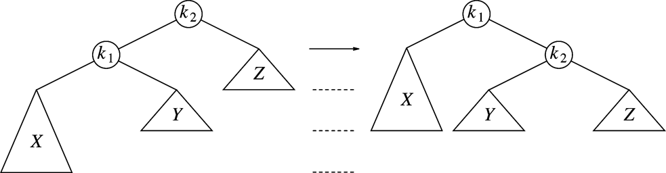
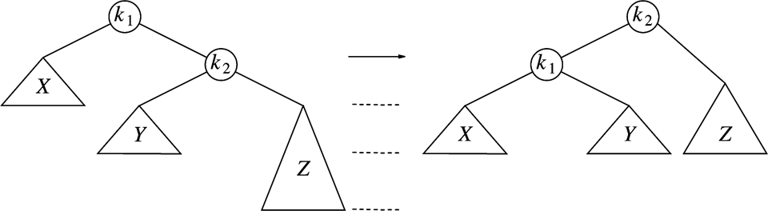
Single rotation
Case 1: new data
inserted to X
Case 2: new data
inserted to Z

Slide 12
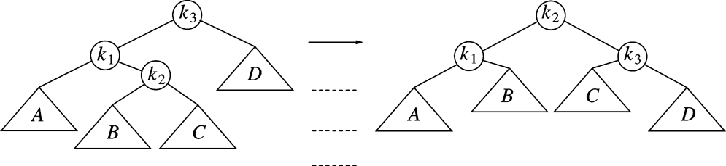
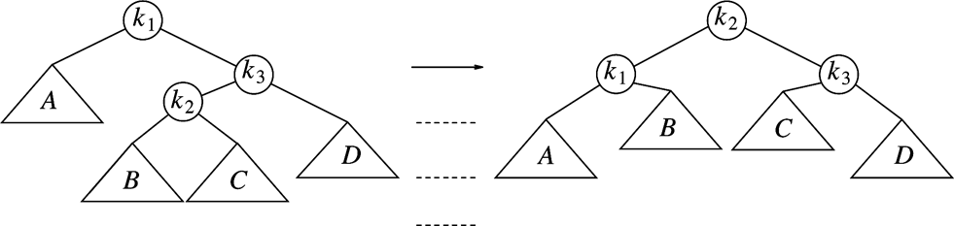
Double rotation
Case 3: new data
inserted to B or C
or just k2
Case 4: new data
Inserted to B or C or k2

Slide 13
Building AVL tree
Draw the AVL tree after each of the following numbers is inserted:
100, 50, 60, 55, 52, 40, 30

Slide 14
B-tree: definition
B-Tree is an M-ary search tree with the following balancing restrictions
  Data items are stored at the leaves
  Non-leaf nodes store up to M-1 keys to guide the searching: keys are sorted within a node, Key i represents the smallest key in subtree (i+1).
  The root can either be a leaf, or have between 2 to M children
  All non-leaf nodes except the root have between ceil(M/2) and M children
  All leaves are at the same depth and have between ceil(L/2) and L data items, for some L.
Key points:
  All leaves are in the same level.
  Each node except the root is at least half full.

Slide 15
Populate the missing keys in the B-tree
For each node, the k-th key is
the smallest value in the k+1 th sub-tree
2
4
7
8
12
14
17
18
32
35
37
39
40
45
46
47
48
50
52
54
56
58
60
63
64
65
70
72
73
78
80
81
83
85
92
94
95
98
99
104
106
107
108
112
114
117
118
119
122
124
127
128

Slide 16
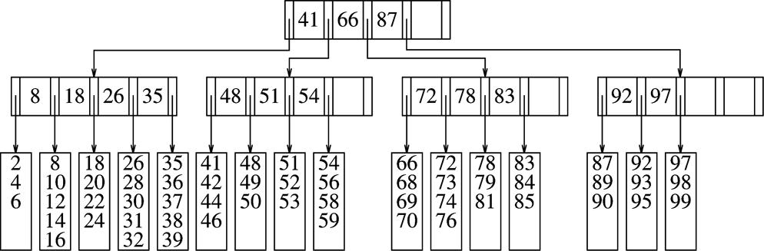
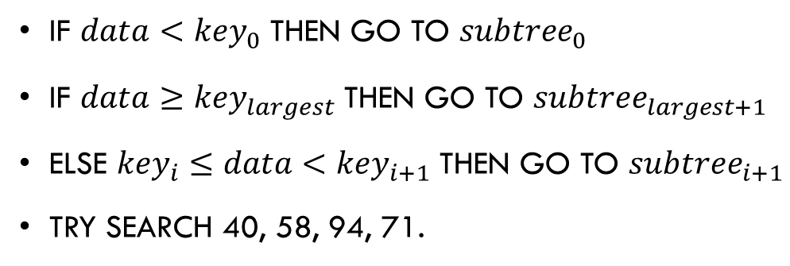
B-tree search
If $data<{key}_{0}$ then go to ${subtree}_{0}$
If $data≥{key}_{largest}$ then go to ${subtree}_{largest+1}$
Else ${key}_{i}≤data<{key}_{i+1}$ then go to ${subtree}_{i+1}$
Try search 40, 58, 94, 71.

Slide 17
B-tree insert (insert 57, 40)
Do a search to find the leaf node to insert the data
Insert the data into the leaf if there is space.
Otherwise, split the leaf into two (which results in one more entry in its parent node, this in turn may result in parent node to split)

Slide 18
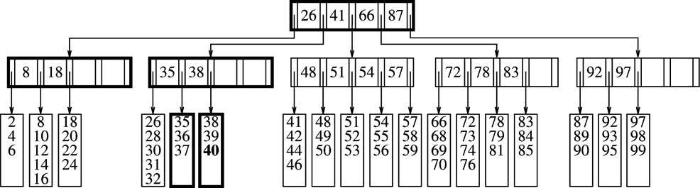
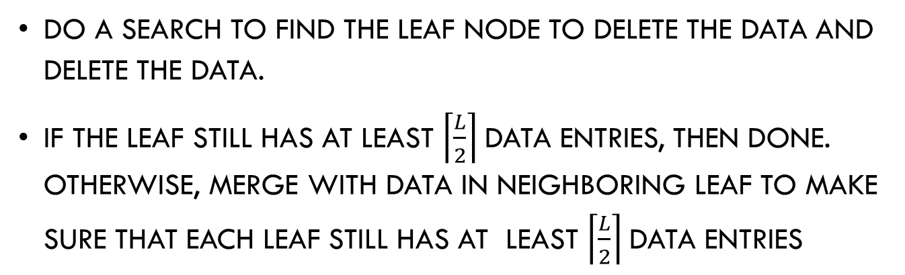
B-tree delete (delete 99)
Do a search to find the leaf node to delete the data and delete the data.
If the leaf still has at least $\left\lceil \frac{L}{2}\right\rceil$data entries, then done. Otherwise, merge with data in neighboring leaf to make sure that each leaf still has at least $\left\lceil \frac{L}{2}\right\rceil$data entries

Slide 19
Chapter 5: Hash table
Big idea: To approximate a giant table indexed by the key
Two key issues: hash function and resolving conflicts
Hash function
  Evenly map the keys into an integer
  The design of hash function is somewhat beyond CS
Resolving conflicts
  Chaining with separate lists
  Probing open address

Slide 20
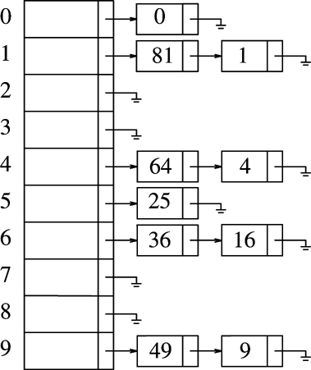
Chaining with separate lists
Hash table is a vector of lists.
Conflicts are resolved with the list: multiple items can be stored in one list
How to do search, insert, and remove on such a table?
Let Hash(x) = x % 10; search 68, 70; insert 23, 45; remove 64

Slide 21
Chaining with separate lists
How to achieve the average O(1) complexity with this?
  load factor

Slide 22
Chaining with separate lists, build the table
Let the hash table has 7 entries, Hash(x) = x % 7
How does the table look after: 10, 7, 9, 3, 16, 20 are inserted?

Slide 23
Probing Open Address
The table contains an array of elements
If collision occurs, try another cell to look.
  try cells h₀(x), h₁(x), h₂(x), h₃(x)… in succession until a free cell is found.
    h_{i}(x) = hash(x) + f(i)and f(0) = 0
  Linear probling: f(i) = i; try hash(x), hash(x) + 1, hash(x)+2
  Describe how to do search, insert, and remove with linear probing
  Let the hash table size be 10, Hash(x) = x % 10
  How does the table look after: 10, 19, 9, 3, 22, 20 are inserted assuming no rehashing?

Slide 24
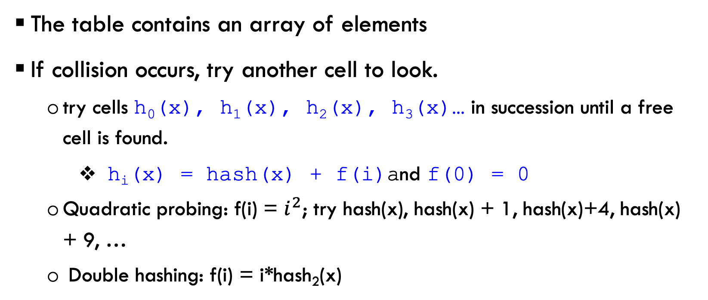
Probing Open Address
The table contains an array of elements
If collision occurs, try another cell to look.
  try cells h₀(x), h₁(x), h₂(x), h₃(x)… in succession until a free cell is found.
    h_{i}(x) = hash(x) + f(i)and f(0) = 0
  Quadratic probing: f(i) = $i^{2}$; try hash(x), hash(x) + 1, hash(x)+4, hash(x) + 9, …
  Double hashing: f(i) = i*hash₂(x)

Slide 25
Probing Open Address
How to make sure that insert, search, and remove have the average O(1) complexity?
True or False: The worse case time complexity for search in a hash table is O(N).

Slide 26
Chapter 6: priority queue
Heap concept:
  A partially ordered tree (POT) is a tree T such that:
    There is an order relation <= defined for the vertices of T
    For any vertex p and any child c of p, p <= c
  Partially ordered complete binary tree
    Allowing vector representation of the tree

Slide 27
Vector representation of the tree
Storing the tree in level order continuously
May start from index 0 or index 1
  Different starting index affects the tree navigation (how to compute parent and children nodes)
  Starting from index 1:
    parent of v[k] is ?
    left child of v[k] is?, right child of v[k] is?
  What if the index starts from 0?

Slide 28
Heap operations
DeleteMIN: the heap size decreases by 1
  Move the last element to root and percolate down from the root.
    How to percolate down?
Insert
  Put the new element at the end of the vector
  fix the heap towards to root.

Slide 29
Building heap
Inserting items one by one resulting in O(N log N) heap building algorithms
A better O(N) heap building algorithm builds the heap from bottom up by percolate elements backward (from N/2 to 1).
  Logically, this heap building algorithm operates by dumping the original data into the heap and then fixing the heap from bottom up (from the last node to the first node)!
  Build the heap: 100 80 60 90 10 1 70 40

Slide 30
Building heap and heap operations
Using the O(N) algorithm to build the heap for the following items:
30 20 60 70 10 7 100
After the heap is built, insert 1, 32, 50 to the heap
After the insertions, do deleteMIN two times, show the heap after each deleteMIN.

