Slide 1
Chapter 2: Complexity Analysis
Outline
  Motivation and background
    What does complexity analysis do?
    Under what conditions does the execution time of a program matter?

Slide 2
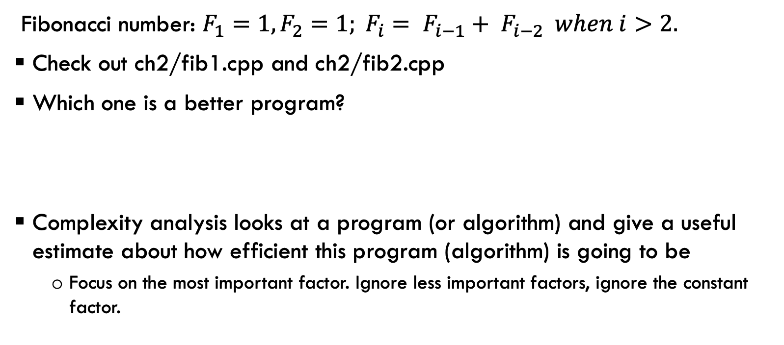
Tale of Two Fibonacci Number Calculators
Fibonacci number: $F_{1}=1, F_{2}=1; F_{i}= F_{i−1}+ F_{i−2} when i>2.$
Check out ch2/fib1.cpp and ch2/fib2.cpp
Which one is a better program?
Complexity analysis looks at a program (or algorithm) and give a useful estimate about how efficient this program (algorithm) is going to be
  Focus on the most important factor. Ignore less important factors, ignore the constant factor.

Slide 3
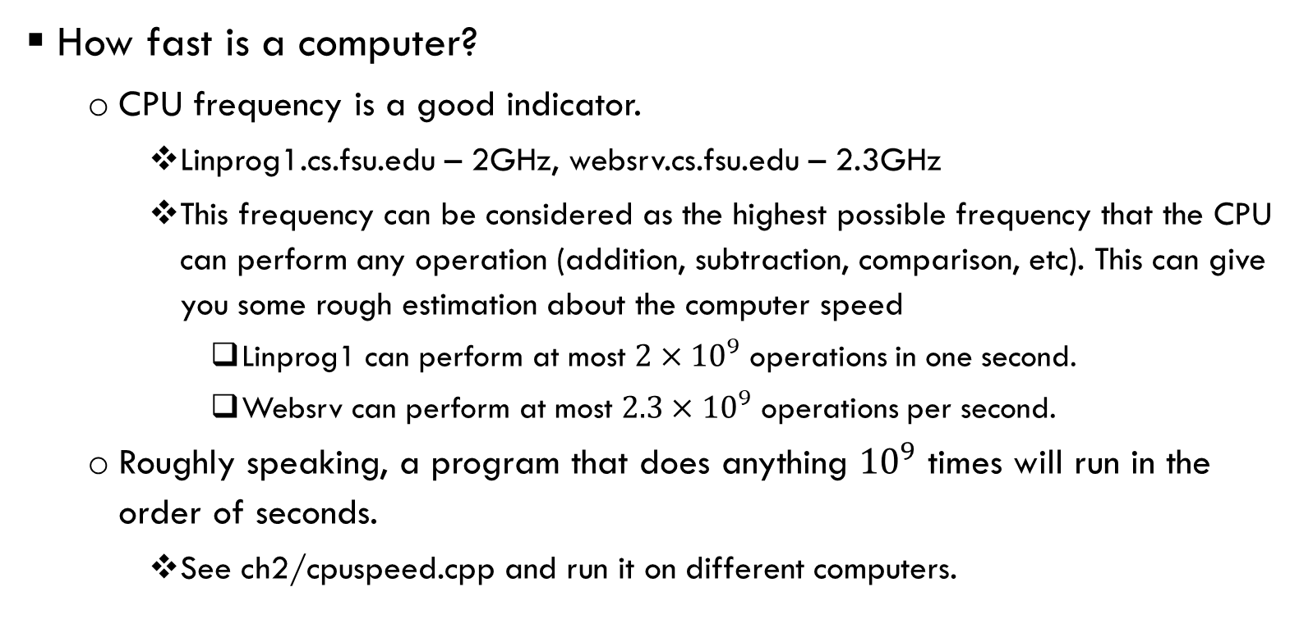
Why program execution time for large inputs matters?
How fast is a computer?
  CPU frequency is a good indicator.
    Linprog1.cs.fsu.edu – 2GHz, websrv.cs.fsu.edu – 2.3GHz
    This frequency can be considered as the highest possible frequency that the CPU can perform any operation (addition, subtraction, comparison, etc). This can give you some rough estimation about the computer speed
      Linprog1 can perform at most $2×{10}^{9}$ operations in one second.
      Websrv can perform at most $2.3×{10}^{9}$ operations per second.
  Roughly speaking, a program that does anything ${10}^{9}$ times will run in the order of seconds.
    See ch2/cpuspeed.cpp and run it on different computers.

Slide 4
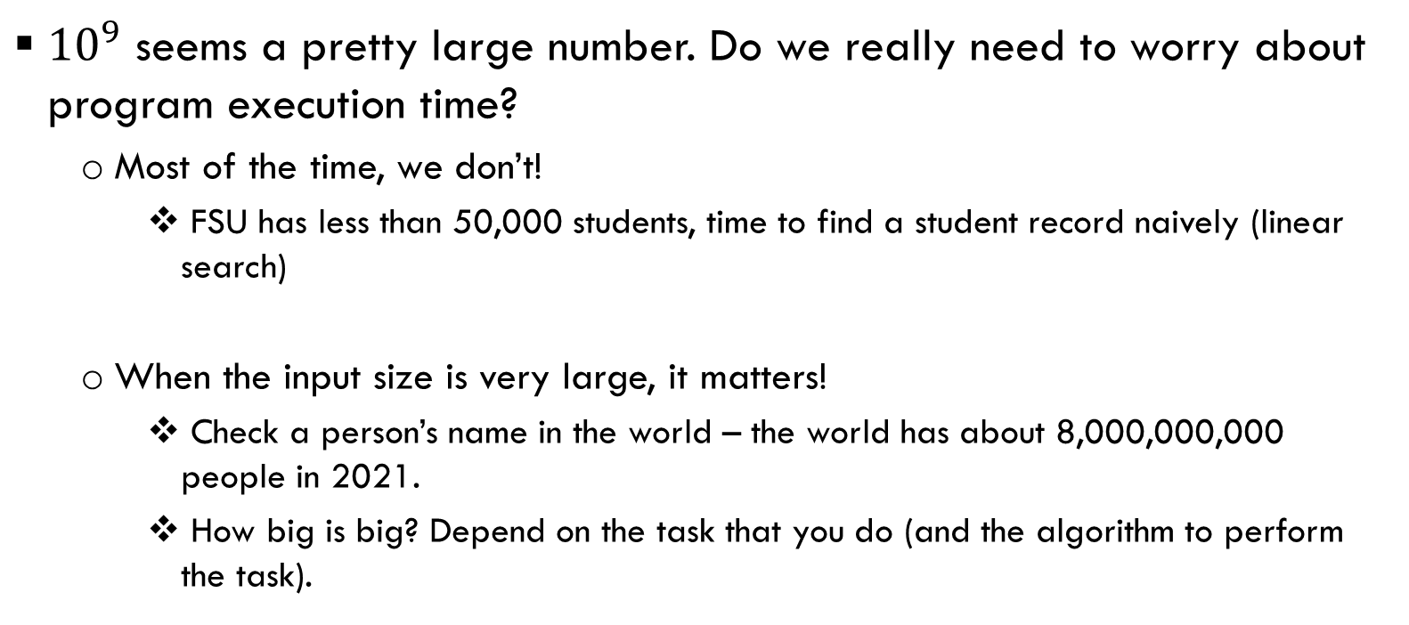
Why program execution time for large inputs matters?
${10}^{9}$ seems a pretty large number. Do we really need to worry about program execution time?
  Most of the time, we don’t!
    FSU has less than 50,000 students, time to find a student record naively (linear search)
  When the input size is very large, it matters!
    Check a person’s name in the world – the world has about 8,000,000,000 people in 2021.
    How big is big? Depend on the task that you do (and the algorithm to perform the task).

Slide 5
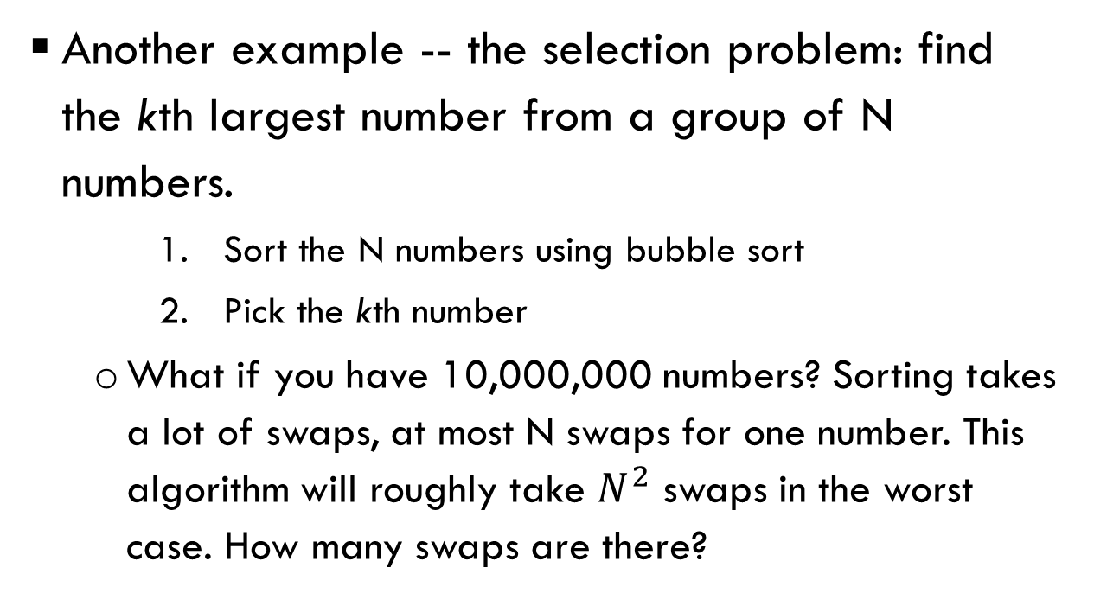
Why program execution time for large inputs matters?
Another example -- the selection problem: find the kth largest number from a group of N numbers.
    Sort the N numbers using bubble sort
    Pick the kth number
  What if you have 10,000,000 numbers? Sorting takes a lot of swaps, at most N swaps for one number. This algorithm will roughly take $N^{2}$ swaps in the worst case. How many swaps are there?
10
8
6
4
2
1
New item: 11
This will take 6 swaps to process one item.

Slide 6
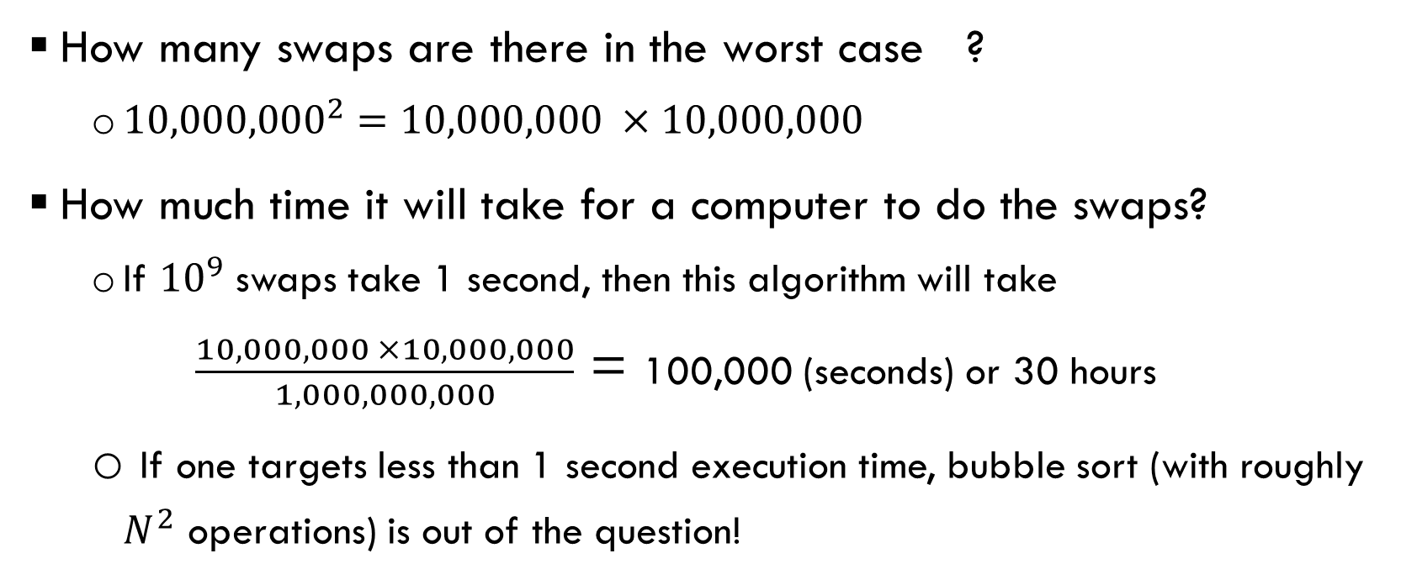
Why program execution time for large inputs matters?
How many swaps are there in the worst case ?
  ${10,000,000}^{2}=10,000,000 ×10,000,000$
How much time it will take for a computer to do the swaps?
  If ${10}^{9}$ swaps take 1 second, then this algorithm will take
  $\frac{10,000,000 ×10,000,000}{1,000,000,000}$ = 100,000 (seconds) or 30 hours
  If one targets less than 1 second execution time, bubble sort (with roughly $N^{2}$ operations) is out of the question!

Slide 7
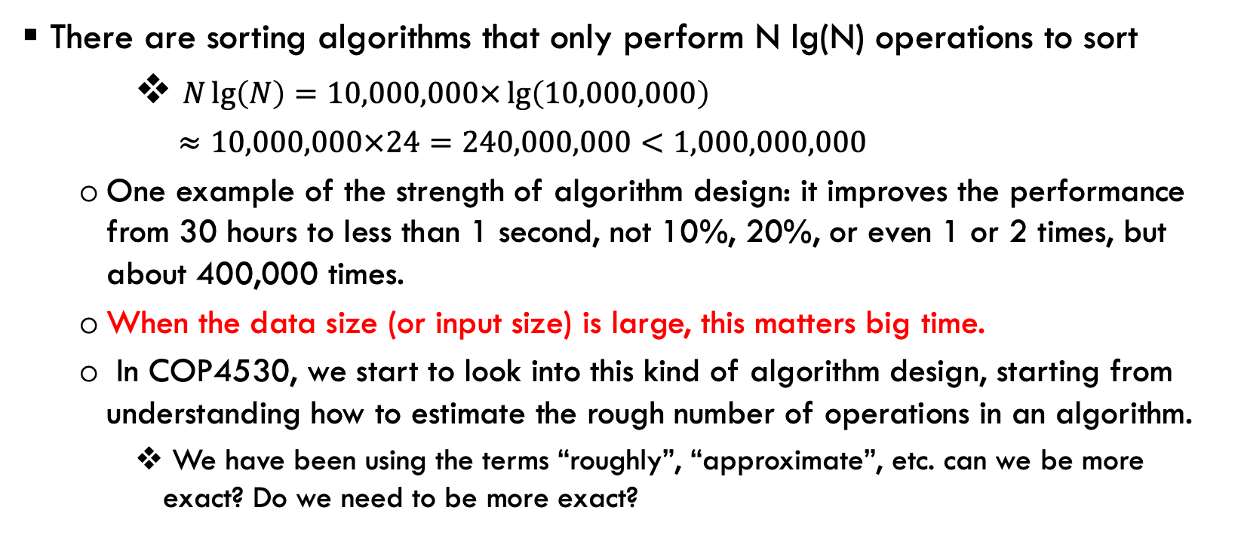
Why program execution time for large inputs matters?
There are sorting algorithms that only perform N lg(N) operations to sort
    $N\lg\left(N\right)=10,000,000×\lg\left(10,000,000\right)$
    $≈10,000,000×24=240,000,000<1,000,000,000$
  One example of the strength of algorithm design: it improves the performance from 30 hours to less than 1 second, not 10%, 20%, or even 1 or 2 times, but about 400,000 times.
  When the data size (or input size) is large, this matters big time.
  In COP4530, we start to look into this kind of algorithm design, starting from understanding how to estimate the rough number of operations in an algorithm.
    We have been using the terms “roughly”, “approximate”, etc. can we be more exact? Do we need to be more exact?

