Slide 1
Chapter 2
Algorithm Analysis
Reading: Chapter 2

Slide 2
Complexity Analysis
Establishing the relationship between the input size（or parameter) and the time and/or space requirement.
  Time complexity and space complexity
  Estimate the time and space requirement for a given (large) input size
  Compare algorithms
Time complexity: counting operations
  Count the number of operations that the algorithm will perform.
Asymptotic analysis
  The big O notation
  Capture how fast time/space requirement increases as the input size increases
  Ignore less important factors
2
Notes:
2

Slide 3
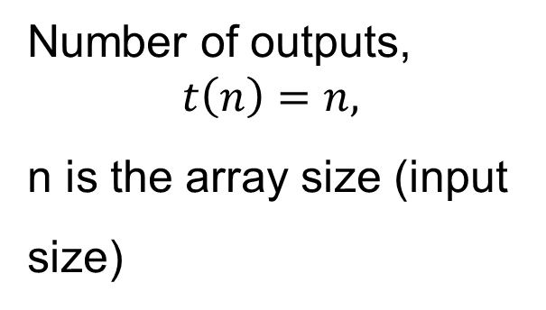
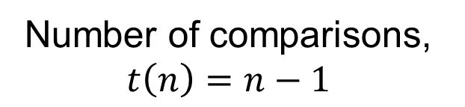
Operation Count Examples
Example 1
for(i=0; i<n; i++)
cout << A[i] << endl;
Example 2
template <class T>
bool IsSorted(T *A, int n)
{
bool sorted = true;
for(int i=0; i<n-1; i++)
if(A[i] > A[i+1])
sorted = false;
return sorted;
}
Number of outputs,
$$t\left(n\right)=n,$$
n is the array size (input
size)
Number of comparisons,
$$t\left(n\right)=n−1$$
Convention: expressing the count as a function of input size (n or N).
3
Notes:
3

Slide 4
Best case, worst case, average case?
for(i=0; i<n; i++)
if (…)
cout << A[i] << endl;
Number of outputs:
Best case?
Worst case?
Average case?
Algorithm analysis mostly considers worst case, sometimes
considers average case. Average case complexity is much hard to
Analyze than worst case complexity.
4
Notes:
4

Slide 5
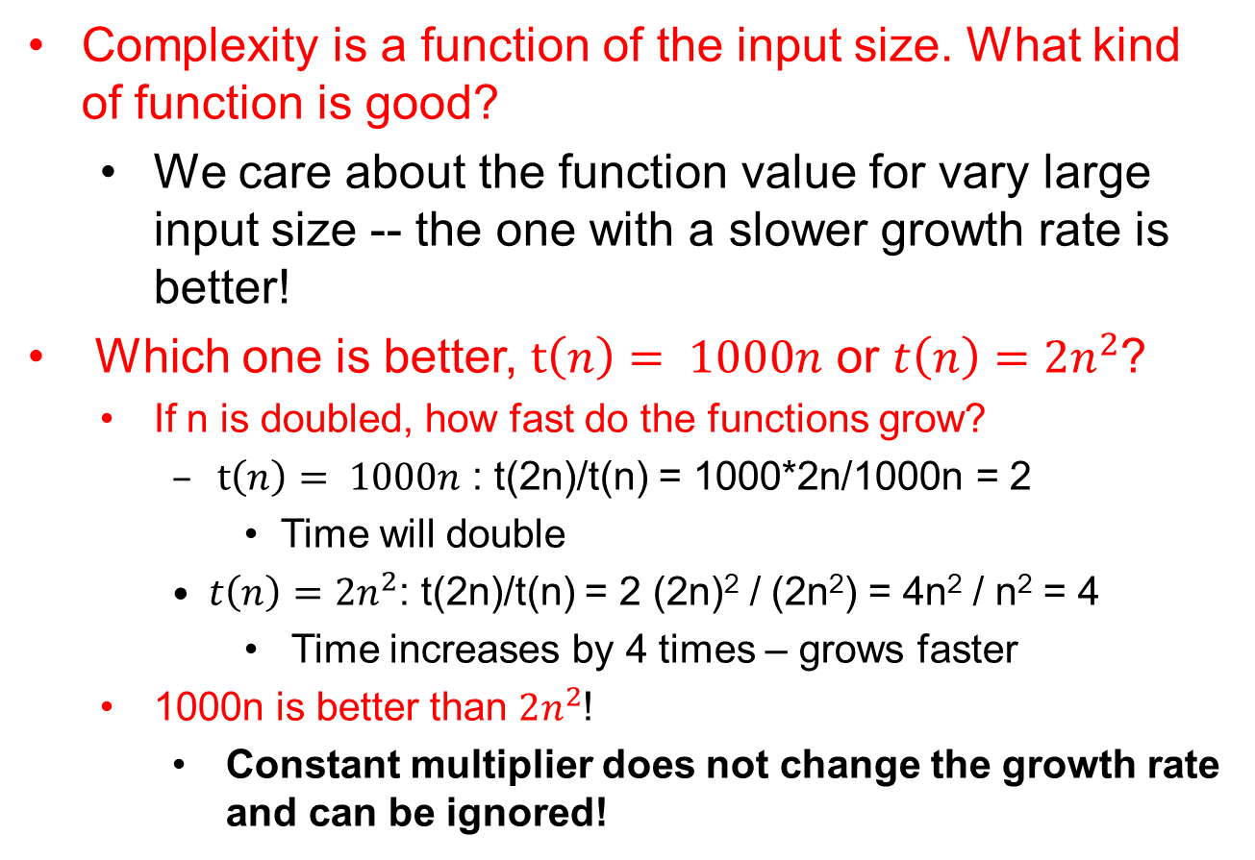
Scaling Analysis – the growth rate of a function
Complexity is a function of the input size. What kind of function is good?
  We care about the function value for vary large input size -- the one with a slower growth rate is better!
Which one is better, $t\left(n\right)= 1000n$ or $t\left(n\right)=2n^{2}$?
  If n is doubled, how fast do the functions grow?
    $t\left(n\right)= 1000n$ : t(2n)/t(n) = 1000*2n/1000n = 2
      Time will double
    $t\left(n\right)=2n^{2}$: t(2n)/t(n) = 2 (2n)² / (2n²) = 4n² / n² = 4
      Time increases by 4 times – grows faster
  1000n is better than $2n^{2}$!
    Constant multiplier does not change the growth rate and can be ignored!
5
Notes:
5

Slide 6
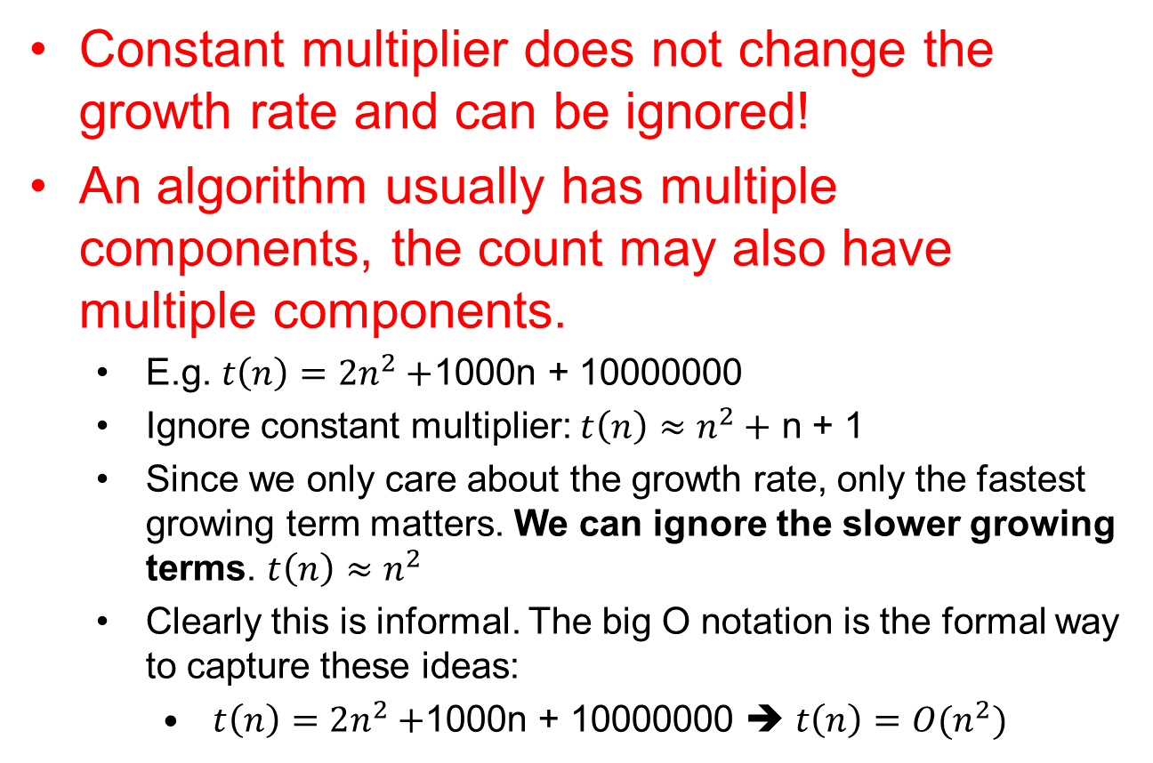
Scaling Analysis – the growth rate of a function
Constant multiplier does not change the growth rate and can be ignored!
An algorithm usually has multiple components, the count may also have multiple components.
  E.g. $t\left(n\right)=2n^{2}+$1000n + 10000000
  Ignore constant multiplier: $t\left(n\right)≈n^{2}+$ n + 1
  Since we only care about the growth rate, only the fastest growing term matters. We can ignore the slower growing terms. $t\left(n\right)≈n^{2}$
  Clearly this is informal. The big O notation is the formal way to capture these ideas:
    $t\left(n\right)=2n^{2}+$1000n + 10000000 ➔ $t\left(n\right)=O(n^{2})$
6
Notes:
6

Slide 7
Asymptotic Complexity Analysis
Compares growth rate of two functions
  T = f(n) (estimated run time)
  Variables: non-negative integers
    For example, size of input data
  Values: non-negative real numbers
    For example, running time of an algorithm
Dependent on
  Eventual (asymptotic) behavior
Independent of
  constant multipliers
  and lower-order effects
Metrics
  “Big O” Notation: O()
  “Big Omega” Notation: ()
  “Big Theta” Notation: ()

Slide 8

Big “O” Notation
f(n) =O(g(n))
  If and only if
    there exist two positive constants c > 0 and n₀ > 0,
    such that f(n) < cg(n) for all n >= n₀
  iff ∃ c, n₀ > 0 | 0 < f(n) < cg(n) ∀ n >= n₀
cg(n)
f(n)
f(n) is asymptotically
upper bounded by g(n)
n₀
$$n^{2}=O\left(n\right)? n=O\left(n^{2}\right)?$$

Slide 9

Big “Omega” Notation
f(n) = Ω(g(n))
  iff ∃ c, n₀ > 0 | 0 < cg(n) < f(n) ∀ n >= n₀
f(n)
cg(n)
f(n) is asymptotically
lower bounded by g(n)
n₀
$$n^{2}=Ω\left(n\right)? n=Ω\left(n^{2}\right)?$$

Slide 10
Big “Theta” Notation
f(n) = Θ(g(n))
  iff ∃ c₁, c₂, n₀ > 0 | 0 < c₁g(n) < f(n) < c₂g(n) ∀ n >= n₀
c₂g(n)
f(n)
f(n) has the
same long-term
rate of
growth as g(n)
c₁g(n)
n₀

Slide 11
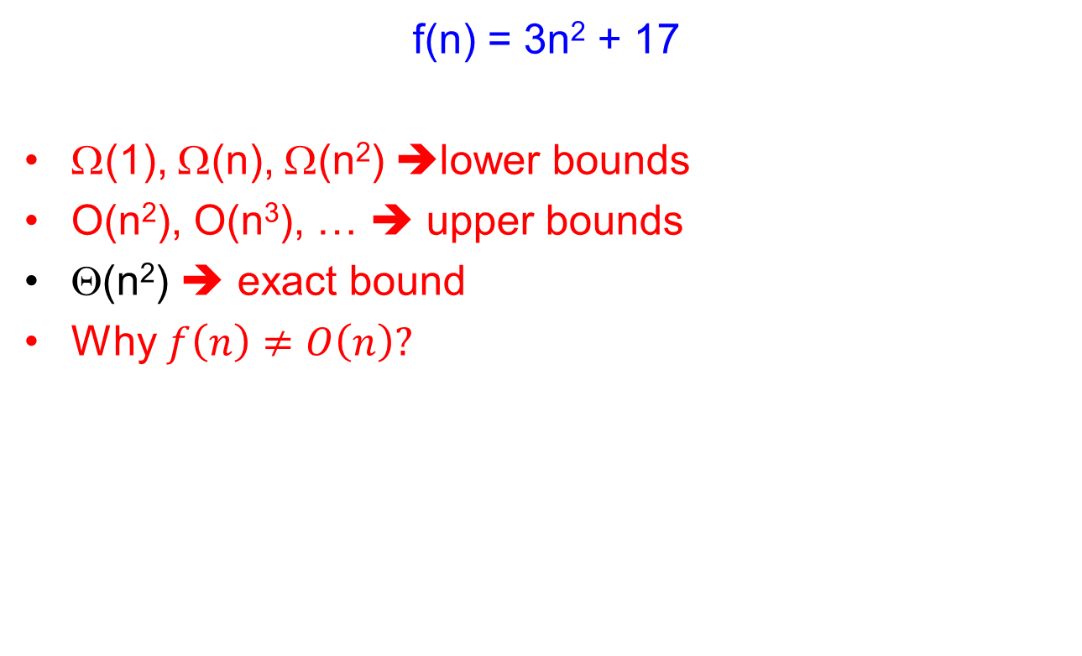
Example
f(n) = 3n² + 17
Ω(1), Ω(n), Ω(n²) ➔lower bounds
O(n²), O(n³), … ➔ upper bounds
Θ(n²) ➔ exact bound
Why $f\left(n\right)≠O\left(n\right)?$

Slide 12
Analogous to Real Numbers
f(n) = O(g(n)) (a < b)
f(n) = Ω(g(n)) (a > b)
f(n) = Θ(g(n)) (a = b)
The above analogy is not quite accurate, but its convenient to think of function complexity in these terms.

Slide 13
Transitivity
f(n) = O(g(n)) (a < b)
f(n) = Ω(g(n)) (a > b)
f(n) = Θ(g(n)) (a = b)
If f(n) = O(g(n)) and g(n) = O(h(n))
  Then f(n) = O(h(n))
If f(n) = Ω(g(n)) and g(n) = Ω(h(n))
  Then f(n) = Ω(h(n))
If f(n) = Θ(g(n)) and g(n) = Θ(h(n))
  Then f(n) = Θ(h(n))
And many other properties

Slide 14
Arithmetic Properties
Additive property
  If e(n) = O(g(n)) and f(n) = O(h(n))
  Then e(n) + f(n) = O(g(n) + h(n))
  Less formally: O(g(n)+h(n)) = max(O(g(n)), O(h(n))
Multiplicative property
  If e(n) = O(g(n)) and f(n) = O(h(n))
  Then e(n) * f(n) = O(g(n) * h(n))

Slide 15
Some Rules of Thumb
If f(n) is a polynomial of degree k
  Then f(N) = Θ (N^{k})
log^{k}N = O(N) for any constant.
  Logarithms grow very slowly compared to even linear growth

Slide 16
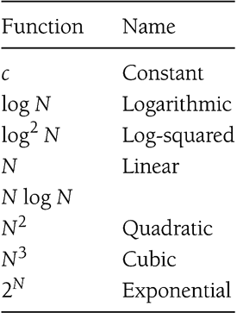
Typical Growth Rates

Slide 17
Exercise
f(N) = N logN and g(N) = N^{1.5}
  Which one grows faster??
Note that g(N) = N^{1.5} = N*N^{0.5}
  Hence, between f(N) and g(N), we only need to compare growth rate of logN and N^{0.5}
  Equivalently, we can compare growth rate of log²N with N
  Now, refer to the result on the previous slide to figure out whether f(N) or g(N) grows faster!

Slide 18
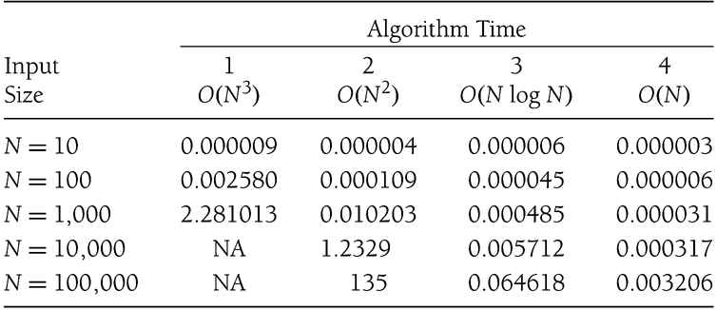
Maximum Subsequence Sum Problem
Given a sequence of integers A₁, A₂, …, A_{N}
  Find the maximum subsequence (A_{i} + A _{i+1} + … + A _{k}), where 1 < i < N
  For example
    for: –2, 11, -4, 13, -5, -2
    The answer is 20: (11, -4, 13)
  Many algorithms of differing complexity can be found
  Example run times from some computer illustrated below

Slide 19
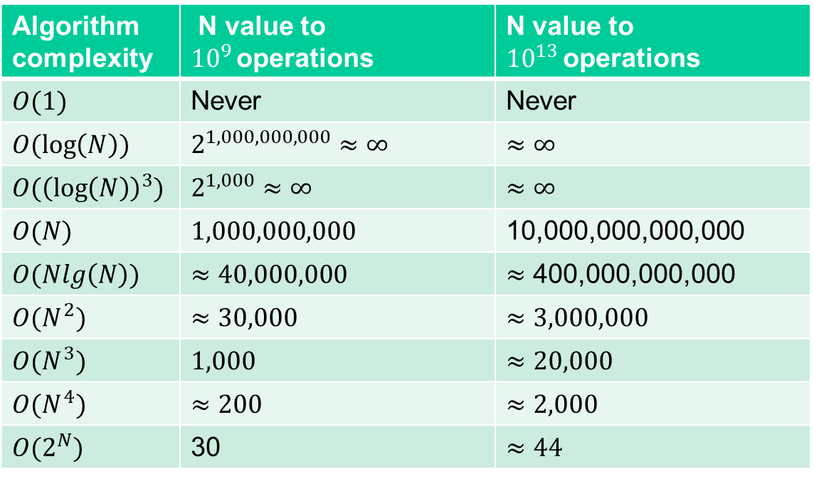
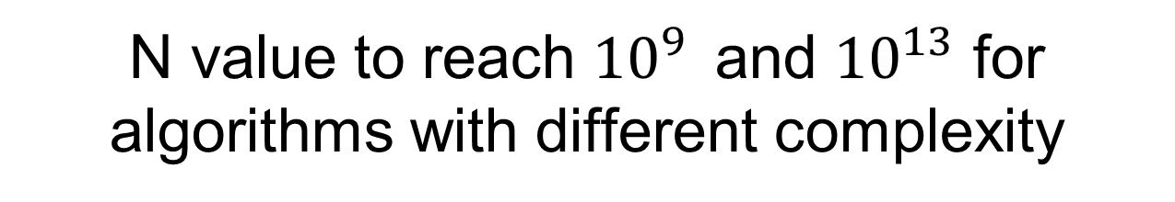
N value to reach ${10}^{9 }$ and ${10}^{13}$ for algorithms with different complexity
Algorithm complexity | N value to ${10}^{9 }$operations | N value to ${10}^{13 }$operations
$$O(1)$$ | Never | Never
$$O(\log\left(N\right))$$ | $$2^{1,000,000,000}≈∞$$ | $$≈∞$$
$$O({\left(\log\left(N\right)\right)}^{3})$$ | $$2^{1,000}≈∞$$ | $$≈∞$$
$$O(N)$$ | $$1,000,000,000$$ | 10,000,000,000,000
$$O(Nlg\left(N\right))$$ | $$≈40,000,000$$ | $≈$ 400,000,000,000
$$O(N^{2})$$ | $$≈30,000$$ | $$≈3,000,000$$
$$O(N^{3})$$ | $$1,000$$ | $$≈20,000$$
$$O(N^{4})$$ | $$≈200$$ | $$≈2,000$$
$$O(2^{N})$$ | 30 | $$≈44$$

Slide 20
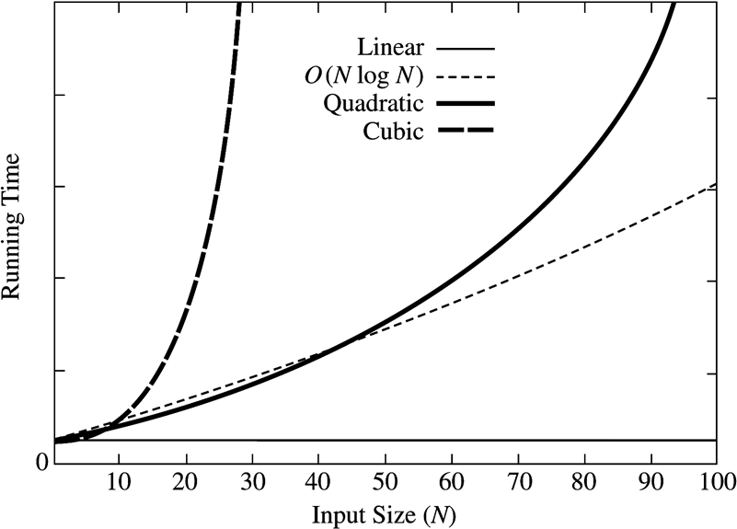
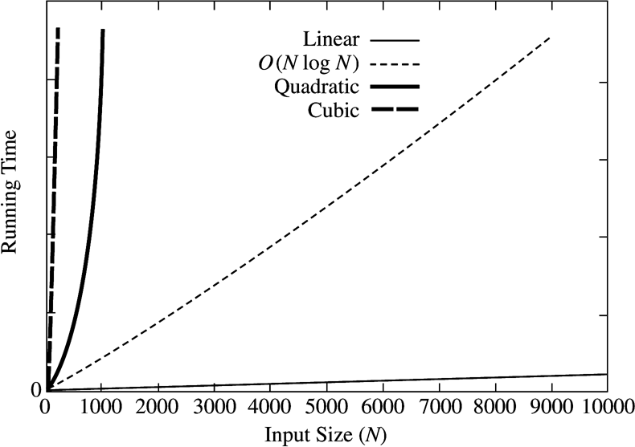
How Complexity Affects Running Times
20
Notes:
20

Slide 21

A question
True or False: Program A has complexity O($n^{2}$); Program B has complexity O(n). Thus, Program A always runs faster than Program B.

Slide 22
Complexity Analysis
Steps
  Find n = size of input
  Find atomic activities to count
    Primitive operations such as +, -, *, /.
    Assumed to finish within one unit of time
  Find f(n) = the number of atomic activities done by an input size of n
  Complexity of an algorithm = complexity of f(n)

Slide 23
Running Time Calculations -
Loops
for (j = 0; j < n; ++j) {
// 3 atomics
}
Number of atomic operations
  Each iteration has 3 atomic operations, so 3n
  Cost of the iteration itself (c*n, c is a constant)
    One initialization assignment
    n increment (of j)
    n comparisons (between j and n)
Complexity = Θ(3n + c*n) = Θ(n)

Slide 24
Loops with Break
for (j = 0; j < n; ++j) {
// 3 atomics
if (condition) break;
}
Upper bound = O(4n) = O(n)
Lower bound = Ω(4) = Ω(1)
Complexity = O(n)
Why don’t we have a Θ(…) notation here?

Slide 25
Sequential Search
Given an unsorted vector a, find the location of element X.
for (size_t i = 0; i < a.size(); i++) {
if (a[i] == X) return true;
}
return false;
Input size: n = a.size()
Complexity = O(n)

Slide 26
If-then-else Statement
if(condition)
i = 0;
else
for ( j = 0; j < n; j++)
a[j] = j;
Complexity = ??
= O(1) + max ( O(1), O(N))
= O(1) + O(N)
= O(N)

Slide 27
Consecutive Statements
Add the complexity of consecutive statements
Complexity = Θ(3n + 5n) = Θ(n)
for (j = 0; j < n; ++j) {
// 3 atomics
}
for (j = 0; j < n; ++j) {
// 5 atomics
}

Slide 28
Nested Loop Statements
Analyze such statements inside out
for (j = 0; j < n; ++j) {
// 2 atomics
for (k = 0; k < n; ++k) {
// 3 atomics
}
}
Complexity = Θ((2 + 3n)n) = Θ(n²)

Slide 29
Recursion
long factorial( int n )
{
if( n <= 1 )
return 1;
else
return n * factorial( n - 1 );
}
long fib( int n )
{
if ( n <= 1)
return 1;
else
return fib( n – 1 ) + fib( n – 2 );
}
We need to determine how many times a recursive function is called
t(n) = 1 + t(n-1)
t(n) = t(n-1) + t(n-2) + 1

Slide 30
Recursion
t(n) = 1 + t(n-1)
long factorial( int n )
{
if( n <= 1 )
return 1;
else
return n * factorial( n - 1 );
}
Expanding this recurrence form results in a summation. Some are quite simple, others can be complex.
T(n) = 1 + T(n-1) = 1 + 1 + T(n-2) = 1 + 1 + 1 + T(n-3)
= … = 1 + 1 + 1 + … + 1 + T(n – (n-1))
How many 1s’ are there? T(n) = n -1 + T(1) = O(n)

Slide 31
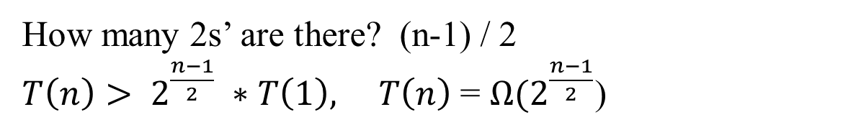
Recursion
t(n) = t(n-1) + t(n-2) + 1
long fib( int n )
{
if ( n <= 1)
return 1;
else
return fib( n – 1 ) + fib( n – 2 );
}
When trying to expand this, one will lose track quickly. It needs to be simplified in order to get some meaningful results.
T(n-1) >= T(n-2)
so T(n) = T(n-1) + T(n-2) + 1 >= 2T(n-2) + 1 > 2*T(n-2)
T(n) > 2 * T(n-2) > 2 * 2 * T(n-4) > 2 * 2 * 2 * T(n-6)
> 2 * 2 * 2 * … * 2 * T(n – (n-1))
How many 2s’ are there? (n-1) / 2
$T\left(n\right)> 2^{\frac{n−1}{2}} ∗T\left(1\right), T\left(n\right)$ = Ω($2^{\frac{n−1}{2}}$)

Slide 32
Logarithms in Running Time
General rule:
  If constant time is required to merely reduce the problem by a constant amount, the algorithm is O(N).
  An algorithm is O(logN) if it takes constant O(1) time to cut the problem size by a fraction (usually ½N).
Binary search
Euclid’s Algorithm
Exponentiation

Slide 33
Binary Search
Given a sorted vector a, find the location of element X
int binary_search(const vector<int> & a, int X)
{
unsigned int low = 0, high = a.size()-1;
while (low <= high) {
int mid = (low + high) / 2;
if (a[mid] < X)
low = mid + 1;
else if( a[mid] > X )
high = mid - 1;
else
return mid;
}
return NOT_FOUND;
}
Input size: n = a.size()
t(n) = 1 + t(n/2)
Complexity = O( k iterations x (1 comparison+1 assignment) per loop)
  = O(log(n))

Slide 34
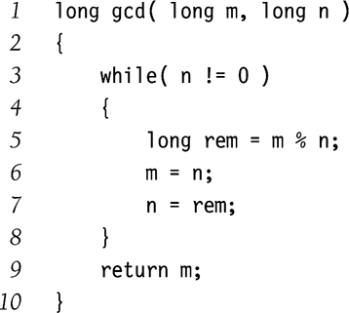
Euclid’s Algorithm
Find the greatest common divisor (gcd) between m and n
  Given M > N
For example
  M = 50, N = 15
  Remainders
    5, 0
  So gcd(50, 15) = 5
Complexity = O(logN)
Exercise:
  Why is it O(logN) ?
  If M > N, then (M mod N) < M/2
T(M, N) = T(N, M mod N) + 1
= T(M mod N, N mod
(M nod N)) + 2
< T(M/2, N/2) + 2;

Slide 35
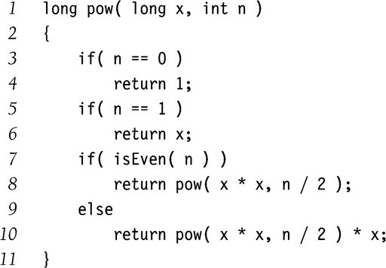
Exponentiation
Calculate x^{n}
Example:
  x¹¹ = x⁵ * x⁵ * x
  x⁵ = x² * x² * x
  x² = x * x
Complexity = O( logN )
Why didn’t we implement the recursion as follows?
  pow(x,n/2)*pow(x,n/2)*x

