Slide 1
  Mathematics review and proving techniques
Reading: Sections 1.1, 1.2, 1.3

Slide 2
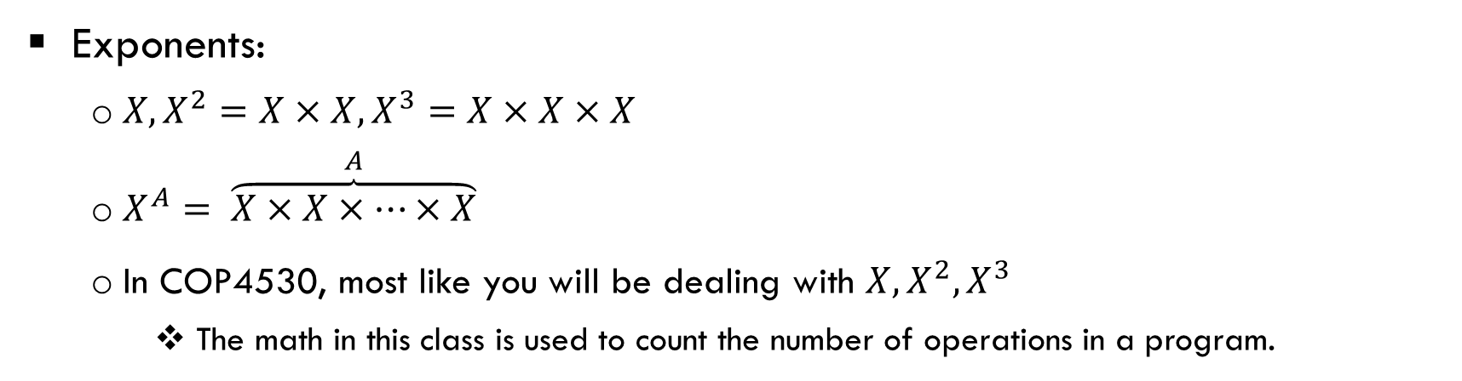
Math review
Exponents:
  $X, X^{2}=X×X, X^{3}=X×X×X$
  $X^{A}= \overset{A}{\overbrace{X×X×…×X}}$
  In COP4530, most like you will be dealing with $X, X^{2}, X^{3}$
    The math in this class is used to count the number of operations in a program.
for (i=0; i<N; i++) {
A[i] = 0;
}
for (i=0; i<N; i++)
for (k=0; k < N; k ++) {
A[i][k] = 0;
}

Slide 3

Exponents
Manipulating exponents:
  $X^{A}X^{B}= X^{A}×X^{B}= X^{?}$
  $X^{A}{/ X}^{B}= X^{?}$
  ${{(X}^{A})}^{B}= X^{?}$
  $X^{N}+X^{N}= ?$
  $2^{N}+2^{N}= ?$

Slide 4
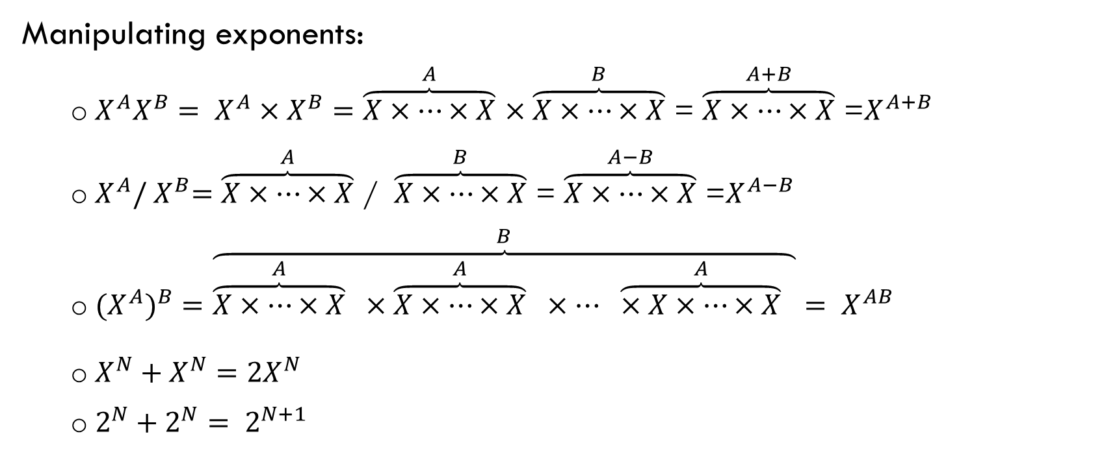
Exponents
Manipulating exponents:
  $X^{A}X^{B}= X^{A}×X^{B}=\overset{A}{\overbrace{X×…×X}}$ $×\overset{B}{\overbrace{X×…×X}}$ = $\overset{A+B}{\overbrace{X×…×X}}$ =$X^{A+B}$
  $X^{A}{/ X}^{B}=\overset{A}{\overbrace{X×…×X}}$ / $\overset{B}{\overbrace{X×…×X}}$ = $\overset{A−B}{\overbrace{X×…×X}}$ =$X^{A−B}$
  ${{(X}^{A})}^{B}=$ $\overset{B}{\overbrace{\overset{A}{\overbrace{X×…×X}} ×\overset{A}{\overbrace{X×…×X}} ×… \overset{A}{\overbrace{×X×…×X}} }}= X^{AB}$
  $X^{N}+X^{N}=2X^{N}$
  $2^{N}+2^{N}= 2^{N+1}$

Slide 5
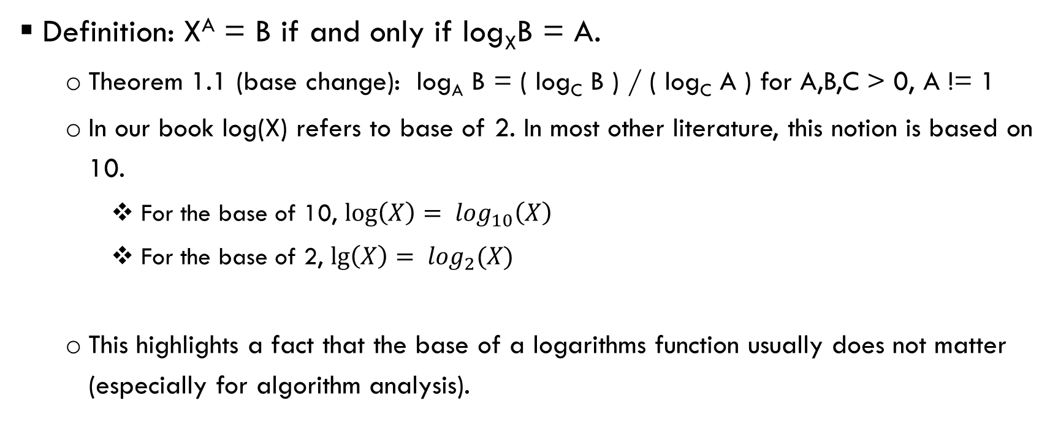
Logarithms
Definition: X^{A} = B if and only if log_{X}B = A.
  Theorem 1.1 (base change): log_{A} B = ( log_{C} B ) / ( log_{C} A ) for A,B,C > 0, A != 1
  In our book log(X) refers to base of 2. In most other literature, this notion is based on 10.
    For the base of 10, ${\log\left(X\right)= log}_{10}\left(X\right)$
    For the base of 2, $\lg\left(X\right)= \log_{2}(X)$
  This highlights a fact that the base of a logarithms function usually does not matter (especially for algorithm analysis).

Slide 6
Logarithms
Other easlily derived (and provable) properties (all can be proved for any base)
  log AB = log A + log B; for A,B > 0
  log A/B = log A - log B
  log (A^{B}) = B log A
  log X < X for all X > 0

Slide 7

Logarithms
Proof: log AB = log A + log B; for A,B > 0
  X = log AB → ${10}^{X}=AB$
  Y = log A → ${10}^{Y}=A$
  Z = log B → ${10}^{Z}=B$
  We need to prove X = Y + Z
  Since ${10}^{X}=AB={10}^{Y}{10}^{Z}= {10}^{Y+Z}$ , X = Y+Z.

Slide 8
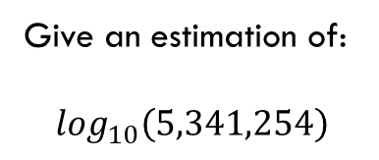
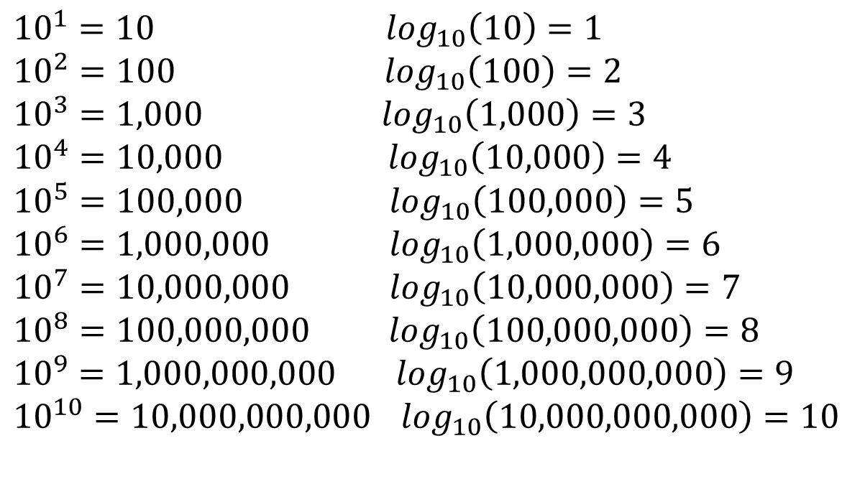
Useful logarithms table
${10}^{1}=10$ $\log_{10}\left(10\right)=1$
${10}^{2}=100$ $\log_{10}\left(100\right)=2$
${10}^{3}=1,000$ $\log_{10}\left(1,000\right)=3$
${10}^{4}=10,000$ $\log_{10}\left(10,000\right)=4$
${10}^{5}=100,000$ $\log_{10}\left(100,000\right)=5$
${10}^{6}=1,000,000$ $\log_{10}\left(1,000,000\right)=6$
${10}^{7}=10,000,000$ $\log_{10}\left(10,000,000\right)=7$
${10}^{8}=100,000,000$ $\log_{10}\left(100,000,000\right)=8$
${10}^{9}=1,000,000,000$ $\log_{10}\left(1,000,000,000\right)=9$
${10}^{10}=10,000,000,000$ $\log_{10}\left(10,000,000,000\right)=10$
Give an estimation of:
$$\log_{10}\left(5,341,254\right)$$

Slide 9
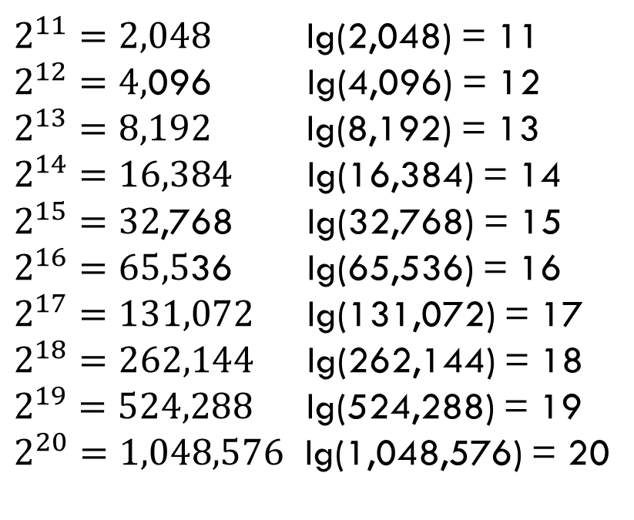
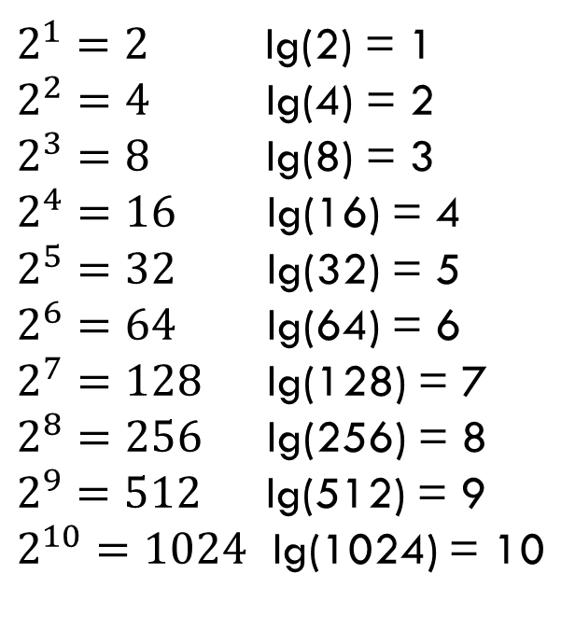
Useful logarithm table
$2^{1}=2$ lg(2) = 1
$2^{2}=4$ lg(4) = 2
$2^{3}=8$ lg(8) = 3
$2^{4}=16$ lg(16) = 4
$2^{5}=32$ lg(32) = 5
$2^{6}=64$ lg(64) = 6
$2^{7}=128$ lg(128) = 7
$2^{8}=256$ lg(256) = 8
$2^{9}=512$ lg(512) = 9
$2^{10}=1024$ lg(1024) = 10
$2^{11}=2,048$ lg(2,048) = 11
$2^{12}=4,$096 lg(4,096) = 12
$2^{13}=8,192$ lg(8,192) = 13
$2^{14}=16,384$ lg(16,384) = 14
$2^{15}=32$,768 lg(32,768) = 15
$2^{16}=65,5$36 lg(65,536) = 16
$2^{17}=131,072$ lg(131,072) = 17
$2^{18}=262,144$ lg(262,144) = 18
$2^{19}=524,288$ lg(524,288) = 19
$2^{20}=1,048,576$ lg(1,048,576) = 20
Estimate:
lg(333,253)
lg(40,000,000,233)
$$2^{10}≈1,000, 2^{20}≈1,000,000, 2^{30}≈1,000,000,000, 2^{40}≈1,000,000,000,000$$

Slide 10

Math review
Series: some examples.
  $$\sum_{i=0}^{N}{2^{i}}= 2^{0}+2^{1}+…+2^{N}= 2^{N+1} −1$$
  $$\sum_{i=0}^{N}{A^{i}}= A^{0}+A^{1}+…+A^{N}= \frac{A^{N+1}−1}{A−1}$$
  $$\sum_{i=1}^{N}{i=1+2+ …+N= \frac{N(N+1)}{2}≈\frac{N^{2}}{2}}$$
  $$\sum_{i=1}^{N}{\frac{1}{i}=1+ }\frac{1}{2}+\frac{1}{3}+ …+ \frac{1}{N}≈ \log_{e}(N)$$

Slide 11
Proof Techniques
Common proof techniques that will be used in data structure and algorithm analysis (and in CS, in general):
  Proof by induction
  Proof by contradiction
  Proof by counter-example
    This one is typically used for showing that an assertion is false

Slide 12
Proof by Induction
Given a statement or theorem to prove:
  Establish a base case. i.e. show the theorem is true for a small value, usually a trivial step to prove.
  Assume an inductive hypothesis.
    e.g. Assume the theorem is true for all cases up to some limit k
  Using this assumption, show that the theorem holds for the next value k+1
    Note that in doing this, we are showing that "it's true for 1 ... k" implies that "it's true for k+1"

Slide 13
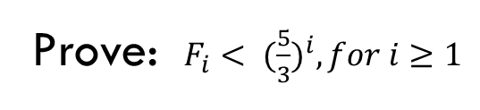
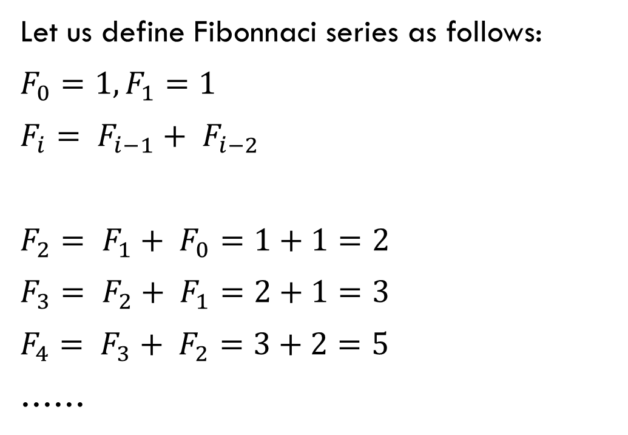
Example (induction)
Let us define Fibonnaci series as follows:
$F_{0}=1, F_{1}=1$
$F_{i}= F_{i−1}+ F_{i−2}$
$F_{2}= F_{1}+ F_{0}=1+1=2$
$F_{3}= F_{2}+ F_{1}=2+1=3$
$F_{4}= F_{3}+ F_{2}=3+2=5$
……
Prove: $F_{i}< {(\frac{5}{3})}^{i}, for i≥1$

Slide 14
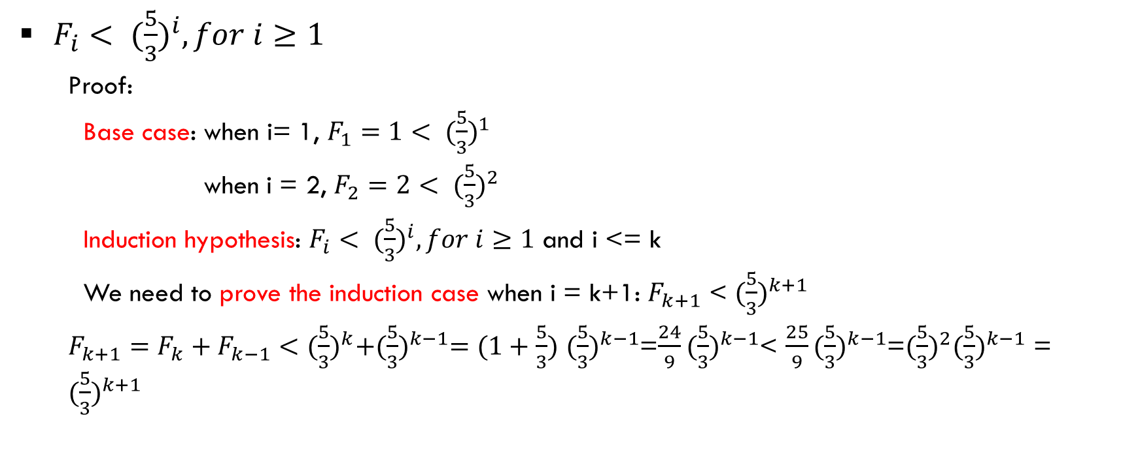
Induction example
$F_{i}< {(\frac{5}{3})}^{i}, for i≥1$
  Proof:
  Base case: when i= 1, $F_{1}=1< {(\frac{5}{3})}^{1}$
  when i = 2, $F_{2}=2< {(\frac{5}{3})}^{2}$
  Induction hypothesis: $F_{i}< {(\frac{5}{3})}^{i}, for i≥1$ and i <= k
  We need to prove the induction case when i = k+1: $F_{k+1}$ < ${(\frac{5}{3})}^{k+1}$
  $F_{k+1}=F_{k}+F_{k−1}<{(\frac{5}{3})}^{k}+{(\frac{5}{3})}^{k−1}=(1+\frac{5}{3})$ ${(\frac{5}{3})}^{k−1}$=$\frac{24}{9}{(\frac{5}{3})}^{k−1}$< $\frac{25}{9}{(\frac{5}{3})}^{k−1}$=${(\frac{5}{3})}^{2}{(\frac{5}{3})}^{k−1}$ = ${(\frac{5}{3})}^{k+1}$

Slide 15
Proof by contradition
To use this technique to prove a statement or theorem:
  Assume that the theorem is false
  From this assumption, show how it implies that some known (i.e. axiomatic) property is false
  Since this would lead to a contradiction, the original assumption must be erroneous, so the theorem is true

Slide 16
Proof by contradiction example
Theorem: There are an infinite number of primes
Proof:
  Suppose the theorem is false. Then there are a finite number of primes
  Therefore, you can list them. Let the primes be P₁, P₂, ... , P_{k} be the finite list of primes, from smallest to largest. (i.e. P_{k} is the largest prime)
  Consider N = P₁P₂P₃...P_{k} + 1
  Clearly, N is larger than P_{k} (which is the largest prime), so N must not be prime
  However, none of the primes in the list divides N exactly, because the remainder is always 1
  This contradicts the known property that every number is either prime or a product of primes
  Therefore the assumption (finite primes) is false, implying the theorem is true

Slide 17
Proof by counterexample
This is the easiest way to prove a given assertion to be false.
  For a statement to be true, it must be true in all cases
  Provide one counterexample. This will show that in at least one case, the assertion does not hold (therefore, it's false)

Slide 18
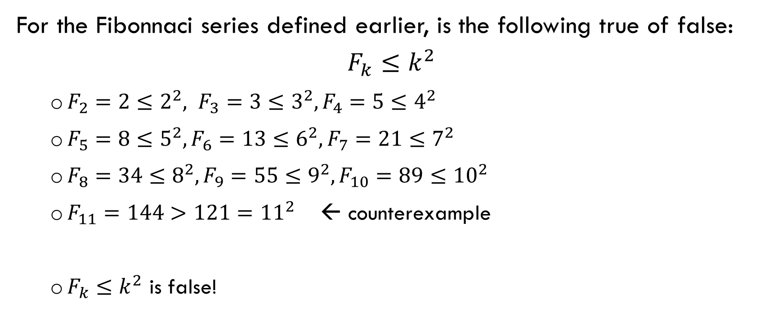
Proof by counter example
For the Fibonnaci series defined earlier, is the following true of false:
$$F_{k}≤k^{2}$$
  $F_{2}=2≤2^{2}, F_{3}=3≤3^{2}, F_{4}=5≤4^{2}$
  $F_{5}=8≤5^{2}, F_{6}=13≤6^{2}, F_{7}=21≤7^{2}$
  $F_{8}=34≤8^{2}, F_{9}=55≤9^{2}, F_{10}=89≤{10}^{2}$
  $F_{11}=144>121={11}^{2}$ ← counterexample
  $F_{k}≤k^{2}$ is false!

