Slide 1
Lecture 9 Socket Programming with Python

Slide 2
Socket Programming in Python
Socket programming is supported in the socket module in python
  This is a wrapper around the OS socket API.
  Python socket is easier to use than native OS socket.
So, let’s create our first socket.
  from socket import *
  s = socket(AF_INET, SOCK_STREAM) # or socket()
Now we got an IPv4 TCP socket that you can use to connect to other machines.

Slide 3
Creating a socket end point: the socket function
socket.socket([family, [type]]) creates a socket object. Remember, this is one endpoint of a two-way communication link.
The family argument is the address family. The default is socket.AF_INET, which tells the socket to support the IPv4 protocol (32-bit IP addresses). Other choices include:
  socket.AF_INET6 for IPv6 protocol (128-bit IP address).
The type argument is the type of socket.
  socket.SOCK_STREAM for reliable connection-oriented sockets (TCP).
  socket.SOCK_DGRAM for unreliable datagram sockets (UDP).

Slide 4
Connecting to a remote end-point: the connect function
After a socket is created, a network client program can use connect(addr) to connect to the socket end-point specified address addr. The addr argument is a tuple containing the host name/address (as a string) and port number (as an int).
    s = socket()
    s.connect(("websrv.cs.fsu.edu", 80))

Slide 5
Sending data: the send function
send(bytes) returns the number of bytes sent.
To send the whole string, Use sendall(bytes) blocks until all data has been transmitted. None is returned on success.
Need to convert string into bytes using encode() or use b’…’ for string literals.
    s = socket()
    s.connect(("websrv.cs.fsu.edu", 80))
    s.send(b"GET /index.html HTTP/1.0\r\n\r\n")

Slide 6
Receiving data: the recv function
recv(bufsize) receives and returns up to bufsize bytes of data from the connection.
  Return empty string is the connection is closed.
    s = socket()
    s.connect(("websrv.cs.fsu.edu", 80))
    s.send(b"GET /index.html HTTP/1.0\r\n\r\n")
    data = s.recv(100000)
    print(data)

Slide 7
Close socket: the close function
Like a file, a socket need to be closed when it is done
    s = socket()
    s.connect(("websrv.cs.fsu.edu", 80))
    s.send(b"GET /index.html HTTP/1.0\r\n\r\n")
    data = s.recv(1000000)
    print(data)
    s.close()

Slide 8
The control flow of major socket calls in a network client
socket
connect
While not done
Write/read
close

Slide 9
Binding a socket to address+port: the bind function
bind(addr) binds the socket object to an address addr. As before, addr is a tuple containing hostname or host IP address and port.
  Done by the network server program to obtain a well-known port
  Optional for the network client
    If not used, a system assigned random port is assigned to the socket when making connection.
from socket import *
s = socket()
h = socket.gethostname()
s.bind((h, 9000))
# We could also bind to localhost:
# s.bind(("localhost", 9000))
# s.bind(("127.0.0.1", 9000))
# Or bind to any address the machine has:
# s.bind(("", 9000))

Slide 10
Turn a socket passive: the listen function
There two are types of sockets, active socket and passive socket.
  Active socket: sockets used to actively connect to another application and to send/recv data.
  Passive socket: Sockets used by the server to accept connections from client. The passive socket only deals with connection, but not data communication. When a connection is accepted, an new active socket will be created at the server side for sending/receiving data.
listen(backlog) makes the socket passive (listening for connections).
  The backlog argument specifies how many connections to queue before connections become refused in case that the connections cannot be processed fast enough.

Slide 11
Accept a connection: the accept function
accept() blocks the server program until a connection is made from a client and accepts the connection, then returns.
  The return value is a pair(conn, address) where conn is a new active socket object usable to send and receive data on the connection, and address is the address bound to the socket on the other end of the connection (client’s IP address and port number).

Slide 12
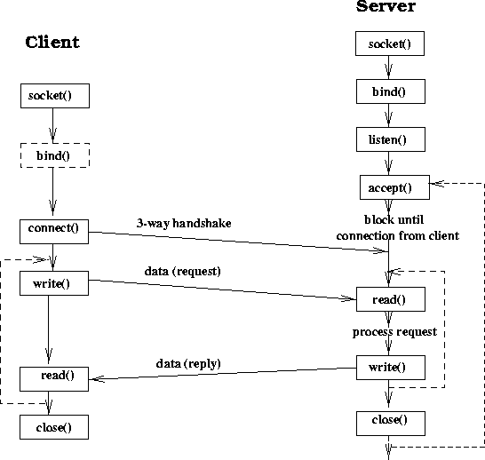
Socket functions in Client and Server

Slide 13
Analogy between socket and phone calls
Client
Server
Socket calls | Phone analogy
socket | Pickup the phone
connect | Dial the number
write/read | Talk/listen
close | hang up
Socket calls | Phone analogy
socket | Install a phone
bind | Get a phone number
listen | Turn on the ringer, ready to receive phone calls
accept | Answer a call
write/read | Talk/listen
close | hangup

Slide 14
Echo Client and Server example
See lect9/echo_server.py and lect9/echo_client.py

Slide 15
Concurrent Server
A typical network server handles many connections simultaneously. But sequential server only handle one connection at a time.
Extending the sequential server with multiprocessing is a simple way to enable the server to handle many connections
A concurrent server starts a new child process to handle a connection after it is accepted.
  Advantages
    simple program, most of the servers are implemented this way.
    Almost no limits on the number of connection.
  Main limitations: overheads, no shared state among child processes

Slide 16
Extend a sequential server to a concurrent server
Put this block in a process

Slide 17
Sequential server
Concurrent server (mp_echo_server.py)
socket()
socket()
bind()
bind()
listen()
listen()
Loop forever
accept()
accept()
read()
p.start()
Close
accepted
socket
Close listen
socket
write()
read()
write()
read()
close()
close()
read()

