Slide 1
Lecture 8 Introduction to Networking
OOP in Python

Slide 2
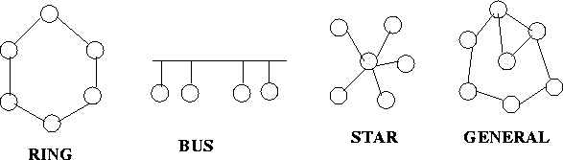
What is a Computer Network
A computer network consists of a set of end-systems/hosts and switches/routers connected by communication links. It supports communications among entities in the network.
  Many types
    network on chip, system area network, person area network, local area network, data center network, wide area network
  Many topologies (how the entities are connected in the network)

Slide 3
Elements of a Network
Hosts, end-systems
  pc’s, workstations, servers
  PDA’s, phones, toasters
  CPUs, memory controllers
  running network applications
  Operate at the edge of the network
Routers, switches, and middleboxes:
  Forward/filter packets (chunks) of data thru network
  Operate at the core of the network
Communication links
  Point-to-point, multiaccess
  fiber, copper, radio, satellite
router
workstation
server
mobile
local ISP
regional ISP
company
network

Slide 4
Challenges in the Networking System
What problems need to be solved for us to observing networking like how the Internet is used today?
  Dealing with heterogeneity in the networking environment
    different types of media: wired, wireless, satellite, radio, etc
    Dealing with different types of networks: telephone, data, ATM, fiber channel, Cable network, DSL
  Complex network functionality
    Reliability, routing, network congestion, speed-mismatch between communicating parties (flow control), naming and addressing, fragmentation and reassembly
What are the common techniques in computing to deal with complexity and heterogeneity in Computer Science?

Slide 5
Challenges in Networking Software
What the common techniques in computing to deal with complexity and heterogeneity?
  Divide-and-conquer: partitioning the software to smaller pieces such that each piece becomes more manageable.
  Abstraction:
Result: Layered architecture in networking software
WWW
ssh
email
WWW
ssh
email
link
Complexity reduced
From M*N to M+N
Wifi
Cable
DSL
Wifi
Cable
DSL

Slide 6
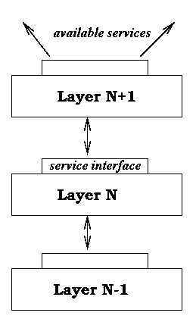
Layered Architecture
Layering simplifies the architecture of a complex system
Layer N relies on services from layer N-1 to provide a service to layer N+1
Interfaces define the services offered
Service required from a lower layer is independent of the implementation
  Layer N change doesn’t affect other layers
  Information/complexity hiding
Layer N+1 Protocol
Layer N Protocol

Slide 7
Layered Architecture
Entities in the same layer on different hosts interact (peer entities) through a protocol.
  An entity can be an IO chip, a process, a procedure, etc
  A protocol governs how communication should happen between entities in the same layer on different hosts.
Entities on the same machine between two adjacent layers interact through the service interface.
Layer N+1 Protocol
Layer N Protocol

Slide 8
Type of Communication Services
Connection-oriented service & connectionless service -- order of packets
  Connection-oriented -- like the telephone.
    Establish the connection, use the connection, then release the connection. Even when multiplexed, minimal header information
    The packets received are in the same order as the packets sent.
  Connectionless (datagram) -- like the postal system.
    Each message carries its destination’s address and is routed to the destination independently.
    The packets received may not be in the same order as the packets send.
Reliable and unreliable – loss or no loss of packets
  reliable: all packets sent are received correctly
  unreliable: packets sent may not be received

Slide 9
Type of Communication Services
Four combinations of service types:
  Reliable connection-oriented
  Reliable connectionless
  Unreliable connection-oriented
  Unreliable connectionless
Example:
  send 1 2 3 4 5
  receive: 1 2 3 4 5
  1 3 2 5 4
  1 2 4
  3 1 4
Many applications use reliable connection-oriented service. Why not just do reliable connection-oriented all the time?

Slide 10
ISO/OSI Reference Model
ISO: International Standards Organization
OSI: Open Systems Interconnection.
Seven layers ISO/OSI reference model:
    Application Appl ication
    Presentation Presentation
    Session Session
    Transport Transport
    Network Network Network
    Data Link Data link Data link
    Physical Physical Physical

Slide 11
7-Layer ISO/OSI Reference Model
Physical layer: how to transfer bits over a physical link
  conversion of bits into signals, what is 0, 1? How long does a bit lasts? How many pins in a connection?
Data link layer: how to transfer frames between directly connected entities
  A frame is a sequence of bits as one unit
Network layer: how to send a packet to the destination that may not be directly connected
Transport layer: how to achieve end to end communication.
  Lowest layer with end to end communication, not run on routers.

Slide 12
7-Layer ISO/OSI Reference Model
Session layer: allows users to establish session, enhanced services.
  Checkpointing.
Presentation layer: provides general solutions to users.
  Compression, syntax conversion, cryptography
Application layer: variety of protocols that are commonly used.
  Email, FTP, Telnet: these are all network applications that call tcp_send, and tcp_recv routines to perform communications.

Slide 13
TCP/IP Reference Model
The 7-layer OSI/ISO reference model is well throught-out, but does not have real implementation.
  Internet had already been built when the 7-layer model was developed. Internet does not follow this 7 layer model.
TCP/IP reference model:
    Application layer (ssh, FTP SMPT, DNS, NNTP, HTTP) --- application, presentation, session
    Transport layer (TCP, UDP)
    Internet layer (IP) – network
    Host to Network layer (Ethernet, FDDI, X.25) -- data link, physical

Slide 14
TCP/IP Reference Model
Application layer (HTTP, SSH, FTP SMPT, DNS, NNTP)
Interface – socket programming: (socket, TCP_send, TCP_recv, UDP_send, UDP_recv) ------- OS interface (system calls)
Transport layer (TCP, UDP) -- performed at the end host
  Major function: end-to-end communicate
  TCP (transmission control protocol): reliable connection-oriented
  UDP (user datagram protocol): unreliable connectionless
Interface: (IP_send, IP_recv)
Internet layer (IP) – unreliable connectionless -- performed at routers (and end-hosts)
  Major function: Routing – packet can reach destination multiple hops away
  A packet switching network based on connectionless communication. Hosts send packets into the network and then the packets travel independently to their destinations.
  Format conversion: for different networks.
  Packet format and protocol: IP
Interface – network dependent, Ethernet: (Eth_send, Eth_recv) ---- HW/SW interface
Host to Network layer (Ethernet, FDDI, X.25)
  Major function: Communication between directly connected devices
  Undefined, rely on the existing technology - must be able to send IP packets over this layer.

Slide 15
Networked Applications
Application layer --- this is where network applications are!
Interface – socket programming (OS system call interface)
Transport layer (TCP, UDP)
Internet layer (IP)
Host to Network layer (Ethernet, FDDI, X.25)
Network applications: Use TCP or UDP (through socket programming) to perform communication between programs (application) on different machines.
  A network application usually has its own protocol, which decides how the programs in the application will communicate.

Slide 16
Port number
The port number is a 16-bit number
  0 to 1023 are reserved ports to well known services
  Example: ssh (22), http(80)
1024-65535 are ephemeral ports that you can use for your application.
  Many ports are blocked by the firewall, so to open to public, you need to work with the system administrator.
  On linprog, use port 50000 and above for your application.
You can try to connect to a service using telnet from linprog
  Try ‘telnet www.cnn.com 80’ and then ‘GET / HTTP/1.1’.

Slide 17
Networked Applications
Application layer --- this is where network applications are!
Need to have a way to identify another application on another machine
  This is done through the pair: (IP address, port number)
IPv4 addresses are 32 bit binary numbers
  Often represented as dotted decimal notation – 4 decimal values, each representing 8 bits in the range 0 to 255
    Example linprog1.cs.fsu.edu, 128.186.120.188
  It is supposed to be replaced by IPv6, but is still going strong
IPv6 addresses are 128 bits binary numbers
Machines often have both IPv4 and IPv6 addresses

Slide 18
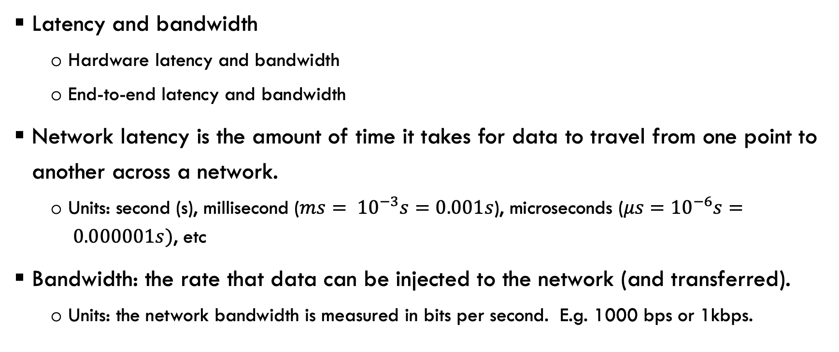
Network performance metrics
Latency and bandwidth
  Hardware latency and bandwidth
  End-to-end latency and bandwidth
Network latency is the amount of time it takes for data to travel from one point to another across a network.
  Units: second (s), millisecond ($ms= {10}^{−3}s=0.001s$), microseconds ($μs={10}^{−6}s= 0.000001s)$, etc
Bandwidth: the rate that data can be injected to the network (and transferred).
  Units: the network bandwidth is measured in bits per second. E.g. 1000 bps or 1kbps.

Slide 19
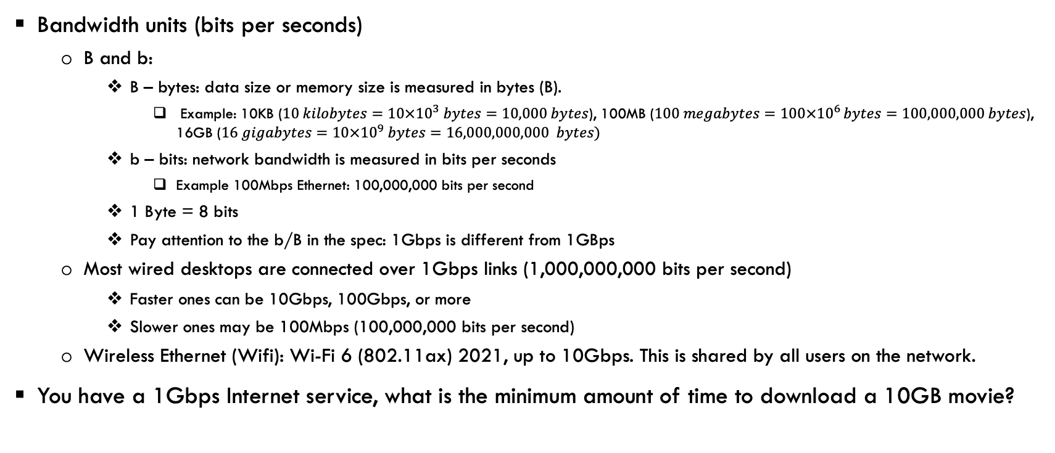
Network performance metrics
Bandwidth units (bits per seconds)
  B and b:
    B – bytes: data size or memory size is measured in bytes (B).
      Example: 10KB ($10 kilobytes=10×{10}^{3} bytes=10,000 bytes$), 100MB ($100 megabytes=100×{10}^{6 }bytes=100,000,000 bytes$), 16GB ($16 gigabytes=10×{10}^{9} bytes=16,000,000,000 bytes)$
    b – bits: network bandwidth is measured in bits per seconds
      Example 100Mbps Ethernet: 100,000,000 bits per second
    1 Byte = 8 bits
    Pay attention to the b/B in the spec: 1Gbps is different from 1GBps
  Most wired desktops are connected over 1Gbps links (1,000,000,000 bits per second)
    Faster ones can be 10Gbps, 100Gbps, or more
    Slower ones may be 100Mbps (100,000,000 bits per second)
  Wireless Ethernet (Wifi): Wi-Fi 6 (802.11ax) 2021, up to 10Gbps. This is shared by all users on the network.
You have a 1Gbps Internet service, what is the minimum amount of time to download a 10GB movie?

Slide 20
Network performance metrics
Bandwidth determines the message injection (and transmission) time
  Let W bits per second be the bandwidth of a link. Given a message of size M bytes (or 8M bits), it will take 8M/W seconds to transmit the message: transmission time = 8M/W
  What is the transmission time to send 10000 bits over a 1Gbps link?
Time of flight (propagation delay) is another component of the hardware communication time
  The time between the first bit is placed on the wire in the sender to the time it reaches the receiver. This time is bounded by the speed of light.
    If we send a message from Tallahassee to LA (distance roughly 3000 miles), what is the time of flight for this message assuming that the signal propagation speed on the wire is 2/3 of the speed of light (300,000,000 meters per second)?
    The distance of a geostationary satellite from the earth is 22,236 miles (35,786km), estimate the communication latency when a communication goes through the such a satellite?
      How does Space X’s Starlink make this work?

Slide 21
Network performance metrics
End-to-end latency: the amount of time from the time the sender calls write() to the time the receiver receives the data.
  Software time at both sender (OS runs the write() code) and receiver (interrupt and OS runs the read() code) and
  Hardware time: propogation time (time of flight) + transmission time
    The propogation time is determined by the physical law (bound by the speed of light).

Slide 22
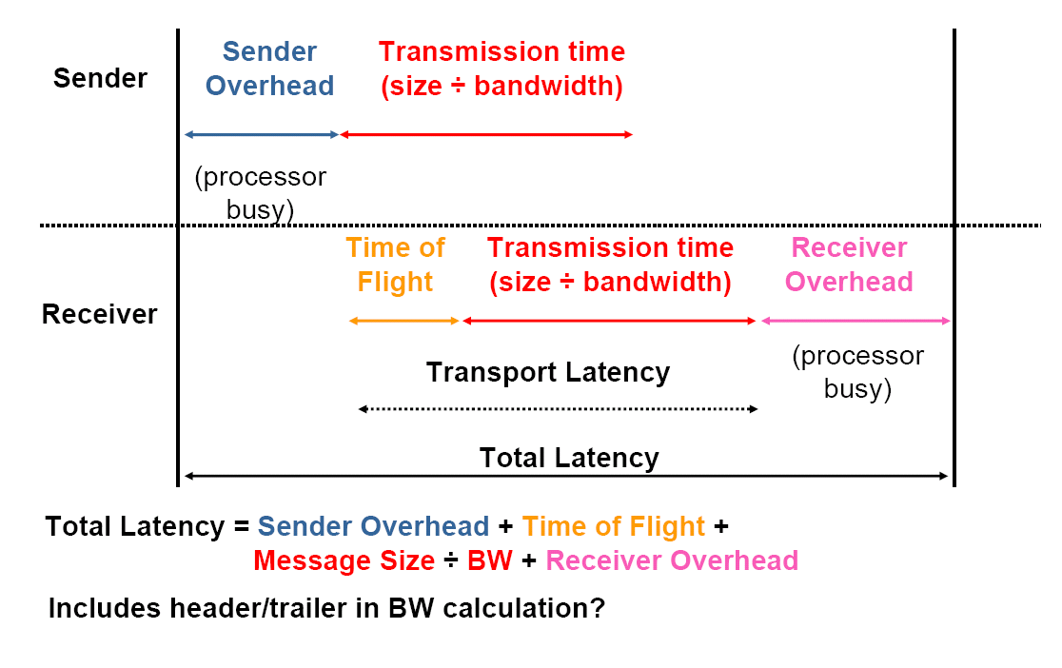
Network performance metrics

Slide 23
Network performance metrics
End-to-end bandwidth: the amount of data transferred / the time to transfer the data from sender to receiver.
  An application: Internet speed test
  In an Internet speed test, 500MB of data is transferred in 10 seconds over the uplink, what is the uplink bandwidth?

