Slide 1
Lecture 5 Parallel Programming with Python
Python threads

Slide 2
Flynn’s classification
SISD: single instruction single data
SIMD: single instruction multiple data
MISD: multiple instruction single data
MIMD: multiple instruction multiple data
MIMD is the most generic form of parallel programming:
  The program creates multiple streamings of instructions that operate simultaneously on different data.
  Multithreading and multiprocessing are common mechanisms to create multiple streamings (threads) of instructions.

Slide 3
Processes vs Threads
Multithreading: program executes with multiple threads
Multiprocessing: program executes with multiple processes.
Process: A program in execution is called a process.
  When you type ‘python3 myprog.py’, you basically create a process to run ‘python3 myprog.py’.
  Process context:
    Many processes share computing resources such as CPU, registers.
    In order for a process to run correctly, it must executes within its own context. Process context is all information necessary to run the program correctly.
    Before the computer can run a program (to start a process for running the program), it must establish the process context for the program.
    Context switching: Switching the context in the computer to run the program.
      Example: all processes share the registers in CPU, so to switch from one program to another, all register values must be changed.

Slide 4
Processes sharing CPU
time
CPU running Process 1’s instructions
CPU running instructions to store P1’s context
Context switching overhead
CPU running instructions to load P2’s context
CPU running Process 2’s instructions

Slide 5
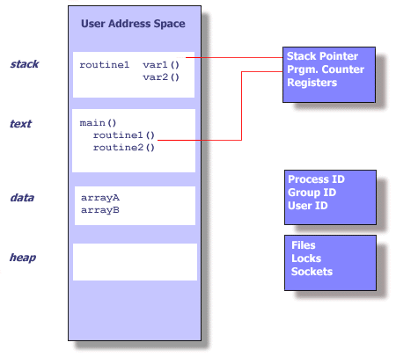
Process context
Some of the items in process context:
  Process ID
  Environment
  Program instructions
  Registers (including PC)
  Stack
  Heap
  Global memory
  Shared libraries
  ……
Process creation and Context Switching are expensive operations.

Slide 6
Threads
Threads exist within a process, and thus share (and have access to) all process context.
Thread context is the minimum part of the process context that are absolutely necessary to support a stream of instructions (a thread of execution).
  Process is more for isolation than for just providing a thread of execution!
What are the absolute necessary?
  Process ID
  Environment
  Program instructions
  Registers (including PC)
  Stack
  Heap
  Global memory
  Shared libraries
  ……

Slide 7
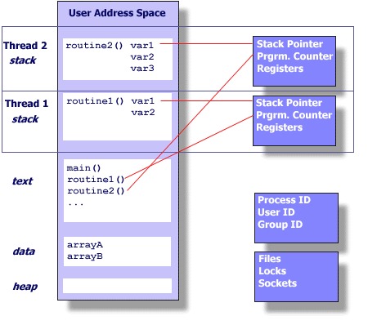
Thread Context
What are the absolute necessary?
  Process ID
  Environment
  Program instructions
  Registers (including PC)
  Stack
  Heap
  Global memory
  Shared libraries
  ……
Thread creation and switching is much cheaper than process creation and switching!
  This is why thread is sometimes called lightweight process.

Slide 8
Platform
fork()
pthread_create()
real
user
sys
real
user
sys
AMD 2.4 GHz Opteron (8cpus/node)
17.6
2.2
15.7
1.4
0.3
1.3
IBM 1.9 GHz POWER5 p5-575 (8cpus/node)
64.2
30.7
27.6
1.7
0.6
1.1
IBM 1.5 GHz POWER4 (8cpus/node)
104.5
48.6
47.2
2.1
1.0
1.5
INTEL 2.4 GHz Xeon (2 cpus/node)
54.9
1.5
20.8
1.6
0.7
0.9
INTEL 1.4 GHz Itanium2 (4 cpus/node)
54.5
1.1
22.2
2.0
1.2
0.6

Slide 9
Multiprocessing vs Multithreading
Multiprocessing: create multiple processes in a program and the processes work together to complete the task
  Process creation and switching are expensive
  Processes do not share memory by default. Communication between processes must use inter-process communication (IPC) mechanism
    IPC is less prone to errors
Multithreading: create multiple threads in a program and the threads work together to complete the task
  Thread creation and switching are inexpensive
  Threads share process memory. Communication between threads is trivial.
    But this make multithreading prone to errors.
In general, multithreading is preferred for parallel computing due to its performance advantages.

Slide 10
Concurrent Programming vs Parallel Programming
Is multithreading/multiprocessing = parallel execution?
  Multithreading/multiprocessing creates multiple streams of instructions
  What about multithreading/multiprocessing on a computer with only one CPU?
Multithreading/multiprocessing = concurrent programming
  Multiple threads progress concurrently (but may not in parallel)
Parallel programming
  Multiple threads progress in parallel.
Concurrent Programming and parallel programming share similar issues
  When the same memory (variable) is accessed, there can be problems for both.

Slide 11
Thread safe/challenges in concurrent programming
Consider using push_front() of the C++ linked list library in an environment with multiple threads.
  What can happen with two threads run the push_front()?
  Depending on the order of the instructions executed in the two threads, the results are different!
Many library and system calls were developed for single thread execution.
  They are not safe to be used in the multithreading environment by default
  The ones that can be used in multithreading environment are marked as thread safe.
Thread 1
Thread 2
push_front():
n = new node (…)
n->next = front
front = n
push_front():
n = new node (…)
n->next = front
front = n

Slide 12
Python Threads
By default, each program has at least one thread of execution, which usually called the main thread
  In C++, it is the execution of the main function.
  In Python, it is the execution of the python statements in the .py file.
The first support needed for writing parallel programs is a way to start multiple threads of execution in a program.
  This is a necessary condition for parallel execution, not sufficient.
The operating system/runtime system provides support for the execution of multiple threads through an API. For a particular language like Python, we need to know at the language level how to use such functionality.
  Some language has parallel constructs such as parallel loop
  Others use libraries/modules - Python thread using a built-in threading module to manage threads

Slide 13
Python Threads
To create a Python thread:
  Create an instance of the threading.Thread class.
  Specify the name of the function via the “target” argument.
  Call the start() function.
  We can explicitly wait for the new thread to finish executing by calling the join()
Run lect6/RunFunctionThread.py, you can see the main thread and the task thread are progressing concurrently.
# Example adapted from Karen Works
from time import sleep
from threading import Thread
# function to run as a thread
def task():
print('Message’) # print a message
# create a thread instance
thread = Thread(target=task)
thread.start() #
# wait for the thread to finish
print('Waiting for the thread...')
thread.join()

Slide 14
Python Threads
To run a function in a thread with parameters:
Create an instance of the threading.Thread class
Specify the name of the function via the “target” argument
  The function has parameters
Specify the arguments in order that the function expects them via the “args”
Call the start() function.
We can explicitly wait for the new thread to finish executing by calling the join()
See lect6/RunFunctionThreadWArgs.py
……
def task(arg1, arg2):
# display a message
print("arg1=",arg1)
print("arg2=",arg2)
# create a thread
thread = Thread(target=task, args=("One",2))

Slide 15
Daemon Threads
You can also start a thread as a daemon thread by setting the daemon to true in the thread object.
Whether a child thread is a daemon affects the behavior of the main thread:
  The main thread can exit without waiting for a daemon thread to finish. The exit of the main thread will also kill the daemon thread.
    If a child thread is not a daemon, the main thread cannot exit before the child thread is finished.
See lect6/daemon.py and lect6/nondaemon.py
……
def task(arg1, arg2):
# display a message
print("arg1=",arg1)
print("arg2=",arg2)
# create a thread
thread = Thread(target=task, args=("One",2),
daemon=true)

Slide 16
Thread Attributes
Each thread has a unique name as it attributes.
The thread name is an attribute.
The current thread is returned by the current_thread function
See lect6/ThreadInstanceAttributes.py for example.
def worker(val):
global num
num+=val
print ("No! This is Patrick!",val,
threading.current_thread().name)
print(num)
return

Slide 17
Note about Python thread
Python threads are executed concurrently, but not in parallel. Due to Python interpreter implementation, at one time, only one thread can run. If we partition job into multiple threads, you will not see speedups.
This highlights the distinction between concurrency and parallelism
  Concurrency: Multiple threads progress concurrently
  Parallelism: Multiple threads progress in parallel
What is the use of Python threads?

Slide 18
Python Threading
The software applications can be classified into CPU-bound applications (application performance bounded by the processing speed) and IO-bound applications (application performance bounded by the IO speed).
Python threading can benefit IO-bound applications.
See lect6/cpuwiththreads.py and lect6/iowiththreads.py

Slide 19
Thread Synchronization
When multiple threads assess the same variable, the outcome of the execution may be non-deterministic.
  The timing of the progress of a thread is not controlled by the programmer
See lect6/racecondition.py
For such cases, a synchronization mechanism must be employed to ensure the correctness of the program.
  Lock, event, condition, semaphore, barrier, etc
  Python synchronization mechanisms can be found in https://docs.python.org/3/library/asyncio-sync.html
  Different design patterns use different types of synchronization mechanisms.

Slide 20
Critical Section
Critical section is a section of code with shared variables and/or resources. Only one thread can enter the section at a given time. If more than one thread executes instructions in a critical section, the data may not be consistent or the outcome becomes non-deterministic.
  An example is shown in the code to the right
  This is a design pattern in parallel and concurrent programming. Other examples include:
    To make most of data structures work with threads, the insert and remove functions are critical sections.
      Insert and remove functions in tree, linked list, etc
import threading
count = 0
def produce():
global count
for x in range(10):
x = count
time.sleep(1)
count = x + 1

Slide 21
Implementing critical section: lock
Acquire a lock before entering critical section
Release the lock after exiting critical section
The lock ensures only one thread will be in the critical section
import threading
count = 0
def produce():
global count
for x in range(10):
Lock()
x = count
time.sleep(1)
count = x + 1
Unlock()

Slide 22
Lock in Python
See lect6/raceconditionfixed.py
import threading
count = 0
lock = threading.lock()
def produce():
global count
for x in range(10):
lock.acquire()
x = count
time.sleep(1)
count = x + 1
lock.release()
import threading
count = 0
lock = threading.lock()
def produce():
global count
for x in range(10):
with lock:
x = count
time.sleep(1)
count = x + 1

