Slide 1
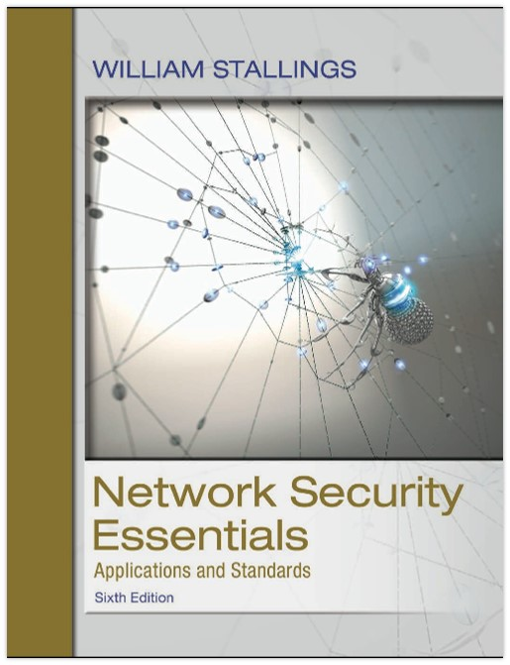
Network Security Essentials: Applications and Standards
Sixth Edition
Chapter 10
Malicious Software
Copyright © 2017 Pearson Education, Inc. All Rights Reserved
Notes:
If this PowerPoint presentation contains mathematical equations, you may need to check that your computer has the following installed:
1) MathType Plugin
2) Math Player (free versions available)
3) NVDA Reader (free versions available)
There are application-specific security mechanisms for a number of application
areas, including electronic mail (S/MIME, PGP), client/server (Kerberos), Web access
(Secure Sockets Layer), and others. However, users have security concerns that
cut across protocol layers. For example, an enterprise can run a secure, private IP
network by disallowing links to untrusted sites, encrypting packets that leave the
premises, and authenticating packets that enter the premises. By implementing security
at the IP level, an organization can ensure secure networking not only for
applications that have security mechanisms but also for the many security-ignorant
applications.
IP-level security encompasses three functional areas: authentication, confidentiality,
and key management. The authentication mechanism assures that a received
packet was, in fact, transmitted by the party identified as the source in the packet
header. In addition, this mechanism assures that the packet has not been altered in
transit. The confidentiality facility enables communicating nodes to encrypt messages
to prevent eavesdropping by third parties. The key management facility is concerned
with the secure exchange of keys.
We begin this chapter with an overview of IP security (IPsec) and an introduction
to the IPsec architecture. We then look at each of the three functional areas in
detail. Appendix D reviews Internet protocols.

Slide 2
Malicious software - malware
SP 800-83 (Guide to Malware Incident Prevention and Handling for Desktops and Laptops, July 2013) definition:
A program that is covertly inserted into another program with the intent to destroy data, run destructive or intrusive programs, or otherwise compromise the confidentiality, integrity, or availability of the victim’s data, applications, or operating system.
Notes:
One of the two most publicized threats to security is the intruder (the other is
viruses), often referred to as a hacker or cracker. In an important early study of
intrusion, Anderson [ANDE80] identified three classes of intruders:
• Masquerader: An individual who is not authorized to use the computer and
who penetrates a system’s access controls to exploit a legitimate user’s account
• Misfeasor: A legitimate user who accesses data, programs, or resources for
which such access is not authorized, or who is authorized for such access but
misuses his or her privileges
• Clandestine user: An individual who seizes supervisory control of the system
and uses this control to evade auditing and access controls or to suppress audit
collection
The masquerader is likely to be an outsider, the misfeasor generally is an insider,
and the clandestine user can be either an outsider or an insider.

Slide 3
A Broad Classification of Malware
Two broad categories:
    Based first on how it spreads or propagates to reach the desired targets
    Then on the actions or payloads it performs once a target is reached
Notes:
One of the two most publicized threats to security is the intruder (the other is
viruses), often referred to as a hacker or cracker. In an important early study of
intrusion, Anderson [ANDE80] identified three classes of intruders:
• Masquerader: An individual who is not authorized to use the computer and
who penetrates a system’s access controls to exploit a legitimate user’s account
• Misfeasor: A legitimate user who accesses data, programs, or resources for
which such access is not authorized, or who is authorized for such access but
misuses his or her privileges
• Clandestine user: An individual who seizes supervisory control of the system
and uses this control to evade auditing and access controls or to suppress audit
collection
The masquerader is likely to be an outsider, the misfeasor generally is an insider,
and the clandestine user can be either an outsider or an insider.

Slide 4
Malware Propagation mechanisms
  Include infection of existing executable or interpreted content by viruses that is subsequently spread to other system
  Exploit of software vulnerabilities either locally or over a network by worms or drive-by-downloads to allow the malware to replicate
  Social engineering attacks that convince users to bypass security mechanisms to install trojans or to respond to phishing attacks
Notes:
One of the two most publicized threats to security is the intruder (the other is
viruses), often referred to as a hacker or cracker. In an important early study of
intrusion, Anderson [ANDE80] identified three classes of intruders:
• Masquerader: An individual who is not authorized to use the computer and
who penetrates a system’s access controls to exploit a legitimate user’s account
• Misfeasor: A legitimate user who accesses data, programs, or resources for
which such access is not authorized, or who is authorized for such access but
misuses his or her privileges
• Clandestine user: An individual who seizes supervisory control of the system
and uses this control to evade auditing and access controls or to suppress audit
collection
The masquerader is likely to be an outsider, the misfeasor generally is an insider,
and the clandestine user can be either an outsider or an insider.

Slide 5
A Broad Classification of Malware
Another distinction used was:
  Malware that does not replicate, such as trojans and spam e-mail
  Malware that does, including viruses and worms
Notes:
One of the two most publicized threats to security is the intruder (the other is
viruses), often referred to as a hacker or cracker. In an important early study of
intrusion, Anderson [ANDE80] identified three classes of intruders:
• Masquerader: An individual who is not authorized to use the computer and
who penetrates a system’s access controls to exploit a legitimate user’s account
• Misfeasor: A legitimate user who accesses data, programs, or resources for
which such access is not authorized, or who is authorized for such access but
misuses his or her privileges
• Clandestine user: An individual who seizes supervisory control of the system
and uses this control to evade auditing and access controls or to suppress audit
collection
The masquerader is likely to be an outsider, the misfeasor generally is an insider,
and the clandestine user can be either an outsider or an insider.

Slide 6
Examples of Payload actions performed by malware
  Corruption of system or data files
  Theft of service in order to make the system a zombie agent of attack as part of a botnet
  Theft of information from the system, especially of logins, passwords, or other personal details by keylogging or spyware programs
  Stealthing where the malware hides its presence on the system from attempts to detect and block it.
Notes:
One of the two most publicized threats to security is the intruder (the other is
viruses), often referred to as a hacker or cracker. In an important early study of
intrusion, Anderson [ANDE80] identified three classes of intruders:
• Masquerader: An individual who is not authorized to use the computer and
who penetrates a system’s access controls to exploit a legitimate user’s account
• Misfeasor: A legitimate user who accesses data, programs, or resources for
which such access is not authorized, or who is authorized for such access but
misuses his or her privileges
• Clandestine user: An individual who seizes supervisory control of the system
and uses this control to evade auditing and access controls or to suppress audit
collection
The masquerader is likely to be an outsider, the misfeasor generally is an insider,
and the clandestine user can be either an outsider or an insider.

Slide 7
Table 10.1 Terminology for Malicious Software (1 of 3)
Name | Description
Virus | Malware that, when executed, tries to replicate itself into other executable code; when it succeeds the code is said to be infected. When the infected cod is executed, the virus also executes.
Worm | A computer program the can run independently and can propagate a complete working version of itself onto other hosts on a network.
Logic bomb | A program inserted into software by an intruder. A logic bomb lies dormant until a predefined condition is met ; the program then triggers an unauthorized act.
Trojan horse | A computer program that appears to have a useful function, but also has a hidden and potentially malicious function that evades security mechanisms, sometimes by exploiting legitimate authorizations of a system entitity that invokes the Trojan horse program.
Backdoor (trapdoor) | Any mechanisms that bypasses a normal security check; it may allow unauthorized access to functionality.
Mobile code | Software(e.g., script, macro, or other portable instruction) that can be shipped unchanged to a heterogeneous collection of platforms and execute with identical semantics.
Exploits | Code specific to a single vulnerability or set of vulnerabilities.
Notes:
(This table can be found on page 323 in the textbook.)
The terminology in this area presents problems because of a lack of universal agreement
on all of the terms and because some of the categories overlap. Table 10.1 is a
useful guide to some of the terms in use.

Slide 8
Table 10.1 Terminology for Malicious Software (2 of 3)
Name | Description
Downloaders | Program that installs other items on a machine that is under attack. Usually, a downloader is sent in an e-mail.
Auto-rooter | Malicious hacker tools used to break into new machines remotely.
Kit (virus generator) | Set of tools for generating new viruses automatically.
Spammer programs | Used to send large volumes of unwanted e-mail.
Flooders | Used to attack networked computer systems with a large volume of traffic to carry out a denial-of-service (DoS) attack.
Keyloggers | Captures keystrokes on a compromised system.
Rootkit | Set of hacker tools used after attacker has broken into a computer system and gained root level access.
Zombie, bot | Program activated on an infected machine that is activated to launch attacks on other machines.
Notes:
(This table can be found on page 323 in the textbook.)
The terminology in this area presents problems because of a lack of universal agreement
on all of the terms and because some of the categories overlap. Table 10.1 is a
useful guide to some of the terms in use.

Slide 9
Table 10.1 Terminology for Malicious Software (3 of 3)
Name | Description
Spyware | Software that collects information from a computer and transmits it to another system.
Adware | Advertising that is integrated into software. It can result in pop-up ads or redirection of a browser to a commercial site.
Notes:
(This table can be found on page 323 in the textbook.)
The terminology in this area presents problems because of a lack of universal agreement
on all of the terms and because some of the categories overlap. Table 10.1 is a
useful guide to some of the terms in use.

Slide 10
Blended attack
  Uses multiple methods of infection or propagation to maximize the speed of contagion and the severity of the attack
Notes:
One of the two most publicized threats to security is the intruder (the other is
viruses), often referred to as a hacker or cracker. In an important early study of
intrusion, Anderson [ANDE80] identified three classes of intruders:
• Masquerader: An individual who is not authorized to use the computer and
who penetrates a system’s access controls to exploit a legitimate user’s account
• Misfeasor: A legitimate user who accesses data, programs, or resources for
which such access is not authorized, or who is authorized for such access but
misuses his or her privileges
• Clandestine user: An individual who seizes supervisory control of the system
and uses this control to evade auditing and access controls or to suppress audit
collection
The masquerader is likely to be an outsider, the misfeasor generally is an insider,
and the clandestine user can be either an outsider or an insider.

Slide 11
Attack Kits
Initially the development and deployment of malware required considerable technical skill by software authors
This changed with the development of virus-creation toolkits in the early 1990s and more general attack kits in the 2000s
  These toolkits are often known as crimeware
  Include a variety of propagation mechanisms and payload modules that even novices can combine, select, and deploy
  Can easily be customized with the latest discovered vulnerabilities in order to exploit the window of opportunity between the publication of a weakness and the deployment of patches to close it
  These kits greatly enlarged the population of attackers able to deploy malware
Notes:
Intruder attacks range from the benign to the serious. At the benign end of the
scale, there are many people who simply wish to explore internets and see what is
out there. At the serious end are individuals who are attempting to read privileged
data, perform unauthorized modifications to data, or disrupt the system.
[GRAN04] lists the following examples of intrusion:
• Performing a remote root compromise of an e-mail server
• Defacing a Web server
• Guessing and cracking passwords
• Copying a database containing credit card numbers
• Viewing sensitive data, including payroll records and medical information,
without authorization
• Running a packet sniffer on a workstation to capture usernames and passwords
• Using a permission error on an anonymous FTP server to distribute pirated
software and music files
• Dialing into an unsecured modem and gaining internal network access
• Posing as an executive, calling the help desk, resetting the executive’s e-mail
password, and learning the new password
• Using an unattended, logged-in workstation without permission

Slide 12
Attack Sources
Another significant malware development over the last couple of decades is the change from attackers being individuals to more organized and dangerous attack sources
  These include politically motivated attackers, criminals, organized crime, organizations that sell their services to companies and nations, and national government agencies
This has significantly changed the resources available and motivation behind the rise of malware leading to development of a large underground economy involving the sale of attack kits, access to compromised hosts, and to stolen information
Notes:
Intruder attacks range from the benign to the serious. At the benign end of the
scale, there are many people who simply wish to explore internets and see what is
out there. At the serious end are individuals who are attempting to read privileged
data, perform unauthorized modifications to data, or disrupt the system.
[GRAN04] lists the following examples of intrusion:
• Performing a remote root compromise of an e-mail server
• Defacing a Web server
• Guessing and cracking passwords
• Copying a database containing credit card numbers
• Viewing sensitive data, including payroll records and medical information,
without authorization
• Running a packet sniffer on a workstation to capture usernames and passwords
• Using a permission error on an anonymous FTP server to distribute pirated
software and music files
• Dialing into an unsecured modem and gaining internal network access
• Posing as an executive, calling the help desk, resetting the executive’s e-mail
password, and learning the new password
• Using an unattended, logged-in workstation without permission

Slide 13
Advanced Persistent Threat (A P T) (1 of 2)
Have risen to prominence in recent years
A well-resourced, persistent application of a wide variety of intrusion technologies and malware to selected targets, usually business or political
APTs differ from other types of attack by their careful target selection, and persistent, often stealthy, intrusion efforts over extended periods
  Stuxnet is a well-known example
Notes:
Traditionally, those who hack into computers do so for the thrill
of it or for status. The hacking community is a strong meritocracy in which status
is determined by level of competence. Thus, attackers often look for targets
of opportunity and then share the information with others. A typical example is a
break-in at a large financial institution reported in [RADC04]. The intruder took
advantage of the fact that the corporate network was running unprotected services,
some of which were not even needed. In this case, the key to the break-in was the
pcAnywhere application. The manufacturer, Symantec, advertises this program as
a remote control solution that enables secure connection to remote devices. But the
attacker had an easy time gaining access to pcAnywhere; the administrator used the
same three-letter username and password for the program. In this case, there was
no intrusion detection system on the 700-node corporate network. The intruder was
only discovered when a vice-president walked into her office and saw the cursor
moving files around on her Windows workstation.
Benign intruders might be tolerable, although they do consume resources and
may slow performance for legitimate users. However, there is no way in advance to
know whether an intruder will be benign or malign. Consequently, even for systems
with no particularly sensitive resources, there is a motivation to control this problem.
Intrusion detection systems (IDSs) and intrusion prevention systems (IPSs)
are designed to counter this type of hacker threat. In addition to using such systems,
organizations can consider restricting remote logons to specific IP addresses and/or
use virtual private network technology.
One of the results of the growing awareness of the intruder problem has been
the establishment of a number of computer emergency response teams (CERTs).
These cooperative ventures collect information about system vulnerabilities and disseminate
it to systems managers. Hackers also routinely read CERT reports. Thus,
it is important for system administrators to quickly insert all software patches to
discovered vulnerabilities. Unfortunately, given the complexity of many IT systems,
and the rate at which patches are released, this is increasingly difficult to achieve
without automated updating. Even then, there are problems caused by incompatibilities
resulting from the updated software. Hence the need for multiple layers of
defense in managing security threats to IT systems.

Slide 14
Advanced Persistent Threat (A P T) (2 of 2)
  Advanced
    The individual components may not necessarily be technically advanced, but are carefully selected to suit the chosen
  Persistent
    Determined application of the attacks over an extended period against the chosen target in order to maximize the chance of success
  Threats
    Threats to the selected targets as a result of the organized, capable, and well-funded attackers intent to compromise the specifically chosen targets
Notes:
Traditionally, those who hack into computers do so for the thrill
of it or for status. The hacking community is a strong meritocracy in which status
is determined by level of competence. Thus, attackers often look for targets
of opportunity and then share the information with others. A typical example is a
break-in at a large financial institution reported in [RADC04]. The intruder took
advantage of the fact that the corporate network was running unprotected services,
some of which were not even needed. In this case, the key to the break-in was the
pcAnywhere application. The manufacturer, Symantec, advertises this program as
a remote control solution that enables secure connection to remote devices. But the
attacker had an easy time gaining access to pcAnywhere; the administrator used the
same three-letter username and password for the program. In this case, there was
no intrusion detection system on the 700-node corporate network. The intruder was
only discovered when a vice-president walked into her office and saw the cursor
moving files around on her Windows workstation.
Benign intruders might be tolerable, although they do consume resources and
may slow performance for legitimate users. However, there is no way in advance to
know whether an intruder will be benign or malign. Consequently, even for systems
with no particularly sensitive resources, there is a motivation to control this problem.
Intrusion detection systems (IDSs) and intrusion prevention systems (IPSs)
are designed to counter this type of hacker threat. In addition to using such systems,
organizations can consider restricting remote logons to specific IP addresses and/or
use virtual private network technology.
One of the results of the growing awareness of the intruder problem has been
the establishment of a number of computer emergency response teams (CERTs).
These cooperative ventures collect information about system vulnerabilities and disseminate
it to systems managers. Hackers also routinely read CERT reports. Thus,
it is important for system administrators to quickly insert all software patches to
discovered vulnerabilities. Unfortunately, given the complexity of many IT systems,
and the rate at which patches are released, this is increasingly difficult to achieve
without automated updating. Even then, there are problems caused by incompatibilities
resulting from the updated software. Hence the need for multiple layers of
defense in managing security threats to IT systems.

Slide 15
Viruses
Parasitic software fragments that attach themselves to some existing executable content
Can “infect” other programs or any type of executable content and modify them
The modification includes injecting the original code with a routine to make copies of the virus code, which can then go on to infect other content
One reason viruses dominated the malware scene in earlier years was the lack of user authentication and access controls on personal computer systems
Notes:
Traditionally, those who hack into computers do so for the thrill
of it or for status. The hacking community is a strong meritocracy in which status
is determined by level of competence. Thus, attackers often look for targets
of opportunity and then share the information with others. A typical example is a
break-in at a large financial institution reported in [RADC04]. The intruder took
advantage of the fact that the corporate network was running unprotected services,
some of which were not even needed. In this case, the key to the break-in was the
pcAnywhere application. The manufacturer, Symantec, advertises this program as
a remote control solution that enables secure connection to remote devices. But the
attacker had an easy time gaining access to pcAnywhere; the administrator used the
same three-letter username and password for the program. In this case, there was
no intrusion detection system on the 700-node corporate network. The intruder was
only discovered when a vice-president walked into her office and saw the cursor
moving files around on her Windows workstation.
Benign intruders might be tolerable, although they do consume resources and
may slow performance for legitimate users. However, there is no way in advance to
know whether an intruder will be benign or malign. Consequently, even for systems
with no particularly sensitive resources, there is a motivation to control this problem.
Intrusion detection systems (IDSs) and intrusion prevention systems (IPSs)
are designed to counter this type of hacker threat. In addition to using such systems,
organizations can consider restricting remote logons to specific IP addresses and/or
use virtual private network technology.
One of the results of the growing awareness of the intruder problem has been
the establishment of a number of computer emergency response teams (CERTs).
These cooperative ventures collect information about system vulnerabilities and disseminate
it to systems managers. Hackers also routinely read CERT reports. Thus,
it is important for system administrators to quickly insert all software patches to
discovered vulnerabilities. Unfortunately, given the complexity of many IT systems,
and the rate at which patches are released, this is increasingly difficult to achieve
without automated updating. Even then, there are problems caused by incompatibilities
resulting from the updated software. Hence the need for multiple layers of
defense in managing security threats to IT systems.

Slide 16
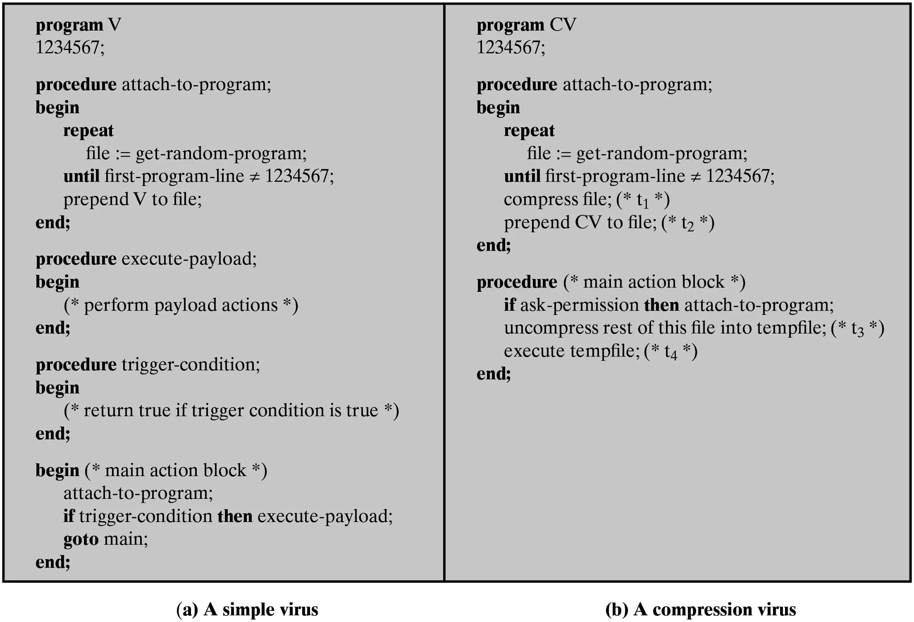
Figure 10.1 Example Virus Logic
Notes:
Traditional machine-executable virus code can be
prepended or postpended to some executable program, or it can be embedded into
the program in some other fashion. The key to its operation is that the infected program,
when invoked, will first execute the virus code and then execute the original
code of the program.
A very general depiction of virus structure is shown in Figure 10.1a. In this
case, the virus code, V, is prepended to infected programs, and it is assumed that the
entry point to the program, when invoked, is the first line of the program.
The infected program begins with the virus code and works as follows.
The first line of code labels the program, which then begins execution with the
main action block of the virus. The second line is a special marker that is used
by the virus to determine whether or not a potential victim program has already
been infected with this virus. When the program is invoked, control is immediately
transferred to the main virus program. The virus program may first seek
out uninfected executable files and infect them. Next, the virus may execute its
payload if the required trigger conditions, if any, are met. Finally, the virus
transfers control to the original program. If the infection phase of the program
is reasonably rapid, a user is unlikely to notice any difference between the
execution of an infected and an uninfected program.
A virus such as the one just described is easily detected because an infected version
of a program is longer than the corresponding uninfected one. A way to thwart
such a simple means of detecting a virus is to compress the executable file so that
both the infected and uninfected versions are of identical length. Figure 10.1b shows
in general terms the logic required. The key lines in this virus are labeled with times,
and Figure 10.2 illustrates the operation.

Slide 17
Virus Structure (1 of 2)
A computer virus and many contemporary types of malware includes one or more variants of each of these components:
Infection mechanism
The means by which a virus spreads or propagates, enabling it to replicate
Also referred to as the infection vector
Trigger
The event or condition that determines when the payload is activated or delivered
Notes:
Organized groups of hackers have become a widespread and common
threat to Internet-based systems. These groups can be in the employ of a corporation
or government but often are loosely affiliated gangs of hackers. Typically, these gangs
are young, often Eastern European, Russian, or southeast Asian hackers who do
business on the Web [ANTE06]. They meet in underground forums with names like
DarkMarket.org and theftservices.com to trade tips and data and coordinate attacks.
A common target is a credit card file at an e-commerce server. Attackers attempt to
gain root access. The card numbers are used by organized crime gangs to purchase
expensive items and are then posted to carder sites, where others can access and use
the account numbers; this obscures usage patterns and complicates investigation.
Whereas traditional hackers look for targets of opportunity, criminal hackers
usually have specific targets, or at least classes of targets in mind. Once a site
is penetrated, the attacker acts quickly, scooping up as much valuable information as
possible and exiting.
IDSs and IPSs can also be used for these types of attackers, but may be less
effective because of the quick in-and-out nature of the attack. For e-commerce
sites, database encryption should be used for sensitive customer information, especially
credit cards. For hosted e-commerce sites (provided by an outsider service),
the e-commerce organization should make use of a dedicated server (not used to
support multiple customers) and closely monitor the provider’s security services.

Slide 18
Virus Structure (2 of 2)
Sometimes known as a logic bomb
Payload
What the virus does, besides spreading
May involve damage or benign but noticeable activity
Notes:
Organized groups of hackers have become a widespread and common
threat to Internet-based systems. These groups can be in the employ of a corporation
or government but often are loosely affiliated gangs of hackers. Typically, these gangs
are young, often Eastern European, Russian, or southeast Asian hackers who do
business on the Web [ANTE06]. They meet in underground forums with names like
DarkMarket.org and theftservices.com to trade tips and data and coordinate attacks.
A common target is a credit card file at an e-commerce server. Attackers attempt to
gain root access. The card numbers are used by organized crime gangs to purchase
expensive items and are then posted to carder sites, where others can access and use
the account numbers; this obscures usage patterns and complicates investigation.
Whereas traditional hackers look for targets of opportunity, criminal hackers
usually have specific targets, or at least classes of targets in mind. Once a site
is penetrated, the attacker acts quickly, scooping up as much valuable information as
possible and exiting.
IDSs and IPSs can also be used for these types of attackers, but may be less
effective because of the quick in-and-out nature of the attack. For e-commerce
sites, database encryption should be used for sensitive customer information, especially
credit cards. For hosted e-commerce sites (provided by an outsider service),
the e-commerce organization should make use of a dedicated server (not used to
support multiple customers) and closely monitor the provider’s security services.

Slide 19
Virus Phases (1 of 2)
During its lifetime, a typical virus goes through the following four phases:
Dormant phase
  The virus is idle
  Will eventually be activated by some event
  Not all viruses have this stage
Propagation phase
  The virus places a copy of itself onto other programs or into certain system areas on the disk
Notes:
Insider attacks are among the most difficult to detect and prevent.
Employees already have access and knowledge about the structure and content of
corporate databases. Insider attacks can be motivated by revenge or simply a feeling
of entitlement. An example of the former is the case of Kenneth Patterson, fired
from his position as data communications manager for American Eagle Outfitters.
Patterson disabled the company’s ability to process credit card purchases during
five days of the holiday season of 2002. As for a sense of entitlement, there have
always been many employees who felt entitled to take extra office supplies for home
use, but this now extends to corporate data. An example is that of a vice-president
of sales for a stock analysis firm who quit to go to a competitor. Before she left, she
copied the customer database to take with her. The offender reported feeling no
animus toward her former employee; she simply wanted the data because it would
be useful to her.
Although IDS and IPS facilities can be useful in countering insider attacks,
other more direct approaches are of higher priority. Examples include the
following:
• Enforce least privilege, only allowing access to the resources employees need
to do their job.
• Set logs to see what users access and what commands they are entering.
• Protect sensitive resources with strong authentication.
• Upon termination, delete employee’s computer and network access.
• Upon termination, make a mirror image of employee’s hard drive before reissuing
it. That evidence might be needed if your company information turns up
at a competitor.
In this section, we look at the techniques used for intrusion. Then we examine
ways to detect intrusion.

Slide 20
Virus Phases (2 of 2)
Triggering phase
  The virus is activated to perform the function for which it was intended
  Can be caused by a variety of system events
Execution phase
  The function is performed
Notes:
Insider attacks are among the most difficult to detect and prevent.
Employees already have access and knowledge about the structure and content of
corporate databases. Insider attacks can be motivated by revenge or simply a feeling
of entitlement. An example of the former is the case of Kenneth Patterson, fired
from his position as data communications manager for American Eagle Outfitters.
Patterson disabled the company’s ability to process credit card purchases during
five days of the holiday season of 2002. As for a sense of entitlement, there have
always been many employees who felt entitled to take extra office supplies for home
use, but this now extends to corporate data. An example is that of a vice-president
of sales for a stock analysis firm who quit to go to a competitor. Before she left, she
copied the customer database to take with her. The offender reported feeling no
animus toward her former employee; she simply wanted the data because it would
be useful to her.
Although IDS and IPS facilities can be useful in countering insider attacks,
other more direct approaches are of higher priority. Examples include the
following:
• Enforce least privilege, only allowing access to the resources employees need
to do their job.
• Set logs to see what users access and what commands they are entering.
• Protect sensitive resources with strong authentication.
• Upon termination, delete employee’s computer and network access.
• Upon termination, make a mirror image of employee’s hard drive before reissuing
it. That evidence might be needed if your company information turns up
at a competitor.
In this section, we look at the techniques used for intrusion. Then we examine
ways to detect intrusion.

Slide 21
Virus Classification By Target (1 of 2)
Includes the following categories:
Boot sector infector
Infects a master boot record or boot record and spreads when a system is booted from the disk containing the virus
File infector
Infects files that the operating system or shell consider to be executable
Notes:
The objective of the intruder is to gain access to a system or to increase the range of
privileges accessible on a system. Most initial attacks use system or software vulnerabilities
that allow a user to execute code that opens a backdoor into the system.
Alternatively, the intruder attempts to acquire information that should have been
protected. In some cases, this information is in the form of a user password. With
knowledge of some other user’s password, an intruder can log in to a system and
exercise all the privileges accorded to the legitimate user.
Typically, a system must maintain a file that associates a password with each
authorized user. If such a file is stored with no protection, then it is an easy matter
to gain access to it and learn passwords. The password file can be protected in one
of two ways:
• One-way function: The system stores only the value of a function based on the
user’s password. When the user presents a password, the system transforms
that password and compares it with the stored value. In practice, the system
usually performs a one-way transformation (not reversible), in which the password
is used to generate a key for the one-way function and in which a fixed length
output is produced.
• Access control: Access to the password file is limited to one or a very few
accounts.

Slide 22
Virus Classification By Target (2 of 2)
Macro virus
Infects files with macro or scripting code that is interpreted by an application
Multipartite virus
Infects files in multiple ways
Notes:
The objective of the intruder is to gain access to a system or to increase the range of
privileges accessible on a system. Most initial attacks use system or software vulnerabilities
that allow a user to execute code that opens a backdoor into the system.
Alternatively, the intruder attempts to acquire information that should have been
protected. In some cases, this information is in the form of a user password. With
knowledge of some other user’s password, an intruder can log in to a system and
exercise all the privileges accorded to the legitimate user.
Typically, a system must maintain a file that associates a password with each
authorized user. If such a file is stored with no protection, then it is an easy matter
to gain access to it and learn passwords. The password file can be protected in one
of two ways:
• One-way function: The system stores only the value of a function based on the
user’s password. When the user presents a password, the system transforms
that password and compares it with the stored value. In practice, the system
usually performs a one-way transformation (not reversible), in which the password
is used to generate a key for the one-way function and in which a fixed length
output is produced.
• Access control: Access to the password file is limited to one or a very few
accounts.

Slide 23
Virus Classification by Concealment Strategy (1 of 2)
Includes the following categories:
  Encrypted virus
    Portion of the virus creates a random encryption key and encrypts the remainder of the virus
    When an infected program is invoked, the virus uses the stored random key to decrypt the virus
    When the virus replicates, a different random key is selected
    Because the bulk of the virus is encrypted with a different key for each instance, there is no constant bit pattern to observe
Notes:
Organized groups of hackers have become a widespread and common
threat to Internet-based systems. These groups can be in the employ of a corporation
or government but often are loosely affiliated gangs of hackers. Typically, these gangs
are young, often Eastern European, Russian, or southeast Asian hackers who do
business on the Web [ANTE06]. They meet in underground forums with names like
DarkMarket.org and theftservices.com to trade tips and data and coordinate attacks.
A common target is a credit card file at an e-commerce server. Attackers attempt to
gain root access. The card numbers are used by organized crime gangs to purchase
expensive items and are then posted to carder sites, where others can access and use
the account numbers; this obscures usage patterns and complicates investigation.
Whereas traditional hackers look for targets of opportunity, criminal hackers
usually have specific targets, or at least classes of targets in mind. Once a site
is penetrated, the attacker acts quickly, scooping up as much valuable information as
possible and exiting.
IDSs and IPSs can also be used for these types of attackers, but may be less
effective because of the quick in-and-out nature of the attack. For e-commerce
sites, database encryption should be used for sensitive customer information, especially
credit cards. For hosted e-commerce sites (provided by an outsider service),
the e-commerce organization should make use of a dedicated server (not used to
support multiple customers) and closely monitor the provider’s security services.

Slide 24
Virus Classification by Concealment Strategy (2 of 2)
  Stealth virus
    A form of virus explicitly designed to hide itself from detection by antivirus software
    The entire virus, not just a payload is hidden
  Polymorphic virus
    A virus that mutates with every infection, making detection by the “signature” of the virus impossible
  Metamorphic virus
    Mutates with every infection
    Rewrites itself completely at each iteration, increasing the difficulty of detection
    May change their behavior as well as their appearance
Notes:
Organized groups of hackers have become a widespread and common
threat to Internet-based systems. These groups can be in the employ of a corporation
or government but often are loosely affiliated gangs of hackers. Typically, these gangs
are young, often Eastern European, Russian, or southeast Asian hackers who do
business on the Web [ANTE06]. They meet in underground forums with names like
DarkMarket.org and theftservices.com to trade tips and data and coordinate attacks.
A common target is a credit card file at an e-commerce server. Attackers attempt to
gain root access. The card numbers are used by organized crime gangs to purchase
expensive items and are then posted to carder sites, where others can access and use
the account numbers; this obscures usage patterns and complicates investigation.
Whereas traditional hackers look for targets of opportunity, criminal hackers
usually have specific targets, or at least classes of targets in mind. Once a site
is penetrated, the attacker acts quickly, scooping up as much valuable information as
possible and exiting.
IDSs and IPSs can also be used for these types of attackers, but may be less
effective because of the quick in-and-out nature of the attack. For e-commerce
sites, database encryption should be used for sensitive customer information, especially
credit cards. For hosted e-commerce sites (provided by an outsider service),
the e-commerce organization should make use of a dedicated server (not used to
support multiple customers) and closely monitor the provider’s security services.

Slide 25
Worms
A program that actively seeks out more machines to infect
  Upon activation, the worm may replicate and propagate again
  To replicate itself, a worm uses some means to access remote systems:
    Electronic mail or instant messenger facility
    File sharing
    Remote execution capability
    Remote file access or transfer capability
    Remote login capability
Notes:
Inevitably, the best intrusion prevention system will fail. A system’s second line
of defense is intrusion detection, and this has been the focus of much research in
recent years. This interest is motivated by a number of considerations, including the
following:
1. If an intrusion is detected quickly enough, the intruder can be identified and
ejected from the system before any damage is done or any data are compromised.
Even if the detection is not sufficiently timely to preempt the intruder,
the sooner that the intrusion is detected, the less the amount of damage and
the more quickly that recovery can be achieved.
2. An effective intrusion detection system can serve as a deterrent, so acting to
prevent intrusions.
3. Intrusion detection enables the collection of information about intrusion techniques
that can be used to strengthen the intrusion prevention facility.
Intrusion detection is based on the assumption that the behavior of the
intruder differs from that of a legitimate user in ways that can be quantified. Of
course, we cannot expect that there will be a crisp, exact distinction between an
attack by an intruder and the normal use of resources by an authorized user. Rather,
we must expect that there will be some overlap.

Slide 26
Worm Phases
A worm typically uses the same phases as a computer virus:
  Dormant
  Propagation
  Triggering
  Execution
The propagation phase generally performs the following functions:
  Search for appropriate access mechanisms to other systems to infect by examining host tables, address books, buddy lists, trusted peers, and other similar repositories of remote system access details
  Use the access mechanisms found to transfer a copy of itself to the remote system and cause the copy to be run
Notes:
[PORR92] identifies the following approaches to intrusion detection:
1. Statistical anomaly detection: Involves the collection of data relating to the
behavior of legitimate users over a period of time. Then statistical tests are
applied to observed behavior to determine with a high level of confidence
whether that behavior is not legitimate user behavior.
a. Threshold detection: This approach involves defining thresholds, independent
of user, for the frequency of occurrence of various events.
b. Profile based: A profile of the activity of each user is developed and used to
detect changes in the behavior of individual accounts.
In essence, anomaly approaches attempt to define normal, or expected,
behavior, whereas signature-based approaches attempt to define proper behavior.
In terms of the types of attackers listed earlier, statistical anomaly detection is
effective against masqueraders, who are unlikely to mimic the behavior patterns of
the accounts they appropriate. On the other hand, such techniques may be unable to
deal with misfeasors. For such attacks, rule-based approaches may be able to recognize
events and sequences that, in context, reveal penetration. In practice, a system may exhibit
a combination of both approaches to be effective against a broad range of attacks.

Slide 27
Target Discovery (1 of 2)
Scanning/fingerprinting
  The function in the propagation phase for a network worm to search for other systems to infect
Worm network scanning strategies:
  Random
    Each compromised host probes random addresses in the IP address space, using a different seed
    Produces a high volume of Internet traffic, which may cause generalized disruption even before the actual attack is lunched
  Hit list
    The attacker first compiles a long list of potential vulnerable machines
    Once the list is compiled, the attacker begins infecting machines on the list
Notes:
[PORR92] identifies the following approaches to intrusion detection:
1. Statistical anomaly detection: Involves the collection of data relating to the
behavior of legitimate users over a period of time. Then statistical tests are
applied to observed behavior to determine with a high level of confidence
whether that behavior is not legitimate user behavior.
a. Threshold detection: This approach involves defining thresholds, independent
of user, for the frequency of occurrence of various events.
b. Profile based: A profile of the activity of each user is developed and used to
detect changes in the behavior of individual accounts.
In essence, anomaly approaches attempt to define normal, or expected,
behavior, whereas signature-based approaches attempt to define proper behavior.
In terms of the types of attackers listed earlier, statistical anomaly detection is
effective against masqueraders, who are unlikely to mimic the behavior patterns of
the accounts they appropriate. On the other hand, such techniques may be unable to
deal with misfeasors. For such attacks, rule-based approaches may be able to recognize
events and sequences that, in context, reveal penetration. In practice, a system may exhibit
a combination of both approaches to be effective against a broad range of attacks.

Slide 28
Target Discovery (2 of 2)
    Each infected machine is provided with a portion of the list to scan
    This results in a very short scanning period, which may make it difficult to detect that infection is taking place
  Topological
    Uses information contained on an infected victim machine to find more hosts to scan
  Local subnet
    If a host is infected behind a firewall, that host then looks for targets in its own local network
    The host uses the subnet address structure to find other hosts that would otherwise be protected by the firewall
Notes:
[PORR92] identifies the following approaches to intrusion detection:
1. Statistical anomaly detection: Involves the collection of data relating to the
behavior of legitimate users over a period of time. Then statistical tests are
applied to observed behavior to determine with a high level of confidence
whether that behavior is not legitimate user behavior.
a. Threshold detection: This approach involves defining thresholds, independent
of user, for the frequency of occurrence of various events.
b. Profile based: A profile of the activity of each user is developed and used to
detect changes in the behavior of individual accounts.
In essence, anomaly approaches attempt to define normal, or expected,
behavior, whereas signature-based approaches attempt to define proper behavior.
In terms of the types of attackers listed earlier, statistical anomaly detection is
effective against masqueraders, who are unlikely to mimic the behavior patterns of
the accounts they appropriate. On the other hand, such techniques may be unable to
deal with misfeasors. For such attacks, rule-based approaches may be able to recognize
events and sequences that, in context, reveal penetration. In practice, a system may exhibit
a combination of both approaches to be effective against a broad range of attacks.

Slide 29
The Morris Worm
Released onto the Internet by Robert Morris in 1988
Designed to spread on U N I X systems and used a number of different techniques for propagation
When a copy began execution its first task was to discover other hosts known to this host that would allow entry from this host
For each discovered host, the worm tried a number of methods for gaining access:
  It attempted to log on to a remote host as a legitimate user
  It exploited a bug in the U N I X finger protocol, which reports the whereabouts of a remote user
  It exploited a trapdoor in the debug option of the remote process that receives and sends mail
Notes:
A fundamental tool for intrusion detection is the audit record. Some record of
ongoing activity by users must be maintained as input to an intrusion detection
system. Basically, two plans are used:
• Native audit records: Virtually all multiuser operating systems include
accounting software that collects information on user activity. The advantage
of using this information is that no additional collection software is needed.
The disadvantage is that the native audit records may not contain the needed
information or may not contain it in a convenient form.
• Detection-specific audit records: A collection facility can be implemented that
generates audit records containing only that information required by the intrusion
detection system. One advantage of such an approach is that it could
be made vendor independent and ported to a variety of systems. The disadvantage
is the extra overhead involved in having, in effect, two accounting
packages running on a machine.

Slide 30
Worm Technology (1 of 3)
Multiplatform
Newer worms can attack a variety of platforms
Multi-exploit
New worms penetrate systems in a variety of ways, using exploits against Web servers, browsers, e-mail, file sharing, and other network-based applications, or via shared media
Ultrafast spreading
Exploit various techniques to optimize the rate of spread of a worm to maximize its likelihood of locating as many vulnerable machines as possible in a short time period
Notes:
A fundamental tool for intrusion detection is the audit record. Some record of
ongoing activity by users must be maintained as input to an intrusion detection
system. Basically, two plans are used:
• Native audit records: Virtually all multiuser operating systems include
accounting software that collects information on user activity. The advantage
of using this information is that no additional collection software is needed.
The disadvantage is that the native audit records may not contain the needed
information or may not contain it in a convenient form.
• Detection-specific audit records: A collection facility can be implemented that
generates audit records containing only that information required by the intrusion
detection system. One advantage of such an approach is that it could
be made vendor independent and ported to a variety of systems. The disadvantage
is the extra overhead involved in having, in effect, two accounting
packages running on a machine.

Slide 31
Worm Technology (2 of 3)
Polymorphic
To evade detection, skip past filters, and foil real-time analysis, each copy of the worm has new code generated on the fly using functionally equivalent instructions and encryption techniques
Metamorphic
In addition to changing their appearance, metamorphic worms have a repertoire of behavior patterns that are unleashed at different stages of propagation
Transport vehicles
Because worms can rapidly compromise a large number of systems, they are ideal for spreading a wide variety of malicious payloads
Notes:
A fundamental tool for intrusion detection is the audit record. Some record of
ongoing activity by users must be maintained as input to an intrusion detection
system. Basically, two plans are used:
• Native audit records: Virtually all multiuser operating systems include
accounting software that collects information on user activity. The advantage
of using this information is that no additional collection software is needed.
The disadvantage is that the native audit records may not contain the needed
information or may not contain it in a convenient form.
• Detection-specific audit records: A collection facility can be implemented that
generates audit records containing only that information required by the intrusion
detection system. One advantage of such an approach is that it could
be made vendor independent and ported to a variety of systems. The disadvantage
is the extra overhead involved in having, in effect, two accounting
packages running on a machine.

Slide 32
Worm Technology (3 of 3)
Zero-day exploit
To achieve maximum surprise and distribution, a worm should exploit an unknown vulnerability that is only discovered by the general network community when the worm is launched
Notes:
A fundamental tool for intrusion detection is the audit record. Some record of
ongoing activity by users must be maintained as input to an intrusion detection
system. Basically, two plans are used:
• Native audit records: Virtually all multiuser operating systems include
accounting software that collects information on user activity. The advantage
of using this information is that no additional collection software is needed.
The disadvantage is that the native audit records may not contain the needed
information or may not contain it in a convenient form.
• Detection-specific audit records: A collection facility can be implemented that
generates audit records containing only that information required by the intrusion
detection system. One advantage of such an approach is that it could
be made vendor independent and ported to a variety of systems. The disadvantage
is the extra overhead involved in having, in effect, two accounting
packages running on a machine.

Slide 33
Distributed Denial of Service Attacks (D D o S)
Attacks that make computer systems inaccessible by flooding servers, networks, or even end-user systems with useless traffic so that legitimate users can no longer gain access to those resources
One way to classify DDoS attacks is in terms of the type of resources that is consumed
The resource consumed is either an internal host resource on the target system or data transmission capacity in the local network to which the target is attacked
Notes:
Rule-based techniques detect intrusion by observing events in the system and applying
a set of rules that lead to a decision regarding whether a given pattern of activity
is or is not suspicious. In very general terms, we can characterize all approaches as
focusing on either anomaly detection or penetration identification, although there is
some overlap in these approaches.
Rule-based anomaly detection is similar in terms of its approach and strengths
to statistical anomaly detection. With the rule-based approach, historical audit
records are analyzed to identify usage patterns and to automatically generate rules
that describe those patterns. Rules may represent past behavior patterns of users,
programs, privileges, time slots, terminals, and so on. Current behavior is then
observed, and each transaction is matched against the set of rules to determine if it
conforms to any historically observed pattern of behavior.
As with statistical anomaly detection, rule-based anomaly detection does not
require knowledge of security vulnerabilities within the system. Rather, the scheme
is based on observing past behavior and, in effect, assuming that the future will be
like the past. In order for this approach to be effective, a rather large database of
rules will be needed.

Slide 34
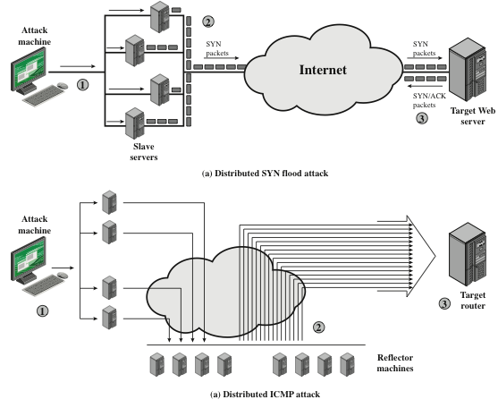
Figure 10.5 Examples of Simple D D o S Attacks

Slide 35
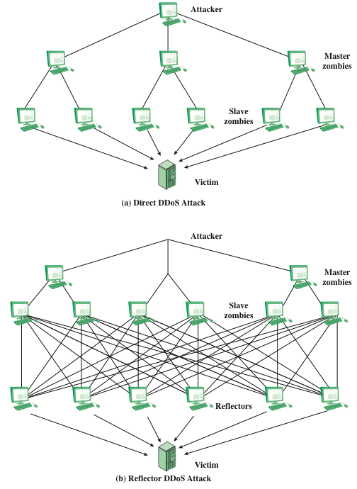
Figure 10.6 Types of Flooding-Based D D o S Attacks

Slide 36
Constructing the Attack Network (1 of 2)
The first step in a DDoS attack is for the attacker to infect a number of machines with zombie software that will ultimately be used to carry out the attack
Essential ingredients:
  Software that can carry out the DDoS attack
  A vulnerability in a large number of systems
  A strategy for locating vulnerable machines (scanning)
Scanning strategies:
  Random
    Each compromised host probes random addresses in the IP address space, using a different seed
Notes:
Rule-based techniques detect intrusion by observing events in the system and applying
a set of rules that lead to a decision regarding whether a given pattern of activity
is or is not suspicious. In very general terms, we can characterize all approaches as
focusing on either anomaly detection or penetration identification, although there is
some overlap in these approaches.
Rule-based anomaly detection is similar in terms of its approach and strengths
to statistical anomaly detection. With the rule-based approach, historical audit
records are analyzed to identify usage patterns and to automatically generate rules
that describe those patterns. Rules may represent past behavior patterns of users,
programs, privileges, time slots, terminals, and so on. Current behavior is then
observed, and each transaction is matched against the set of rules to determine if it
conforms to any historically observed pattern of behavior.
As with statistical anomaly detection, rule-based anomaly detection does not
require knowledge of security vulnerabilities within the system. Rather, the scheme
is based on observing past behavior and, in effect, assuming that the future will be
like the past. In order for this approach to be effective, a rather large database of
rules will be needed.

Slide 37
Constructing the Attack Network (2 of 2)
  Hit list
    The attacker first compiles a long list of potential vulnerable machines
  Topological
    This method uses information contained on an infected victim machine to find more hosts to scan
  Local subnet
    If a host is infected behind a firewall, that host then looks for targets in its own local network
Notes:
Rule-based techniques detect intrusion by observing events in the system and applying
a set of rules that lead to a decision regarding whether a given pattern of activity
is or is not suspicious. In very general terms, we can characterize all approaches as
focusing on either anomaly detection or penetration identification, although there is
some overlap in these approaches.
Rule-based anomaly detection is similar in terms of its approach and strengths
to statistical anomaly detection. With the rule-based approach, historical audit
records are analyzed to identify usage patterns and to automatically generate rules
that describe those patterns. Rules may represent past behavior patterns of users,
programs, privileges, time slots, terminals, and so on. Current behavior is then
observed, and each transaction is matched against the set of rules to determine if it
conforms to any historically observed pattern of behavior.
As with statistical anomaly detection, rule-based anomaly detection does not
require knowledge of security vulnerabilities within the system. Rather, the scheme
is based on observing past behavior and, in effect, assuming that the future will be
like the past. In order for this approach to be effective, a rather large database of
rules will be needed.

Slide 38
D D o S Countermeasures
In general, there are three lines of defense against DDoS attacks:
  Attack prevention and preemption (before the attack)
    These mechanisms enable the victim to endure attack attempts without denying service to legitimate clients
  Attack detection and filtering (during the attack)
    These mechanisms attempt to detect the attack as it begins and respond immediately
  Attack source traceback and identification (during and after the attack)
    This is an attempt to identify the source of the attack as a first step in preventing future attacks
Notes:
To be of practical use, an intrusion detection system should detect a substantial
percentage of intrusions while keeping the false alarm rate at an acceptable
level. If only a modest percentage of actual intrusions are detected, the system
provides a false sense of security. On the other hand, if the system frequently
triggers an alert when there is no intrusion (a false alarm), then either system
managers will begin to ignore the alarms or much time will be wasted analyzing
the false alarms.
Unfortunately, because of the nature of the probabilities involved, it is very difficult
to meet the standard of high rate of detections with a low rate of false alarms.
In general, if the actual numbers of intrusions is low compared to the number of
legitimate uses of a system, then the false alarm rate will be high unless the test is
extremely discriminating. This is an example of a phenomenon known as the base rate
fallacy . A study of existing intrusion detection systems, reported in [AXEL00],
indicated that current systems have not overcome the problem of the base-rate fallacy.
See Appendix J for a brief background on the mathematics of this problem.

Slide 39
Network Security Essentials: Applications and Standards
Sixth Edition
Chapter 12
Firewalls
Copyright © 2017 Pearson Education, Inc. All Rights Reserved
Notes:
If this PowerPoint presentation contains mathematical equations, you may need to check that your computer has the following installed:
1) MathType Plugin
2) Math Player (free versions available)
3) NVDA Reader (free versions available)
There are application-specific security mechanisms for a number of application
areas, including electronic mail (S/MIME, PGP), client/server (Kerberos), Web access
(Secure Sockets Layer), and others. However, users have security concerns that
cut across protocol layers. For example, an enterprise can run a secure, private IP
network by disallowing links to untrusted sites, encrypting packets that leave the
premises, and authenticating packets that enter the premises. By implementing security
at the IP level, an organization can ensure secure networking not only for
applications that have security mechanisms but also for the many security-ignorant
applications.
IP-level security encompasses three functional areas: authentication, confidentiality,
and key management. The authentication mechanism assures that a received
packet was, in fact, transmitted by the party identified as the source in the packet
header. In addition, this mechanism assures that the packet has not been altered in
transit. The confidentiality facility enables communicating nodes to encrypt messages
to prevent eavesdropping by third parties. The key management facility is concerned
with the secure exchange of keys.
We begin this chapter with an overview of IP security (IPsec) and an introduction
to the IPsec architecture. We then look at each of the three functional areas in
detail. Appendix D reviews Internet protocols.

Slide 40
The Need for firewalls (1 of 2)
Internet connectivity is no longer optional for organizations
  Individual users within the organization want and need Internet access
While Internet access provides benefits to the organization, it enables the outside world to reach and interact with local network assets
  This creates a threat to the organization
  While it is possible to equip each workstation and server on the premises network with strong security features, this may not be sufficient and in some cases is not cost-effective
Notes:
Information systems in corporations, government agencies, and other organizations
have undergone a steady evolution. The following are notable developments:
• Centralized data processing system, with a central mainframe supporting a
number of directly connected terminals
• Local area networks (LANs) interconnecting PCs and terminals to each other
and the mainframe
• Premises network, consisting of a number of LANs, interconnecting PCs,
servers, and perhaps a mainframe or two
• Enterprise-wide network, consisting of multiple, geographically distributed
premises networks interconnected by a private wide area network (WAN)
• Internet connectivity, in which the various premises networks all hook into the
Internet and may or may not also be connected by a private WAN
Internet connectivity is no longer optional for organizations. The information
and services available are essential to the organization. Moreover, individual users
within the organization want and need Internet access, and if this is not provided via
their LAN, they will use dial-up capability from their PC to an Internet service provider
(ISP). However, while Internet access provides benefits to the organization, it
enables the outside world to reach and interact with local network assets. This creates
a threat to the organization. While it is possible to equip each workstation and
server on the premises network with strong security features, such as intrusion protection,
this may not be sufficient and in some cases is not cost-effective. Consider
a network with hundreds or even thousands of systems, running various operating
systems, such as different versions of UNIX and Windows. When a security flaw
is discovered, each potentially affected system must be upgraded to fix that flaw.
This requires scaleable configuration management and aggressive patching to function
effectively. While difficult, this is possible and is necessary if only host-based
security is used. A widely accepted alternative or at least complement to host-based
security services is the firewall. The firewall is inserted between the premises network
and the Internet to establish a controlled link and to erect an outer security
wall or perimeter. The aim of this perimeter is to protect the premises network from
Internet-based attacks and to provide a single choke point where security and auditing
can be imposed. The firewall may be a single computer system or a set of two or
more systems that cooperate to perform the firewall function.
The firewall, then, provides an additional layer of defense, insulating the
internal systems from external networks. This follows the classic military doctrine of
“defense in depth,” which is just as applicable to IT security.

Slide 41
The Need for firewalls (2 of 2)
Firewall
  An alternative, or at least complement, to host-based security services
  Is inserted between the premises network and the Internet to establish a controlled link and to erect an outer security wall or perimeter
  The aim of this perimeter is to protect the premises network from Internet-based attacks and to provide a single choke point where security and auditing can be imposed
  May be a single computer system or a set of two or more systems that cooperate to perform the firewall function
Notes:
Information systems in corporations, government agencies, and other organizations
have undergone a steady evolution. The following are notable developments:
• Centralized data processing system, with a central mainframe supporting a
number of directly connected terminals
• Local area networks (LANs) interconnecting PCs and terminals to each other
and the mainframe
• Premises network, consisting of a number of LANs, interconnecting PCs,
servers, and perhaps a mainframe or two
• Enterprise-wide network, consisting of multiple, geographically distributed
premises networks interconnected by a private wide area network (WAN)
• Internet connectivity, in which the various premises networks all hook into the
Internet and may or may not also be connected by a private WAN
Internet connectivity is no longer optional for organizations. The information
and services available are essential to the organization. Moreover, individual users
within the organization want and need Internet access, and if this is not provided via
their LAN, they will use dial-up capability from their PC to an Internet service provider
(ISP). However, while Internet access provides benefits to the organization, it
enables the outside world to reach and interact with local network assets. This creates
a threat to the organization. While it is possible to equip each workstation and
server on the premises network with strong security features, such as intrusion protection,
this may not be sufficient and in some cases is not cost-effective. Consider
a network with hundreds or even thousands of systems, running various operating
systems, such as different versions of UNIX and Windows. When a security flaw
is discovered, each potentially affected system must be upgraded to fix that flaw.
This requires scaleable configuration management and aggressive patching to function
effectively. While difficult, this is possible and is necessary if only host-based
security is used. A widely accepted alternative or at least complement to host-based
security services is the firewall. The firewall is inserted between the premises network
and the Internet to establish a controlled link and to erect an outer security
wall or perimeter. The aim of this perimeter is to protect the premises network from
Internet-based attacks and to provide a single choke point where security and auditing
can be imposed. The firewall may be a single computer system or a set of two or
more systems that cooperate to perform the firewall function.
The firewall, then, provides an additional layer of defense, insulating the
internal systems from external networks. This follows the classic military doctrine of
“defense in depth,” which is just as applicable to IT security.

Slide 42
Firewall characteristics (1 of 2)
Design goals for a firewall:
  All traffic from inside to outside, and vice versa, must pass through the firewall
  Only authorized traffic, as defined by the local security policy, will be allowed to pass
  The firewall itself is immune to penetration
Characteristics that a firewall access policy could use to filter traffic:
I P Address and Protocol Values
Controls access based on the source or destination addresses and port numbers, direction of flow being inbound or outbound, and other network and transport layer characteristics
Notes:
[BELL94] lists the following design goals for a firewall:
1. All traffic from inside to outside, and vice versa, must pass through the firewall.
This is achieved by physically blocking all access to the local network
except via the firewall. Various configurations are possible, as explained later
in this chapter.
2. Only authorized traffic, as defined by the local security policy, will be allowed
to pass. Various types of firewalls are used, which implement various types of
security policies, as explained later in this chapter.
3. The firewall itself is immune to penetration. This implies the use of a hardened
system with a secured operating system. Trusted computer systems are
suitable for hosting a firewall and often required in government applications.
A critical component in the planning and implementation of a firewall is
specifying a suitable access policy. This lists the types of traffic authorized to pass
through the firewall, including address ranges, protocols, applications, and content
types. This policy should be developed from the organization’s information security
risk assessment and policy. This policy should be developed from a broad specification
of which traffic types the organization needs to support. It is then refined to
detail the filter elements we discuss next, which can then be implemented within an
appropriate firewall topology.
SP 800-41-1 (Guidelines on Firewalls and Firewall Policy , September 2009)
lists a range of characteristics that a firewall access policy could use to filter traffic,
including:
■ IP Address and Protocol Values: Controls access based on the source or
destination addresses and port numbers, direction of flow being inbound or
outbound, and other network and transport layer characteristics. This type of
filtering is used by packet filter and stateful inspection firewalls. It is typically
used to limit access to specific services.
■ Application Protocol: Controls access on the basis of authorized application
protocol data. This type of filtering is used by an application-level gateway
that relays and monitors the exchange of information for specific application
protocols, for example, checking SMTP e-mail for spam, or HTPP Web
requests to authorized sites only.
■ User Identity: Controls access based on the users identity, typically for inside
users who identify themselves using some form of secure authentication technology,
such as IPSec (Chapter 9).
■ Network Activity: Controls access based on considerations such as the time
or request, for example, only in business hours; rate of requests, for example,
to detect scanning attempts; or other activity patterns.

Slide 43
Firewall characteristics (2 of 2)
  Application Protocol
Controls access on the basis of authorized application protocol data
User Identity
Controls access based on the user’s identity, typically for inside users who identify themselves using some form of secure authentication technology, such as I P Sec
Network Activity
Controls access based on considerations such as the time or request
Notes:
[BELL94] lists the following design goals for a firewall:
1. All traffic from inside to outside, and vice versa, must pass through the firewall.
This is achieved by physically blocking all access to the local network
except via the firewall. Various configurations are possible, as explained later
in this chapter.
2. Only authorized traffic, as defined by the local security policy, will be allowed
to pass. Various types of firewalls are used, which implement various types of
security policies, as explained later in this chapter.
3. The firewall itself is immune to penetration. This implies the use of a hardened
system with a secured operating system. Trusted computer systems are
suitable for hosting a firewall and often required in government applications.
A critical component in the planning and implementation of a firewall is
specifying a suitable access policy. This lists the types of traffic authorized to pass
through the firewall, including address ranges, protocols, applications, and content
types. This policy should be developed from the organization’s information security
risk assessment and policy. This policy should be developed from a broad specification
of which traffic types the organization needs to support. It is then refined to
detail the filter elements we discuss next, which can then be implemented within an
appropriate firewall topology.
SP 800-41-1 (Guidelines on Firewalls and Firewall Policy , September 2009)
lists a range of characteristics that a firewall access policy could use to filter traffic,
including:
■ IP Address and Protocol Values: Controls access based on the source or
destination addresses and port numbers, direction of flow being inbound or
outbound, and other network and transport layer characteristics. This type of
filtering is used by packet filter and stateful inspection firewalls. It is typically
used to limit access to specific services.
■ Application Protocol: Controls access on the basis of authorized application
protocol data. This type of filtering is used by an application-level gateway
that relays and monitors the exchange of information for specific application
protocols, for example, checking SMTP e-mail for spam, or HTPP Web
requests to authorized sites only.
■ User Identity: Controls access based on the users identity, typically for inside
users who identify themselves using some form of secure authentication technology,
such as IPSec (Chapter 9).
■ Network Activity: Controls access based on considerations such as the time
or request, for example, only in business hours; rate of requests, for example,
to detect scanning attempts; or other activity patterns.

Slide 44
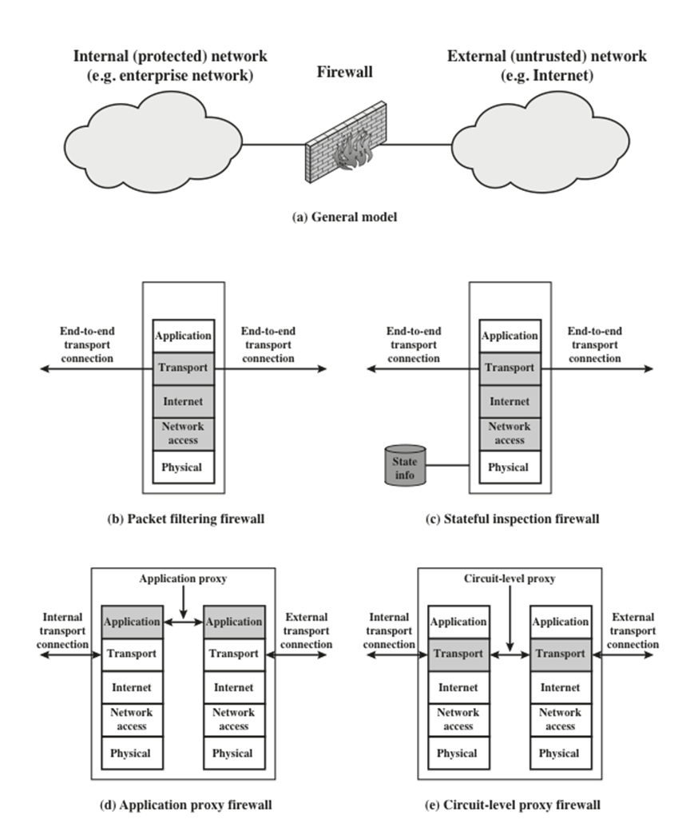
Figure 12.1 Types of Firewalls
Notes:
A packet filtering firewall applies a set of rules to each incoming and outgoing
IP packet and then forwards or discards the packet (Figure 12.1b). The firewall
is typically configured to filter packets going in both directions (from and to
the internal network). Filtering rules are based on information contained in a
network packet:
• Source IP address: The IP address of the system that originated the IP packet
(e.g., 192.178.1.1)
• Destination IP address: The IP address of the system the IP packet is trying to
reach (e.g., 192.168.1.2)
• Source and destination transport-level address: The transport-level (e.g., TCP
or UDP) port number, which defines applications such as SNMP or TELNET
• IP protocol field: Defines the transport protocol
• Interface: For a firewall with three or more ports, which interface of the
firewall the packet came from or which interface of the firewall the packet is
destined for
The packet filter is typically set up as a list of rules based on matches to fields
in the IP or TCP header. If there is a match to one of the rules, that rule is invoked
to determine whether to forward or discard the packet. If there is no match to any
rule, then a default action is taken. Two default policies are possible:
• Default discard: That which is not expressly permitted is prohibited.
• Default forward: That which is not expressly prohibited is permitted.
The default discard policy is more conservative. Initially, everything is
blocked, and services must be added on a case-by-case basis. This policy is more
visible to users, who are more likely to see the firewall as a hindrance. However,
this is the policy likely to be preferred by businesses and government organizations.
Further, visibility to users diminishes as rules are created. The default forward
policy increases ease of use for end users but provides reduced security; the
security administrator must, in essence, react to each new security threat as it
becomes known. This policy may be used by generally more open organizations,
such as universities.

Slide 45
Table 12.1 Packet-Filtering Example
Rule | Direction | Src address | Dest address | Protocol | Dest port | Action
A | In | External | Internal | T C P | 25 | Permit
B | Out | Internal | External | T C P | >1023 | Permit
C | Out | Internal | External | T C P | 25 | Permit
D | In | External | Internal | T C P | >1023 | Permit
E | Either | Any | Any | Any | Any | Deny
Effective against: IP spoofing, source routing attack, tiny fragment attack
Notes:
Table 12.1 is a simplified example of a ruleset for SMTP traffic. The goal is to
allow inbound and outbound e-mail traffic but to block all other traffic. The rules
are applied top to bottom to each packet.
A. Inbound mail from an external source is allowed (port 25 is for SMTP
incoming).
B. This rule is intended to allow a response to an inbound SMTP connection.
C. Outbound mail to an external source is allowed.
D. This rule is intended to allow a response to an inbound SMTP connection.
E. This is an explicit statement of the default policy. All rulesets include this rule
implicitly as the last rule.

Slide 46
Table 12.2 Example Stateful Firewall Connection State Table [S C A R 09b]
Source Address | Source Port | Destination Address | Destination Port | Connection State
192.168.1.100 | 1030 | 210.22.88.29 | 80 | Established
192.168.1.102 | 1031 | 216.32.42.123 | 80 | Established
192.168.1.101 | 1033 | 173.66.32.122 | 25 | Established
192.168.1.106 | 1035 | 177.231.32.12 | 79 | Established
223.43.21.231 | 1990 | 192.168.1.6 | 80 | Established
2122.22.123.32 | 2112 | 192.168.1.6 | 80 | Established
210.922.212.18 | 3321 | 192.168.1.6 | 80 | Established
24.102.32.23 | 1025 | 192.168.1.6 | 80 | Established
223.21.22.12 | 1046 | 192.168.1.6 | 80 | Established
Notes:
A stateful inspection packet firewall tightens up the rules for TCP traffic by
creating a directory of outbound TCP connections, as shown in Table 12.2. There is
an entry for each currently established connection. The packet filter will now allow
incoming traffic to high-numbered ports only for those packets that fit the profile of
one of the entries in this directory.
A stateful packet inspection firewall reviews the same packet information
as a packet filtering firewall, but also records information about TCP connections
(Figure 12.1c). Some stateful firewalls also keep track of TCP sequence numbers
to prevent attacks that depend on the sequence number, such as session hijacking.
Some even inspect limited amounts of application data for some well-known
protocols like FTP, IM and SIPS commands, in order to identify and track related
connections.

Slide 47
Application Level Gateway
Also called an application proxy
Acts as a relay of application-level traffic
If the gateway does not implement the proxy code for a specific application, the service is not supported and cannot be forwarded across the firewall
The gateway can be configured to support only specific features of an application that the network administrator considers acceptable while denying all other features
Tend to be more secure than packet filters
Disadvantage:
  The additional processing overhead on each connection
Notes:
An application-level gateway, also called an application proxy , acts as a relay of
application-level traffic (Figure 12.1d). The user contacts the gateway using a TCP/
IP application, such as Telnet or FTP, and the gateway asks the user for the name
of the remote host to be accessed. When the user responds and provides a valid
user ID and authentication information, the gateway contacts the application on
the remote host and relays TCP segments containing the application data between
the two endpoints. If the gateway does not implement the proxy code for a specific
application, the service is not supported and cannot be forwarded across the firewall.
Further, the gateway can be configured to support only specific features of an
application that the network administrator considers acceptable while denying all
other features.
Application-level gateways tend to be more secure than packet filters. Rather
than trying to deal with the numerous possible combinations that are to be allowed
and forbidden at the TCP and IP level, the application-level gateway need only
scrutinize a few allowable applications. In addition, it is easy to log and audit all
incoming traffic at the application level.
A prime disadvantage of this type of gateway is the additional processing
overhead on each connection. In effect, there are two spliced connections between
the end users, with the gateway at the splice point, and the gateway must examine
and forward all traffic in both directions.

Slide 48
Circuit-Level Gateway
Also called circuit-level proxy
Can be a stand-alone system or it can be a specialized function performed by an application-level gateway for certain applications
Does not permit an end-to-end T C P connection
The security function consists of determining which connections will be allowed
Typical use is a situation in which the system administrator trusts the internal users
Can be configured to support application-level or proxy service on inbound connections and circuit-level functions for outbound connections
Example of implementation is the S O C K S package
Notes:
A fourth type of firewall is the circuit-level gateway or circuit-level proxy
(Figure 12.1e). This can be a stand-alone system or it can be a specialized function
performed by an application-level gateway for certain applications. As with
an application gateway, a circuit-level gateway does not permit an end-to-end TCP
connection; rather, the gateway sets up two TCP connections, one between itself
and a TCP user on an inner host and one between itself and a TCP user on an outside
host. Once the two connections are established, the gateway typically relays
TCP segments from one connection to the other without examining the contents.
The security function consists of determining which connections will be allowed.
A typical use of circuit-level gateways is a situation in which the system administrator
trusts the internal users. The gateway can be configured to support
application-level or proxy service on inbound connections and circuit-level functions
for outbound connections. In this configuration, the gateway can incur the processing
overhead of examining incoming application data for forbidden functions
but does not incur that overhead on outgoing data.
An example of a circuit-level gateway implementation is the SOCKS package
[KOBL92]; version 5 of SOCKS is specified in RFC 1928. The RFC defines SOCKS
in the following fashion:
The protocol described here is designed to provide a framework for
client-server applications in both the TCP and UDP domains to conveniently
and securely use the services of a network firewall. The
protocol is conceptually a “shim-layer” between the application layer
and the transport layer, and as such does not provide network-
layer gateway services, such as forwarding of ICMP messages.
SOCKS consists of the following components:
• The SOCKS server, which often runs on a UNIX-based firewall. SOCKS is
also implemented on Windows systems.
• The SOCKS client library, which runs on internal hosts protected by the firewall.
• SOCKS-ified versions of several standard client programs such as FTP and
TELNET. The implementation of the SOCKS protocol typically involves
either the recompilation or relinking of TCP-based client applications or the
use of alternate dynamically loaded libraries, to use the appropriate encapsulation
routines in the SOCKS library.
When a TCP-based client wishes to establish a connection to an object that is
reachable only via a firewall (such determination is left up to the implementation),
it must open a TCP connection to the appropriate SOCKS port on the SOCKS
server system. The SOCKS service is located on TCP port 1080. If the connection
request succeeds, the client enters a negotiation for the authentication method to
be used, authenticates with the chosen method, and then sends a relay request. The
SOCKS server evaluates the request and either establishes the appropriate connection
or denies it. UDP exchanges are handled in a similar fashion. In essence, a TCP
connection is opened to authenticate a user to send and receive UDP segments, and
the UDP segments are forwarded as long as the TCP connection is open.

Slide 49
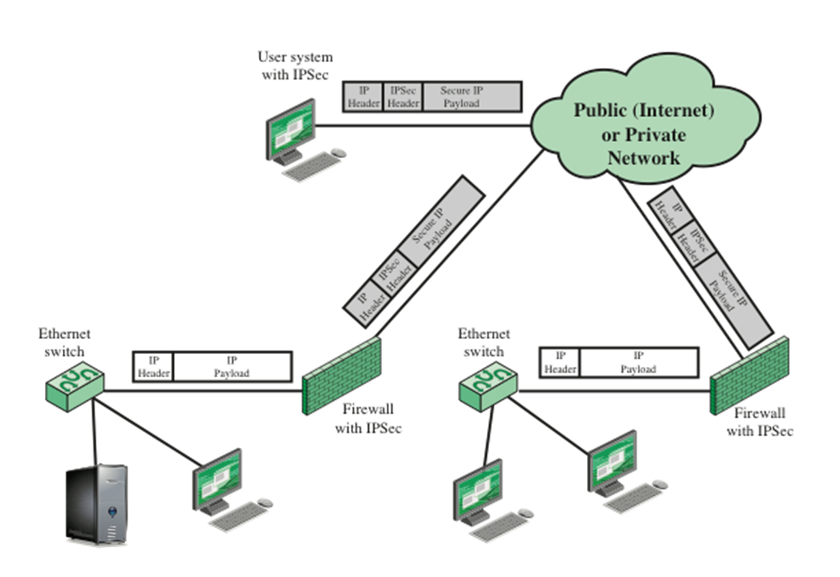
Figure 12.3 A V P N Security Scenario
Notes:
In today’s distributed computing environment, the virtual private network (VPN)
offers an attractive solution to network managers. In essence, a VPN consists of
a set of computers that interconnect by means of a relatively unsecure network
and that make use of encryption and special protocols to provide security. At each
corporate site, workstations, servers, and databases are linked by one or more local
area networks (LANs). The Internet or some other public network can be used to
interconnect sites, providing a cost savings over the use of a private network and
offloading the wide area network management task to the public network provider.
That same public network provides an access path for telecommuters and other
mobile employees to log on to corporate systems from remote sites.
But the manager faces a fundamental requirement: security. Use of a public
network exposes corporate traffic to eavesdropping and provides an entry point for
unauthorized users. To counter this problem, a VPN is needed. In essence, a VPN
uses encryption and authentication in the lower protocol layers to provide a secure
connection through an otherwise insecure network, typically the Internet. VPNs are
generally cheaper than real private networks using private lines but rely on having
the same encryption and authentication system at both ends. The encryption may
be performed by firewall software or possibly by routers. The most common protocol
mechanism used for this purpose is at the IP level and is known as IPsec.
Figure 12.3 (Compare Figure 9.1) is a typical scenario of IPSec usage. An
organization maintains LANs at dispersed locations. Nonsecure IP traffic is conducted
on each LAN. For traffic off site, through some sort of private or public
WAN, IPSec protocols are used. These protocols operate in networking devices,
such as a router or firewall, that connect each LAN to the outside world. The IPSec
networking device will typically encrypt and compress all traffic going into the
WAN and decrypt and uncompress traffic coming from the WAN; authentication
may also be provided. These operations are transparent to workstations and servers
on the LAN. Secure transmission is also possible with individual users who dial into
the WAN. Such user workstations must implement the IPSec protocols to provide
security. They must also implement high levels of host security, as they are directly
connected to the wider Internet. This makes them an attractive target for attackers
attempting to access the corporate network.
A logical means of implementing an IPSec is in a firewall, as shown in
Figure 12.3. If IPSec is implemented in a separate box behind (internal to) the firewall,
then VPN traffic passing through the firewall in both directions is encrypted.
In this case, the firewall is unable to perform its filtering function or other security
functions, such as access control, logging, or scanning for viruses. IPSec could be
implemented in the boundary router, outside the firewall. However, this device is
likely to be less secure than the firewall and thus less desirable as an IPSec platform.

Slide 50

Copyright

